Slide 1
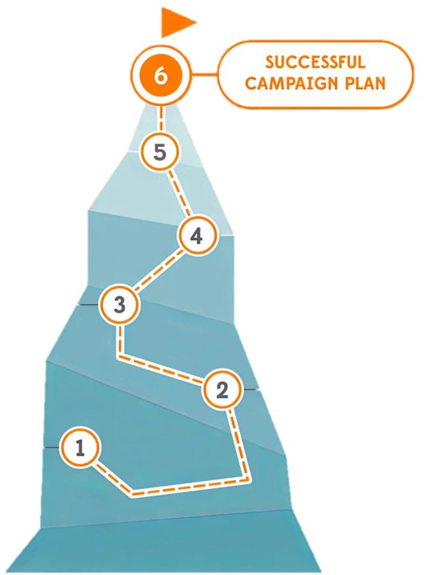
Turning Issues Into Winning Campaigns
With the NEA Campaign Lab

Slide 2
NEA Members and External Audiences
This presentation and its contents are closed to the press and may not be further distributed or passed on to any other person, or published, or reproduced, in whole or in part, by any medium, in any form, or for any purpose. Audio/video recording, copying of slides, and the use of AI note-taking tools are prohibited without written consent from the presenters. Violation of these terms may result in legal action.

Slide 3

Let’s dream of a school and community built on love.
Notes:
Just imagine what would make up a loving community or a loving school? Imagine a school and community intentionally built with everything that you and your students need. Really, take moment and imagine that. Now ask yourself, is this the work of my union? Sometimes, our own thinking about what "is" union work gets in the way of achieving this. Sometimes its how our state affiliate has structured union work, and sometimes it is NEA that prevents us from expanding our thinking about what union work is. As part of the campaign lab, no issue campaign is off limits. You might begin with an internal "union building" issue such as "we should have a collective bargaining agreement." You may also begin with an "inside-outside power building" issue such as affordable housing creates stable communities for all workers in our schools and creates strong learning conditions for students.

Slide 4

Why Campaign Lab Now?
Notes:
Our dreams for our schools and communities are under attack and the news of all this can begin to make us lose hope. The National Education Association is working to promote, protect, and strengthen public education. Our goals are ambitious, and require the sum of us, not just some of us, to stand up for schools in every district, join together with partners and allies, and create a system that enables all public school supporters to save public education today and for the future. NEA and its partners believe that public education is the cornerstone of our democracy. All students, in every state and neighborhood—have the right to an education that is based on truth, imparts academic and life skills, instills a lifelong love of learning, and encourages them to dream without limits.
Ultimately, if our public schools and our public sector unions are going to survive, we have to learn to do the work that leads to broad alignments with other organizations who share our common vision for loving communities and loving schools. This is what the campaign lab is about. At its core, the Campaign Lab is about shifting the fundamental way that locals in the NEA affiliate "do Union." The goal is to have 500 locals leading issue campaigns and actions, connected and coaches by 250 member coaches, all supported and strategically networked by 50 Mentor Coaches.
In this networked and growing ecosystem, a group of locals will want to be engaged as what we refer to as, "May Day Locals." These are a coalition of unions and pro public education groups across the country that are already building the power and structures to fight and win against the growing right wing attacks on our schools, our communities, and frankly our democracy.

Slide 5
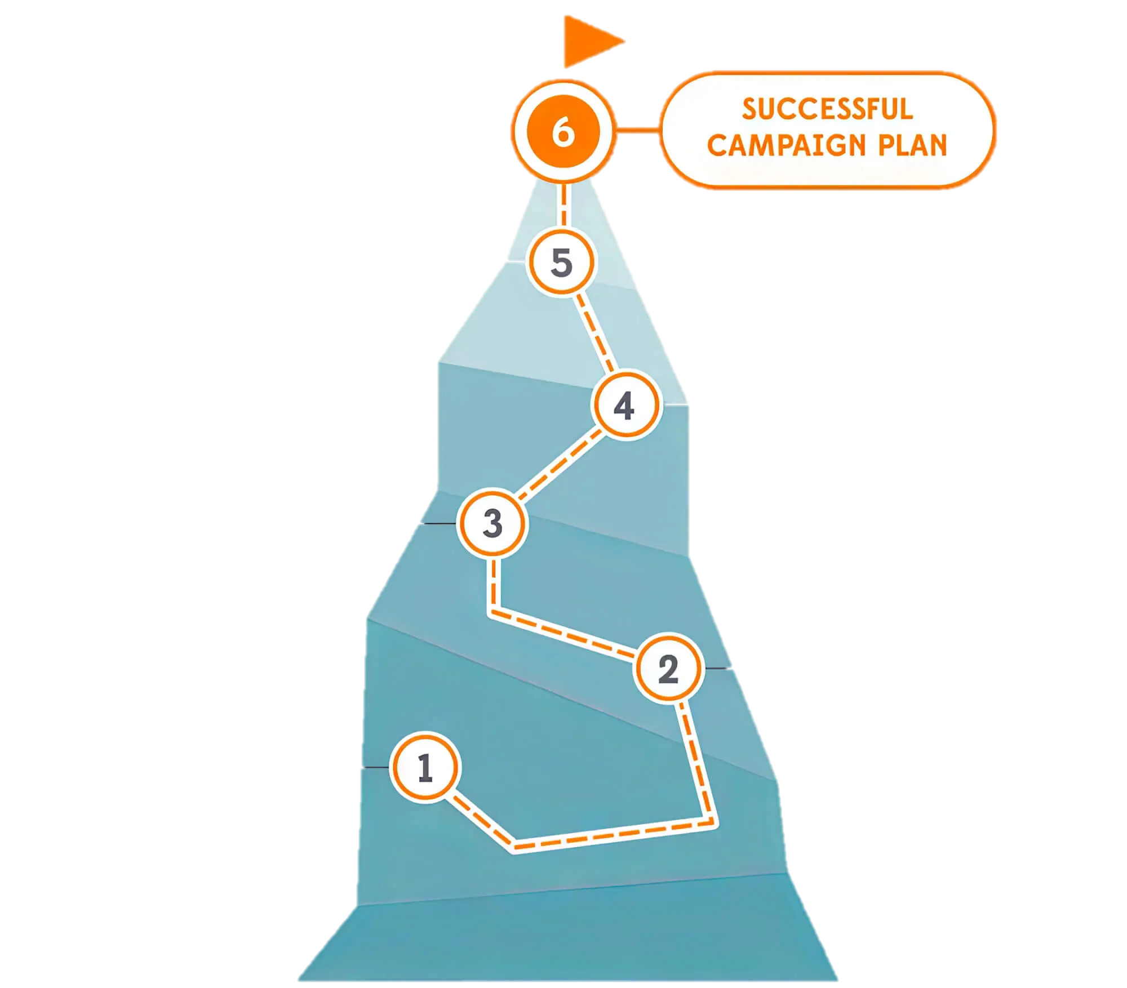
From Dream to Plan…
With NEA Campaign Lab Supports
Notes:
The NEA’s Campaign Lab is a way for you to begin moving your dreams into actions.

Slide 6
Basic Structure of Campaign Lab
250
500
Coach
Team Lead
Team Lead
Coach
Team Lead
Team Lead
Coach
Team Lead
Team Lead
50
Campaign Lab Coordinators
Tech
Logistics and Grants
Payments
Mentor Coach
7
7
Notes:
The goal is to have 500 locals leading issue campaigns and actions, connected and coaches by 250 member coaches, all supported and strategically networked by 50 Mentor Coaches. This is supported by Coordination Team of 7 NEA staff.
This goal begins with the recruitment of teams, who have a lead that applies to the Campaign Lab. The commitment for the local team lead is that they meet twice a month with a campaign coach to discuss their progress and receive just in time problem solving, advice, and coaching towards next steps. They also agree to attend an all call meeting once month to hear from others across the country that are also doing this work. Once a coach and a mentor coach agree that the Team Lead and local have a plan, have a team, and are ready to begin taking actions according to an actual escalating plan, they receive a seed grant of $2500.
Coaches, high capacity, campaign minded, leaders can serve as coaches and will receive training and support to do this. They agree to coach locals, up to two — and receive an annual stipend of up to $1800. They commit to meet with one to two teams, twice a month and attend the monthly all call meeting.
Mentor coaches are typically staff, who have a record of leading campaigns or growing locals through organizing. They do not receive a stipend. They have no more than 5 coaches that they meet with once a month and attend the all call meetings.
The Campaign Lab Coordinators, Amanda, Carrie, and Ellen, are managed by Kyle. Kyle is primarily focused on building the alignments with our outside partners and moves the Campaign Lab strategically into other aspects of the NEA enterprise. Amanda, Carrie, and Ellen work together they keep the system connected, convene the people in the system, build capacity across the system, manage and monitor applications of teams and coaches, and develop a strategic intent for the work across the campaign lab. They are supported by Dommie, Shola, and Karla. Dommie provides technology and data support, Shola coordinates the payment of coaches, Karla pulls team applications from the grant system and provides all travel logistics.

Slide 7
How the Campaign Lab works
Local or State team wants to run a campaign
Team applies to the Campaign Lab
Team starts planning their campaign with a coach.
Local or states have a team that wants to run a campaign on a particular issue.
They notify their state affiliate.
NEA will review the Campaign Lab application and conduct an interview with the team to make sure we are aligned.
Team meets with coach to start planning their campaigns.
They determine what type of training they need to run their campaign.
Notes:
You, in your local or with your state decide you want to run a campaign to win the good ideas in your dream. You notify your state of your intentions, just as you would with any of your union work. Then, your team applies to the Campaign Lab. It takes about 15 minutes to complete. Once we receive it, a Coach from the Campaign Lab will reach out to set up a 30 minute interview. Once that has been completed, you and your state are notified of your acceptance in the Campaign Lab. You are then assigned a coach who will want to set up two brief meetings a month to help you develop your campaign plan, implement your campaign plan, and keep you moving towards winning all those ideas that make up your big dream.

Slide 8
How the Campaign Lab works
Execute their campaign & Apply for grant
Campaign Lab Community
Execute campaign plan.
Bi-weekly meeting with their member coach.
Apply for grant up to $2500.
Monthly meeting with all of the other locals and states that are running campaigns
Notes:
Once you have developed a repoire with your coach, and you have established a plan, and you and your coach feel that you are meeting regularly and making good progess, you will receive a $2500 investment in your campaign from the Campaign Lab. This can be used for nearly any aspect of you campaign that engages members and serves to move you towards your win. In addition to meeting with your coach, you will be networked each month for 90 minutes with other locals, coaches, and mentor coaches from across the country . This is where you learn, build relationships, and share your good work. There are also 3 in person convenings planned for this upcoming school year that will build your leadership and coaching skills within an issue campaign.

Slide 9

Are you ready to achieve your dreams?
Notes:
If you are ready to get started, to being union actions that will lead to achieving what your schools and communities need, then join us in the Campaign Lab.

