Slide 1
Educators Fighting Authoritarianism
Freedom Trainers Presentation about non-cooperation, pillars of support, and countering democratic backsliding…

Slide 2

Chat
Think about a time you successfully went against the rules or took some risk in order to stand up for someone else.
What did you do? Why did you do it? Share with us what you did!

Slide 3
01
The Context
Notes:
Maria

Slide 4
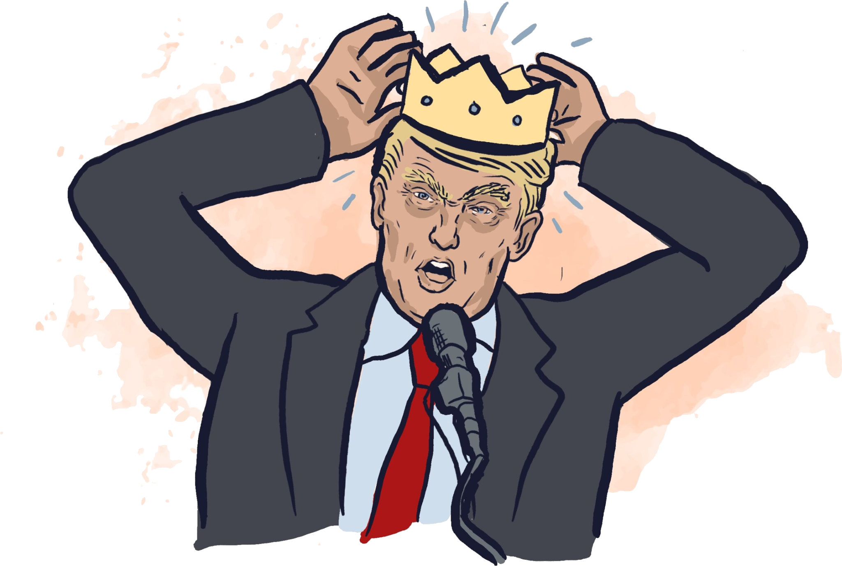


Authoritarianism in the US and Globally
2 decades of rising global autocracy; “elected autocrats” subvert democracy; extensive far-right authoritarian collaboration
In the US, a long history of authoritarianism grounded in misogyny,
racism & white supremacy; the South has faced it for a long time
Consolidation is happening quicker in the US than in other similar cases (e.g. Hungary, Turkey); crossed threshold into “competitive authoritarianism”
Authoritarianism is a system, not just a person, propped up by
multiple institutions.
Academic freedom often an early casualty of authoritarianism: autocrats don’t like free thinking (ex. Hungary)
Notes:
Maria

Slide 5
The Authoritarian Playbook
Direct Investigations Against Critics
Deploy Military Domestically
Give License to Lawbreaking
Federal Law Enforcement Overreach
Regulatory Retaliation
The Autocrat Won’t Leave
Notes:
Daniel

Slide 6
Chat
How is this affecting you or your community? What are you observing in your communities from this playbook?
Notes:
Daniel

Slide 7
02
How to fight?
Notes:
Daniel

Slide 8
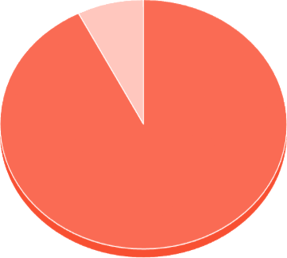
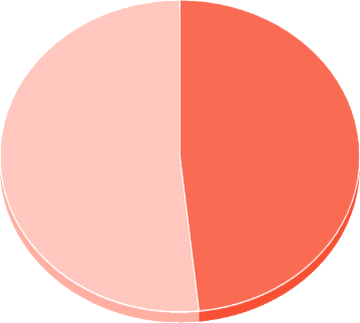
How we get a democratic u-turn
Analyzing 35 cases from 1991-2021, the predicted probability of stopping democratic backsliding:
Without a civil resistance movement
With a civil
resistance movement
7.5%
51.7%
NB: approximately 83% of movements with national trade union participation succeed, versus only 29% of movements without.
Source: Jonathan Pinckney, Claire Trilling (2024). Breaking Down Pillars of Support for Democratic Backsliding
Notes:
Maria

Slide 9
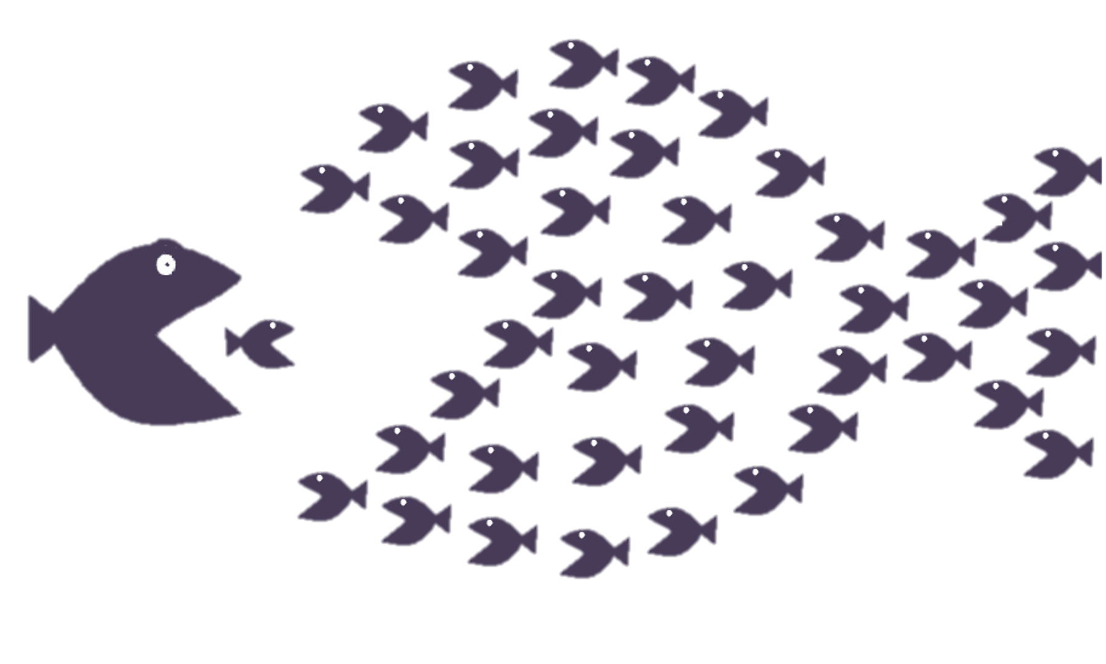
What is Civil Resistance?
Waging struggle for political, economic, or social objectives without the use or threat of violence. It can include protest, sit-ins, strikes, boycotts, civil disobedience, and constructive interventions.
Notes:
Maria

Slide 10

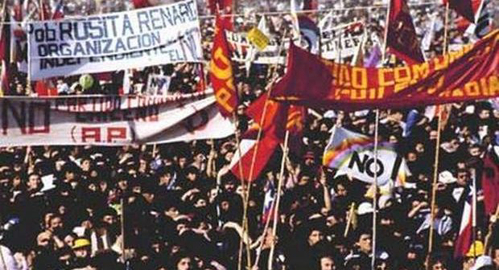
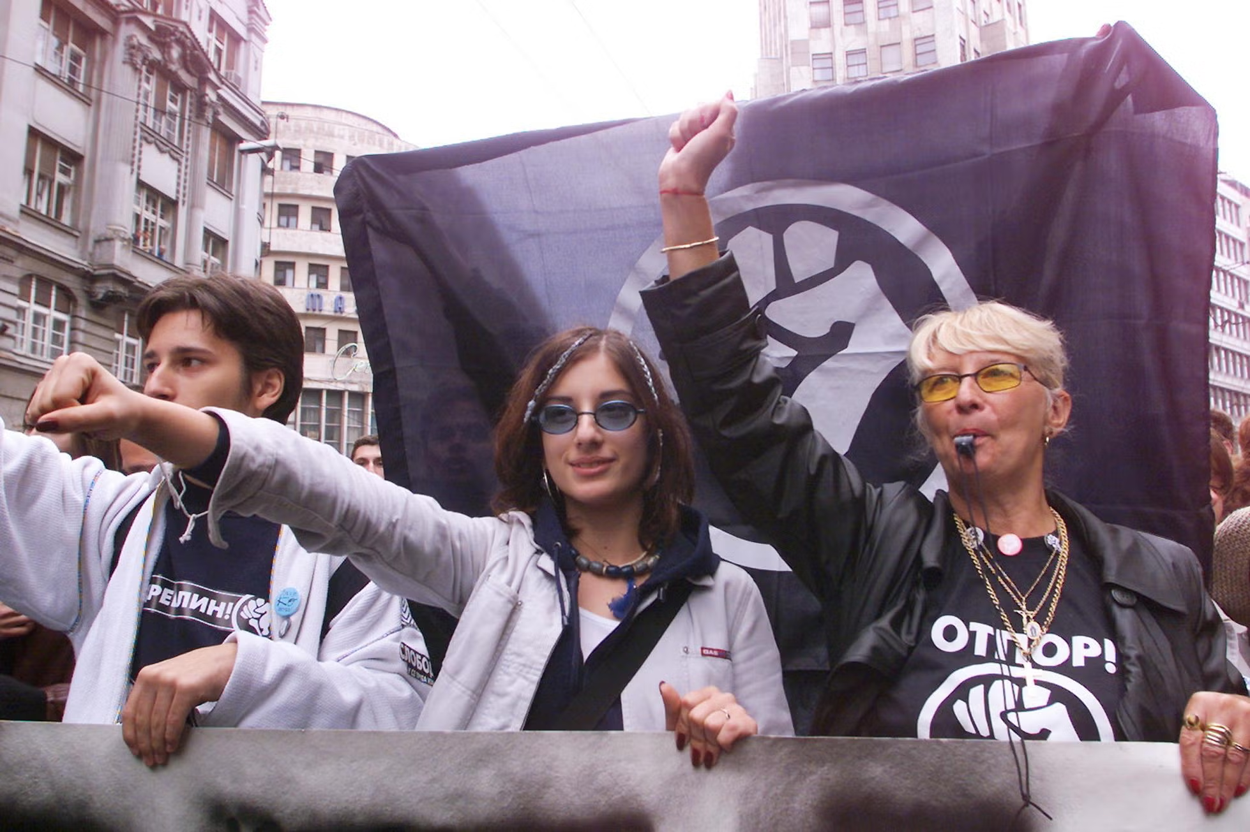
Notes:
Daniel
Does anyone recognize these photos? Chile example: Diverse audiences brought in; a lot of training- madres kids, campaign about positive future- no campaign about the future.
Under Pinochet, institutions like community kitchens (Ollas Comunes) and the Catholic Church’s Vicaría de la Solidaridad provided not just services but also safe spaces. These institutions were harder for the regime to repress without drawing international condemnation. What are the institutions in DC we can partner with?
https://antiauthoritarianplaybook.substack.com/p/lessons-from-solidarity-networks
https://antiauthoritarianplaybook.substack.com/p/how-chiles-affinity-groups-resisted
https://antiauthoritarianplaybook.substack.com/p/distributed-protest-organizing
https://en.wikipedia.org/wiki/Otpor
1. Leverage Trusted Institutions
Under Pinochet, institutions like community kitchens (Ollas Comunes) and the Catholic Church’s Vicaría de la Solidaridad provided not just services but also safe spaces. These institutions were harder for the regime to repress without drawing international condemnation.
What Worked in Chile:
Ollas Comunes: Women-led communal kitchens fed entire neighborhoods, fostering solidarity while addressing the immediate crisis of hunger caused by neoliberal economic policies.
Vicaría de la Solidaridad: Sponsored by the Catholic Church, it provided humanitarian aid, legal support for victims of state violence, and meticulously documented human rights abuses.
Recommendation for Today:
Partner with faith-based groups, cultural organizations, and trusted community spaces. Their established legitimacy can provide mutual aid networks with protection and resources.
Work with these institutions to create “sanctuaries” for organizing and mutual aid, shielding efforts from direct state interference.
2. Focus on Localized, Decentralized Efforts
Decentralization was key to survival. By distributing leadership and organizing at the grassroots level, Chilean networks avoided large-scale crackdowns and ensured their movements couldn’t be wiped out in one fell swoop.
What Worked in Chile:
Neighborhood committees organized aid distribution and resistance efforts autonomously, limiting exposure and enhancing trust among members.
Clear boundaries between local and national efforts made networks harder to infiltrate.
Recommendation for Today:
Prioritize grassroots leadership and ensure that decisions are made at the local level by those closest to the issues.
Keep mutual aid groups small, trusted, and interconnected rather than centralized under one big organization, which could be targeted by authoritarians.
3. Document and Advocate
The Vicaría didn’t just provide aid—it built a meticulous archive of human rights abuses. This dual approach of care and advocacy put a spotlight on the regime’s brutality, forcing international actors to pay attention.
What Worked in Chile:
Detailed documentation of torture, disappearances, and killings gave survivors and families tools to demand justice and accountability.
Media networks helped spread these stories beyond Chile, pressuring Pinochet’s regime internationally.
Recommendation for Today:
Establish networks of trusted journalists, citizen documentarians, and advocates who can safely record and disseminate stories of repression and neglect.
Use encrypted digital tools to protect vulnerable communities while amplifying their struggles to both local and international audiences.

Slide 11
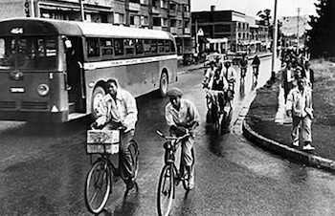
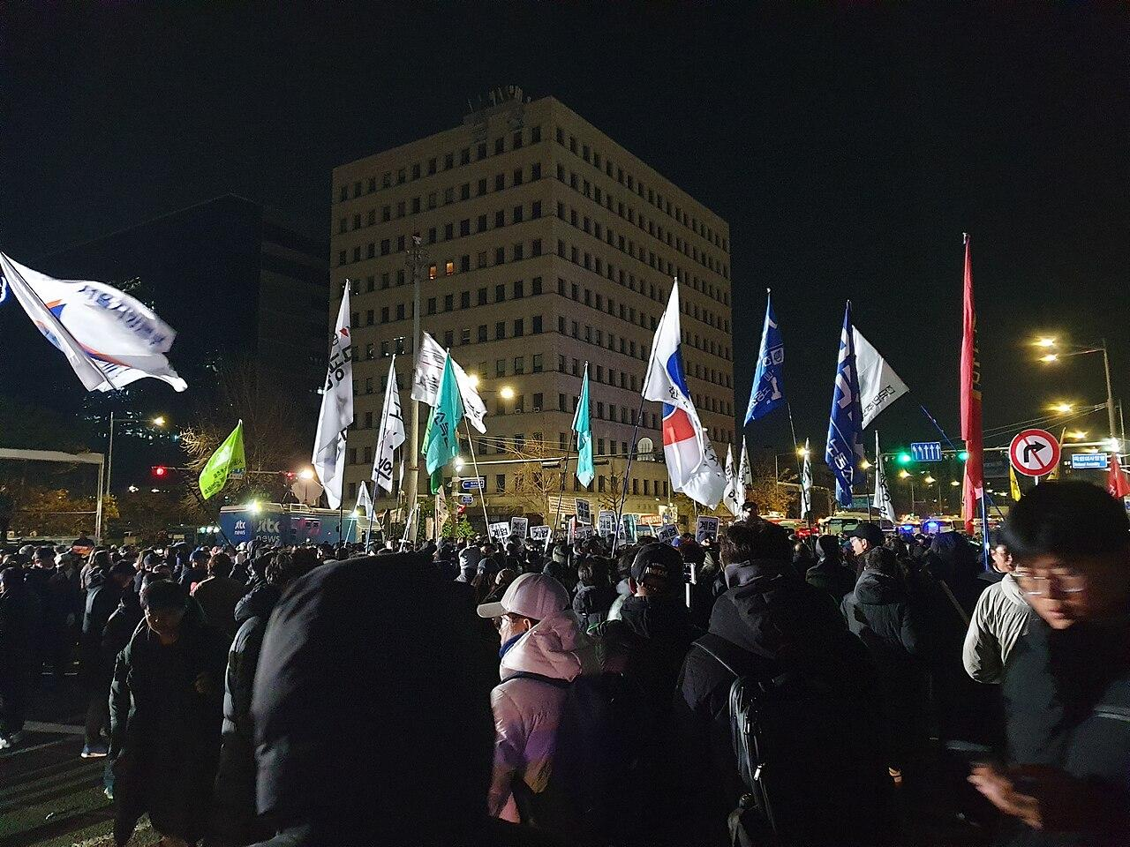
Notes:
Daniel
December 3, 2024 at 10:27pm – President Yoon declared martial law. (This was later revealed to be a full-fledged coup attempt).
Different people are able to take different types of risks– some people might help watch others’ kids while they go to a protest, while other protest. The bus boycott lasted over a year and some people played the critical role of supporting with childcare and food preparation for people who sustained long commutes.
https://en.wikipedia.org/wiki/2024_South_Korean_martial_law_crisis
In December 2024, the South Korean Labor Confederation, including the Korean Metal Workers Union and the Korean Confederation of Labor, played a crucial role in mobilizing against President Yoon Suk Yeol's attempted imposition of martial law. These unions swiftly called for a strike to defend democracy, with tens of thousands of workers participating in protests and urging the president's resignation.
Here's a more detailed look:
Unions' Response:
The Korean Confederation of Trade Unions (KCTU) and other labor groups reacted immediately to President Yoon's declaration of martial law, viewing it as a threat to democracy and a violation of the rule of law.
Mobilization and Protests:
Unions mobilized their members, calling for strikes and mass demonstrations to oppose the martial law and demand the president's resignation.
Impact on Martial Law:
The unified opposition, including the unions, played a significant role in forcing President Yoon to reverse his decision and lift the martial law decree within hours.
Ongoing Struggle:
The unions continued to push for the president's impeachment and to address the underlying political issues that led to the crisis.
Historical Context:
The unions' actions were seen as a continuation of a long tradition of South Korean labor activism in defending democracy and fighting for workers' rights.
The Montgomery Bus Boycott was a landmark civil rights protest in Montgomery, Alabama, where African Americans refused to ride city buses for 381 days to protest segregation laws on public transportation. This boycott, which began in December 1955, was a direct response to Rosa Parks's arrest for refusing to give up her seat to a white passenger. The boycott ultimately led to the desegregation of Montgomery buses in 1956 after the Supreme Court ruled that segregation on buses was unconstitutional.
Key aspects of the Montgomery Bus Boycott:
Rosa Parks& Spark:
Rosa Parks' arrest on December 1, 1955, for refusing to give up her bus seat sparked the boycott, but the community had been actively working towards civil rights for some time.
Women's Political Council & Planning:
Jo Ann Robinson, president of the Women's Political Council, played a key role in organizing the boycott and distributing leaflets calling for the one-day bus boycott.
Montgomery Improvement Association (MIA) & Continued Boycott:
A group of local ministers, including Martin Luther King Jr., formed the MIA to organize and lead the boycott.
Impact & Success:
The boycott had a significant economic impact on the bus company and demonstrated the power of nonviolent civil disobedience, leading to the Supreme Court ruling against segregation on buses.
Desegregation:
Montgomery buses were finally desegregated on December 20, 1956, marking a victory for the civil rights movement.
Legacy:
The Montgomery Bus Boycott is considered a pivotal event in the civil rights movement, inspiring other protests and paving the way for future legal and social change.

Slide 12
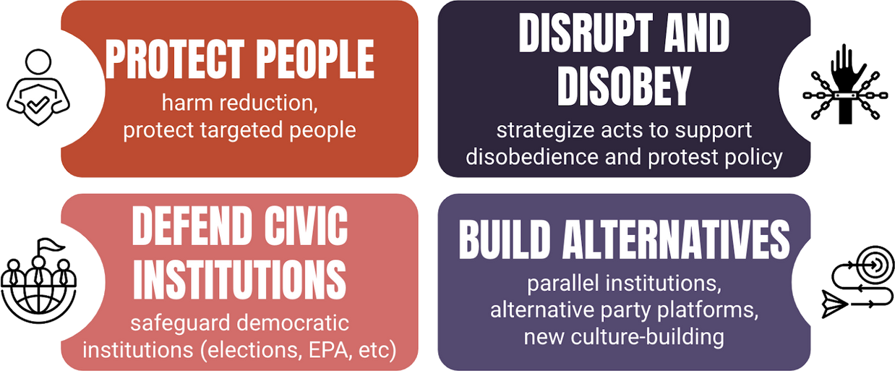
Source: Daniel Hunter / Choose Democracy
Notes:
Daniel

Slide 13
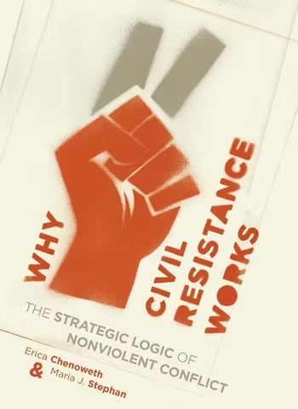
Winning Pro-Democracy Campaigns
Large, diverse participation & sustained momentum (3.5% rule)
Expanding the repertoire of nonviolent tactics
Elicit loyalty shifts among key pillars
Maintain discipline & resilience despite escalating repression
Notes:
Maria

Slide 14
Winning Pro-Democracy Campaigns
Educators can be key!
Notes:
Maria

Slide 15
Educators and resistance: global examples
Norway: Prevented Nazi takeover of education (1942)
Argentina: Created lessons plans designed to ignore Perón’s regime (1946-55, 1973-4)
Chile: Educators and students mobilized against Pinochet’s dictatorship (1973-1990)
Venezuela: Resisted the teaching of regime-friendly materials (2001-2013)
Türkiye: Supported minority (Kurdish) rights in education under Erdogan (2016)
Hungary: Tanítanék (“I wish to teach” in Hungarian) movement of resistance against Orbán’s attack on education (2024)
Notes:
A few transnational examples in which educators played a key role in resisting authoritarianism in the classroom and beyond.

Slide 16
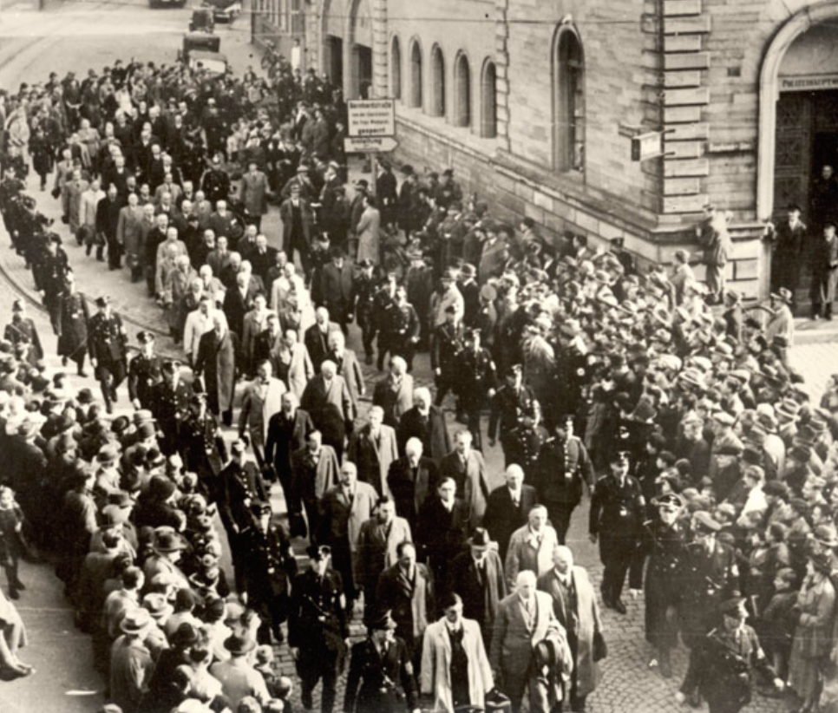
Norway (1942)
Around 8,000 - 10,000 of Norway’s 12,000 teachers refused to teach the Nazis’ fascist curricula, submitted letters of refusal, and continued to teach classes clandestinely. Prevented schools from being incorporated in fascist state and thwarted Quisling regime.
Tactics:
Wearing of symbols (paper clips)
Boycotted state institutions
Refused to teach curriculum
Resigned, taught in secret, made repression backfire
Notes:
Around 8,000 - 10,000 of Norway’s 12,000 teachers refused to teach the Nazis’ fascist curricula, submitting letters of refusal.
The government shut down schools, prompting 200,000 parents to send protest letters. Meanwhile, schools continued to teach in secret.
The regime arrested around 1,000 teachers, 499 of whom were sent to a concentration camp near Kirkenes in the Arctic.
By November 1942, the regime abandoned its fascist education goals and released the detained teachers, effectively ending the Nazi takeover of schools.
Creative tactics:
Wearing of symbols (paperclips worn as clips)
Displays of flags and symbolic colors
Letters of opposition or support
Boycott of government-supported institutions

Slide 17
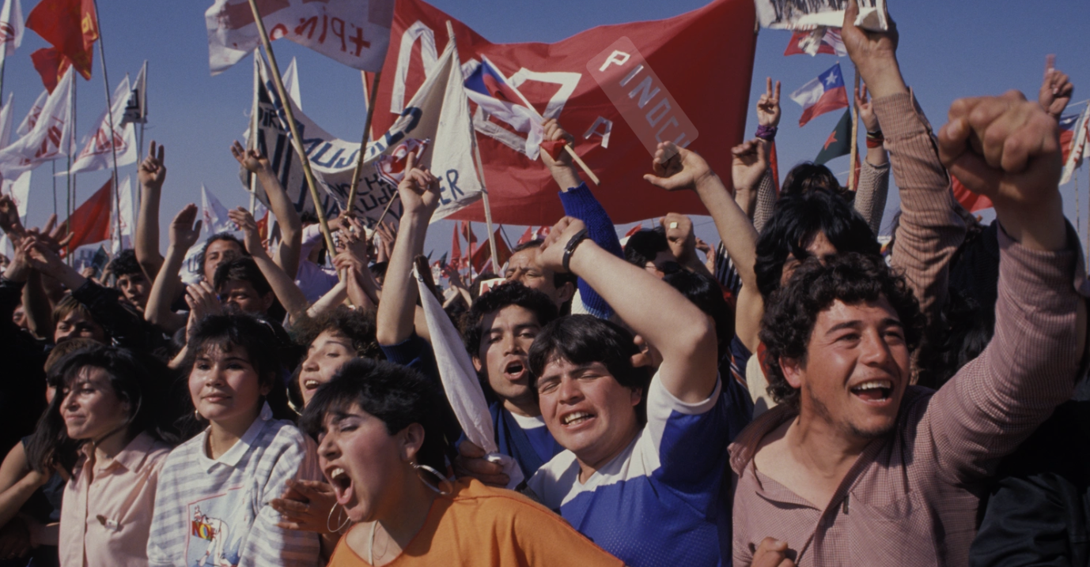
Chile (1980s)
During Pinochet’s dictatorship, diverse groups of Chilean educators and students organized strikes, underground study circles, and mass demonstrations, using schools and universities as hubs of nonviolent resistance against authoritarian rule.
Tactics:
Hunger strikes
Occupying spaces
Public shaming of Pinochet’s regime
Clandestine education
Notes:
Educators, students, and educational institutions were deemed as incubators of socialism by the Pinochet regime and were therefore brutally targeted.
Teachers were fired, arrested, exiled, and even “disappeared” by the regime. Schools became militarized and mandated coursework that supported the authoritarian ideologies of Pinochet’s dictatorship.
Drawing international attention to their movement, student groups at the University of Chile occupied the French Embassy and UNESCO headquarters in Santiago demanding the restoration of their academic freedoms. Students also went on hunger strikes in protest of the exclusions of fellow students.
The regime responded by shutting down universities but this only further fueled the movement and resistance.
Creative tactics:
Students went on hunger strikes in protest of their peers being expelled and in some cases disappeared
Students occupied the French Embassy and UNESCO’s Santiago headquarters, which helped gain international awareness and support
A faculty group created an academic journal with the support of UNESCO that was used as a public platform to criticize and shame Pinochet’s regime.

Slide 18
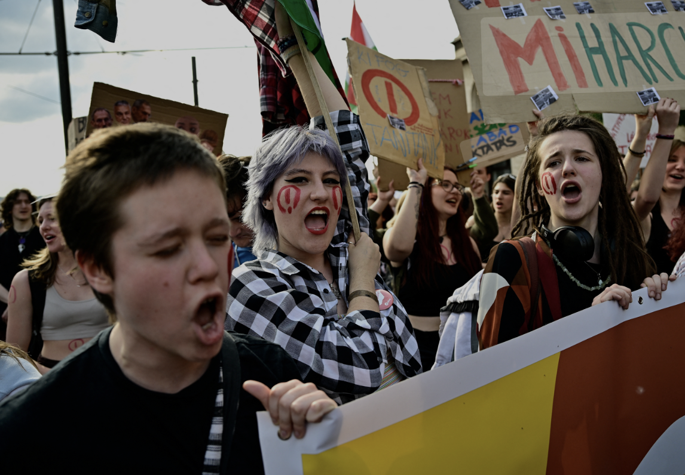
Hungary (2022-present)
Tanítanék, the grassroots movement, built a nationwide coalition, supporting punished educators, mobilizing 90,000+ supporters, and sustaining nonviolent resistance to Orbán’s authoritarian education policies.
Tactics:
Strikes over unjust wages, poor conditions
Student walkouts & human chains
Creation of public strike fund (backed by key influencers)
Significant digital outreach
Notes:
The Orbán administration used Hungary’s education system as a means of centralizing its power.
In response, Hungarian teachers, students, and parents organized strikes, and practiced other forms of noncooperation.
Teachers, students, and parents organized large assemblies, formed human chains that blocked a key bridge, burned official warning letters from the state, and chanted protest slogans such as “We are not afraid” and “Orbán get out.” These actions marked some of the largest public demonstrations in Hungary since the fall of communism.
Tanitanek was launched in 2016 by a fired teacher and built a coalition including teachers, students, parents, and other members of civil society. They organized a mailing list exceeding 90,000 and supported striking educators, those arrested, and broader organizing efforts.
Creative tactics:
Assemblies of protest/ support
Students formed human chains throughout Hungary and would block a vital bridge for several hours
Destruction of government documents (warning letters demanding teachers to cease the protests)

Slide 19
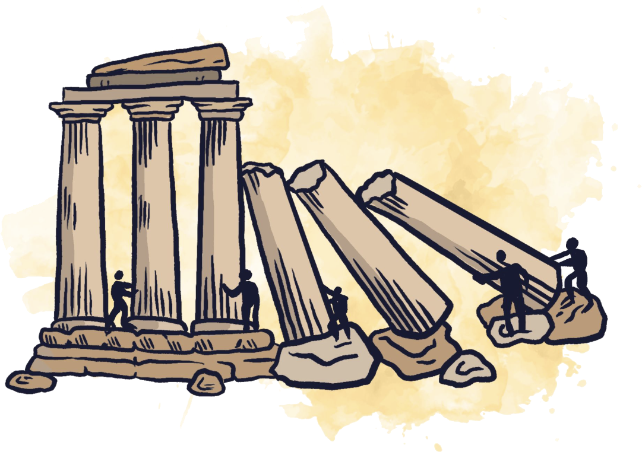
Pillars of Support
Notes:
Daniel

Slide 20
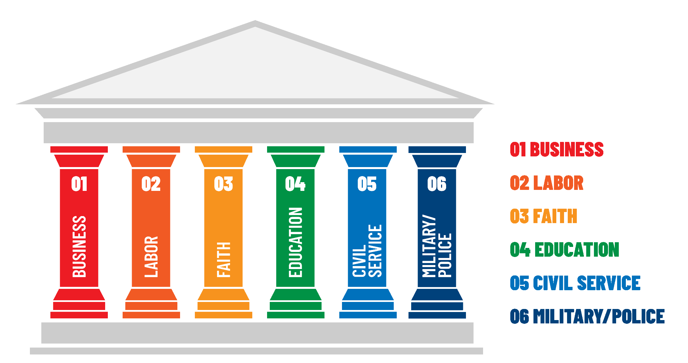
the Regime’s Pillars of Support
…and many more.
Notes:
Daniel

Slide 21


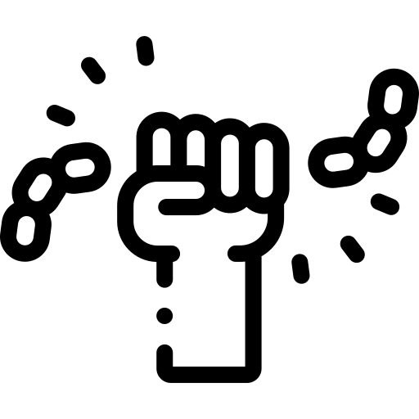
Types of People Power
Building Alternatives
Noncooperation
Protest & Persuasion
To raise public awareness of an issue and persuade a target to act in a desired way
To build an alternative institution or policy by acting as though it is already in place to disrupt or directly challenge the current system/policy, and demonstrate alternatives
To undermine the authority of an unjust system by disrupting it, refusing to cooperate with it, or otherwise making it harder, or impossible, for the system to keep its unfair policy
Examples:
Marches/rallies/vigils
Street theater
Letter-writing/petition drives
Skywriting
Mock awards
Picketing
Group lobbying
Mock elections
Birddogging
Examples:
Occupation of buildings
Mutual Aid food/health
Guerilla gardening
Mississippi Freedom Democratic Party alternative elections
Examples:
Worker strikes
Boycotts
Rent strikes
Tax refusal
Fix bathrooms signs
Jury- conscientious objection
Source: “What if Trump Wins” by Choose Democracy
Notes:
Daniel
There are three main kinds of actions. But being clear about which kind of action we are taking and what we hope to achieve becomes especially important during times of repression. It can help us make the most of strained resources.

Slide 22

Noncooperation is the act of refusing to cooperate or comply with requests, demands, or orders.
Enough noncooperation will cause a pillar to completely defect — or at least be unreliable in the autocrat’s aims.
Notes:
Daniel

Slide 23

Levels of Noncooperation
Individual & Small Group Noncooperation
Collective Noncooperation
Mass Noncooperation
Notes:
Daniel
Federal workers have been at some of the front here.
They’ve done so much.
Tesla takedown / DOGE emails

Slide 24

— Howard Zinn
Author of A People’s History of the United States
“Civil disobedience is not our problem. Our problem is civil obedience.… Our problem is that people are obedient while the jails are full of petty thieves… (and) the grand thieves are running the country. That’s our problem”
Notes:
Maria

Slide 25
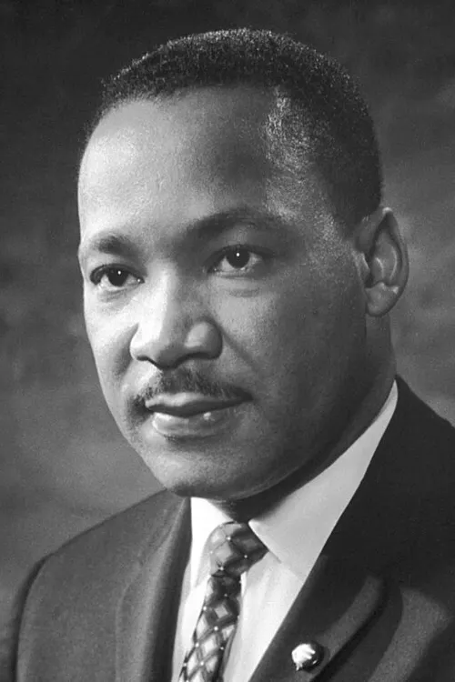
— Martin Luther King, Jr.
Letter from a Birmingham Jail
“We should never forget that everything Adolf Hitler did in Germany was 'legal' and everything the Hungarian freedom fighters did in Hungary was 'illegal.' It was 'illegal' to aid and comfort a Jew in Hitler's Germany.”
Notes:
Maria

Slide 26
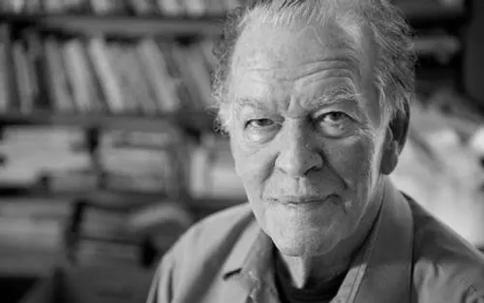
— Gene Sharp
Author of From Dictatorship to Democracy
“By themselves, rulers cannot collect taxes, enforce repressive laws and regulations, keep trains running on time, prepare national budgets, direct traffic, manage ports, print money, repair roads, train the police and army, issue postage stamps or even milk a cow.”
Notes:
Maria

Slide 27


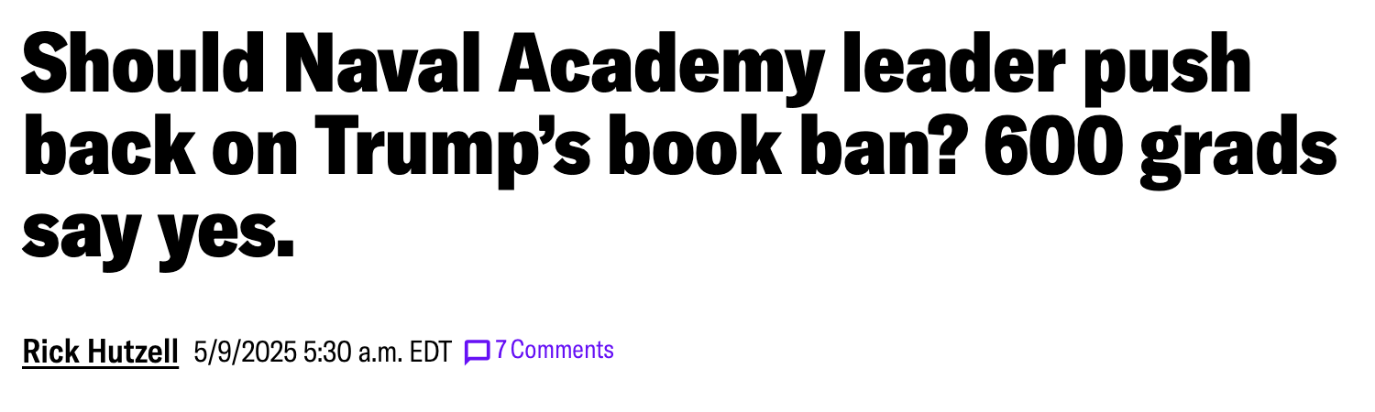


Notes:
Maria

Slide 28
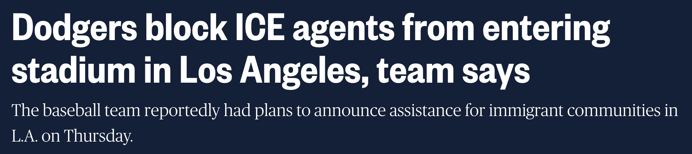
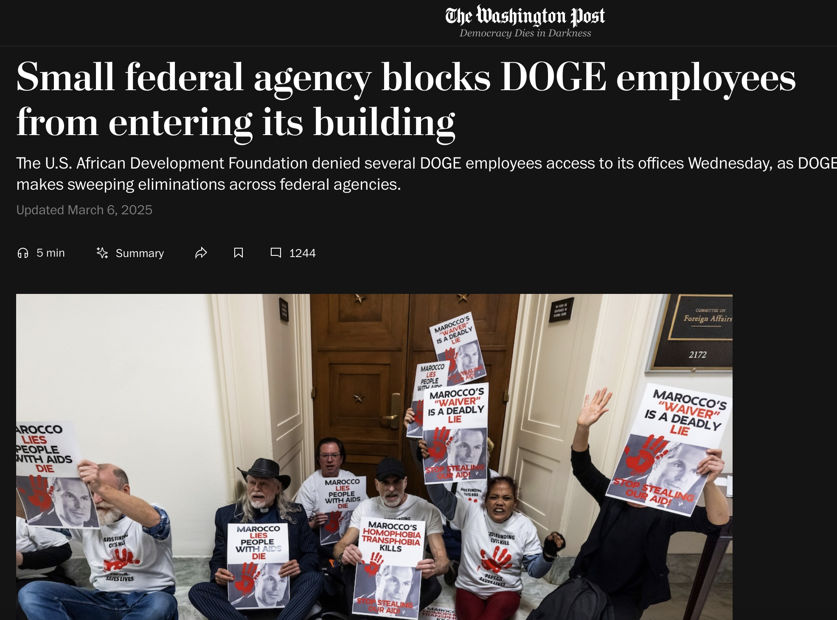

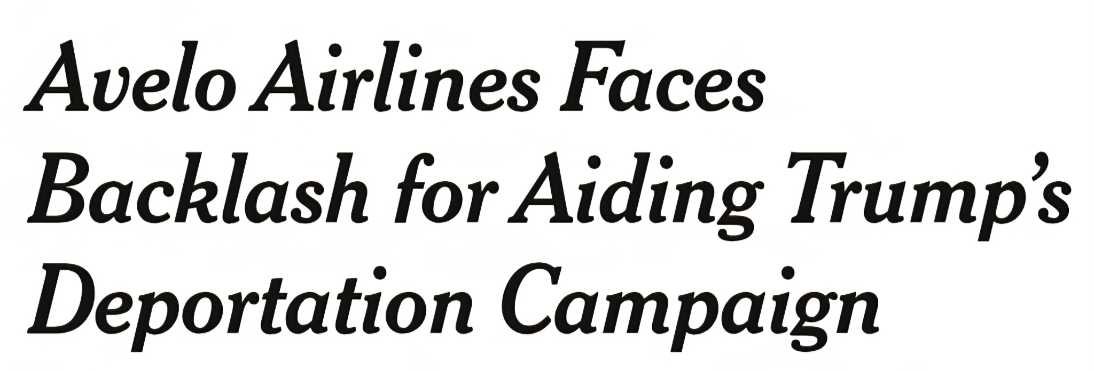
Notes:
Maria

Slide 29


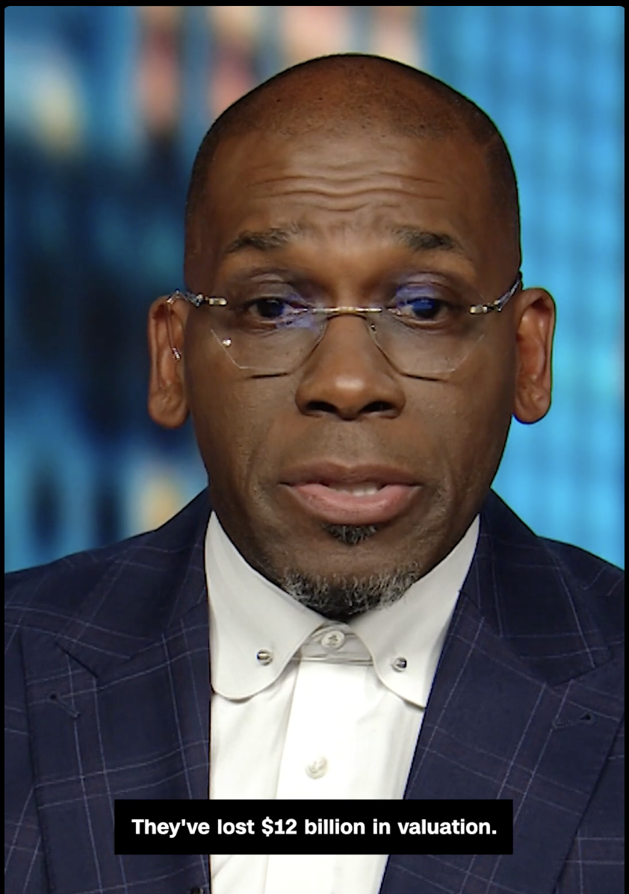
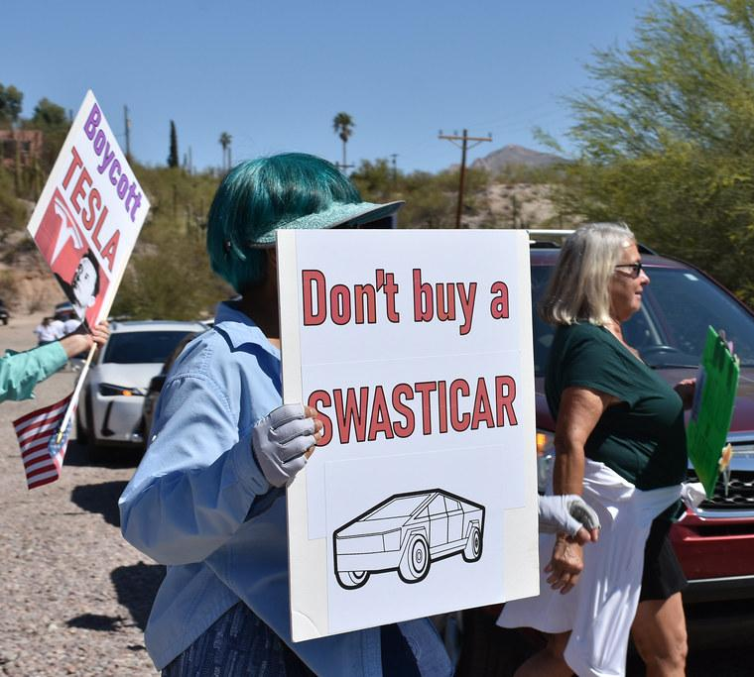
Notes:
Daniel
Photo credits: "Tesla protest IMG 7000-(104) (54324145324)" by Becker1999 from Columbus, OH is licensed under CC BY 2.0.
"Target" by JeepersMedia is licensed under CC BY 2.0; CNN via Youtube
"Tesla-Musk Protest 2025" by dl bone is marked with Public Domain Mark 1.0.
MAKE SURE TO MENTION pension angle with AFT.

Slide 30
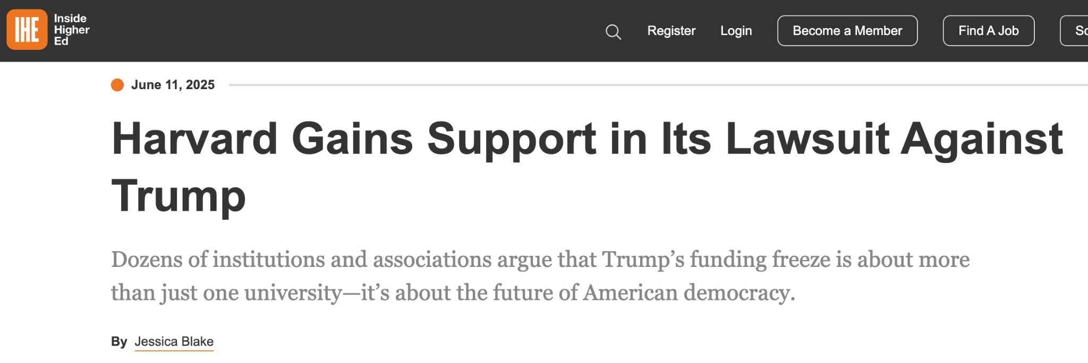
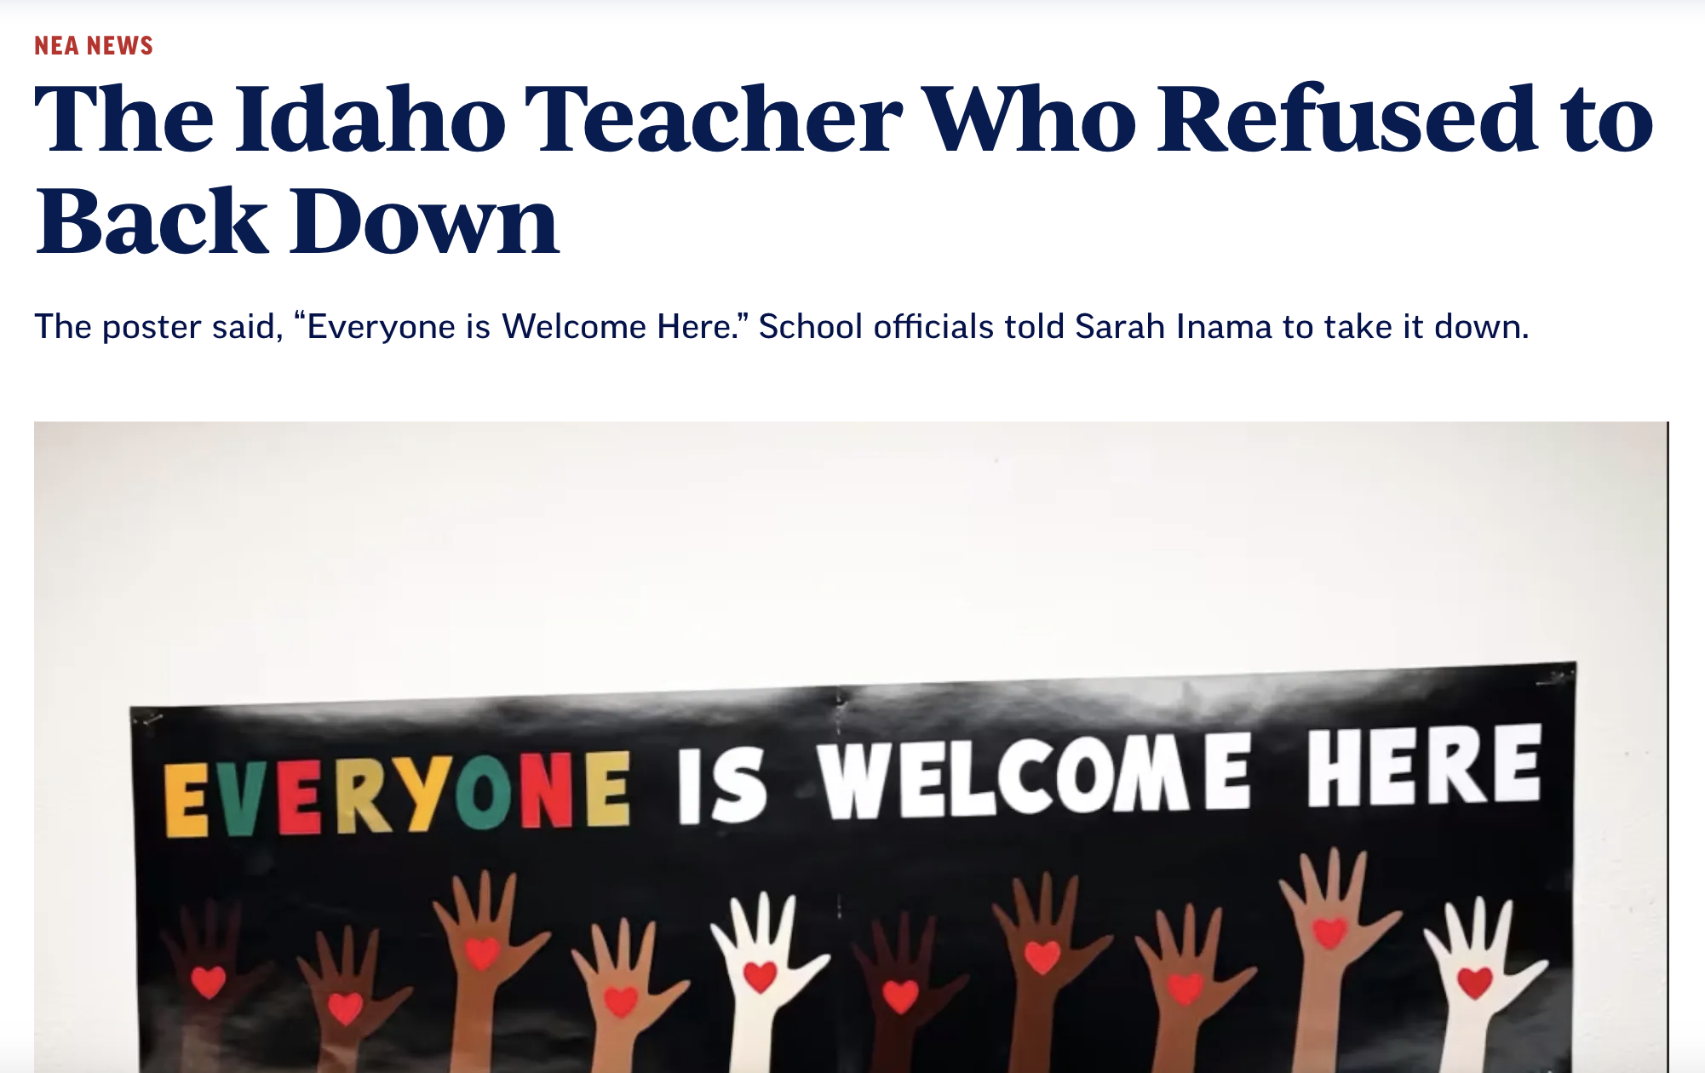
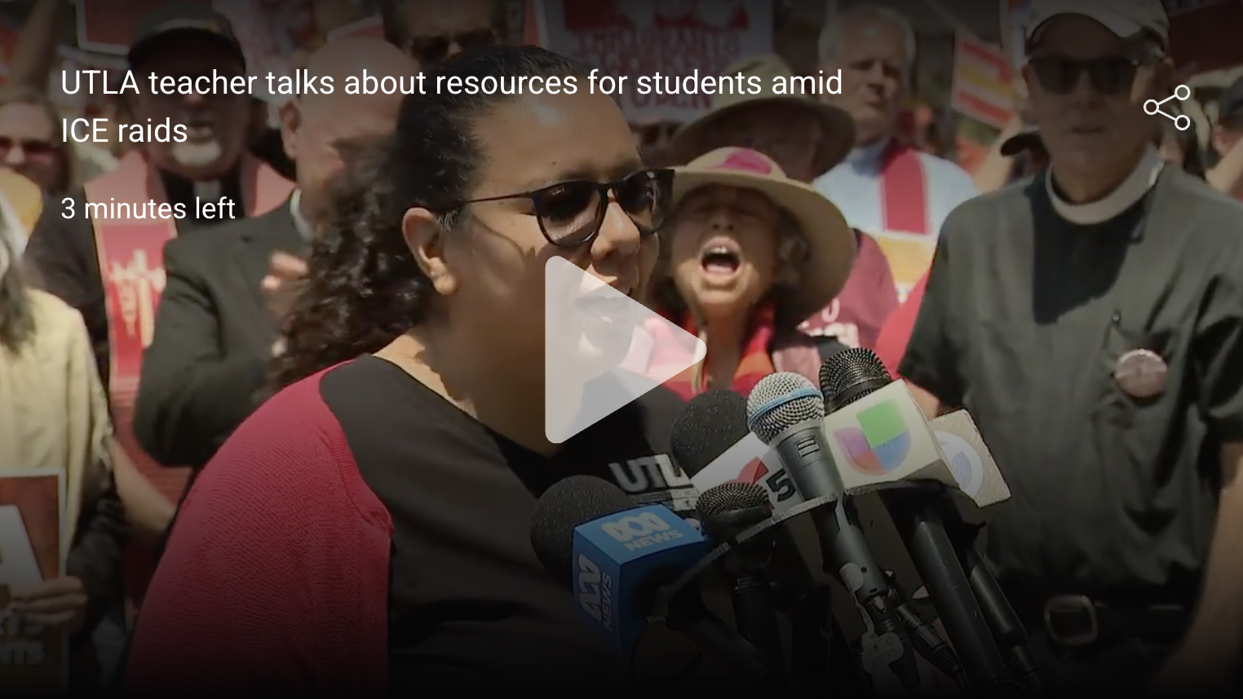
Notes:
Daniel
Thalía Cataño — high school social studies teacher at Theodore Roosevelt High School in Los Angeles (UTLA!)

Slide 31

Notes:
Daniel
Reiterate the point that when repression increases, so does resistance. This lesson has been shown by many struggles in many places.

Slide 32
Chat
We’ve given a lot of stories and tactics. What’s one tactic that’s interesting to you to explore today?
Notes:
Maria

Slide 33
04
Planning and Redlines
Notes:
Daniel

Slide 34
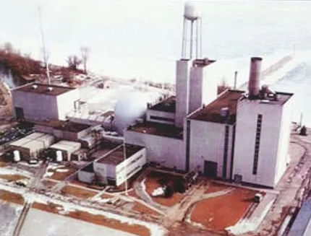
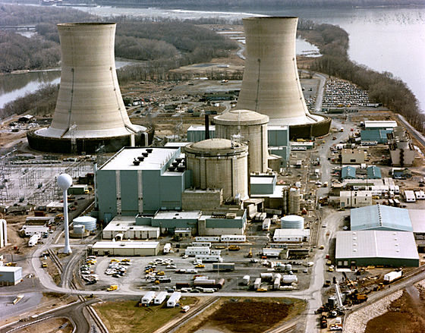
Bad things don’t create movements — organizing does
Oct 5, 1966 — Fermi Plant’s partial meltdown of
nuclear fuel in the reactor's core
March 28, 1979 — Three Mile Island nuclear facility
Notes:
President Trump is going to do outrageous things. But outrageous things don’t necessarily mean that people will “rise up.” They have to be prepared and organized to rise up.
Let’s look at two nuclear disasters to understand this:
In 1979, the Three Mile Island reactor nearly melted down — risking millions of lives. But it didn’t just trigger fear; it sparked massive protest, deepened the anti-nuclear movement, and brought in new activists. This wasn’t just about the event — it was about the infrastructure of movement already in place, ready to act.
Contrast that with an earlier, nearly identical crisis at the Fermi nuclear plant near Detroit. It, too, nearly melted down — but hardly anyone noticed. Why? Because there was no visible movement, no voices to explain the danger, no ready-made community to take action.
People are more likely to rise up in those moments if we have:
Organized networks for rapid-response (a broad network, a highly concentrated bold crew ready for escalated direct action, or ideally both)
Prepared simple messages that speak to mainstream values
Create a space for people to “get the facts” — so they aren’t relying solely on state information
Prepared key institutionalists or others with perceived expertise to act
Offer a noncooperation tactic that matches the moment (sending out a request for petitions or sharing talking point memos will not be that).
This workbook focuses primarily on that last component.

Slide 35
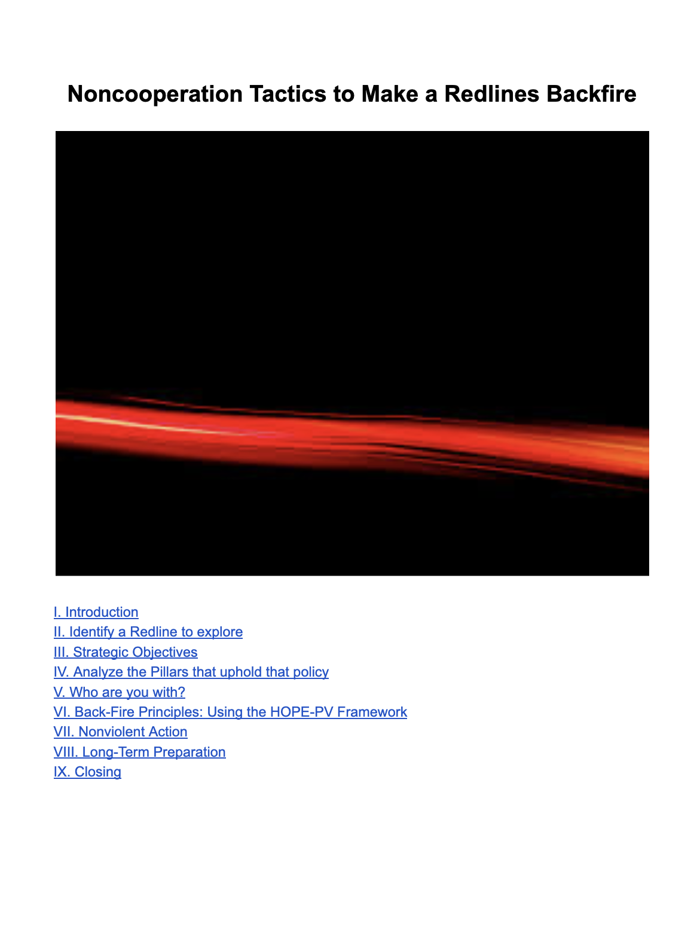
Redline Exercise
Pick a Redline
Remind yourself of the strategic goals
Cut through confusion by identifying your red lines to trigger mobilization to your base (and beyond)
Advance greater unity.
Build capacities (e.g. mobilization skills, strategic coordination, networks of trust) that increase flexibility and durability for the road ahead.
Avoid despair and dropping out.
Get public defections — even if they are long-term
Remain nonviolent.
Who are allies, friends, comrades, colleagues, fence sitters that you can act with?
Identify some tactics to do before (another) redline is crossed and then after it’s crossed

Slide 36
Tactics to consider
A. Protest and Persuasion
Mass demonstrations outside government buildings or courthouses.
Silent vigils or symbolic acts (e.g. “blackouts,” empty chairs, candlelight marches).
National days of protest themed around constitutional defense.
B. Social Noncooperation
Boycotts of businesses aligned with anti-democratic actors.
Cultural refusal: artists, athletes, public figures withdraw participation in government-linked events.
Mass symbolic resignation from advisory boards or commissions.
C. Economic Noncooperation
General strikes or targeted walkouts (e.g. teachers, tech workers, service sectors).
Divestment campaigns against corporations funding election deniers.
Tax resistance or “withholding campaigns” in protest of unconstitutional governance (legal advice required).
D. Political Noncooperation
Local governments and city councils refuse to recognize illegitimate actions.
Electoral officials publicly affirm rule of law and refuse to carry out unlawful directives.
Cross-party coalitions to publicly denounce redlines and enforce political norms.

Slide 37
Spectrum of allies
middle
passive allies
passive
opponents
MOVEMENT
active allies
active opponents
OPPONENTS
Notes:
Active opponents are the cores of the pillars - they will not shift loyalties

Slide 38
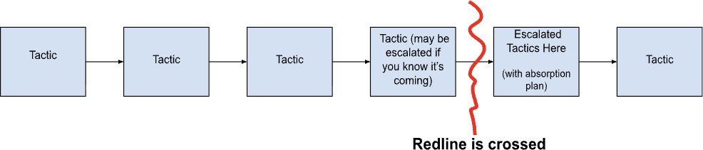
Put actions in some order
In the face of an authoritarian, you will not win with strong talking points, merely turning out a lot of people to a rally, doing a press conference, or gathering signatures. Anti-authoritarian struggles undermine the pillars of support, using noncooperation to stretch the boundaries of what’s acceptable so that pillars heed the call to also resist/slow down orders.
Not all tactics will be escalated, risky noncooperation. But to get there, there may be a range of different persuasion and organizing efforts to get to larger levels of noncooperation.
Identify what larger noncooperation that might be achieved? Put those at or near the end. Then place other actions in sequence. What are the actions before the redline? What are after? Talk about how you’d absorb new people’s energy.

Slide 39
Group # Alliance to Reclaim Our Schools
What redline are we exploring? | Privatize public education and drain funds from public schools, in order to enrich corporate shareholders in (charter schools?) and private schools, as well as tax payers seeking a tax credits for funding school vouchers Silence or diminish parent and community voice in how our local, public schools are run Remove instruction or reading material related to the histories of whole groups of people based on their identities, including Black people, Indigenous people, immigrants, LGBTQ+ people and people with disabilities Create conditions that limit teachers’ ability to perform their roles with excellence Diminish programs that advance equity for students with disabilities any special needs, including differently-abled children Reduce or eliminate critical in-school programs due to removal of federal funding
Who are you with? | parents, students, educators and other stakeholders who love public education

Slide 40
Group # Alliance to Reclaim Our Schools
Tactics we might use before/after redlines What are different organizing nonviolent actions – symbolic actions, noncooperation, etc — we might we use? | Set and reach a percentage of parents in your school who will sign the non-permission slip Turn your school bake sale, fall barbecue, party into a celebration of histories of Black people and immigrant communities being targeted by the federal administration Host a backpack giveaway & include books featuring LGBTQ+ and BIPOC protagonists Post a message to your social networks with the amount of money your school district is losing from federal cuts and ask parents to email superintendent & school board members to find out what schools will lose, and ask them to go ON RECORD with their response Weekly non-compliant rituals like “ten minutes of truth” that families, teachers and students deliver to groups at their schools or online to break down context and history of current events Form a committee to take escalated action: observe and interrupt ICE activity in the school area, protest or boycott a local or regional donor to privatization efforts, enact “disruptive teaching & learning” like wheeling a blackboard into an event with electeds or banner drops DC mobilization and establishment of the People’s Department of Education Whole school communities turn out to May Day actions
Next Steps | To get involved, please share your contact info: bit.ly/EdNonCooperation

Slide 41
Group # ___
What redline are we exploring? | ICE inside schools ICE abduct students Ordered to remove all “DEI” materials National Guard deployment in our city Other: _____________________________
Who are you with? | List allies, friends, comrades, colleagues, fence sitters that you can act with?
Tactics we might use before/after redlines What are different organizing nonviolent actions – symbolic actions, noncooperation, etc — we might we use? | TACTIC TACTIC [REDLINE IS CROSSED] ESCALATED TACTIC TACTIC
Next Steps | What are organizing next steps for us to do to carry this out?

Slide 42
Debrief

Slide 43
Interesting actions we see
1
2
3
4
Educate students and the public about authoritarianism and effective solutions
E.g.
Use holidays, like King Day and International Day of Democracy (September 15th)
Teach the broader public: teach-ins
Lead Freedom Trainings
Use symbolic actions to grow the movement and keep using free expression
E.g.
Alliance to Reclaim Our Schools
ICE resistance: signs of solidarity
Noncooperation with enablers of ICE and authoritarianism
E.g.
Avelo Boycott
Target Boycott
T-Mobile boycott
Shareholder pressure via pension funds
Encourage and provide awards to those who take courageous stands for democracy
E.g.
Celebrate librarians who refuse to remove books
Teachers teaching truth
Support outside of NEA with people doing great work

Slide 44
05
Resources!

Slide 45
Full Redline Workbook
Download the complete
Redline Workbook at this link.
See more resources at FreedomTrainers.net.

Slide 46

Videos
Teachable movies about noncooperation and how people have overthrown unjust regimes:
1-hour Bringing Down a Dictator - story of Otpor’s overthrow of dictator Milosevic in Serbia (translated into many languages)
30-minute views A Force More Powerful - case studies of nonviolent resistance in Chile, Denmark, South Africa, and more… (translated into many languages, has study guide for classrooms)
4-minute video explaining Pillars of Support
2-minute video explaining 4 paths to resist Trump (Protect people | Disrupt | Defend civic institutions | Build alternative)

Slide 47

Read more
Horizons Project
Authoritarianism: How You Know it When You See it
Horizons Project Pillars of Support caselets
Pillars of Support short case studies (unions, faith, business, professional associations, vets/military groups)
Big Tents & Collective Action Can Defeat Authoritarianism
We Are Stronger Than We Think
Global Nonviolent Action Database (Swarthmore University)
Norwegian Teachers Prevent Nazi Takeover of Education (1942)
Choose Democracy
10 ways to be prepared and grounded now that Trump has won
Explore a “choose-your-own-adventure”-style book on how resistance might look: http://whatiftrumpwins.org/
Harnessing Our Power to End Political Violence (HOPE) trainings and materials focused on skills related to how to make violence and repression backfire
Waging Nonviolence:
Hungarian teachers’ movement (Tanitanek) challenging authoritarianism
Busting the Myth that Gen Z Isn’t Protesting
Freedom Trainers: supporting trainings focused on strategic nonviolent action and organized noncooperation

Slide 48

Want more training?
Beautiful Trouble offers skills training on tactics: BeautifulTrouble.org
Horizon’s Project leads training with Harnessing our Power to End Political Violence (HOPE-PV): https://horizonsproject.us/hope-pv/
Maria and Daniel work with Freedom Trainers: freedomtrainers.net

Slide 49

Freedom Trainers
Freedom Trainers has workshops coming up:
San Francisco TOT (Aug 20-21)
Seattle TOT (Sept 12-14)
New York TOT (Nov 7-10)
Minneapolis TOT (likely Nov 18-20)
…more coming!
We do not publicly post our training-of-trainers workshops.
If you want to join but don’t see an upcoming workshop, please contact us at freedomtraining@proton.me !

