Slide 1
Foundations of LGBTQ+ Justice

Slide 2
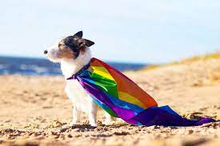
Who are we?
Linda
Matt
Salina
Natasha
Grat
Michelle
Ellen

Slide 3
Land Acknowledgement
Every community owes its existence and vitality to generations from around the world who contributed their hopes, dreams, and energy to making the history that led to this moment. Some were brought here against their will, some were drawn to leave their distant homes in hope of a better life, and some have lived on this land for more generations than can be counted. Truth and acknowledgment are critical to building mutual respect and connection across all barriers of heritage and difference. We begin this effort to acknowledge what has been buried by honoring the truth. We are standing on the ancestral lands of Indigenous People. We pay respects to their elders past and present. Please take a moment to consider the many legacies of violence, displacement, migration, and settlement that bring us together here today.

Slide 4

Our Time Together
90 Minute Dash
  Starting the conversation outside the umbrella
  Issues
  Framework for Determining Actions
  A Little Law Talk
  Lessons Learned and Actions to Apply

Slide 5

Community Agreements
Awareness and Self-Knowledge
Listen for Understanding
Be Gracious
Stay Engaged
Be Open and Suspend Judgment
Say “I”- tell your truth
Seek Discomfort
Reach for Empathy
Expect non- Resolution and non-Closure

Slide 6
Why we are here!
LGBTQ+ youth are more than four times as likely to attempt suicide than their peers
A majority of LGBTQ+ people say that they or an LGBTQ+ friend or family member have been threatened or non-sexually harassed (57 percent), been sexually harassed (51 percent), or experienced violence (51 percent) because of their sexuality or gender identity. [2]
NEA RA Support and Part of NEA Mission and Vision Pg 5
[1] Human Rights Campaign Foundation. (2017, July). Mental health and the LGBTQ community. https://suicidepreventionlifeline.org/wp-content/uploads/2017/07/LGBTQ_MentalHealth_OnePager.pdf
[2] National Public Radio, the Robert Wood Johnson Foundation, & The Harvard T.H. Chan School of Public Health. (2017, November). Discrimination in America: Experiences and views of LGBTQ Americans. Retrieved June 24, 2020 from https://www.rwjf.org/en/library/research/2017/10/discrimination-in-america--experiences-and-views.html

Slide 7
The Words of Our Members
“Know that even if you do not personally know of any LGBTQ+ staff person in your district, they are there. Be an ally even if you do not know them. Speak up when you hear, see, or perceive bias and/or discrimination. Advocate for inclusive policies for both students and staff.”
7
Notes:
Throughout today’s training, we will be sharing the words of NEA members who are a part of the LGBTQ+ community. We shared an anonymous survey and think it’s important to hear the words of our colleagues—whether they are out or not—about their experiences as LGBTQ+ educators.

Slide 8

Building Beyond the Umbrella
How do you begin the work with your colleagues of seeking justice with those who don’t share the experiences, identities, and issues that you do?

Slide 9
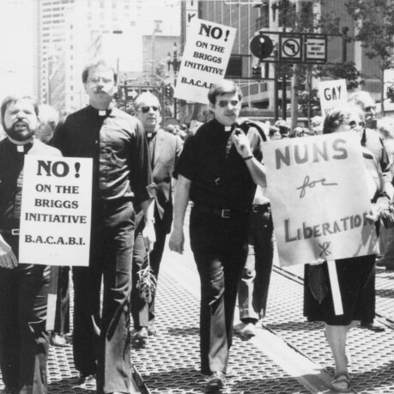


Building Beyond the Umbrella
Solidarity
sol / i / dar / i / ty
Noun
  1. Unity or agreement of feeling or action especially among individuals with a common interest, mutual support; mutual support within a group.
Notes:
In 1978 LGBTQ educators in California were successful in defeating Proposition 6/the Briggs Initiative (a statewide ban on LGBTQ educators) by building solidarity with other members of their communities. They built a multi-racial, inter-faith, coalition both within and outside their unions to win this fight. Solidarity is Successful!

Slide 10
TRUE OR FALSE
In my state, an employee can be fired for being transgender.

Slide 11
TRUE OR FALSE
In my state, an employee can be fired for marching in a pride parade—and a parent complains about it.

Slide 12
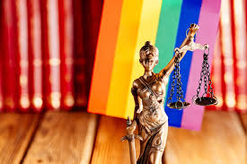
FALSE!
There are federal laws that protect LGBTQ+ workers from workplace discrimination in ALL states (yes, even yours).

Slide 13

A LANDMARK RULING
Bostock v. Clayton County
Prior to June 15, 2020
It was legal to fire an employee for being gay, bisexual or transgender, in more than half of the 50 states.
June 15, 2020
The Supreme Court rules it is illegal to discriminate against
or fire an employee based on their sexual orientation or gender identity.
13
Notes:
The Civil Rights Act of 1964 prohibits discrimination based on race, color, religion, sex, or national origin. The courts and the federal government have long refused to recognize LGBTQ+ discrimination as a form of sex discrimination. Over the past 20 years, however, federal courts and the government have at times recognized LGBTQ+ discrimination as sex discrimination.
It was not until June 15, 2020 that the Supreme Court finally recognized that LGBTQ+ employment discrimination is prohibited sex discrimination under Title VII of the Civil Rights Act of 1964.
This ruling recognized that it is illegal to discriminate against or fire an employee based on their sexual orientation or gender identity. Now lower federal courts and the Biden Administration are applying that ruling to education, health care, housing, credit discrimination, and more.

Slide 14
BOSTOCK V. CLAYTON COUNTY
Employment Discrimination is Illegal
Title VII of the 1964 Civil Rights Act prohibits employment discrimination based on race, color, religion, sex and national origin. Bostock interprets “sex” to include gender identity and sexual orientation.
14
Notes:
The Bostock ruling specifically states that employment discrimination on the basis of gender identity and sexual orientation is illegal.
Title VII of the Civil Rights Act covers the full spectrum of employment decisions, including recruitment, selections, terminations, and other actions concerning terms and conditions of employment. This is significant for the LGBTQ+ community because, as we saw, in many states it was legal to be denied an interview or a promotion, and even to be fired because of one’s gender identity or sexual orientation.

Slide 15
Title IX
Discrimination in Educational
Programs is Illegal
Title IX of the Education Amendments Act of 1972 states: "No person in the United States shall, on the basis of sex, be excluded from participation in, be denied the benefits of, or be subjected to discrimination under any education program or activity receiving Federal financial assistance."
15
Notes:
On March 26, 2021, the Department of Justice concluded that, as a result of the Bostock ruling, Title IX of the Education Amendments Act of 1972 also prohibits sexual-orientation and gender-identity discrimination in educational institutions that receive federal funding. This means all public schools. This means that students cannot be discriminated against in schools based on their LGBTQ+ identity.
There have been some significant wins recently for LGBTQ+ rights in the US But while progress is being made, attacks on LGBTQ+ rights in certain states have accelerated.
Reference: Department of Justice, “Application of Bostock v. Clayton County to Title IX of the Education Amendments of 1972,” March 26, 2021, https://www.justice.gov/crt/page/file/1383026/download

Slide 16
LAYERED PROTECTIONS
Our responsibility to provide service, advocacy support and help to those directly and indirectly affected
Title VII Employment
Protections
Redefined under the Bostock case
Title IX Program Protections that are now stronger due to recent amendments
16
Notes:
The Bostock ruling specifically states that employment discrimination on the basis of gender identity and sexual orientation is illegal.
Title VII of the Civil Rights Act covers the full spectrum of employment decisions, including recruitment, selections, terminations, and other actions concerning terms and conditions of employment. This is significant for the LGBTQ+ community because, as we saw, in many states it was legal to be denied an interview or a promotion, and even to be fired because of one’s gender identity or sexual orientation.

Slide 17
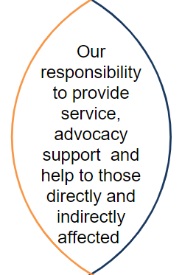
SERVICE vs. ADVOCACY
GUIDING QUESTIONS:
What positions are protected by my contract?
Is this a student issue or an educator issue?
Is my District enjoined from applying new Title IX regs?
What School Policies/Current Language is in place? What changes need to happen?
Remember: Title IX Regs are a CEILING, not a FLOOR.
17
Notes:
The Bostock ruling specifically states that employment discrimination on the basis of gender identity and sexual orientation is illegal.
Title VII of the Civil Rights Act covers the full spectrum of employment decisions, including recruitment, selections, terminations, and other actions concerning terms and conditions of employment. This is significant for the LGBTQ+ community because, as we saw, in many states it was legal to be denied an interview or a promotion, and even to be fired because of one’s gender identity or sexual orientation.

Slide 18
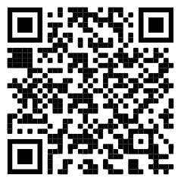
Review the Laws in Your State
1. Go to www.lgbtmap.org and Click Equality Maps or use the QR Code
2. Select “Choose a State” in the drop down menu.
3. Select a state and review the data.
How might this data impact members who are transitioning or transgender in your selected state?
Notes:
Look at Your State’s Equality Profile.
How might this impact members who are transitioning or transgender?
Instructions:
Go to www.lgbtqmap.org
Click Equality Maps
Select “Choose a State” in the drop down menu.
Select a state and review the data. How might this data impact members who are transitioning or transgender in your selected state?

Slide 19
Key Ideas
At least for now, ALL LGBTQ+ workers are protected under Bostock - BUT Bostock is limited to Employment
Title IX has applications to the protection of LGBTQ+ workers in public funded educational programs.

Slide 20
PROBLEM vs. ISSUE
Campaigns start with issues that workers have value-based solidarity around.
An issue is a slice of a workplace problem.
Often a problem can have different issues depending on the perspective of the people we are working with.
It is KEY to get enough input on what the issues are that make up the problem so that YOU do not drive the solution.
Investigating the issue is necessary but not sufficient – we also need to identify workers’ SHARED values – WHY is this an issue? WHY do you want to fix this?

Slide 21

PROBLEM vs. ISSUE
Values that build a relatable “why”
Deserve safe and reliable transportation
Access to quality parts

Slide 22
EXAMPLE- Problem and Issue
PROBLEM -Our school is hostile to LGBTQ+ staff and students
◦ Issue – There are no gender inclusive bathrooms and/or transgender students are forced to use the wrong restroom
Values – Equity, Safety, Personal Choice, Student Choice
◦ Issue – Our healthcare and leave benefits do not cover non-“traditional” family structures or are not fully accessible to people with same-gender partners.
Values – Equitable Access, Fair Pay, Family
◦ Issue – Our administration forces us to “out” trans and queer students to their families.
Values- Professional Judgement, Safety, Student Choice

Slide 23

Issues Lead to Collective Action
• It is widely felt
• It is deeply felt
• It is winnable
• It builds the union and builds leaders
• It has a connection to students and the public
Notes:
Slide Time Allotment: 10 minutes
Share out issues from around the room.

Slide 24
Key Ideas
Problems are disabling.
Issues build solidarity.
We don’t choose the issues, the people who want the change choose the issue AND work to build a bigger base.

Slide 25

What are all the issues that LGBTQ+ people face in their work and union lives?
Notes:
11:00-11:30

Slide 26
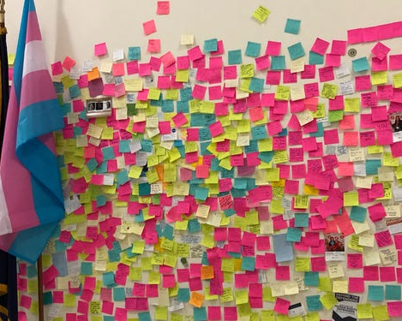
What are the issues?
Padlet Activity
Go to the Padlet Link
3 FULL Minutes, list one issue that LGBTQ members face in their work or union life. Put one issue per post. Feel free to post more than one.
5 Minutes – in breakout groups, sort the issues into categories – name the categories, and write those names in the chat

Slide 27

What are the issues?
What did you see that was common?
What was new to you?

Slide 28
SCENARIO: Supporting a Trans Educator
You are a Leader in a medium-sized conservative school district. A member reaches out to you and asks for your help. They explain to you that they are a returning employee who is transgender and began transitioning over the summer break. They are nervous about coming back in the fall and are asking for your help in navigating their return.
•What additional information would you need? How would you go about finding that information? What resources would you use or seek out?
•What would be your first steps?
•Knowing what we know now about transitioning and gender, what would you avoid doing?
In break out groups discuss the questions.
One person from each group will report out on the questions.
28

Slide 29
DEBRIEF
What additional information would you need? How would you go about finding that information? What resources would you use or seek out?
What would be your first steps?
Knowing what we know now about transitioning and gender, what would you avoid doing?

Slide 30
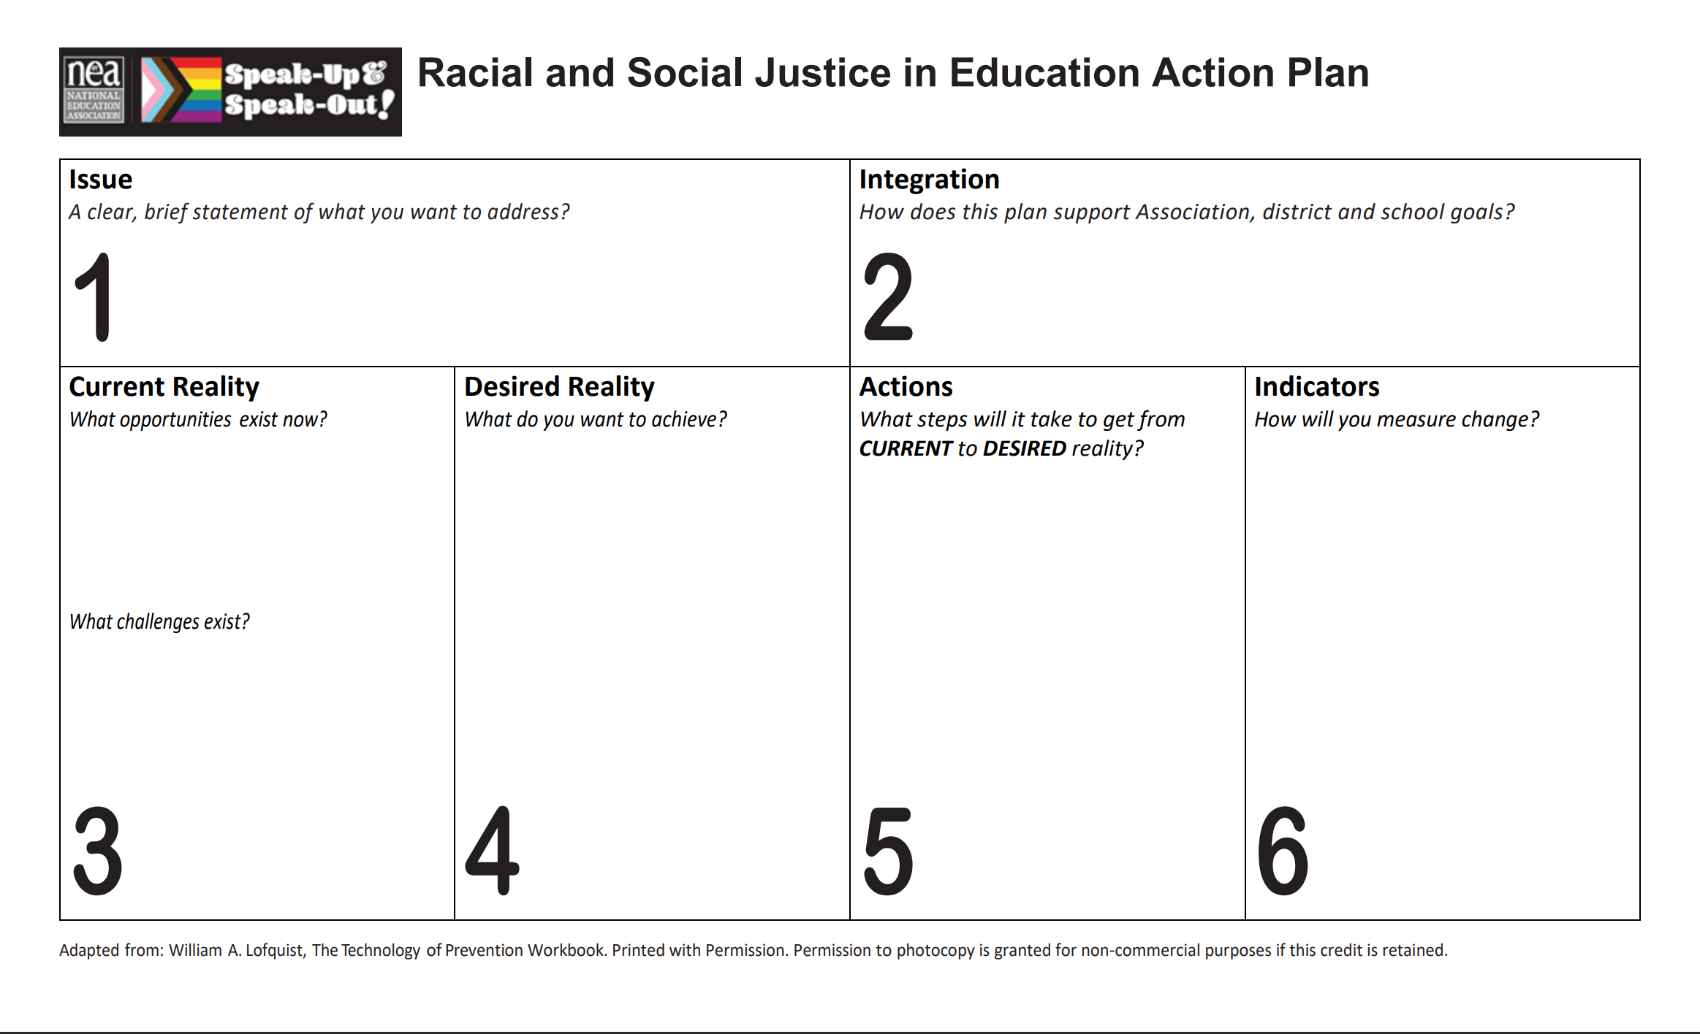
Turning Your Issue into Action

Slide 31
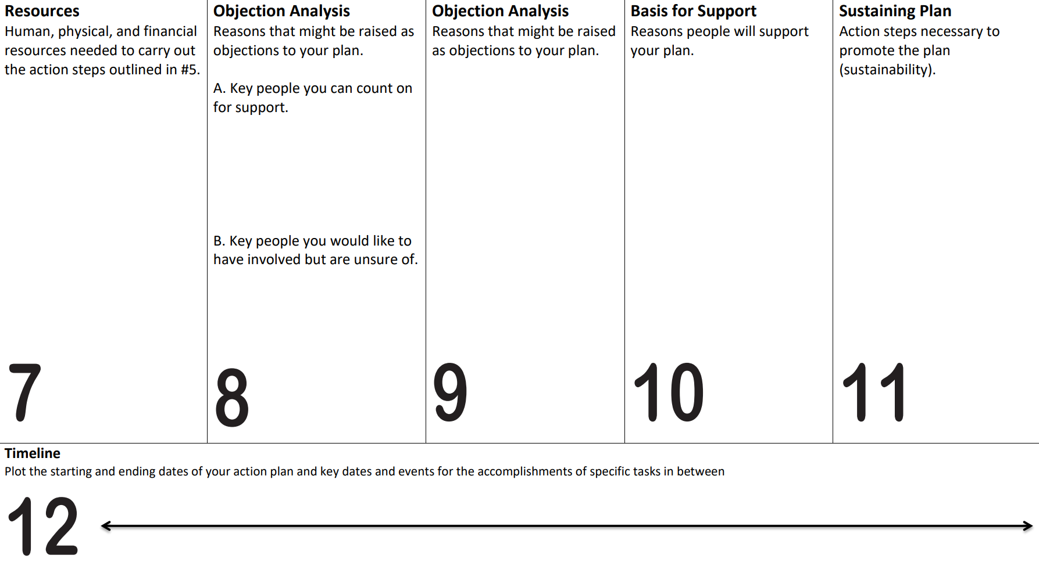
Turning Your Issue into Action

Slide 32

Ending It Right
What did you learn about today that:
You’re going to immediately tell your union bestie?
You’re going to use in the near future as part of your union work?
You’re going to work to learn more about?
Share your ideas and thoughts in the chat

Slide 33
Thank you!
Notes:
11:00-11:30

