Slide 1
Foundations of LGBTQ+ Justice

Slide 2
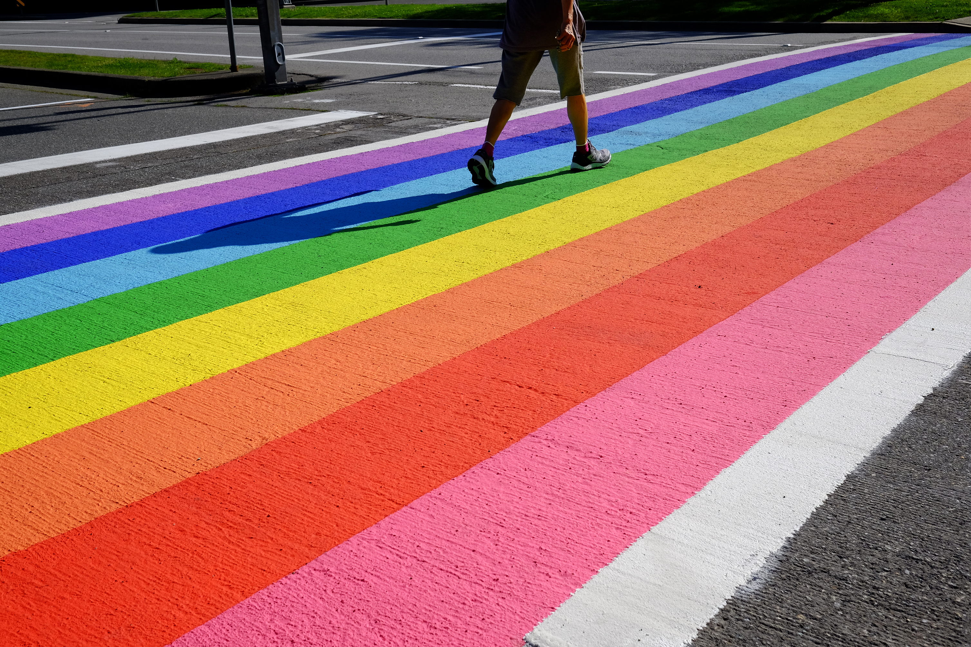
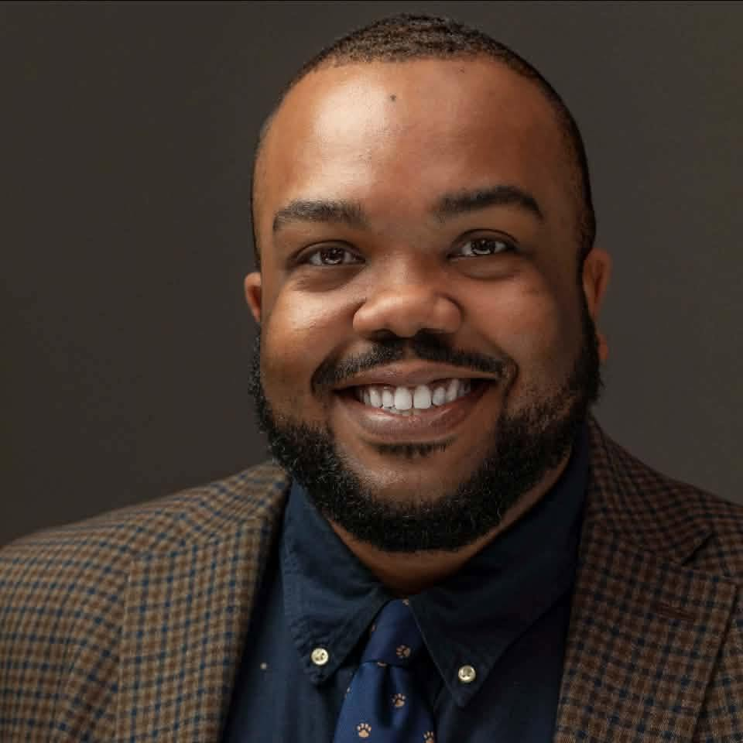
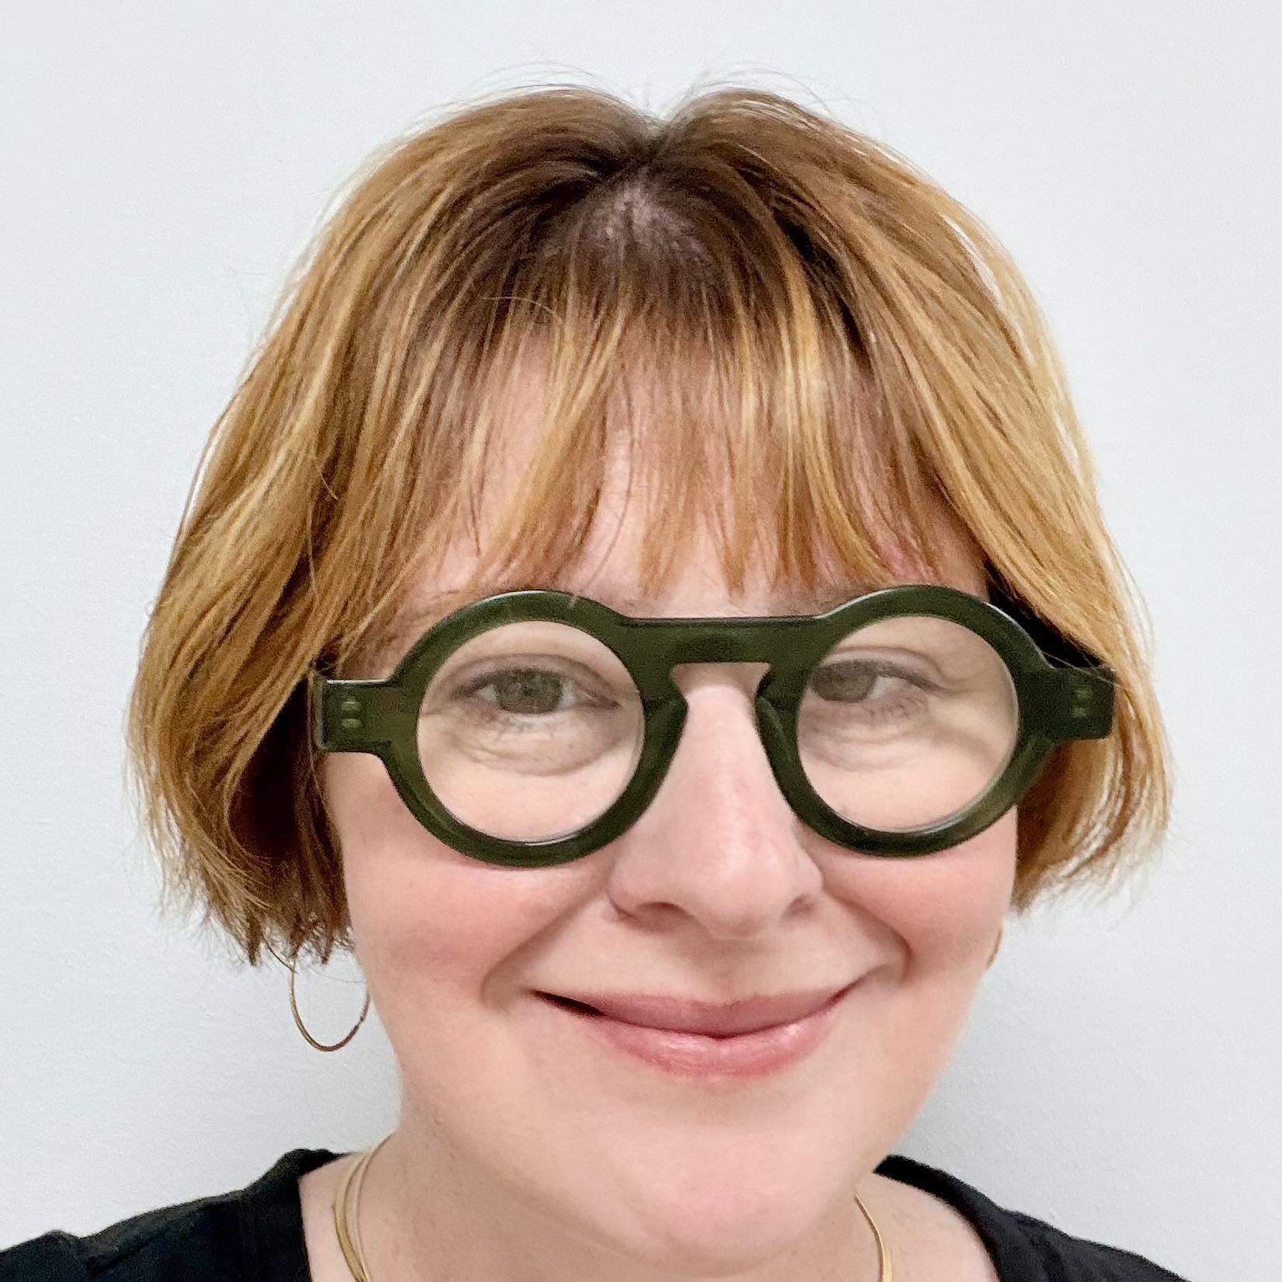
Today's Facilitators:
Greylor Walston, UniServ Director
Michigan Education Association
Gwalston@mea.org
Rachel Tollett, UniServ Director
Illinois Education Association
rachel.tollett@ieanea.org

Slide 3
Land Acknowledgement
Every community owes its existence and vitality to generations from around the world who contributed their hopes, dreams, and energy to making the history that led to this moment. Some were brought here against their will, some were drawn to leave their distant homes in hope of a better life, and some have lived on this land for more generations than can be counted. Truth and acknowledgment are critical to building mutual respect and connection across all barriers of heritage and difference. We begin this effort to acknowledge what has been buried by honoring the truth. We are standing on the ancestral lands of Indigenous People. We pay respects to their elders past and present. Please take a moment to consider the many legacies of violence, displacement, migration, and settlement that bring us together here today.

Slide 4

Agenda
What's covered today? - 90 minutes
  Background
  Problems vs. Issues
  Framework for Determining Action
  Legal Framework
  Lessons Learned and Actions to Apply

Slide 5

Community Agreements
Awareness and Self-Knowledge
Listen for Understanding
Be Gracious
Stay Engaged
Be Open and Suspend Judgment
Say “I”- tell your truth
Seek Discomfort
Reach for Empathy
Expect non- Resolution and non-Closure

Slide 6

What the data show:
LGBTQ+ youth are 4x more likely than their peers to attempt suicide
Majority of LGBTQ+ youth were victimized at school in the past year
NEA RA Support and Part of NEA Mission and Vision charges us to do this work!
[1] Human Rights Campaign Foundation. (2017, July). Mental health and the LGBTQ community. https://suicidepreventionlifeline.org/wp-content/uploads/2017/07/LGBTQ_MentalHealth_OnePager.pdf
[2] National Public Radio, the Robert Wood Johnson Foundation, & The Harvard T.H. Chan School of Public Health. (2017, November). Discrimination in America: Experiences and views of LGBTQ Americans. Retrieved June 24, 2020 from https://www.rwjf.org/en/library/research/2017/10/discrimination-in-america--experiences-and-views.html
Notes:
In 2017, a study by the Human Rights Campaign Foundation found that:
LGBTQ+ Youth are 4x more likely than their peers to attempt suicide.
57% of LGBTQ people report that they have been threatened or harassed.
51% of LGBTQ people report that they have been sexually harassed due to their orientation or gender expression.
Advancing social and racial justice are part of NEA's mission and vision so this is important to the work that we do.

Slide 7
The Words of Our Members
“Know that even if you do not personally know of any LGBTQ+ staff person in your district, they are there. Be an ally even if you do not know them. Speak up when you hear, see, or perceive bias and/or discrimination. Advocate for inclusive policies for both students and staff.”
7
Notes:
Throughout today’s training, we will be sharing the words of NEA members who are a part of the LGBTQ+ community. We shared an anonymous survey and think it’s important to hear the words of our colleagues—whether they are out or not—about their experiences as LGBTQ+ educators.

Slide 8

The Work
How do we do the work of seeking justice with those who may not share the experiences, identities, and issues?

Slide 9
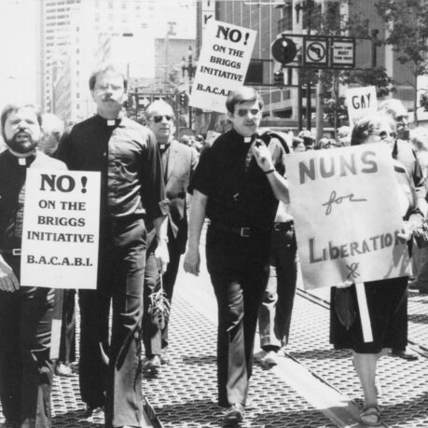


The Work:
Solidarity
sol / i / dar / i / ty
Noun
  1. Unity or agreement of feeling or action especially among individuals with a common interest, mutual support; mutual support within a group.
Notes:
In 1978 LGBTQ educators in California were successful in defeating Proposition 6/the Briggs Initiative (a statewide ban on LGBTQ educators) by building solidarity with other members of their communities. They built a multi-racial, inter-faith, coalition both within and outside their unions to win this fight. Solidarity is Successful!

Slide 10

LGBTQ+ Legal Framework
Bostock v. Clayton County
Prior to June 15, 2020
It was legal to fire an employee for being gay, bisexual or transgender, in more than half of the 50 states.
June 15, 2020
The Supreme Court rules it is illegal to discriminate against
or fire an employee based on their sexual orientation or gender identity.
10
Notes:
The Civil Rights Act of 1964 prohibits discrimination based on race, color, religion, sex, or national origin. The courts and the federal government have long refused to recognize LGBTQ+ discrimination as a form of sex discrimination. Over the past 20 years, however, federal courts and the government have at times recognized LGBTQ+ discrimination as sex discrimination.
It was not until June 15, 2020 that the Supreme Court finally recognized that LGBTQ+ employment discrimination is prohibited sex discrimination under Title VII of the Civil Rights Act of 1964 in Bostock v. Clayton County.
This ruling recognized that it is illegal to discriminate against or fire an employee based on their sexual orientation or gender identity. Now lower federal courts and the Biden Administration are applying that ruling to education, health care, housing, credit discrimination, and more.

Slide 11
BOSTOCK V. CLAYTON COUNTY
Employment Discrimination is Illegal
Title VII of the 1964 Civil Rights Act prohibits employment discrimination based on race, color, religion, sex and national origin. Bostock interprets “sex” to include gender identity and sexual orientation.
11
Notes:
The Bostock ruling specifically states that employment discrimination on the basis of gender identity and sexual orientation is illegal.
Title VII of the Civil Rights Act covers the full spectrum of employment decisions, including recruitment, selections, terminations, and other actions concerning terms and conditions of employment. This is significant for the LGBTQ+ community because, as we saw, in many states it was legal to be denied an interview or a promotion, and even to be fired because of one’s gender identity or sexual orientation.

Slide 12
Title IX
Discrimination in Educational
Programs is Illegal
Title IX of the Education Amendments Act of 1972 states: "No person in the United States shall, on the basis of sex, be excluded from participation in, be denied the benefits of, or be subjected to discrimination under any education program or activity receiving Federal financial assistance."
12
Notes:
On March 26, 2021, the Department of Justice concluded that, as a result of the Bostock ruling, Title IX of the Education Amendments Act of 1972 also prohibits sexual-orientation and gender-identity discrimination in educational institutions that receive federal funding. This means all public schools. This means that students cannot be discriminated against in schools based on their LGBTQ+ identity.
There have been some significant wins recently for LGBTQ+ rights in the US But while progress is being made, attacks on LGBTQ+ rights in certain states have accelerated.
Reference: Department of Justice, “Application of Bostock v. Clayton County to Title IX of the Education Amendments of 1972,” March 26, 2021, https://www.justice.gov/crt/page/file/1383026/download

Slide 13
LAYERED PROTECTIONS
Our responsibility to provide service, advocacy support and help to those directly and indirectly affected
Title VII Employment
Protections
Redefined under the Bostock case
Title IX Program Protections were stronger under Biden, but have reverted to Trump's rules
13
Notes:
The Bostock ruling specifically states that employment discrimination on the basis of gender identity and sexual orientation is illegal.
Title VII of the Civil Rights Act covers the full spectrum of employment decisions, including recruitment, selections, terminations, and other actions concerning terms and conditions of employment. This is significant for the LGBTQ+ community because, as we saw, in many states it was legal to be denied an interview or a promotion, and even to be fired because of one’s gender identity or sexual orientation.

Slide 14
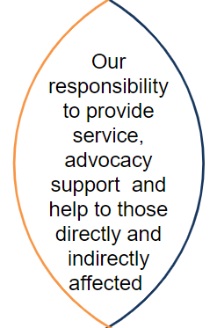
SERVICE vs. ADVOCACY
GUIDING QUESTIONS:
What positions are protected by my contract?
Is this a student issue or an educator issue?
What School Policies/Current Language is in place? What changes need to happen?
How can we center the humanity and dignity of the people being affected?
14
Notes:
The Bostock ruling specifically states that employment discrimination on the basis of gender identity and sexual orientation is illegal.
Title VII of the Civil Rights Act covers the full spectrum of employment decisions, including recruitment, selections, terminations, and other actions concerning terms and conditions of employment. This is significant for the LGBTQ+ community because, as we saw, in many states it was legal to be denied an interview or a promotion, and even to be fired because of one’s gender identity or sexual orientation.

Slide 15
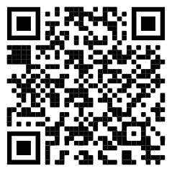
Review the Laws in Your State
1. Go to www.lgbtmap.org and Click Equality Maps or use the QR Code
2. Select “Choose a State” in the drop down menu.
3. Select a state and review the data.
How might this data impact members who are transitioning or transgender in your selected state?
Notes:
Look at Your State’s Equality Profile.
How might this impact members who are transitioning or transgender?
Instructions:
Go to www.lgbtqmap.org
Click Equality Maps
Select “Choose a State” in the drop down menu.
Select a state and review the data. How might this data impact members who are transitioning or transgender in your selected state?

Slide 16
Key Ideas
At least for now, ALL LGBTQ+ workers are protected under Bostock - BUT Bostock is limited to Employment
Title IX has some limited application.
State & local laws and language in the CBA or board policy are more important than ever.

Slide 17
PROBLEM vs. ISSUE
Campaigns start with issues that workers have value-based solidarity around.
An issue is a slice of a workplace problem.
Often a problem can have different issues depending on the perspective of the people we are working with.
It is KEY to get enough input on what the issues are that make up the problem so that YOU do not drive the solution.
Investigating the issue is necessary but not sufficient. We also need to identify workers’ SHARED values – WHY is this an issue? WHY do you want to fix this?

Slide 18

PROBLEM vs. ISSUE
Values that build a relatable “why”
Deserve safe and reliable transportation
Access to quality parts
Notes:
Using the graphic on your screen, who can explain the difference between a "problem," and an "issue?"
PROBLEM = My car is not working.
ISSUE = The pipe that is responsible for starting the engine is disconnected.
As a reminder, often problems have different issues depending on the perspective of the people we are working with. A campaign must start with identifying what issues are causing the problems and the shared values of union members.

Slide 19
EXAMPLE- Problem and Issue
PROBLEM:
Our school is hostile to LGBTQ+ staff and students
ISSUES:
There are no gender inclusive bathrooms
Transgender students are forced to use the wrong restroom
Our healthcare and leave benefits do not cover non-“traditional” family structures
Our administration forces us to “out” queer students to their families.
Notes:
Here's an example of problems versus issues identified in one-on-one conversations with the membership:
Problem = School/District is hostile to LGBTQ+ staff and students.
Issues
Values – Equity, Safety, Personal Choice, Student Choice
Values – Equitable Access, Fair Pay, Family
Values- Professional Judgement, Safety, Student Choice

Slide 20

Issues Lead to Collective Action
• It is widely felt
• It is deeply felt
• It is winnable
• It builds the union and builds leaders
• It has a connection to students and the public
Notes:
Slide Time Allotment: 10 minutes
Share out issues from around the room.

Slide 21
Key Ideas
Problems are disabling.
Issues build solidarity.
We as organizers don’t choose the issues, the people who want the change choose the issue AND work to build a bigger base.

Slide 22

What are all the issues that LGBTQ+ people face in their work and union lives?
Notes:
11:00-11:30

Slide 23
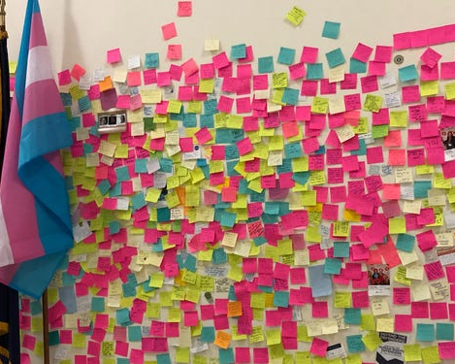
What are the issues?
Padlet Activity
Go to the Padlet Link
3 FULL Minutes, list one issue that LGBTQ members face in their work or union life. Put one issue per post. Feel free to post more than one.
5 Minutes – in breakout groups, sort the issues into categories – name the categories, and write those names in the chat

Slide 24

What are the issues?
What did you see that was common?
What was new to you?

Slide 25
SCENARIO: Supporting a Trans Educator
You are a Leader in a medium-sized conservative school district. A member reaches out to you and asks for your help. They explain to you that they are a returning employee who is transgender and began transitioning over the summer break. They are nervous about coming back in the fall and are asking for your help in navigating their return.
•What additional information would you need? How would you go about finding that information? What resources would you use or seek out?
•What would be your first steps?
•Knowing what we know now about transitioning and gender, what would you avoid doing?
In break out groups discuss the questions.
One person from each group will report out on the questions.
25

Slide 26
DEBRIEF
What additional information would you need? How would you go about finding that information? What resources would you use or seek out?
What would be your first steps?
Knowing what we know now about transitioning and gender, what would you avoid doing?

Slide 27
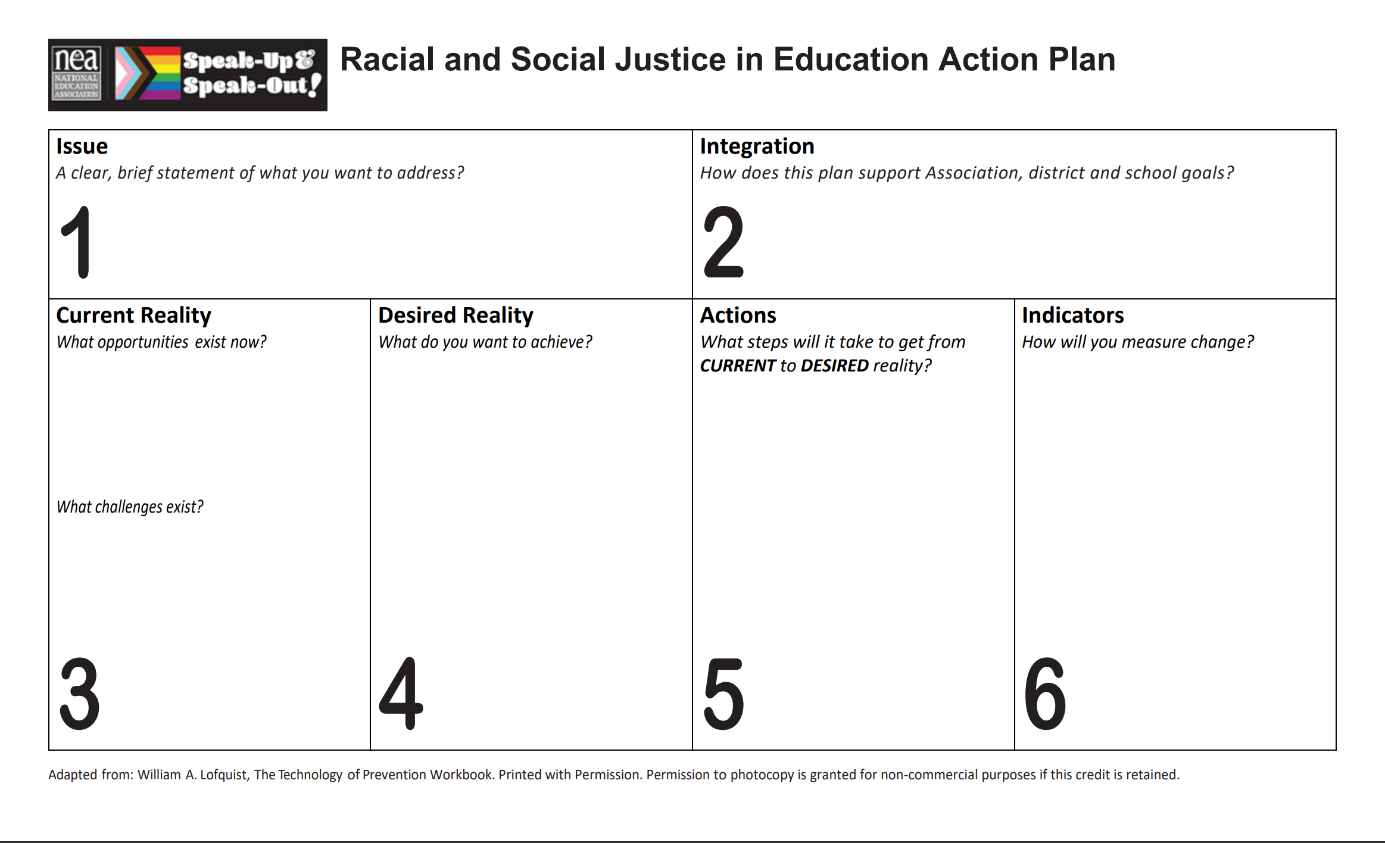
Turning Your Issue into Action

Slide 28
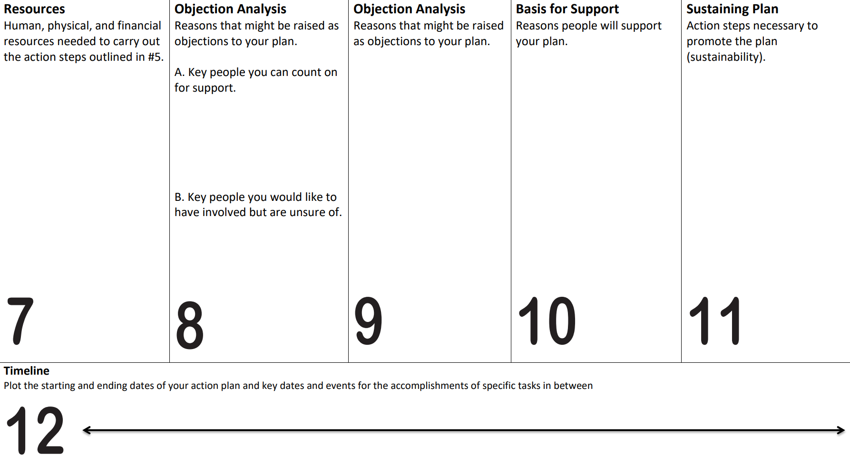
Turning Your Issue into Action

Slide 29

Ending It Right
What did you learn about today that:
You’re going to immediately tell your union bestie?
You’re going to use in the near future as part of your union work?
You’re going to work to learn more about?
Share your ideas and thoughts in the chat

Slide 30
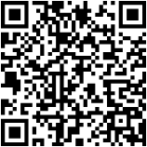
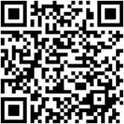
How can I take the next step?
In-Person Advancing LGBTQ+ Justice Training
Staff and member teams are invited to attend:
WHEN: October 20-22, 2026
WHERE: TBD
STEP 1:
Register for NEA in person trainings:
STEP 2:
Register for the Advancing
LGBTQ+ Justice Training :

Slide 31
THANK YOU!
Greylor Walston, UniServ Director
Michigan Education Association
Gwalston@mea.org
Rachel Tollett, UniServ Director
Illinois Education Association
rachel.tollett@ieanea.org

