Slide 1

Building Power
November 14, 2024, NEA Organizer Support Program
We will begin shortly.
In the chat, please let us know:
Name & Pronouns
State Affiliate
A cool thing you built or made

Slide 2
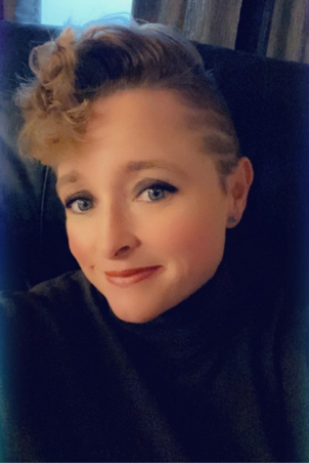
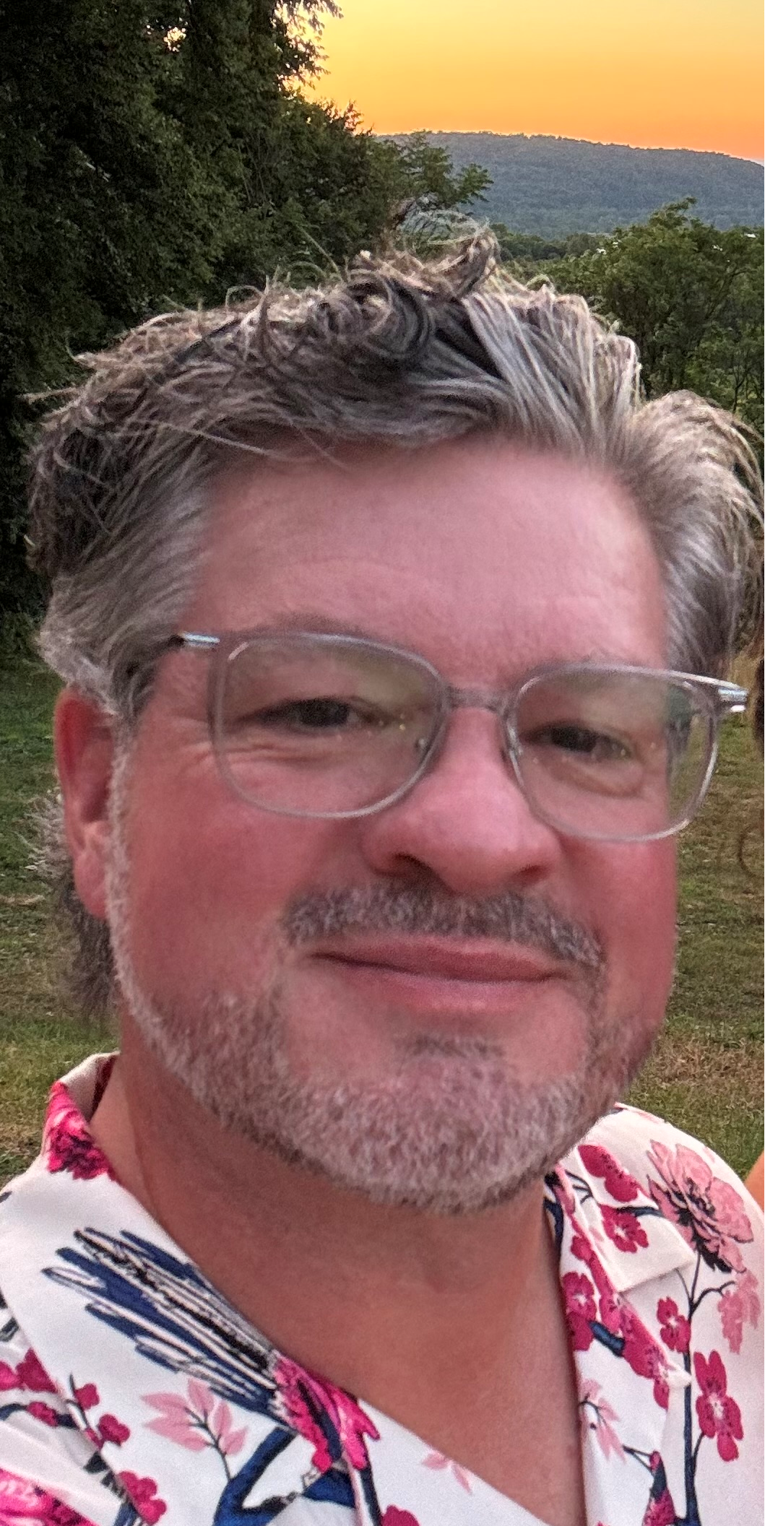
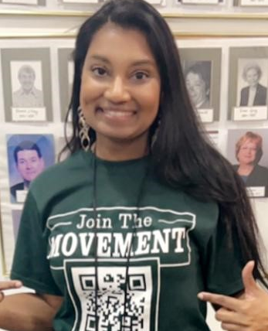
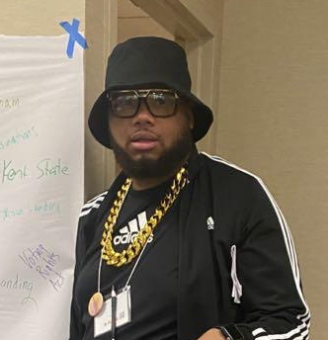
Welcome!
Series of Online and Face to Face
https://www.nea.org/UD-Org-Support
Facilitator and Content Team
Jeny Gardner
She/He/They
Uniserv Director
Wyoming Education Association
Jgardner@wyoea.org
Matt Fargen
He/Him/His
UniServ Representative
Pennsylvania Education Association
Mfargen@psea.org
Albert Jones
He/Him/His
Organizational Specialist
Maryland State Education Association
aljones@mseanea.org
Melissa Dan
She/Her
CTA Labor Relations Consultant
Florida Education Association
melissa.dan@floridaea.org
Notes:
Melissa

Slide 3
Land Acknowledgement
Every community owes its existence and vitality to generations from around the world who contributed their hopes, dreams, and energy to making the history that led to this moment. Some were brought here against their will, some were drawn to leave their distant homes in hope of a better life, and some have lived on this land for more generations than can be counted. Truth and acknowledgment are critical to building mutual respect and connection across all barriers of heritage and difference. We begin this effort to acknowledge what has been buried by honoring the truth. We are standing on the ancestral lands of Indigenous People. We pay respects to their elders past and present. Please take a moment to consider the many legacies of violence, displacement, migration, and settlement that bring us together here today.
Notes:
Melissa

Slide 4
Community Agreements
Using Self-Awareness and Self-Knowledge
Listening for Understanding
Being Gracious
Staying Engaged
Being Open and Suspend Judgment
Saying “I”- tell your truth
Lean into Discomfort
Reaching Empathy
Expecting Non-Resolution and Non-Closure
*Adapted from “Embracing equity and inclusion”, Annie E. Casey Foundation
Notes:
Melissa

Slide 5

Welcome!
Series of Online and Face to Face
https://www.nea.org/UD-Org-Support
It Takes A Village
Ellen Holmes-NEA
Melissa Dan-PBCCTA
Chad Williams-MEA
Matt Fargen-PSEA
Albert Jones-MSEA
Jeny Gardner-WEA
Notes:
Melissa

Slide 6
Power is…
The ability to act.
The possession of control, authority, or influence over others
Notes:
Matt

Slide 7
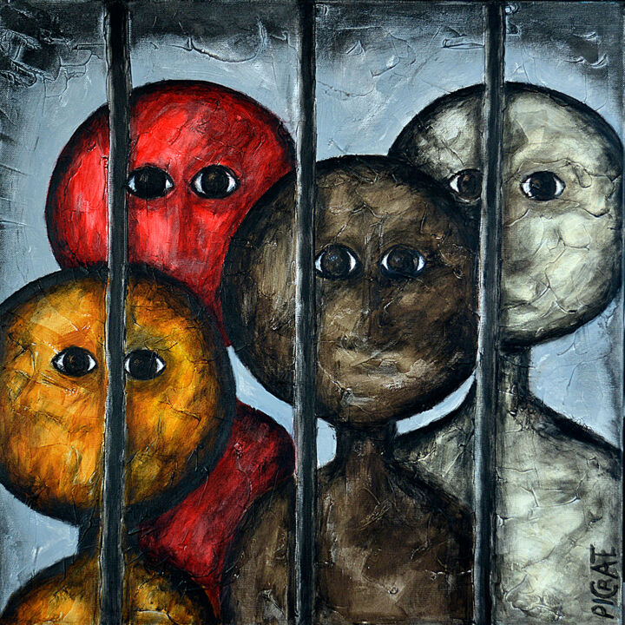
Oppression is…
The exercise of authority or power in a burdensome, cruel, or unjust manner.
Notes:
Matt

Slide 8
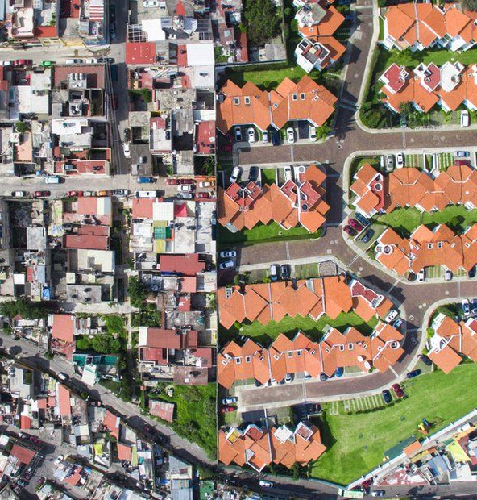
Privilege is… a special right, advantage, or immunity granted or available only to a particular person or group.
Notes:
Matt

Slide 9
Building power requires…
The intentional inclusion of those who experience oppression.
The strategic risking of privileges from those that have them.
+
Notes:
Matt

Slide 10
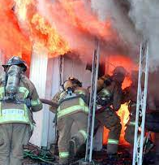
Structure is a group of people that have relationships with each other that allow them to take risks in order to achieve a common purpose.
Notes:
Matt

Slide 11
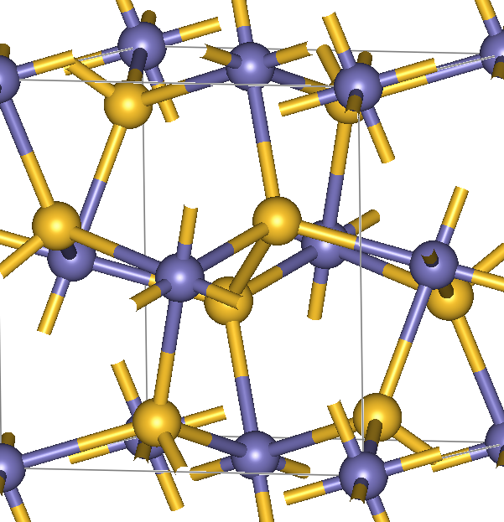
If building power requires high levels of participation, then organizers need structures to sustain the coordination and development of large numbers of people.
Structures are the scaffolding that enable participation at scale.
This Photo by Unknown Author is licensed under CC BY-SA
Notes:
Matt

Slide 12
3 Theories of Power
Advocacy doesn’t involve ordinary people, just privileged people pressuring decision makers on behalf of others.
Mobilizing brings larger numbers of people to the fight, but they are usually the same people (dedicated activists) without much intentional thought for who IS NOT included.
Organizing places the agency for success with continually expanding the base of ordinary people who are willing to take a collective risk
Notes:
Matt

Slide 13
Breakout Room
How does a leader respond/react in our different theories of power?
Successful organizing (that wins) relies on leadership, what is one method you use to ensure inclusivity and diversity?
Successful organizing (that wins) relies on relies on majority participation. What are your methods you use to measure increased participation in your local (AKA increase power)?
Notes:
Jeny

Slide 14
Activists (mobilizers) | Leaders (organizers)
Self-selected, volunteered | Selected by their coworkers of have a track record of bringing others along with them.
Identified by responding to an email asking for a rep/leader, by stepping up, by succession | Identified by asking “which of your colleagues are amount the most trusted and respected around here?” –structure testing
Brings commitment, already committed to union vales | Brings capacity, sometimes needs to be moved to our position
Known for speaking out at staff meetings, standing up to the boss, might be labeled a troublemaker OR be close to the boss | Known for being trusted and respected by their coworkers and being good at their job.
Typically 0-1 at a worksite Ex. Worksite of 100, 1-2 Activists | Minimum of 1 leader for every ten workers at a worksite Ex. Worksite of 100, 10+ Leaders
Good for MOBILZING: mobilizing involves getting people who already agree with you to do something-to move them from passive to active support. In general, mobilizing can win small changes. | Good for ORGANIZING: organizing seeks to convince everyone within a defined group of the need to united around a shared objective. In general, organizing can win big, life-altering changes.
Mobilizers and Organizers
Notes:
Albert

Slide 15
Breakout Room
How do you look for leaders in a workplace?
Has anyone struggled with a leader in a workplace that was anti-union? Did you have any successful strategies to shift them to use their leadership towards their union's campaign?
When thinking about leadership structures- how do you coach your leaders, how do you coach your activists to make a strong structure that builds power?
Notes:
Albert

Slide 16
 | Power Building | Power Draining
Victory | Advances multiple outcomes of the issue in the immediate and sets it up to fundamentally shift conditions in the long term | May have won demands on the surface in the immediate but advanced damaging conditions for our ability to change in the long term.
Defeat | Leads to advancing multiple outcomes long term even though immediate demands were not met. | Not only did this have poor implications in the immediate, it also shifted dynamics for us to advance on the long term.
Notes:
Melissa

Slide 17
Poll 1
A local had a situation with about half of its membership. They were underpaid for their overtime work. It came to light at a union meeting. The union leadership brought it to their UD. The UD took the concern to the business manager, and they worked out a process to make sure each member recouped their lost wages.
Power Building Victory
Power Draining Victory
Power Building Defeat
Power Draining Defeat
Notes:
Melissa

Slide 18
Poll 2
Local's primary issue next to wages is addressing mold which has caused many sick staff and students. The membership has been engaging in internal actions with great turnout. The district is not engaged in the process. Members have engaged parents and community leaders to speak publicly to the Board. They ultimately win timely improvements in air quality measures along with their raises.
Power Building Victory
Power Draining Victory
Power Building Defeat
Power Draining Defeat
Notes:
Melissa

Slide 19
Poll 3
Members are upset about the temperatures in the building this fall, as some rooms were over 95 degrees, and the kitchen was over 100 degrees. They brought the concern to their local president. His room is air conditioned. He didn’t think it was worth bothering administration, as there is no law in their state or contract language that has been violated. It’s just part of the job they chose.
Power Building Victory
Power Draining Victory
Power Building Defeat
Power Draining Defeat
Notes:
Melissa

Slide 20
Poll 4
Members are upset about the temperatures in the building this fall, as some rooms were over 95 degrees, and the kitchen was over 100 degrees. They brought the concern to their local president. His room is air conditioned. He said we need to find out how big the problem is and engaged a group of leaders who are trusted by their colleagues to do 1:1s on the issue. They held parent meetings to see how the situation was impacting their children. And jointly developed a resolution for the board to commit to fixing the problem. The resolution failed.
Power Building Victory
Power Draining Victory
Power Building Defeat
Power Draining Defeat
Notes:
Melissa

Slide 21
Contact Us
Series of Online and Face to Face
https://www.nea.org/UD-Org-Support
Look for: Feedback form – Please complete – thanks!
Today’s Facilitators
Jeny Gardner
She/He/They
Uniserv Director
Wyoming Education Association
Jgardner@wyoea.org
Matt Fargen
He/Him/His
UniServ Representative
Pennsylvania Education Association
Mfargen@psea.org
Albert Jones
He/Him/His
Organizational Specialist
Maryland State Education Association
aljones@mseanea.org
Melissa Dan
She/Her
CTA Labor Relations Consultant
Florida Education Association
melissa.dan@floridaea.org
Notes:
Melissa

