Slide 1
Day 1

Slide 2
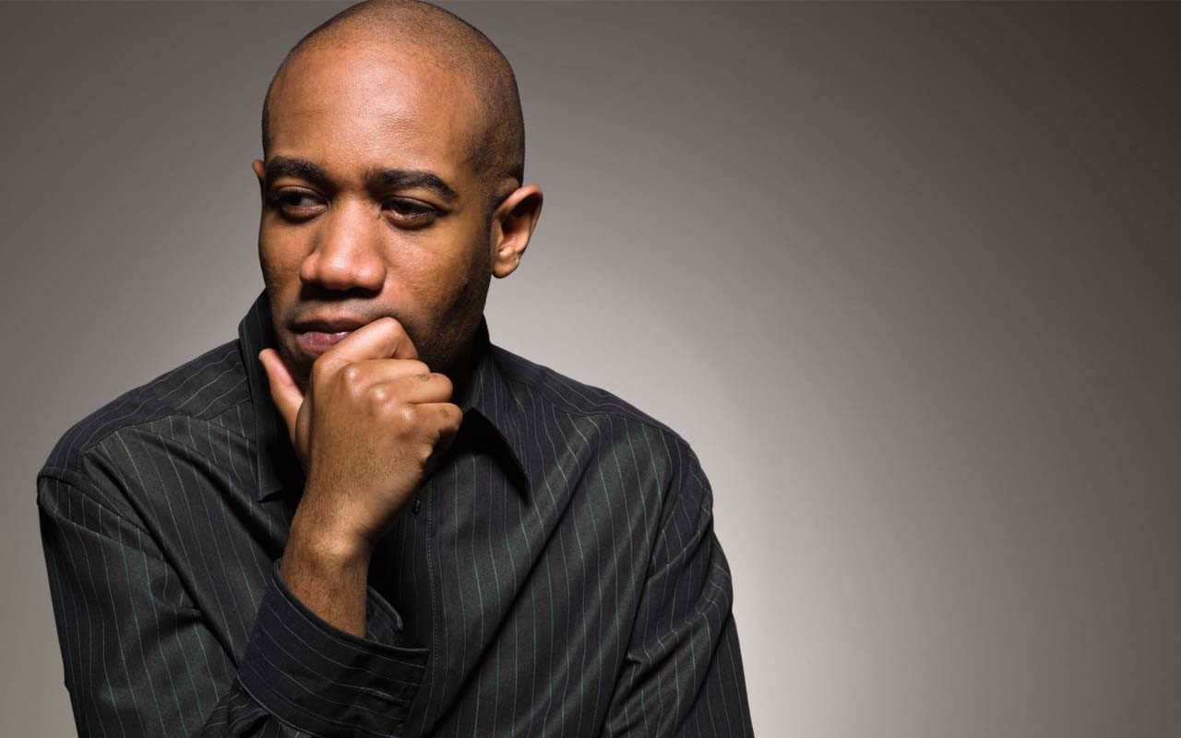

Entry Activity
Who Is A Leader?
Among your leaders in your local(s) who do you consider a leader? Why?
- Use Sticky Notes and Post on the Wall -

Slide 3
Effective Worksite Leadership Structures
UniServ Focus Academy

Slide 4
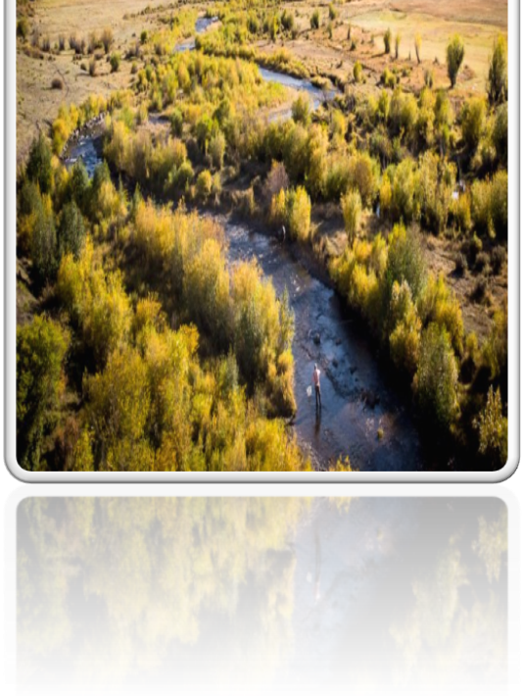
We begin by acknowledging that we meet on the traditional lands served by the Cheyenne, Arapaho, Ute, Kiowa, Navajo, Apache, Shoshone, Comanche, and Pueblo people. We honor America’s First People and all elders, past, present and emerging and we are called on to learn and share what we learn about the tribal history, culture, and contributions that have been suppressed in telling the story of America. We invite you to think about the spaces you are inhabiting and the Indigenous people who came before them and were stewards of the land.

Slide 5

Why are we here?

Slide 6

Meet the Team

Slide 7

Three Day Agenda Overview
Day 1: Identifying Leaders and the power of structure
Day 2: Structure design and coaching
Day 3: Coalitions and presentations
Notes:
M

Slide 8
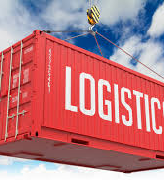
Logistics to Remember
Parking Lot
Bathroom Location
Materials
Food
Room Temp
Sha as Resource
Questions?

Slide 9

Agenda Review – Days 1 and 2
7:30 – Breakfast-Superior
8:30 – Getting Started
10:00 – 10:15 Break
12:00 –1:00 Lunch
2:15 – 2:30 Break
4:30 – Choice Networking Time
5:00 - Adjourn

Slide 10
Agenda Review – Day 3
7:30 – Breakfast
8:30 – Getting Started
11:00 – 11:15 Break
1:00 – Lunch
No flights before 3:00pm

Slide 11

Getting to Know Each Other
Name
Location
Preferred Pronoun
15 Seconds Each

Slide 12

Community Agreements p. 2
Using Self-Awareness and Self-Knowledge
Listening for Understanding
Being Gracious
Staying Engaged
Being Open and Suspend Judgment
Saying “I”- tell your truth
Seeking Discomfort
Reaching Empathy
Expecting Non-Resolution and Non-Closure
*Adapted from “Embracing equity and inclusion”, Annie E. Casey Foundation
Notes:
Community Agreements for Our Time
Awareness and Self-Knowledge
This requires self-knowledge and self-awareness. Self-knowledge allows you to see what causes you pain and conflict and enables you to embrace your contradictions and inconsistencies. It allows the space to work on things about yourself that you are not happy with. In turn, self-knowledge helps to prevent you from projecting your negative aspects onto other people. Bringing your best self also requires that you have a positive attitude, are willing to deeply explore your perspectives and remain open to the perspectives and experiences of others.
Listening for Understanding
Be an active listener. Active listening involves paying full and careful attention to the other person, looking him or her in the eye, avoiding interruptions, reflecting your understanding, clarifying information, summarizing the other person’s perspectives and sharing your own. Remember that most people need time to open up and might not be willing to immediately share their personal stories, hopes, fears and/or concerns.
Being Gracious
Being kind is a vital way of bringing meaning to our own lives, as well as the lives of others. Kindness is about caring genuinely for others around you, wanting the best for them and recognizing in them the same wants, needs, aspirations and even fears that you may have. Being kind and generous allows us to communicate better with others, to be more self-compassionate and to be a positive force in other people’s lives. This includes following the COVID protocols that are in place to protect the health of this learning community.
Stay Engaged
Staying engaged requires you to be morally, emotionally, intellectually and socially involved in the conversation. Staying engaged means that you are listening with curiosity and willing to deepen your understanding. Staying engaged might also require you to sustain the conversation even when it gets uncomfortable or diverted. This also means a commitment to keeping your electronic communications to a minimum with folks not present in this learning community.
Be Open and Suspend Judgment
Listening with an open mind includes being receptive to the influence of others. You can suspend judgment by becoming aware of preconceived notions and listening to everything someone has to say before jumping to conclusions. Most importantly, suspending judgment also means listening to what the speaker has to say for understanding, not just to determine whether the speaker is right or wrong.
Say “I”- tell your truth
Speaking your truth in authentic and courageous conversations about race requires a willingness to take risks. It means that you will be absolutely honest and candid about your own thoughts, feelings, experiences and opinions and not just saying what you perceive others want to hear. Speaking your truth will require you to speak from the “first person” and use “I” statements.
Seek Discomfort
Leaning in to discomfort will require you to let go of racial understandings and stereotypes that you may be holding onto in order to move forward. Leaning in means that you will avoid judgment, assume positive intent and be open to the kernel of wisdom in each individual’s experiences. Leaning in to discomfort will require you to sit through moments of embarrassment, confusion, anxiety and/or fear.
Reaching Empathy
Empathy and compassion allow you to understand the other person’s point of view. When you are empathetic, you are more understanding, patient and kind. Expanding your capacity to feel empathy will also allow others to enter your circle of human concern.
Resolution and Closure
Expect and accept that there may not be closure. It is not likely that you will resolve your personal understanding about race or another person’s racial experience in a single conversation. The more you talk about race with another person, the more you learn and the more they will learn. Authentic and productive conversations about race are continuous and always evolving.
*Adapted from “Embracing equity and inclusion”, Annie E. Casey Foundation

Slide 13
Labor History Merry Mixer
Albert

Slide 14

Labor History Merry Mixer
  You each have a card.
  Find a partner – you each introduce your Person of Labor History
  (Three minutes per pair)
  At the signal – switch to another partner and repeat.
  Let’s try to do this three times.

Slide 15
Reboot with Natural Leaders
Zac

Slide 16
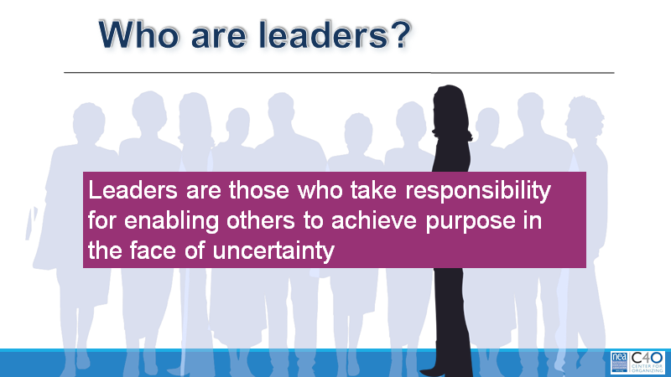

Slide 17

The SEA Theory of Change…
They said, “We can reboot Seattle EA by identifying natural school leaders, building relationships with them, and inviting them to lend their leadership to a new shared purpose.”

Slide 18

Why reboot?
2012
2015 to 2018
PAC membership less than 25%
Few political volunteers
Close contract votes
Felt powerless with District
Rep Assemblies all about sending letters
Transactional Relationship with members
PAC Membership at 50% (and they doubled the minimum contribution from $5 to $10)
Lead the state in volunteers for political initiates
Powerful strike in 2015
Powerful strike vote in 2018
Defeated budget cuts
Rep Assemblies, well, they still send letters, but they also talk more about organizing
Peer Assistance and Review System implemented- evaluation is increasingly meaningful
Center for Racial Equity Established
Relationships are more transformational

Slide 19

SEA's Theory…
"They can reboot SEA by identifying natural school leaders, building relationships with them, and inviting them to lend their leadership to a new shared purpose."

Slide 20
How it typically goes…
Members self-select into leadership roles
“We don’t have a building rep, so I told everyone I would volunteer.”
We recruit members without confirming their leadership
“She’s excited about the union; I invited her to an event and to become a building rep.”
Result: “leaders” struggle to deliver when it counts
PLUS, lots of implicit bias as we choose “leaders” who meet our criteria

Slide 21

Organizing and Leadership
(definitions from Marshall Ganz)
Organizing is turning the resources they have into the power they need to get the change they want
Often, they say that their resource is “people”
But it’s much more than that: the resource they have is people who have close working relationships with each other.

Slide 22
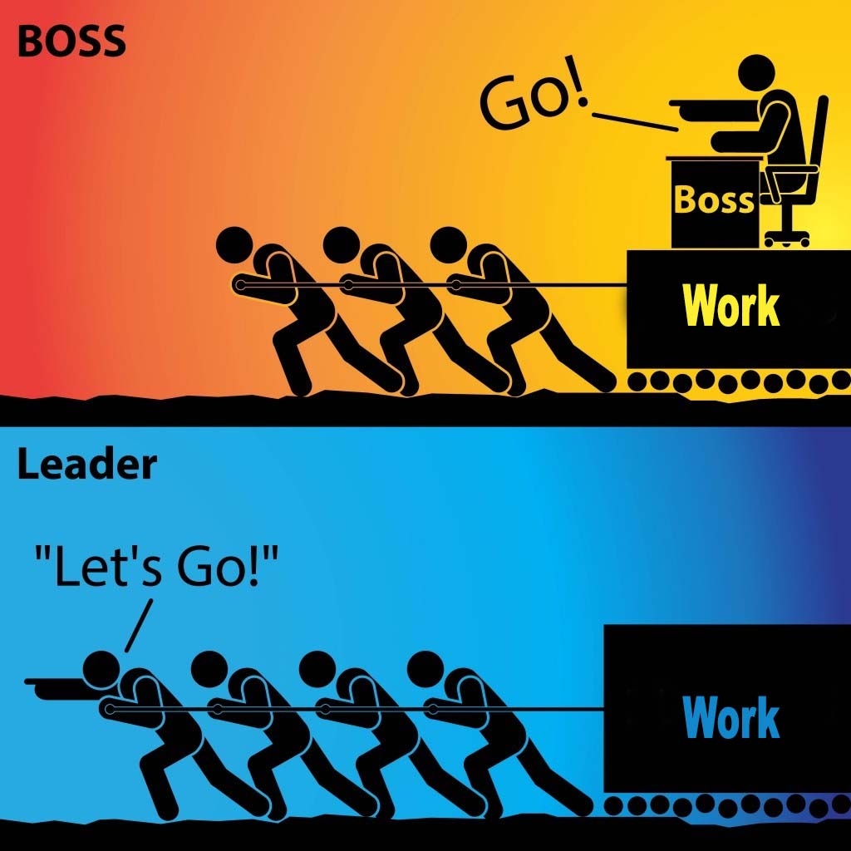
Organizing and Leadership
Leadership is taking responsibility for enabling others to achieve shared purpose in the face of uncertainty.
The members who can lead most successfully are those who already have followers, i.e. people who trust and respect them.

Slide 23

The Blitz, an organizing tool
Have 10 minute individual conversations with as many members as possible in a building:
What do you think are the biggest issues facing us in public education? In our school district?
Who’s trusted and respected here in the building?

Slide 24

Frequent Questions SEA got…
  Why is this any better than sitting in the staff lunch room?
  Isn’t this a great opportunity to ask people to join the union or to contribute to the PAC?
  Why Trusted and Respected?

Slide 25
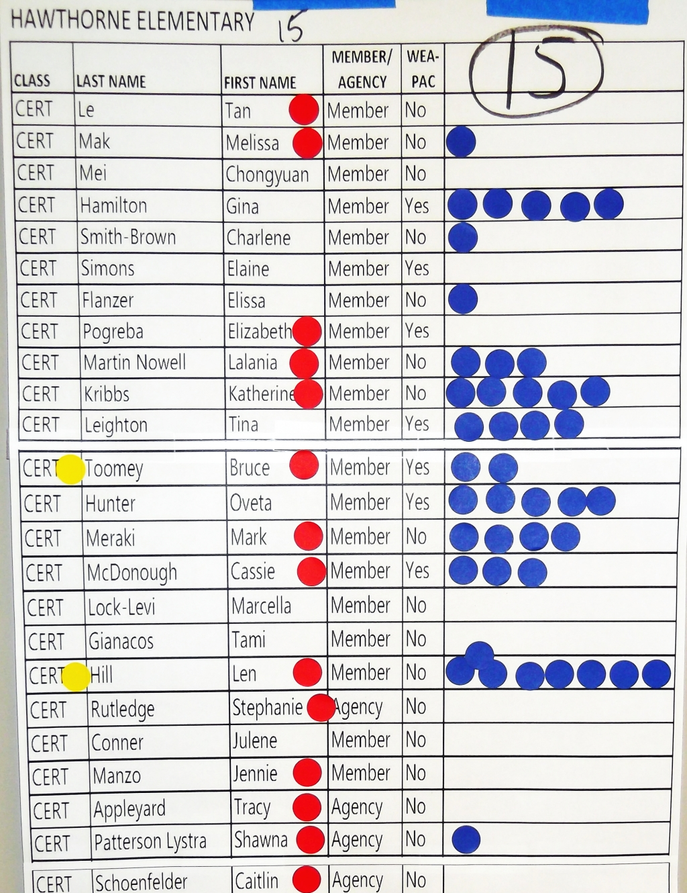
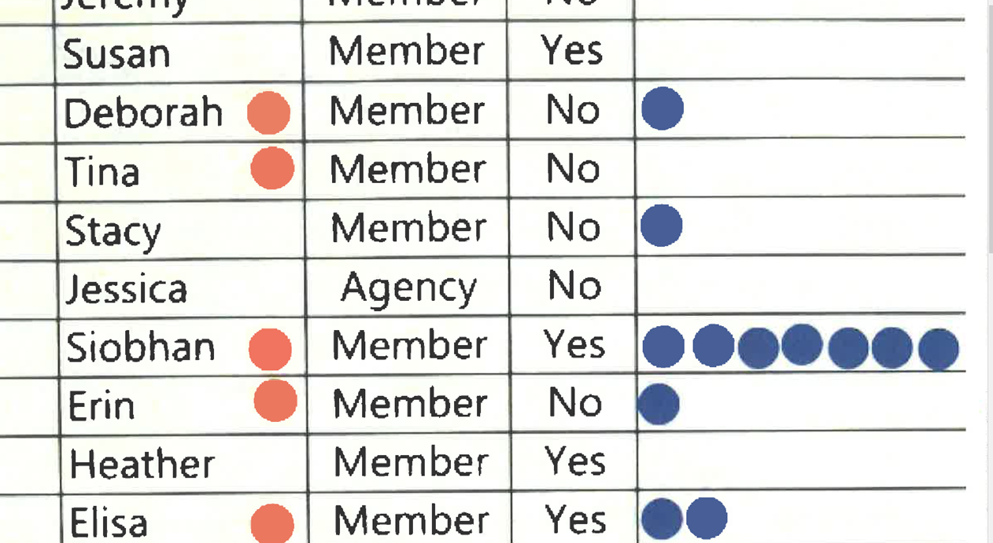
Responses SEA got… what do you notice?

Slide 26

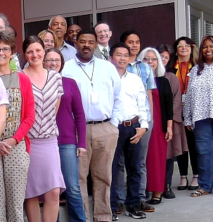
Leader Identification

Slide 27
Leader Identification -

Slide 28

Surveys: Another organizing tool
24 Credit Survey, Final question:
SEA is creating a large committee with multiple representatives from each school to meet with the District about the 24-credit implementation.
Who are three people you trust and respect to potentially represent your school?

Slide 29
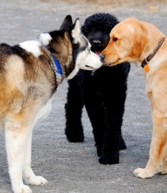
Time to Talk
Where could you start?

Slide 30

Key Points
We recruit those who look and sound like us.
We do the organizing first and THEN the membership drive.
Resources include our members' relationships and their shared values
Trusted and Respected IS the question
Apply a race and equity lens to this work at all levels
Staff Balance in the work – contract bargaining vs. non-bargaining

Slide 31

BREAK

Slide 32
Terri and Lakilia

Slide 33
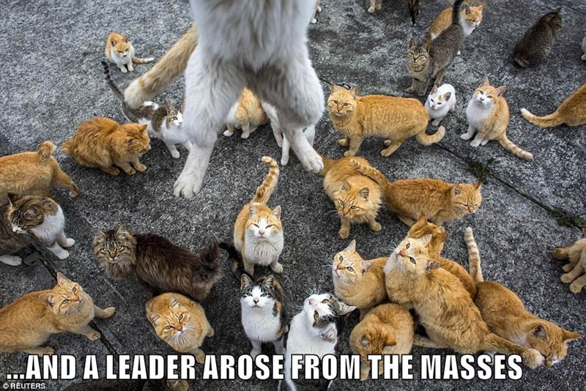
What makes a leader?
Why did you identify the member you did in this morning’s entry activity?

Slide 34
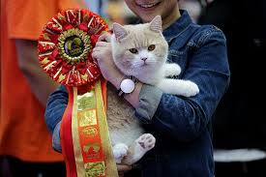
Rate the Leaders Activity
You are the UniServ Director for Walking Path High School and are trying to restart the school site leadership committee. This committee works closely with the building administration on solving work site problems around schedules, curriculum, and contract maintenance. The committee used to have 10 members but hasn’t been meeting for a while. You would like to recruit some new leaders to the committee.

Slide 35
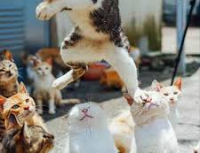
Leader Ranking Debrief
Who was the # 1 recruit?
Who was the last person you'd talk to?
WHY?
What are other ways you identify leaders?

Slide 36
Key Points
Who is the “best leader” – “it depends” as there is little to indicate what their agenda is and there is too little information about what the “union” agenda is.
How you invite someone into YOUR agenda matters
Understanding their agenda and their willingness to link it with your agenda matters
Determining how the interaction between other leaders' agendas matter

Slide 37
Albert and Jessica

Slide 38

Why do we do one-on-ones?
Talk at your tables and chart responses.

Slide 39
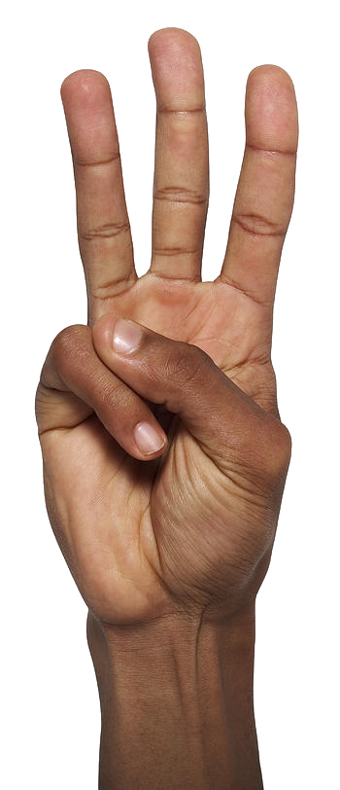
Three Kinds of
One on Ones
Small group- count off 1-6
1-2 Recruitment
3-4 Maintenance
5-6 Escalation
Refer to handout pages 14-15

Slide 40

In your role, how would you facilitate having a one on one with every worker in your unit?

Slide 41
Balancing One on Ones
Staff Focus
Identified leaders and on identifying leaders
To build relationships and seek commitment around common agendas
Coaching leaders and escalating commitments
Governance Focus (Local Level)
In your context is this closer to staff or closer to Member Leader?
Member Leader Focus (Building Level)
All workers to build a presence and identify possible leaders
To build relationships and seek commitment around common agendas
To gather data about agendas
To ask – Who is trusted and respected?

Slide 42
Key Points
If you are talking to EVERYONE, then you don’t have time to follow through on the higher-level work of developing leaders.
The initial meeting with an identified leader has a Relational goal - discover the leader’s agenda – suggest where the union shares that and other leaders share that – explore the dynamics and agendas.

Slide 43
Let’s watch…
Using your handout on page 20
What were the kinds of questions that were asked?
What was the organizer’s agenda?
When did it become clearer to you if this person would be a leader or not, aligned with the agenda presented by the organizer?

Slide 44
What Did You See?

Slide 45
Key Points
Power comes from our commitment to work together to achieve a common purpose, and commitment is developed through relationships.
The one on one is the key tool for establishing relationships, seeking commitments and growing and coaching leaders

Slide 46
Lakilia

Slide 47

Leadership In The Age of Complexity
Read and prepare to discuss
10 Minutes

Slide 48

Table Talk
What does this article make you think about when it comes to how we should approach or how we have been approaching our work as staff?
What does this article make you think about what it means to be a “Trusted and Respected” leader?
What does this article make you think about how we help identified leaders lead?

Slide 49
Charting the Challenges
Count by 4’s
Challenge Charts:
Illusion of controls
Challenge from Superiors/Managers
Re-Engaging People
Journey from Hero to Host
Questions for Each Group to Answer:
How do you overcome the challenge?
What is the positive outcome from overcoming this challenge?

Slide 50
Key Points
To build Ownership and Leadership we must provide our members the opportunity to experience:
Authentic Importance
Connection to Shared Purpose
Adult autonomy AND accountability
Growth in Opportunity
Growth in Capacity

Slide 51

Lunch
We will resume at:
1pm

Slide 52
Zac

Slide 53
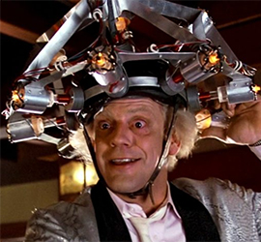
Building Engaged Leaders
“Social scientists have found that tasks designed to yield “intrinsic” rewards (inherently satisfying) produces great motivation, commitment, and adaptive learning than tasks that only yield financial, recognition or status rewards.”
-Hackman and Olham, 1980

Slide 54

Task Design
Sierra Club Leadership Development Project
How to redesign any task to enhance their motivational
properties, and how to create levels of responsibility that move volunteers up the “ladder”
to become partners in exercising leadership.

Slide 55
Conditions of Motivational Task Design
Experience meaningfulness: the task is important in the overall scheme of things.
1
Experience responsibility: how well the task gets done is up to me.
2
Experience results: as I do the work I can see whether or not I am doing well.
3

Slide 56
Conditions of Motivational Task Design are Achieved When:
Task Significance – understand and recognize the impact of the work on the world
Task Identity – one’s own contribution, from start to finish, is clear in the final result
Skill Variety – engaging a variety of skills, including heart, hands, and head.
Autonomy – having the space to make competent choices about how to do the work.
Feedback – results are visible to the person performing the task as they perform it.

Slide 57
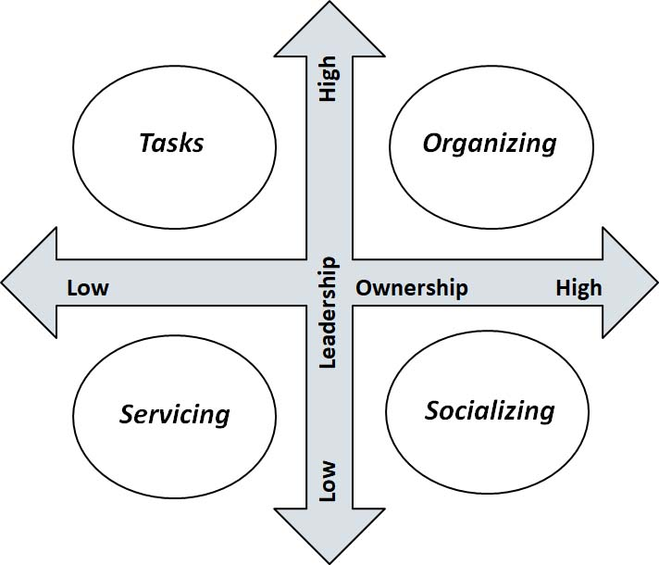
How we categorize tasks and activities…
…Let’s sort it out

Slide 58
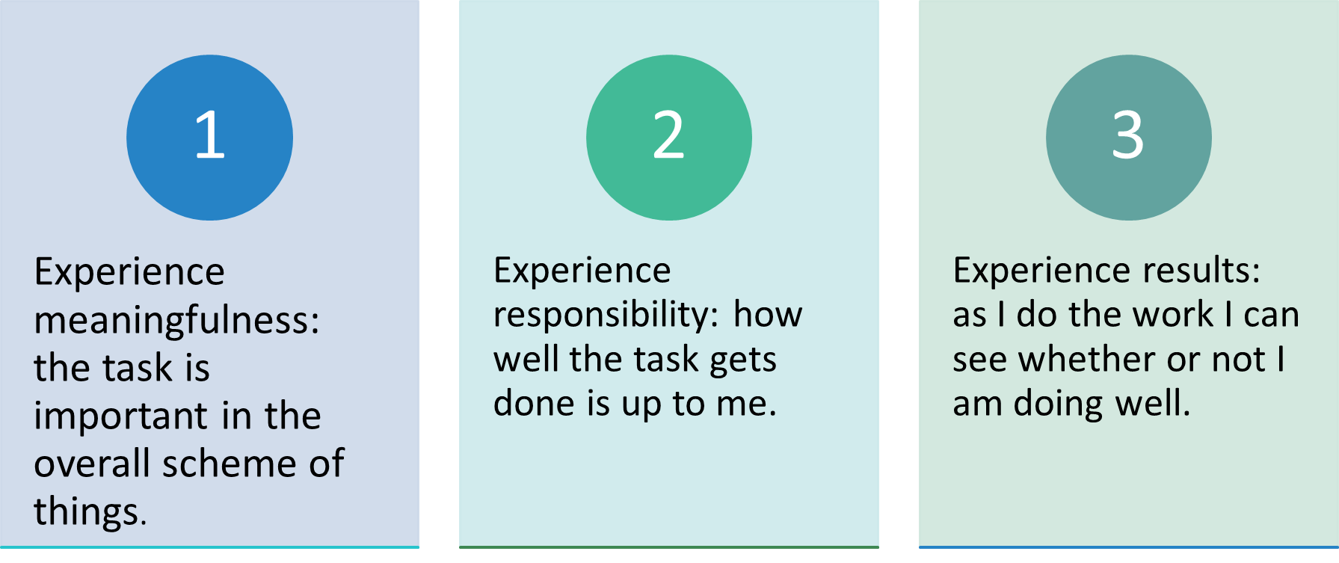
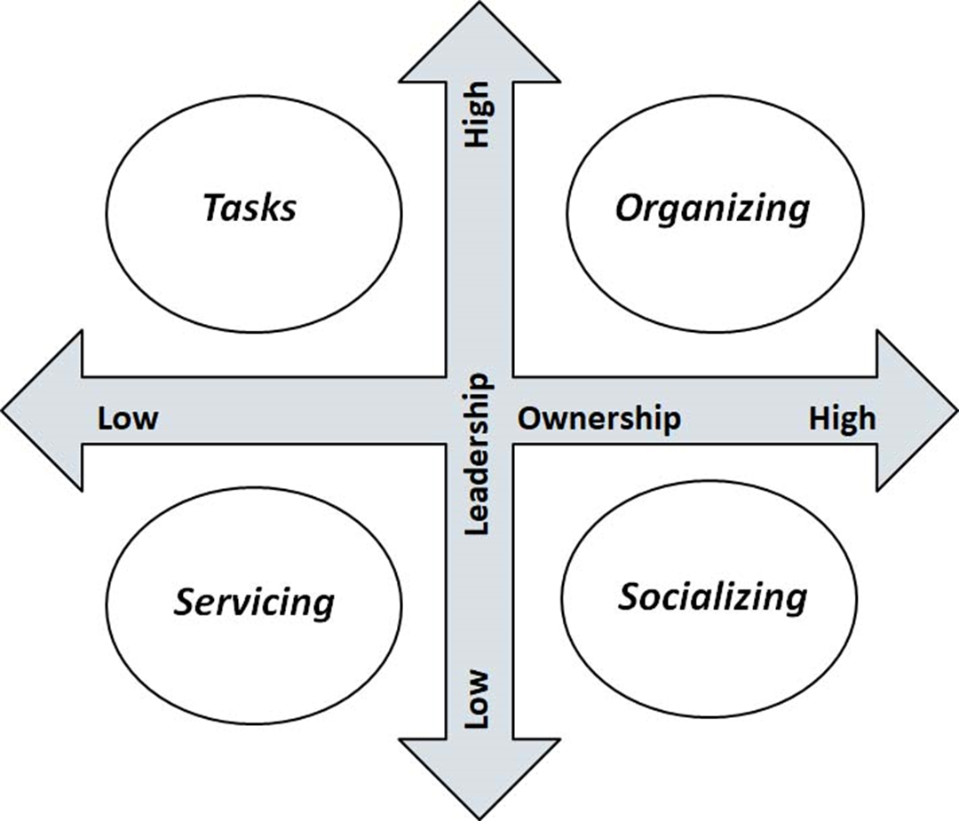

Debrief
Why did you place the tasks and activities in the quadrant you did?
What might be ways to move a task/activity to a different quadrant?

Slide 59
Host
Hero

Slide 60
Key Points
Tasks must be meaningful and members need to own them.
Our job is to look for opportunities to increase ownership and leadership wherever possible.

Slide 61
Terri

Slide 62
Definitions for Today
Leaders – Trusted and respected by their colleagues in ways that cut across communities of workers- is connected by values and influential relationships with mobilizers, activists, and those not yet part of the work. Get people to move their thinking and take action.
Mobilizers – Are already convinced members, who are already willing to take action. They are connected to the other already convinced.
Activists – Supportive and willing to act if invited but not able to move others.

Slide 63



Leaders, Mobilizers, and Activists – Scenarios

Slide 64
Leaders, Mobilizers, and Activists
Who do you identify as the Leader who has moved people the most? Why?
Who is the mobilizer – actively working on the behalf of the union and carrying out actions that get others involved? Why?
Who is an activist – a pro-union supporter and may take action if asked? Why?
In what order should you be building relationships with your choices?

Slide 65
Bringing it back home
Which quadrant do Activists typically occupy? Mobilizers? Leaders?
How do you help move them into quadrants with more leadership and ownership?

Slide 66
Key Points
People grow when they have to stretch. When the union staff step back, members can step forward.
Tasks have to be meaningful and members need to own them.
Our job is to look for opportunities to increase ownership and leadership wherever possible.

Slide 67
BREAK

Slide 68
Albert

Slide 69
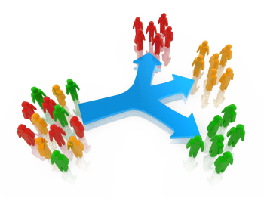
Consider this…
Structures allow for the distribution of power and responsibility and prioritizes leadership development. Because we think about organizing as a leadership practice that enables people to turn the resources, they have into the power to make the change they want… structures are typically “groups of people” organized around a common purpose or value. Teams, committees, networks, boards, coalitions … etc.

Slide 70
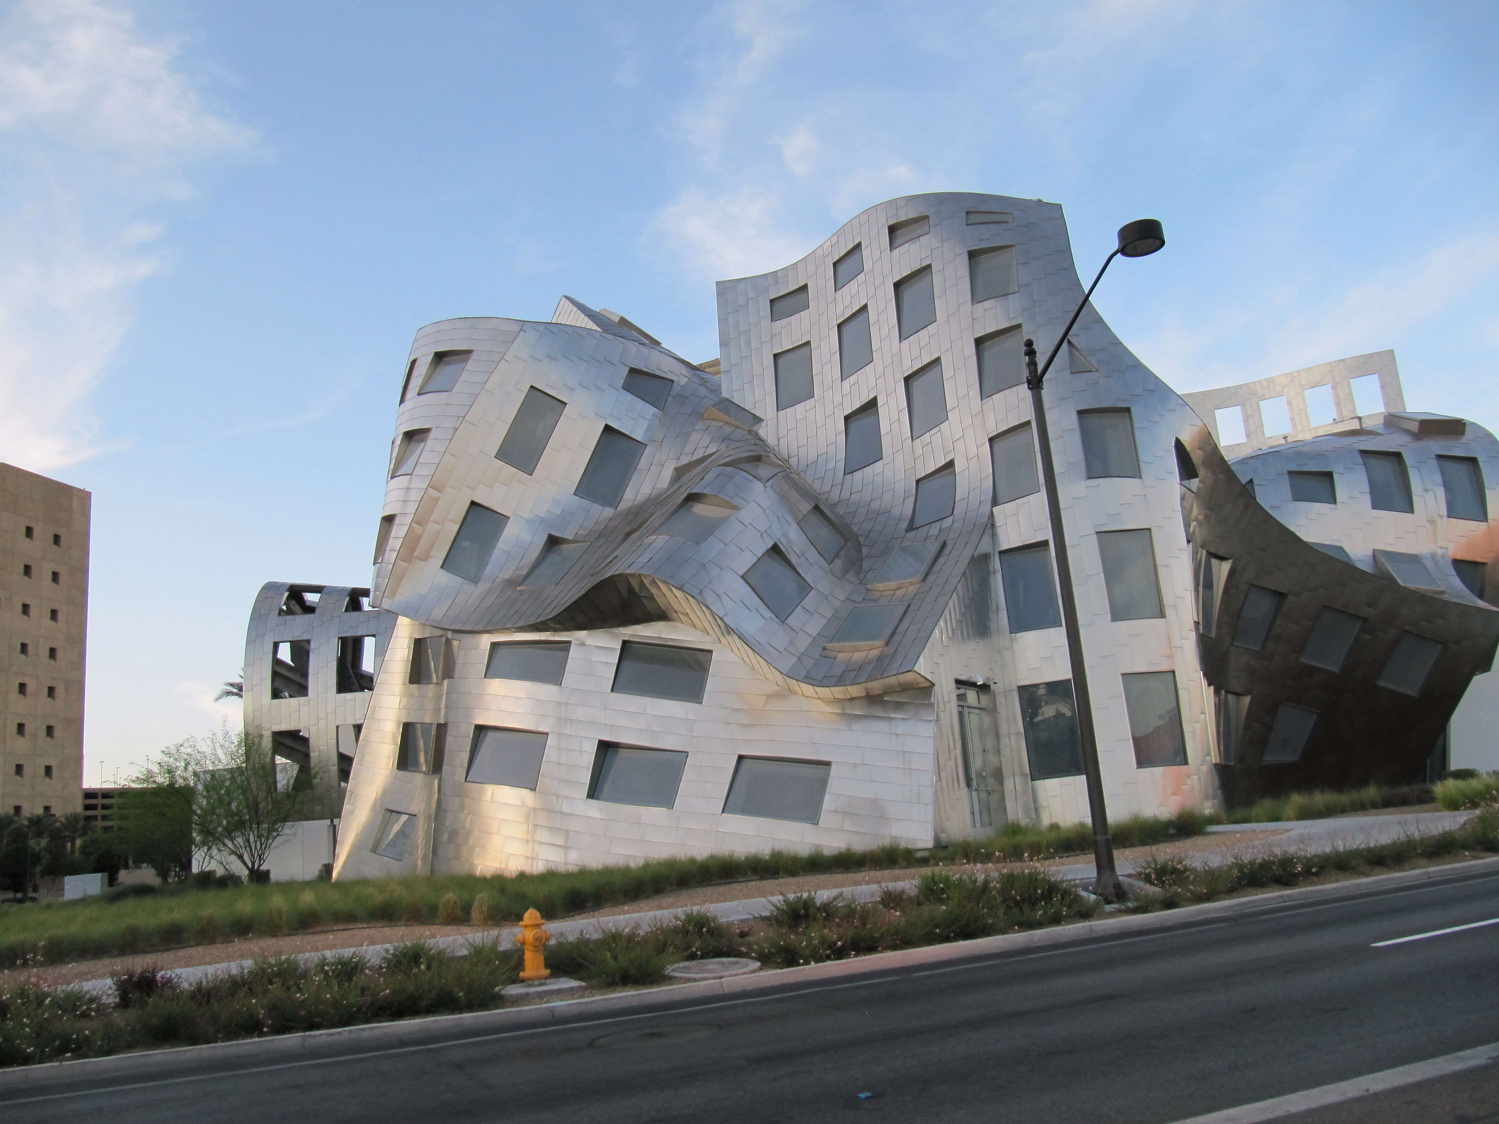
Leadership Structure Challenge

Slide 71

Instructions: build the tallest freestanding structure
Spheres and beads are workers.
The larger the sphere, the more leadership that person embodies. The larger the sphere the more engaged and aligned with the agenda of the structure the person is.
Sticks are relationships.
Sticks are connections, commitments, influence, and shared purpose. Larger and longer sticks are stronger. The longer the stick, the more substantial the relationship.
MUST use ALL materials!

Slide 72
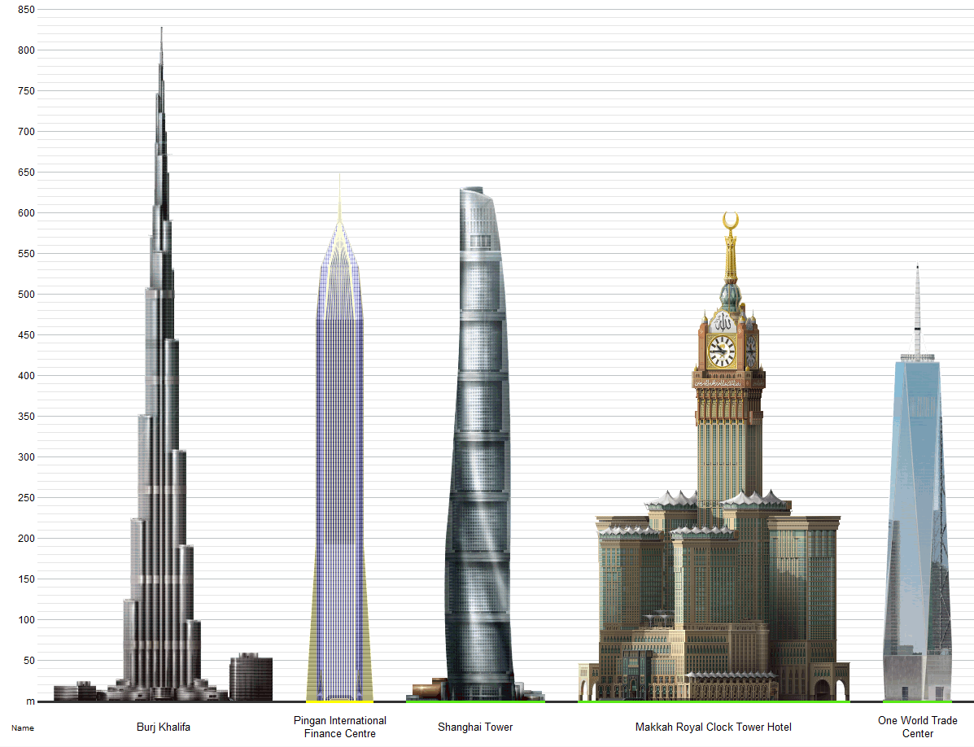
Challenge
The team will have 15 minutes to build the tallest, freestanding structure using only the ingredients in the bag.
This Photo by Unknown author is licensed under CC BY-SA-NC.

Slide 73

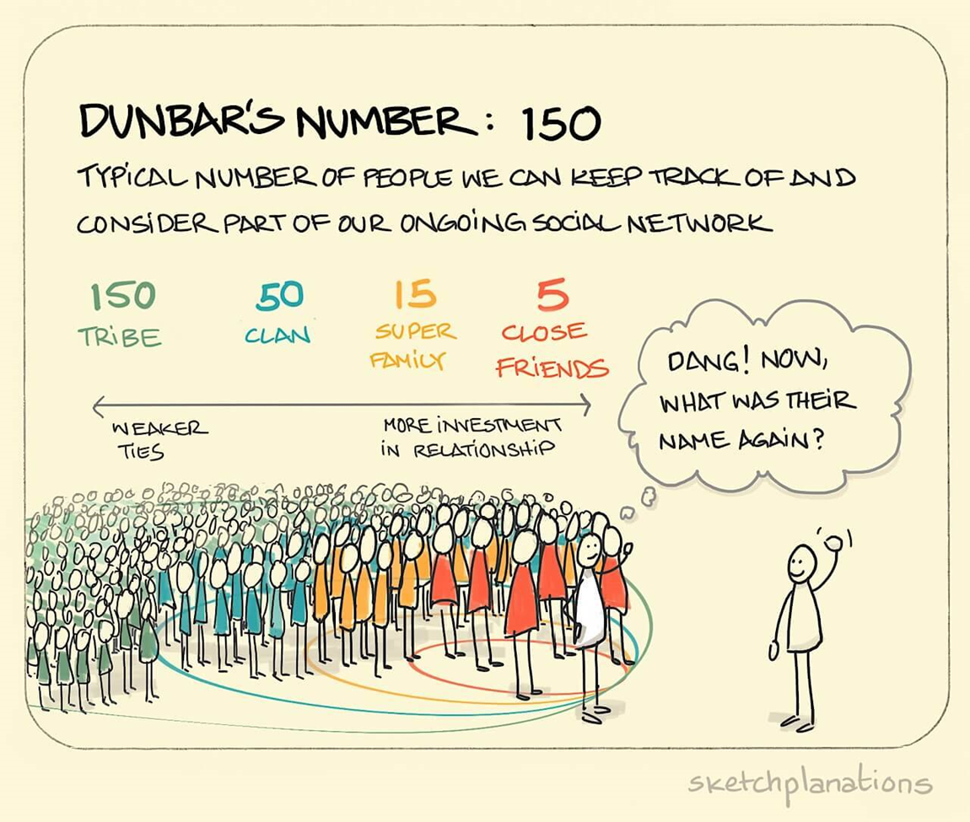
What Did You Notice?
Go Deeper:

Slide 74
Key Points
Without enough leaders who have enough connections with members, you can’t build and use power.
The size of the “spheres” can change, the amount of engagement that leaders take on causes their influence to grow.
  The role of staff is in the development of structures by connecting leaders.

Slide 75
Yvie

Slide 76
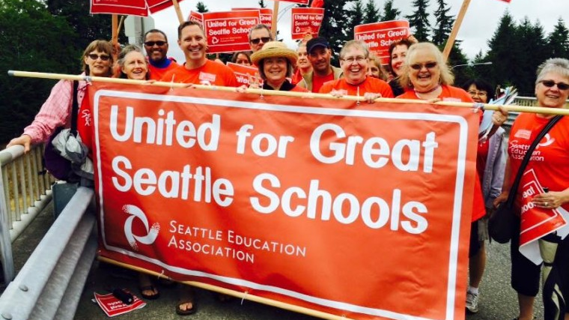
Members Into Structures

Slide 77
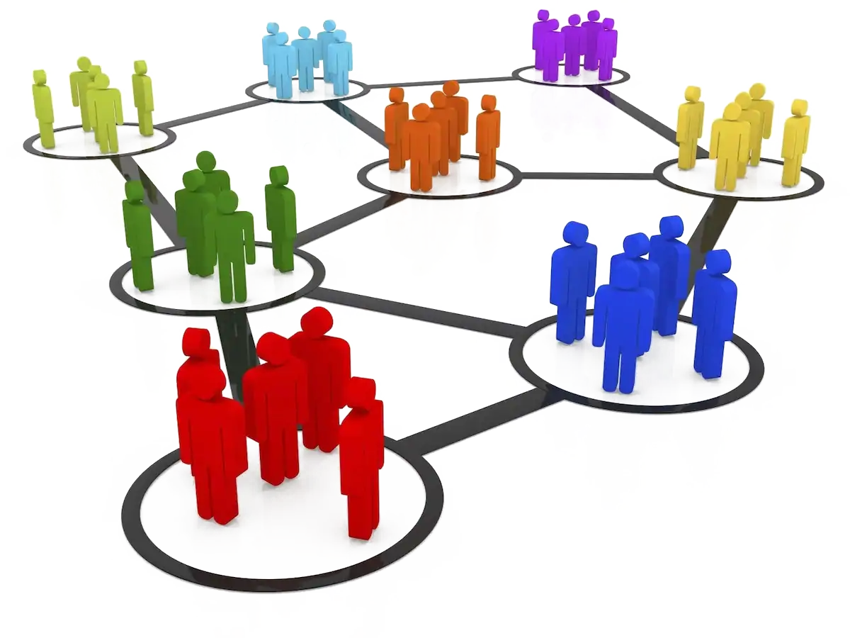
Using Structures to Connect Leaders
Leaders from different worksites connect through structures
We create (or re-create) structures so that we can connect leaders in pursuit of important shared agendas
Also a way to invite leaders into the union. They could see their agenda being realized through the union.
Members Into Structures

Slide 78
Listen for the Following Connections
Task and ‘ask’ design that allows for:
Authentic Importance
Connection to Shared Purpose
Adult autonomy AND accountability
Growth in Presence
Growth in Capacity

Slide 79
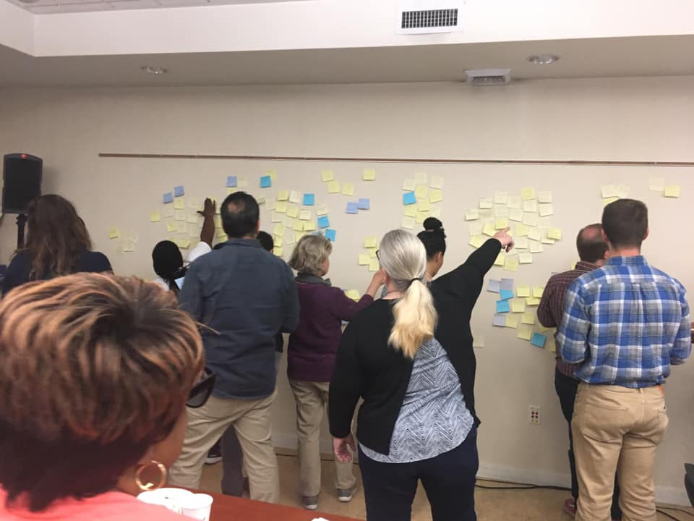
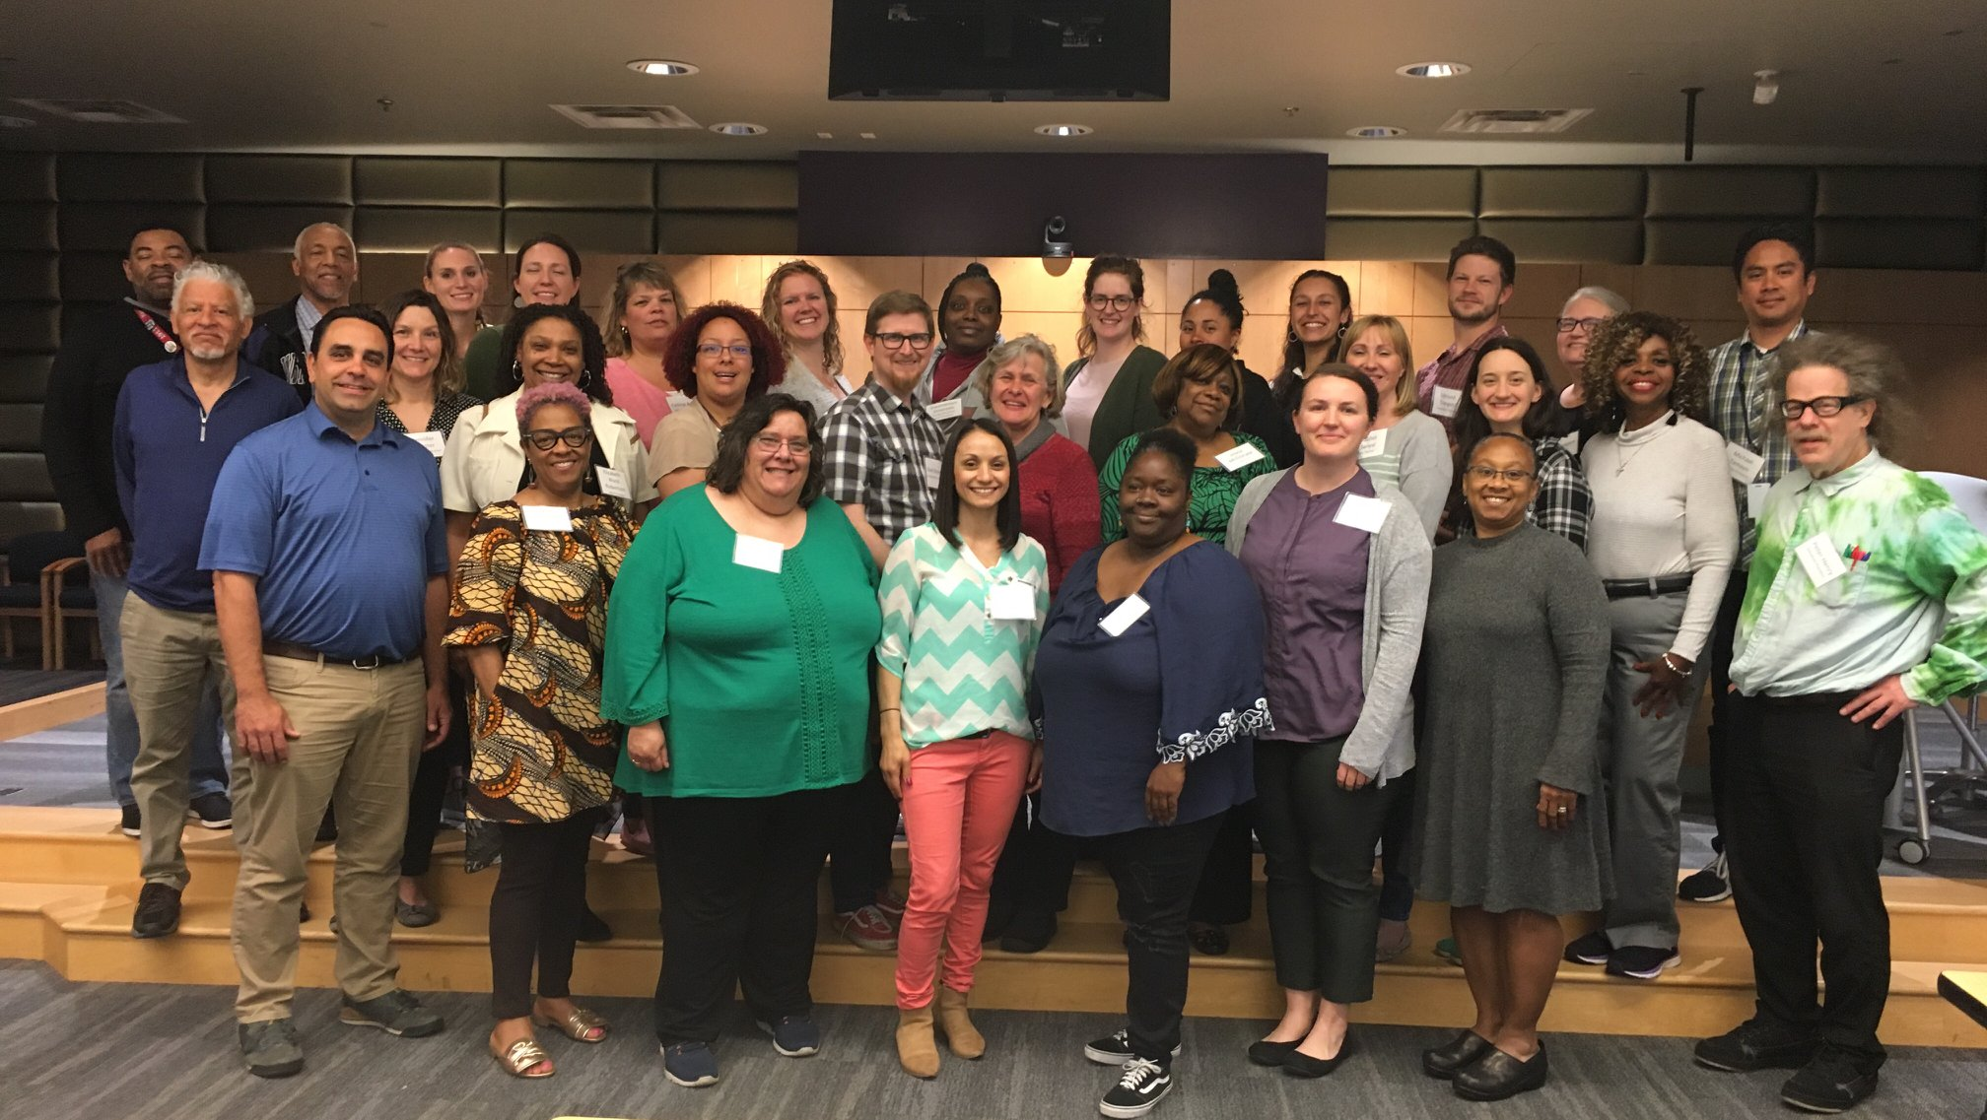
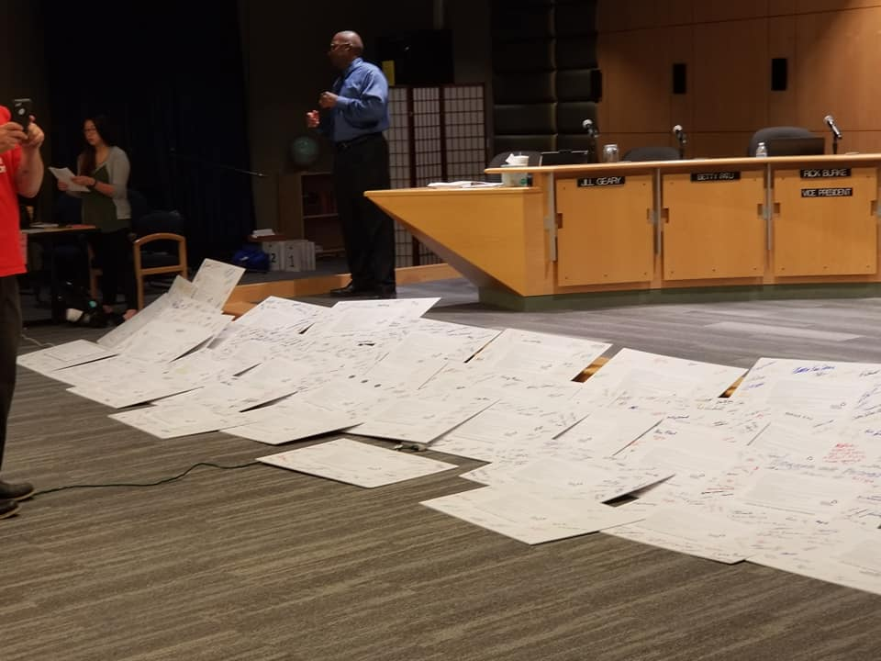
2019 Bargaining Team

Slide 80
Bargaining Groups: 2019
Total Team: 42
Sub Tables: 60
Invited to work on issues: 100
Total: 202(ish)
Main Bargaining Table
Community Schools
Dual Language
Librarian Funding Committee
ELL
Special education
Fundamental Course of Study
ESA CLT Groups

Slide 81

SEA Center for
Racial Equity
Advisory Board
Annual leadership summit
Created a coaching program for the RETs, run entirely by the CRE
Project committees
Member on release is now an elected officer
Doubled the CRE Budget in Sept 2019

Slide 82
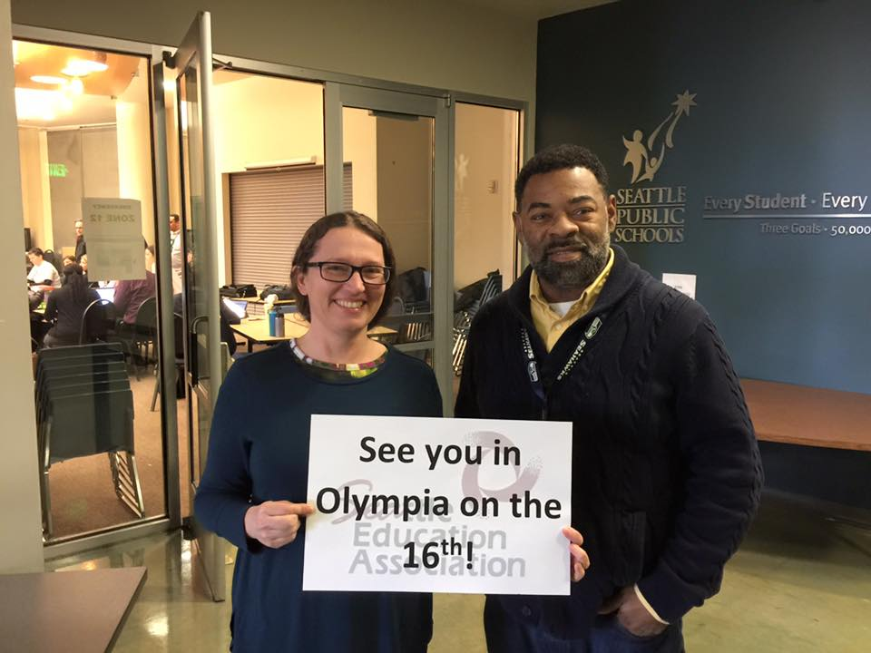
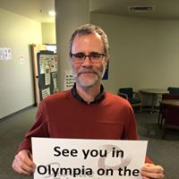
Peer Assistance and Review

Slide 83
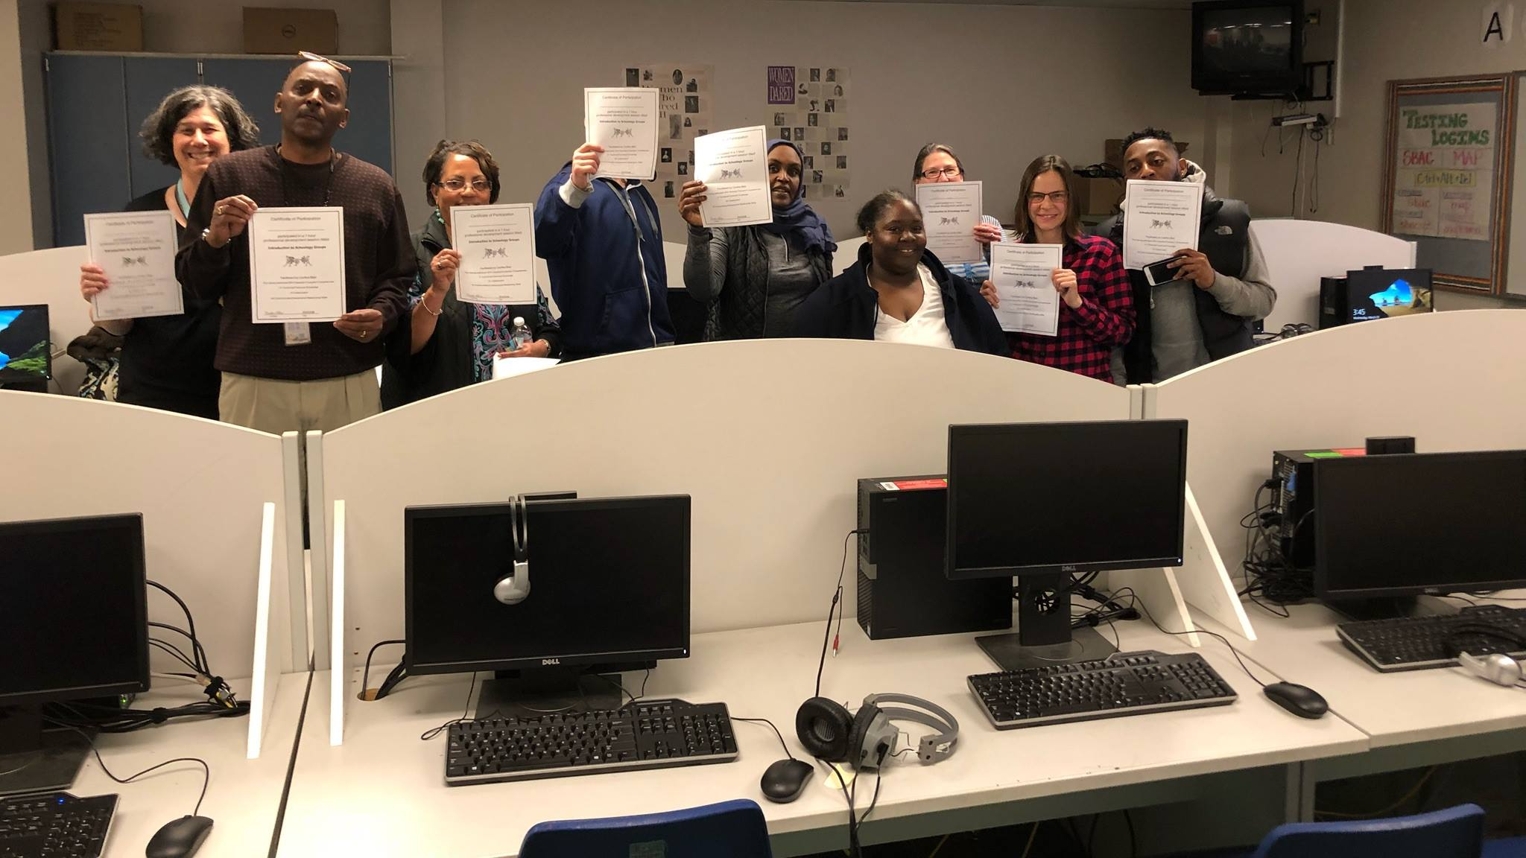
Classified Training Structure

Slide 84
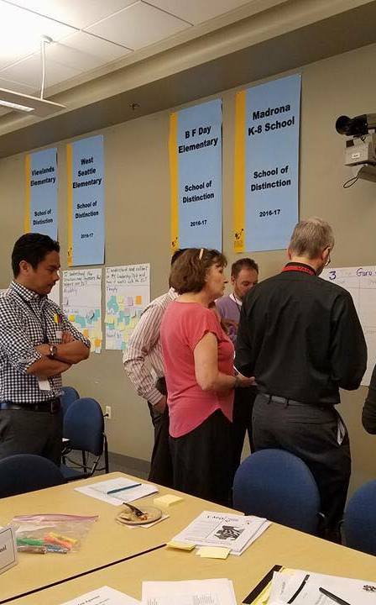
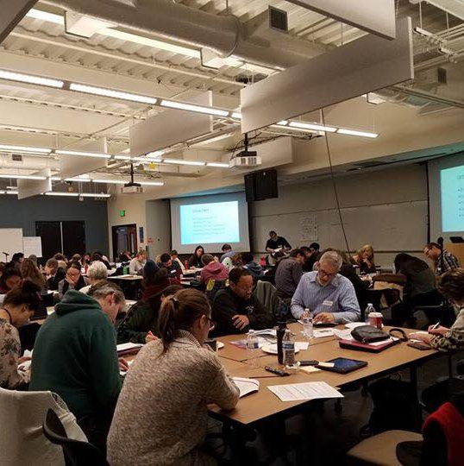
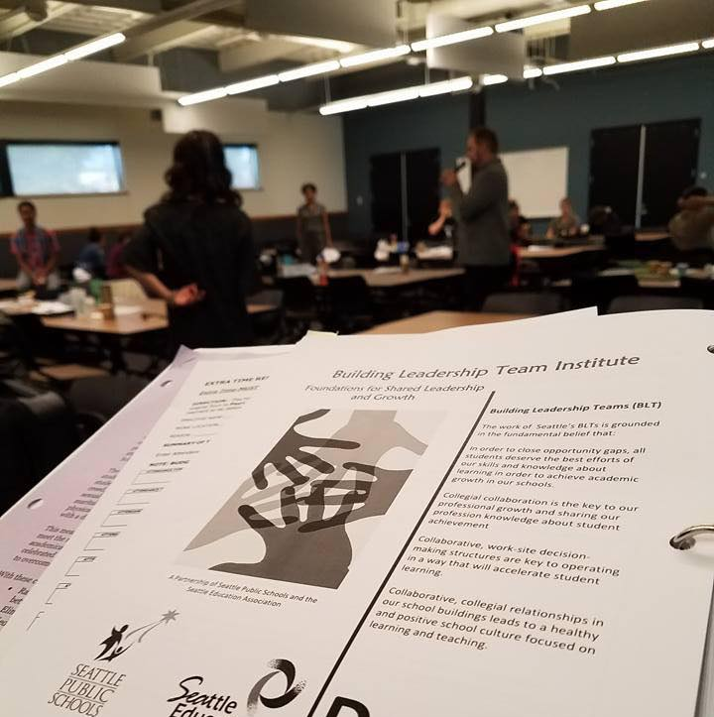
Building Leadership Teams Training
SEA Members lead this training with support from governance and staff.

Slide 85
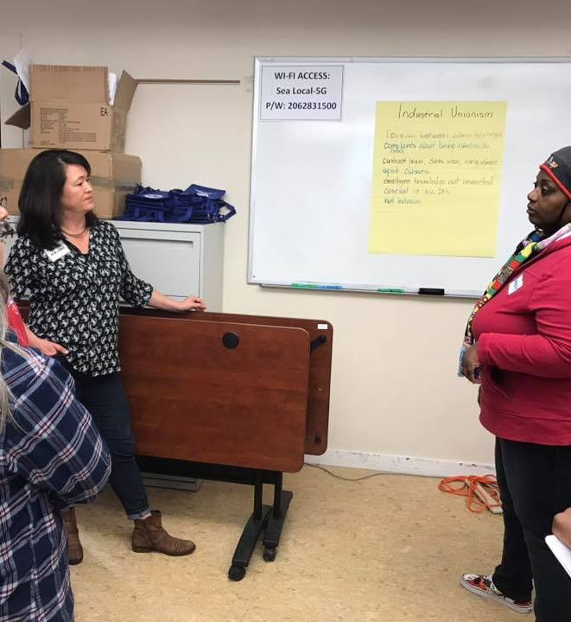
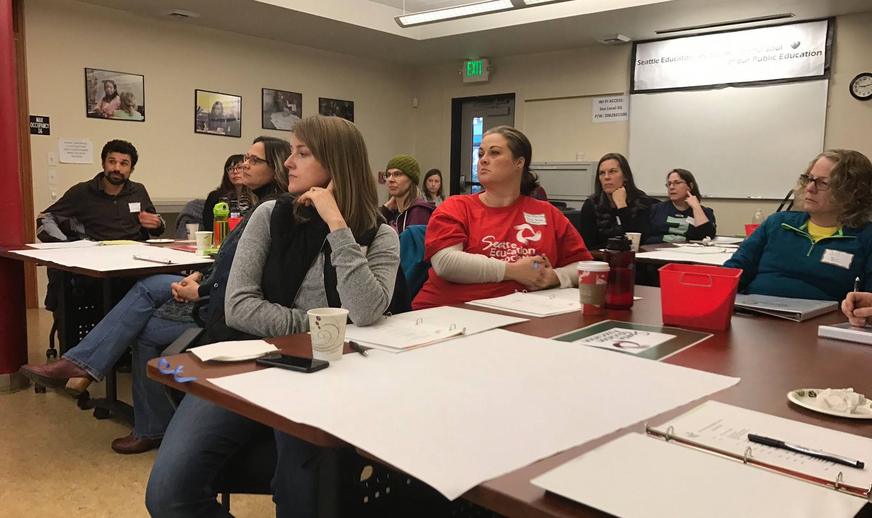
Rep Training
Member leader developed the materials and lead the training with staff support and coaching.

Slide 86
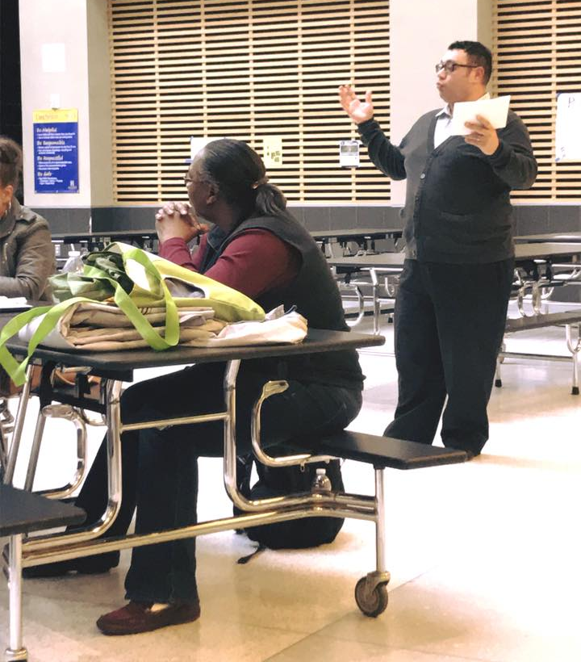
Now staff only do 1:1s with identified leaders and begin thinking of ways to invite them into active leadership with the union.

Slide 87
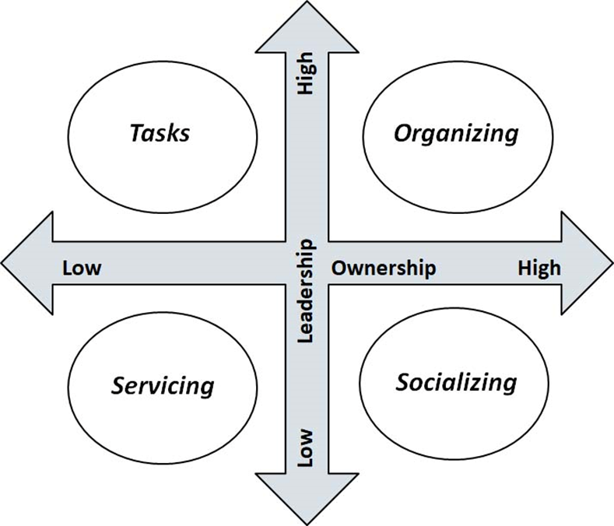
What did Seattle do?
Seattle Structures
Identify Leaders
Know what your leader's issues are
Ask them to join in shaping the agenda with other leaders
Give leaders meaningful tasks/roles around the issues they care about.

Slide 88
Key Points
Don’t do for others what they can do
Structures allow adults to use their agency to pursue THEIR agendas
Structures are defined by issues, purpose, and relationships
Structures can either endure or be time bound
Structures are how we help people convert their resources into power to make change
Don’t be afraid to create new structures

Slide 89
Yvie

Slide 90

Reading Jigsaw – Same Article Groups
Three Guiding Questions on p.40:
What were the ways that leaders were identified and grown?
What were the structures that were developed, expanded and tested?
What do you think was the role of the staff in these examples?

Slide 91
Reading Jigsaw – One of Each Groups
Using your handout – each person shares answers from the guiding questions as it relates to their article.

Slide 92
Whole Group Debrief
What were some things that were similar across all articles?
What was surprising to you in these examples?
What are you left wondering?

Slide 93
Article Assignments
Indiana Teachers Go Green p. 20-22
Greg Ardoin
Nathan Coutsoubos
Rachel Grabowski
Nicole Sipka
Heidi Miller
Trusted and Respected p.23-31
Ginny Bollwahn
Lois Dubay
Allen Gumm
Izaak Standridge
Albert Jones
What Vermont Paraeducators Learned p.42-46
Rachel Brown
Angelina Gallesi-Schmidt
David Peacock
Emily Wytiaz
Lakilia Bedeau
Colorado Coalition p.57-62
Kathleen Cheshire
Tara Gonzalez
Sobia Sheikh
Zac Johnson
Nashville Teachers Union p.49-56
Wendy Cannon
Jennifer Given
Jedd Rivera
Tina McMullin
Terri Jones
It's Not Magic p.33-39
Alex Borenstein
Pamela Ferrill
Randal Oddi
Matt Tomko
Jessica Minguez

Slide 94
Whole Group Debrief
What were some things that were similar across all articles?
What was surprising to you in these examples?
What are you left wondering?
What looked familiar to your life back home?

Slide 95

Ending it Right
Choice Networking
Housekeeping
Plus and Delta at the Door

Slide 96

For Tomorrow…
A problem of practice is something that you care about that would make a difference for your locals if you improved it.
The more specific the problem of practice is, the more helpful the recommendations for your next level of work will be.

Slide 97

Choice Network Time

