Slide 1
Day 2

Slide 2

Entry Activity
The problem of practice is something that you care about that would make a difference for your locals if you improved it.
The more specific the problem of practice is, the more helpful the recommendations for your next level of work will be.

Slide 3
Effective Worksite Leadership Structures
UniServ Focus Academy

Slide 4

Agenda Review – Days 1 and 2
7:30 – Breakfast
8:30 – Getting Started
10:00 – 10:15 Break
12:00 –1:00 Lunch
2:15 – 2:30 Break
4:30 – Choice Networking Time
5:00 - Adjourn

Slide 5

Community Agreements p. 2
Using Self-Awareness and Self-Knowledge
Listening for Understanding
Being Gracious
Staying Engaged
Being Open and Suspend Judgment
Saying “I”- tell your truth
Seeking Discomfort
Reaching Empathy
Expecting Non-Resolution and Non-Closure
*Adapted from “Embracing equity and inclusion”, Annie E. Casey Foundation
Notes:
Community Agreements for Our Time
Awareness and Self-Knowledge
This requires self-knowledge and self-awareness. Self-knowledge allows you to see what causes you pain and conflict and enables you to embrace your contradictions and inconsistencies. It allows the space to work on things about yourself that you are not happy with. In turn, self-knowledge helps to prevent you from projecting your negative aspects onto other people. Bringing your best self also requires that you have a positive attitude, are willing to deeply explore your perspectives and remain open to the perspectives and experiences of others.
Listening for Understanding
Be an active listener. Active listening involves paying full and careful attention to the other person, looking him or her in the eye, avoiding interruptions, reflecting your understanding, clarifying information, summarizing the other person’s perspectives and sharing your own. Remember that most people need time to open up and might not be willing to immediately share their personal stories, hopes, fears and/or concerns.
Being Gracious
Being kind is a vital way of bringing meaning to our own lives, as well as the lives of others. Kindness is about caring genuinely for others around you, wanting the best for them and recognizing in them the same wants, needs, aspirations and even fears that you may have. Being kind and generous allows us to communicate better with others, to be more self-compassionate and to be a positive force in other people’s lives. This includes following the COVID protocols that are in place to protect the health of this learning community.
Stay Engaged
Staying engaged requires you to be morally, emotionally, intellectually and socially involved in the conversation. Staying engaged means that you are listening with curiosity and willing to deepen your understanding. Staying engaged might also require you to sustain the conversation even when it gets uncomfortable or diverted. This also means a commitment to keeping your electronic communications to a minimum with folks not present in this learning community.
Be Open and Suspend Judgment
Listening with an open mind includes being receptive to the influence of others. You can suspend judgment by becoming aware of preconceived notions and listening to everything someone has to say before jumping to conclusions. Most importantly, suspending judgment also means listening to what the speaker has to say for understanding, not just to determine whether the speaker is right or wrong.
Say “I”- tell your truth
Speaking your truth in authentic and courageous conversations about race requires a willingness to take risks. It means that you will be absolutely honest and candid about your own thoughts, feelings, experiences and opinions and not just saying what you perceive others want to hear. Speaking your truth will require you to speak from the “first person” and use “I” statements.
Seek Discomfort
Leaning in to discomfort will require you to let go of racial understandings and stereotypes that you may be holding onto in order to move forward. Leaning in means that you will avoid judgment, assume positive intent and be open to the kernel of wisdom in each individual’s experiences. Leaning in to discomfort will require you to sit through moments of embarrassment, confusion, anxiety and/or fear.
Reaching Empathy
Empathy and compassion allow you to understand the other person’s point of view. When you are empathetic, you are more understanding, patient and kind. Expanding your capacity to feel empathy will also allow others to enter your circle of human concern.
Resolution and Closure
Expect and accept that there may not be closure. It is not likely that you will resolve your personal understanding about race or another person’s racial experience in a single conversation. The more you talk about race with another person, the more you learn and the more they will learn. Authentic and productive conversations about race are continuous and always evolving.
*Adapted from “Embracing equity and inclusion”, Annie E. Casey Foundation

Slide 6

Feedback on Feedback

Slide 7
Albert Jones

Slide 8






It’s Time To Get Your Clap On!
We Need 4 volunteers to act as Organizers
-
And 4 volunteers to act as Leaders

Slide 9
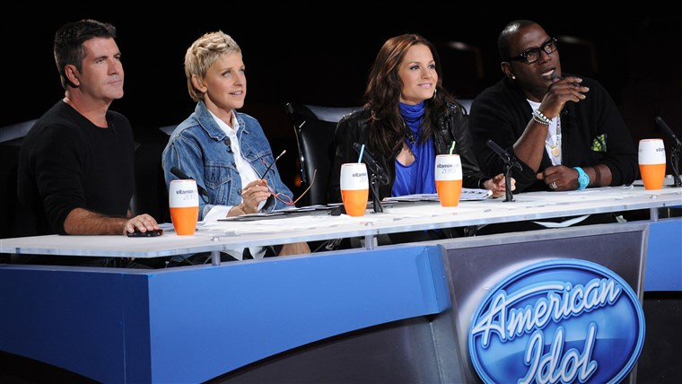
Get your clap on…
Round 1
Please Clap
And Exit

Slide 10
Get your clap on…
Round 1
and the Judges say...

Slide 11

Get your clap on…
Round 2
Please Clap

Slide 12
Get your clap on…
Round 2
and the judges say…
Why?
(Feedback)

Slide 13

Get your clap on…
Round 3
Please Clap …

Slide 14
Get your clap on…
Round 3
and the judges say…
Successful clapping looks like:
(Aligned Expectations)

Slide 15

Get your clap on…
Round 4
Successful Clapping Looks Like:
(shared expectations)
Please Clap
And the judges say…
Improvement would look like:
(Coaching)
Please Clap
And the judges say…

Slide 16

Key Points
Leaders Grow Best When they Know:
Clear Goals
Clear Metrics
Actionable Feedback
Chance to Do Again

Slide 17
Yvie and Zac

Slide 18

Coaching
Regroup!
You will need to get into groups of 3.
Note: there may be 1 group of 4

Slide 19
Coaching Content Page 43-49
Coaching is a direct intervention in an individual or team’s work process to help them improve effectiveness.
Coaching enables others to build their own capacity to act.
Coaching moves leaders from a relationship where staff have an external control to one where they focus on how to grow.

Slide 20
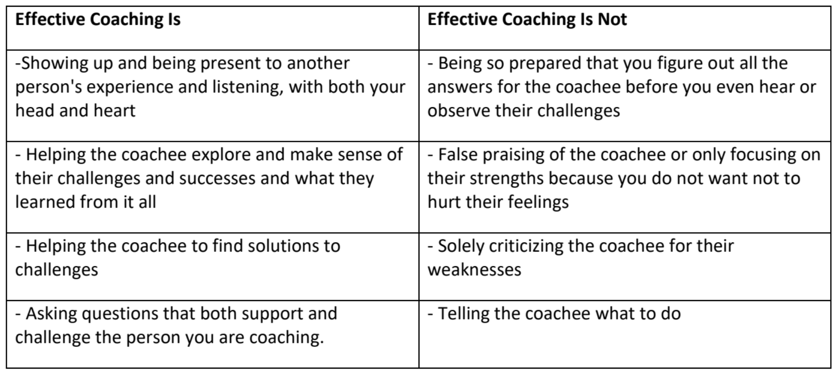
to hurt their feelings

Slide 21
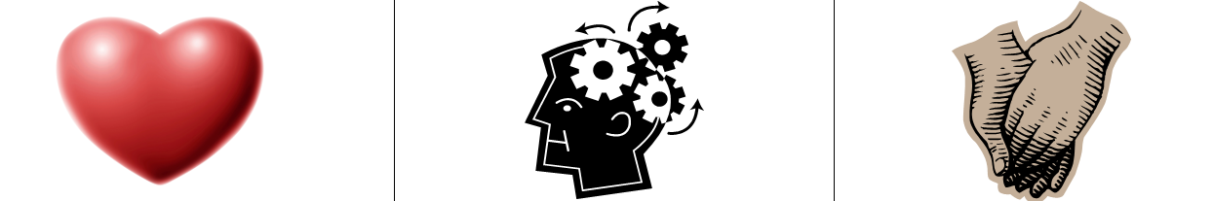
3 Kinds of Coaching-p.44-46
Motivational - Heart Coaching aimed at enhancing motivation
Strategic – Head Coaching aimed at helping plan, evaluate, strategize
Skills-based – Hands Coaching aimed at effective execution of a skill

Slide 22
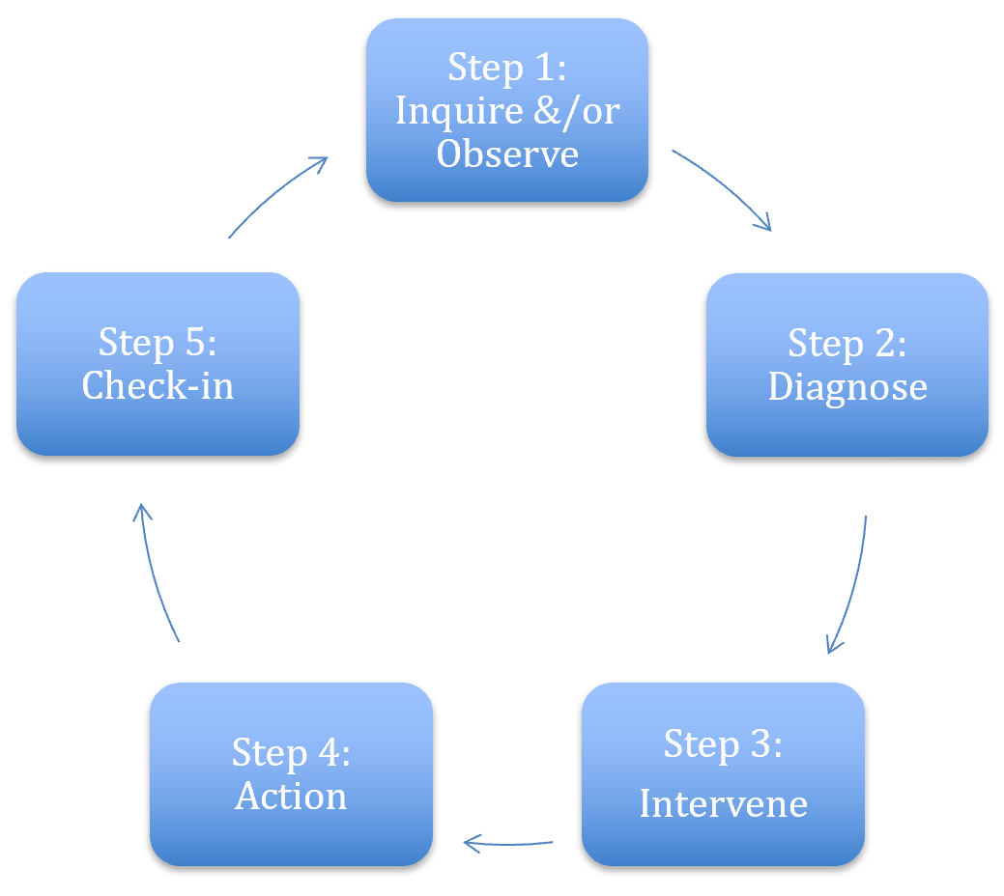
Coaching Cycle
The reason to apply this cycle is to stop yourself from providing THE answer.
Leaders grow from productive struggle.
p.45

Slide 23
Now it is your turn…
Get into Teams - 3…there may be 1 team of 4
Four Scenarios found on Page 49 (refer to p.45)
Which “kind” of coaching “diagnoses” would you make

Slide 24
Key Points
Coaching is about releasing your external control and enabling the leader to grow.
Coaching is as much about you changing your behavior and growing your skill as it is about growing a leader.
We only get good at coaching by practicing it.

Slide 25

BREAK

Slide 26
Problem of Practice
The problem of practice is something that you care about that would make a difference for your locals if you improved it.
The more specific the problem of practice is, the more helpful the recommendations for your next level of work will be.

Slide 27
Terri

Slide 28

30 Day Structure for Action Challenge
Table Teams
Chart Paper and Markers
For your assigned challenge
Identify the structures required to achieve the goals
Identify the STAFF person’s role in this work would be.

Slide 29
30 Day Structure for Action Challenge
On your charts, with your team,
Describe the structures you would need to put in place to achieve the goal of your challenge.
Be as detailed and “out of the box” as possible.

Slide 30
30 Day Action Structure Challenge
1 month to get at least 500 people, with 200 picket signs, all wearing the same color, at a march, starting at the union parking lot and ending at city hall with a 3-hour rally
1 month to get 25 worksites to sticker up at least 50% of workers and post group pictures by noon on the day of the sticker up.
1 month to get a 90+% commitment to strike vote out of 3000 members on a paper ballot
1 month to get volunteers to cover 4-hour shifts (noon to 4, and 4 to 8) across five days at 20 polling locations – 2 Volunteers per shift per location -- At least 400 Volunteers
1 month to get at least 10,000 certified signatures for a ballot initiative
1 month to secure at least 50 canvassers who will do a GOTV (get out the vote) including a literature drop in your endorsed candidate’s district – looking to make 500 contacts.

Slide 31

Debrief

Slide 32
Key Points
Our primary job is to identify leaders who can share power, responsibility and authority
We support members and leaders by helping them identify structures that distribute power, responsibility and authority
We are not the leaders – we are a resource

Slide 33
Problem of Practice
The problem of practice is something that you care about that would make a difference for your locals if you improved it.
The more specific the problem of practice is, the more helpful the recommendations for your next level of work will be.

Slide 34

Lunch
We will resume at:
1pm

Slide 35
Lakilia

Slide 36
Problem of Practice
The problem of practice is something that you care about that would make a difference for your locals if you improved it.
The more specific the problem of practice is, the more helpful the recommendations for your next level of work will be.

Slide 37
Problems of Practice
Triads
Find the “Consultancy Protocol” on page 50
The purpose for the listeners is to ask good questions – not provide answers.
The purpose for the presenter is to determine what about their work with this problem needs to change.
There will not be a group debrief.

Slide 38
Discuss the Protocol Page 50
Opening (We are doing that part now)
Presenter – Shares the Dilemma
Clarifying questions (NOT Probing)- Review pages 51-52
Group Fishbowl – Presenter steps out and listens to the group.
Closing – Presenter shares what they learned

Slide 39
Problems of Practice
50 Minutes Total
Each person has a chance to be the presenter
15 Minutes per round

Slide 40
BREAK

Slide 41
Jessica

Slide 42
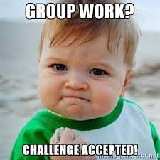
Team Planning for Leaders and Structures
Teams will select a scenario.
Identify a goal for the scenario and a basic campaign timeline.
Focus is not on actions – but on leaders and structures needed to achieve the various “wins along the way” to reach the ultimate win.

Slide 43
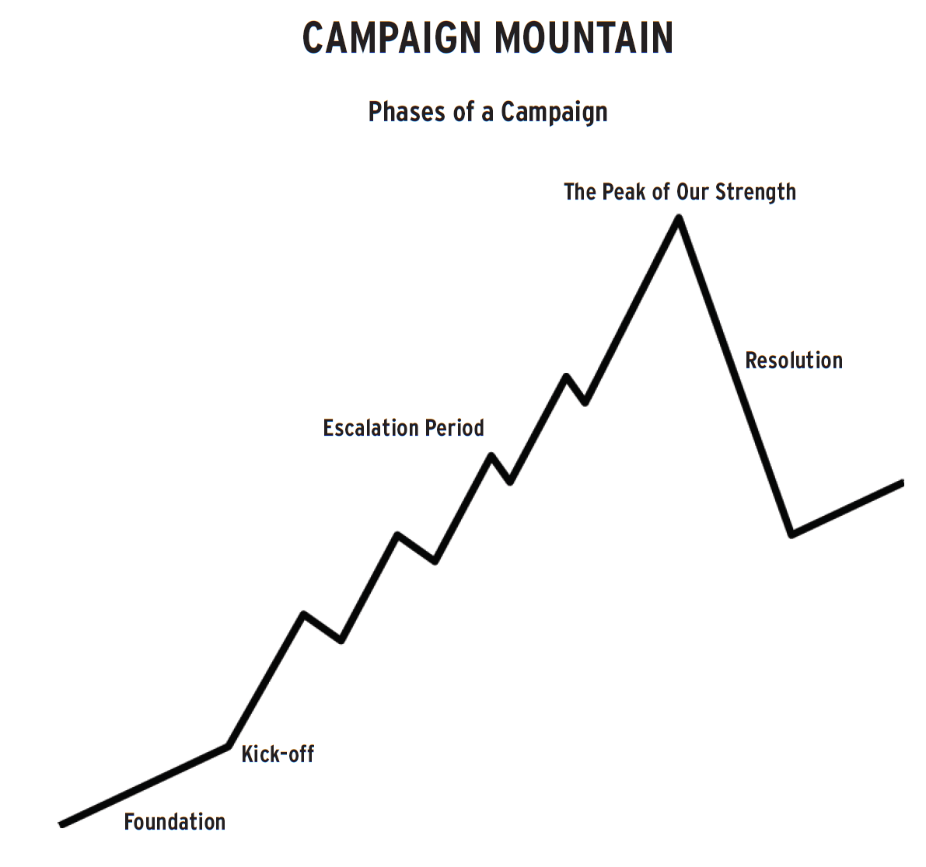

Example
For Example:
What sort of leaders do you need in the foundation stage and what sort of structures are being developed?
Make sure there are at least 3 leaders in each building who want to make sure the union turns out the vote for the democratic candidate. This team is talking to members and non-members, doing surveys and working identifying possible future volunteers for actions.
Structure – Political Action Team in each building that is part of the locals Political Action Network.
Post your campaign poster on the wall for a gallery walk debrief when done.

Slide 44
Heidi

Slide 45

Your thoughts so far…

Slide 46

Ending it Right
Choice Networking
Housekeeping
Day 3 Checking out, Flights, Taxis
    Check out BEFORE you come down tomorrow
    Luggage can be checked in the lobby
    Check or post to the “ride share” board to share a ride with a colleague to the airport.
Plus and Delta at the Door

Slide 47

Choice Network Time

