Slide 1
Effective Worksite Leadership Structures
UniServ Focus Academy

Slide 2
Day 3

Slide 3

Entry Activity
Have you made a plan to check out?
Do you know how you are getting to the airport?

Slide 4
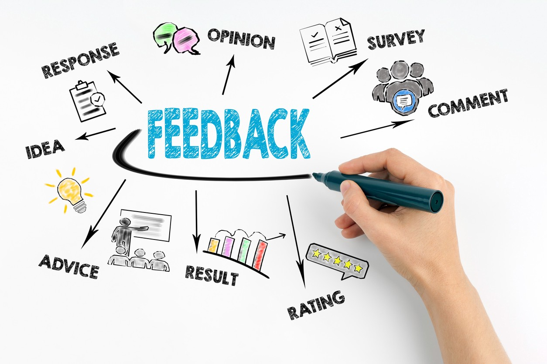
Feedback on Feedback

Slide 5

Agenda Review - Today
7:30 – Breakfast
8:30 – Welcome back
10:15-10:30 Break
12:00 – Presentations
1:00 Lunch

Slide 6

Community Agreements p. 2
Using Self-Awareness and Self-Knowledge
Listening for Understanding
Being Gracious
Staying Engaged
Being Open and Suspend Judgment
Saying “I”- tell your truth
Seeking Discomfort
Reaching Empathy
Expecting Non-Resolution and Non-Closure
*Adapted from “Embracing equity and inclusion”, Annie E. Casey Foundation
Notes:
Community Agreements for Our Time
Awareness and Self-Knowledge
This requires self-knowledge and self-awareness. Self-knowledge allows you to see what causes you pain and conflict and enables you to embrace your contradictions and inconsistencies. It allows the space to work on things about yourself that you are not happy with. In turn, self-knowledge helps to prevent you from projecting your negative aspects onto other people. Bringing your best self also requires that you have a positive attitude, are willing to deeply explore your perspectives and remain open to the perspectives and experiences of others.
Listening for Understanding
Be an active listener. Active listening involves paying full and careful attention to the other person, looking him or her in the eye, avoiding interruptions, reflecting your understanding, clarifying information, summarizing the other person’s perspectives and sharing your own. Remember that most people need time to open up and might not be willing to immediately share their personal stories, hopes, fears and/or concerns.
Being Gracious
Being kind is a vital way of bringing meaning to our own lives, as well as the lives of others. Kindness is about caring genuinely for others around you, wanting the best for them and recognizing in them the same wants, needs, aspirations and even fears that you may have. Being kind and generous allows us to communicate better with others, to be more self-compassionate and to be a positive force in other people’s lives. This includes following the COVID protocols that are in place to protect the health of this learning community.
Stay Engaged
Staying engaged requires you to be morally, emotionally, intellectually and socially involved in the conversation. Staying engaged means that you are listening with curiosity and willing to deepen your understanding. Staying engaged might also require you to sustain the conversation even when it gets uncomfortable or diverted. This also means a commitment to keeping your electronic communications to a minimum with folks not present in this learning community.
Be Open and Suspend Judgment
Listening with an open mind includes being receptive to the influence of others. You can suspend judgment by becoming aware of preconceived notions and listening to everything someone has to say before jumping to conclusions. Most importantly, suspending judgment also means listening to what the speaker has to say for understanding, not just to determine whether the speaker is right or wrong.
Say “I”- tell your truth
Speaking your truth in authentic and courageous conversations about race requires a willingness to take risks. It means that you will be absolutely honest and candid about your own thoughts, feelings, experiences and opinions and not just saying what you perceive others want to hear. Speaking your truth will require you to speak from the “first person” and use “I” statements.
Seek Discomfort
Leaning in to discomfort will require you to let go of racial understandings and stereotypes that you may be holding onto in order to move forward. Leaning in means that you will avoid judgment, assume positive intent and be open to the kernel of wisdom in each individual’s experiences. Leaning in to discomfort will require you to sit through moments of embarrassment, confusion, anxiety and/or fear.
Reaching Empathy
Empathy and compassion allow you to understand the other person’s point of view. When you are empathetic, you are more understanding, patient and kind. Expanding your capacity to feel empathy will also allow others to enter your circle of human concern.
Resolution and Closure
Expect and accept that there may not be closure. It is not likely that you will resolve your personal understanding about race or another person’s racial experience in a single conversation. The more you talk about race with another person, the more you learn and the more they will learn. Authentic and productive conversations about race are continuous and always evolving.
*Adapted from “Embracing equity and inclusion”, Annie E. Casey Foundation

Slide 7

Let’s Get Graphic -
Each table has only one sheet of chart paper
Only pictures - no words, letters or numbers
Must be a joint effort, all table members should contribute

Slide 8
Zac and Terri

Slide 9
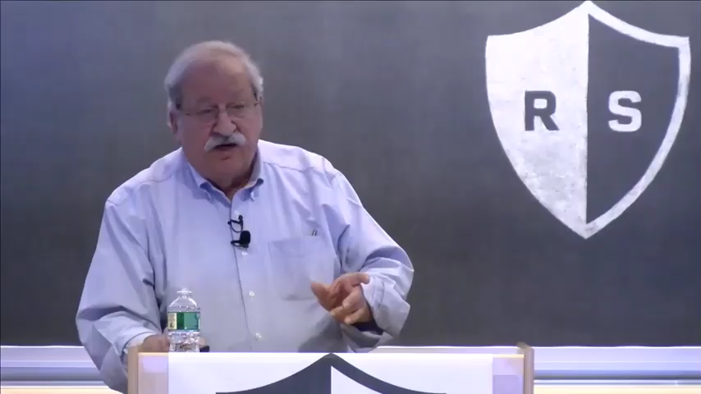
Team & Leader Structures - Ganz

Slide 10
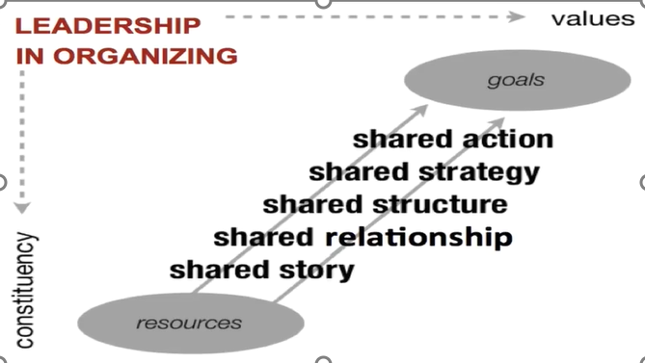
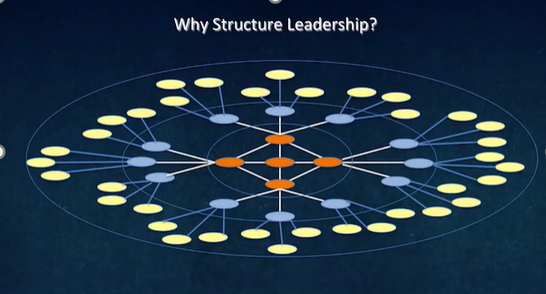
How can we expand our power and impact?

Slide 11
What problems are "too big" to solve in your local right now?

Slide 13
Who, why, when?
WHO: Other labor groups? Congregations? Parents and parent groups? Non-profits?
WHY: Are we duplicating one another's work? Could a problem be "solvable" if we worked together? Do we need to pool resources?
WHEN: Short-term? Long-term? Permanent? Temporary?

Slide 14



Example:
Building toward food justice in Colorado

Slide 15
Context
2020 - Pandemic school shutdowns
Recently launched coalition – Coloradans for the Common Good

Slide 16
Common Issues
School Shutdown
- Kitchen staff without work
- Transportation staff without work
- (Title I schools) students without food
- (Title I schools) students without transportation

Slide 17
Existing Structures
- Union members
- Congregations
- Food-focused non-profits

Slide 18
Early Wins – Expansion of Food Delivery
Public Forum
Led by Pastor (member institution of CCG)
Direct ask for commitment from Superintendent
Expansion of food program to 7 bus routes

Slide 19
Follow-up Actions
- Candidate forums (member-led)
- Bargaining support rallies (pay increase - $3/hr over 2 years)
- State-wide campaign kickoff (member voices)

Slide 20
Shifting Needs
Employee compensation
Expiration of federal school lunch funds

Slide 21
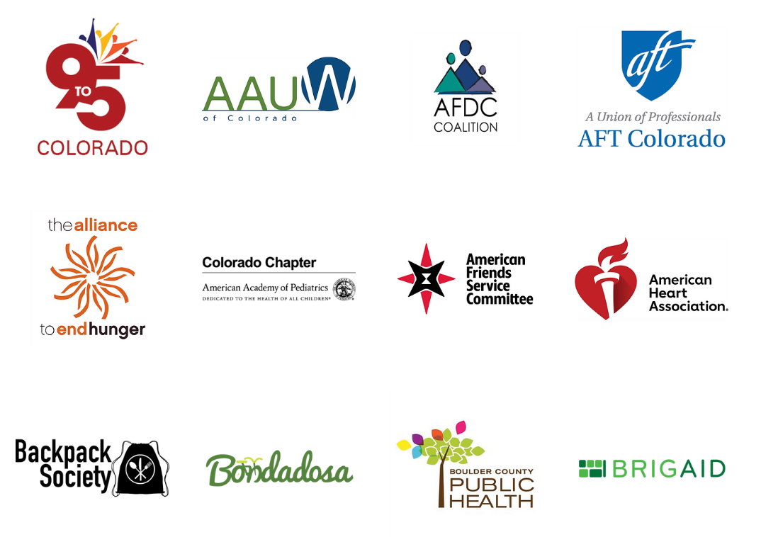
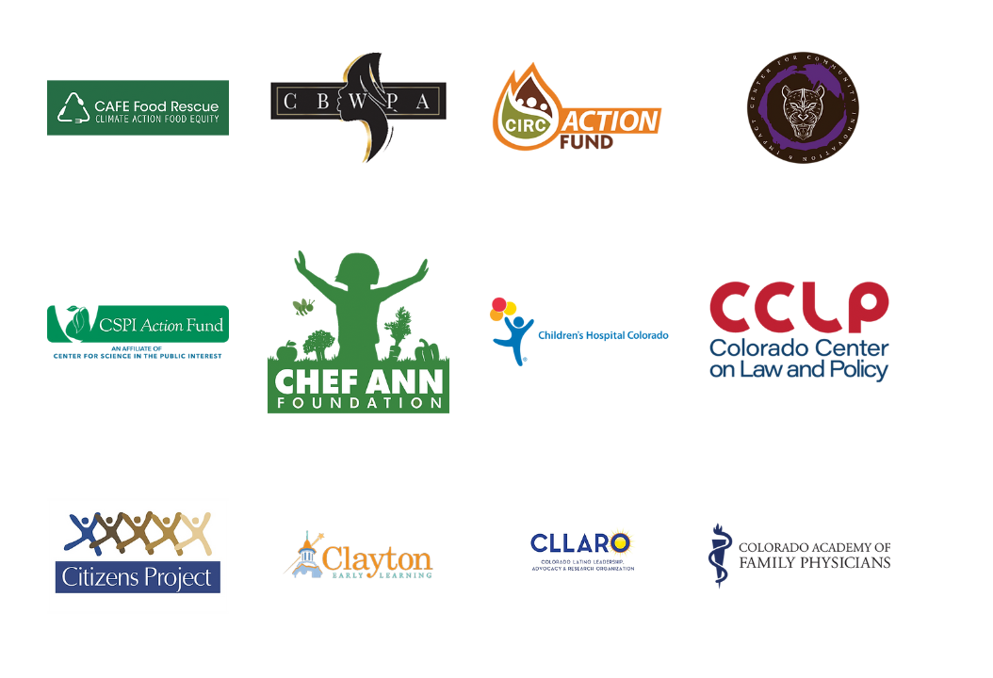




"Yes on FF" campaign supporters

Slide 22



Slide 23

Key Points
Coalitions are an organization of diverse interest groups that join resources to produce a specific change that they are unable to deliver as individual groups.
Coalitions require strong leadership and ongoing maintenance.
Coalitions allow organizations to support each other – they do not exist for the benefit of just one of the partners.

Slide 24
Albert

Slide 25

When is the best time to form a coalition?

Slide 26
Reflecting on Coalitions
Review the Checklist for Starting a Coalition. p.53-54
1. What statements do you agree with?
2. What statement do you disagree with?

Slide 27
3 Types of Coalitions
Casual Coalitions
Clubs
Social Events
Traditional Coalitions
Issue Based
Alliances
Long term
Fundraising
Immediate Change
Value based
BCG

Slide 28

Simulation Time!

Slide 29
Directions for Simulation p.58
Read the workplace violence scenario.
Open your envelope to determine what role you will play.
DO NOT TELL ANYONE YOUR ROLE.
UniServ identifies themself to the group as the lead.
30 minutes to discuss the scenario.
5 minutes to debrief.

Slide 30
Key Points
Coalitions are diverse organizations with similar values and interests that join resources to produce a specific change that they are unable to deliver alone.
A coalition is a type of structure.
Coalitions require strong leadership and ongoing maintenance.

Slide 31

BREAK

Slide 32
Lakilia and Yvie

Slide 33
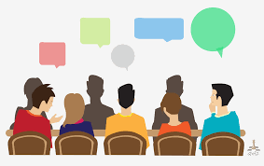
Coalition Seminar

Slide 34

Food for Thought
What were the leadership barriers that came up? How did you solve this?
What were the differences in values that came up? How did you solve this?
What were the ownership or turf issues that came up? How did you solve this?

Slide 35
Key Points
We form coalitions around specific, shared agendas.
The coalition is not how “we” achieve something – but how all the coalition members achieve something together.
They are there for us, and we are there for them.

Slide 36
Jessica

Slide 37
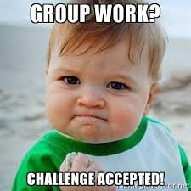
Team Planning for Leaders and Structures
Teams will select a scenario.
Identify a goal for the scenario and a basic campaign timeline.
Focus is not on actions – but on leaders and structures needed to achieve the various “wins along the way” to reach the ultimate win.

Slide 38
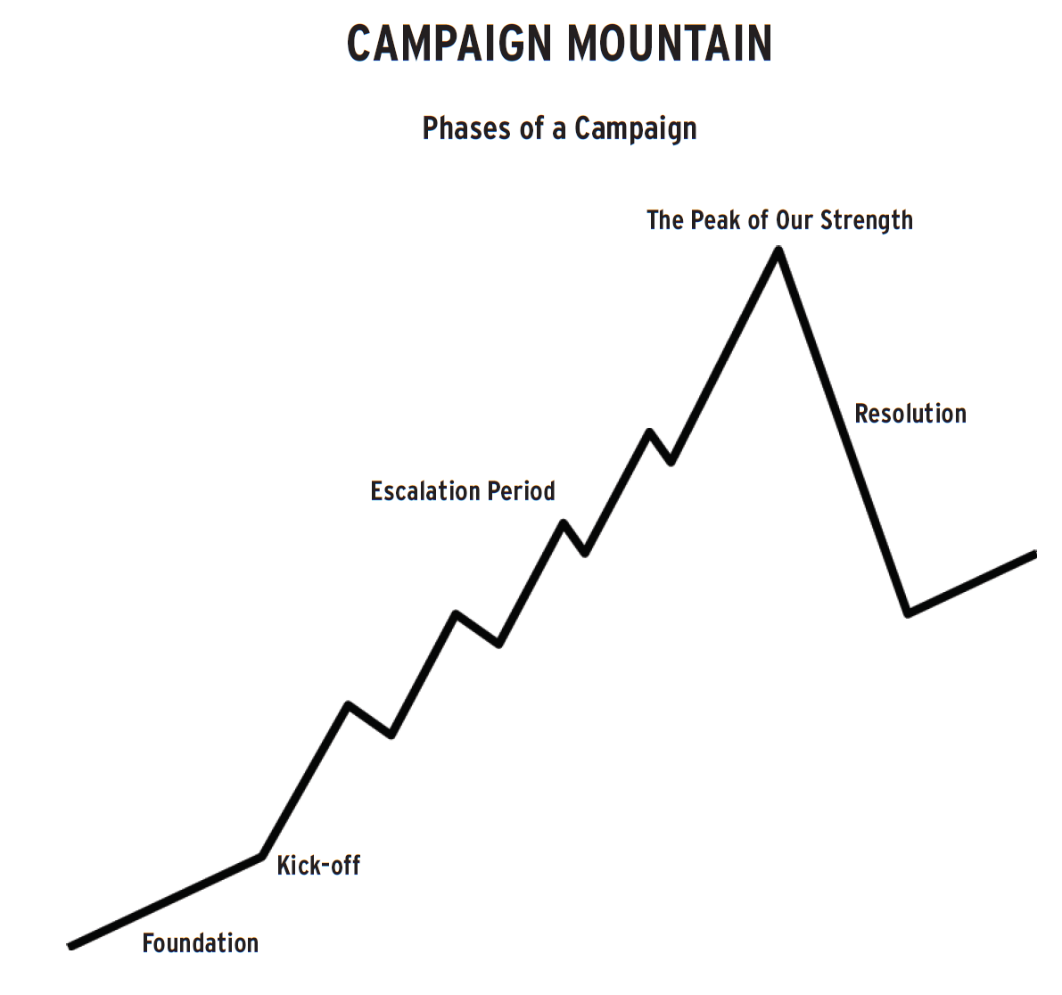
Example
What sort of leaders do you need in the foundation stage and what sort of structures are being developed?
Want to make sure there are at least 3 leaders in each building who want to make sure the union turns out the vote for the democratic candidate. This team is talking to members and non-members, doing surveys and working ID'ing possible future volunteers for actions.
Structure – Political Action Team in each building that is part of the local’s Political Action Network.

Slide 39
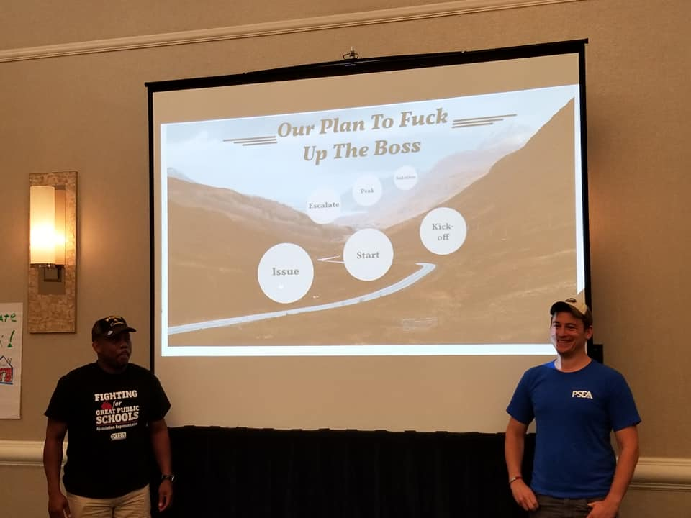
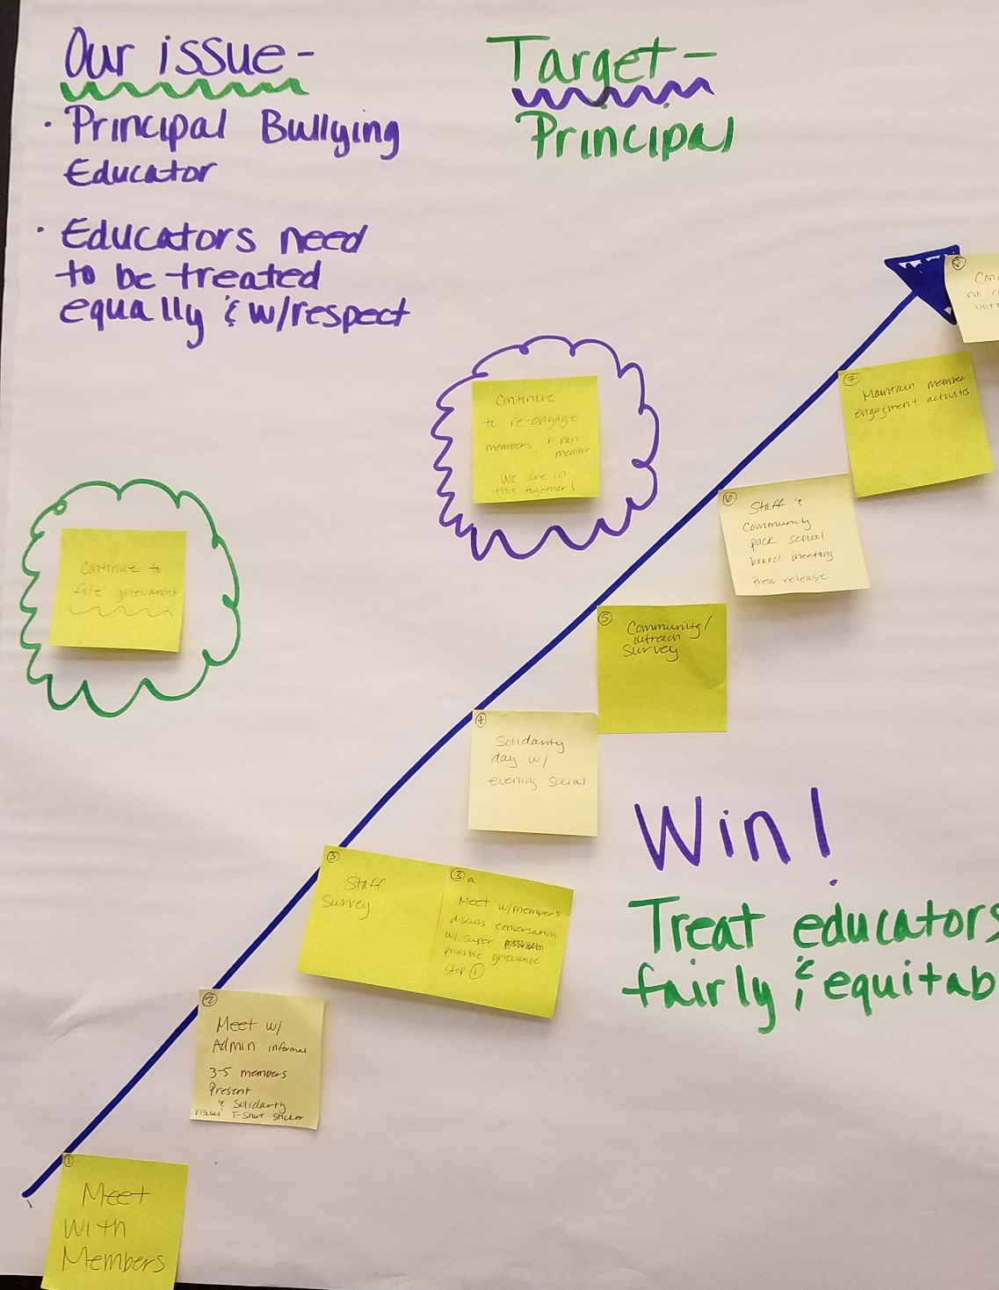

Team Work Time

Slide 40
Lakilia and Team

Slide 41
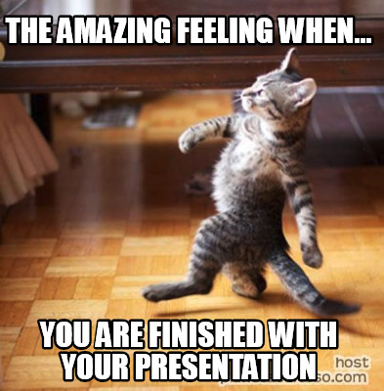
Team Presentation and Coaching Time

Slide 42
Heidi

Slide 43
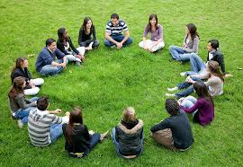
Final Debrief

Slide 44

Gratitude
Evaluations
Final Words for the Good of the Order

Slide 45

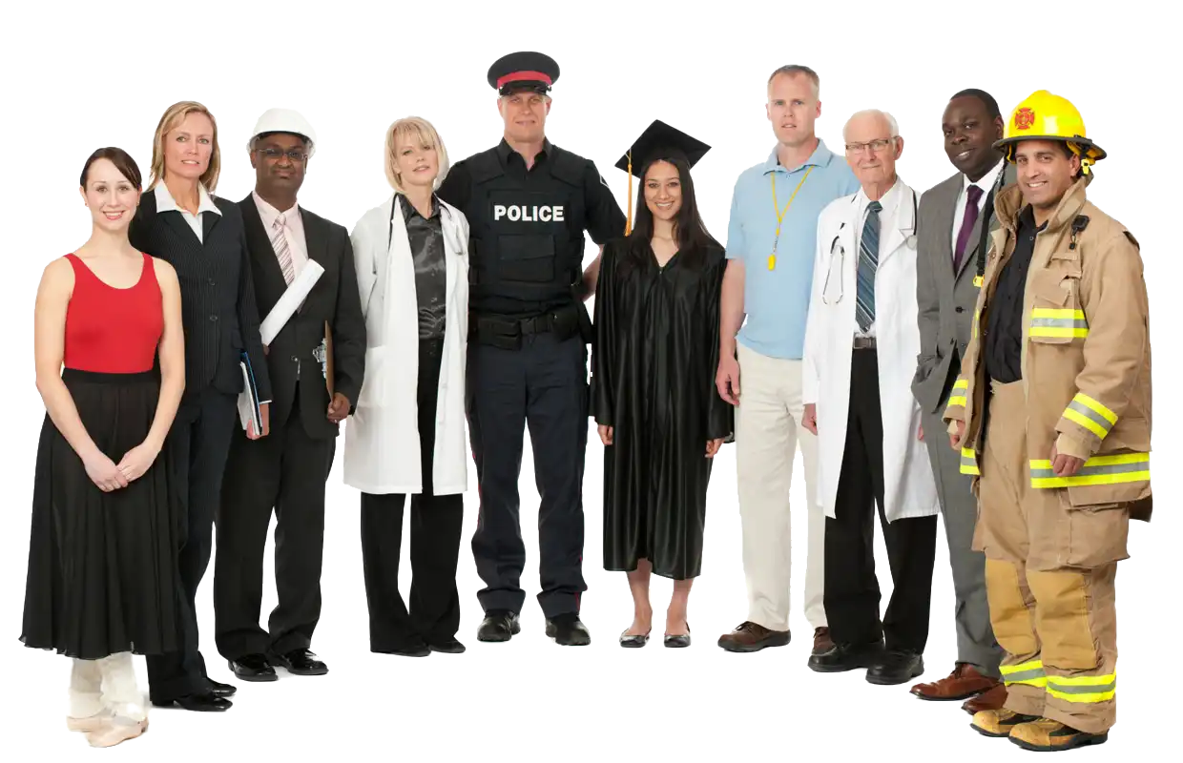
Organizing Around School Safety
Coalition to address Workplace Violence and violent students

Slide 46

Tip of the iceberg
Nearly 1 in 10 educators threatened with violence.
Female students feel most unsafe at or away from school (Hispanic students highest)
Nearly 1 in 10 Freshman report having been threatened or injured with a weapon at school.
71% of schools record violent crime – only 35% is reported to law enforcement.
1 in 3 H.S. students use per month (Alc. / Marj.)
Mid-size towns with lowest minority populations have highest incidents of reported bullying (~1 in 5 weekly)
1 in 5 students report hindered learning due unsafe environment
Only 37% of schools take serious action
Complete USDE & USDOJ Study: Indicators of School Crime and Safety 2017 https://tinyurl.com/school-violence-2017

Slide 47
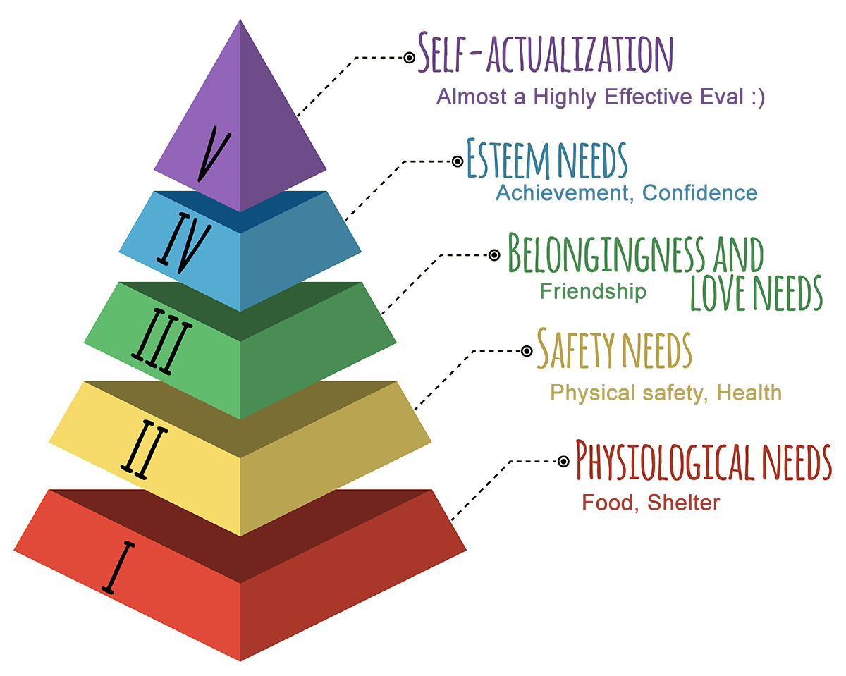
Safety is a prerequisite for education
Safety is the most powerful organizing issues crossing all interest groups.
Educators and coalition partners are in a unique position to leverage this issue to effect change.

Slide 48
Effecting change is a process
Awareness to action for coalitions

Slide 49
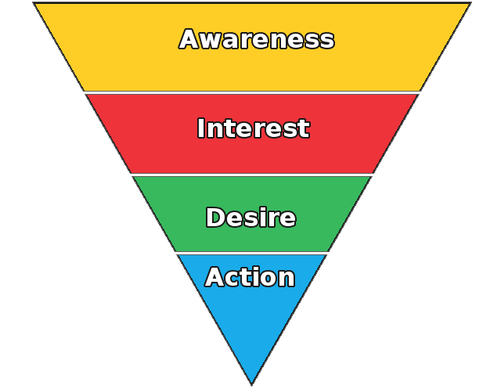
Awareness to action model
Awareness
[eyes & ears]
Understanding
[head]
Commitment
[heart]
Action
[feet]
The 4 step process is used in both political action and marketing

Slide 50
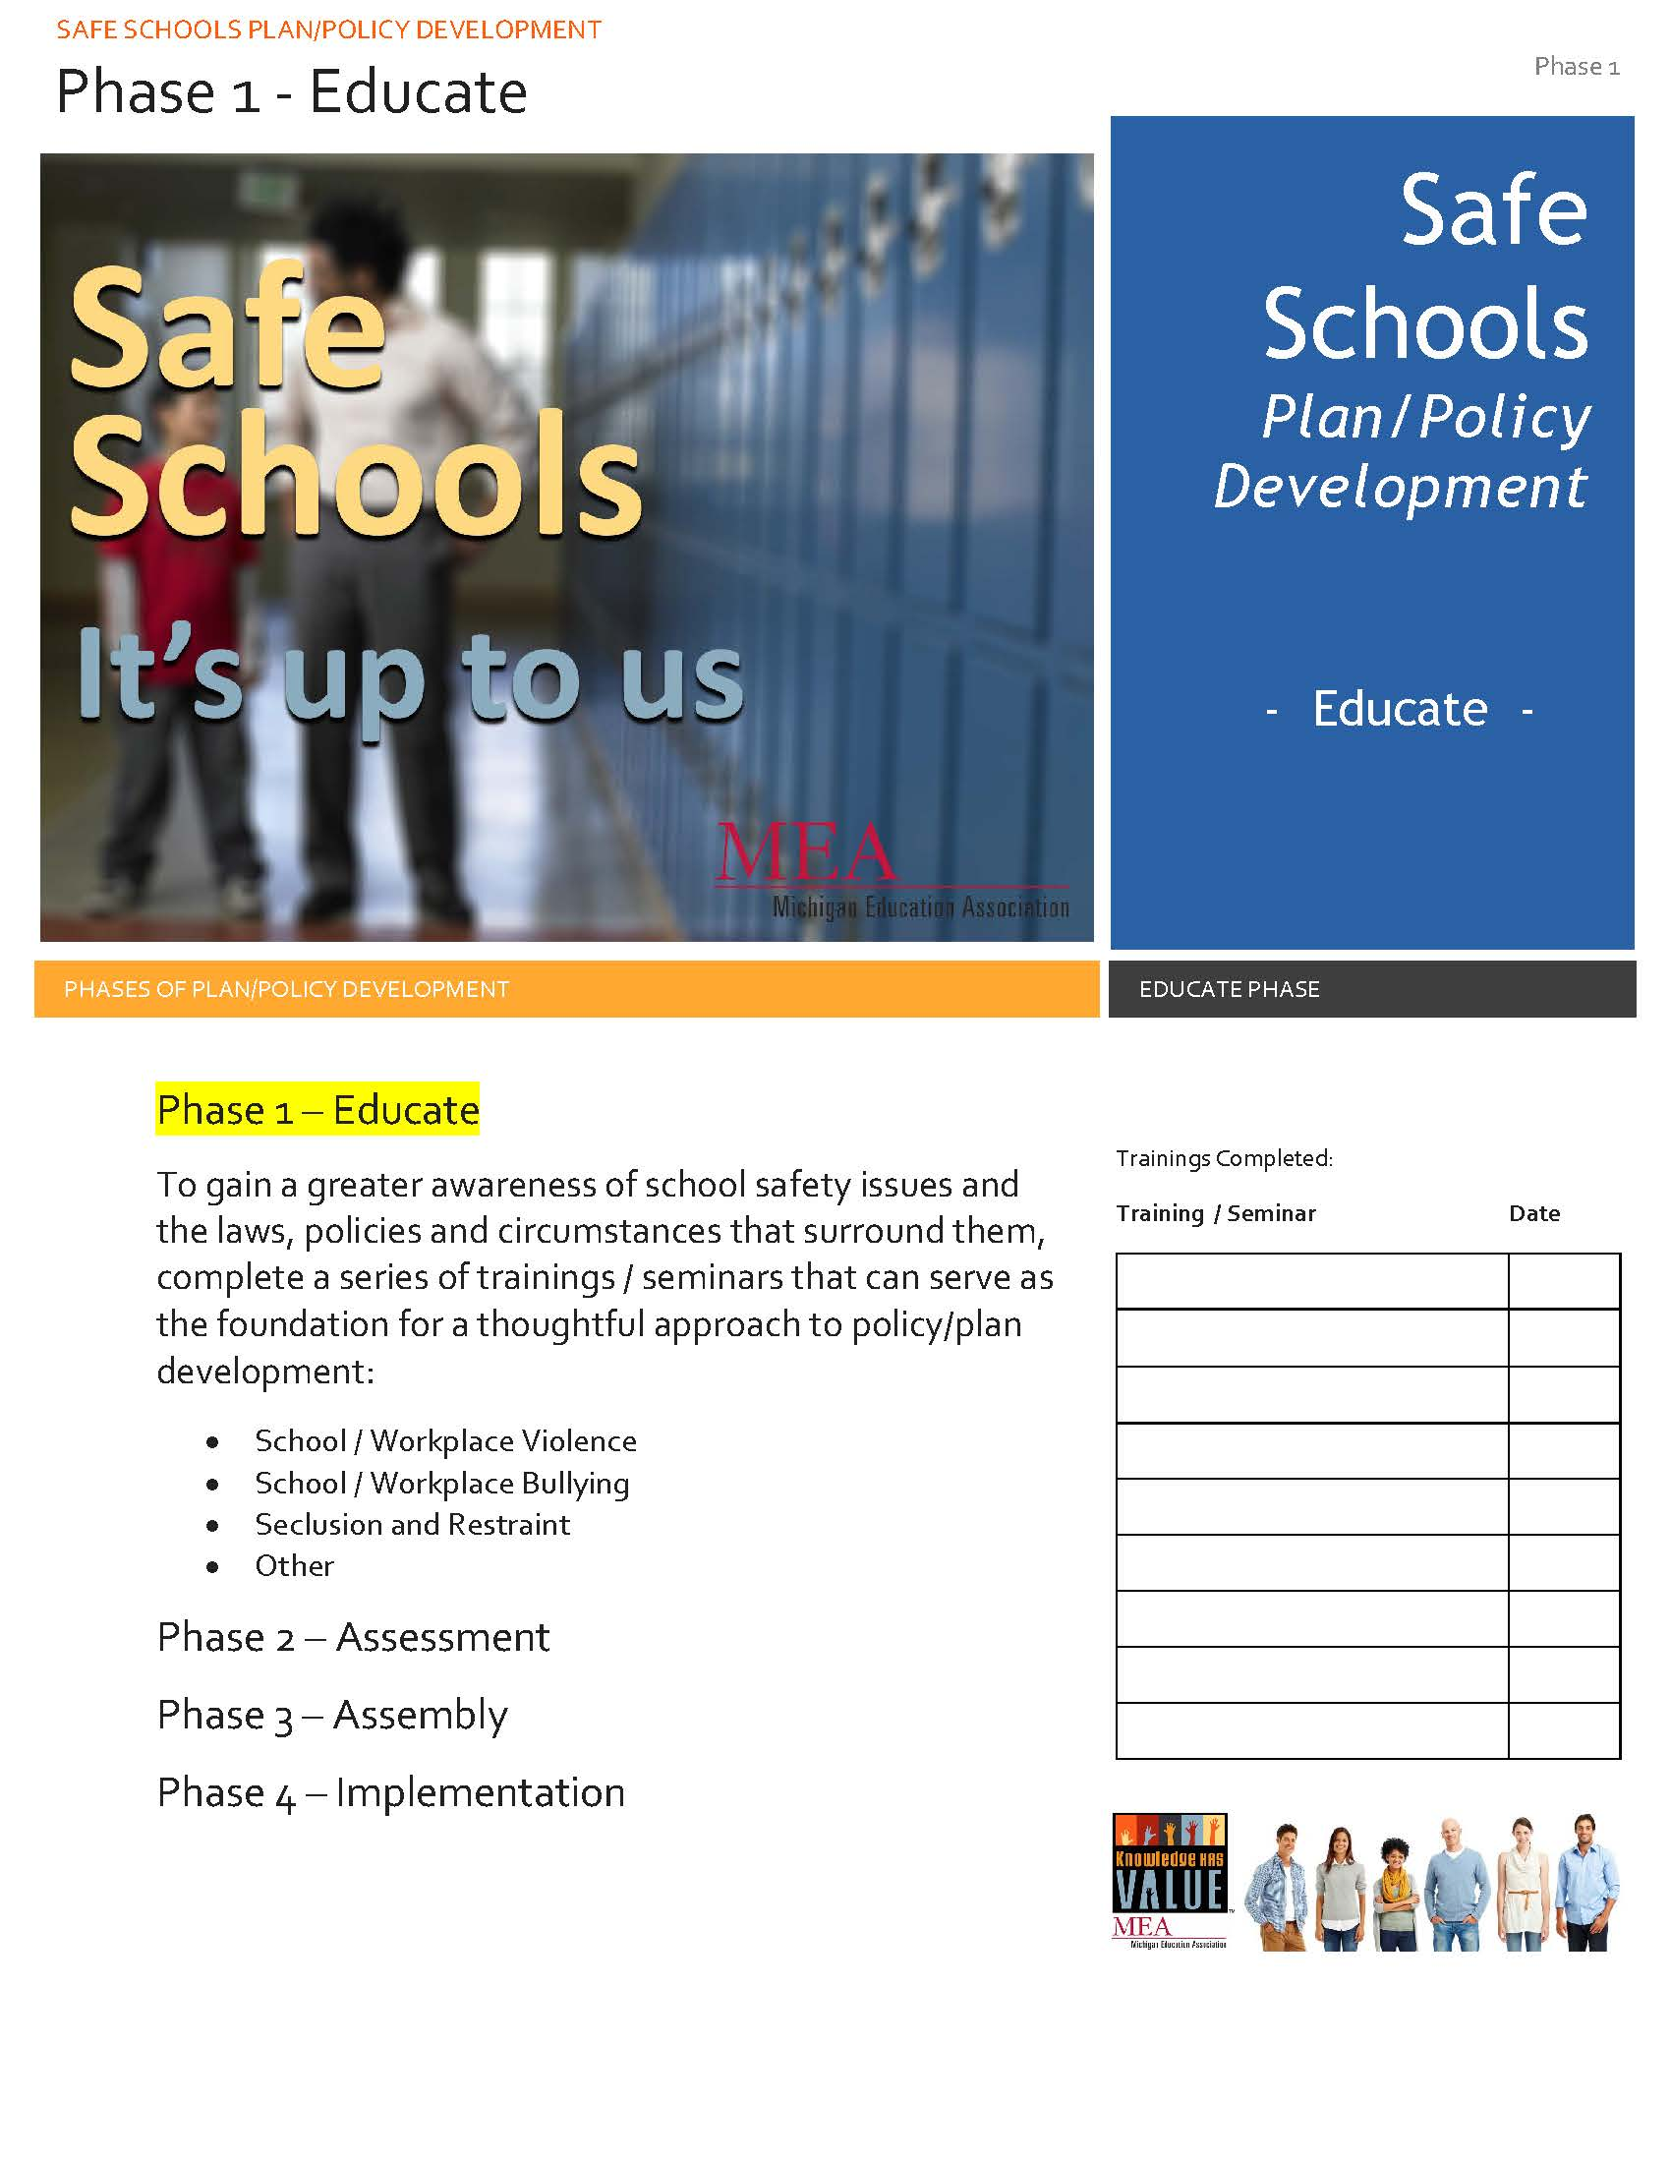
Objective: Educative [Awareness]
Audience: Internal & External
Rationale:
Developing awareness builds community
Expands the scope of engagement as a consequence of unrealized connection or interest.
Activate: Eyes and Ears
Tactics to achieve objective: ?

Slide 51

Objective: Assess [understand]
Audience: Internal & External
Rationale:
Need to separate the actual from the assumption
Determine capacity & needs to address the issues
Activate: head
Tactics to achieve objective: ?

Slide 52
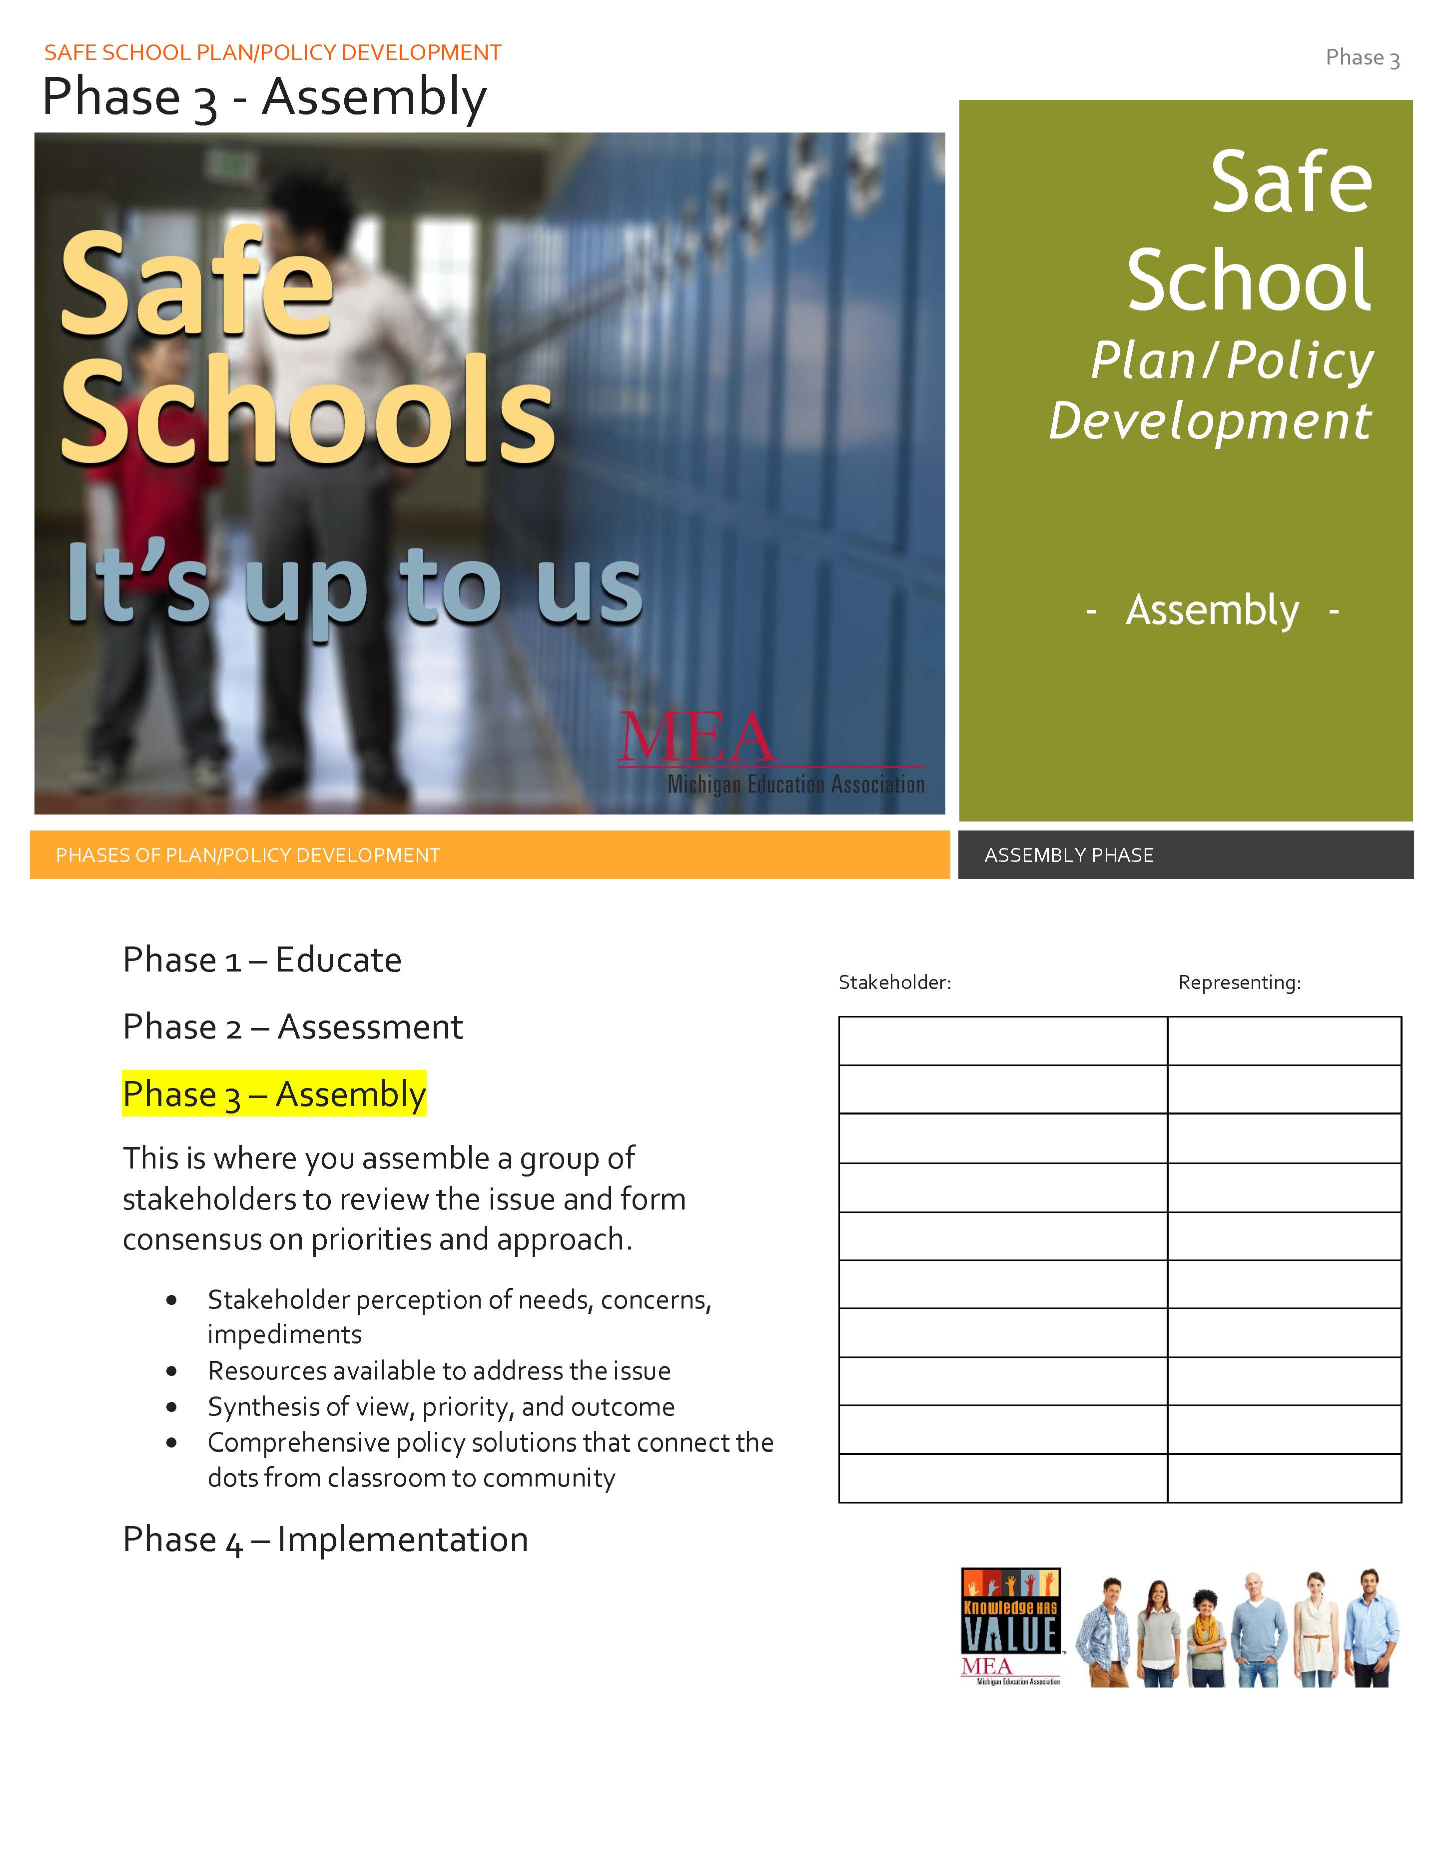
Objective: Assemble [commitment]
Audience: Internal & External
Rationale:
People who are aware of need, understand the issue and know there’s are others who share that knowledge and awareness are more likely to commit to act
You know the why’s, who’s and what’s…now comes the how?
Activate: heart
Who are stakeholders: ?

Slide 53
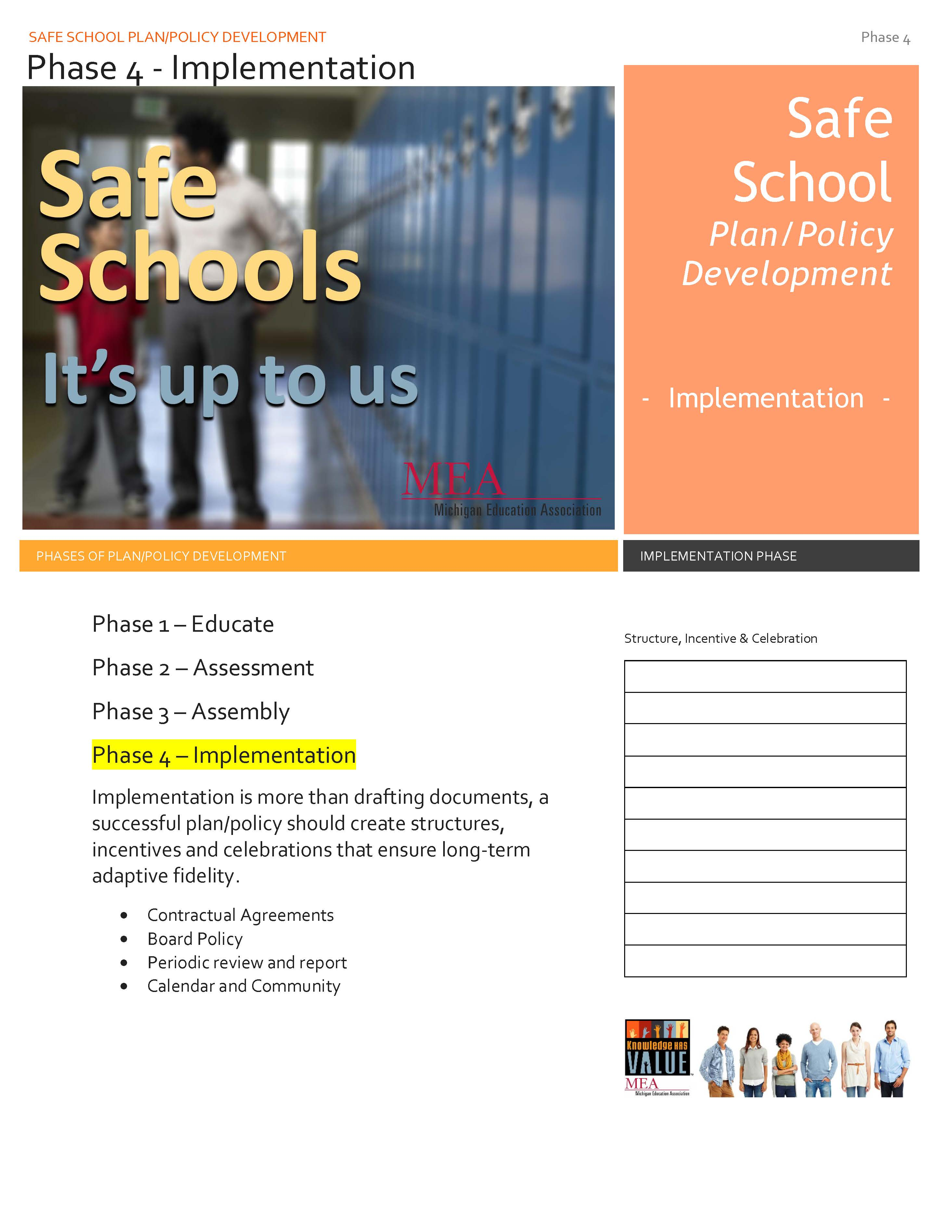
Objective: Implement [action]
Audience: Internal & External
Rationale:
Successful plans/policies should create structures, incentives, and celebrations that ensure long-term adaptive fidelity
Activate: feet
What does successful implementation look like: ?

Slide 54
Disclaimer:
This is not an overnight process.
Expect suspicion and resistance
Success may look different than planned – go with it!
Your name may never be known – your effort/commitment will

