Slide 1

Building Power
October 12, 2023 NEA Organizer Support Program

Slide 2

Welcome
Series of Online and
Face to Face
https://www.nea.org/UD-Org-Support

Slide 3


Community Agreements
Using Self-Awareness and Self-Knowledge
Listening for Understanding
Being Gracious
Staying Engaged
Being Open and Suspend Judgment
Saying “I”- tell your truth
Seeking Discomfort
Reaching Empathy
Expecting Non-Resolution and Non-Closure
*Adapted from “Embracing equity and inclusion”, Annie E. Casey Foundation

Slide 4
Introducing Your Team
Ellen Holmes-NEA
Helenna Chun-CEA
Melissa Dan-PBCCTA
Heidi Miller-NYSUT
Beth Anderson-EM
Michelle Couture-NYSUT
Chad Williams-MEA
Vanessa Pulkrabek-EM
Terri Jones-TEA

Slide 5
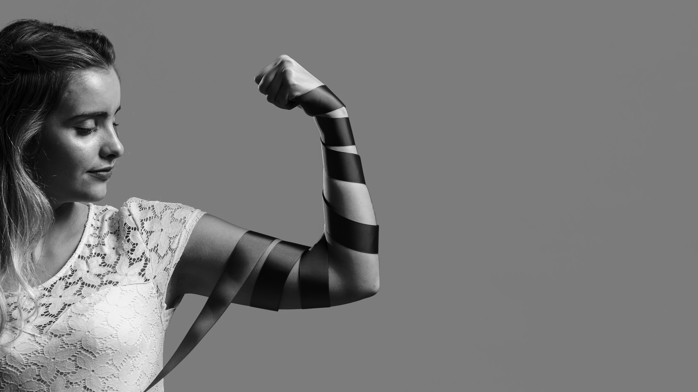
Power is… the ability to act. the possession of control, authority, or influence over others.

Slide 6

Oppression is… the exercise of authority or power in a burdensome, cruel, or unjust manner.
—

Slide 7

Privilege is…
a special right, advantage, or immunity granted or available only to a particular person or group.

Slide 8



the intentional inclusion of those who experience oppression.
Building power requires…
the strategic risking of privileges from those that have them.

Slide 9

Structure
Structure is a group of people that have relationships with each other that allow them to take risks in order to achieve a common purpose.
If building power requires high levels of participation, then organizers need structures to sustain the coordination and development of large numbers of people.
Structures are the scaffolding that enable participation at scale.

Slide 10

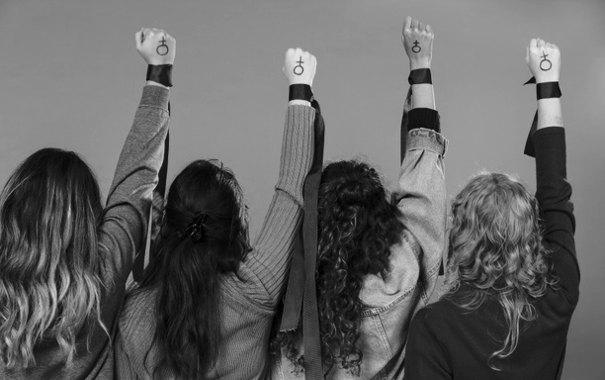
3 Theories of Power
Advocacy doesn’t involve ordinary people, just privileged people pressuring decision makers on behalf of others.
Mobilizing brings larger numbers of people to the fight, but they are usually the same people (dedicated activists) without much intentional thought for who IS NOT included.
Organizing places the agency for success with continually expanding the base of ordinary people who are willing to take a collective risk.

Slide 11

Breakout Room
How does a leader respond/react in our different theories of power?
Successful organizing (that wins) relies on leadership, what is one method you use to ensure inclusivity and diversity?
Successful organizing (that wins) relies on majority participation. What are the methods you use to measure increased participation in your local (AKA increase power)?

Slide 12
Activists (mobilizers) | Leaders (organizers)
Self-selected, volunteered | Selected by their coworkers of have a track record of bringing others along with them.
Identified by responding to an email asking for a rep/leader, by stepping up, by succession | Identified by asking “which of your colleagues are amount the most trusted and respected around here?” –structure testing
Brings commitment, already committed to union vales | Brings capacity, sometimes needs to be moved to our position
Known for speaking out at staff meetings, standing up to the boss, might be labeled a troublemaker OR be close to the boss | Known for being trusted and respected by their coworkers and being good at their job.
Typically 0-1 at a worksite Ex. Worksite of 100, 1-2 Activists | Minimum of 1 leader for every ten workers at a worksite Ex. Worksite of 100, 10+ Leaders
Good for MOBILZING: mobilizing involves getting people who already agree with you to do something-to move them from passive to active support. In general, mobilizing can win small changes. | Good for ORGANIZING: organizing seeks to convince everyone within a defined group of the need to united around a shared objective. In general, organizing can win big, life-altering changes.
Mobilizers and Organizers

Slide 13
Breakout
How do you look for leaders in a workplace?
Has anyone struggled with a leader in a workplace that was anti-union? Did you have any successful strategies to shift them to use their leadership towards their union's campaign?
When thinking about leadership structures- how do you coach your leaders, how do you coach your activists to make a strong structure that builds power.

Slide 14
 | Power Building | Power Draining
Victory | Advances multiple outcomes of the issue in the immediate and sets it up to fundamentally shift conditions in the long term | May have won demands on the surface in the immediate but advanced damaging conditions for our ability to change in the long term.
Defeat | Leads to advancing multiple outcomes long term even though immediate demands were not met. | Not only did this have poor implications in the immediate, it also shifted dynamics for us to advance on the long term.

Slide 15
Poll
Question 1
A local had a situation with about half of its membership. They were underpaid for their overtime work. It came to light at a union meeting. The union leadership brought it to their UD. The UD took the concern to the business manager and they worked out a process to make sure each member recouped their lost wages.
Power Building Victory
Power Draining Victory
Power Building Defeat
Power Draining Defeat

Slide 16
Poll
Question 2
Local's primary issue next to wages is addressing mold which has caused many sick staff and students. The membership has been engaging in internal actions with great turnout. The district is not engaged in the process. Members have engaged parents and community leaders to speak publicly to the Board. They ultimately win timely improvements in air quality measures along with their raises.
Power Building Victory
Power Draining Victory
Power Building Defeat
Power Draining Defeat

Slide 17
Poll
Question 3
Members are upset about the temperatures in the building this fall, as some rooms were over 95 degrees and the kitchen was over 100 degrees. They brought the concern to their local president. His room is air conditioned. He didn’t think it was worth bothering administration, as there is no law in their state or contract language that has been violated. It’s just part of the job they chose.
Power Building Victory
Power Draining Victory
Power Building Defeat
Power Draining Defeat

Slide 18
Poll
Question 4
Members are upset about the temperatures in the building this fall, as some rooms were over 95 degrees and the kitchen was over 100 degrees. They brought the concern to their local president. His room is air conditioned. He said we need to find out how big the problem is and engaged a group of leaders who are trusted by their colleagues to do 1:1s on the issue. They held parent meetings to see how the situation was impacting their children. And jointly developed a resolution for the board to commit to fixing the problem. The resolution failed.
Power Building Victory
Power Draining Victory
Power Building Defeat
Power Draining Defeat

Slide 19
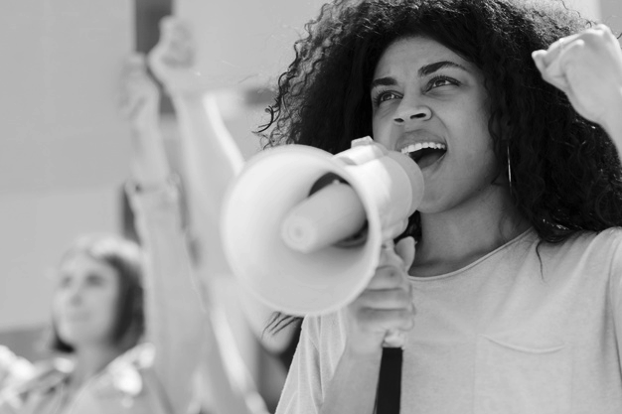
Ending it Right
Email Feedback Form – Please Complete
Check: https://www.nea.org/UD-Org-Support for the next online and in person sessions.

