Slide 1
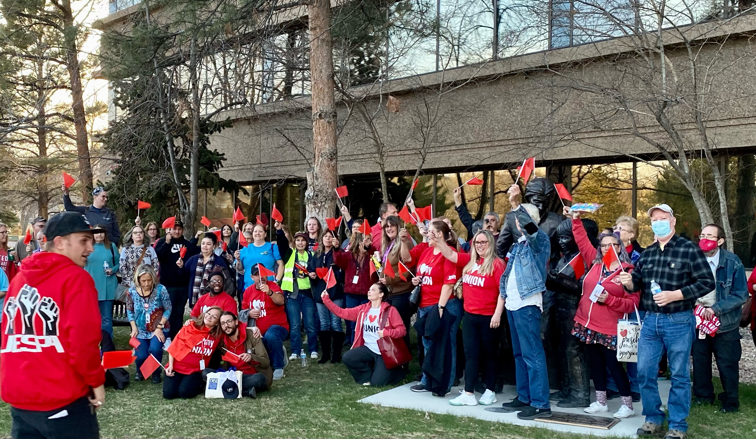
Raising expectations
A STORY ABOUT REBULDING JESPA

Slide 2
AGENDA
Introductions
Achievements
Road to achievements
What we did
JESPAs Trajectory
Notes:
Quick introduction to the JESPA staff whom you'll be hearing from in a bit.

Slide 3
Bargaining 2021 – coming off a loss
JESPA moved to impasse and suffered a huge loss for ESPs at spring 2020 bargaining.
We took the loss and immediately made certain demands for 2021.
Resulting in wins:
$12.49 to $15.00 per hour starting pay
Step increases
A preschool organizing fight resulting in recognition for preschool ESPs
Notes:
A group preschool workers reached to JESPA and were desperate to have union rights. We asked them "how angry are you?" They were ready to take lead and roll up their sleeves and get to work. The JESPA office was key to guiding them in rolling the work. But we did not do it for them. Long story short they are now recognized as a stand alone local under the JESPA contract and have their own article.
This was not an easy process but we worked with the prek leaders
THis Momentum from PreK and recognition energized other locals to take collective action

Slide 4
Bargaining 2022 – gaining momentum
2022 $17 in September 2022
2023 at least $18 in September 2023
Major improvements to leave time including:
  ADA discrimination language and ability to go on long term disability without termination
  Payouts for unused PTO for paraprofessionals
  Bereavement language for all
  “Family” definition expanded to be more inclusive
  Improvements to RIF language – eliminating any performance factors and winning seniority only
Adequate preschool classroom supplies and ordering process
The district withdrew most of their proposals
Notes:
Given the power built up through heavy communication with our members; we were able to make demands and win big this year in bargaining. Pause to let them read slide

Slide 5
we didn’t always win
A HISTORY OF POWERLESSNESS AND LOSING
A DIVIDED MEMBERSHIP
LOW MORALE AND HOPELESSNESS AMONGST LEADERS
COMMON PHRASES WE REPEATED
WE CAN’T DO THAT
THAT’S NOT HOW IT WORKS
WE HAVE TO KEEP STRONG RELATIONSHIPS WITH MANAGEMENT/ADMINISTRATION
WE CAN’T RAISE OUR MEMBER’S EXPECTATIONS
WE HAVE TO BE COLLABORATIVE
WE CAN’T AGITATE OUR MEMBERS
THERE’S NOTHING WE CAN DO ABOUT THAT
Notes:
We had a history of not winning much, but we weren’t losing much either.
It was almost a culture of powerlessness that held us back.
Lara’s story:
I was checking out books to students
Students who need consistent paras in their lives, consistent lunch staff, consistent bus assistants – as you heard from Kyle
I know that each of our students need this consistency for their educational growth
There is no light between the students and the Union
I was in my position for the first three years and we were not doing anything to improve our member’s lives…in other words, we were hurting our students
Me being afraid could have negative impact on our members and our students. I had to stop being afraid.
JESPA made uncomfortable but necessary choices because the alternative was not acceptable

Slide 6
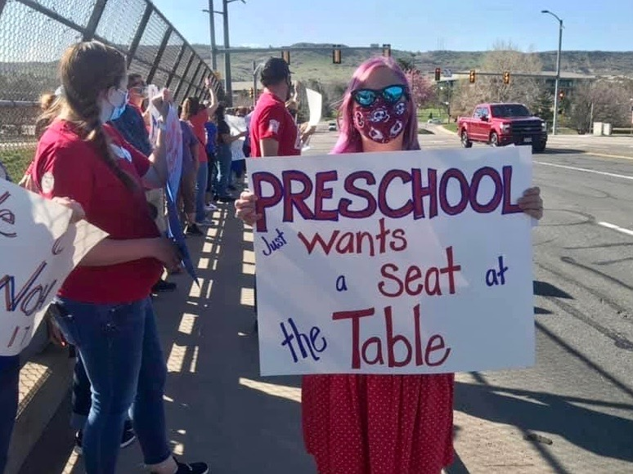
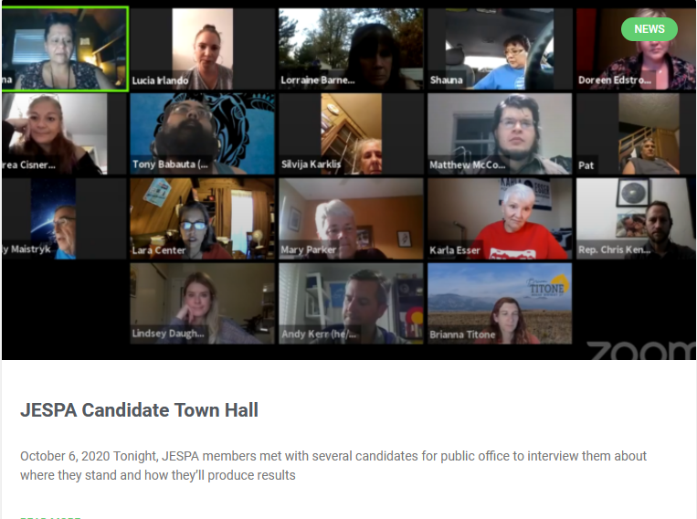
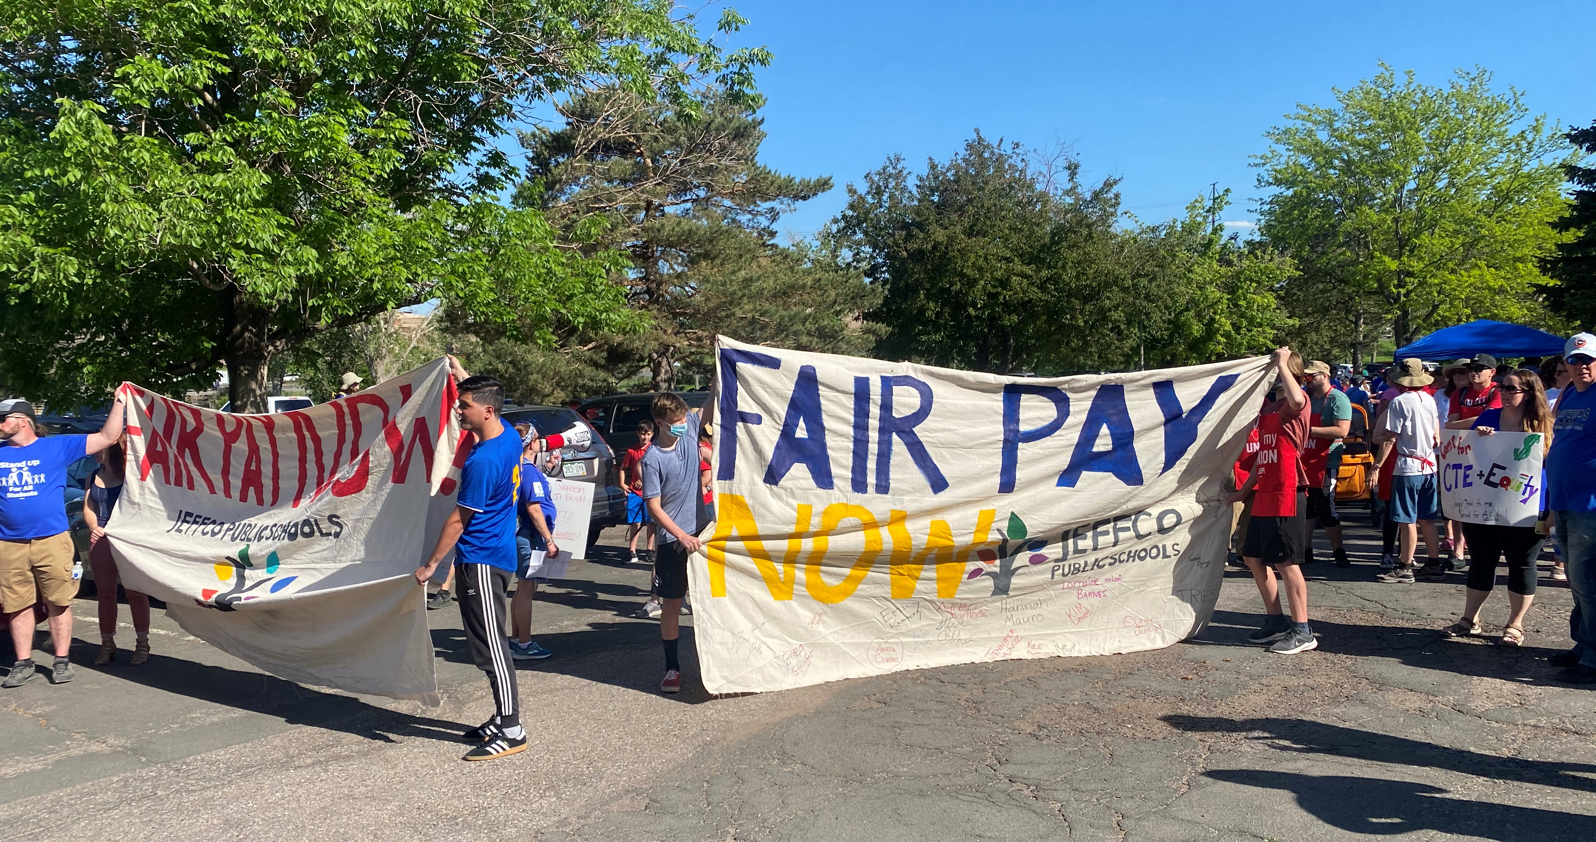
In order to start winning, we had to start fighting
Headlines:
Open Letter re: the district’s decision to close 141 of 156 school cafeterias during remote learning.
Open Letter to Supt. Schuh, Stop the Furloughs, Feed Our Students
Jeffco cancels bargaining with JESPA, Declares Impasse
Notes:
Our first strategy to rebuild started before the pandemic hit!
We took on every single righteous fight we could and publicized everything we were doing
Open letters
We sent serial postcards to the district asking the superintendent and other cabinet admin why they weren't interested in feeding kids
We continued tickling our members with Hustle texts declaring the Prek win and holding a rally on the day they were certified by
We had to take every single opportunity no matter how small to elevate the work and hold district leadership and our "friendly" school board that never just falls in line with the district and hold them accountable to their campaign promises.
Public press conferences
Live streamed round tables

Slide 7
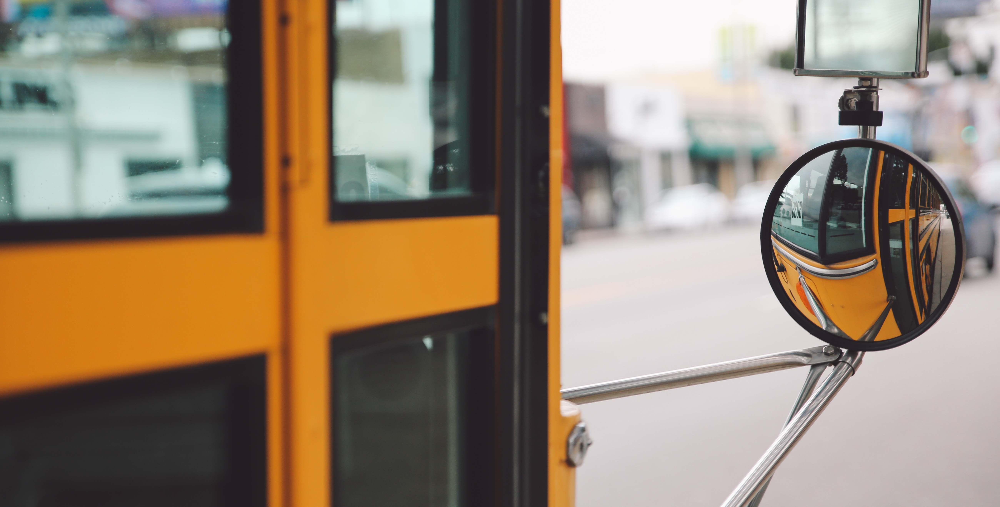
Kyle Martinez
Jeffco Bus Assistant

Slide 8
Key highlights of jespa strategy

Slide 9
Fight key fights publicly
District Moves to Close Fact-Finding to the Public; Loses.
Just days before the start of fact-finding over 2020 financial bargaining, the district filed a motion to close the proceeding to the public. JESPA’s attorney filed a counter motion to keep fact-finding open to the public. The fact-finder sided with JESPA and upheld Colorado Public Bargaining Law, meaning, if the district brings 3 or more officials to fact-finding the proceeding must be open to the public.
Notes:
Every fight we fight, we fight publicly.
Fact finding.
Fighting confidentiality agreements
Public bargaining
Visible tactics
Direct action training
Press conferences
Communications
Democratic Decision Making
GRIEVANCES
Over 100 grievances filed over the course of 3 years, with an increasing number of class action grievances
Very public grievances – 7 arbitrations filed and 6 wins, with a recent victory for our member to the tune of $600,000
Every Step 2 lost save for one,
The supposed “union friendly” board of education elected after the recall voted every single one of our wins down, and refused the arbitrator’s decision
BARGAINING:
We stayed at the table in 2020 for 10 months – the longest bargaining fight in JESPA’s history. We wanted to keep the fight public and continue putting pressure as long as we could - keeping the fight public.
Forcing the district to declare impasse, cancel bargaining, and then fight to move behind closed doors only served to get more and more members interested.
PUBLIC FIGHTS AROUND THE COMMON GOOD
More and more members taking action – including Kyle, a bus assistant turned JESPA organizer

Slide 10
build power with a common good approach
Working together with community and other local partners
Joined CCG and supported other member institutions’ actions – UFCW strike
Notes:
Organizing is raising expectations –

Slide 11
Increase member participation in strategy and tactical decisions

Slide 12
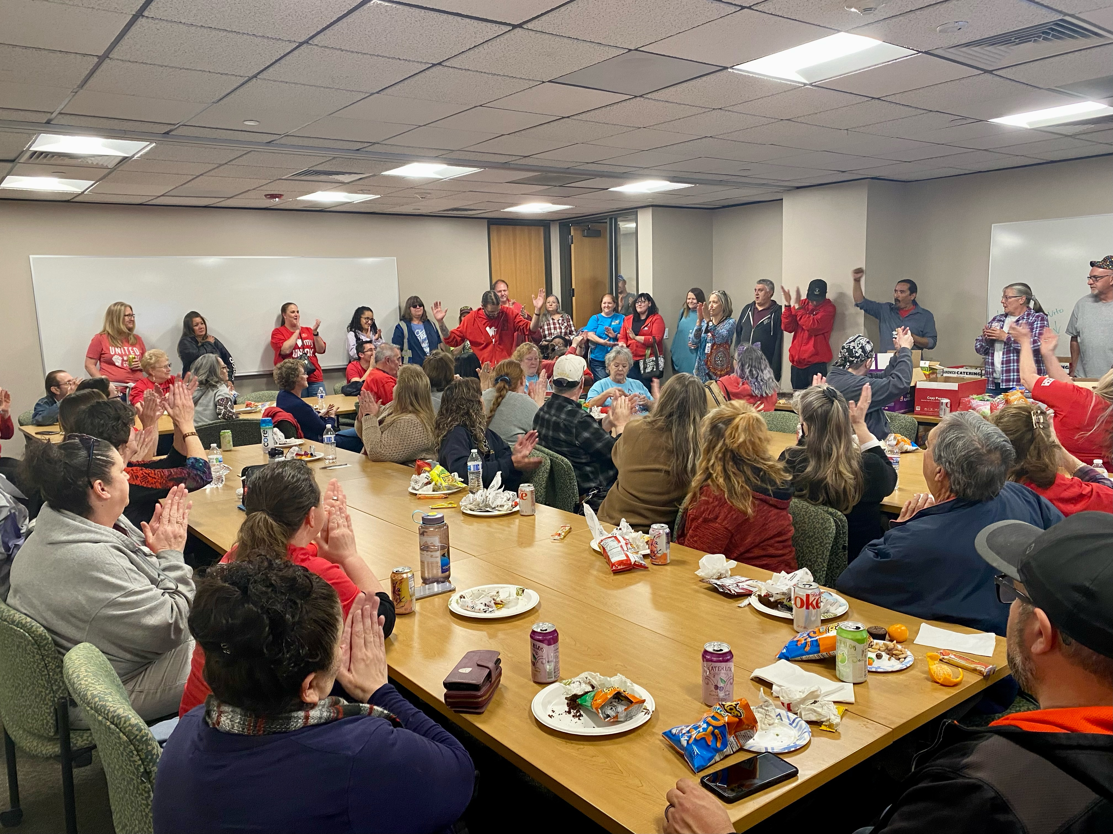
A TYPICAL JESPA BARGAINING CAUCUS
Notes:
A bargaining caucus

Slide 13
Polarize and personalize
Notes:
Pick the target, freeze it, personalize it, polarize it. Don't try to attack abstract corporations or bureaucracies. Identify a responsible individual. Ignore attempts to shift or spread the blame.
This is probably the most controversial part of our approach, but it is key to successful organizing.
We also refused to engage in IBB. To effectively polarize and win, we moved to traditional bargaining

Slide 14
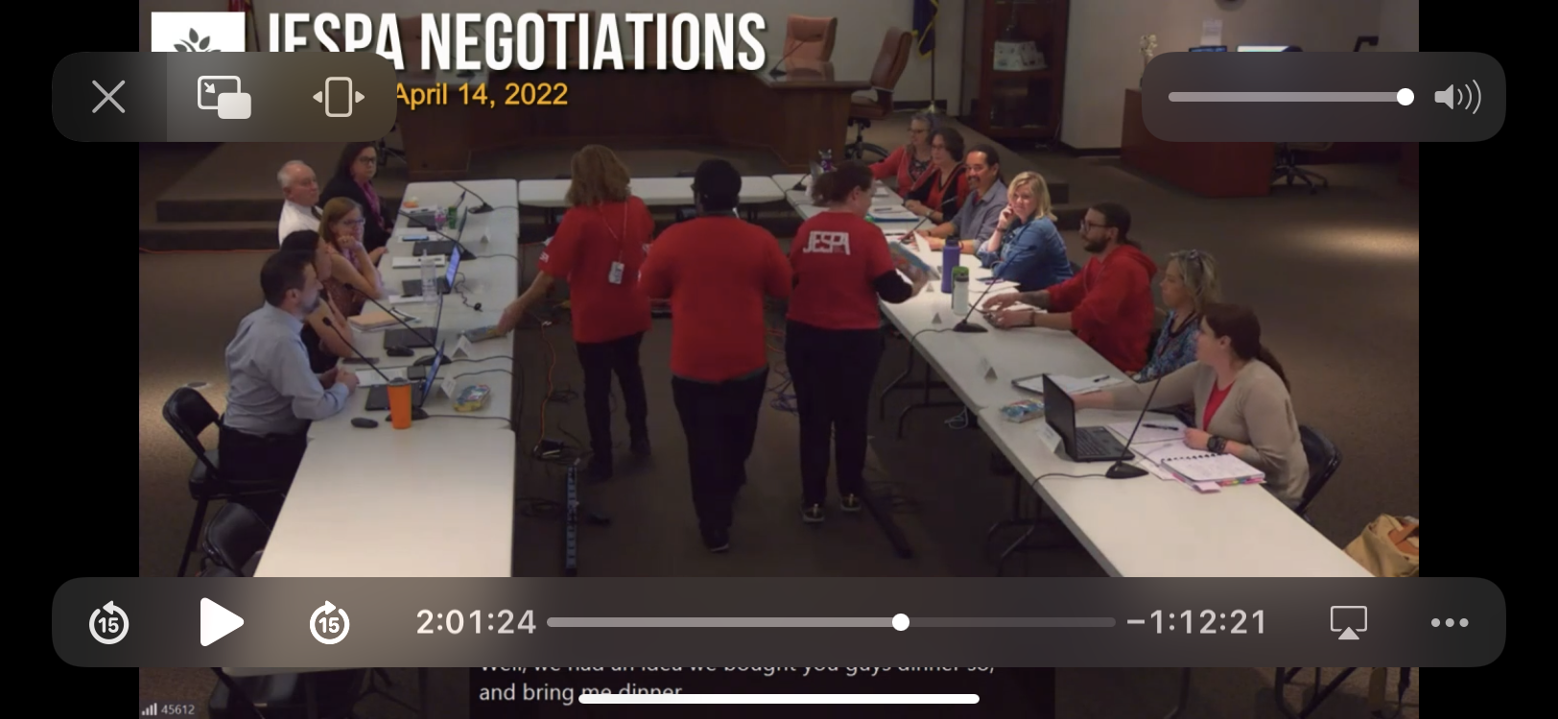
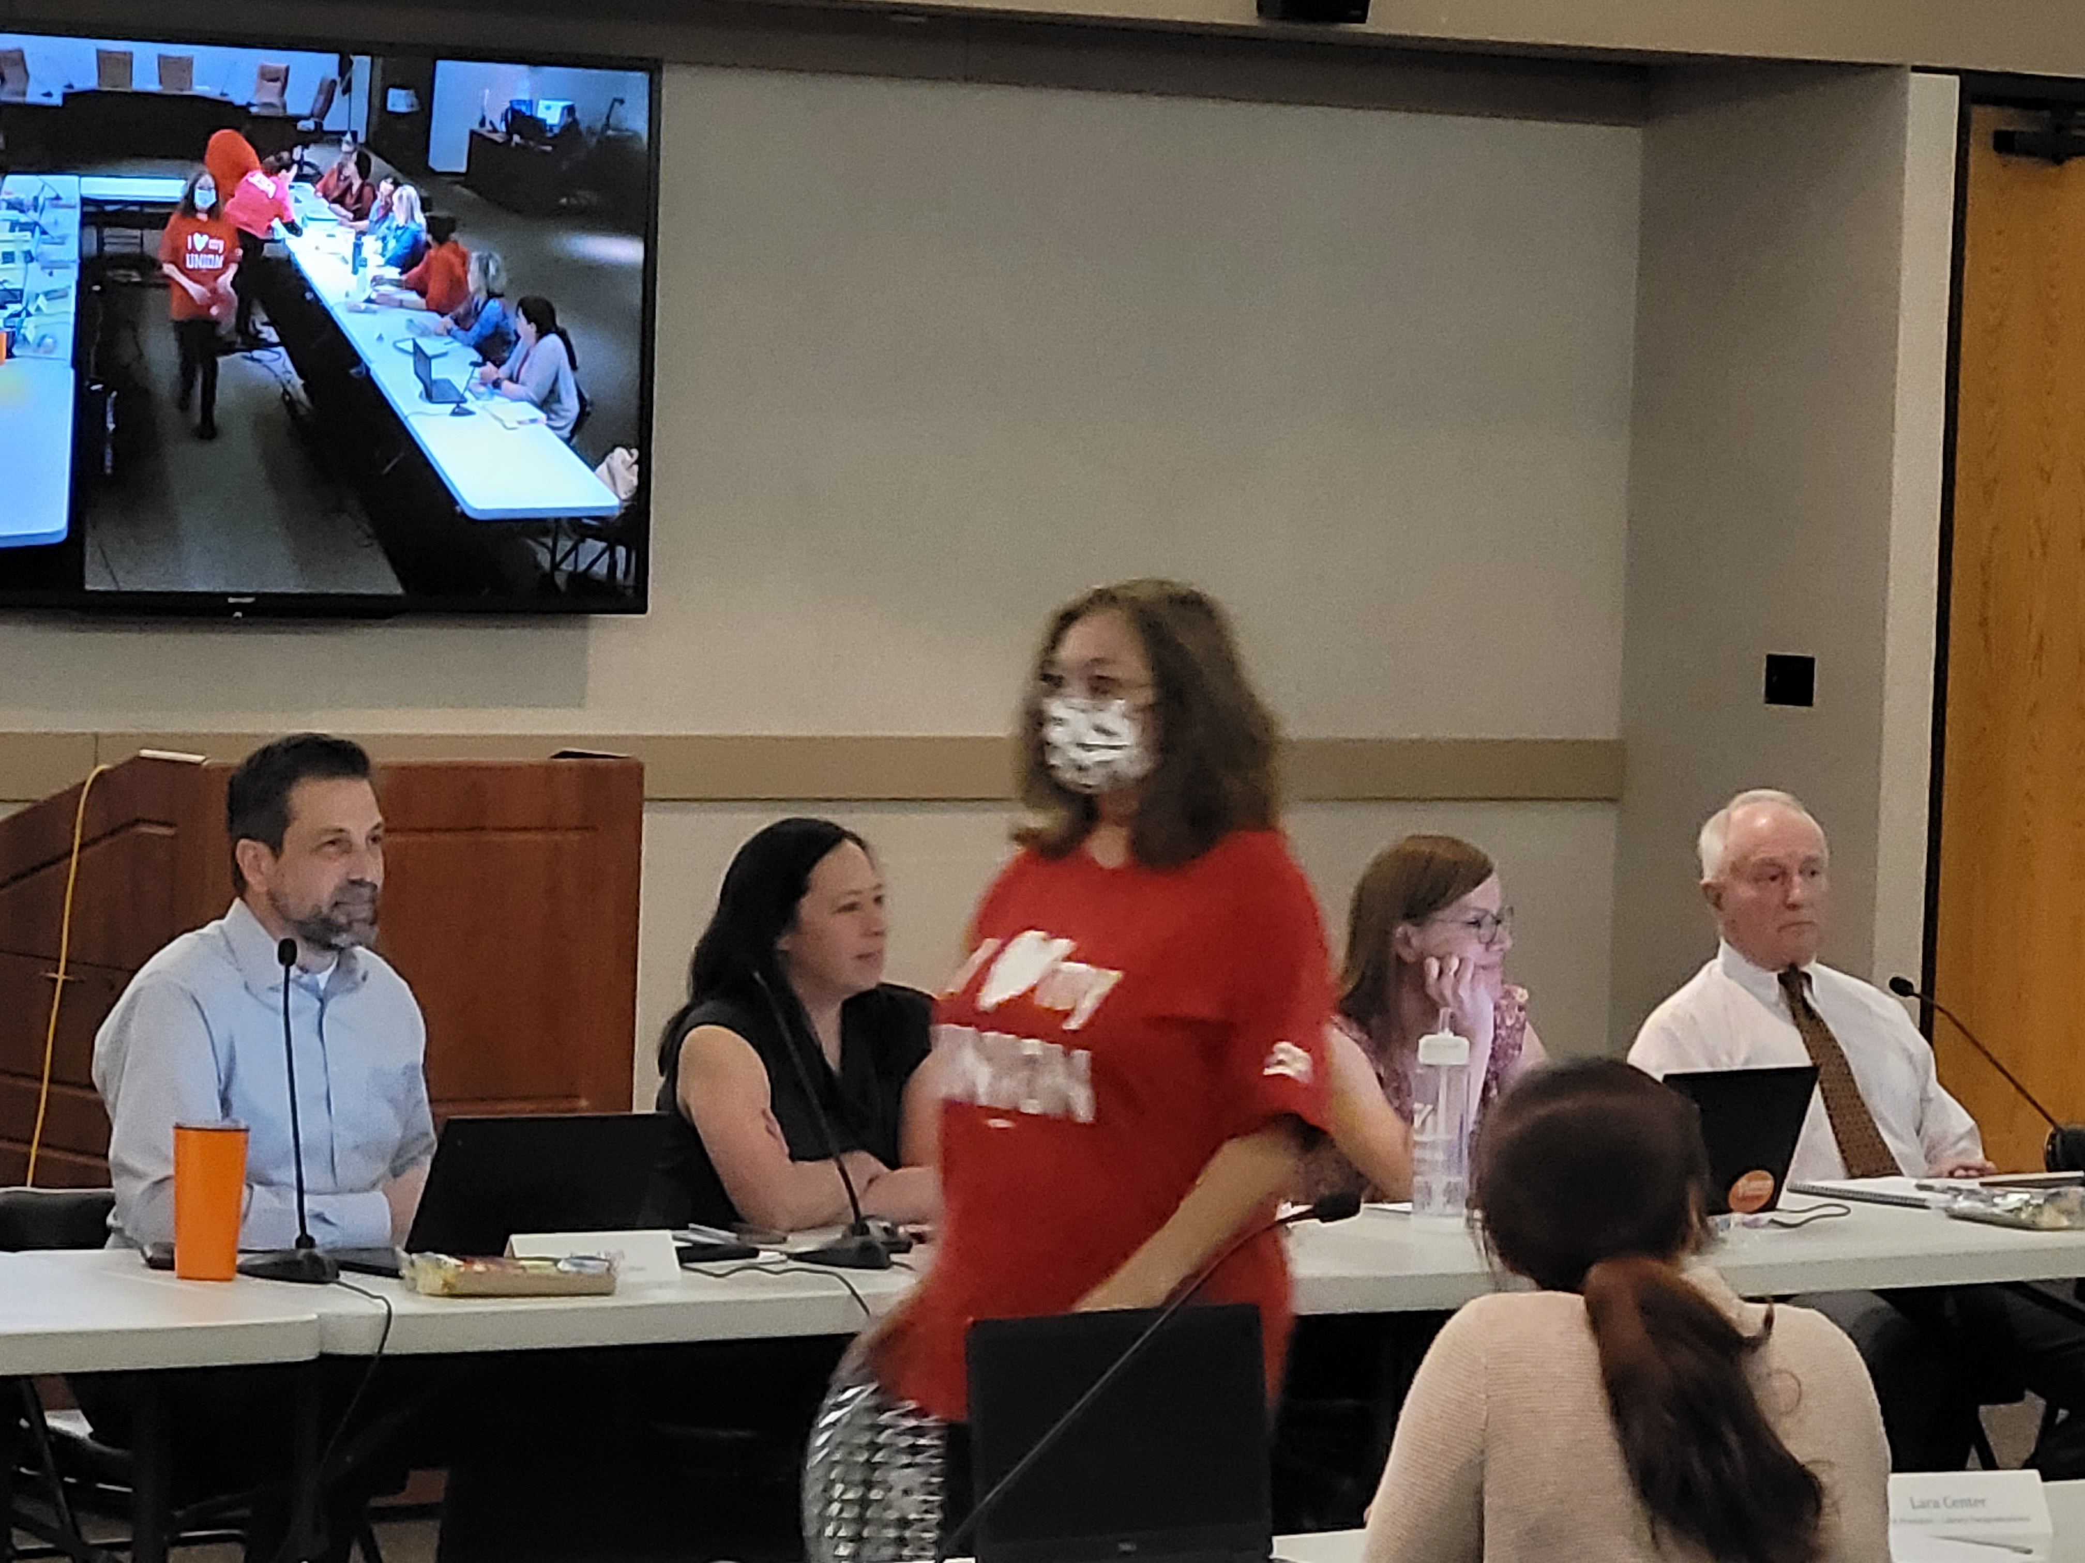

Slide 15
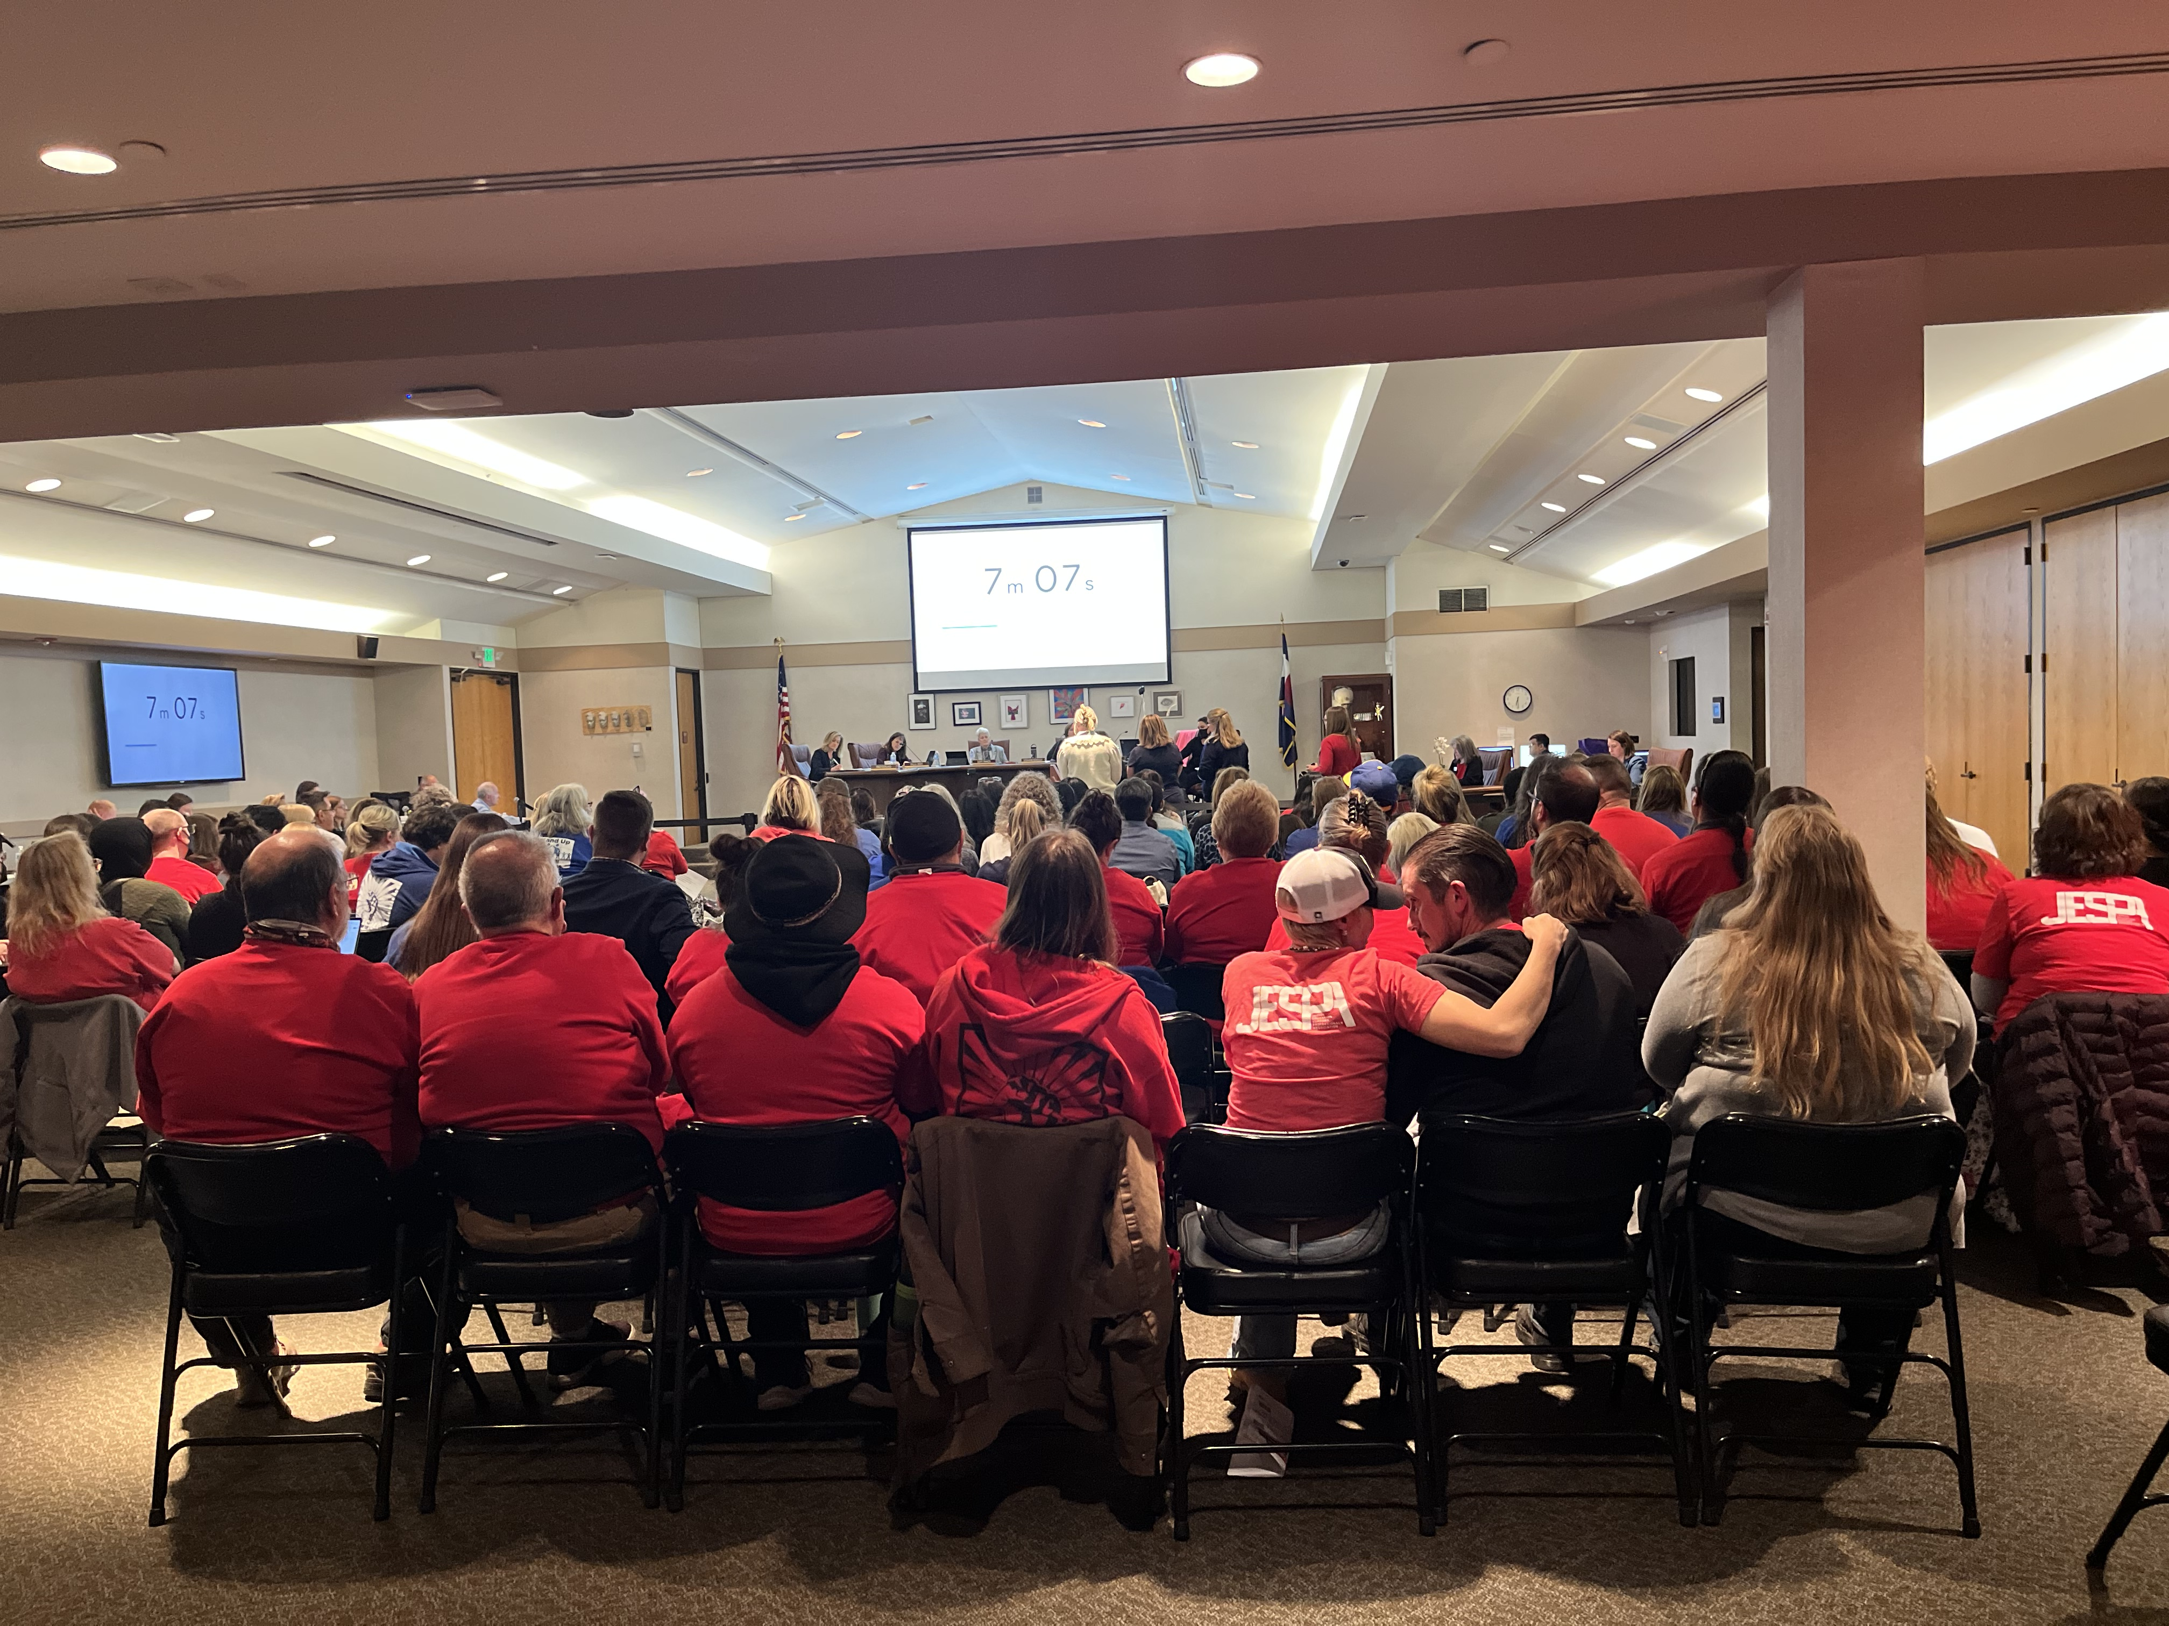
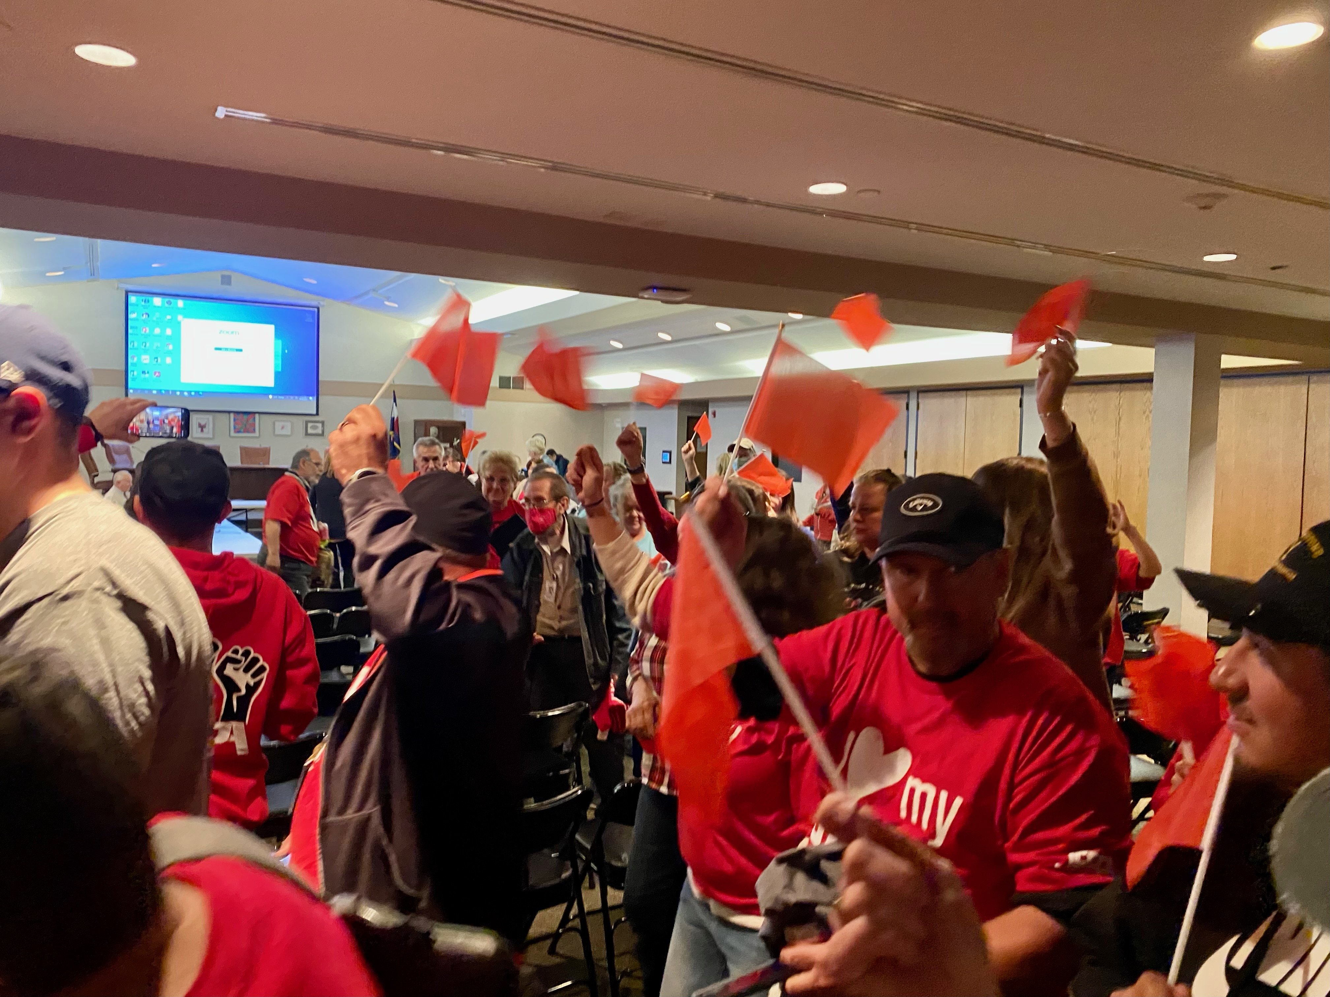
BARGAINING ACTION AND BOARD OF ED ACTION

Slide 16
AREAS OF GROWTH
​ | Building Leadership | Membership | Activists
2020 | 30 | 171* | 11
2021 | 40 | 127* | 27
2022 | 88 | 237 | 38
Notes:
Over this time we saw our building representatives calling to be more active in their buildings. Some called wondering why they don't have a JESPA rep in their building. This is progress! This is how we know that workers are listening to each other and wanting to get involved by becoming an activist and also more confident in asking others to join!
HIGH TURNOVER – if our strategy proves successful, the turnover rate will start to decrease as wages and benefits improve.
We have a long way to go toward sustainable leadership in buildings
Signed up over 800 members but netted the 237
*Estimate

Slide 17
Phase 1
Rebuild from crisis – low membership/consistent loss/etc.
Phase 2
Pick some smaller, winnable fights by filing grievances, and using bargaining to achieve some wins. Build community, increase leadership and membership capacity
Phase 3
Fight bigger, common good fights, and win some previously unwinnable fights
Phase 4
Use momentum to work toward vision of member owned union.
Notes:
So to sum up, we planned and executed strategically about how to leverage our growing power. We had to keep assessing where we were at and where we still needed to go, alter our course, etc.
The district is finally truly collaborating with JESPA. Last week at our monthly meeting with the Superintendent she invited her new Director whose only job is to focus on pd for ESP.
Further, Jeffco is reaching out to JESPA for input on how to best support ESPs – one of those ways is by utilizing the upcoming non-contact days to train our members and the district is going to pay them for this training.
We could never have stood up to the district if we didn't have our members paying attention and being engaged. The district grew to understand that we could turnout a lot of angry employees if necessary.
Thank you! Do you have any questions for us?

Slide 18
Day to day operations practices
Analyze and Target
Reflect on calendars and Time
Analysis of bigger picture
Course Correction
PLANNING
Weekly strategy meetings
Strategy Briefs
1:1 practice
Data – tracking potential members and leaders
ORGANIZING
Weekly building blitzes and 1:1s,
Recruit members and leaders
Training
Issue campaigns
Strategy meetings
LEADERSHIP
Leadership assignments
Organizing Charts
Snowflake model – Organizing Committee/Core Development
All bargaining unit communications
Weekly news
Leader communications
Transparency
REFLECT
COMMS
Notes:
What does working at JESPA day to day look like? Probably what everyone else is doing!

Slide 19
“I am not interested in picking up crumbs of compassion thrown from the table of someone who considers himself my master. I want the full menu of rights.”
Archbishop Desmond Tutu

