Slide 1

UniServ and Organizer Focused Discussion:
Building the Power to
Win in these Times
August 19, 2025

Slide 2


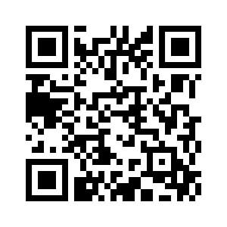
Interested in coaching?
Scan the QR code!

Slide 3

Focused Discussion
By attending this training, you confirm that you are either an NEA affiliate staff person or NEA member in good standing. The information you receive here is only for your use in your capacity as an NEA affiliate staff person or NEA member.
This presentation and its contents are confidential and may not be further distributed or passed on to any other person or published or reproduced, in whole or in part, by any medium or in any form, for any purpose unless written consent has been provided by Ellen Holmes. Audio/video recording, copying of slides, and the use of AI note-taking tools are prohibited without the written consent from Kyle Serrette. Violation of these terms may result in legal action.

Slide 4
Honoring This Space
We begin by acknowledging that through a history of colonization and brutality, we are all currently logging in from traditional lands stewarded by generations of indigenous people.
We honor these indigenous people, all elders, past, present, and emerging. We are called to learn and share these learnings about this tribal history, culture, and contributions that have been suppressed in the telling of the story of what we now call the United States of America.

Slide 5
Key OUtcomes
Participants will understand: Why the Campaign Lab exists How the Campaign Lab operates to support and network local campaigns How to apply for participation in the Campaign Lab

Slide 6

Shout Out from Zoomtown in the Chat
Name
Pronouns
Work Location

Slide 7
Dreams and Challenges

Slide 8

What does a Loving Community or School look like?
What of these descriptors is your Union Work now?

Slide 9
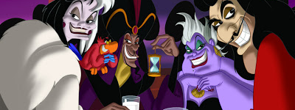
What or Who is preventing you from achieving this dream?
Notes:
Advocates, Mobilizers, Organizers Scenario

Slide 10
Breakout Time
10 minutes
Select a person who will report out when we return

Slide 11
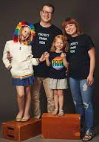
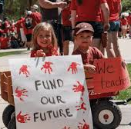
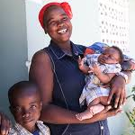


Funded, fed, inclusive, safe, cared for…
This IS ALL union work in the
Campaign Lab

Slide 12
The Campaign Lab

Slide 13
So what is different about the Campaign Lab?
Local Focused
Any member can apply
Coach and Mentor Coach Structure
Nationally Networked

Slide 14
The Campaign Lab Focuses on This
Organizing
“To organize is to build mass support and strength among ordinary people. Organizing draws its power from working people’s biggest strength: our numbers. The work of organizing is systematic and rigorous: It requires connecting with every single worker in a shop, every educator in a building, every building in a district. At its core, it asks people to understand their own agency and to make choices about how they will exercise it.”

Slide 15
Imagine
A network of 500 NEA locals all in some stage of a pro-public school issue campaign.
A structure of 250 Campaign Coaches supporting and connecting the Leads of those campaigns.
A layer of 50 Mentor Coaches providing support and resources
All convened under the Campaign Lab in Coalition with National Education and Worker Justice Partners.
What kind of power structure could we build?

Slide 16
And that is what is different about Campaign Lab.
This is an intentionally created and networked leadership structure focused on building and using power within and across issue campaigns.

Slide 17
Possibilities

Slide 18
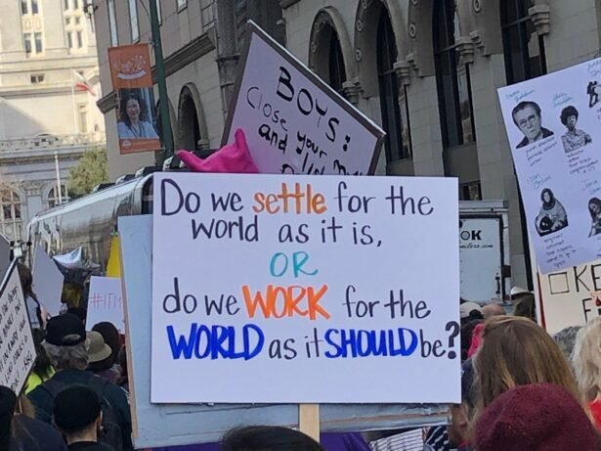
Breakout Time
What could your locals do in the Campaign Lab?
Questions for us?
Select a Reporter

Slide 19

What could your locals do in the Campaign Lab?
What questions do you have about this?

Slide 20
Nuts and Bolts

Slide 21
How the Campaign Lab works
Local or State team wants to run a campaign
Team applies to the Campaign Lab
Team starts planning their campaign with a coach.
Local or states have a team that wants to run a campaign on a particular issue.
They notify their state affiliate.
NEA will review the Campaign Lab application and conduct an interview with the team to make sure we are aligned.
Team meets with coach to start planning their campaigns.
They determine what type of training they need to run their campaign.

Slide 22
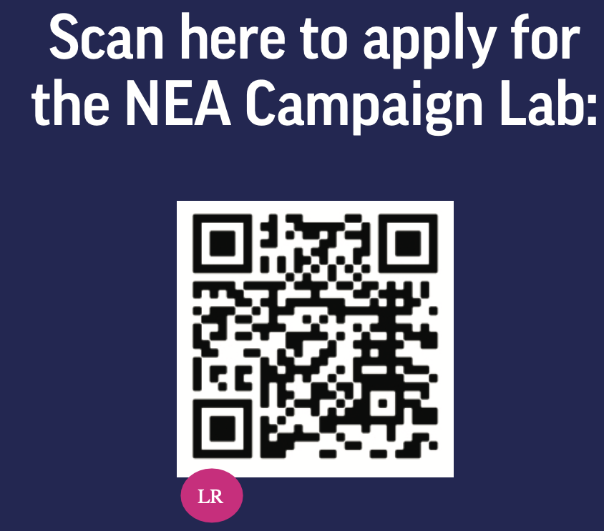
How the Campaign Lab works
Execute their campaign & Apply for grant
Campaign Lab Community
Execute campaign plan.
Bi-weekly meeting with their member coach.
Monthly meeting with all of the other locals and states that are running campaigns

Slide 23
Basic Structure of Campaign Lab
Team Lead
Team Lead
Coach
Coach
Coach
Campaign Lab Coordinators
Tech
Logistics and Grants
Payments
Team Lead
Team Lead
Mentor Coach
Team Lead
Team Lead
7
Notes:
The commitment for the local team lead is that they meet twice a month with a campaign coach to discuss their progress and receive just in time problem solving, advice, and coaching towards next steps. They also agree to attend an all call meeting once month to hear from others across the country that are also doing this work. Once a coach and a mentor coach agree that the Team Lead and local have a plan, have a team, and are ready to begin taking actions according to an actual escalating plan, they receive a seed grant of $2500.
Coaches, high capacity, campaign minded, leaders can serve as coaches and will receive training and support to do this. They agree to coach locals, up to two — and receive an annual stipend of up to $1800. They commit to meet with one to two teams, twice a month and attend the monthly all call meeting.
Mentor coaches are typically staff, who have a record of leading campaigns or growing locals through organizing. They do not receive a stipend. They have no more than 5 coaches that they meet with once a month and attend the all call meetings.
The Campaign Lab Coordinators, Amanda, Carrie, and Ellen, are managed by Kyle. Kyle is primarily focused on building the alignments with our outside partners and moves the Campaign Lab strategically into other aspects of the NEA enterprise. Amanda, Carrie, and Ellen work together they keep the system connected, convene the people in the system, build capacity across the system, manage and monitor applications of teams and coaches, and develop a strategic intent for the work across the campaign lab. They are supported by Dommie, Shola, and Karla. Dommie provides technology and data support, Shola coordinates the payment of coaches, Karla pulls team applications from the grant system and provides all travel logistics.

Slide 24
Description of the Coaching Structure
Team Leads, a local member, commits to meeting twice a month with a campaign coach to discuss their progress for problem solving, advice, and coaching towards next steps. They attend an all call meeting once a month to hear from others across the country that are also doing this work. Once a coach and a mentor coach agree that the Team Lead and local have a plan, have a team, and are ready to begin taking actions according to an actual escalating plan, the team receives a seed grant of $2500.
Coaches, high capacity, campaign minded, members serve as coaches. They receive training and support to do this. They agree to coach up to two local teams and receive an annual stipend of up to $1800. They commit to meet with one to two teams, twice a month and attend the monthly all call meetings.
Mentor Coaches are typically staff, who have a record of leading campaigns or growing locals through organizing. They do not receive a stipend. They have no more than 5 coaches that they meet with once a month and attend the all call meetings.

Slide 25
Three Levels of Campaigns
Foundation
Planning and implementation of a single issue, single organization campaign
Escalating
Planning and implementation of single issue campaign, not the first campaign cycle for the team, and beginning to work with other organizations.
Advanced
High capacity locals that have applied to be part of the Advanced Campaign group – funding, capacity requirements, and accountability is at a high level.

Slide 26
Interested in coaching?
Scan the QR code!

Slide 27
Final Thoughts about Campaign Lab
What is one key take away you have from today’s session?

Slide 28

Ending it Right
Feedback via email and link in chat
Check out other online trainings at
https://www.nea.org/UD-Org-Support/online-learning
Notes:
Zac J
UniServ & Organizer Support | NEA

