Slide 1
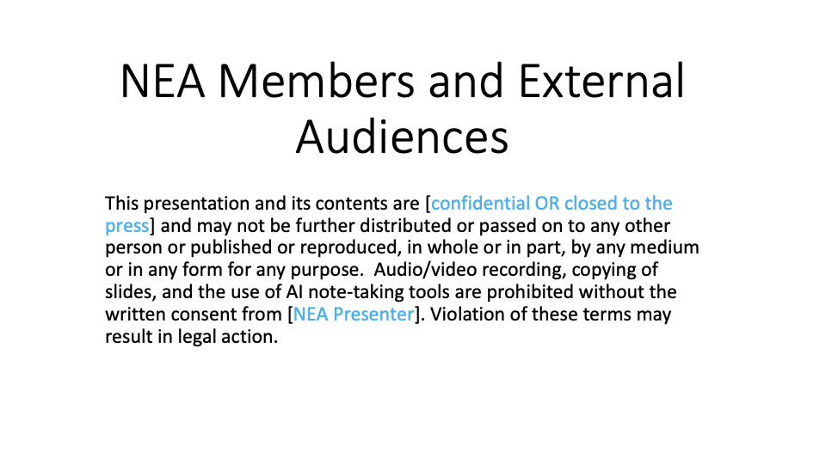

Slide 2



Slide 3
How the Campaign Lab works
Local or State team wants to run a campaign
Team applies to the Campaign Lab
Team starts planning their campaign with a coach.
Local or states have a team that wants to run a campaign on a particular issue.
They notify their state affiliate.
NEA will review the Campaign Lab application and conduct an interview with the team to make sure we are aligned.
Team meets with coach to start planning their campaigns.
They determine what type of training they need to run their campaign.

Slide 4
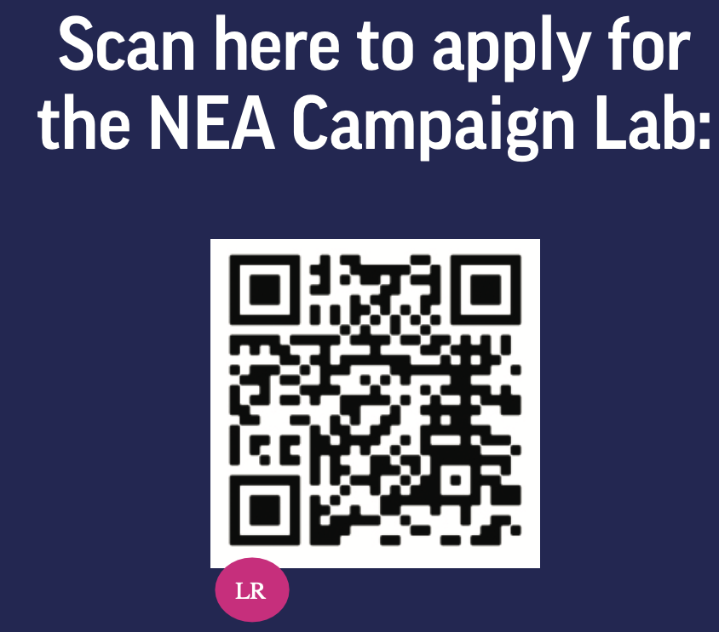
How the Campaign Lab works
Execute their campaign & Apply for grant
Campaign Lab Community
Execute campaign plan.
Bi-weekly meeting with their member coach.
Apply for grant up to $2500.
Monthly meeting with all of the other locals and states that are running campaigns

