Slide 1

Coalition Building
NEA Organizer Support Program

Slide 2
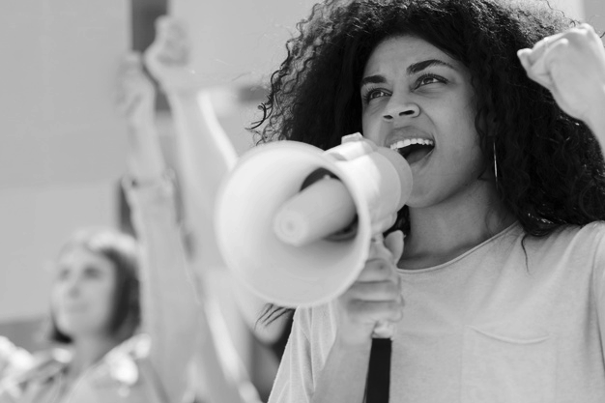
While You Wait Share in the Chat Window
Name
Required Pronoun
State

Slide 3
Honoring This Space
We are all connecting from lands inhabited by indigenous people past and present. We begin by acknowledging that through a history of colonization and brutality we all are connecting from lands stewarded by generations of indigenous people.
We honor these indigenous people, all elders, past, present, and emerging. We are called to learn and share these learnings about this tribal history, culture, and contributions that have been suppressed in the telling of the story of what we now call the United States of America.

Slide 4

WHY ARE WE HERE?
NEA has an enterprise wide emphasis on organizing.
Our UniServ focused events don’t always meet the needs of organizers.
Series of Online and
Face to Face New for 2023-24
https://www.nea.org/UD-Org-Support

Slide 5
Introducing Your Team
Alice Floros
Lakresha Hodge
Chad Williams
Ellen Holmes
Missouri NEA
UniServ Director
NJEA
Organizer
Michigan Education Association
Professional Issues
NEA Coordinator UniServ
and Organizer Programs

Slide 6
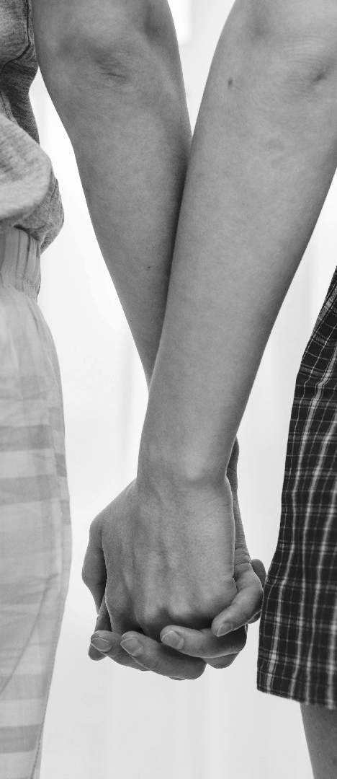

Community Agreements
Using Self-Awareness and Self-Knowledge
Listening for Understanding
Being Gracious
Staying Engaged
Being Open and Suspend Judgment
Saying “I”- tell your truth
Seeking Discomfort
Reaching Empathy
Expecting Non-Resolution and Non-Closure
*Adapted from “Embracing equity and inclusion”, Annie E. Casey Foundation

Slide 7

TODAY’S OUTCOMES
Participants will discuss the following concepts:
Building Beyond Our Base
Winning With Coalitions
Supporting and Maintaining

Slide 8
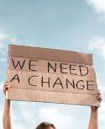
Chad
Breakout Time

Slide 9
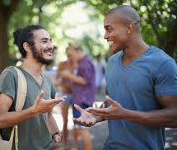
What did you discover?

Slide 10
A coalition is:
Something that Chad is going to define.

Slide 11
Building Power with a Coalition Means:
Something that Chad is going to define.

Slide 12
Alice
Panel Discussion

Slide 13

Welcome Panelists
Moira Kaleida
AROS
Chad Williams
Michigan Education Association
Notes:
In a moment, I will open up 5 break out rooms. I will give you a link.
1- What is becoming communicated by these join 'asks'.
2- Reflect on your back home membership 'ask'/'invitation'.
Similar different. But at its core what expectations and/or values does your invite communicate?
No shade or judgement- looking at 5 random webpages to see what is being communicated by these 5 different web pages.

Slide 14
Panelist Discussion Points
What have we won with coalitions?
How do you pick a specific goal you want to win?
How do you build alignment of values and interests?
Once assembled, how do you keep it together?
How do staff train members and leaders to do this work?

Slide 15
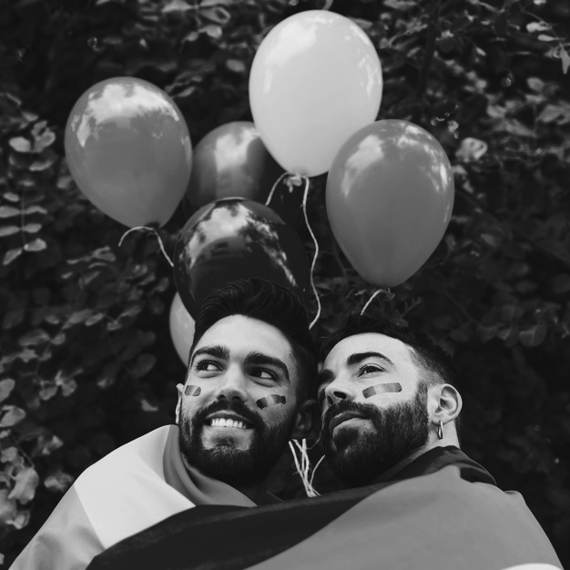
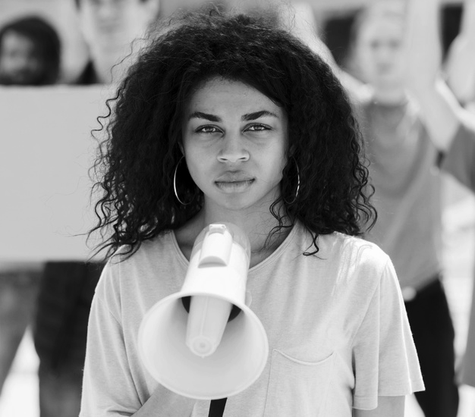

https://www.nea.org/about-nea/grants-funding/nea-affiliates
Resources…
Notes:
If our unions are just groups of certain leaders- we will fail to grow our power and represent the entirety of our membership. We have to intentionally look at who is and who is not part of the work of our union or we are doomed to miss out on our full power potential.

Slide 16
Lakresha
Breakout Time

Slide 17
Breakout Questions
How can we as staff manage our time to help with coalitions? How can we as staff participate in coalitions if the affiliate isn't all in?

Slide 18
Ending it Right
Email Feedback Form – Please Complete
Next online session – June – Fight Back Campaigns: Getting Away from Subcontracting
New Programs for 2023-24 Year at
https://www.nea.org/UD-Org-Support

