Slide 1
Bargaining for All

Slide 2
Honoring This Space
We begin by acknowledging that through a history of colonization and brutality, we are currently on the traditional lands stewarded by generations of the Arapaho, Ute and Cheyanne peoples.
We honor these indigenous people, all elders, past, present, and emerging. We are called to learn and share these learnings about this tribal history, culture, and contributions that have been suppressed in the telling of the story of what we now call the United States of America.

Slide 3

Why are we Here?
NEA has an enterprise wide emphasis on organizing.
Our UniServ focused events don’t always meet the needs of organizers.

Slide 4

Logistics to Remember
Questions to Ask
Bathroom
Materials
Food
Room Temperature
Karla as a Resource
Travel
Vouchers

Slide 5

3 Day Agenda
Day 3
7:30-8:30 Breakfast
8:30 Convene
11:00-11:15 Break
1:00 Boxed Lunch
1:00-2:00 Choice Networking
2:00 Adjourn
Days 1 and 2
7:30-8:30 Breakfast
8:30 Convene
10:15-10:30 Break
12:00- 1:00 LUNCH
2:15-2:30 Break
4:30-5:00 Choice Networking
5:00 Adjourn

Slide 6

Today’s Outcomes
Why Collective Bargaining
They Can Bargain, Why Don't They
Workplace Democracy
What Do We Say about Collective Bargaining
Power

Slide 7

Community Agreements p. 3-4
Using Self-Awareness and Self-Knowledge
Listening for Understanding
Being Gracious
Staying Engaged
Being Open and Suspend Judgment
Saying “I”- tell your truth
Seeking Discomfort
Reaching Empathy
Expecting Non-Resolution and Non-Closure
*Adapted from “Embracing equity and inclusion”, Annie E. Casey Foundation
Notes:
Community Agreements for Our Time
Awareness and Self-Knowledge
This requires self-knowledge and self-awareness. Self-knowledge allows you to see what causes you pain and conflict and enables you to embrace your contradictions and inconsistencies. It allows the space to work on things about yourself that you are not happy with. In turn, self-knowledge helps to prevent you from projecting your negative aspects onto other people. Bringing your best self also requires that you have a positive attitude, are willing to deeply explore your perspectives and remain open to the perspectives and experiences of others.
Listening for Understanding
Be an active listener. Active listening involves paying full and careful attention to the other person, looking him or her in the eye, avoiding interruptions, reflecting your understanding, clarifying information, summarizing the other person’s perspectives and sharing your own. Remember that most people need time to open up and might not be willing to immediately share their personal stories, hopes, fears and/or concerns.
Being Gracious
Being kind is a vital way of bringing meaning to our own lives, as well as the lives of others. Kindness is about caring genuinely for others around you, wanting the best for them and recognizing in them the same wants, needs, aspirations and even fears that you may have. Being kind and generous allows us to communicate better with others, to be more self-compassionate and to be a positive force in other people’s lives. This includes following the COVID protocols that are in place to protect the health of this learning community.
Stay Engaged
Staying engaged requires you to be morally, emotionally, intellectually and socially involved in the conversation. Staying engaged means that you are listening with curiosity and willing to deepen your understanding. Staying engaged might also require you to sustain the conversation even when it gets uncomfortable or diverted. This also means a commitment to keeping your electronic communications to a minimum with folks not present in this learning community.
Be Open and Suspend Judgment
Listening with an open mind includes being receptive to the influence of others. You can suspend judgment by becoming aware of preconceived notions and listening to everything someone has to say before jumping to conclusions. Most importantly, suspending judgment also means listening to what the speaker has to say for understanding, not just to determine whether the speaker is right or wrong.
Say “I”- tell your truth
Speaking your truth in authentic and courageous conversations about race requires a willingness to take risks. It means that you will be absolutely honest and candid about your own thoughts, feelings, experiences and opinions and not just saying what you perceive others want to hear. Speaking your truth will require you to speak from the “first person” and use “I” statements.
Seek Discomfort
Leaning in to discomfort will require you to let go of racial understandings and stereotypes that you may be holding onto in order to move forward. Leaning in means that you will avoid judgment, assume positive intent and be open to the kernel of wisdom in each individual’s experiences. Leaning in to discomfort will require you to sit through moments of embarrassment, confusion, anxiety and/or fear.
Reaching Empathy
Empathy and compassion allow you to understand the other person’s point of view. When you are empathetic, you are more understanding, patient and kind. Expanding your capacity to feel empathy will also allow others to enter your circle of human concern.
Resolution and Closure
Expect and accept that there may not be closure. It is not likely that you will resolve your personal understanding about race or another person’s racial experience in a single conversation. The more you talk about race with another person, the more you learn and the more they will learn. Authentic and productive conversations about race are continuous and always evolving.
*Adapted from “Embracing equity and inclusion”, Annie E. Casey Foundation

Slide 8

One Revolution Around the Room
Name
Required Pronoun
State

Slide 9

Halimah

Slide 10

Fold the Line
Name, Pronouns, Work Location
What is your highest hope?
What is your lowest expectation?
You CAN bargain, so why aren't you?

Slide 11
Fold the Line Whole Room Discussion
What are some of the lowest expectations you heard?
What are some of the highest hopes you heard?
Why aren’t you bargaining?
What else does the room need to know?

Slide 12
Final Words from The Future We Need – p. 207
“Collective bargaining is fundamental to building a healthy democracy by creating pathways for elevating the decisions of workers alongside those of employers. And in an era of advanced global capitalism, where financialization, fissured employment, and entrenched white supremacy and patriarchy exist, collective bargaining must be expanded to meet the needs of modern workers, addressing all the ways that they interact with the economy.”

Slide 13
Ellen

Slide 14

Why Collective Bargaining is an NEA Focus
  DEFINITIONS: Organizing and Organizers
    Organizing is leadership that enables people to turn the resources they have into the power they need to make the change they want.
    Organizing means enabling workers and changing lives.
    The duty of the organizer is to provide people with the opportunity to work for what they believe in. Our job is to create those opportunities. The members will build their union.

Slide 15
Why Collective Bargaining is an NEA Focus
NEA C4O Discussion Paper- Strategic Building Blocks p.56
    “Focus on opportunities across bargaining states to run majority status campaigns to win exclusive representation and first contracts. (in both permissive and mandatory bargaining states). Expansion of majority status bargaining rights directly correlates with increased member density and thereby increased member voice and power. Recognition campaigns expand the union.”

Slide 16
Why Collective Bargaining is an NEA Focus
Nationwide support for organized labor is highest since the 1960s
Ambitious new union drives in the service sector
Historically low unemployment and an infusion of federal dollars into the economy
Surge of educator strikes continues – focused on winning student-centered issues

Slide 17
Why Collective Bargaining is an NEA Focus
We have to recruit 250,000 new members a year just to maintain current levels of union density. (Necessary)
Maintenance does not build.
(Not Sufficient)

Slide 18
Why Collective Bargaining is an NEA Focus
States with near universal contracts have higher density than states with permissive bargaining laws, almost all of whom have higher density than states where collective bargaining is prohibited. The more widespread collective bargaining is, the higher our membership density.
Among our certificated membership:
61% density across all the mandatory bargaining states
    10 states are above 80%
We are at 39% density across permissive bargaining states
We are at 12% density across prohibited bargaining states

Slide 19
Why Collective Bargaining is an NEA Focus
Winning recognition and bargaining rights inevitably result in increased membership, density and strength.
Members and potential members are rarely more engaged than during campaigns for recognition and first contracts. These can be critical compression points for increasing membership, engagement, and strength.
Our ability to assist locals without bargaining rights, to win exclusive recognition and first contracts can qualitatively expand and strengthen the union.

Slide 20
Why Collective Bargaining is an NEA Focus
Increased membership and density isn't just about numbers, it's about the power to make systemic change through working together.
"We claim the power to make the big decisions that will shape the changes that impact our lives in the years to come." (p. 206)

Slide 21
Why Collective Bargaining is an NEA Focus
Leaders are developed through action.
Campaigns for recognition and first contracts are powerful crucibles for the identification, testing and validation of trusted and respected worksite leaders.
Successful recognition campaigns are led by effective member organizing committees. And they build effective worksite leadership networks.

Slide 22

Key Ideas
Help more of our members win the right to bargain collectively, and they will advance their own self-interest, bargain for the common good, and fight for the safe, just and equitable schools our students deserve.
Winning the right to bargain empowers workers and changes lives.
Focusing on that, makes everything else possible.

Slide 23
Charles

Slide 24

Is Collective Bargaining Urgent or Important?
Important activities have an outcome that leads to the achievement of your goals.
These are the activities that we know would help us out in the “long term” and we “intend” to them when the “timing is right” but the consequences of not doing them are not immediate so we put off acting on them.
Urgent activities demand immediate attention, and are usually associated with the achievement of someone else’s goals, or with an uncomfortable problem or situation that needs to be resolved.
Urgent activities are often the ones we concentrate on. These are the “squeaky wheels that get the grease.” They demand attention because the consequences of not dealing with them are immediate.
Based on the definitions found in The Future We Need, which do you think it is?

Slide 25
Is Collective Bargaining Urgent or Important?
(p.13-15, 19)
Discussion
Which of the definitions is closest to your definition of collective bargaining as you CURRENTLY think about it?
They already have the “right” to bargain collectively, why aren't they?
What would you have to stop doing in order to make this happen?
Who would you have to convince that this was both important and urgent?

Slide 26
Is Collective Bargaining Urgent or Important?
What are some important ideas that your table discussed that you think the room would benefit from hearing?

Slide 27


Slide 28
Zac

Slide 29
Is Collective Bargaining Urgent or Important?
If they CAN bargain, why don’t they?

Slide 30
REMINDER -- Urgent or Important
Important activities have an outcome that leads to the achievement of your goals.
Urgent activities demand immediate attention, and are usually associated with the achievement of someone else’s goals, or with an uncomfortable problem or situation that needs to be resolved.

Slide 31
Important vs.
Urgent
Someone Else’s Goals
Urgent BUT
NOT Important
BOTH Urgent and Important
Urgent
NOT Urgent or Important
NOT Urgent
BUT Important
Organization’s
or Your Goals
Important
Notes:
Urgent but not important – what is the school policy on what teacher’s can wear
Urgent and Important – The only active leader in a local has dropped membership
Not Urgent or Important – Member benefits flyers arrive in the office to be distributed
Not Urgent but Important – Local groups are organizing to start a community school

Slide 32
3 Steps for the Urgent or Important Matrix
On Your Own – Brainstorm for 5 Full Minutes –
What is all the work you do?
With your Team – 10 Minutes - Categorize your work into the various quadrants. You are working on your own AND helping each other at the same time. Where you have similar work, listen to how each of you think about it.
With your Team – 5 Minutes – Discuss
  What did you notice that you COULD stop doing, or get others to do?
  What are ways that you can make space to include collective bargaining?
  What would it take to get others to pick this work up along with you?
  How do you stay employed and push this agenda?

Slide 33
Whole Room Report
What did you notice that you COULD stop doing, or get others to do?
What are ways that you can make space to include collective bargaining?
What would it take to get others to pick this work up along with you?
How do you stay employed and push this agenda?

Slide 34

Closing Thoughts From The Future We Need
"To fulfill its true potential, collective bargaining should be seen as a gateway to democracy in the entire economic arena. … We need to not only ensure that collective bargaining is accessible to workers in this climate but also deepens its effect if it is to become an impetus to the revival of democracy." p.19

Slide 35
Key Ideas
Collective Bargaining, done strategically, is a principled, activist process that can engage 100% of the workers in a meaningful relationship with their union.
Collective Bargaining engages members in securing wins for their workplace, their students, and their communities.

Slide 36
Jeny

Slide 37

3 Lessons From History
Don’t bargain away power
Confront discrimination in our own organizations
Don't compromise core-values to maintain perceived relationships

Slide 38
From Our Reading
Think on: What parts of the book emphasized these lessons for you?

Slide 39

What is Your Current Situation
Small Groups – 2 Groups per ea. lesson
Create a T Chart – >
List the
-beliefs -practices -messages
That locals currently use as either counters or exemplify the lesson your group is examining.
COUNTERS
EXEMPLIFIES
References in the book:
P. 20 Black Washerwomen of Atlanta
P. 22 Knights of Labor, IWW, Craft Unions
P. 24 Laws and Acts
P. 25 Main point
P. 27 Wagner Act
P 28 Black Rail Workers

Slide 40
Current Situation
What is your role in moving your affiliates to understand that this is what collective bargaining is about?

Slide 41
Key Ideas
As we have moved through time, we have forgotten the lessons from history
History doesn't repeat, it rhymes.
Collective Bargaining is what democracy looks like in the workplace.

Slide 42


Slide 43

Authors' Visit

Slide 45
Sara

Slide 46

An Institutional Problem

Slide 47

What do they say about unions?

Slide 48

What is the word on the street?
What do you think the average people in our school communities say about collective bargaining?

Slide 49
What is the word from the boss?
What does the School Board and the Superintendents have to say about collective bargaining?

Slide 50
What is the word in our own house?
What do you think the average member has to say about collective bargaining?

Slide 51
Report out!
What do you think the average person, board member/superintendent, union member has to say about collective bargaining?
What are the top themes in the chart you ended on?
What was one that stood out to you?

Slide 52
Monet
(and a little Sara)

Slide 53
Why does the story matter?
A dominant narrative is an explanation or story that is told in service of the dominant social group’s interests and ideologies.
Dominant narratives achieve dominance through repetition, the apparent authority of the speaker, and the silencing of alternative accounts.
Because dominant narratives are so normalized through their repetition and authority, they have the illusion of being objective and apolitical, when in fact they are neither.

Slide 54

Why does language matter?
Approaching the conversation...
Should vs How?

Slide 55

Narratives
1) trigger imagination and make connection
2) are expressions of or a counter to cultures
3) are resources for empowerment or oppression
Did the narratives on your charts do any of these?

Slide 56
Shifting and Using Narratives- The DO's
Unmask
  Name the dominant narrative when you see it at work.
  Point out that what you just saw on the news or heard from a friend, or the law that was just passed, was based on particular values and beliefs.
  “The way you are talking about the recent contract settlement sounds like you think teachers are pretty greedy and we’re only looking out for ourselves.”

Slide 57
Shifting and Using Narratives
Elevate
  Name the values and beliefs from our new narrative that you want to see lived out in the world.
  Connect it to places where your audience may see that happening already.
  “I really like it when parents come in and express their appreciation – especially when they acknowledge they don’t now how we do it – it helps me feel valued and respected”

Slide 58
Shifting and Using Narratives
Contrast
  Lay out what might be different if your values/convictions were the ones shaping what happens in the world.
  Be specific about how we have the choice to approach situations through a different belief system.
  Invite a rethinking of the situation.
  “I guess we have to decide if we want to scapegoat paraprofessionals for the many challenges we face or accept them as willing and able partners in educating all kids.”

Slide 59
Shifting and Using Narratives
Draw on your own journey
  While it’s important to personalize this, it’s also important to do it in a way that anyone can see themselves in it. Describing your own realizations and shifts will help others
  Find their own way in the conversation.
  “I can understand your reaction, there are times when I realize that I've been reacting to what others say and not putting forth my own beliefs – it gets discouraging – but I realize now I've only been making it worse.”

Slide 60
Key Points to Remember…
Sustain your efforts and connect with others
  Shifting a dominant narrative does not happen quickly – it takes sustained effort, over.
  Time, with many people working at it.
Demonstrate your worldview, don’t just write & talk about it.
  Our actions say as much or more about our values and beliefs as our words.

Slide 61
Shifting the Narrative - DON’Ts
Focus on challenging facts or interpretations of information.
Attack people for their worldview.
Name the dominant narrative as “wrong.”
Try to convert or convince people.

Slide 62
Try the Shift!
Five Groups
You will be assigned a scenario –
  1 through 5
Try the shift using the steps we discussed
  Use your handouts for support

Slide 63
Debrief that Shift!
What do you notice?
What was tough?
What worked well?

Slide 64
What SHOULD be the narrative?
If we are successful in building our own narratives, what would each group be saying about collective bargaining?
Return to your 1st chart

Slide 65
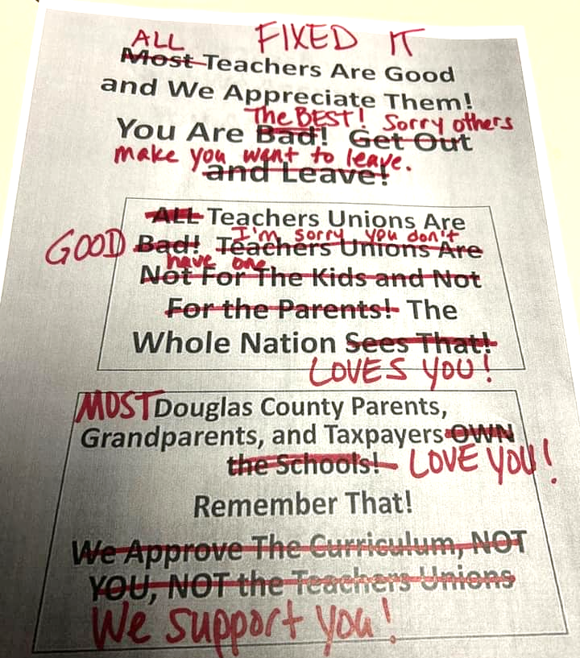
What do you wish they said about unions?

Slide 66

Organizing to Bargain
Your moment to transform how your members think about your union.
Members see themselves in the union, fighting for the issues they feel most passionate about.
Notes:
Schools Our Kids Deserve…Chicago

Slide 67
Key Ideas
Narratives are powerful tools that can be used to maintain power over an oppressed group
Narratives can be intentionally changed and used by an oppressed group to advance a change agenda

Slide 68
Key Ideas
Communicate how you and the people with a shared purpose and shared values can do the work you want to do and invite others to join with you.
Sustain your efforts and connect with others
  Shifting a dominant narrative does not happen quickly – it takes sustained effort, over
  Time, with many people working at it.
  Authentic and earnest engagement.
Demonstrate your shared values, don’t just write and talk about them.
  Our actions say as much or more about our values and beliefs as our words.

Slide 69
Heidi

Slide 70
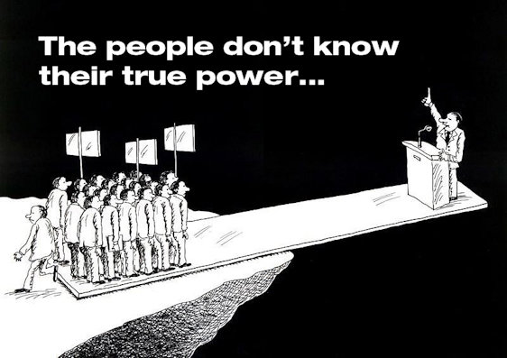
What is your definition of Power?
No Devices – just discuss with the folks at your tables for 5 minutes.
Notes:
Recognition requires the school board to:
specify appropriate unit of school employees for collective bargaining and
establish procedures for certification of exclusive representatives.
Unit and certification are not defined in statute, which allows the local association/union to use general definitions and experience with collective bargaining to persuade the school board on local meaning.

Slide 71
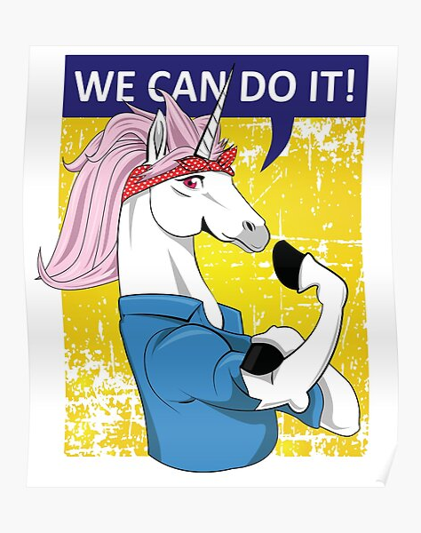
Power Is
Invisible AND Visible
People Driven
Risky
Strategic

Slide 72
Quick Table Talk
What happens when we remove one element of power?
  Invisible AND Visible
  People Driven
  Risky
  Strategic

Slide 73
We need members to have power (resources to deploy and people to act), but if we have 100% members and none of the other elements, we have no power.

Slide 74
Small Group Discussion and Speed Draw
Get into groups of five based on shoe similarity and new to you
12 Minutes to Move, Discuss, and Draw – How does your state or local express power?
Draw it (one for each state or local that your group represents)

Slide 75
Key Ideas
Power is visible, people driven, risky, and strategic.
Power is NOT just in the number of members.
It is critical for members to be authentically invited where their involvement is key to exercising power.

Slide 76
Ellen

Slide 77

Ending it Right
PLAN FOR BREAKFAST
Choice Networking
Housekeeping
Feedback via email

Slide 78

Choice Network Time

