Slide 1
Bargaining for All
Day 2

Slide 2

Community Agreements p. 3-4
Using Self-Awareness and Self-Knowledge
Listening for Understanding
Being Gracious
Staying Engaged
Being Open and Suspend Judgment
Saying “I”- tell your truth
Seeking Discomfort
Reaching Empathy
Expecting Non-Resolution and Non-Closure
*Adapted from “Embracing equity and inclusion”, Annie E. Casey Foundation
Notes:
Community Agreements for Our Time
Awareness and Self-Knowledge
This requires self-knowledge and self-awareness. Self-knowledge allows you to see what causes you pain and conflict and enables you to embrace your contradictions and inconsistencies. It allows the space to work on things about yourself that you are not happy with. In turn, self-knowledge helps to prevent you from projecting your negative aspects onto other people. Bringing your best self also requires that you have a positive attitude, are willing to deeply explore your perspectives and remain open to the perspectives and experiences of others.
Listening for Understanding
Be an active listener. Active listening involves paying full and careful attention to the other person, looking him or her in the eye, avoiding interruptions, reflecting your understanding, clarifying information, summarizing the other person’s perspectives and sharing your own. Remember that most people need time to open up and might not be willing to immediately share their personal stories, hopes, fears and/or concerns.
Being Gracious
Being kind is a vital way of bringing meaning to our own lives, as well as the lives of others. Kindness is about caring genuinely for others around you, wanting the best for them and recognizing in them the same wants, needs, aspirations and even fears that you may have. Being kind and generous allows us to communicate better with others, to be more self-compassionate and to be a positive force in other people’s lives. This includes following the COVID protocols that are in place to protect the health of this learning community.
Stay Engaged
Staying engaged requires you to be morally, emotionally, intellectually and socially involved in the conversation. Staying engaged means that you are listening with curiosity and willing to deepen your understanding. Staying engaged might also require you to sustain the conversation even when it gets uncomfortable or diverted. This also means a commitment to keeping your electronic communications to a minimum with folks not present in this learning community.
Be Open and Suspend Judgment
Listening with an open mind includes being receptive to the influence of others. You can suspend judgment by becoming aware of preconceived notions and listening to everything someone has to say before jumping to conclusions. Most importantly, suspending judgment also means listening to what the speaker has to say for understanding, not just to determine whether the speaker is right or wrong.
Say “I”- tell your truth
Speaking your truth in authentic and courageous conversations about race requires a willingness to take risks. It means that you will be absolutely honest and candid about your own thoughts, feelings, experiences and opinions and not just saying what you perceive others want to hear. Speaking your truth will require you to speak from the “first person” and use “I” statements.
Seek Discomfort
Leaning in to discomfort will require you to let go of racial understandings and stereotypes that you may be holding onto in order to move forward. Leaning in means that you will avoid judgment, assume positive intent and be open to the kernel of wisdom in each individual’s experiences. Leaning in to discomfort will require you to sit through moments of embarrassment, confusion, anxiety and/or fear.
Reaching Empathy
Empathy and compassion allow you to understand the other person’s point of view. When you are empathetic, you are more understanding, patient and kind. Expanding your capacity to feel empathy will also allow others to enter your circle of human concern.
Resolution and Closure
Expect and accept that there may not be closure. It is not likely that you will resolve your personal understanding about race or another person’s racial experience in a single conversation. The more you talk about race with another person, the more you learn and the more they will learn. Authentic and productive conversations about race are continuous and always evolving.
*Adapted from “Embracing equity and inclusion”, Annie E. Casey Foundation

Slide 3

Today’s Outcomes
Status of Bargaining
Teams for Building Power
Communication and Coaching
Power Mapping

Slide 4
Feedback on Feedback

Slide 5

Halimah

Slide 6


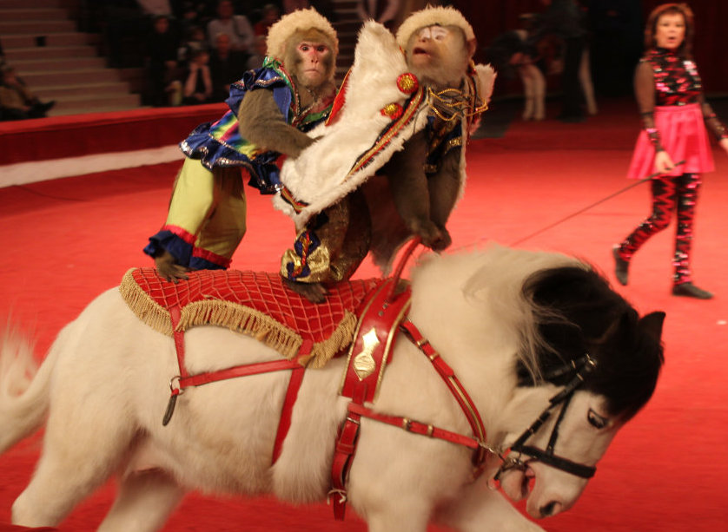
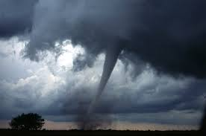
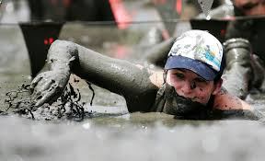

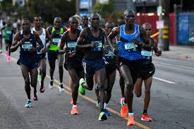


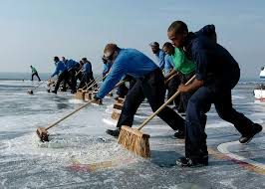

Go to the picture that best describes how you feel about convincing your locals to move to Collective Bargaining.
Gather, greet.
Share why.
One person report out.

Slide 7
Once you have selected a picture -
Greet one another
Share why you chose this picture
Select one person to report in 3 sentences or less why this group of folks gathered at this picture
Report out around the room

Slide 8
Charles

Slide 9
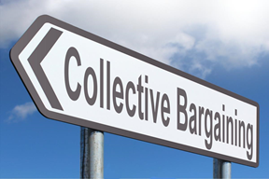
Basics of Public Sector Bargaining
While the unionization of most private-sector workers is governed by the National Labor Relations Act (NLRA), the legal scope of collective bargaining for state and local public-sector workers is the domain of states.

Slide 10

Basics of Public Sector Bargaining
State Law and Case Law Determine, including but not limited to:
  Right to Bargain
  Scope of Bargaining
  Impasse resolution options:
  *Mediation
  *Fact-Finding
  *Interest Binding Arbitration
  Right to Strike

Slide 11
3 Types of Statutory Bargaining Status Categories
Which are you?
Bargaining Law
Permissive/
….No Statute requiring
Prohibited

Slide 12
Status of K-12 Public School Teacher Bargaining
Bargaining laws covering K-12 teachers (34 + DC)
No bargaining law but limited bargaining takes place in some states (9)
AK
Bargaining is prohibited (6)
Collaborative conferencing permitted (1)
* NOTE: MO – Although there is no bargaining statute, the state Supreme Court ruled that all public employees have a constitutional right to bargain with their employer.
MT
ND
VT
NH
WA
MN
*Note: MI – Emergency mgr can modify, reject, or terminate a CBA.
WI
ME
OR
SD
MA
ID
WY
MI
NY
RI
NE
IA
IL
IN
OH
PA
NV
UT
CO
CT
KS
WV
NJ
CA
MO
KY
KY
VA
DE
AZ
NM
OK
AR
TN
NC
MD
* SC
DC
MS
GA
* Note: S.C. – Although bargaining is not statutorily prohibited, the state Supreme Court ruled that public employees do not have the right to bargain.
TX
LA
AL
HI
FL
NEA COLLECTIVE BARGAINING AND MEMBER ADVOCACY (MAP CURRENT AS OF July 2022)

Slide 13
Status of ESP Bargaining Laws: ESP for K-12 & ESP for Higher Education
Bargaining laws covering K-12 and HE ESP (31+ D.C.)
No bargaining law, limited bargaining takes place in some states (12)
AK
Bargaining prohibited (7)
* NOTE: MO – the state Supreme Court ruled that all public employees have a constitutional right to bargain with their employer and ESPs are not listed in labor law exceptions listing.
*Note: MI – Emergency mgr can modify, reject, or terminate a CBA.
MT
ND
VT
NH
WA
MN
WI
ME
OR
SD
MA
ID
WY
MI
NY
IA
RI
NE
IL
IN
OH
PA
NV
UT
CO
CT
KS
MO
m
NJ
CA
WV
KY
VA
DE
AZ
NM
OK
AR
TN
NC
MD
SC
DC
MS
GA
TX
LA
AL
* Note: S.C. – Although bargaining is not statutorily prohibited, the state Supreme Court ruled that public employees do not have the right to bargain.
HI
FL
NEA COLLECTIVE BARGAINING AND MEMBER ADVOCACY (CURRENT AS OF July 2022)
Notes:
And here is the same map for 2011. If you look carefully, you’ll see that there, in fact, were no changes. No ESP lost the right to bargain in 2011.

Slide 14
Brief History of Public School Employee Bargaining
1950-1960 Beginning of Public Sector Bargaining Labor Laws
1960-1980 Establishment of State Institutions Governing Labor Laws
VERY LITTLE CHANGED until 2011
2011–2012 Indiana, Michigan, Tennessee, and Wisconsin substantially restricted or entirely prohibited collective bargaining rights of public-sector employees

Slide 15

Indiana
In 2011, Indiana enacted a law stating that collective bargaining is no longer mandatory, and only wages and wage-related items can be part of the collective bargaining process.

Slide 16

Tennessee
In 2011, Tennessee passed the Professional Educators’ Collaborative Conferencing Act, making collective bargaining for teachers illegal

Slide 17
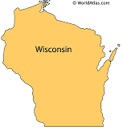
Wisconsin
Wisconsin’s Act 10 enacted in 2011 eliminated fair share fees for public employee unions and restricted public-sector collective bargaining to only wage and wage-related items. It also capped the annual growth in affected public-sector workers’ base pay to the rate of inflation and required teachers unions to obtain annual recertification, a laborious process in which unions that already received enough employee votes to be created must ask their members to vote for the union again every year to retain its status.

Slide 18

Michigan
In 2012, the Michigan legislature passed the “Freedom to Work” law, a so-called right-to-work (RTW) law. Michigan’s RTW law reduced the financial strength of unions by making it illegal for a group of unionized workers to negotiate a collective bargaining contract that includes fair share fees for nonmembers covered by the contract. (Note that the Janus decision has been described as a decision that effectively made all states into RTW states for the public sector.)

Slide 19

Virginia
Virginia's longstanding ban on collective bargaining for public sector workers, which include teachers, law enforcement and firefighters, was lifted when state lawmakers passed legislation in 2020.

Slide 20
Exploring Your State Process
What is the state law that allows you to bargain?
Is there a state compliance agency that governs the
above law ?
What are the pertinent benchmarks, timelines, conditions that are required?
Who do you bargain with at the table (District; City/County Agency; State Agency)?
What are the statutory rules about the actual bargaining process (closed, open, date deadlines, subjects of bargaining; etc.)
Create a summary and timeline of these that would define how this process would proceed for you.

Slide 21

Key Take-aways
State Law and Case Law Determine, including but not limited to:
  Right to Bargain
  Scope of Bargaining
  Impasse resolution options:
  *Mediation
  *Fact-Finding
  *Binding
  Interest Arbitration
  Right to Strike
  Understanding the framework in your state

Slide 22


Slide 23
Monet

Slide 24

Teams for Building Power
Visualize teams you know
  What made them successful?
  What made them less than successful?

Slide 25
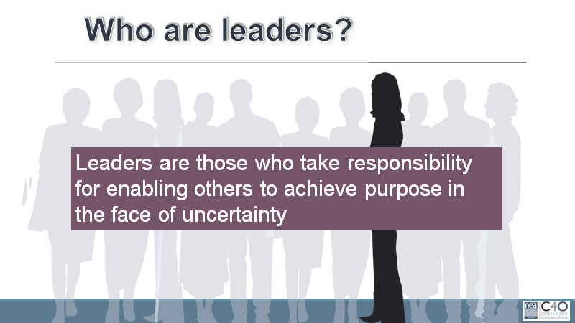

Slide 26

We coach towards the Interdependent Structure – Leadership

Slide 27

Drawing Your Local’s Leadership IQ
Count off into teams of 4
EACH person thinks of one local they want to move to a first contract
The team uses one chart paper divided into fourths
Each person DRAWS what their leadership IQ looks like based on the next slide.

Slide 28
Drawing your local’s leadership IQ?
How many leaders do you see doing leadership work?
Is there one “leader” with everyone else linked to that leader like spokes to the hub of a wheel?
Or are there lots of “leaders” linked with each other and with other members, multiple centers of coordination, inspiration and action.
Are some people “followers” in relation to some “leaders” but “leaders” in relation to other “followers”?
Or are some people always “leaders” and others always “followers”?

Slide 29

How do I know I am coaching a team that can build power?

Slide 30

A Power Building team is formed in Three Steps
Establish a shared purpose.
Establish clear ground rules or norms
Organize the work into interdependent roles.

Slide 31
A Power Building Team has Three Conditions
Your team is bounded.
Your team is stable.
Your team is diverse.

Slide 32
A Power Building Team has Three Outcomes
The team accomplishes the goals for which it is responsible.
The team is operating in ways that make it better as a performing unit over time
The team contributes the learning and well-being of individual members

Slide 33
Leadership Team Cycle and Leadership Team Growth
Leader Growth
Accountable
Implement
Reflect Assess
Proceed
Make Change
Stop
Recruit
Develop
Identify

Slide 34
Key Ideas
We can’t become powerful enough to do what we need to do if we can’t even work together as a leadership team.
You can create the conditions that will increase the odds your team will work drawing on the craft of team design
Structuring a leadership team creates strategic capacity: the ability to strategize creatively together in ways that produce more vibrant, engaging strategy than any individual could create alone.
.Well-designed teams put to productive use the unique talents of the individuals who make up the team.

Slide 35

Jeny

Slide 36

Communication Matters Team Task
Groups of 5 to 6
One person is the Organizing Staff
Everyone else is a member of the Leadership Team
You need –
Blindfolds
Table with paper and markers

Slide 37
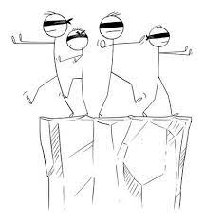
Communication Matters Team Task
Each Organizing Staff person has been given a picture in an envelope.
The Leadership Team Members are all blindfolded.
The only person who can speak is the Organizing Staff person. That person has to direct all members of the team to reproduce the picture in the envelope onto their team chart paper.
The only people who can draw or touch the paper are the members of the Leadership Team.

Slide 38
Communication Matters Task
What did you learn about communication?
What was most helpful as a Leadership Team Member?
What was a challenge as the Organizer?

Slide 39
Key Ideas
People can grow if given direct, actionable feedback.
Communicating outcomes first provides a big picture
Continuous reinforcement and correction keeps a team on track

Slide 40
Zac

Slide 41
Reminder…

Slide 42
How do we enable teams?
When we direct action (teach) –this is OUR agency.
When someone defines their goal and uses THEIR agency to move towards it.
Think, "I do." "We do." "You do."
WE BUILD LEADERS WHEN WE COACH

Slide 43
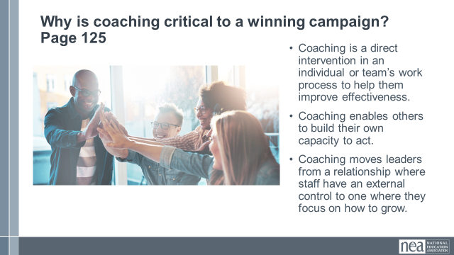
Why is coaching critical to a strong team?
Coaching is a direct intervention in an individual or team’s work process.
Coaching enables others to build their own capacity to act.
Coaching moves leaders from a relationship where staff have an external control to one where they focus on how to grow.

Slide 44
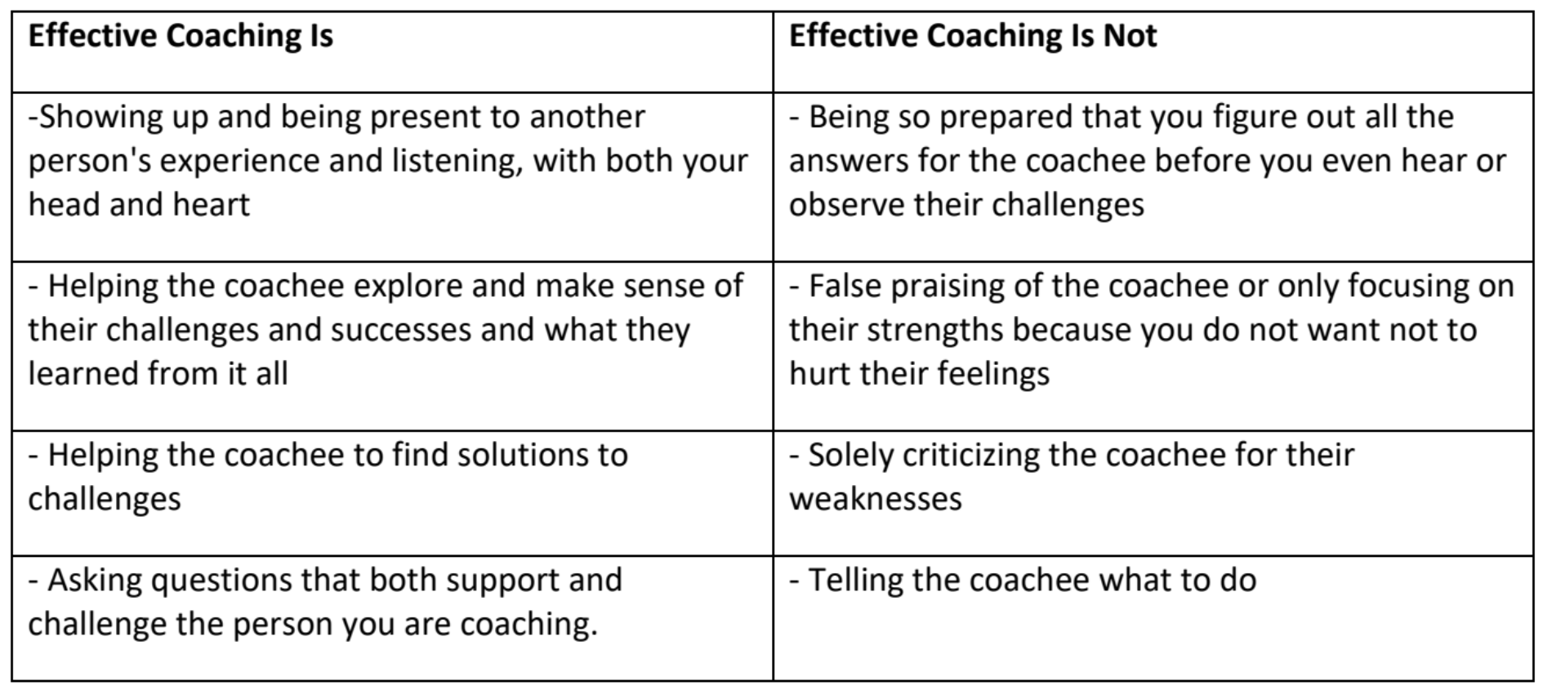
Page 117

Slide 45
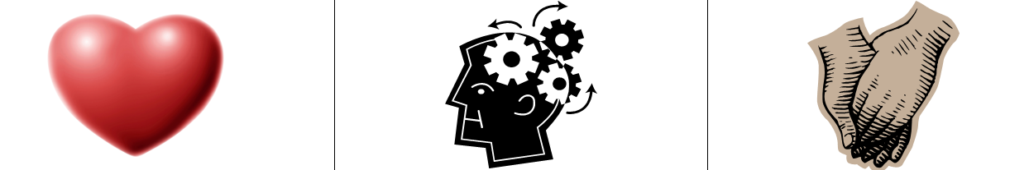
3 Kinds of Coaching- Page
Motivational – Heart Coaching aimed at enhancing motivation
Strategic – Head Coaching aimed at helping plan, evaluate, strategize
Skills-based – Hands Coaching aimed at effective execution of a skill

Slide 46
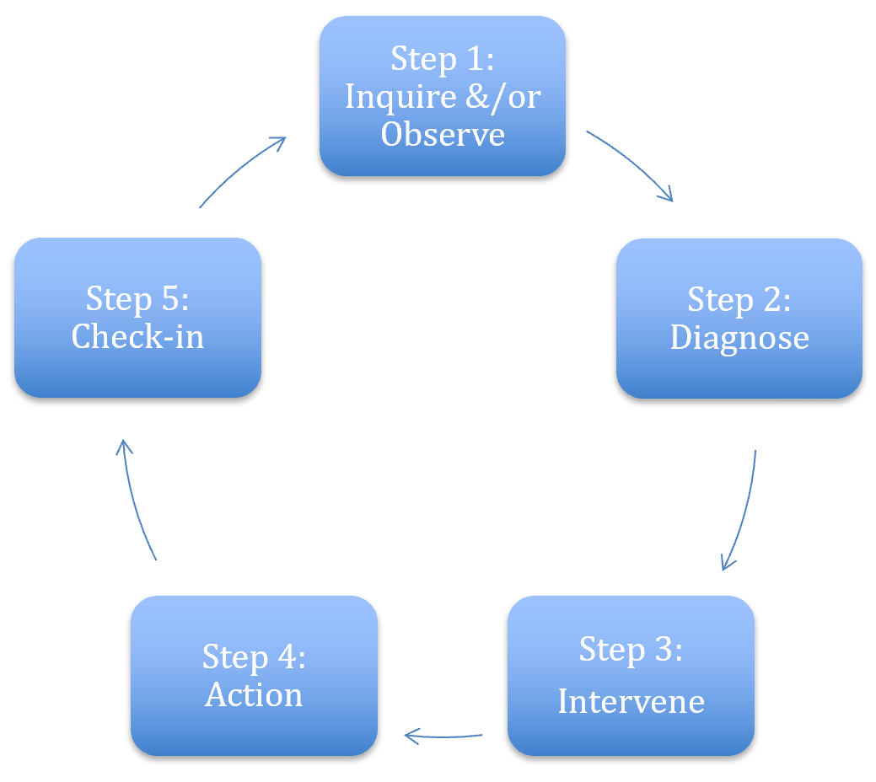
Coaching Cycle-
The reason to apply this cycle is to stop yourself from providing THE answer.
Leaders grow from productive struggle.

Slide 47

Coaching Scenarios- Page
Regroup!
You will need to get into groups of 3.
Note: there may be 1 group of 4

Slide 48
Coaching Scenarios- Page
Debrief

Slide 49
Key Ideas
Coaching is about releasing your external control and enabling the leader to grow.
Coaching is as much about you changing your behavior and growing your skill as it is about growing a leader.
We only get good at coaching by practicing it.

Slide 50
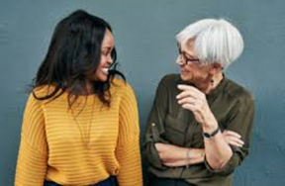
Coaching Across Differences p.
1. Curiosity and Compassion
Develop you Own Emotional Intelligence
Invite Conversations about Differences

Slide 51
Good Questions to Ask
What do you need me to understand about your identity in this work?
What would you like to know about me that would help you to work with me?
Do you have a story that will help me understand a part of your identity that you feel impacts you in this work?
What might be challenging about us working together?
What can I do to support you when those challenges arise?

Slide 52
Key Ideas
We can’t ever make assumptions about someone’s identity and experience.
Our words and attitude signal if we’re comfortable acknowledging difference and if we affirm who they are.
Inherent, in a coaching relationship is trust. There has to be trust to give and receive feedback.

Slide 53


Slide 54
Sara

Slide 55

Assessment of Locals
Strategy
Power
Teams
Resources

Slide 56
Campaign Readiness Assessment
Working at your tables BUT each on their own local
Use the categories in the tool to assess your local
For each category reflect on where your current strengths, Weaknesses, Opportunities, and Threats.

Slide 57
Quick Report Out
What did this tool illuminate for you?
What do you think this tool would illuminate for members?

Slide 58
Strategy Steps to Win a Collective Bargaining Agreement Tool -
Review the 5 Phases
(3 minutes on your own)
Which phase are you in?
Get into working groups of 4 based on similar phases

Slide 59
5 Phases Group Discussion and Chart
Why did you pick that phase?
What could you do to move from the phase you are currently in, to the next phase? (Look at the hallmarks and look at your assessment).
Chart up your group thinking on what made you choose the phase you are in and how you are moving to the next phase.
Share out responses

Slide 60
Key Ideas
Plan early, plan often
Strategies are dynamic and should reflect the conditions and goals of your team.
Planning and assessing your current state is necessary and should be a consistent practice.
If your team cannot complete an assessment of their work, they’re not ready to bargain.
This is not YOUR work. It’s the work of the local.
.

Slide 62
Heidi

Slide 63

School Boards ~a hill to climb

Slide 64
School Board Assessment
Map your school board’s support of Collective Bargaining
Extremely influential
Somewhat influential
Influential
Not very influential
Not influential
 | Outspoken Champion | Supporter | Neutral or unknown | Opponent | Actively Opposed

Slide 65
Power Mapping
Powerful, influential, strongly opposes your objective
Powerful, influential, strongly supports your objective
Less powerful and influential, strongly opposes your objective
Less powerful and influential, strongly supports your objective
Power, Influence
Support for Your Position
Notes:
2 min

Slide 66

Power Mapping-Breakout
Let’s get more specific.
Go to the Power Analysis/Mapping Document.
Start filling in your internal (current members and potential members), external (administration, other workers at your employer, school board), community (parents, other community), and at-large power actors (mayor, county/city council members, legislators, etc…).
    Cohorts may vary in the volume of power players that can be currently identified.
Return to your engagement maps/lists. Which of your people are connected to these power actors?
Notes:
3 min introduce
20 Min breakout (end 10:55)

Slide 67
Power Mapping-Debrief
What trends did you see?
What information are you missing?
Notes:
5 min debrief

Slide 68
Key Ideas
Find the right people, to move the people of power and influence.
1:1’s and mapping, together, help put the pieces of the puzzle together.
If we don’t know how our people connect to the people who have power and influence, we can’t win.
This isn’t an activity to do alone.
Connecting with each other is how we connect our way into power.

Slide 69
Monet

Slide 70
VEA Panel: Amanda Kail & Evette Wilson
Things we want you to listen for:
How did they get started?
What was their narrative?
Who were the power players in this situation?
What was the process for winning CB?
Who was on their leadership team?
What role did the staff play?
What did they win?
What resources did it take to win their campaign?

Slide 71
Sara

Slide 72

Organizer Discourse
A conversation of professionals, not specifically led by any one person. These professionals share a particular way of working, values, language, and issues.
What are the challenges you are currently facing that you hoped this training would address?
In response you can
  Question
  Provide suggestion
  Add to the story (me too, and…)

Slide 73
Ellen

Slide 74

Ending it Right
Prep to Go Home
Choice Networking
Housekeeping
Feedback via email

Slide 75

Choice Network Time

