Slide 1
Bargaining for All
Day 3

Slide 2

Community Agreements pg 2-3
Using Self-Awareness and Self-Knowledge
Listening for Understanding
Being Gracious
Staying Engaged
Being Open and Suspend Judgment
Saying “I”- tell your truth
Seeking Discomfort
Reaching Empathy
Expecting Non-Resolution and Non-Closure
*Adapted from “Embracing equity and inclusion”, Annie E. Casey Foundation
Notes:
Community Agreements for Our Time
Awareness and Self-Knowledge
This requires self-knowledge and self-awareness. Self-knowledge allows you to see what causes you pain and conflict and enables you to embrace your contradictions and inconsistencies. It allows the space to work on things about yourself that you are not happy with. In turn, self-knowledge helps to prevent you from projecting your negative aspects onto other people. Bringing your best self also requires that you have a positive attitude, are willing to deeply explore your perspectives and remain open to the perspectives and experiences of others.
Listening for Understanding
Be an active listener. Active listening involves paying full and careful attention to the other person, looking him or her in the eye, avoiding interruptions, reflecting your understanding, clarifying information, summarizing the other person’s perspectives and sharing your own. Remember that most people need time to open up and might not be willing to immediately share their personal stories, hopes, fears and/or concerns.
Being Gracious
Being kind is a vital way of bringing meaning to our own lives, as well as the lives of others. Kindness is about caring genuinely for others around you, wanting the best for them and recognizing in them the same wants, needs, aspirations and even fears that you may have. Being kind and generous allows us to communicate better with others, to be more self-compassionate and to be a positive force in other people’s lives. This includes following the COVID protocols that are in place to protect the health of this learning community.
Stay Engaged
Staying engaged requires you to be morally, emotionally, intellectually and socially involved in the conversation. Staying engaged means that you are listening with curiosity and willing to deepen your understanding. Staying engaged might also require you to sustain the conversation even when it gets uncomfortable or diverted. This also means a commitment to keeping your electronic communications to a minimum with folks not present in this learning community.
Be Open and Suspend Judgment
Listening with an open mind includes being receptive to the influence of others. You can suspend judgment by becoming aware of preconceived notions and listening to everything someone has to say before jumping to conclusions. Most importantly, suspending judgment also means listening to what the speaker has to say for understanding, not just to determine whether the speaker is right or wrong.
Say “I”- tell your truth
Speaking your truth in authentic and courageous conversations about race requires a willingness to take risks. It means that you will be absolutely honest and candid about your own thoughts, feelings, experiences and opinions and not just saying what you perceive others want to hear. Speaking your truth will require you to speak from the “first person” and use “I” statements.
Seek Discomfort
Leaning in to discomfort will require you to let go of racial understandings and stereotypes that you may be holding onto in order to move forward. Leaning in means that you will avoid judgment, assume positive intent and be open to the kernel of wisdom in each individual’s experiences. Leaning in to discomfort will require you to sit through moments of embarrassment, confusion, anxiety and/or fear.
Reaching Empathy
Empathy and compassion allow you to understand the other person’s point of view. When you are empathetic, you are more understanding, patient and kind. Expanding your capacity to feel empathy will also allow others to enter your circle of human concern.
Resolution and Closure
Expect and accept that there may not be closure. It is not likely that you will resolve your personal understanding about race or another person’s racial experience in a single conversation. The more you talk about race with another person, the more you learn and the more they will learn. Authentic and productive conversations about race are continuous and always evolving.
*Adapted from “Embracing equity and inclusion”, Annie E. Casey Foundation

Slide 3
Feedback on Feedback

Slide 4
Your Words on our work –

Slide 5

Today’s Outcomes

Slide 6

The Bargaining Team
and
Important topics for the 1st contract

Slide 7
Basic Bargaining concepts for local Bylaws
(See Sample Bylaw language in your resources):
Bargaining Team to be “elected” ..(or appointed)
    Racial Diversity
    Representative of bargaining unit job
    assignments/classifications/specialists etc.
Responsibilities of the bargaining team
Communication with members including the proposals from both sides

Slide 8
Basic Bargaining concepts for local Bylaws
(See Sample Bylaw language in your resources):
Share ENTIRE Tentative Agreement (NOT just a summary)
Ratification Process
Quorum (members present …or…total membership)

Slide 9
Bargaining Table Team Member Roles
Spokesperson: Advocates the Association’s positions and responds to those of the employer
Communications Person: Sends updates to membership & passes notes to Spokesperson
Official Note taker: Takes the official notes/including intent of the parties for record keeping
Numbers Person: Does quick math at the table/caucusing and might do the costing
Board Reaction Observer: Interpreting Board/District behaviors/reactions/reading upside down

Slide 10
Important Topics to include in the 1st contract
(See 1st contract materials including model/sample contract language and contract analyses in your resources)
Recognition
Workday/ workweek / work year
Just Cause
Grievance Procedure with Binding Arbitration

Slide 11
Important Topics to include in the 1st contract
(See 1st contract materials including model/sample contract language and contract analyses in your resources)
Union Rights
Representation
Nondiscrimination
Duty-Free Lunch (might be statutory)

Slide 12
Important Topics to include in the 1st contract
(See 1st contract materials including model/sample contract language and contract analyses in your resources)
Transfers (voluntary & involuntary)
Seniority Rights
Reduction in Force/Layoffs/Recall Rights
Personnel Files

Slide 13
Important Topics to include in the 1st contract
(See 1st contract materials including model/sample contract language and contract analyses in your resources)
Leave
Holidays
Health and Safety provisions
Salary

Slide 14
Important Topics to include in the 1st contract
(See 1st contract materials including model/sample contract language and contract analyses in your resources)
Health Insurance
Dues Deduction
Successor Contract
Duration Clause

Slide 15
Your Turn...Take 5 min...
….Take 5 min and write down 3 additional topics that have been areas of concern/need final written clarification regarding your local/district relations that must be in the 1st contract

Slide 16

Key Take aways
Internal concepts and protocols re Bargaining and the Bargaining Team must be in the Local Constitution and Bylaws
Each person on the bargaining table team should have an active role
There are important topics that must be in the 1st contract because the topics immediately and directly impact the lives of members on a daily basis during the school year

Slide 18
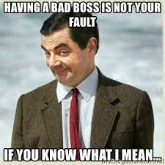
Make a list
What are all the problems that the boss creates to jack up and take advantage of the workers?

Slide 19
Boss Problems and Worker Solutions
2 Columns
  1 Problems the boss creates
  2 Worker solution
Come to consensus on your top 4 issues.
For those 4 – Create a collective bargaining solution.
Share out.

Slide 20
Key Ideas
Currently we tinker with Decisive Power and we capitulate to get what we want.
We want to move to a place where we have collective power to demand, win, and protect

Slide 21

Roadmap to Collective Bargaining
Your map should clearly show the following:
Who are the decision maker (school board, state board, county council, etc.), what decision do they make?
How do the members indicate their support or interest (formally) with the decision makers?
What happens if you get denied on your petition for recognition?
What are the deadlines, if any?
What is the minimum support workers have to show to win recognition?
What do you have to do to be ready to get recognition?
Add some thoughts on time to do each step (1 month, 2 months, etc.)
How many members are in your unit?
How many work sites?
How many leaders do you need?
What will you do to test your leaderships team ability to move people?

Slide 22

Start with the End Goal
You win a Collective Bargaining Agreement
Ratification vote by 95% of the members
Bargaining process-Teams, Teams, Teams
Support Collective Bargaining Card Signing (50% plus 1 minimum, but want at least 70% of ALL workers)
Get an MOU signed with the School Board
Worksite Teams-members or not-yet-members who are in a relationship with 90% of the workers in the worksite, are connected routinely to the leadership team, and have been trained on member-to-member conversations.
Identify a Bargaining Leadership Team-members only, trusted and respected, great if they were elected.
Notes:
3 min

Slide 23
Key Ideas
You need a diverse, trusted/respected, large, stable, committed team to generate the power to make it to the bargaining table.
Knowing your pathway to win CB is critical to giving strategic and campaign advice to leaders.
You need to set deadlines for your work, especially where there are no statutory limits. Your team needs to know there is a timeline for this work.
More people invited, identified, and doing the work of the union
You can’t have power if your reach and ability to activate the entire unit is under 65%.
Power is built from shared relationships between workers doing authentic work on teams across worksites and with other allies.
Notes:
This seems like too much for a slide and more like the talking points for slide 21 – Zac.

Slide 24
Key Ideas
The real win is not a bargaining agreement – it is a union with enough power to win the demands that materially improve the lives of members and students.
Notes:
I like this as *the* key idea slide.

Slide 26
How do you get people engaged in the work of winning a campaign to bargain?

Slide 27
Writing a Theory of Change…
IF we (do something(s)) then we will achieve (outcome(s) ).

Slide 28

Theory of Change (TOC)
“If we invite people authentically into the work of the union, engage them authentically and earnestly, give them meaningful roles and tasks, then we will build the relationships and power to change our working conditions.”
Notes:
2 min

Slide 29
Writing an organizing theory of change…
We are organizing who Specifically who believe core value, beliefs to do what specifically to demand what outcome by when.

Slide 30
An organizing theory of change…
We are organizing the certified employees of this distric who believe all students should experience teachers with safe and secure economic conditions to join build action teams, to communicate needs with community, and engage in pressuring the school board to demand an MOU outlining thier right to bargain collectively by December 2024 .

Slide 31
Key Ideas
People need to know why they are engaging.
Theories of change succinctly describe why – they tell the story.

Slide 32


Slide 34
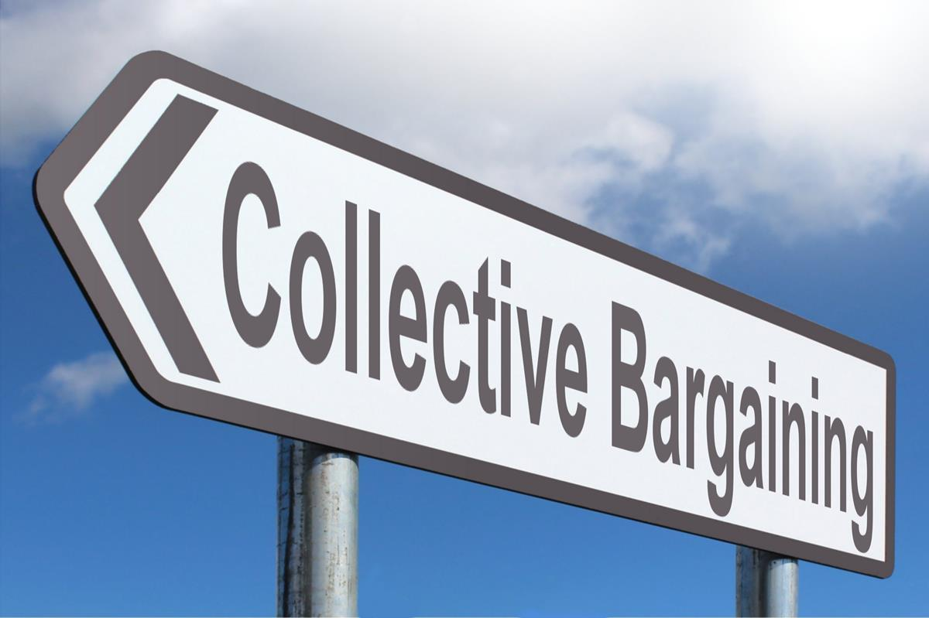
Chart Your Plan
Top Left corner: things you will do before the end of the school year, who’s doing it, and resources needed to complete
Top right corner: things will you do between summer and the end of 1st semester including who’s doing it, and resources needed to complete
Bottom left corner: things you will do in second semester or through the following summer, who’s doing it, and resources needed to complete
Bottom right corner: things that you don’t see the capacity to overcome before start of school 2024, including what the specific barriers are. ?

Slide 35

Coaching Your Plan
Get into threes with people not from your home state.
Present, ask questions.
Be specific in your feedback.

Slide 36
Key Ideas

Slide 38

Ending it Right
Lunch
Travel
Feedback via email

