Slide 1
Embedding Racial Equity into Bargaining
Values, Commitments, Tools, Training

Slide 2

Starts with…
Union Leadership!
Notes:
Who is union leadership?

Slide 3
Typical Process
President of the Local Association Selects the Bargaining Team
Local Union Board Approves the selected bargaining team and helps write the bargaining survey
Leadership makes the values and priorities of the bargain known to members.

Slide 4
Typical Process when we Embed Racial Equity
President of the Local Association Selects the Bargaining Team
Considers WHO is represented and WHO is not.
Asks potential bargaining candidates their commitment to racial equity.
Local Union Board Approves the selected bargaining team and helps write the bargaining survey
Uses a racial equity tool to reflect on their bargaining survey question.
Uses a racial equity tool to reflect on their bargaining priorities.
Leadership makes the values and priorities of the bargain known
How are you communicating this message.
Who is communicating this message and what values are represented?

Slide 5
Some guidance…
DO
DO NOT
State your values clearly to members and district leaders.
Train your team on common racial equity terms and how we will use an equity lens.
Use the equity lens to reflect on proposals or options in the bargaining process.
Create space and support leaders of color when they raise a concern at the bargaining table.
Bring in Leaders of Color and Expect them to be the only ones holding the group accountable to racial equity values
Only do upfront training with no plan to follow up or see the values throughout your bargain.

Slide 6
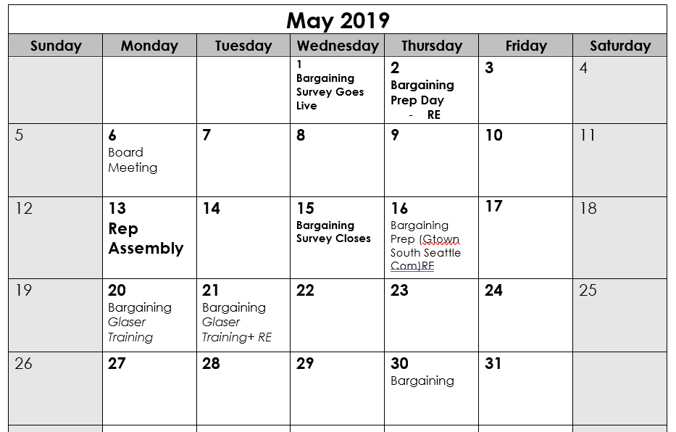
Tools to Support Your Team
Notes:
Equity Lens! (Questions that cause us to pause and reflect)
Equity Detours Articles
List of Common Racial Terms
Schedule time to reflect and use equity tools

Slide 7
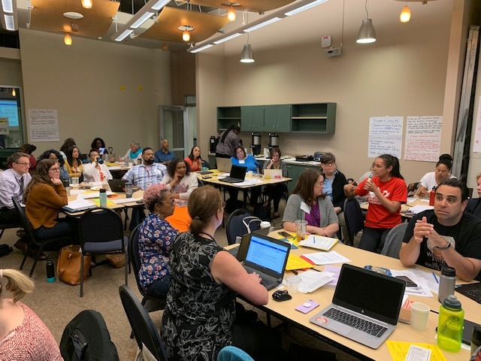
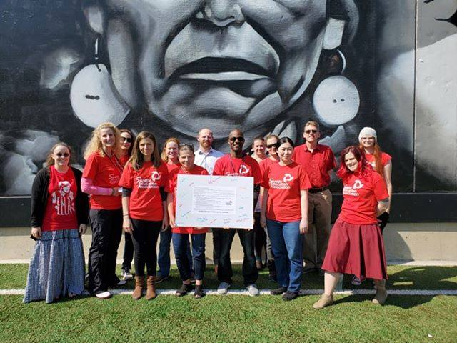

In Practice

