Slide 1
Module 6 Your Plan – Tactics and Strategy
UniServ Focus Academy

Slide 2

Module Agenda Overview
Notes:
M

Slide 3

Community Agreements
Share Responsibility for the Success of Each Session
Move up, Move Back – Participate Fully and Evenly
Respect Confidentiality
Listen Well for Deep Understanding
Expect and Accept Non-Closure
Expect and Accept imperfection
Notes:
Ellen

Slide 4
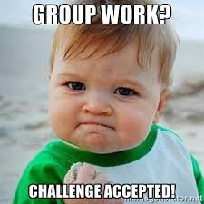
Team Planning for Tactics and Strategy

Slide 5
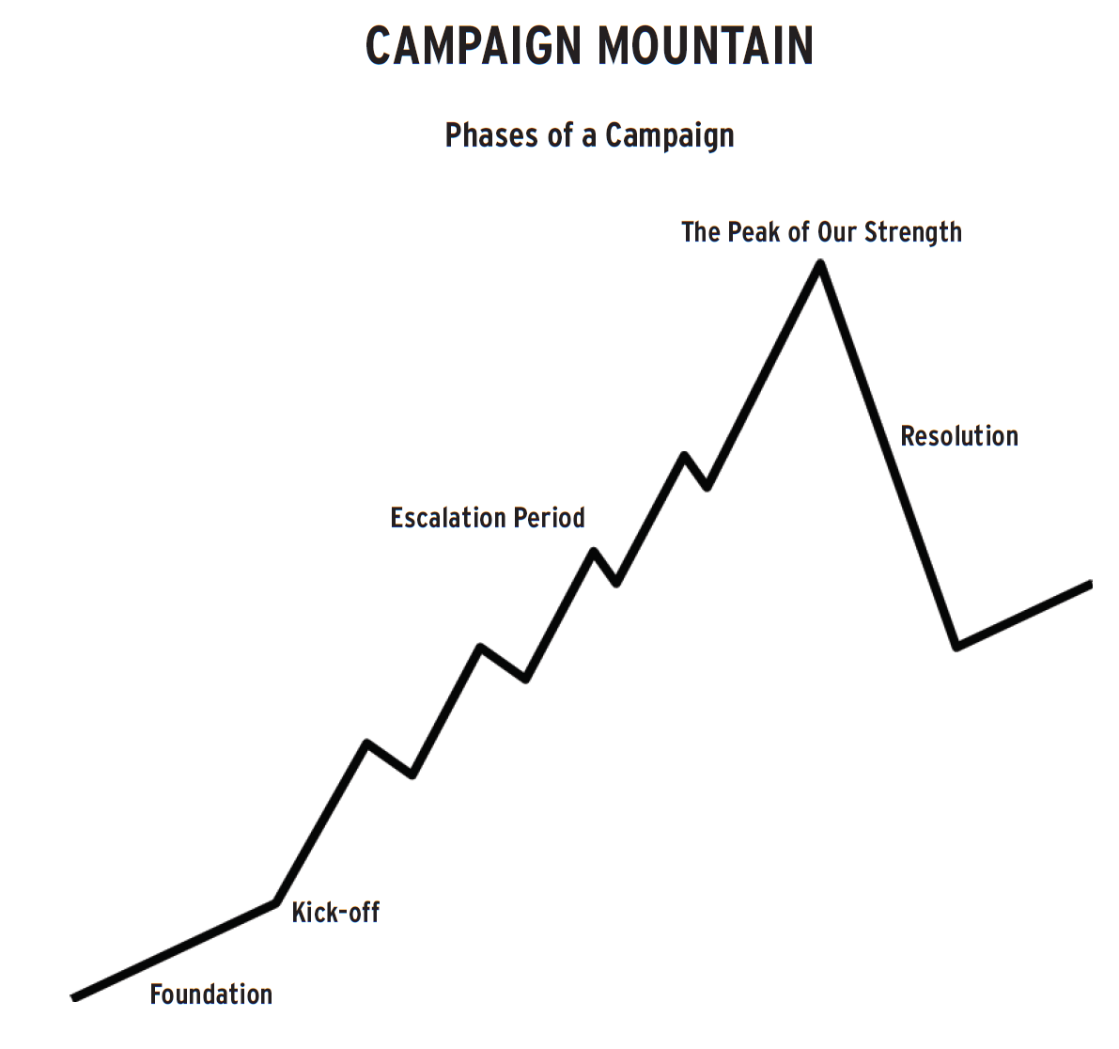

Your Tasks
For Example:
What is the overall strategy for this campaign- example: “We are bargaining to achieve a common good for our communities”
What are the tactics you will employ – from small to big that are going to help you implement that strategy.
What Structures can be developed to implement the tactics?
Remember the Assessment of Tactics

