Slide 1
Module 8 Peer Sharing
UniServ Focus Academy

Slide 2

Module Agenda Overview
Notes:
M

Slide 3

Community Agreements
Share Responsibility for the Success of Each Session
Move up, Move Back – Participate Fully and Evenly
Respect Confidentiality
Listen Well for Deep Understanding
Expect and Accept Non-Closure
Expect and Accept imperfection
Notes:
Ellen

Slide 4
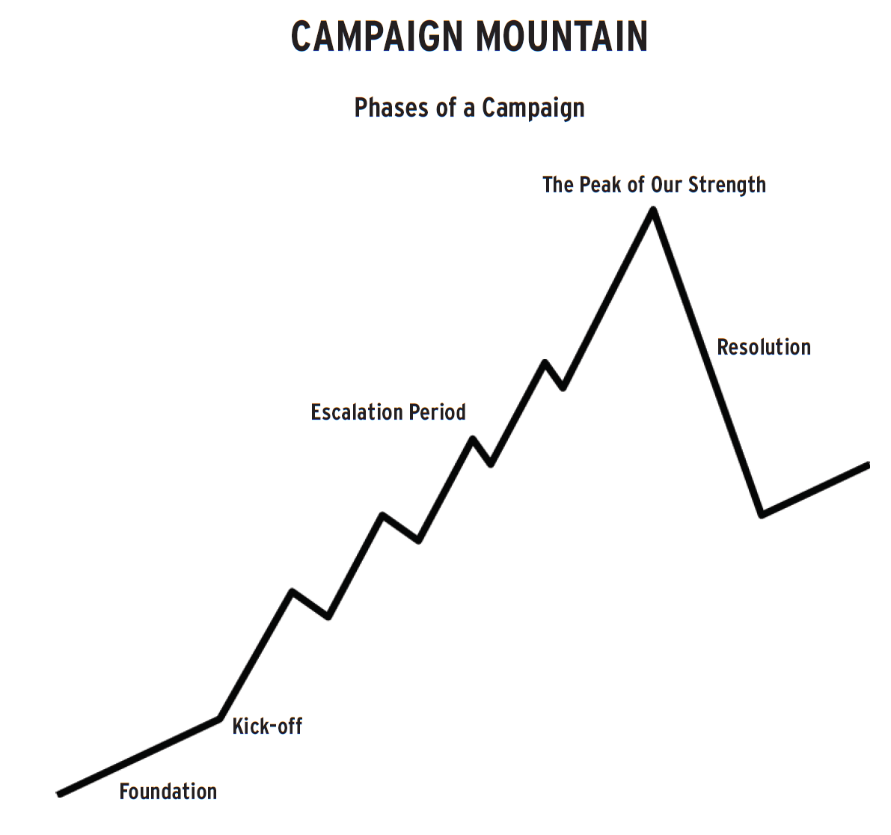

Sharing and Coaching
As you listen -
What is the narrative?
What is the issue?
What are the wins?
Who are the targets?
What is the escalation of tactics?
What are the structures developed?
What are the measures of strength and growth

