Slide 1
Module 5 Your Plan – Wins and Targets
UniServ Focus Academy

Slide 2

Module Agenda Overview
Notes:
M

Slide 3

Community Agreements
Share Responsibility for the Success of Each Session
Move up, Move Back – Participate Fully and Evenly
Respect Confidentiality
Listen Well for Deep Understanding
Expect and Accept Non-Closure
Expect and Accept imperfection
Notes:
Ellen

Slide 4
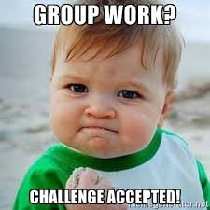
Team Planning for Wins and Targets

Slide 5
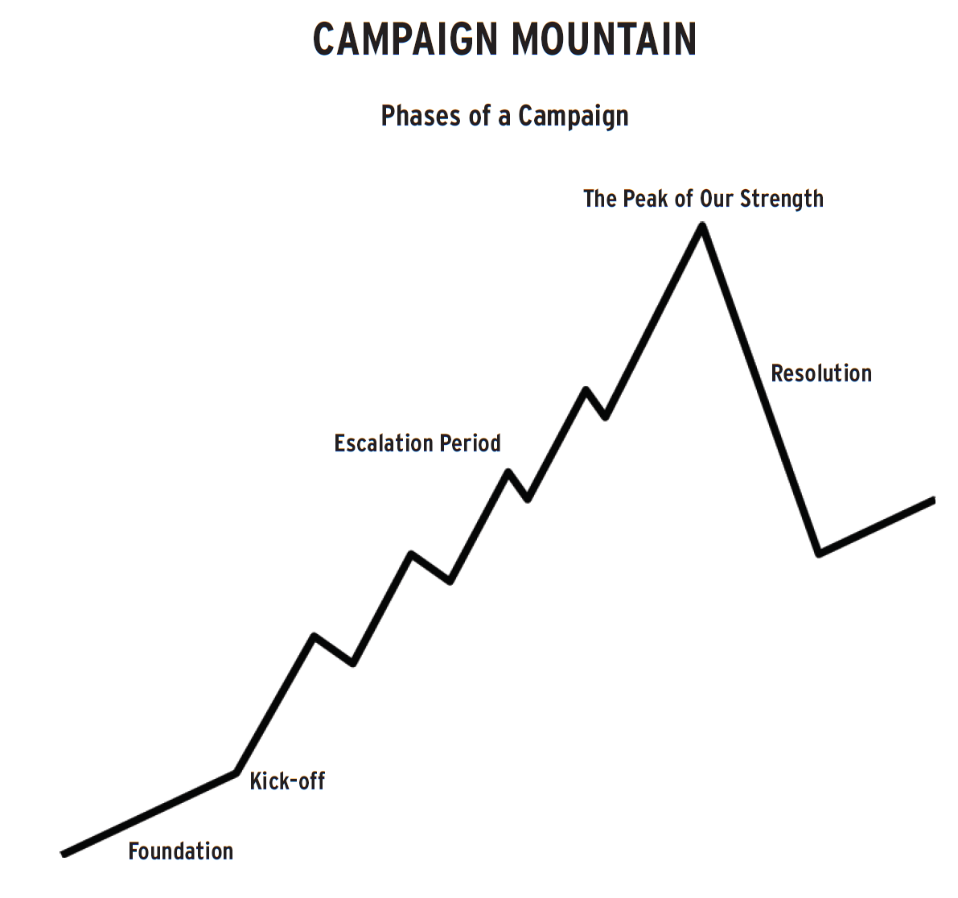

Your Tasks
What are your people’s issues?
What are the wins that your leaders and people want ?
Who are the targets?
Remember -there may be small wins along the way to the big win – and there may be a “cast of targets”
How will you measure the progress of these wins – Growth and Strength
.

