Slide 1
Module 7 Your Plan Focus on Data – Strength and Growth
UniServ Focus Academy

Slide 2

Module Agenda Overview
Notes:
M

Slide 3

Community Agreements
Share Responsibility for the Success of Each Session
Move up, Move Back – Participate Fully and Evenly
Respect Confidentiality
Listen Well for Deep Understanding
Expect and Accept Non-Closure
Expect and Accept imperfection
Notes:
Ellen

Slide 4
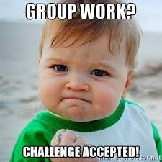
Team Planning for Data

Slide 5
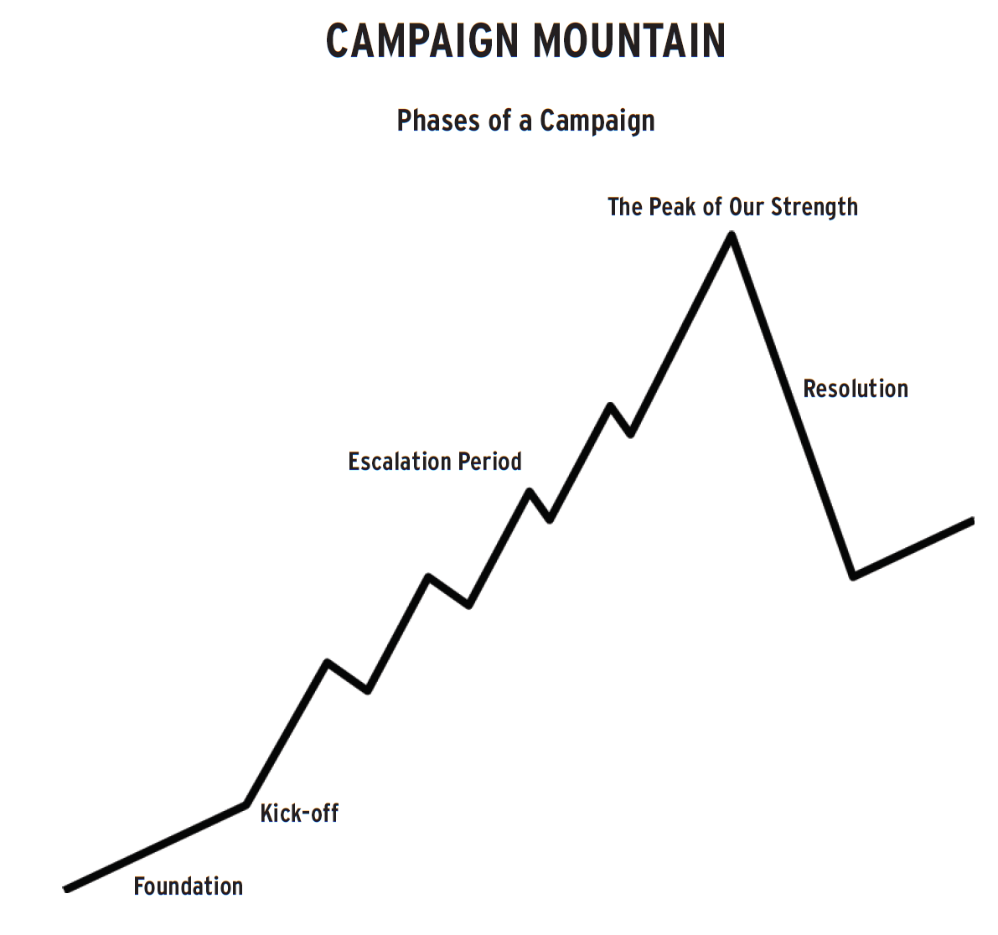

Your Focus
Each tactic should have a growth and a strength metric
How many new…..
How many did what at what level…
What is your strategic growth and strategic strength metric
How many new…..
How many did what at what level…

