Slide 1
VEA Organizing 2 Bargain

Slide 2
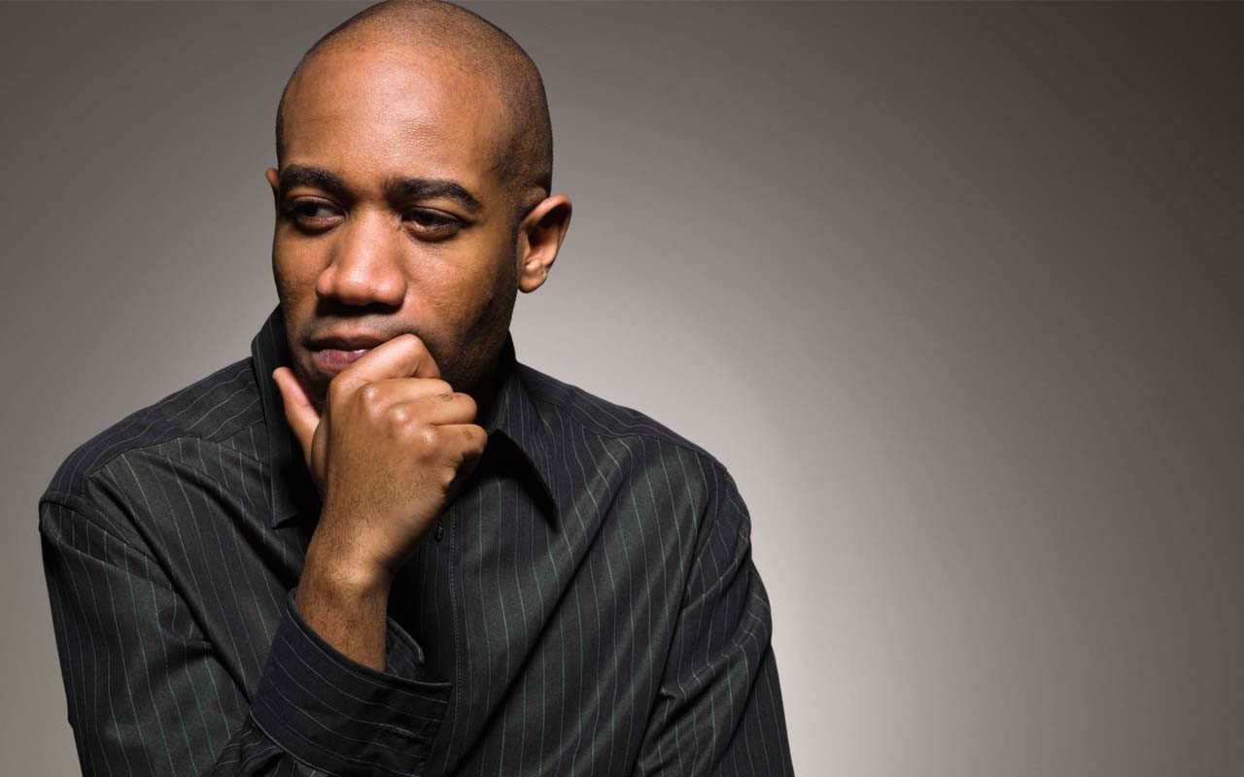
Chat Window Entry Activity
Who Is A Leader?
Among your leaders in your local(s) who do you consider a leader? Why?
- Enter into the Chat Window-

Slide 3
Module 1 Your Locals and the Campaign
UniServ Focus Academy

Slide 4

Module Agenda Overview
Notes:
M

Slide 5

Community Agreements
Share Responsibility for the Success of Each Session
Move up, Move Back – Participate Fully and Evenly
Respect Confidentiality
Listen Well for Deep Understanding
Expect and Accept Non-Closure
Expect and Accept imperfection
Notes:
Ellen

Slide 6

Meet the Team

Slide 7
Core Value
A core value is the fundamental belief of a person. This guiding principle dictates behavior and can help people understand the difference between right and wrong – These can be expressed using one or two words.
Notes:
Ben

Slide 8

Why Core Values?
Values are at the core of relationships, community and solidarity
People “join” with their values and their values and SHARED values keep people together in tough times.
Notes:
Ben

Slide 9

Katie and Todd

Slide 10

Organizing 2 Bargain Campaign Plan
What are our goals, and timeline, and expectations?
What are the opportunities to build your locals?
What are our roles in making this happen (managers, communications, and field)?

Slide 11

Tiers of Readiness to Bargain
  Lighthouse Locals
  Leadership Locals
  List Locals
  Latent Locals

Slide 12
Breakout Time – 30 Minutes
Working with your colleagues, grouped by NEA Organizer, take a look at the Four Tiers of Readiness to Bargain Document. You and your team are going to need to add measurable descriptors for each of the tiers that might include membership density, leadership density, engagement measures – and anything else that will help you as a team “diagnose” what level your locals or worksites are at.
This work will be ongoing, think of this time as a beginning point of conversation with your colleagues to make a document you will use together often to monitor your progress and inform your next steps.

Slide 13
Debrief
  Lighthouse Locals
  Leadership Locals
  List Locals
  Latent Locals

Slide 14

Pre- Meeting Reading Roundup
1. The Power of Deep Organizing
2. Services are Bad for People
3. How Organizations Develop Activists

Slide 15
Breakout – 15 Minutes
Configuration -Random Zoom Rooms of 3
Each person will be either article 1, 2, or 3 to focus 5 minutes of your comments on.
In your Zoom Room Use YOUR 5 minutes to address:
  What would it take for my locals to be like the locals in this article?
  What would be my role in supporting the development of this example?
  What would I need to know and be able to do to implement this example?

Slide 16
Debrief
1. The Power of Deep Organizing
2. Services are Bad for People
3. How Organizations Develop Activists

Slide 17
Where is the power, visibility and accountability:
Affiliate?
UniServ Staff?
Member?
Service
Organizing

Slide 18
From our reading…
“ The professional/client model is a superior versus inferior, or dominant versus submissive relationship. While well-run services have their place. they are never going to empower neighborhoods. ln fact. when analyzing communities, you'll find that the more services there are in the neighborhood, the less power that community has to control its future.”
-Services are Bad for People

Slide 19
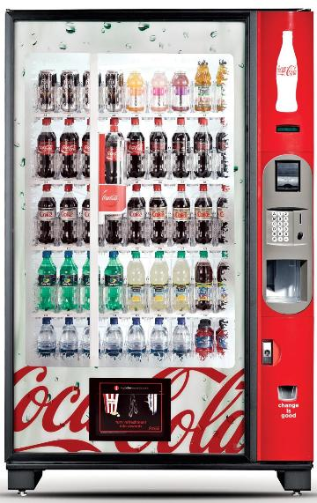

Which represents how you handle grievances?
Pg. 23
Are we a vending machine?
Or are we a gym membership?

Slide 20

Key Points
Services are about individual power and credibility
Collectivize the services you provide to build power
Identify the trusted and respected leaders and coach them
You have to let the members lead – then they grow
Notes:
Heidi

Slide 21


Why do we focus on a campaign model?
Notes:
Ellen

Slide 22
Grievance
Who is speaking, presenting, and doing the most talking/advocacy?
Direct, Staff-led Advocacy is the lowest form of member engagement and is most often invisible.
Well- organized worksites have a positive, visible union presence and members feel that they have the collective power to solve their problems.
When the entire building comes to a grievance meeting- that is powerful!
Notes:
Ellen

Slide 23
Campaign
A campaign is an action plan with a beginning, middle, and end, working towards a specific demand
A campaign involves a series of escalating actions (or tactics)
A campaign creates increasing pressure on decision-makers over time by escalating the intensity and visibility of the tactics and increasing the numbers of people involved
Campaigns are a way to identify in advance the ingredients we need to win and put them together in a way that maximizes our chances of success
Notes:
Ellen

Slide 24
Key Points
Grievances are typically invisible, with private, transactional relationships
Campaigns are visible, with collective displays of power, that transform member relationships with VEA.
Notes:
Ellen

