Slide 1
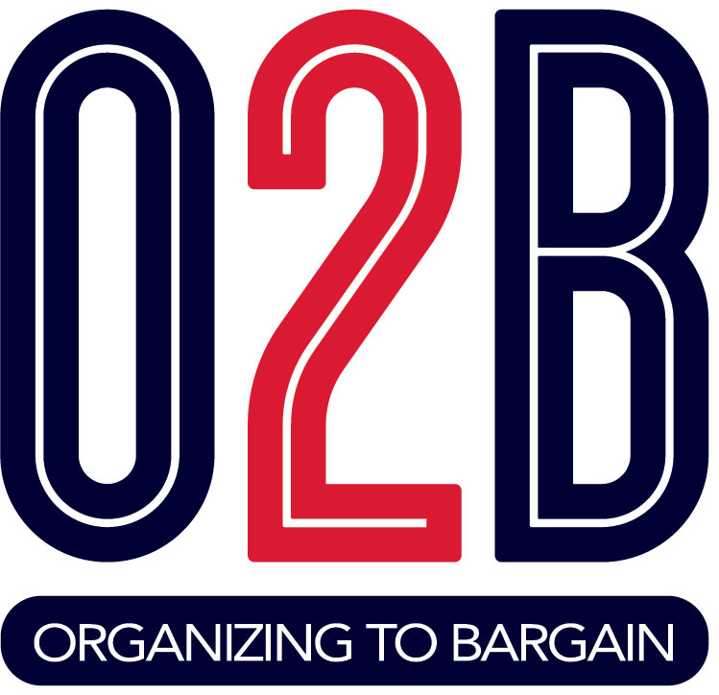
Welcome to VEA’s
Collective Bargaining Session!
Introductions:
Name
Work Position (teacher, bus driver, etc…)
Local Union

Slide 2

What Is Collective Bargaining ?
Collective bargaining
The process by which management and union representatives negotiate the employment conditions for a bargaining unit for a designated period of time. The parties have a mutual obligation to bargain in good faith in an effort to reach agreement with respect to wages, hours, and working conditions.
This obligation does not compel either party to agree to a proposal or to make a concession. Commonly referred to as “negotiations” or “contract bargaining.”

Slide 3
Conducting Negotiations
Generally, “traditional” bargaining refers to a situation where each side places their demands and proposals on the table and the other side responds with counter-proposals. The process is characterized each side clarifying their positions and handing written proposals back and forth, then discussing the proposals.
Interest Based IBB is focused on interests and working through options to get to proposals. Through the process, parties proactively identify durable solutions to outcomes at the bargaining table. Agreements are based on reaching agreements that mirror both sides interests. You first discuss the problem, then work to get what you think both sides need written down.

Slide 4
Traditional Pattern to Bargaining
Get a resolution passed by your school board
Select your local bargaining team, should be representative.
Prepare for bargaining
  Research the district budget
  Survey members
  Make sure your members know what your bargaining priorities are.
Conduct negotiations with School Board.
Ratify an agreement, your membership should vote to accept or not accept the contract
Resolving contract disputes
Changing or modifying the contract

Slide 5

Bargaining for the Common Good
Notes:
Regardless of the process of bargaining you use, bargaining for the common good is a style of bargaining taking root in many local unions. Bargaining for the common good looks at addressing community issues at the bargaining table. From recess in Seattle, to increased mental health supports and EL instructors in St. Paul, MN, people are recognizing the opportunity to improve the lives of students through their contracts. Read your materials for more information.

Slide 6
Benefits of Collective Bargaining
In states with strong unions, all or most of the state money earmarked for schools got spent on schools. In places with weak unions, we see less resources going toward students and being used to enhance the educational experience for our students.
The study finds that in strong union states more money goes into educator salaries not in district slush funds. Having higher paid educators that can spend their time on one job, not two, led to benefits for students.
In states with strong unions, state funding increases led to be greater test scores improvements.
Study entitled, “Unions, and the Allocation of School Resources” October 24, 2018

Slide 7
Would you want a voice in your district? If so, how would you make your voice heard?
BREAK OUT!
- Produce the things you want to have voice in and share them with the group.

Slide 8

What Has Previously Prevented Collective Bargaining in Virginia?
1977 decision by Virginia Supreme Court in Commonwealth v. Arlington County Board (217 VA 558, 1977) held that the State had not given local government or school boards authority to engage in collective bargaining.
This Photo by Unknown Author is licensed under CC BY
Notes:
1977 decision by Virginia Supreme Court in Commonwealth v. Arlington County Board (217 VA 558, 1977) held that the State had not given local government or school boards authority to engage in collective bargaining.

Slide 9
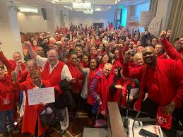
It’s A New Day!
Chapter 1276 of the 2020 Acts of Assembly permits but does not require local school boards to extend recognition to and bargain collectively with local association/union representing employees

Slide 10
What the Law says
Repeals the ban on public employee bargaining on May 1, 2021
School Boards can pass resolutions to support collective bargaining in their districts.
If districts do not pass a resolution, the employees can file for recognition. This means 50%+1 of the unit you represent must indicate they want to be represented.
The board has 120 days to consider the employee's request.
VEA believes an authorization card is the most defensible way to have locals file for recognition.

Slide 11
What the law does not do?
Does NOT guarantee the employer will recognize and bargain with the employee.
Does NOT set parameters on what you can or cannot bargain.
Does NOT create a labor board for employer/employee disagreement resolution.

Slide 12

What About Right to Work?
Doesn’t stop our unity and power.
Notes:
Other RTW states that have bargaining; Colorado, Missouri, Nevada, Indiana, Florida.

Slide 13

At the Local Level:
To bargain collectively a VEA local association must win a school board resolution in favor of bargaining & board recognition as the exclusive representative of school employees. There are many ways this can happen.

Slide 14
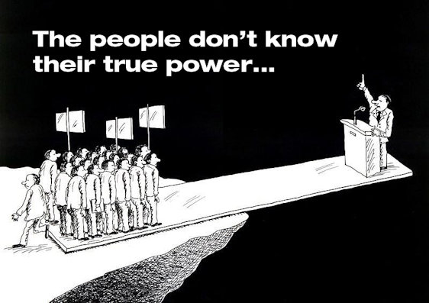
Our Union Can Influence Recognition
Recognition requires the school board to:
Specify appropriate unit of school employees for collective bargaining and
Establish procedures for certification of exclusive representatives.
Notes:
Recognition requires the school board to:
specify appropriate unit of school employees for collective bargaining and
establish procedures for certification of exclusive representatives.
Unit and certification are not defined in statute, which allows the local association/union to use general definitions and experience with collective bargaining to persuade the school board on local meaning.

Slide 15

Questions

Slide 16
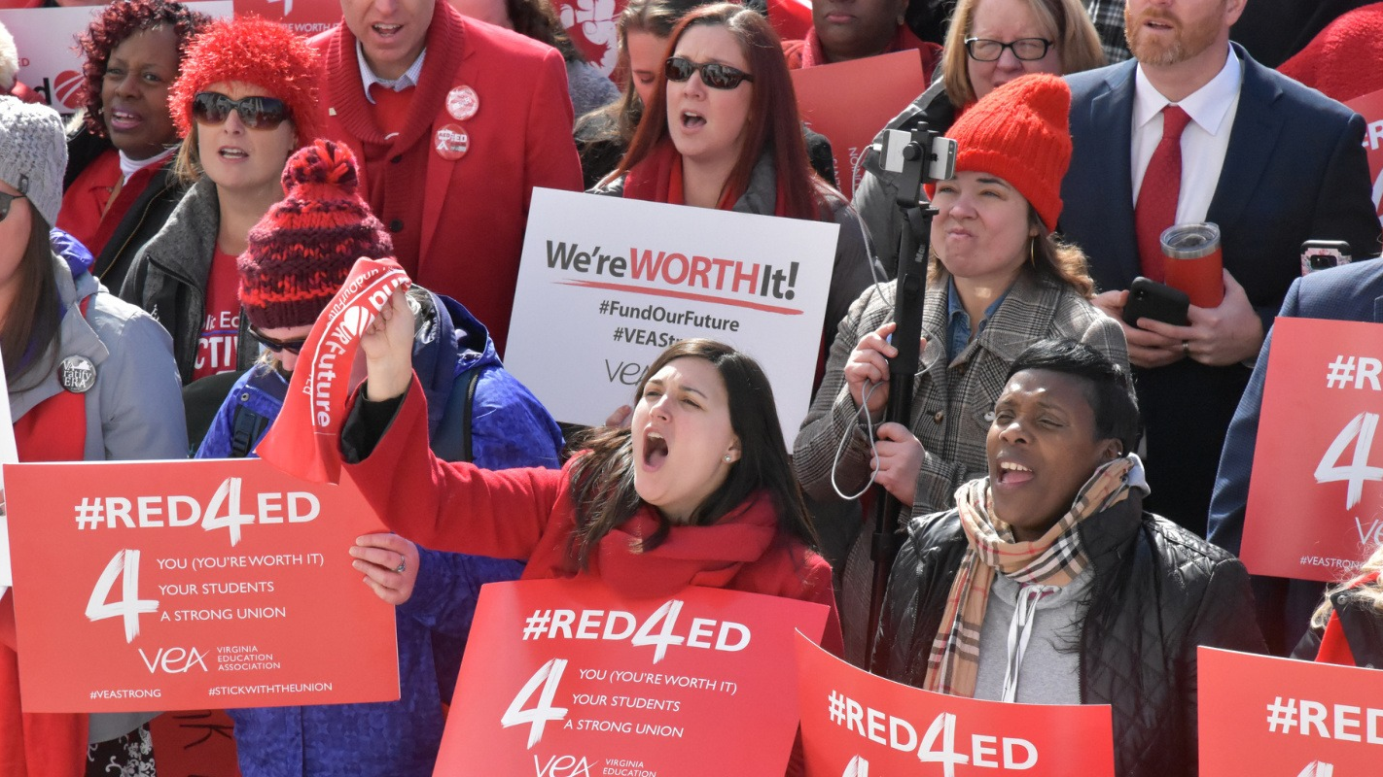
Building Power
“Organizing is turning the Resources we have into the Power we need to make change we want.”
Marshall Ganz
Notes:
Power WITH not OVER. This is not Nixon-style power, but power focused on people coming together around a shared vision for what our work life and public education should be.

Slide 17


Power?
Not POWER OVER
Power WITH
The ability of people coming together and influencing the workplace decision makers (boss/managers) to do things the workers want. (Sometimes, preventing the boss from doing things the workers don't want).
Notes:
Where does power over come from? Unity in action.

Slide 18
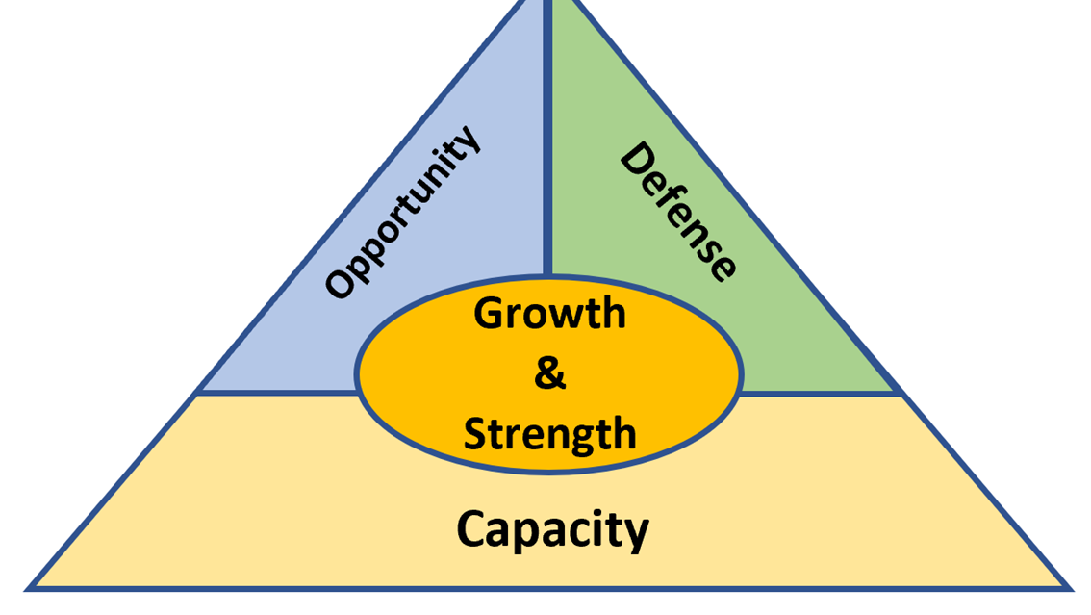
Density and Strength
Notes:
Let’s discuss the difference between Strength and Growth. They work together. Growth is simply the number of members. It is possible to have a very high membership density, and very weak union. So, what is strength? It is the ability (skills, leadership, resources) to achieve change, to act and win both in opportunities and in fighting against challenges. It is impossible to demonstrate strength without growth. People want to belong to something that allows them to be a character in a meaningful story. A local with high density numbers, that receives a lot of services, that views their membership as a product or transaction – will not automatically be able to act collectively.

Slide 19

First Steps
Identify Leaders
Creating A Plan
Mapping Your Worksite

Slide 20

Identifying Leaders
One way to building power is our worksite networks and relationships. It is a key resource because we find mentoring, guidance, friendships, collaboration, and support in those relationships.
There are several networks in our worksites. You must identify the leaders of those networks.
Build relationships within those networks to build the power needed to be effective no matter what tier you are in.

Slide 21
Mapping My Worksite
Worksite: _________________________
1. Place the name of someone who is trusted and respected in
a circle.
2. Write the names of people they have influence with around
the circle and connect them with a line.
3. Repeat until you place everyone you can.
Rob
Randy
*Lisa
Elaine
Randy
Joe
Marcus
Key: Member *New Hire

Slide 22
POWER - People Organizing With Effective Results
During Conversations:
Validate coworker issues.
Provide a solution on how to work together.
Create urgency to act now.
Educate what is being done or could be done to address an issue.
Ask for a meaningful commitment.

Slide 23
For Presidents, Map Your Local
- Density (% of potential bargaining unit)
- Buildings with reps
-Do your reps meet the 1 rep for 20 people in a building.
HS
Building Reps?
1:20?
Trusted/Respected
People ID?
ES
1:20? Building Reps?
Trusted/Respected People ID?
MS
1:20?
Building Reps?
Trusted/Respected
People ID?
Bus Barn
Building Reps?
1:20?
Trusted/Respected People ID?

Slide 24
School Board Assessment
Map your school board’s support of Collective Bargaining
Extremely influential
Somewhat influential
Influential
Not very influential
Not influential
 | Outspoken Champion | Supporter | Neutral or unknown | Opponent | Actively Opposed

Slide 25
Local Organizing to Bargain Committee
Campaigns for recognition have a 15-20% greater likelihood of success with large representative campaign committees.
1:15/20 of your potential membership represented.
Clear goals and benchmarks
Meaningful tasks (Identifying issues, handing out and getting back important surveys, leading meetings, helping trusted and respected staff, giving input into the campaign).

Slide 26

Reflection! Start your plan
Start your plan:
What is the first thing you can do once you are back home?
Who will you talk to?
Who will you approach for your first organizing to bargain committee member?

Slide 27
Next Steps
Talk to your colleagues about the issues they care about.
Create an organizing committee in your local.
Join the VEA PAC, we will need to protect these new rights.
Pre-Register for the Organizing to Bargain Conference on May 1.
Notes:
https://forms.veanea.net/view.php?id=547633
https://veafund.org/easypay/

