Slide 1


The Path to Winning Collective Bargaining
Notes:
Welcome to The Path to Winning Collective Bargaining.
.
Slide 1 Introduce the facilitation team by name, position, and work location. Ask Participants to put their name, work position, and local in the chat.
Our members want and deserve a meaningful seat at the table to ensure that the professionals who work closest with students have the resources they need to ensure that every child receives a quality education regardless of their zip code. Winning the right to collectively bargain around salary, benefits and working conditions is that meaningful seat at the table. We are so excited to have you with us to explore this tonight.

Slide 2
AGENDA
Introductions
Power
SWOT Analysis
Union Structure / CAT Roles
Level of Engagement – Strategies & Tactics
Next Steps – Readiness Factors
Notes:
Slide 2 AGENDA: Have the participants review the agenda, ask if they have any questions before you start.

Slide 3
Listen For Understanding
Participate With Intention
Invite Diverse Opinions
Take Care Of Personal And Group Health
Step up and Step Back
Electronic Etiquette
Norms
Notes:
Slide 3 Norms: Please read these. What else do we need to move forward? Are we okay with these? Have the participants affirm these are your norms.

Slide 4
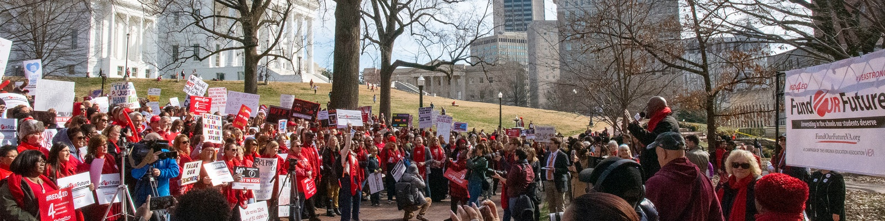
POWER
Notes:
Slide 4: Let's Dive in!

Slide 5

The Equity Principle
A frank, and not always complimentary, exchange of views must be expected;
The relationship between union bargaining team and employer is not a “boss-worker” relationship but one of “equal opposing parties;”
“Robust debate” may occur, but not “intemperate, abusive, or insulting language” (“outrageous” or “indefensible”)
Notes:
Power begins with view of who you are as a union leader and collectively what your local represents. Our Union balances out the level of power. This is a power that you must assume, your superintendent or site administrator may not grant you this power. Doing so, might make them feel they are ceding power. Don't wait for equity to be granted, take it.

Slide 6
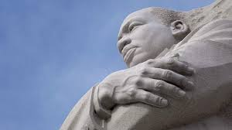
What is Power?
“Power, properly understood, is the ability to achieve purpose. It is the strength required to bring about social, political or economic changes. In this sense power is not only desirable but necessary in order to implement the demands of love and justice. One of the greatest problems of history is that the concept of love and power are usually contrasted as polar opposites.”
Martin Luther King Jr.
Notes:
Slide 6: What is power? (MLK Image)
Take a minute to reflect on this, what resonates with you? Share in the chat or share in our group by raising your hand. ( If time allows)

Slide 7

Power Is …
The ability to achieve a purpose. To have power means to have enough deployable resources to influence the outcome in a situation.
Notes:
Slide 7: Power is…
Read or ask someone in the group to read. Leader may want to repeat the 2nd sentence as emphasis before moving to the next slide.

Slide 8

Recognizing Our Power
Notes:
Slide 8: Recognizing our power
Show Video. If we had all the power in the world, what would we do? https://youtu.be/jop2I5u2F3U

Slide 9
Is Power good or bad?
Power is morally neutral.
To exercise your power, requires a process of evaluation, choice, and deployment—you need to decide if you exercise your power (or not) and how—which results in varying proportions of helpfulness and harmfulness.
Use your power of influence.
Notes:
Slide 9: Is Power good or bad?
We all hold meaning to the term power. We may see power through different frames. The power of a wave to support a surfboard for the ride of your life or the power of a wave to topple boars or buildings. Power itself is neutral. How power is used, what structures that power is embedded in to give advantage to some or disadvantage to others, is where we would see the ethics of how power is used or manipulated. When we talk of building power, we are discussing the power necessary to move seemingly immovable objects.

Slide 10

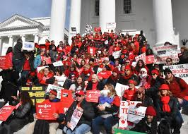
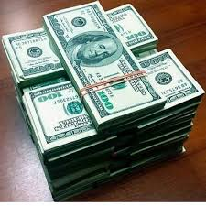
Organized People
Organized Money
Organized Ideas
Sources of Power
Notes:
Slide 10: Sources of Power
Those who have been granted power and who use power for their own benefit will not be easily moved to give up that power. Remember back to the videos that we recently viewed about collective action.
In organized people- relationships we have with each other is our strongest sources of power. We will talk about dipping into that later.
These sources of power can become institutionalized and become structuralized. Power was used to influence ideas and norms of thought into policies that lead to outcomes that perpetuate those ideas and norms. Think structural racism.

Slide 11
Four Pillars of Union Participation
4. The support of most or all of the rest of the group.
3. A group of co-workers who work with and assist building/worksite leaders.
2. Building/worksite leaders who put thought into what is happening, speak up, propose action, and assist union wide leaders.
1. Union wide leaders who put thought into what is happening, speak up, and propose action.
Notes:
Slide 11: Four Pillars of Union Participation
Where do your leaders fit into these layers?
Do our structures provide a path to engagement to reach our desired goals? This is a structure that provides many levels of engagement.
Does this look like your local?

Slide 12
How do we exercise our power during issue campaigns to win collective bargaining?
We Organize and Escalate.
Notes:
Slide 12: How do we exercise our power during issue campaign to win collective bargaining?
The path to winning collective bargaining is similar to the path we use to win on any issue.
We organize and escalate engagement and actions.

Slide 13
SWOT Analysis
SWOT
Strengths
Weaknesses
Threats
Opportunities
Notes:
Slide 13: SWOT Analysis Explanation
A Key step to winning collective bargaining in your local Step one: Analyze your local's level of power within the school system and in the community.
This is what would be done also after winning the right to bargain in order to prepare for negotiating a contract.
So what is a SWOT analysis? SWOT stands for:
Strengths: What do we do well?
Weaknesses: What structures or systems need improving?
Opportunities: What opportunities to grow and strengthen are local do we see?
Threats: Who is acting against us? What happens if we do nothing?

Slide 14
Local Union Activity
Prepare your SWOT Analysis
Determine the objective of your SWOT analysis
Decide on a key project or strategy to analyze and place it at the top of the page.
Label each box.
Add information and draw conclusions.
Make sure your union understands the SWOT analysis.
Notes:
Slide 14: Local Union Activity:
BREAKOUT ROOM: List our your locals SWOT elements. (5 min break out)
We will add them to a shared document that we screen share.
Strengths Weaknesses
Opportunities Threats
Think of the level of power in your local:
Make a list under strengths that answers, What does your local do well? Which structures or systems are working well?
Weaknesses: What can be improved? What structures or systems are not working to full capacity? What is still needed?
Opportunities: What are the opportunities to grow and strengthen your local? How would winning the issue impact the daily lives of your members?
Threats: Who is acting against you? What happens if you do nothing? What barriers are you facing?

Slide 15

Identifying Leaders
Notes:
Slide 15: Identifying Leaders
One common weakness is also an opportunity, the need to identify and engage more leaders. In this discussion we do not mean only those leaders who fill governance positions. We mean a leader simply as someone who has followers. Someone that people respect and will listen to or who are inspired by.

Slide 16
Basic Ways to Identify Potential Leaders
They show a higher level of engagement.
They have great communication skills.
They get the best out of others.
They know when to listen.
They're comfortable with failure.
Notes:
Slide 16: How to ID leaders
Have them trad the slide.
Ask the group… who come to mind for you? Imagine if we engaged those people as part of our bargains… how much power would we have?
Sum up: We are looking for those who are willing to get onto the playing field rather than stay in the stands. These may not always be the loudest person in the crowd, they are the ones who can be counted on.

Slide 17
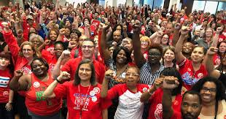
Contract Action Team
Notes:
Slide 17: Contract Action Teams
Contract Action Team is a vehicle for engagement with the purpose of building connections and creating movement that builds power.

Slide 18
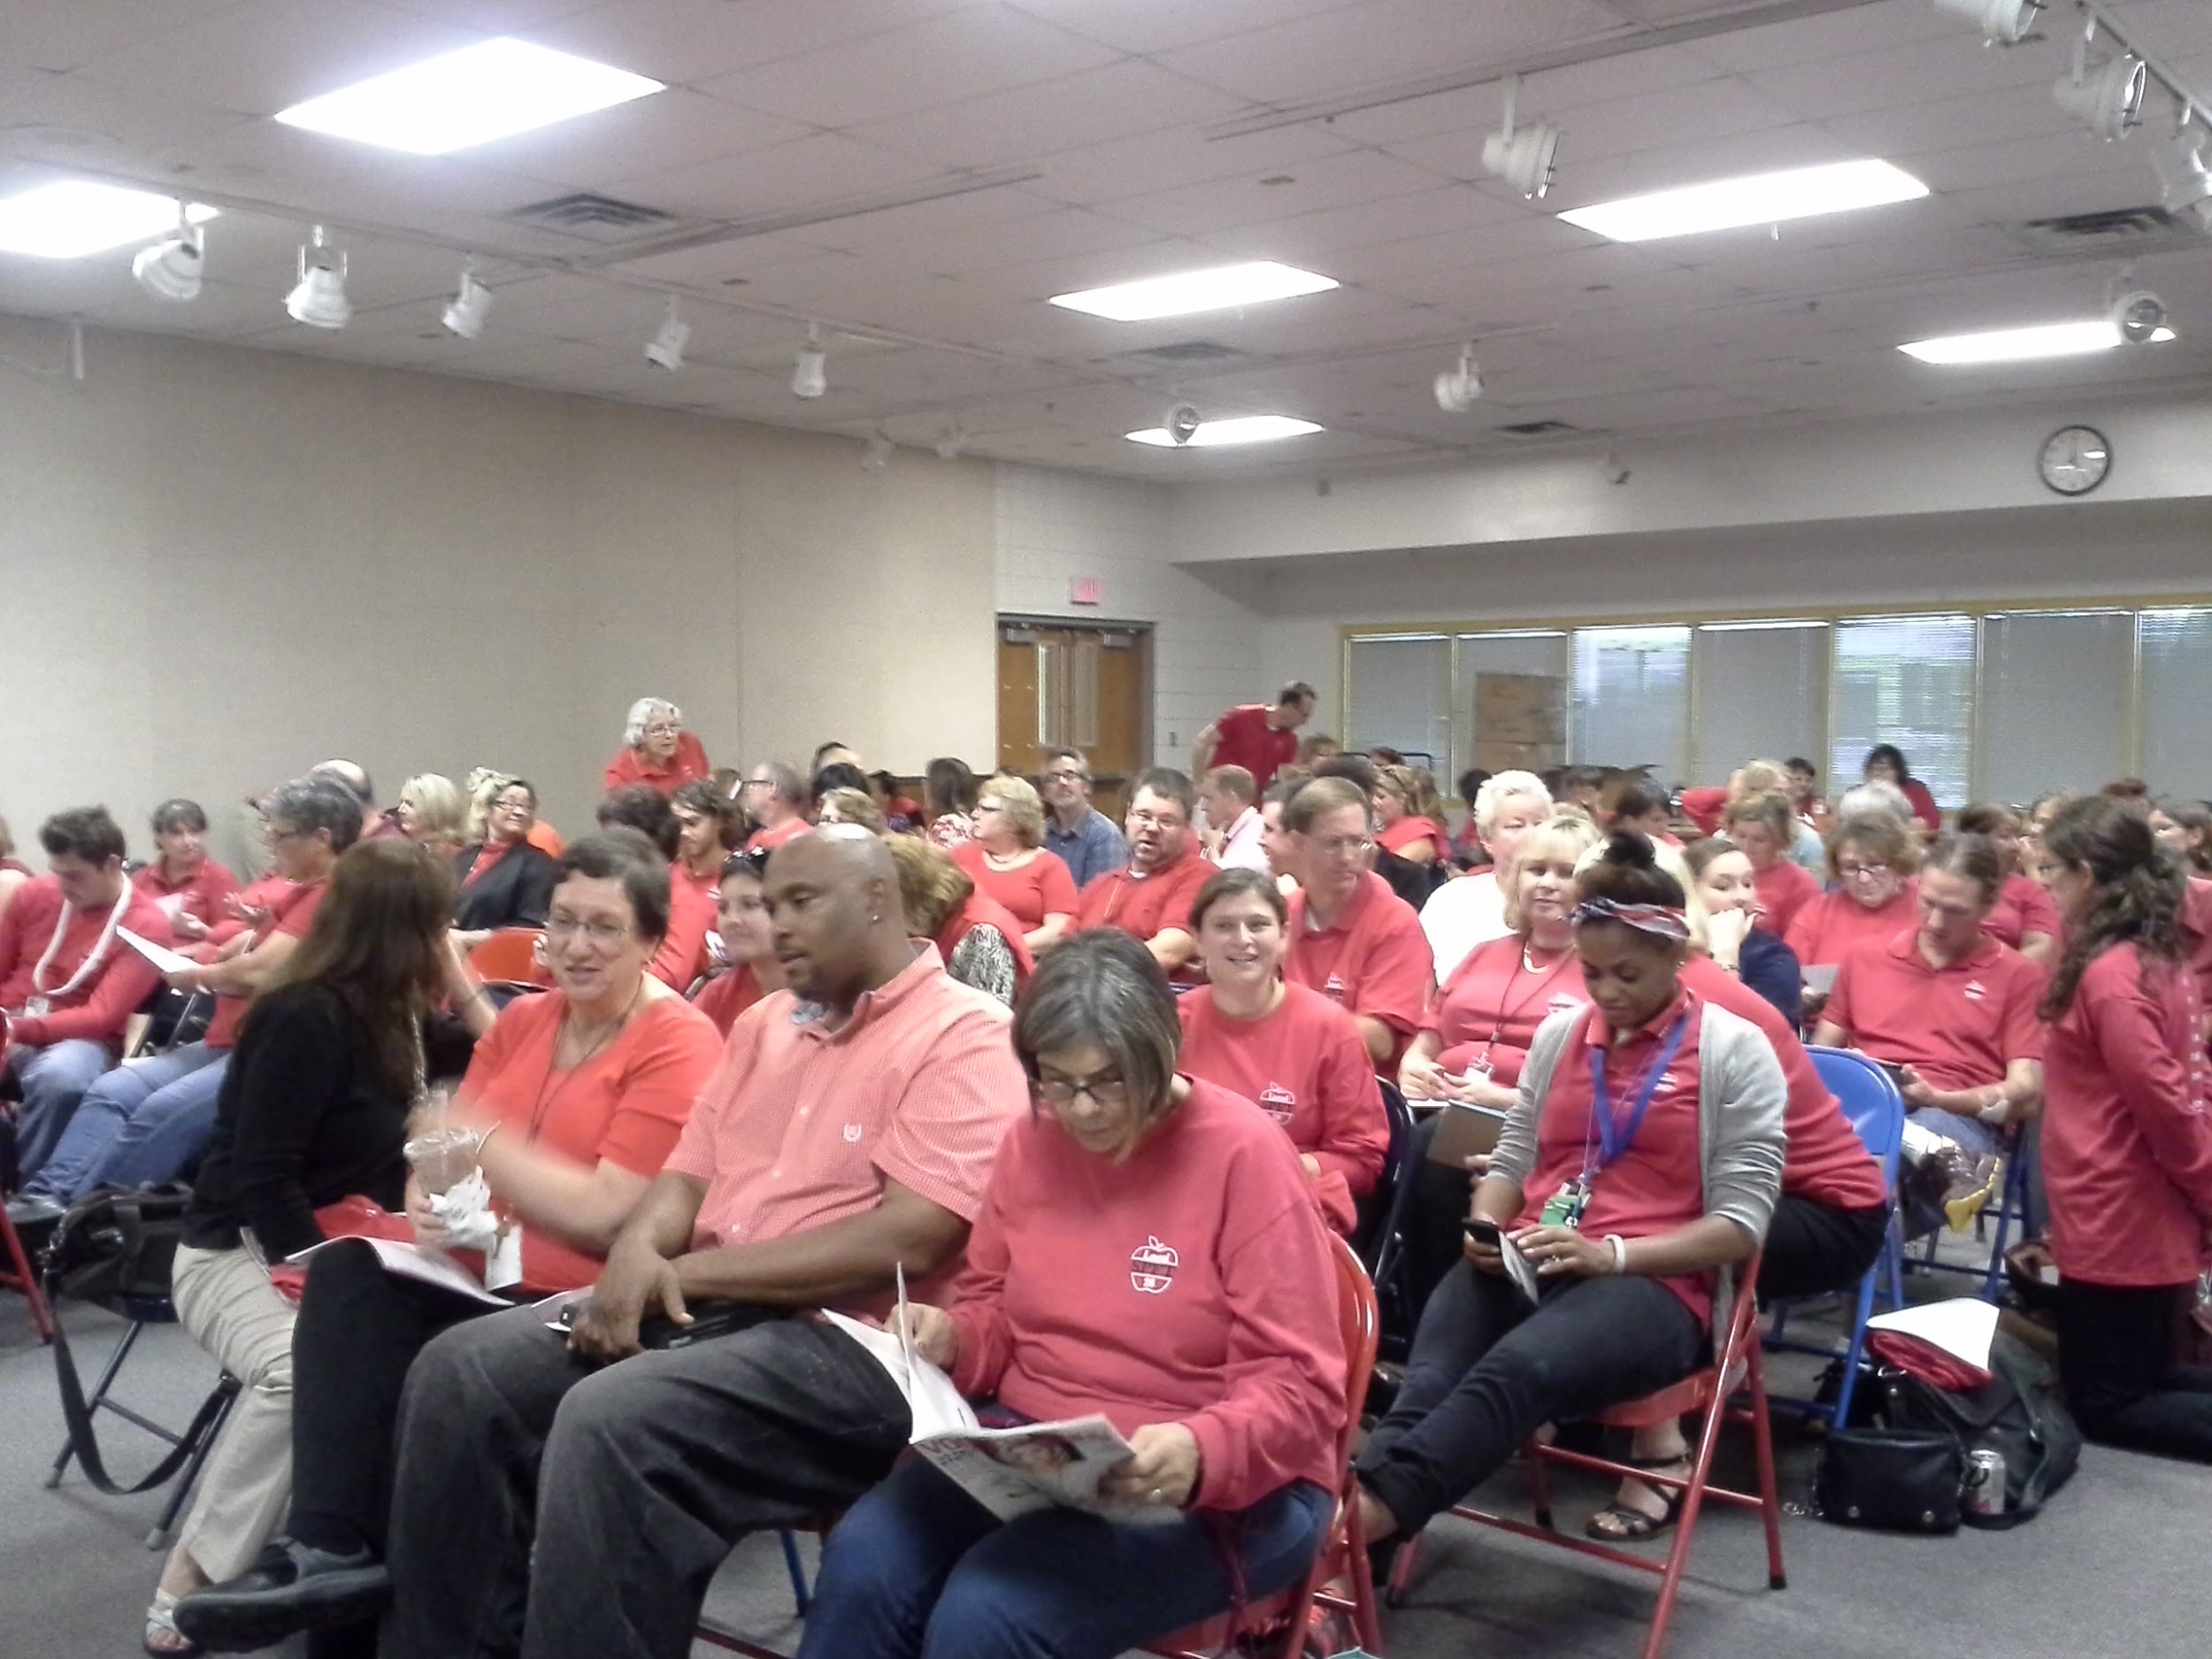
Contract Action Team Roles
Communicate to the membership
Collect information and stories
Attend sessions and turnout members
Organize participation in actions
Attend CAT training and meetings
Notes:
Slide 18: Contract Action Team Roles
Ration of 1:10, at most 1:20. Think about, how many people can be spoken to in a day. Many hands make light the load. This allows opportunity for building members to be engaged in a meaningful way.

Slide 19

Communication Best Practices
Collect personal emails from members (members only) to communicate updates
Make updates about bargaining specific to your building
Make time for one-to-one conversations
Divide up your group with a team member to make sure you are touching base with everyone
Be prepared to answer tough questions
Notes:
Slide 19: Communication Best Practices
Ration of 1:10, at most 1:20. Think about, how many people can be spoken to in a day. This team also uses the power of the ripple affect in communication. Speak to 3 and ask them to speak to 3 and so on, with each ripple reporting back to the one who asked them.
Pause, let them reflect. What is your reflection when you see this? Where would you place your local at this point?

Slide 20

Answer Tough Questions
Affirm
Respect the concern, but not necessarily agree
Answer
Give a clear, concise, concrete answer
Redirect
Ask a question or give a choice to redirect your co-worker back to solving the issues
AAR
Notes:
Foundation of power rests in the people. What is meaningful to those in our buildings to move them to action? The powerwell that results from this form of grassroots work is what is needed to meet or overcome the structural and financial power of our school administration and school board. While top down is a faster method, it is like a tree that grows quickly but with shallow roots. The first gust of wind can knock it down.
This is the work of contract team. Needs to be a network that moves info and call to action quickly. Generally a ration of 1:10 or at max, 1:20.
Watch video demonstrating Organizing Conversations. Note how the organizer Answers the Tough Questions: Affirm, Answer and Redirect

Slide 21

Organizing Conversations
<iframe width="560" height="315" src="https://www.youtube.com/embed/JcQbfnyPg1E" frameborder="0" allow="accelerometer; autoplay; clipboard-write; encrypted-media; gyroscope; picture-in-picture" allowfullscreen></iframe>
Notes:
AFSCME Video 1:1 conversations: https://www.youtube.com/watch?v=JcQbfnyPg1E
What examples did you see of how he answered the tough questions? (Affirm, Answer, Redirect)
What take- aways do you have from this video?
Jane McAlevey: Shared prior to training https://hubblecontent.osi.office.net/contentsvc/videohostpage/video?lcid=1033&syslcid=1033&uilcid=1033&app=3&ver=16&build=16.0.13628&platform=Win32&streamsso=true&appCorrelation=8F55ADBE-15EF-4F22-8CD4-8B55684E959D&url=https%3A%2F%2Fwww.youtube.com%2Fembed%2Fbl6P_2jt_Vs%3Ffeature%3Doembed
Takeaways
Be persistent and patient in identifying the most respected leader
Find out what matters to them
Can not shy away from hard conversations

Slide 22
Levels of Engagement
Everyone files the same grievance
Members turn in petition to superintendent
Effort
Reps wearing red
Survey
Host a Pizza Party
Intensity
Notes:
Level 21: Levels of Engagement
What do you see in this chart.
The harder the action and the more people that participate, the more power we have!
All the identification, leader ID, team building, leads us to this point- acting!

Slide 23
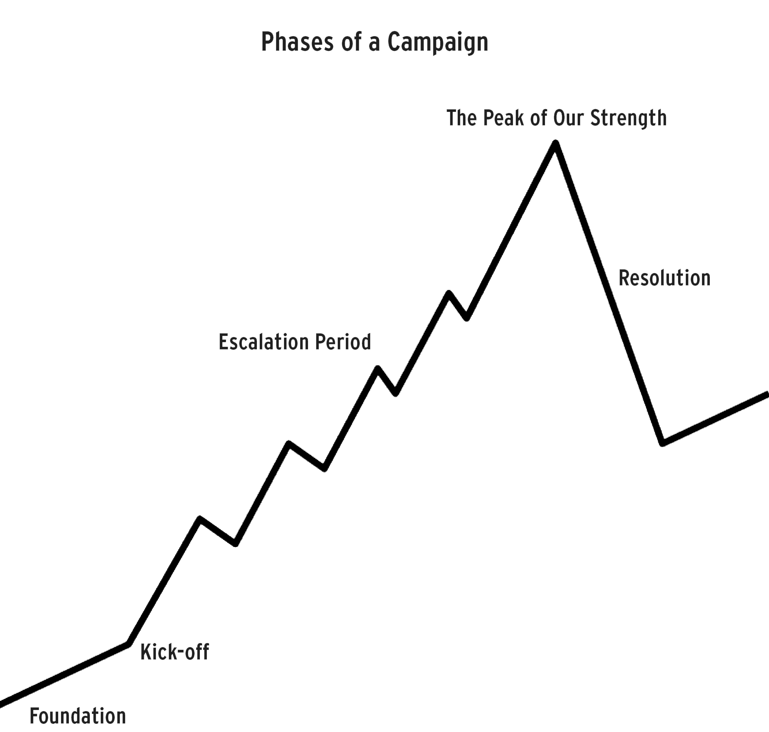
Campaign Mountain
What does an escalating contract campaign look like?
Notes:
Slide 23: Escalating Contract Campaign
When we understand how view to actions based on levels of engagement and intensity, then we want to build on each action to strategically raise the level of impact of leveraged power to influence stakeholders and decision makers. Remembering that nobody willing gives up or shares power.

Slide 24
Next Steps
Establish O2B Team
Map Your Sites
Build Your Contract Teams
Run Tests
Cards
School Board Resolution Vote
Notes:
Connect with your UniServ Director. Your UD has more resources to support your work than can be shared in this training.
Step 1
Get your initial organizing team together and identified.
Someone from each building, if possible. (More if the building is big).
Make sure your team is representative of your members and their work groups. (You may begin with a core group of 6-10 members)
This team will use the story of your local and members and create the narrative of the positive impact of having a meaningful seat at the table will be for your members.
This team will do the SWOT analysis, build the organizing plan, set goals and tactics to win the resolution for collective bargaining.
Step 2
Map Your Sites
Have a rep or someone you know map the building or worksite.
Assess their support of collective bargaining, who does or does not support CB? (Add a notation if they are a member or not).
Who is trusted and respected? Just ask people. You are looking for potential leaders and activists.
Step 3
Build Your Team – Includes your Contract Team at each worksite
Continue to build your team, pull more people into the team,
Once your organizing team is established have them establish:
Benchmarks to win recognition.
Goals.
Tactics to build density of support for collective bargaining.
Identify community stakeholders.
Step 4
Test
Run a test to see if your team can get people to move.
Sticker up.
Petition that your leads circulate.
Whole group pictures.
Step 5
Cards
If you have a majority that have/can act, then run them move to get cards filled out.
Step 6
School Board
How to get your school board to vote on collective bargaining.
Have your organizing team lobby your board members.
SB can vote to approve an ordinance outlining the local CB process.
If the school board has not moved to approve an ordinance, you can file authorization cards. This gives the district 120 days to consider the employee request.

