Slide 1
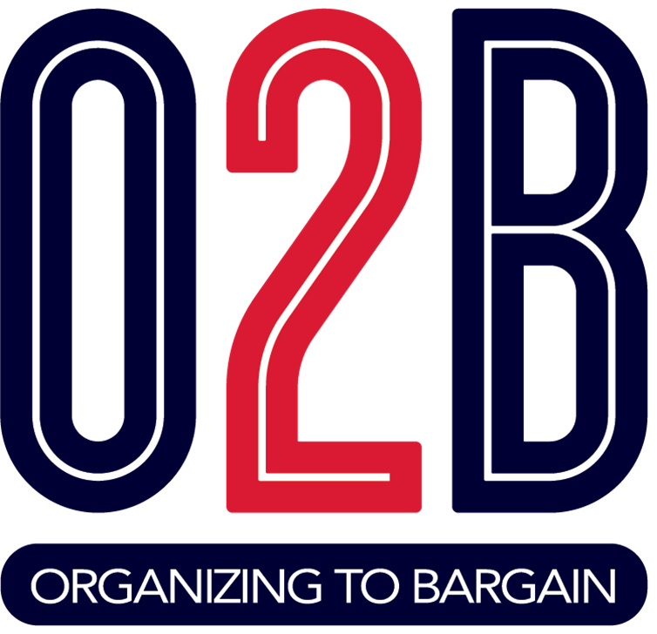
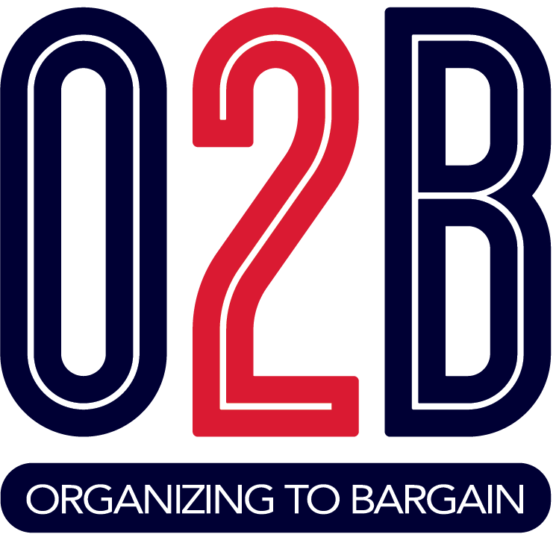

Begin with the End in Mind
Type in the Chat:
What Questions Do You Want Answered From This Session?
Notes:
Entry Activity

Slide 2
The Path to Winning Collective Bargaining

Slide 3
AGENDA
Introduction/Norms
What is Collective Bargaining?
Traditional Steps
Styles
Benefits
VEA’s Messaging on Collective Bargaining
Activity 1: Break Out Groups
VA History of Collective Bargaining
It’s A New Day- Understand the Law on Collective Bargaining
Building Power
First Steps
Local O2B Team
Activity 2: Reflection
Next Steps
Notes:
Time: 1 min
Slide 1-8 (Total Time 5:30-5:55)
Each team member introduces themselves: by name, position, and work location.
Maybe quickly state norms: We all know the basics by now on zoom meetings: Be kind, share the spotlight, mute when you are not speaking & put questions in the chat. We will leave the meeting open from 6:30-6:40 to answer questions that we may not have had time to address during the meeting.

Slide 4
Listen For Understanding
Participate With Intention
Invite Diverse Opinions
Take Care Of Personal And Group Health
Step up and Step Back
Electronic Etiquette
Norms
Notes:
Review Norms. Ask if anything is else needed.

Slide 5

What is Collective Bargaining?
Brings the union’s
collective vision
into a focused
contractual agreement
between employees
and administration.
Notes:
Time 1min
What is Collective Bargaining?
In aspirational terms, collective bargaining brings the union’s collective vision into a focused contractual agreement between employees and administration.
In its simplest terms, collective bargaining in K-12 education is an arrangement whereby a local school board recognizes a local Union as an exclusive representative for an employee group, with representatives of the Union and the school division bargaining a contract that lays out such things as salary, benefits, and working conditions. Teachers and education support professionals are among those commonly represented in contracts negotiated with K-12 school divisions in the U.S.
This obligation does not compel either party to agree to a proposal or to make a concession. Commonly referred to as “negotiations” or “contract bargaining.”
We also think of a contract as :
A written agreement that you (the staff of the district) sit coequal with the district to hammer it out.
Can use different styles, but it takes unity and power to bring everyone together.
Your contract is your voice, rights, and a reflection of your collective values.

Slide 6
Traditional Steps in the Bargaining Process
Select your local bargaining team
Prepare for bargaining
Research the district budget
Survey members
Make sure your members know what your bargaining priorities are.
Conduct negotiations
Ratify an agreement, your membership should vote to accept or not accept the contract
Resolving contract disputes
Changing or modifying the contract
Notes:
Time: 1 min
What are the normal steps of CB?
There is a handout from NEA that helps with this. But take a second to read this slide to get a sense of the typical bargaining pattern.

Slide 7
Various Forms of Collective Bargaining
Traditional Bargaining
Refers to a situation where each side places their demands and proposals on the table and the other side responds with counter-proposals.
Interest Based Bargaining
IBB is focused on interests and working through options to get to proposals. Agreements are based on reaching agreements that mirror both sides interests.
Notes:
Time : 1min
This is the process of HOW we reach an agreement. It is not to say which is better or right for you local. You get to decide that. One does not necessarily mean a better outcome or is inherently hard/better. Your districts stance toward working with you dictates how easily or hard the bargain will go. We all want the best for students and teachers.
Both involve setting norms,
Generally, “traditional” bargaining refers to a situation where each side places their demands and proposals on the table and the other side responds with counter-proposals. The process is characterized by each side clarifying their positions and handing written proposals back and forth, then discussing the proposals.
Interest Based IBB is focused on interests and working through options to get to proposals. Through the process, parties proactively identify durable solutions to outcomes at the bargaining table. Agreements are based on reaching agreements that mirror both sides interests. You first discuss the problem, then work to get what you think both sides need written down.

Slide 8

Addresses Community Issues at the Bargaining Table as Well:
School Nurses in Each Building
Small Class Sizes
Student Study Teams
Resource Allocations
Professional Development
Notes:
Time 1min
Regardless of the process of bargaining you use, bargaining for the common good is a style of bargaining taking root in many local unions. Bargaining for the common good looks at addressing community issues at the bargaining table. From recess in Seattle, to increased mental health supports and EL instructors in St. Paul, MN, and to reducing the number of charter schools in L.A.- people are recognizing the opportunity to improve the lives of students through their contracts. Read your materials for more information.

Slide 9
In states with strong unions, all or most of the state money earmarked for schools got spent on schools.
The study finds that in strong union states more money goes into educator salaries not in district slush funds. Having higher paid educators that can spend their time on one job, not two, led to benefits for students.
In states with strong unions, state funding increases led to be greater test scores improvements.
Source: “Unions, and the Allocation of School Resources” October 24, 2018
Collective Bargaining Benefits All: Students, Communities, and Educators
Notes:
Time: 1min
Collective bargaining benefits all—students, communities, and educators. The primary reason is that efforts to improve the working conditions for school employees simultaneously improve the learning conditions for students. Strong unions produce better outcomes for staff and for students.
In states with strong unions, all or most of the state money earmarked for schools got spent on schools. In places with weak unions, we see less resources going toward students and being used to enhance the educational experience for our students. .
The study finds that in strong union states more money goes into educator salaries not in district slush funds. Having higher paid educators that can spend their time on one job, not two, led to benefits for students.
In states with strong unions, state funding increases led to be greater test scores improvements.
The Advantages of Collective Bargaining
Here is one way of looking at the benefits, drawing upon conditions we now face in the Commonwealth.
Through the collective bargaining process, educators bring their professional experience and ideas to the table—and that will enhance opportunities for students.
In other states with collective bargaining, educators and school districts have negotiated agreements that lowered class sizes, provided for extra resources for students, and addressed school health and safety issues, among other benefits. These things benefit employees such as teachers and ESPs as well as students.
Before the Virginia Supreme Court put an end to locally bargained contracts in 1977, VEA local Unions had bargained provisions on such issues as adding art, music, and reading teachers, school discipline policies, setting of the school calendar, and many others.
Negotiations ensure that the perspective of teachers and ESPs, who see students every day, will be recognized—and that’s good for public schools.
Locally bargained contracts help ensure that Virginia attracts and retains the best educators to our classrooms.
Frequent staff turnover hurts students, and low pay and benefits are one reason that teachers leave their jobs.
Virginia has hundreds of unfilled teaching positions, and many other positions are filled by individuals without full certification. Virginia ranks 32nd in the nation in teacher pay, while enrollments in teacher preparation programs are declining.
Collective bargaining can help ensure educators are paid a professional wage with adequate benefits, and that will increase the supply of excellent educators.
Collective bargaining ensures that educators have a genuine voice in their school division.
Poor working conditions are a barrier to teachers’ and support professionals’ success with students and leave them drained and discouraged. Educators’ working conditions ARE student learning conditions. Through collective bargaining, teachers and support professionals have a genuine voice in decisions that matter for students and for school personnel.
Bargaining provides a means for identifying—and solving—problems and challenges for the betterment of student learning
Collective bargaining provides an avenue for addressing the racial and social inequities that exists in our public schools and communities.
VEA, NEA, and local affiliates of the VEA have long advocated for policies to advance equity and justice and worked to better equip school staff to advance those goals in their classrooms and their communities.
In 2020, two events made these goals even more vital. The COVID-19 pandemic, which disproportionately harmed majority black and brown communities, laid bare the long-standing structural flaws in Virginia K-12 public education funding and lack of support. Moreover, the social movement rising after the deaths of George Floyd and Breonna Taylor brought the inequities into every American living room.
Unions with collective bargaining rights have long fought and won strategies to advance equity in schools and communities, including:
• Funding strategies that target students and schools that need additional resources
• Special programs to develop learning resources and train staff to foster more inclusive teaching practices and materials
• Special positions to advance and monitor equity efforts
• And many more
The events of 2020 underscore the potential of collective bargaining to advance our goals of racial and social justice.
VEA statewide surveys of members have consistently shown that they look for the Union to help them achieve better compensation and working conditions and to help remove barriers they face in providing the best possible learning conditions for students.
The contract a Union is able to bargain becomes the members’ voice at work. Each VEA member should
be carefully considering what their vision is for a

Slide 10
VEA’s Message: The Advantages of Collective Bargaining
Utilize Professional Experience
Recognize Perspective of Those on the Front Line
Attract and Retain the Best Educators
Professional Wage & Benefits
Genuine Voice of Educators are Heard
Means for Real Solutions that Lead to Better Outcomes
Address Racial, Social and Economic Injustices
Notes:
The Advantages of Collective Bargaining
(Slide lists summary of each advantage statement listed below. This messaging is in the white paper that is in the handouts.
Here is one way of looking at the benefits, drawing upon conditions we now face in the Commonwealth.
1.Through the collective bargaining process, educators bring their professional experience and ideas to the table—and that will enhance opportunities for students.
In other states with collective bargaining, educators and school districts have negotiated agreements that lowered class sizes, provided for extra resources for students, and addressed school health and safety issues, among other benefits. These things benefit employees such as teachers and ESPs as well as students.
Before the Virginia Supreme Court put an end to locally bargained contracts in 1977, VEA local Unions had bargained provisions on such issues as adding art, music, and reading teachers, school discipline policies, setting of the school calendar, and many others.
2.Negotiations ensure that the perspective of teachers and ESPs, who see students every day, will be recognized—and that’s good for public schools.
3. Locally bargained contracts help ensure that Virginia attracts and retains the best educators to our classrooms.
Frequent staff turnover hurts students, and low pay and benefits are one reason that teachers leave their jobs.
Virginia has hundreds of unfilled teaching positions, and many other positions are filled by individuals without full certification. Virginia ranks 32nd in the nation in teacher pay, while enrollments in teacher preparation programs are declining.
4. Collective bargaining can help ensure educators are paid a professional wage with adequate benefits, and that will increase the supply of excellent educators.
5. Collective bargaining ensures that educators have a genuine voice in their school division.
Poor working conditions are a barrier to teachers’ and support professionals’ success with students and leave them drained and discouraged. Educators’ working conditions ARE student learning conditions. Through collective bargaining, teachers and support professionals have a genuine voice in decisions that matter for students and for school personnel.
6. Bargaining provides a means for identifying—and solving—problems and challenges for the betterment of student learning
7. Collective bargaining provides an avenue for addressing the racial and social inequities that exists in our public schools and communities.
VEA, NEA, and local affiliates of the VEA have long advocated for policies to advance equity and justice and worked to better equip school staff to advance those goals in their classrooms and their communities.
In 2020, two events made these goals even more vital. The COVID-19 pandemic, which disproportionately harmed majority black and brown communities, laid bare the long-standing structural flaws in Virginia K-12 public education funding and lack of support. Moreover, the social movement rising after the deaths of George Floyd and Breonna Taylor brought the inequities into every American living room.
Unions with collective bargaining rights have long fought and won strategies to advance equity in schools and communities, including:
• Funding strategies that target students and schools that need additional resources
• Special programs to develop learning resources and train staff to foster more inclusive teaching practices and materials
• Special positions to advance and monitor equity efforts
• And many more
The events of 2020 underscore the potential of collective bargaining to advance our goals of racial and social justice.
VEA statewide surveys of members have consistently shown that they look for the Union to help them achieve better compensation and working conditions and to help remove barriers they face in providing the best possible learning conditions for students.
The contract a Union is able to bargain becomes the members’ voice at work. Each VEA member should
be carefully considering what their vision is for a

Slide 11

Activity 1:
In your break-out group discuss:
  Which of the VEA messaging points that we just shared, resonates with you?
  What would the impact be for your colleagues and for students if it became a reality in your school district?
Notes:
Break Out Discussion
Read the directions for the Break Out, and inform how much time they will be in the break out room.
Which of the VEA messaging points that we just shared, resonates with you?
What would the impact be for your colleagues and for students if it became a reality in your school district?
Upon return, call on a few to share which point resonated and what would be the impact if it became a reality.

Slide 12

What Has Previously Prevented Collective Bargaining in Virginia?
1977 decision by Virginia Supreme Court in Commonwealth v. Arlington County Board (217 VA 558, 1977) held that the State had not given local government or school boards authority to engage in collective bargaining.
Notes:
Time: min
A Brief History:
In the late 1960s and early 1970s, in conjunction with nationwide gains in Union membership and passage of laws permitting public sector collective bargaining in some states, VEA and other Unions organizing public employees formed a coalition to win a Virginia law. The effort failed to deliver a law, but several VEA Local Unions capitalized on their strong membership and power to win representation and bargaining rights from their local school boards.
By the 1970s, VEA Locals in Alexandria, Arlington, Charlottesville, Fairfax, Falls Church, Norfolk, Prince William, and Virginia Beach and a few others—representing more than one third of the state’s 90,000 teachers—negotiated contracts, board policy, and/or memoranda of understanding with their local school boards. Wages and benefits were negotiated, but the agreements also included provisions on issues such as discipline policies and the provision of specialist positions in art and music.
The growing influence of VEA’s Locals sparked a backlash, however. Virginia Governor Mills Godwin directed the Attorney General to file suit to stop local school boards from engaging in bargaining.
In 1977 the Virginia Supreme Court overturned these local arrangements, saying that local boards lacked the authority to bargain collectively or to even extend exclusive representation to an employee group as bargaining agent. The loss of a collective bargaining option for educators was a significant blow, but subsequent legal opinions and state regulations made clear that:
• Employees, and representatives of employees, such as Union leaders, did not give up their rights of speech or association. So, for example, a school board could not prevent a Local president from speaking at a school board budget meeting as a person representing the interests of all Union members.
• Local school divisions had a duty, as prescribed by the Standards of Quality, to engage in two- way communication with employees and discuss concerns in an orderly and constructive manner.
• Nothing prevented VEA Locals and school divisions from engaging in a process that became known as “meet-and-confer.” Simply put, meet-and-confer meant that VEA Locals could regularly bring members’ concerns—issues or challenges members were facing—to the school division’s attention. They could also, and did, make proposals regarding salaries and advocate for members by serving on insurance committees, for example. It was a far cry from bargaining that led to an enforceable contract, but at its best it made sure that members’ concerns were heard.
After 1977, VEA campaigned to overturn the ban on public sector collective bargaining in Virginia. As part of one campaign, members approved a 10-year plan to win bargaining back, but it failed to gain traction in the General Assembly. A subsequent VEA campaign using the catchphrase “Professional Negotiations” also failed to deliver a solution. In fact, the General Assembly in 1993 passed legislation codifying the Virginia Supreme Court’s prohibiting collective bargaining by public employees as noted on the slide.
The drought continued until 2020.
Sources
Virginia Education Association History
Keeping the Promise: 150 Years of Advocacy for Children and Public Education
Virginia Education Association Report
“Collective Bargaining in Virginia: What’s Prohibited—What’s Not”

Slide 13
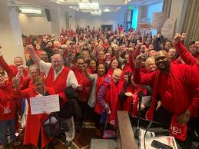
It’s A New Day!
Repeal of the Ban on Collective Bargaining
Notes:
Time: 1 min
It is a New Day!
Chapter 1276 of the 2020 Acts of Assembly permits but does not require local school boards to extend recognition to and bargain collectively with local association/union representing employees
What does the new law say?
It repeals the ban on May 1, 2021.
Your school board must pass a resolution before you can bargain.
If they do not, you can move authorization cards to assert you have 50%+1 of the bargaining unit that wants to be represented. From there, the law is not clear. It will take power.

Slide 14
What the Law Says
Repeals the ban on public employee bargaining on May 1, 2021
School Boards can pass resolutions to support collective bargaining in their districts.
If districts do not pass a resolution, the employees can file for recognition. This means 50%+1 of the unit you represent must indicate they want to be represented.
The board has 120 days to consider the employee's request.
VEA believes an authorization card is the most defensible way to have locals file for recognition.
Notes:
Time: 2 min
Finally, on the last weekend of the 2020 regular session of the General Assembly, the Virginia House and Senate passed a compromise bill, SB 939, that repealed the ban and was “permissive” regarding bargaining: Localities that chose to recognize an employee group and negotiate agreements were now permitted to do so, but localities also had the right not to take these actions.
Though the “permissive” bill was not as robust as advocates sought, it was nonetheless an historic win for the labor movement and for public sector collective bargaining in particular. The ban that had stood since 1977 was overturned. “This is the most significant change in Virginia labor law in decades,” Economic Policy Institute President Thea Lee said about the legislation.
Governor Ralph Northam signed the legislation, but he added an enactment clause delaying implementation until May 1, 2021, saying the impact COVID-19 was having on Virginia’s economy forced that action.
VEA’s work following bill passage began with gaining a better understanding of what the new law would
mean and what it could mean for VEA Locals and for school divisions.
SB 939, as previously noted, did not prescribe all of the parameters typically found in collective bargaining frameworks for school workers and their employers.
It IS clear that in order to win local bargaining, a VEA Local must ensure that the local school board BOTH
adopts a Resolution endorsing bargaining AND recognizes the VEA Local as the bargaining agent.
Section C of the new law appears to allow employees to get the public employer to adopt a bargaining resolution and recognize exclusive representative at the same time. This process works ONLY for initial recognition to start bargaining. VEA hopes to seek initial recognition by presenting a school board with cards or a petition showing that a substantial majority of school employees designate VEA as their representative in bargaining. The School board then has deadline (120 days) in which to adopt collective bargaining resolution and extend recognition.
Significantly, the law does not REQUIRE the local school division to do either of these things. VEA Locals must work diligently to secure school board approval unless and until a more forceful law is passed in a future session of the General Assembly.
The approved changes to Virginia code follow, with language that was struck indicated with strikethrough and language that was added indicated with italic text and yellow highlighting. The law stated:
(Use the text of the law only as a reference and to answer possible questions.
Be it enacted by the General Assembly of Virginia:
1. That §§ 40.1-55, 40.1-57.2, and 40.1-57.3 of the Code of Virginia are amended and reenacted as follows:
§ 40.1-55. Employee striking terminates, and becomes temporarily ineligible for, public employment.
A. Any employee of the Commonwealth, or of any county, city, town or other political subdivision thereof, or of any agency of any one of them, who, in concert with two or more other such employees, for the purpose of obstructing, impeding or suspending any activity or operation of his employing agency or any other governmental agency, strikes or willfully refuses to perform the duties of his employment shall, by such action, be deemed to have terminated his employment and shall thereafter be ineligible for employment in any position or capacity during the next twelve 12 months by the Commonwealth, or any county, city, town or other political subdivision of the Commonwealth, or by any department or agency of any of them.
B. The provisions of subsection A shall apply to any employee of any county, city, or town or local school board without regard to any local ordinance or resolution adopted pursuant to § 40.1-57.2 by such county, city, or town or school board that authorizes its employees to engage in collective bargaining.
§ 40.1-57.2. Collective bargaining.
A. No state, county, municipal city, town, or like governmental officer, agent, or governing body is vested with or possesses any authority to recognize any labor union or other employee association as a bargaining agent of any public officers or employees, or to collectively bargain or enter into any collective bargaining contract with any such union or association or its agents with respect to any matter relating to
them or their employment or service unless, in the case of a county, city, or town, such authority is provided for or permitted by a local ordinance or by a resolution. Any such ordinance or resolution shall provide for procedures for the certification and decertification of exclusive bargaining representatives, including reasonable public notice and opportunity for labor organizations to intervene in the process for designating an exclusive representative of a bargaining unit. As used in this section, "county, city, or town" includes any local school board, and "public officers or employees" includes employees of a local school board.
B. No ordinance or resolution adopted pursuant to subsection A shall include provisions that restrict the governing body's authority to establish the budget or appropriate funds.
C. For any governing body of a county, city, or town that has not adopted an ordinance or resolution
providing for collective bargaining, such governing body shall, within 120 days of receiving certification from a majority of public employees in a unit considered by such employees to be appropriate for the purposes of collective bargaining, take a vote to adopt or not adopt an ordinance or resolution to provide
for collective bargaining by such public employees and any other public employees deemed appropriate by the governing body. Nothing in this subsection shall require any governing body to adopt an ordinance or resolution authorizing collective bargaining.
D. Notwithstanding the provisions of subsection A regarding a local ordinance or resolution granting or permitting collective bargaining, no officer elected pursuant to Article VII, Section 4 of the Constitution of Virginia or any employee of such officer is vested with or possesses any authority to recognize any labor union or other employee association as a bargaining agent of any public officers or employees, or to collectively bargain or enter into any collective bargaining contract with any such union or association or its agents, with respect to any matter relating to them or their employment or service.
§ 40.1-57.3. Certain activities permitted.
Nothing in this article shall be construed to prevent employees of the Commonwealth, of its political subdivisions, or of any governmental agency of any of them from forming associations for the purpose of promoting their interests before the employing agency and, if they are employees of a county, city, or town or local school board that has, by a local ordinance or resolution as provided in § 40.1-57.2, authorized its employees to engage in collective bargaining, from doing so as provided in such ordinance or resolution.

Slide 15
What the Law Does Not Do?
Does NOT guarantee the employer will recognize and bargain with the employee.
Does NOT set parameters on what you can or cannot bargain.
Does NOT create a labor board for employer/employee disagreement resolution.
Notes:
Time: 1 min.
What does the new law not say?
We decide bargaining units (who is in our union.)
It is silent on what we can bargain over.
Does not guarantee bargaining, we need to build power to get to the table.

Slide 16

What About Right to Work?
Doesn’t Stop our Ability to Collectively Bargain
Notes:
Virginia is a “Right to Work” State because state statutes (Virginia code section 40.1-58 -69) prohibit agreement between unions and employers making membership or payment of union dues or "fees" a condition of employment, either before or after hiring.
Other RTW states that have bargaining; Colorado, Missouri, Nevada, Indiana, Florida.

Slide 17

At the Local Level:
To bargain collectively,
a VEA local
Association must WIN a
school board resolution in
favor of bargaining AND
board recognition as the
exclusive representative
of school employees.
Notes:
Law Amended: Repealed Ban on Collective Bargaining of PublicSchool Employees
Senate Bill 939: A Bill to amend and reenact 40.1-55, 40.1-57.3 of the Code of VA, relating to employees of local governments; collective bargaining.
No Strike provision
Permitted by local ordinance or resolution
School Board must vote within 120 days of receiving certification from a majority of employees

Slide 18
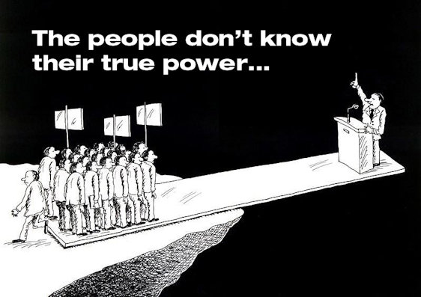
Recognition
Recognition requires the school board to:
Specify appropriate unit of school employees for collective bargaining and
Establish procedures for certification of exclusive representatives.
Notes:
1min.
We build power with the collective action of our membership, unity in action.
Power is our ability to move the decision makers.
Our path towards collective bargaining will begin with building our power as a local.

Slide 19

Questions
or
Comments
Notes:
Time 2 min.
Questions. Check chat

Slide 20
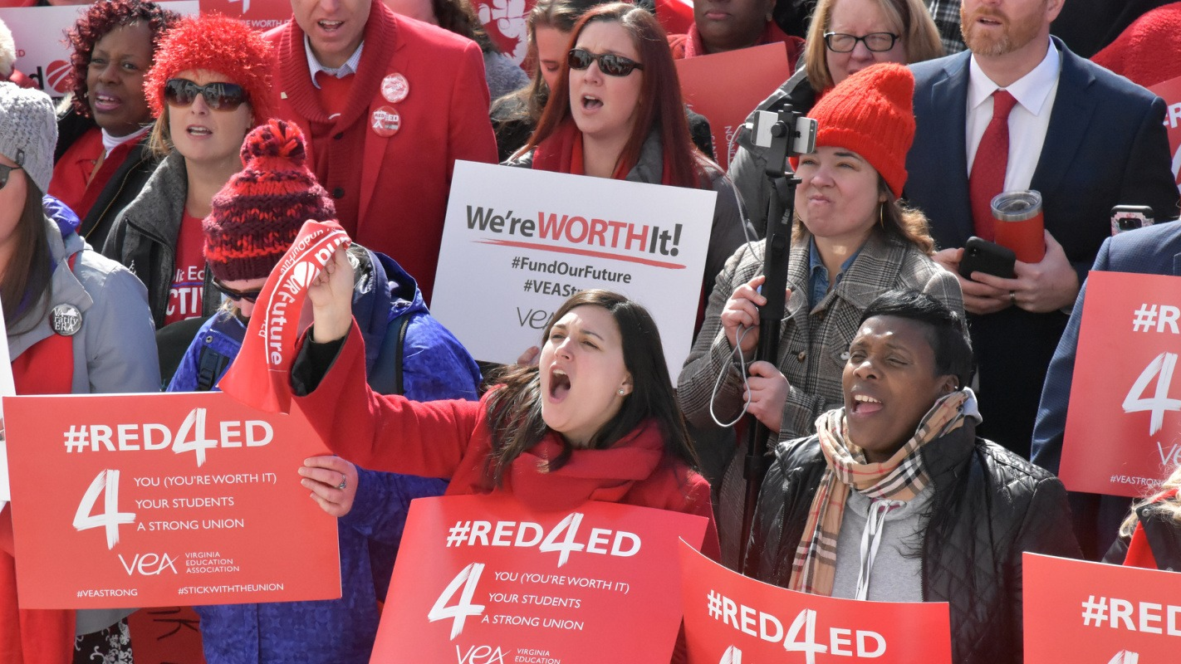
Building Power
“Organizing is turning the Resources we have into the Power we need to make change we want.”
Marshall Ganz
Notes:
Section 2: Slides 14- 22 (5-7 min)
This slide 1 min. 6:05-6:06
Power WITH not OVER. This is not top down-style power, but power focused on people coming together around a shared vision for what our work life and public education should be.

Slide 21
Create a
Local Organizing
to
Bargain Committee
Assess your local’s power
Identify leaders
Create plan based on goals and benchmarks.
Engage members in meaningful tactics that build power that lead to winning Collective Bargaining.
1:15/20 of your potential membership represented at each worksite- Contract Action Teams (CAT)
Notes:
Time 1 min. 6:16-6:17
Review slide to sum up section
Building Power is all about building and mobilizing connections. Every step of the plan to move on the path to collective bargaining must be about building power through engagement and membership recruitment. If a committee member can do a task themselves, they may have completed the task quicker, but they have no more power than when they began the work.

Slide 22
Bus Barn
Building Reps?
1:20?
Trusted/respected people ID?
Power Analysis:
Density
% of potential bargaining unit
Buildings with Reps
Contract Action Teams meet the 1 rep for 20 people in a building.
HS
Building reps?
1:20?
Trusted/Respected
People ID
ELEM
1:20? Building Reps
Trusted/respected people ID?
MS
1:20?
Building Reps?
Trusted/Respected
People ID
Notes:
Time 1 min 6:14-6:15
Connect where you have leaders, prioritize where you need to identify and support leaders.
This is where we ask:
What resources do we have?
What resources do we need to get what we want?

Slide 23
First Steps
Identify Leaders
Creating A Plan
Mapping Your Worksite
Notes:
Time 1 min. 6:09-6:10
Overview of the next slides
Identifying leaders and mapping, come before the plan is drafted. It is also ongoing action while working the plan and afterwards, assessing outcomes.

Slide 24

Identifying Leaders
One way to building power is our worksite networks and relationships
Identify the leaders of those networks.
Build relationships within those networks to build the power needed to be effective no matter what tier you are in.
Notes:
Time: 1 min. 6:10-6:11
First Steps
Identify leaders, Map your workplace, create a plan to engage.
ID leaders, find your people, find their people, those who are trusted and respected. Trusted are those that we go to when we need help or guidance, respected are those that we appreciate their craft and acumen. We go to those that we trust their proficiency to give us good guidance and who we can trust to support us. Each boss knows who these people are and we need to bring them into our union.

Slide 25
Mapping My Worksite
Worksite: _________________________
1. Place the name of someone who is trusted and respected in
a circle.
2. Write the names of people they have influence with around
the circle and connect them with a line.
3. Repeat until you place everyone you can.
Rob
Elaine
Randy
*Lisa
Randy
Marcus
Joe
Key: Member *New Hire
Notes:
Time 1 min. 6:11-6:12
Mapping your worksite. Acquire a list of each member and potential member in each building. There are a lot of ways to do this. But we are going to start with those that you think are Trusted and Respect. Put their name in the middle of the circle, draw the people that they have influence with. Draw circles until you have the entire relationship map laid out. Where do you have holes

Slide 26
POWER - People Organizing With Effective Results
During Conversations:
Validate coworker issues.
Provide a solution on how to work together.
Create urgency to act now.
Educate what is being done or could be done to address an issue.
Ask for a meaningful commitment.
Notes:
Time 2 min. 6:12-6:14
POWER, People Organizing with effective results. A good guide for having conversations with your reps to get to know them better. A commitment might just be to continue talking and learning from each other. This is relational organizing. If you can solve an issue yourself, you have exercised power the power you have, but you have missed the opportunity to increase your local’s power.

Slide 27
School Board Assessment
Map your school board’s support of Collective Bargaining
Extremely Influential
Somewhat influential
Influential
Not very influential
Not influential
 | Outspoken Champion | Supporter | Neutral or unknown | Opponent | Actively Opposed
Notes:
Time: 1 min. 6:15-6:16
Map your school board (give the mapping tool to think about mapping their supporters.)
.

Slide 28

Activity 2: Reflection!
Where will you start?
Vision:
How will CB enhance the story of your local?
Power:
Where are your strengths and weaknesses in your buildings?
Build More Power:
Identify Leaders
1:1 Conversations that lead to Commitments/Actions
Notes:
Christina Slides 28/Time: 8 min. total 6:17-6:25
Time 6:17-6:21
Give participants 3-4 min. to jot down answers to the questions on the slide
Time 6:21-6:25
Ask a few participants to share, ask some to share in the chat how they will start their plan

Slide 29
Next Steps
Local moves an internal resolution to support collective bargaining via a board or membership resolution.
Create an organizing committee
Assess your school board members for collective bargaining support.
Reach out to your UD for Module 2 of the Organizing to Bargain series.
May 1 Collective Bargaining Conference, hold date.
Notes:
Christina
Time: 6:25-6:35
Commitments moving forward
Locals move a resolution to support CB via a board/membership resolution to support CB.
Create an organizing committee.
Assess your school board members support for collective bargaining.
Reach out to your UD about having your board/reps trained on Mod 2 on building power to bargain.
Call for Membershipalooza Feb 6 (LINK IN THE CHAT)
May 1 CB Conference (bring your team). (Pres, board, rank and file).
(We may want to keep the meeting open for an additional 10 min to answer any questions.)
Next Steps
How the State VEA is supporting locals on the Path to Collective Bargaining
On December 7, 2020, a Steering Committee convened by President Fedderman gave feedback to a draft O2B plan that would stretch for at least three years. The plan will now go to the VEA Board of Directors. Key features of the plan in 2021 are:
• Emphasis on education and training. Materials such as this White Paper will be made available to VEA members, and training of UniServ staff and local VEA leaders has either begun or will take place in January and February 2021. As the year progresses, additional informative materials will be produced, and training will continue locally and regionally. VEA will also hold a statewide conference on collective bargaining and the O2B campaign on May 1, 2021.
• Building membership strength. To be approved as a local bargaining agent, the VEA Local must, as a practical matter, represent a majority of eligible members in the school division in question. VEA UniServ staff, organizing staff provided by the NEA, and local representatives are all working hard to increase membership in Locals and to help new and existing members understand the hard work that goes into winning representation and bargaining a contract. Plans also will be developed to strengthen Local building rep structures, aiming for one rep for every 20 members in a building.
• Issue-based organizing. To help recruit new members and begin identifying issues that could eventually be brought to bargaining, VEA organizers will be working closely with target Locals to identify the most pressing issues identified by local educators.
• Focus and commitment. The O2B campaign warrants organization-wide commitment and will require resources from every VEA department. Reflecting the scope and importance of the work, the draft plan includes a proposal for a special $1 per month assessment of each VEA
member to support plan elements. That plan is tentatively slated to go before the Delegate
Assembly in 2021

