Slide 1
Task Design
How do we authentically engage members in the work of the union?
Notes:
Give Sierra Club Document

Slide 2
“enabling others to achieve shared purpose in the face of uncertainty” (Ganz)
Tasks
Organizing
Low Leadership High
Low Ownership High
Servicing
Socializing

Slide 3
Member Driven Union
We say this, but what do we think it actually looks like?

Slide 4
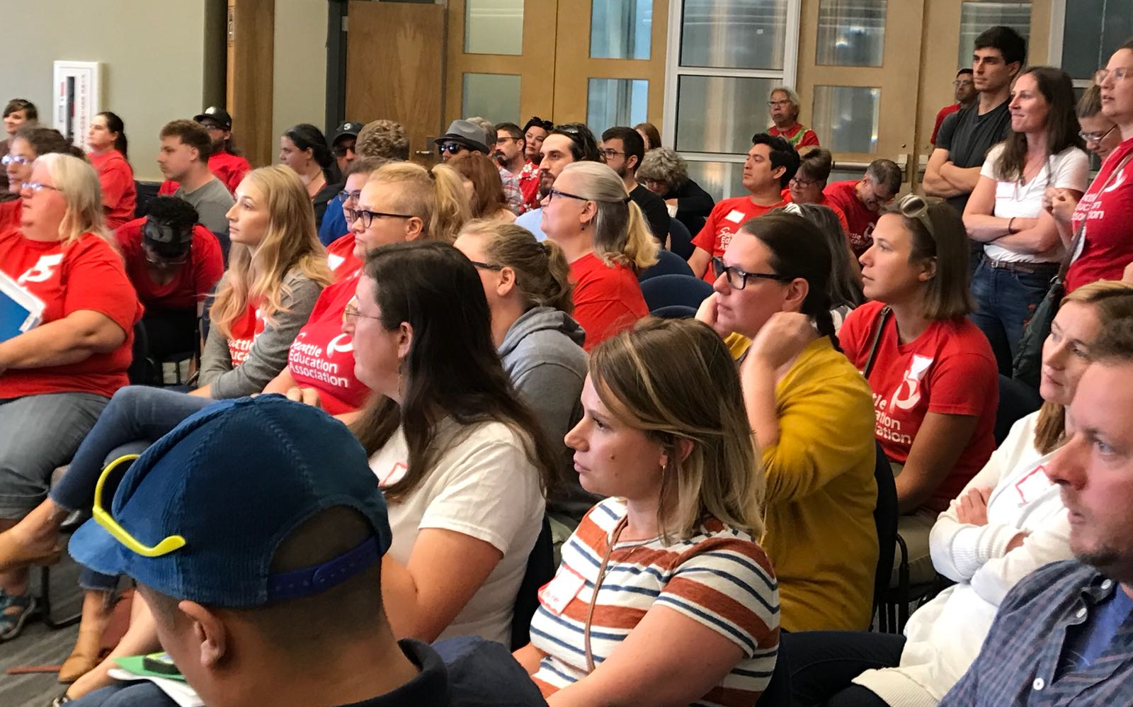
The question we are asking ourselves
How can we engage our members and leaders in shaping our local agenda and actions at a much deeper level than before?

Slide 5
Example… Bargaining Surveys
High levels of participation
Quantifiable input
Mobilizing role for ARs
Shallow questions and answers
Little engagement b/t members
Open ended questions produce flood of data that is difficult to evaluate
Role of AR is to task members
You only learn what you ask about
Limited collective sense

Slide 6
“enabling others to achieve shared purpose in the face of uncertainty” (Ganz)
Tasks
Organizing
Low Leadership High
Low Ownership High
Servicing
Socializing

Slide 7
Building Bargaining Sessions
Ask leaders to gather their colleagues and lead them through the same interest-based process we were planning to use at the table
Ask them to identify the issues they wanted to work on
Do it online so we have a usable record and they can see what other schools and programs said

Slide 8
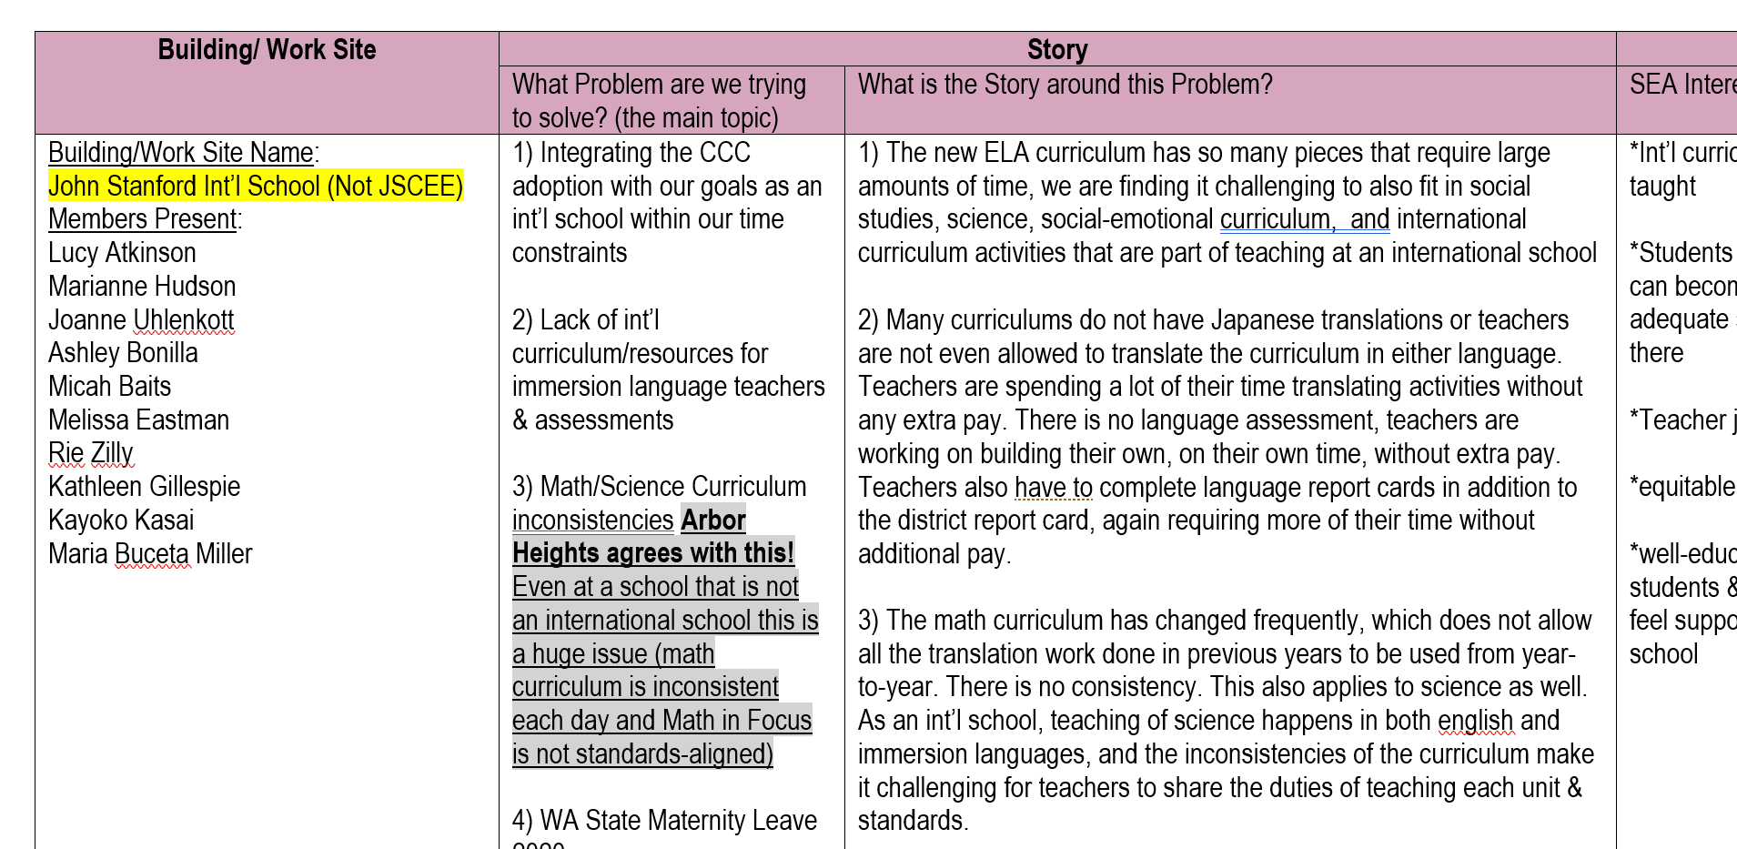
About 1400 members in 80 buildings (30% of membership; 80% of buildings)

Slide 9
Building Bargaining Sessions
AR plays a substantive role: facilitating, framing, leading
Members discuss issues with each other
Member investment in outcome grows
Priorities surface that were not anticipated
Members get sense of collective outside their school
Non-majority action
Results not easily reported

Slide 10
What were the elements that took a survey from “tasking” to “organizing”

Slide 11

Key Points
To build Ownership and Leadership task and ask design should allows for:
Authentic Importance
Connection to Shared Purpose
Adult autonomy AND accountability
Growth in Presence
Growth in Capacity

Slide 12
Key Point
People join people and organizations that represent their values
When people feel authentically engaged, they will continue to come back or carry a union positive story.
Make food or prizes secondary and not the main focus. What we offer, reflects who we are.

Slide 13

Building Engaged Leaders
“Social scientists have found that tasks designed to yield “intrinsic” rewards (inherently satisfying) produces great motivation, commitment, and adaptive learning than tasks that only yield financial, recognition or status rewards.”
-Hackman and Olham, 1980

Slide 14
Conditions of Motivational Task Design
Experience meaningfulness: the task is important in the overall scheme of things.
1
Experience responsibility: how well the task gets done is up to me.
2
Experience results: as I do the work I can see whether or not I am doing well.
3

Slide 15
Conditions of Motivational Task Design are Achieved When
Task Significance – understand and recognize the impact of the work on the world
Task Identity – one’s own contribution, from start to finish, is clear in the final result
Skill Variety – engaging a variety of skills, including heart, hands, and head.
Autonomy – having the space to make competent choices about how to do the work.
Feedback – results are visible to the person performing the task as they perform it.
Notes:
In your local, where do your leaders struggle the most?

Slide 16
Task Design at your table.
How would you move attending school board meetings from “tasking” to organizing using the 6 criteria?
Task Significance
Task Identity
Offers Skill Variety
Autonomy
Feedback

Slide 17
What would you change about those tasks to build leadership within your local?
At your table, pick one a task in your local that takes up YOUR time and energy- but does not build the union.
  Build union = involve members, build their skills and involvement in the union.
How could you turn that into an organizing task for your local?

Slide 18
“enabling others to achieve shared purpose in the face of uncertainty” (Ganz)
Tasks
Organizing
Low Leadership High
Low Ownership High
Servicing
Socializing
Notes:
How can you move that low leadership and low ownership task toward Organizing?
How can you move socializing toward organizing?

Slide 19
(FINAL) Key Points
Tasks must be meaningful and members need to own them
Our job is to look for opportunities to increase ownership and leadership wherever possible.

