Slide 2

Coaching
Regroup!
You will need to get into groups of 3.
Note: there may be 1 group of 4

Slide 3
Coaching
Coaching is a direct intervention in an individual or team’s work process to help them improve effectiveness.
Coaching enables others to build their own capacity to act.
Coaching moves leaders from a relationship where staff have an external control to one where they focus on how to grow.

Slide 4
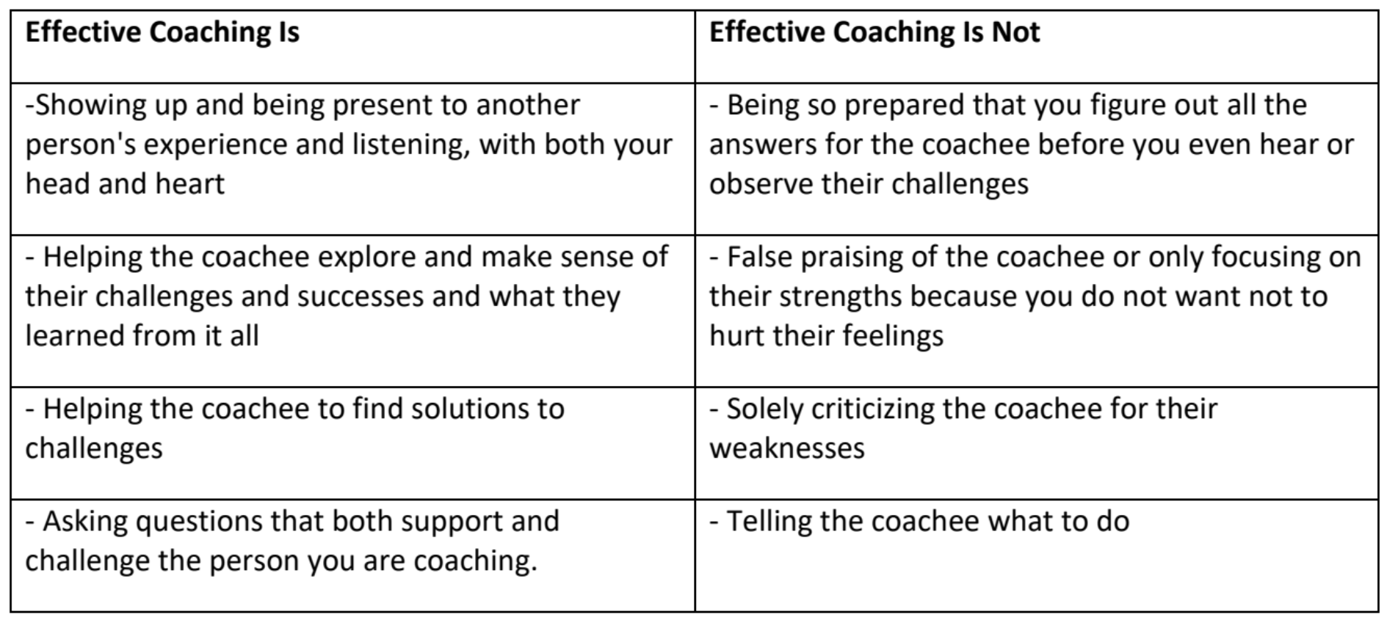
to hurt their feelings

Slide 5
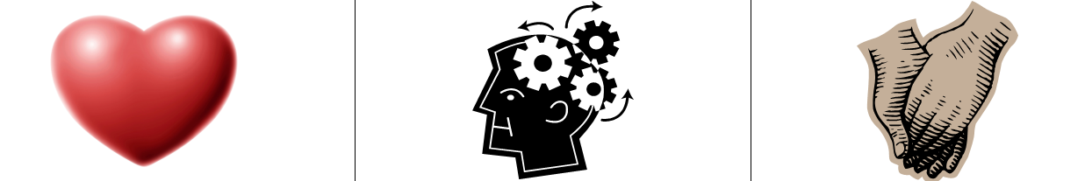
3 Kinds of Coaching
Motivational - Heart Coaching aimed at enhancing motivation
Strategic – Head Coaching aimed at helping plan, evaluate, strategize
Skills-based – Hands Coaching aimed at effective execution of a skill

Slide 6
Now it is your turn…
Get into Teams - 3…there may be 1 team of 4
Four Scenarios
Which “kind” of coaching “diagnoses” would you make

Slide 7
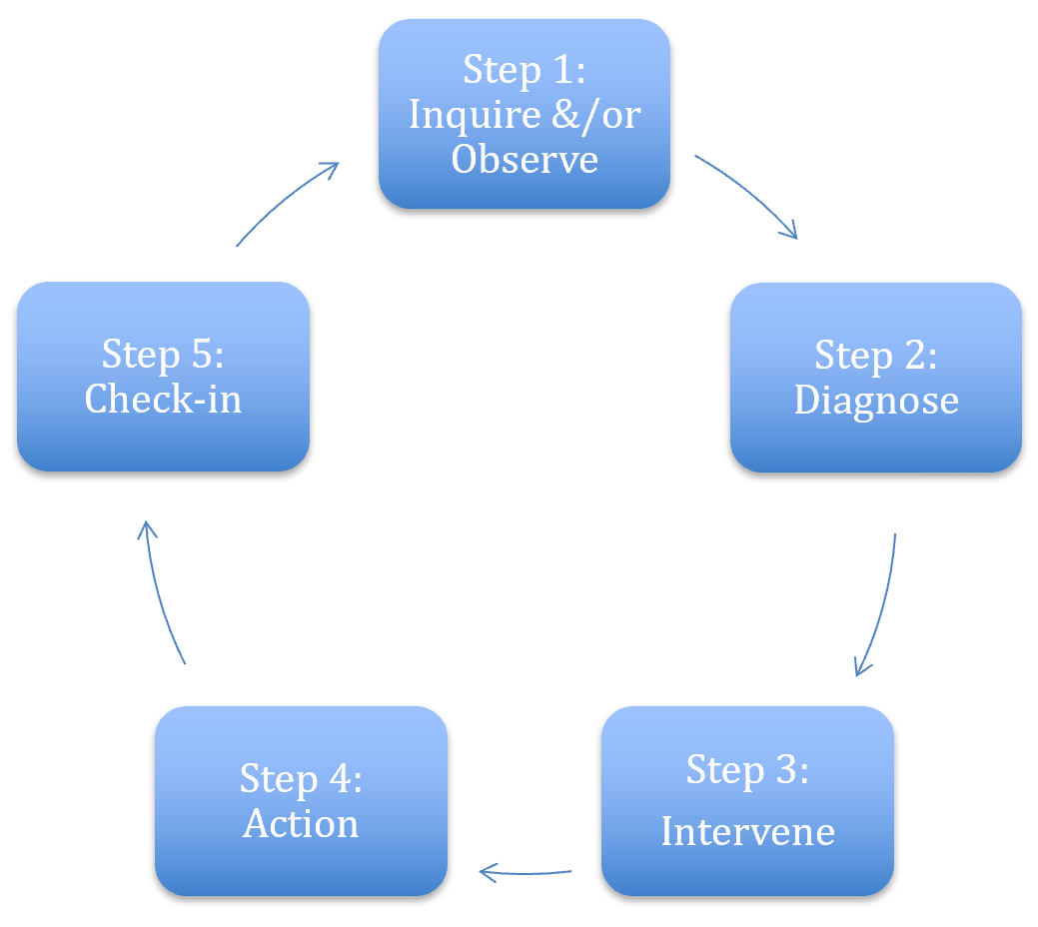
Coaching Cycle
The reason to apply this cycle is to stop yourself from providing THE answer.
Leaders grow from productive struggle.

Slide 8

Key Points
Coaching is about releasing your external control and enabling the leader to grow.
Coaching is as much about you changing your behavior and growing your skill as it is about growing a leader.
We only get good at coaching by practicing it.

