Slide 1
Constituency Organizing
From Club to Fighting Union

Slide 2
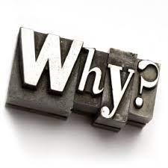
Why are we Here?
NEA has an enterprise wide emphasis on organizing.
Our UniServ focused events don’t always meet the needs of organizers.

Slide 3

Logistics to Remember
Questions to Ask
Bathroom
Materials
Food
Room Temperature
Karla as a Resource
Travel
Vouchers

Slide 4

3 Day Agenda
Days 1
12:00- 1:00 LUNCH
2:40:-2:55 Break
3:30 Adjourn
Off-Site Visit
Day 2
7:30-8:30 Breakfast
8:30am Whole group
8:45am CTFU Breakoff
10:40-10:55 Break
12-1pm Lunch
2:35-2:50 Break
4:30-5pm Choice Networking
5pm Adjourn
Day 3
7:30-8:30 Breakfast
8:30-8:45 Whole Group
8:45 Convene CTFU
11:00-11:15 Break
1:00 Boxed Lunch
1:00-2:00 Choice Networking
2:00 Adjourn

Slide 5

Today’s Outcomes
Community Building
Bridging Our Morning Experience
Understand how we build power in our work
Understanding the difference between communities and constituency

Slide 6

Community Agreements pg 2-3
Using Self-Awareness and Self-Knowledge
Listening for Understanding
Being Gracious
Staying Engaged
Being Open and Suspend Judgment
Saying “I”- tell your truth
Seeking Discomfort
Reaching Empathy
Expecting Non-Resolution and Non-Closure
*Adapted from “Embracing equity and inclusion”, Annie E. Casey Foundation
Notes:
Community Agreements for Our Time
Awareness and Self-Knowledge
This requires self-knowledge and self-awareness. Self-knowledge allows you to see what causes you pain and conflict and enables you to embrace your contradictions and inconsistencies. It allows the space to work on things about yourself that you are not happy with. In turn, self-knowledge helps to prevent you from projecting your negative aspects onto other people. Bringing your best self also requires that you have a positive attitude, are willing to deeply explore your perspectives and remain open to the perspectives and experiences of others.
Listening for Understanding
Be an active listener. Active listening involves paying full and careful attention to the other person, looking him or her in the eye, avoiding interruptions, reflecting your understanding, clarifying information, summarizing the other person’s perspectives and sharing your own. Remember that most people need time to open up and might not be willing to immediately share their personal stories, hopes, fears and/or concerns.
Being Gracious
Being kind is a vital way of bringing meaning to our own lives, as well as the lives of others. Kindness is about caring genuinely for others around you, wanting the best for them and recognizing in them the same wants, needs, aspirations and even fears that you may have. Being kind and generous allows us to communicate better with others, to be more self-compassionate and to be a positive force in other people’s lives. This includes following the COVID protocols that are in place to protect the health of this learning community.
Stay Engaged
Staying engaged requires you to be morally, emotionally, intellectually and socially involved in the conversation. Staying engaged means that you are listening with curiosity and willing to deepen your understanding. Staying engaged might also require you to sustain the conversation even when it gets uncomfortable or diverted. This also means a commitment to keeping your electronic communications to a minimum with folks not present in this learning community.
Be Open and Suspend Judgment
Listening with an open mind includes being receptive to the influence of others. You can suspend judgment by becoming aware of preconceived notions and listening to everything someone has to say before jumping to conclusions. Most importantly, suspending judgment also means listening to what the speaker has to say for understanding, not just to determine whether the speaker is right or wrong.
Say “I”- tell your truth
Speaking your truth in authentic and courageous conversations about race requires a willingness to take risks. It means that you will be absolutely honest and candid about your own thoughts, feelings, experiences and opinions and not just saying what you perceive others want to hear. Speaking your truth will require you to speak from the “first person” and use “I” statements.
Seek Discomfort
Leaning in to discomfort will require you to let go of racial understandings and stereotypes that you may be holding onto in order to move forward. Leaning in means that you will avoid judgment, assume positive intent and be open to the kernel of wisdom in each individual’s experiences. Leaning in to discomfort will require you to sit through moments of embarrassment, confusion, anxiety and/or fear.
Reaching Empathy
Empathy and compassion allow you to understand the other person’s point of view. When you are empathetic, you are more understanding, patient and kind. Expanding your capacity to feel empathy will also allow others to enter your circle of human concern.
Resolution and Closure
Expect and accept that there may not be closure. It is not likely that you will resolve your personal understanding about race or another person’s racial experience in a single conversation. The more you talk about race with another person, the more you learn and the more they will learn. Authentic and productive conversations about race are continuous and always evolving.
*Adapted from “Embracing equity and inclusion”, Annie E. Casey Foundation

Slide 7
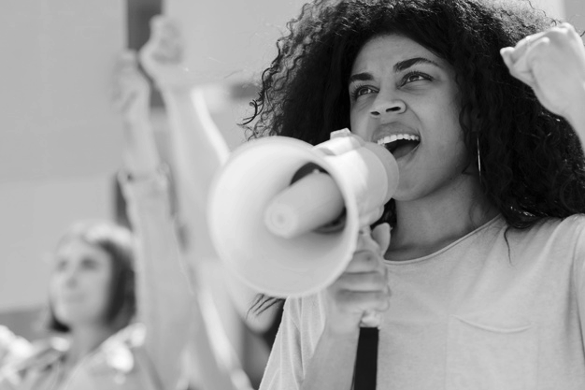
One Revolution Around the Room
Name
Required Pronoun
State
Job Title

Slide 8

Katie Bishop
WEA Sammamish
She/Her/Hers

Slide 9
Connecting to this morning

Slide 10

Picturing Power
At Your Tables – Each Person Picks 3 Pics
Each person shares Name, Pronouns, Location, and uses all three of Pics they Picked to define power.
Round 2 – Stand and form triads – share Name Pronouns, Location and Definition of Power with 3 Pics
Round 3 – Repeat Round 2

Slide 11
Whole Room Report
What are some common themes you heard?
What really surprised you OR left you wondering?

Slide 12
Melissa Dan
Palm Beach County Classroom Teachers Association
She/Her/Her

Slide 13

Power in Our Work p. 8-12
Move into quads (someone you are not currently sitting with and don’t know well)
Each Person in the group develops a statement about how their employer defines power.
HOW does your employer want that power expressed? AKA what does power look like in action?
Each Team Creates a Poster
  Each person draws their state and puts their name and statement about power in the state outline.

Slide 14
Power in Our Work Closing Thoughts
For our time together we will use this definition:
Organizing and leadership are about accepting responsibility for enabling others to achieve shared purpose in the face of uncertainty.

Slide 15
Power in Our Work Closing Thoughts
When we remove enabling -
Organizing and leadership are about accepting responsibility for others to achieve shared purpose in the face of uncertainty.
We lose agency, structures, teams, and shared accountability.

Slide 16
Power in Our Work Closing Thoughts
When we take out “to achieve purpose”
Organizing and leadership are about accepting responsibility for enabling others in the face of uncertainty.
We lose our “why,” the issues, and the problems that matter.

Slide 17
Power in Our Work Closing Thoughts
When we take out uncertainty
Organizing and leadership are about accepting responsibility for enabling others to achieve shared purpose.
It simply becomes socializing with a predictable outcome.

Slide 18

Key Ideas
A number of examples you had were about power over, or using power.
Our final definition is about BUILDING
power together in order to USE it to make change
Organizing is about shared risk and accountability in the face of uncertainty
Unity is the basis of our power.

Slide 19


Slide 20
Zac Johnson
Northern Colorado Uniserv Unit
He/Him/His

Slide 21

Community and Constituency P. 13-17
Quick Table Talk and Article Review
What are the differences between community and constituency?

Slide 22
Defining Communities
A community shares values or interests.
Remember organizing? Enabling, achieve shared purpose, uncertainty

Slide 23
Defining Constituency
Constituencies are communities, people who share common values or interests, organized to use its resources to act in their interests. Constituents are the heart of an organization, they have voice. If we treat people like customers (service model), they can only exit to make influence.

Slide 24
Pause to think:
Is the concept of power different in a community vs. a constituency?

Slide 25

Constituencies: Their Values and Interests
Group Wall Charts
In one column brainstorm all the constituencies you are aware of in your work settings
In the second column, write the special core values, interests, or issues that each constituency has.
Look for what might be common in the second column

Slide 26
Community and Constituency Whole Room
What did your discover by listing these constituencies and their values, interests, and issues?

Slide 27
Key Ideas
Constituencies are distinct from communities.
Organizing identifies their common values and interests builds structure to act. Building power.
When we treat constituents like customers, their only avenue is to exit. They relied on us to have power.
Small organized groups within the larger community have limited power and can access fewer resources for change.

Slide 28
Ending it Right
Feedback Form From Ellen
2. Pick up at 7am from the Holiday Inn, we start at 8:30am
3. Be ready to go to the Civil Rights History Museum Tour at 4pm
4. Pre-Reading for Tomorrow Visions of Justice P. 22-32

