Slide 1
Constituency Organizing: Club to Fighting Union
Day 3

Slide 2

Community Agreements pg 2-3
Using Self-Awareness and Self-Knowledge
Listening for Understanding
Being Gracious
Staying Engaged
Being Open and Suspend Judgment
Saying “I”- tell your truth
Seeking Discomfort
Reaching Empathy
Expecting Non-Resolution and Non-Closure
*Adapted from “Embracing equity and inclusion”, Annie E. Casey Foundation
Notes:
Community Agreements for Our Time
Awareness and Self-Knowledge
This requires self-knowledge and self-awareness. Self-knowledge allows you to see what causes you pain and conflict and enables you to embrace your contradictions and inconsistencies. It allows the space to work on things about yourself that you are not happy with. In turn, self-knowledge helps to prevent you from projecting your negative aspects onto other people. Bringing your best self also requires that you have a positive attitude, are willing to deeply explore your perspectives and remain open to the perspectives and experiences of others.
Listening for Understanding
Be an active listener. Active listening involves paying full and careful attention to the other person, looking him or her in the eye, avoiding interruptions, reflecting your understanding, clarifying information, summarizing the other person’s perspectives and sharing your own. Remember that most people need time to open up and might not be willing to immediately share their personal stories, hopes, fears and/or concerns.
Being Gracious
Being kind is a vital way of bringing meaning to our own lives, as well as the lives of others. Kindness is about caring genuinely for others around you, wanting the best for them and recognizing in them the same wants, needs, aspirations and even fears that you may have. Being kind and generous allows us to communicate better with others, to be more self-compassionate and to be a positive force in other people’s lives. This includes following the COVID protocols that are in place to protect the health of this learning community.
Stay Engaged
Staying engaged requires you to be morally, emotionally, intellectually and socially involved in the conversation. Staying engaged means that you are listening with curiosity and willing to deepen your understanding. Staying engaged might also require you to sustain the conversation even when it gets uncomfortable or diverted. This also means a commitment to keeping your electronic communications to a minimum with folks not present in this learning community.
Be Open and Suspend Judgment
Listening with an open mind includes being receptive to the influence of others. You can suspend judgment by becoming aware of preconceived notions and listening to everything someone has to say before jumping to conclusions. Most importantly, suspending judgment also means listening to what the speaker has to say for understanding, not just to determine whether the speaker is right or wrong.
Say “I”- tell your truth
Speaking your truth in authentic and courageous conversations about race requires a willingness to take risks. It means that you will be absolutely honest and candid about your own thoughts, feelings, experiences and opinions and not just saying what you perceive others want to hear. Speaking your truth will require you to speak from the “first person” and use “I” statements.
Seek Discomfort
Leaning in to discomfort will require you to let go of racial understandings and stereotypes that you may be holding onto in order to move forward. Leaning in means that you will avoid judgment, assume positive intent and be open to the kernel of wisdom in each individual’s experiences. Leaning in to discomfort will require you to sit through moments of embarrassment, confusion, anxiety and/or fear.
Reaching Empathy
Empathy and compassion allow you to understand the other person’s point of view. When you are empathetic, you are more understanding, patient and kind. Expanding your capacity to feel empathy will also allow others to enter your circle of human concern.
Resolution and Closure
Expect and accept that there may not be closure. It is not likely that you will resolve your personal understanding about race or another person’s racial experience in a single conversation. The more you talk about race with another person, the more you learn and the more they will learn. Authentic and productive conversations about race are continuous and always evolving.
*Adapted from “Embracing equity and inclusion”, Annie E. Casey Foundation

Slide 3
Feedback on Feedback

Slide 4

Today’s Outcomes
What is an organizing plan that moves a club to a fighting union?
How do you include all constituencies to build the union?
What are issues that bring a fight to the boss?
Who is the target?
What tactics build a club into a fighting union?
How can I create a winning plan to implement at the local/state level?

Slide 5
Case Studies

Slide 6
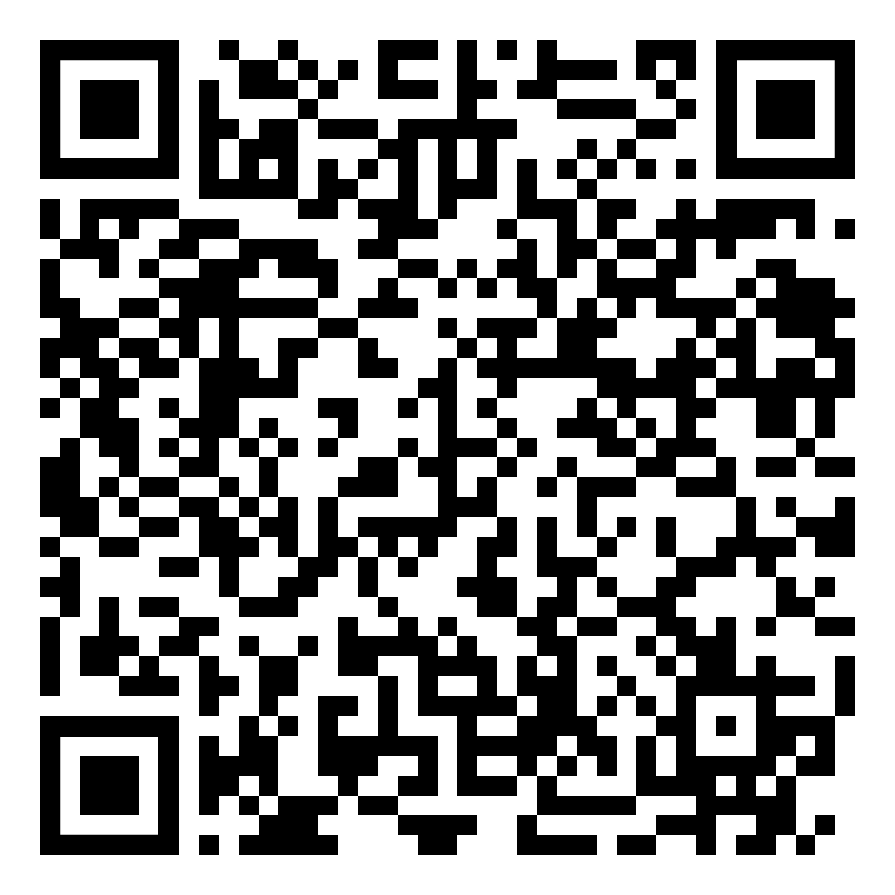
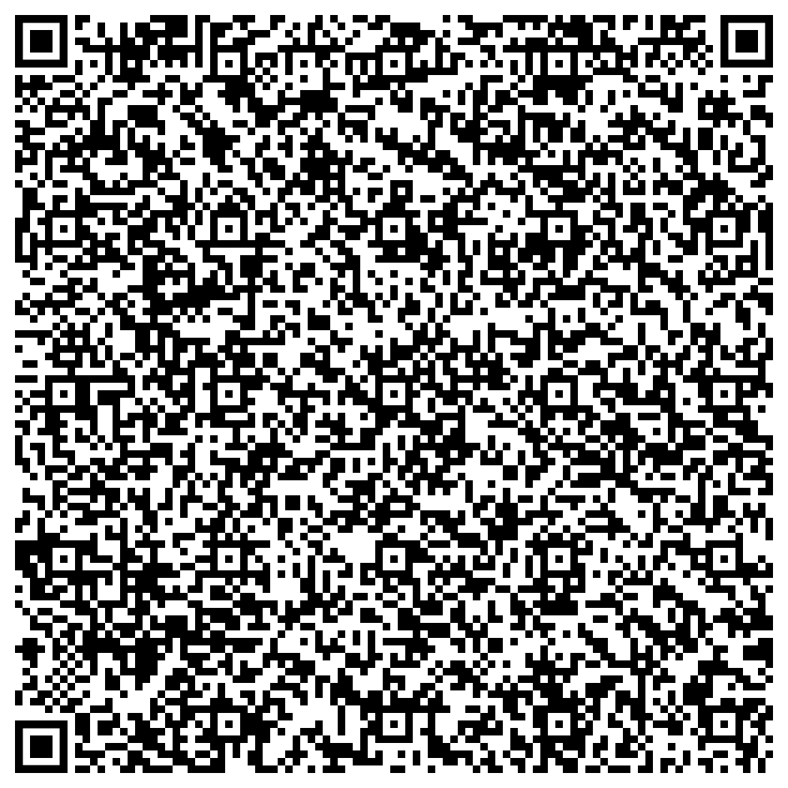

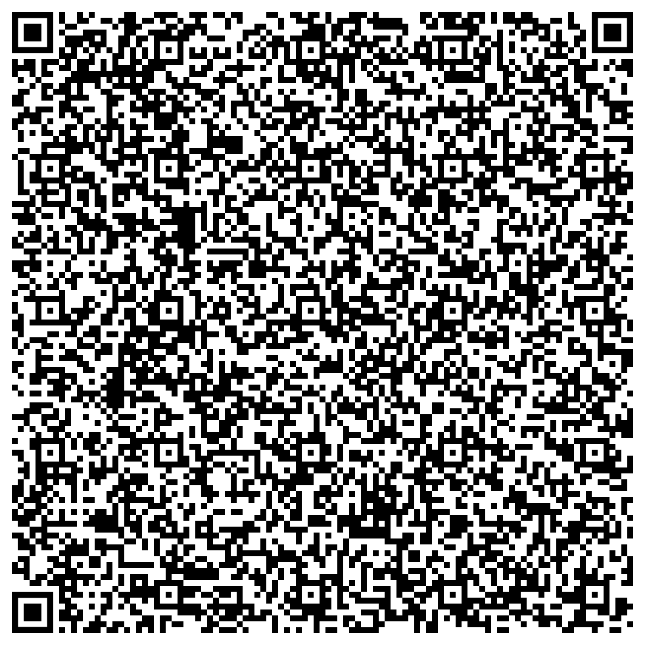
CASE STUDIES
Amazon Union
Seattle PAR
North Carolina

Slide 7
Mapping Your Allies

Slide 8
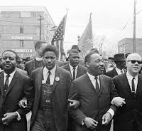
“In the end we will remember not the words of our enemies, but the silence of our friends.”
Martin Luther King, Jr.

Slide 9
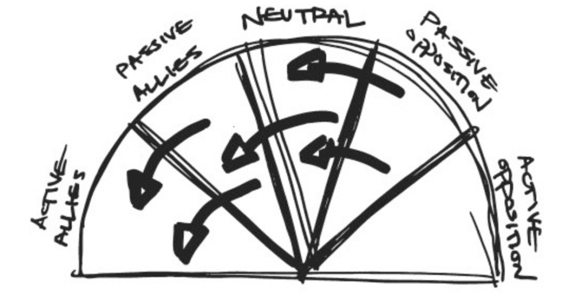
Adding to Your Base from the Outside P. 131-132

Slide 10
Three Kinds of Fights of That Fail P. 130
Only work with Active Allies – Preaching to the Choir
Only focus on Opposition–
Whole World is Against Us
Only focus on Active Opponents – Speak Truth to Power (Moral Appeal and Righteous Argument)

Slide 11
How to Win
Use strategic tactics that shift each segment to the left .
Focus on the “Aims” or outcomes you want from each of the segments.

Slide 12
Definitions to Know
active allies, or people who agree with
you and are fighting alongside you;
passive allies, or people who agree with you but aren’t (yet) doing anything about it;
neutrals, or the unengaged and uninformed;
passive opposition, or people who disagree with you but aren’t actively trying to stop you; and
active opposition, or people who not only disagree with you, but are actively organizing against you.

Slide 13
Let’s Do this Shift - 2 Steps
Use pages 131 and 132 to create a map of allies that would make sense for your assigned constituency group.
Identify visible tactics that create the outcome you want from each group.
Be ready to share what you learned

Slide 14
Whole Room Talk
What did you learn doing this process?
What is important to know if you are going to use this with leadership teams?

Slide 15

Key Ideas
Campaigns are won not by overpowering one’s active opposition, but by shifting each group one notch around the spectrum increasing people power in favor of change and weakening your target.
Tactics and actions need to match your target outcomes

Slide 17
Issues that bring a fight to the boss

Slide 18

Issues are central to organizing
Issues are fixable, widely felt, and deeply felt.

Slide 19
Looking back over yesterday's work...
What are the typical ‘club union’ issues? Using the levels as a guide.
What is a fighting union issue?
What constituencies are affected by the issues and how to we move them to action?
What were the issues people most cared about?
Looking back home: What are the issues people most identify that they want addressed?
Chart it up. Use the Issues to Problem.

Slide 20
Key Ideas
Issues are what move people and give organizations purpose.
If we are to move from club unions to fighting unions, picking strong issues to build teams of members around is critical to engagement and changing the narrative of your union.

Slide 21
The Target

Slide 22

Who has the power and resources to prevent or grant the change you want?

Slide 23
Who is the Boss – P. 60-66
Who is the boss or the fight with?
How did they win?

Slide 24
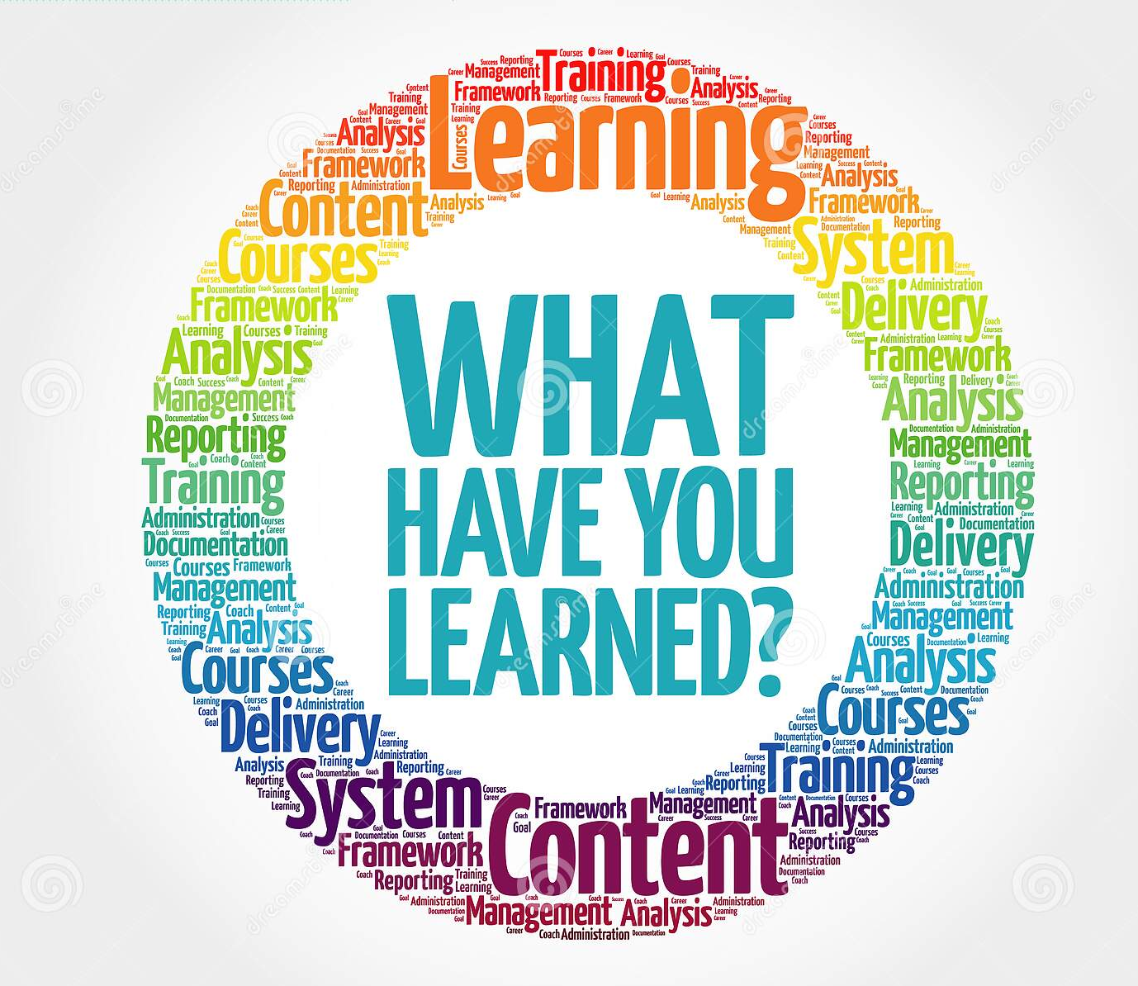
What did you learn?

Slide 25
Key Ideas
Having a clear target to mobilize our leaders around the issues we cannot address alone is critical.
Without a clear target, we do not have an effective strategy or plan.

Slide 27
The Tactics

Slide 28
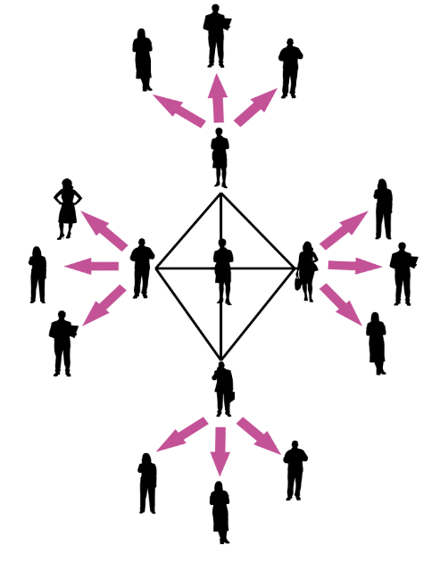
How do we build a club into a fighting union?
Structure Tests
Escalate
Leader Development
Assess Commitments

Slide 29
Power is a function of Courage and Unity P.147
Our Ultimate Power
Amount of Effort or Courage to Persist and Act
Unity - Number of People Sharing the Values, Pain, and Actions

Slide 30
Low level of courage and high number of actors…
Amount of Effort or Courage to Persist and Act
Sign an online Petition
Unity - Number of People Sharing the Values, Pain, and Actions

Slide 31
High level of courage and low number of actors…
Storm the Superintendent’s Office
Amount of Effort or Courage to Persist and Act
Unity - Number of People Sharing the Values, Pain, and Actions

Slide 32
High Participation Is a Prerequisite to Power - Super Majority of Workers Engaged

Slide 33
But Also Need…
Unity (against division) TIGHT STRUCTURE Demonstrable & Sustainable Super-Majorities

Slide 34
Case Study – Seattle P. 87-95
Our Ultimate Power
Focus on P. 93
Was this tactic effective in achieving their demand? Do they have the power to achieve their demand? Why?
Use Tool on 162 to consider the eefectiveness of this tactic.

Slide 35

What were the strengths and weaknesses of this tactic?
Where was this local in the levels of organizing?
What would you do instead?

Slide 36
Key Ideas
If we stay in the 1-1s and never ask to act or choose to act, we stay in the basics to beginning of organizing.
Building power with each other and giving leaders the role of doing the tasks and organizing of the action helps to build the over all unity and allows us to leverage more resources for change.

Slide 37


Slide 39
Creating a Plan

Slide 40

Think About:
Where is your work currently?
How can you take it to the next level? (Dream big!).
Start with where you are currently on the levels of Organizing, where do you want to be.
Draw your roadmap for getting there. Start with your goal.
What activities and actions do you want your local or group to be focused on?
Where are you now in the levels of organizing?
Who is your constituency?
What steps can you take to get there given the levels?

Slide 41
Draw this out:
What is your current constituency group?
What are they asked to do?
In a perfect world what would you ask them to do?
Who are the leaders and how or how will you find them?
What are your communities/local/groups resources?
Who are your leaders? How will you create a cycle of interruption and leader identification?
What the issues and who has the resources to give your constituency what they want?

Slide 43
Group Presentations

Slide 44

Gallery Walk:
Use post-its to leave feedback
Focused questions OR affirmations
  not suggestions

Slide 45

What feedback is particularly useful or thought-provoking?

Slide 46
Key Ideas
Clubs are focused on a problem, but it is not a fight with the boss and/pr on the issues their larger constituency would engage on.
Regardless of how small or large a constituency is, they all bring value in building our union.
Cooperation with the boss will not win the fight for the workers.
Understanding your target will help you to plan tactics to achieve your WIN.

Slide 48

Ending it Right
Lunch
Travel
Feedback via email

Slide 49
Feedback on Feedback

