Slide 1


Using Excel for Organizing
Part 2: Analyzing Data
While we wait to begin, please:
1
2
3
Rename yourself:
Name/State/Pronouns (Sam/GA-he/him)
Download data set
Complete the analogy in the chat.
  “I am to excel, as a duck is to…”

Slide 2






Contributors:
Seleste Harris
UniServ Director
Maryland State
Education Association
sharris@mseanea.org
Monet Reilly
UniServ Representative
Pennsylvania State
Education Association
mreilly@psea.org
Beth Barton
UniServ Director
Illinois Education Association
Beth.Barton@ieanea.org
Chad Williams
UniServ Consultant
Michigan Education Association
cwilliams@mea.org
Dr. Taraja Shephard Allen
UniServ Membership Consultant
Ohio Education Association
Shephardallent@ohea.org

Slide 3

Land Acknowledgement
We begin by acknowledging that through a history of colonization and brutality, we are currently on the traditional lands stewarded by generations of the Indigenous people.
We honor these Indigenous people, all elders, past, present, and emerging. We are called to learn and share these learnings about this tribal history, culture, and contributions that have been suppressed in the telling of the story of what we now call the United States of America.

Slide 4

Series Overview
  September 23, 2025
    Part 1: Using Excel to Evaluate Membership
  December 11, 2025
    Part 2: Using Excel: Advanced Tools for Power Analysis
  March 12, 2026
    Part 3: Disseminating information
  May 21, 2026
  Part 4: Campaign Progress Tracking
  Each session is 2:30pm-4:00pm EST

Slide 5
Today's Agenda
Why is data important?
How do we capture data?
How can we evaluate the data and make it accessible?
Session Outcomes
Explore benefits of using Excel to analyze data
Explore the features within Excel that can assist with organizing
Practice using the features within Excel
  Pivot Tables
  Goal Seeking
  Bonus content: 3D Mapping

Slide 6
Why Is Data Important?
Notes:
Time Allotment:
Taraja

Slide 7
- Break Out -
How do you capture data?
How do you make your data accessible and understandable?
What are some challenges you have in getting local data?
Notes:
Time Allotment: 7 minutes total
Taraja
1 minute directions
5 minutes breakout
2 minutes debrief
After reviewing instructions, you are going to broken into groups. You will be in the breakout group for 3-4 minutes to answer the question: Where do you get data?
Based on the number of participants, use no more than 3-5 breakout groups.
After the participants return, ask each group to share 2 sources of data.

Slide 8
- Debrief -
How do you capture data?
How do you make your data accessible and understandable?
What are some challenges you have in getting local data?
Notes:
Time Allotment: 7 minutes total
Taraja
1 minute directions
5 minutes breakout
2 minutes debrief
After reviewing instructions, you are going to broken into groups. You will be in the breakout group for 3-4 minutes to answer the question: Where do you get data? What do you use to make it make sense?
Based on the number of participants, use no more than 3-5 breakout groups.
After the participants return, ask each group to share 2 sources of data.

Slide 9
How do YOU use data to organize?
Notes:
Time Allotment:
Taraja
HOW DO YOU USE DATA TO ORGANIZE
REFLECTION ON WORK SINCE LAST SESSION

Slide 10
Pivot Tables
Notes:
Seleste

Slide 11
Benefits of Pivot Tables
Summarizes large data sets quickly
Automatically updates
Notes:
Seleste

Slide 12
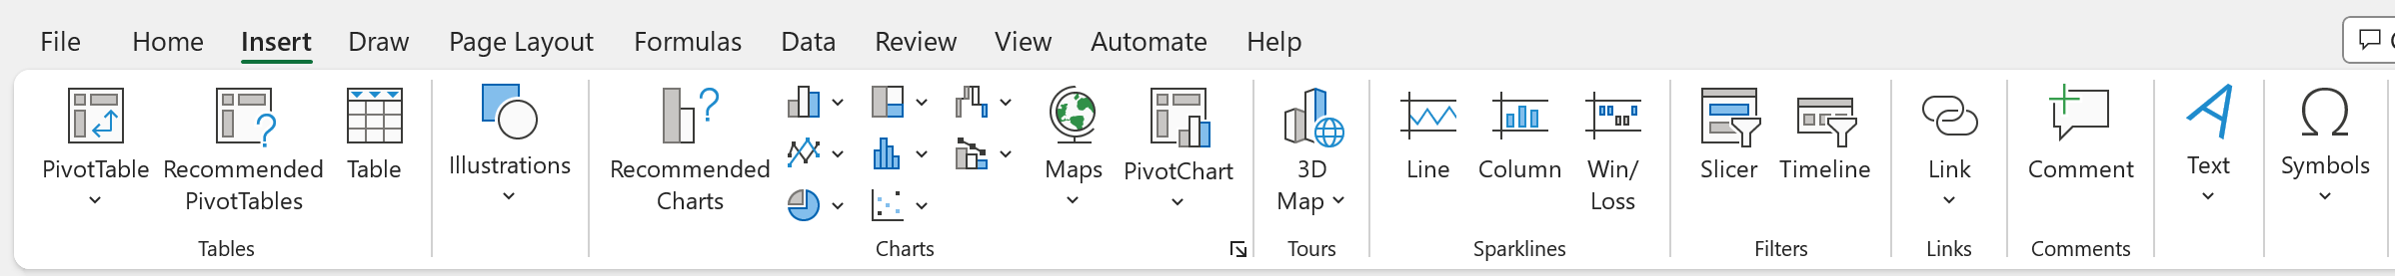

How to Create A Pivot Table
Insert Tab
Click PivotTable
Notes:
Seleste

Slide 13
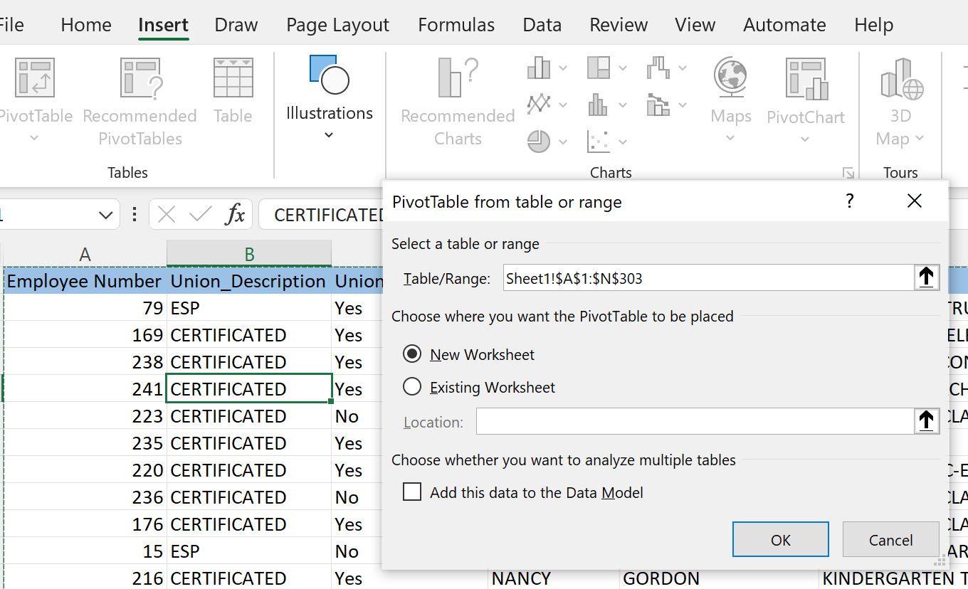
How to Create A Pivot Table
Pop-up window will appear asking for the data set being analyzed
The table range default is the active table.
Recommendation: place the PivotTable in New Worksheet
Select OK
Notes:
Seleste

Slide 14
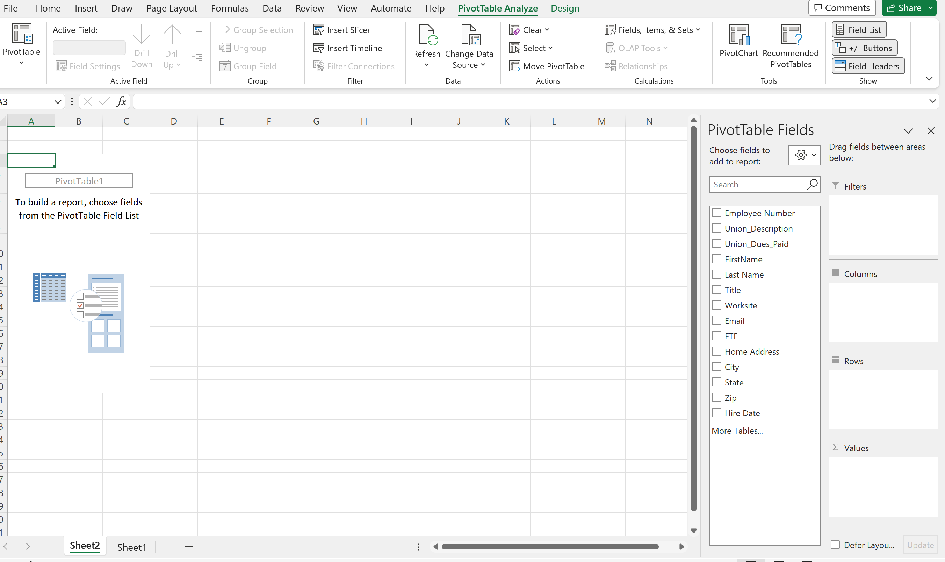

How to Create A Pivot Table
This is where you identify the data that is to be summarized.
Notes:
Seleste

Slide 15
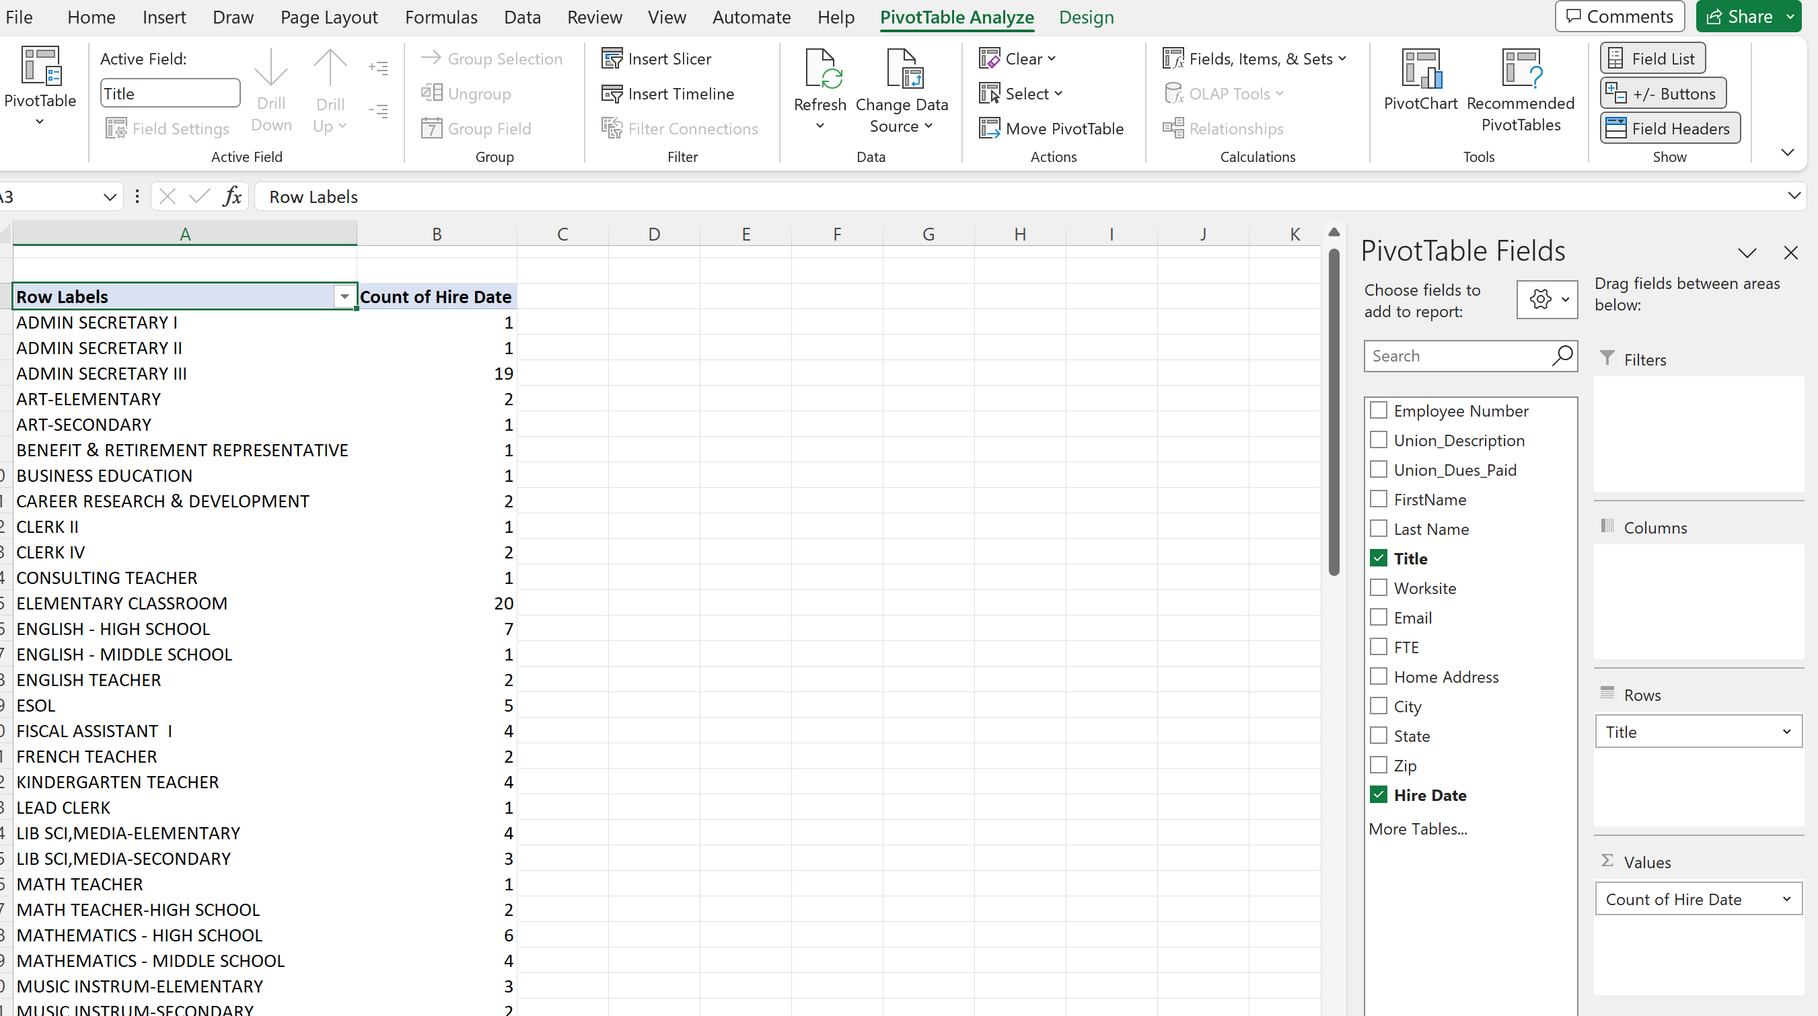
How to Create A Pivot Table
In this example determine how many people within the bargaining unit are in each job title.
What are the top 3 represented job titles?
What are the least represented job titles?
Notes:
Seleste

Slide 16
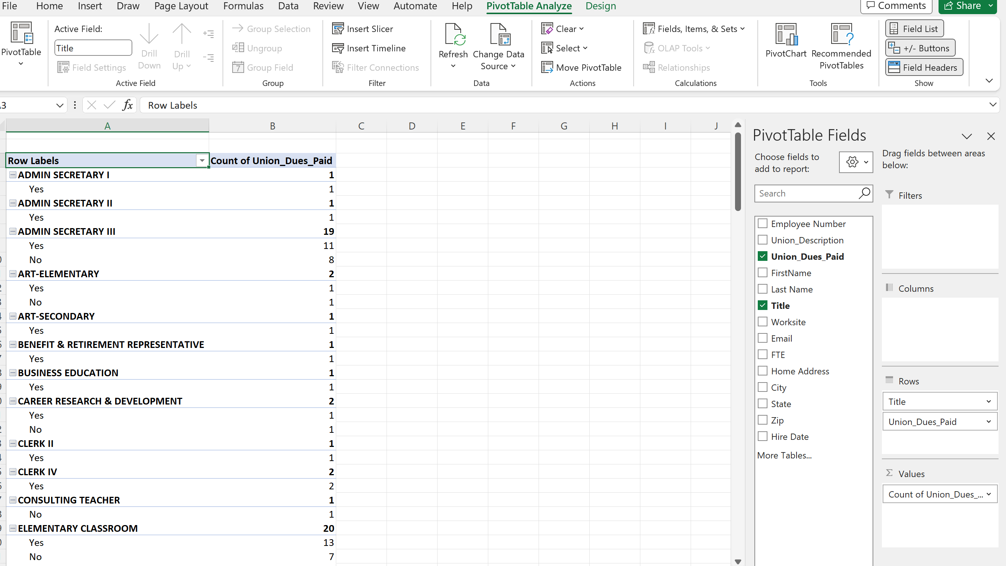
How to Create A Pivot Table
In this example determine how many people are members based on job title.
Which job title has the most membership?
Which job title has the most potential?

Slide 17

Group Work
- Now you try it -
Notes:
15 minutes

Slide 18
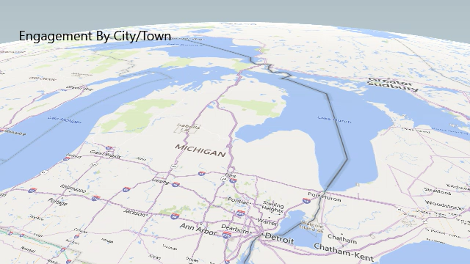
What Mapping Looks Like in IRL
The data visualizations in this case help tell the story of member engagement of professional learning:
Where
Who
What
The staff who represent the school districts shown can see patterns that are best communicated visually.
Notes:
Chad

Slide 19
- Debrief -
In what situations might you want to use the PivotTable feature?
Notes:
Seleste

Slide 20
Power Mapping Excel Sheets
Visualizing The Data
Notes:
Chad

Slide 21
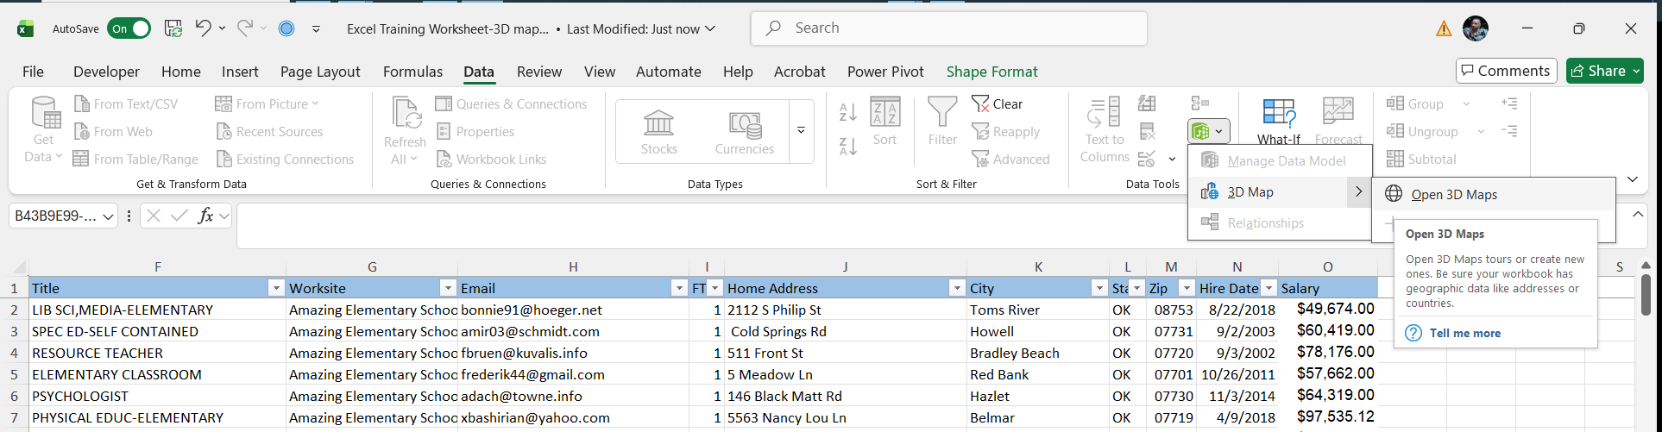

3D Mapping
1
2
3
Data Tab
Data Model
3D Map
4
Open 3D Map
Notes:
Chad

Slide 22
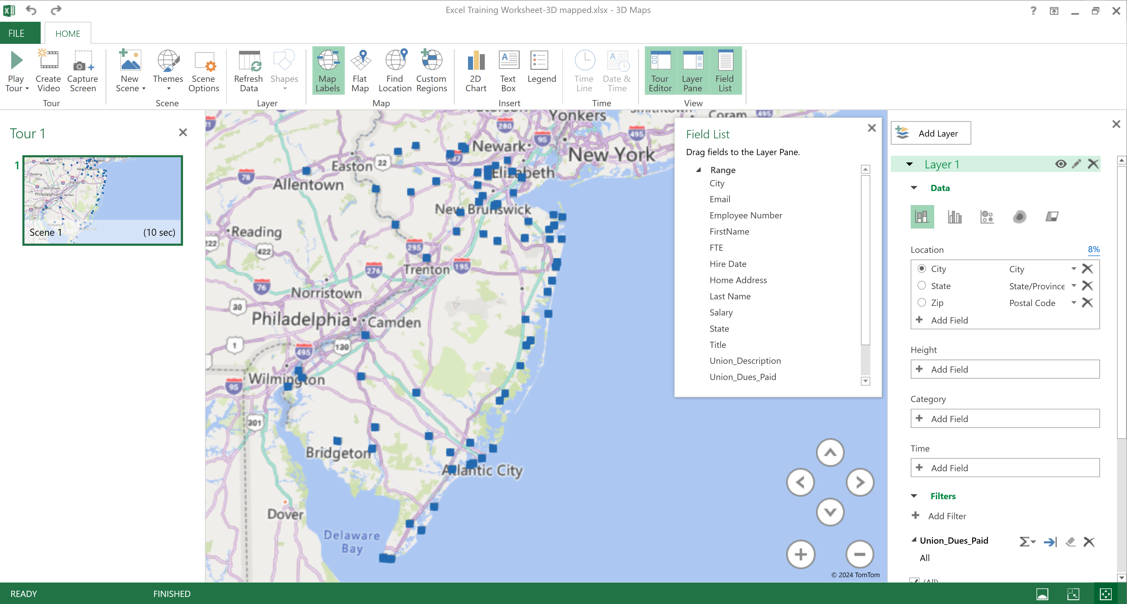
3D Mapping
1
New Scene
2
Set Location
3
Filter Data
Notes:
Chad

Slide 23
Group Work
- Now you try it -
Notes:
CHAD

Slide 24
Making the Information Accessible when Evaluating Membership Data
Notes:
Seleste

Slide 25

Key Concepts:
  Excel is a tool that is widely available and the basis of all database programs.
  Functions such as Pivot Tables, Goal Seeking, and Power Mapping allow you to analyze existing data to strategize based on the data.
Notes:
UPDATE TO APPLY SKILLS FOCUSED ON IN THE SESSION
Slide allotment: 1 minute

Slide 26
QUESTIONS?
WHAT ELSE WOULD YOU LIKE TO LEARN OR SHARE ABOUT USING AND ANALYZING DATA?
Notes:
TARAJA

Slide 27
Looking Ahead:
Share your feedback on today's session.
https://forms.office.com/r/HekdErpq1t
Mark your calendars
  March 12, 2026
    Part 3: Disseminating information
  May 21, 2026
  Part 4: Campaign Progress Tracking
Notes:
Seleste
Slide allotment: 1 minute
UPDATE SLIDE
COMMERCIAL BREAK FOR OTHER SESSIONS
TEACHER UNIONS FOR SOCIAL JUSTICE
CAMPAIGN LAB

Slide 28
Thank You - Contact Us:
Seleste Harris
UniServ Director
Maryland State
Education Association
sharris@mseanea.org
Monet Reilly
UniServ Representative
Pennsylvania State
Education Association
mreilly@psea.org
Beth Barton
UniServ Director
Illinois Education Association
Beth.Barton@ieanea.org
Chad Williams
UniServ Consultant
Michigan Education Association
cwilliams@mea.org
Dr. Taraja Shephard Allen
UniServ Membership Consultant
Ohio Education Association
Shephardallent@ohea.org

