Slide 1


Using Excel for Organizing
Part 2: Analyzing Data
While we wait to begin, please:
1
2
3
Rename yourself:
Name/State/Pronouns (Sam/GA-his/him)
Download data set
Complete the analogy in the chat.
  “I am to excel, as a duck is to…”

Slide 2





Facilitators:
Seleste Harris
UniServ Director
Maryland State
Education Association
sharris@mseanea.org
Monet Reilly
UniServ Representative
Pennsylvania State
Education Association
mreilly@psea.org
Beth Barton
UniServ Director
Illinois Education Association
Beth.Barton@ieanea.org
Chad Williams
UniServ Consultant Michigan
Michigan Education Association
cwilliams@mea.org
Notes:
CHANGE FACILITATOR LIST
Add Taraja

Slide 3

Land Acknowledgement
We begin by acknowledging that through a history of colonization and brutality, we are currently on the traditional lands stewarded by generations of the Indigenous people.
We honor these Indigenous people, all elders, past, present, and emerging. We are called to learn and share these learnings about this tribal history, culture, and contributions that have been suppressed in the telling of the story of what we now call the United States of America.

Slide 4

Series Overview
  October 10, 2024
    Part 1: Evaluating membership data
  December 5, 2024
    Part 2: Analyzing your power
  May 15, 2024
    Part 3: Disseminating information
  Each session is 2:30pm-4:00pm EST
Notes:
UPDATE SERIES DATES

Slide 5
Today's Agenda
Why is data important?
Where does data come from?
How to evaluate the data
Session Outcomes
Explore benefits of using Excel to analyze data
Explore the features within Excel that can assist with organizing
Practice using the features within Excel
  Pivot Tables
  Goal Seeking
  Bonus content: 3D Mapping

Slide 6
Why Is Data Important?
Notes:
Time Allotment:
Taraja

Slide 7
- Break Out -
Where do you get data?
What do you use to make it make sense?
What are some challenges you have in getting local data?
Notes:
Time Allotment: 7 minutes total
Taraja
1 minute directions
5 minutes breakout
2 minutes debrief
After reviewing instructions, you are going to broken into groups. You will be in the breakout group for 3-4 minutes to answer the question: Where do you get data?
Based on the number of participants, use no more than 3-5 breakout groups.
After the participants return, ask each group to share 2 sources of data.

Slide 8
- Debrief -
Where do you get data?
What do you use to make it make sense?
What are some challenges you have in getting local data?
Notes:
Time Allotment: 7 minutes total
Taraja
1 minute directions
5 minutes breakout
2 minutes debrief
After reviewing instructions, you are going to broken into groups. You will be in the breakout group for 3-4 minutes to answer the question: Where do you get data? What do you use to make it make sense?
Based on the number of participants, use no more than 3-5 breakout groups.
After the participants return, ask each group to share 2 sources of data.

Slide 9
Notes:
HOW DO YOU USE DATA TO ORGANIZE
REFLECTION ON WORK SINCE LAST SESSION

Slide 10
Pivot Tables
Notes:
Seleste

Slide 11
Benefits of Pivot Tables
Summarizes large data sets quickly
Automatically updates
Notes:
Seleste

Slide 12
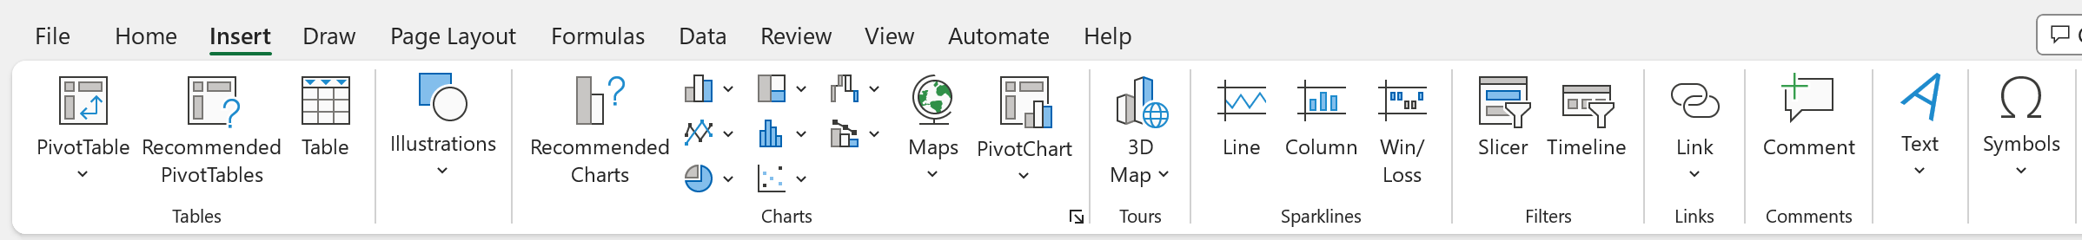
How to Create A Pivot Table
Insert Tab
Click PivotTable
Notes:
Seleste

Slide 13
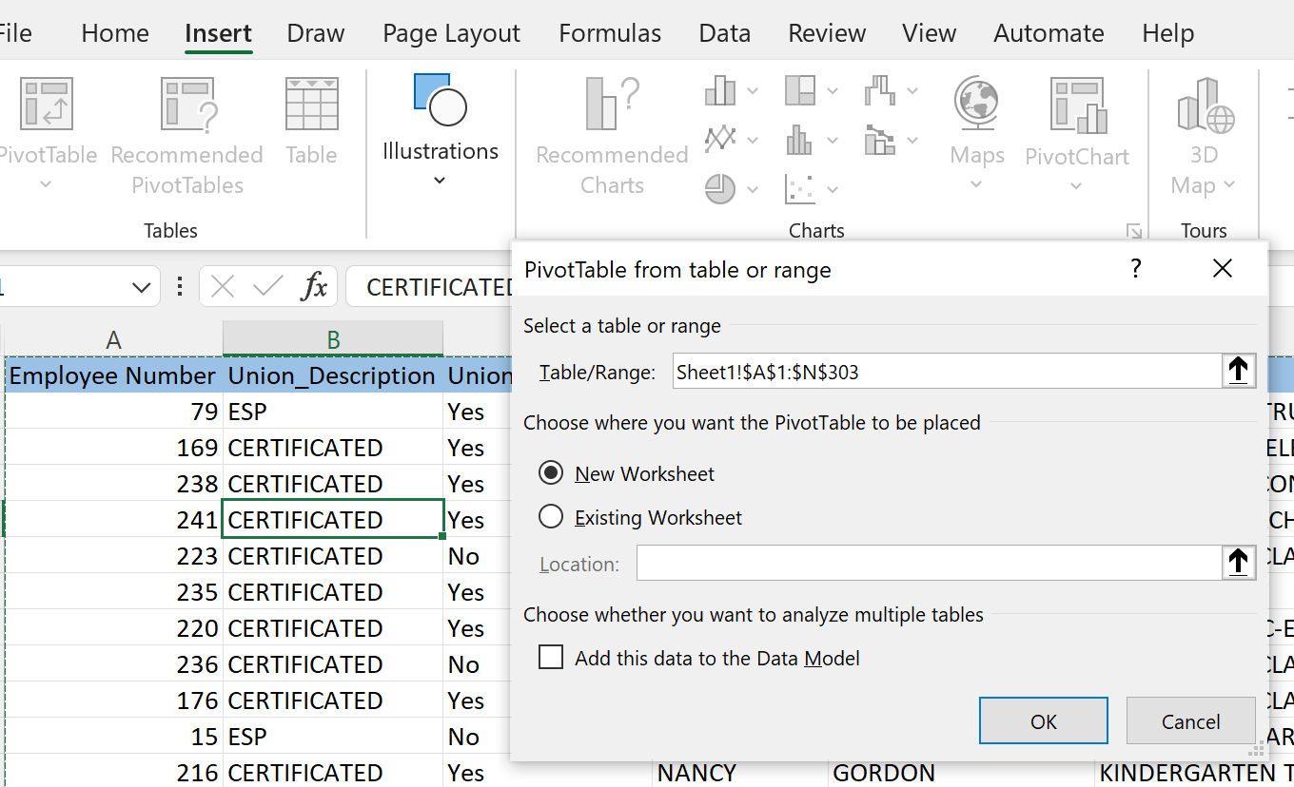
How to Create A Pivot Table
Pop-up window will appear asking for the data set being analyzed
The table range default is the active table.
Recommendation: place the PivotTable in New Worksheet
Select OK
Notes:
Seleste

Slide 14
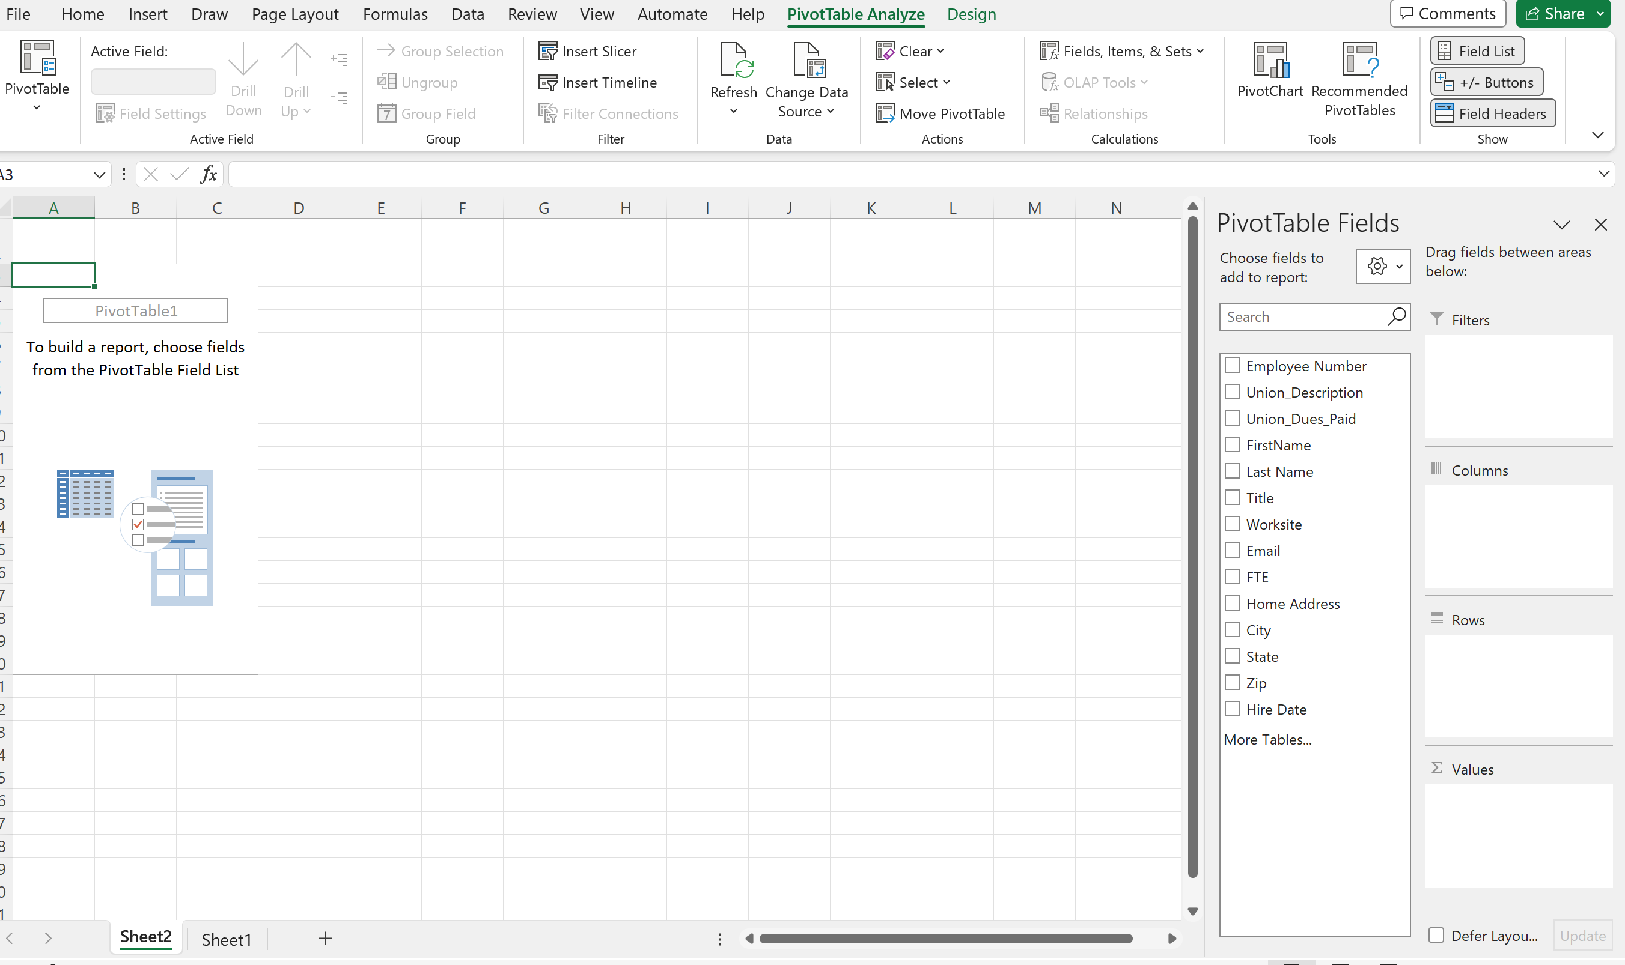
How to Create A Pivot Table
This is where you identify the data that is to be summarized.
Notes:
Seleste

Slide 15
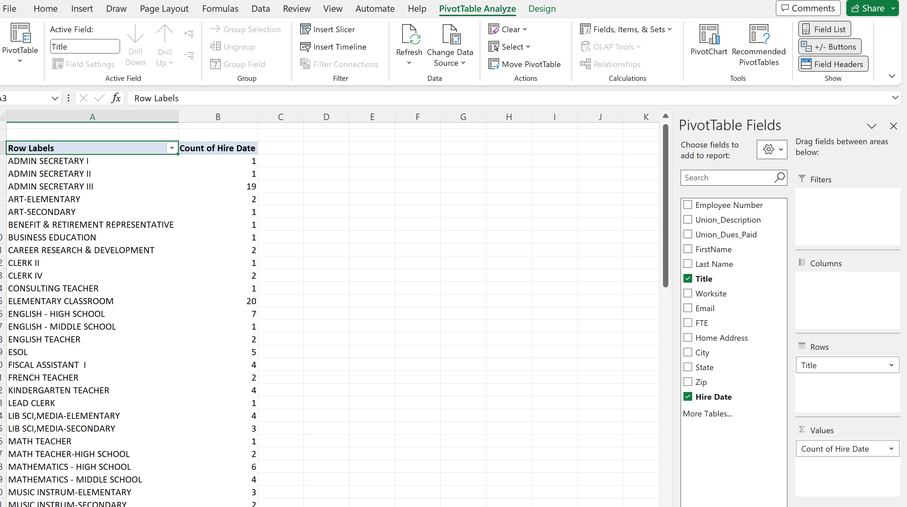
How to Create A Pivot Table
In this example determine how many people within the bargaining unit are in each job title.
What are the top 3 represented job titles?
What are the least represented job titles?
Notes:
Seleste

Slide 16
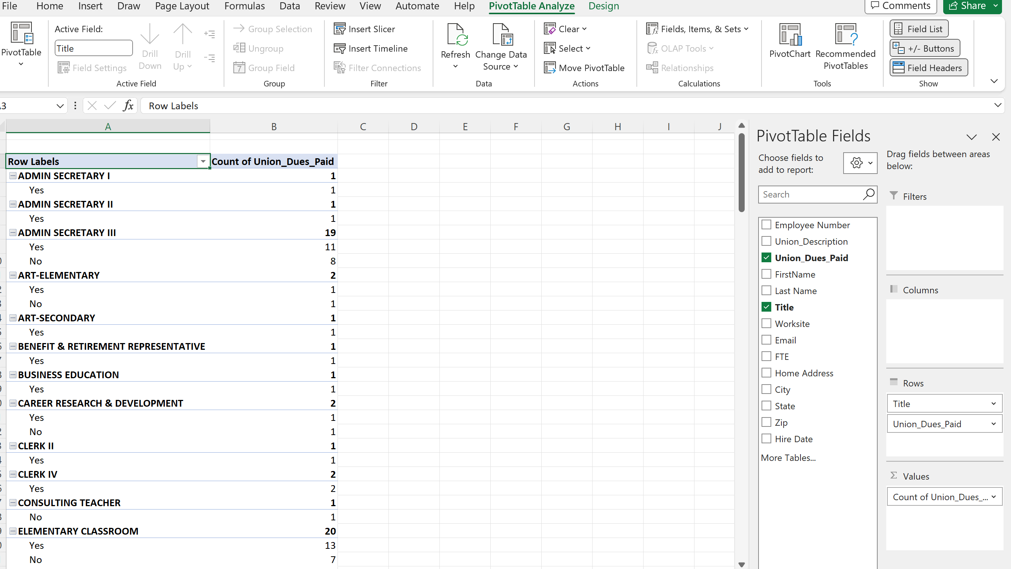
How to Create A Pivot Table
In this example determine how many people are members based on job title.
Which job title has the most membership?
Which job title has the most potential?

Slide 17

Group Work
- Now you try it -
Notes:
15 minutes

Slide 18
- Debrief -
In what situations might you want to use the PivotTable feature?
Notes:
Seleste

Slide 19
Bonus Content
3D Mapping Excel Sheets
Visualizing The Data
Notes:
Chad
RETITLE POWER MAPPING

Slide 20
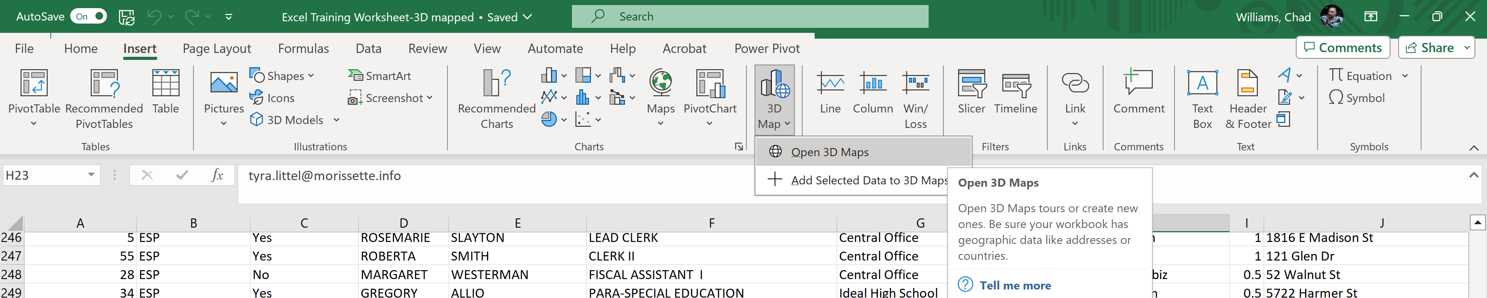
3D Mapping
Insert tab
3D Map
Open 3D Maps
Notes:
Chad

Slide 21
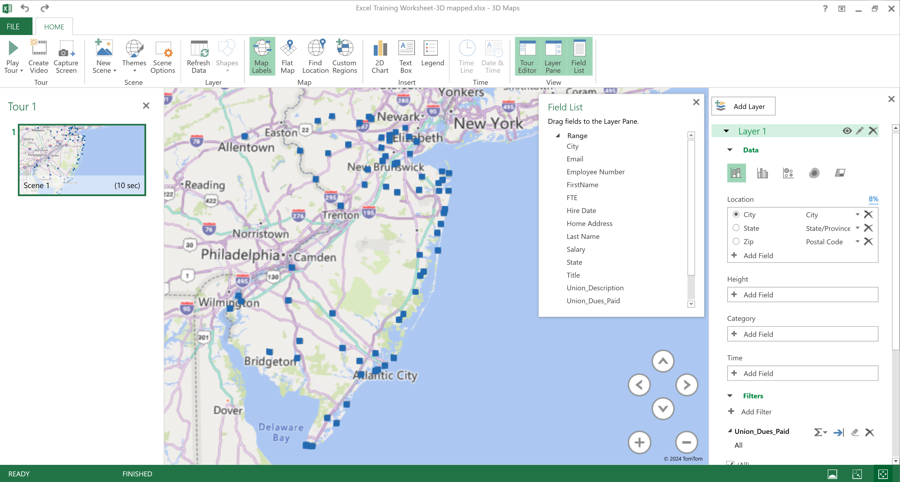
3D Mapping
Choose location
Choose height and/or filter
Create additional scenes to show different visualizations
Notes:
Chad

Slide 22
Group Work
- Now you try it -

Slide 23
Directions
Open Data Sheet Titled "Goal Seek"
Complete all 4 Practice Scenarios
The instructions are on the sheet

Slide 24
Making the Information Accessible when Evaluating Membership Data
Notes:
Seleste

Slide 25
Questions

Slide 26
Notes:
SESSION TAKEAWAYS
WHAT ELSE WOULD YOU LIKE TO LEARN OR HOW YOU USE ANALYZE DATA

Slide 27

Key Concepts:
  Excel is a tool that is widely available and the basis of all database programs.
  Functions such as Pivot Tables, Goal Seeking, and Power Mapping allow you to analyze existing data to strategize based on the data.
Notes:
UPDATE TO APPLY SKILLS FOCUSED ON IN THE SESSION
Slide allotment: 1 minute

Slide 28
Looking Ahead:
Share your feedback on today's session.
https://forms.office.com/r/HekdErpq1t
Mark your calendars
  March 13, 2025 at 2:30pm EST
    Part 3: Disseminating information
  May 22, 2025 at 2:30pm EST
    Part 4: Participant choice
Notes:
Seleste
Slide allotment: 1 minute
UPDATE SLIDE
COMMERCIAL BREAK FOR OTHER SESSIONS
TEACHER UNIONS FOR SOCIAL JUSTICE
CAMPAIGN LAB

Slide 29
Thank You - Contact Us:
Seleste Harris
UniServ Director
Maryland State
Education Association
sharris@mseanea.org
Monet Reilly
UniServ Representative
Pennsylvania State
Education Association
mreilly@psea.org
Beth Barton
UniServ Director
Illinois Education Association
Beth.Barton@ieanea.org
Chad Williams
UniServ Consultant Michigan
Michigan Education Association
cwilliams@mea.org
Notes:
UPDATE FACILITATORS
ADD TARAJA

