Slide 1
Using Excel for Organizing
Notes:
Chad will serve as the meeting host.
Chad

Slide 2
While you wait
Rename yourself to include Name/State/Pronouns (Sam/GA-his/him)
1
Download data set
2
Answer the question in the chat.
3
"insert skill rating system"
Notes:
Chad

Slide 3
Land Acknowledgement
We begin by acknowledging that through a history of colonization and brutality, we are currently on the traditional lands stewarded by generations of the Indigenous people.
We honor these Indigenous people, all elders, past, present, and emerging. We are called to learn and share these learnings about this tribal history, culture, and contributions that have been suppressed in the telling of the story of what we now call the United States of America.
Notes:
Time Allotment: 1 minute
Chad

Slide 4
Overall Agenda
Part of a 4-part training series
  September 13, 2023
    Part 1: Evaluating membership data
  December 6, 2023
    Part 2: Analyzing your power
  March 13, 2024
    Part 3: Disseminating information
  May 15, 2024
    Part 4: Participant choice
  Each session is 2:30pm-4:00pm EST
Notes:
Section Allotment: 5 minutes
Chad

Slide 5
Session Outcomes
Explore benefits of using Excel to analyze data
Explore the features within Excel that can assist with organizing
Practice using the features within Excel
  Pivot Tables
  Goal Seeking
  Bonus content: 3D Mapping
Notes:
Time Allotment: 1 minute
Chad

Slide 6
Pivot Tables
Notes:
Section allotment: 30 minutes
Seleste

Slide 7
Benefits of Pivot Tables
Summarizes large data sets quickly
Automatically updates
Notes:
Seleste
Model in Excel
Share screen
Create a scenario
Show the participants the benefit of making the PivotTable

Slide 8
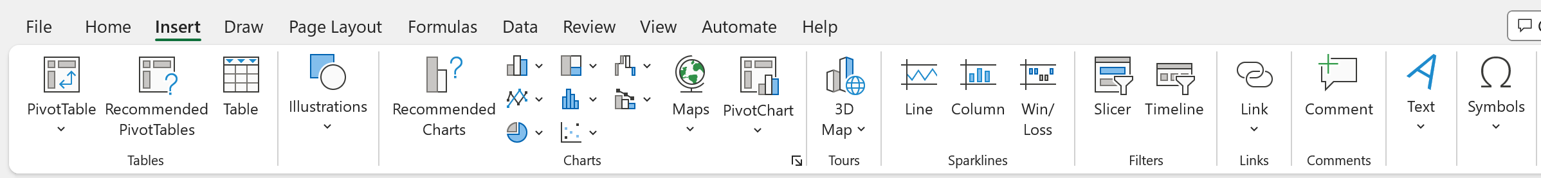
How to Create Pivot Table
Insert Tab
Click PivotTable
Notes:
Seleste

Slide 9
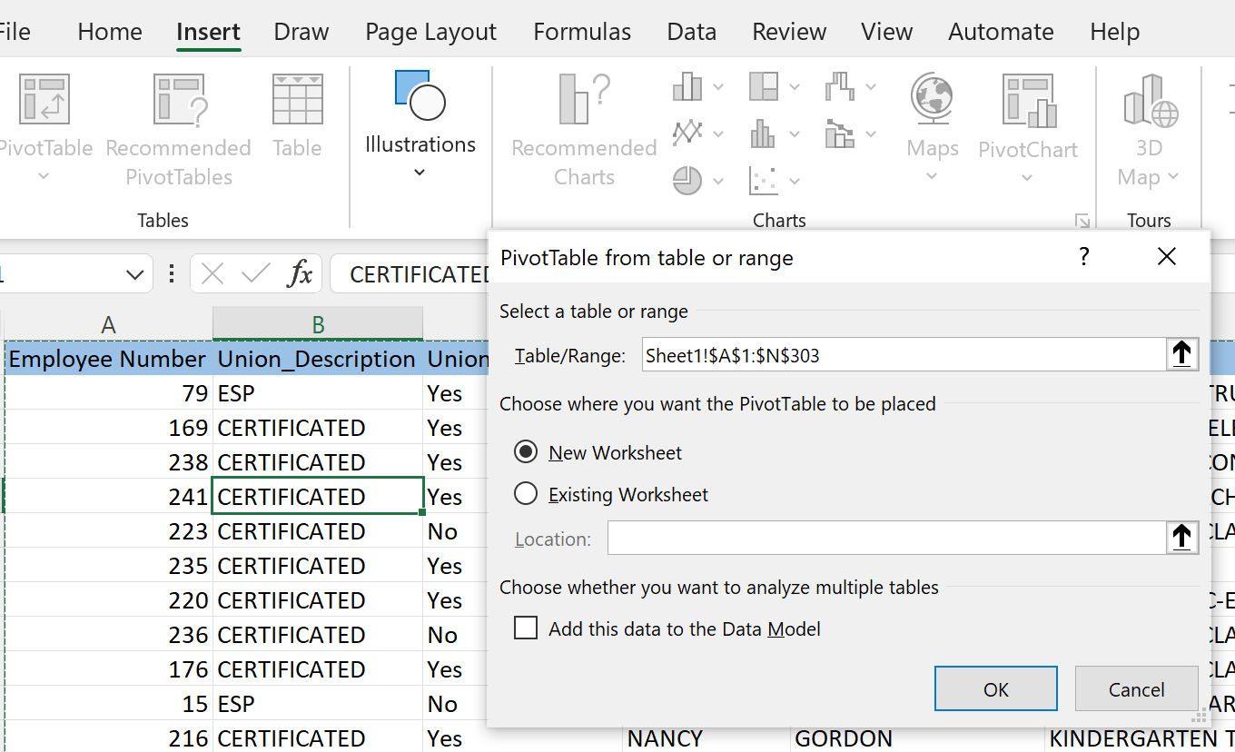
Pop-up window will appear asking for the data set being analyzed
The table range default is the active table.
Recommendation: place the PivotTable in New Worksheet
Select OK
Notes:
Seleste

Slide 10
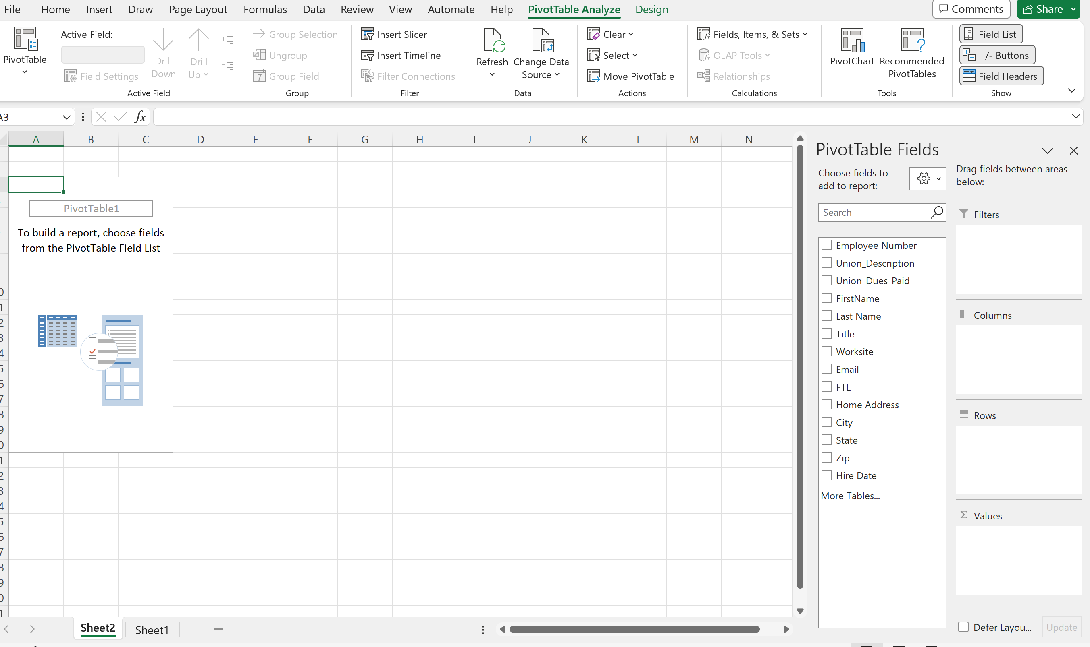
This is where you identify the data that is to be summarized.
Notes:
Seleste

Slide 11
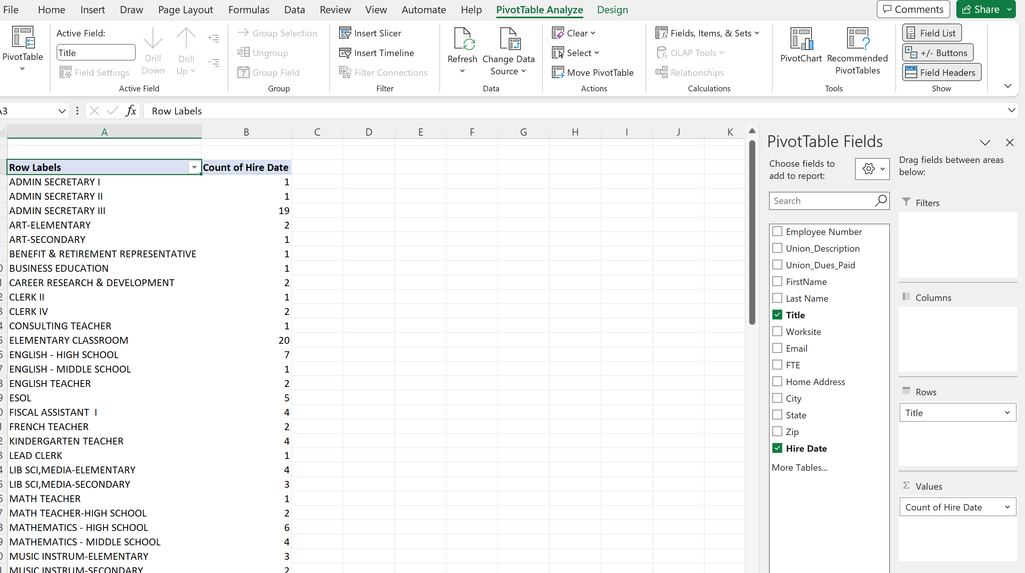
In this example determine how many people within the bargaining unit are in each job title.
What are the top 3 represented job titles?
What are the least represented job titles?
Notes:
Seleste
What are the top 3 represented job titles?
What are the least represented job titles?

Slide 12
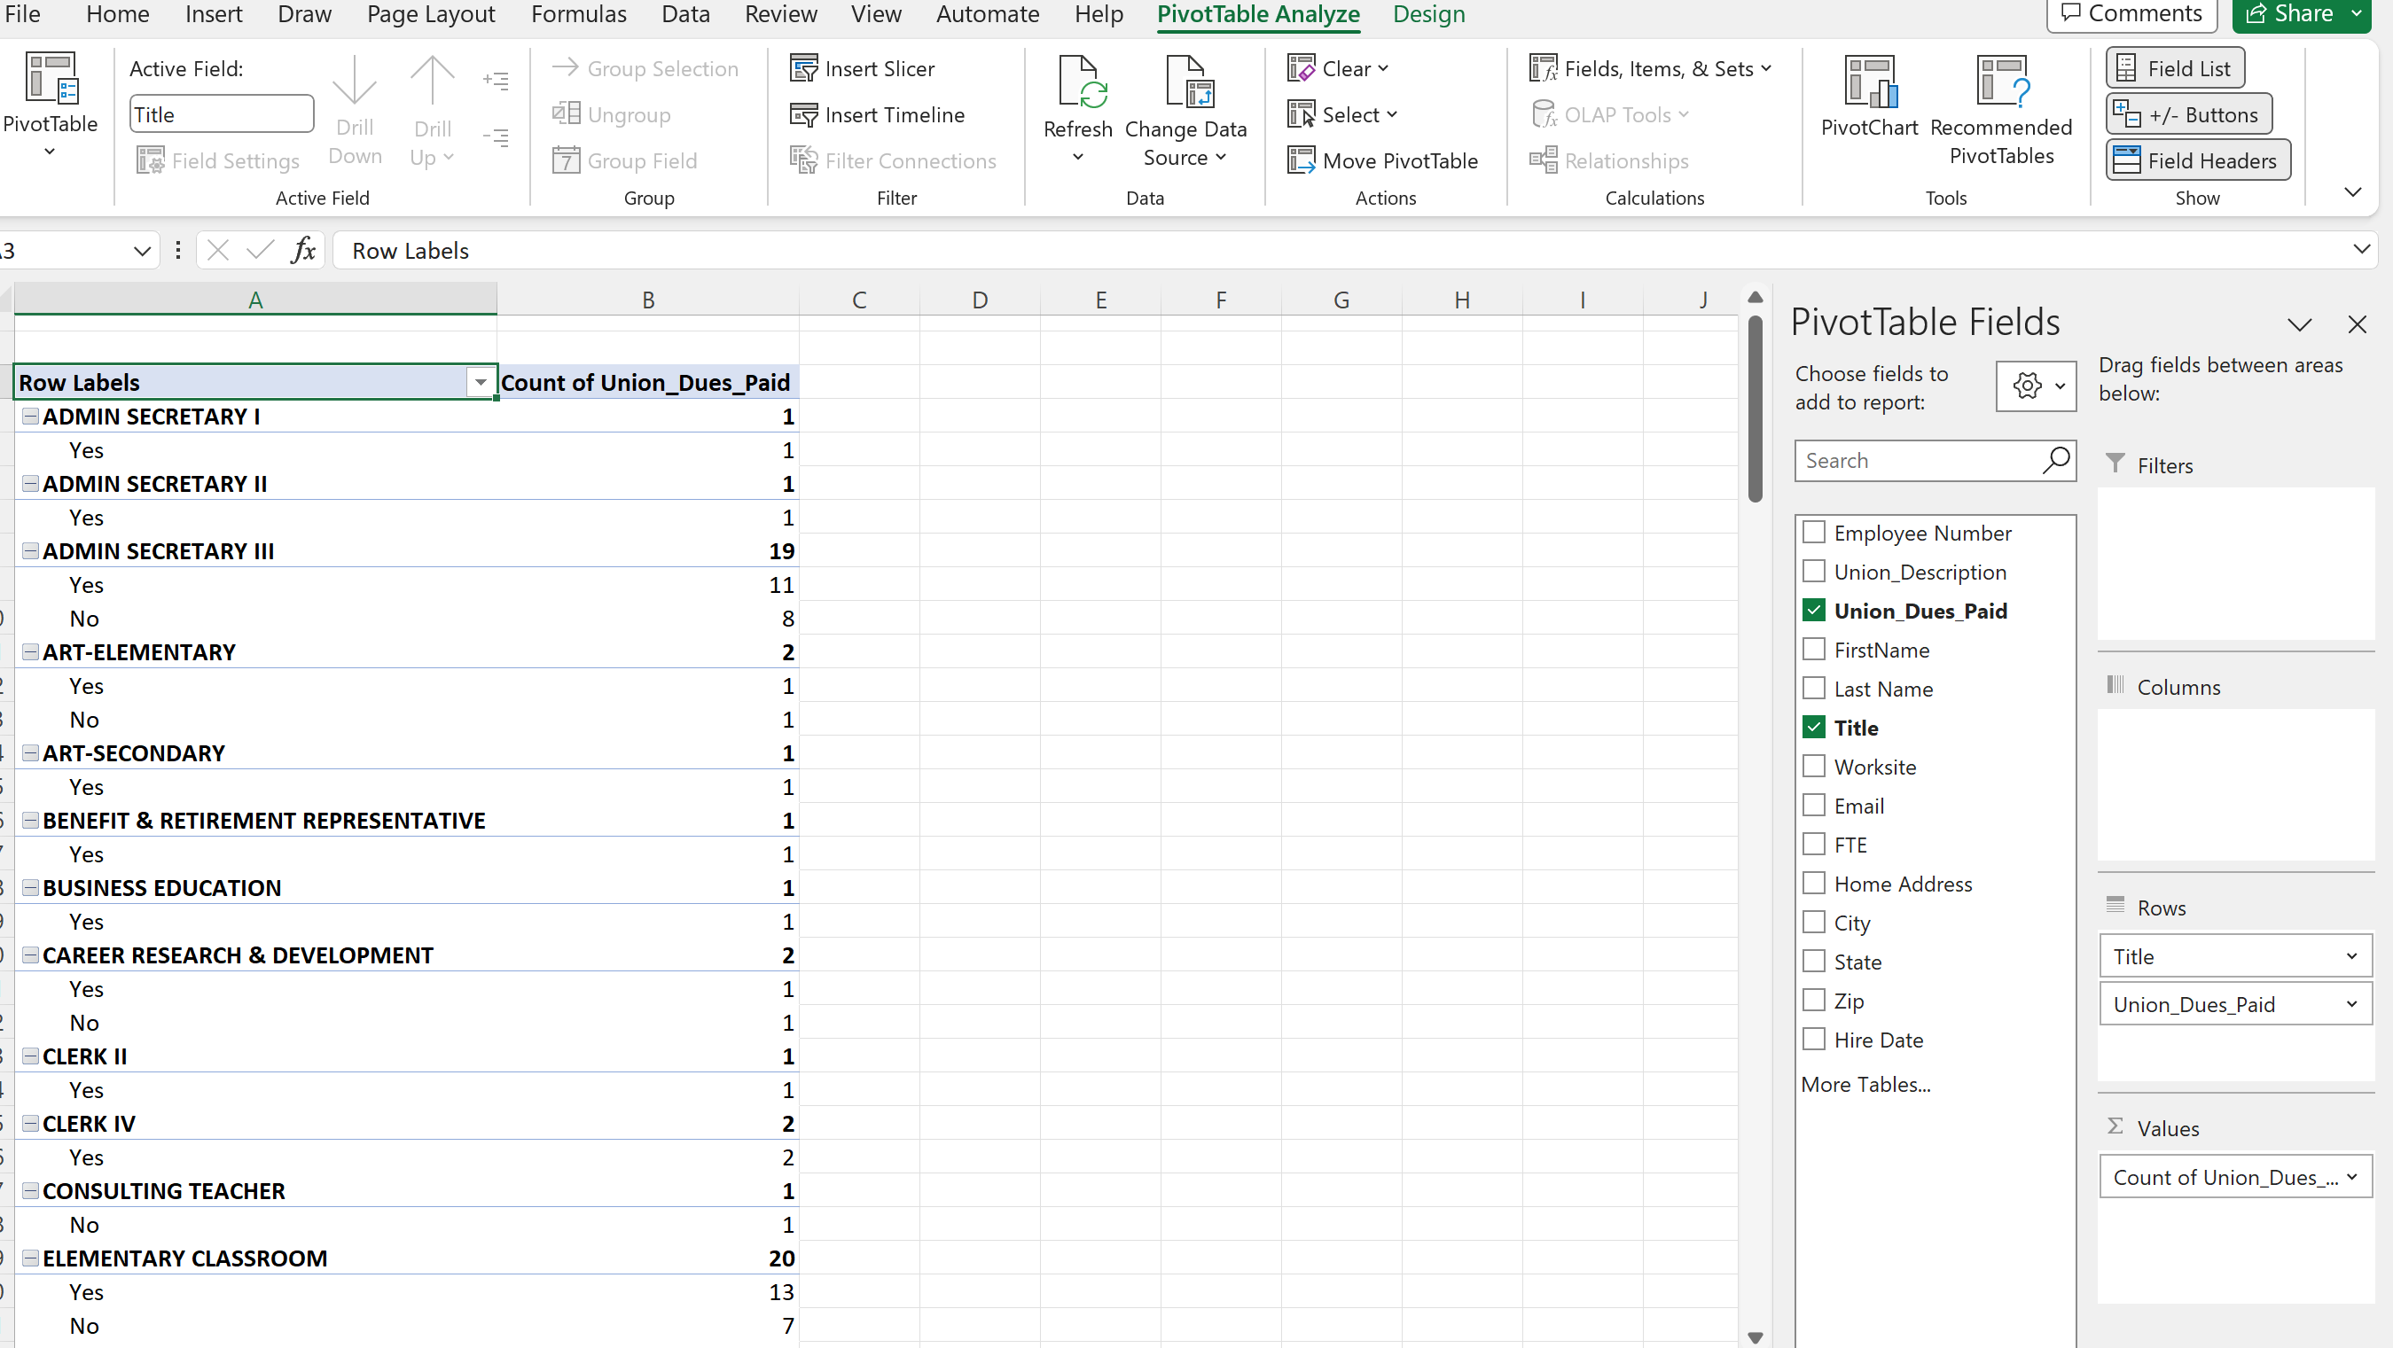
In this example determine how many people are members based on job title.
Which job title has the most membership?
Which job title has the most potential?
Notes:
Seleste
What are the top 3 represented job titles?
What are the least represented job titles?

Slide 13
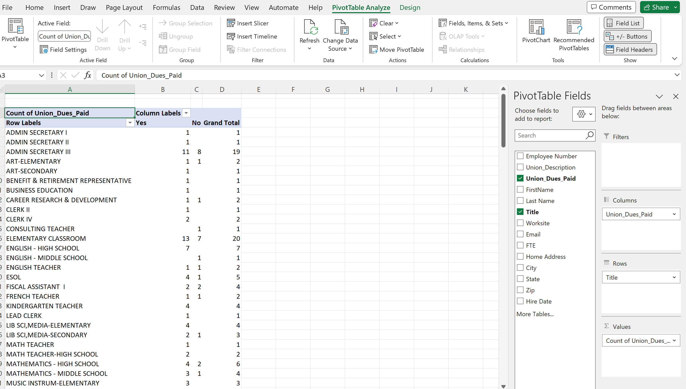
In this another example determine how many people are members based on job title.
Which job title has the most membership?
Which job title has the most potential?
Notes:
Seleste
What are the top 3 represented job titles?
What are the least represented job titles?

Slide 14
Pivot Table Practice Time
Notes:
Seleste
When would you use this???

Slide 15
Debrief
When and how would you use the PivotTable feature?

Slide 16

Goal Seek
Notes:
Section allotment: 15 minutes---THIS IS GOING TO TAKE LONGER THAN 15 MINUTES TO BE SUCCESSFUL.
Seleste

Slide 17

Benefits of Goal Seek
Knowing what you want to do but not sure how to do it.
No manual math needed.
Quick Access Tool
Notes:
Seleste
In negotiations, I use pivot tables to determine how many people would benefit from a particular salary proposal.
Given a scattergram, how many people are at the top of the scale?
Given a scattergram, how many people are in the first 5 years of their career?

Slide 18
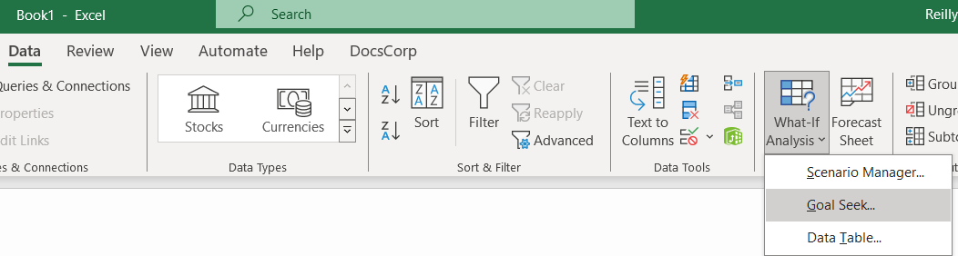
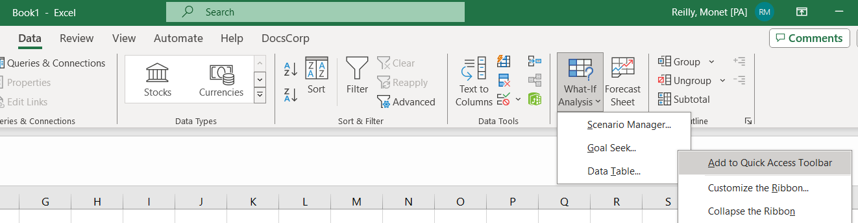

Where to find it
Data
What If Analysis
Goal Seek
How to pin it to Quick Access Toolbar
Right Click
Add to

Slide 19
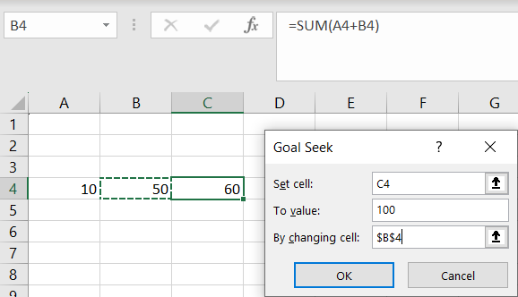
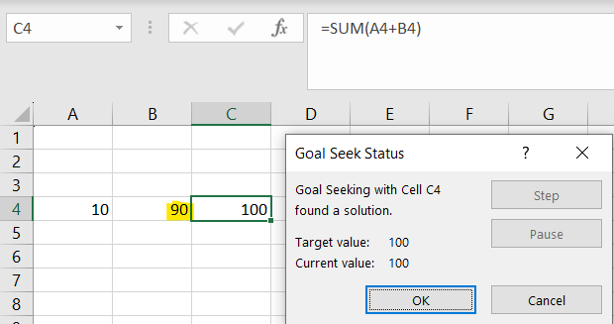
How to use basic (What plus 10 equals 100)
Find the cell where you want your end result to be (C4.)
Click Goal Seek
Type what you are desiring as an end result in "To Value:" (100)
Type what other box needs to change to do calculate the result (B4.)
Hit OK

Slide 20
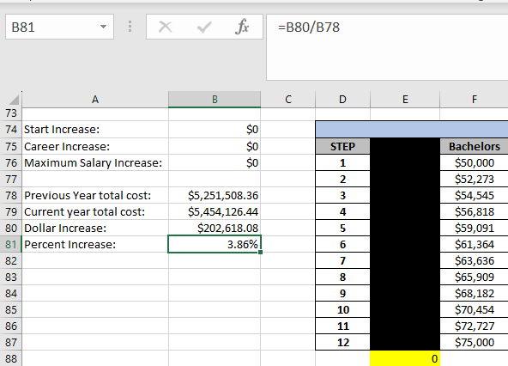
How to use (Advanced Salary Schedules)
Year one of a new schedule
5% overall raise inclusive of step movement
Money to be spread evenly across schedule to minimize a jump/bump step forming
How much money can we put on each cell to reach a 5% overall raise for this bargaining unit?

Slide 21
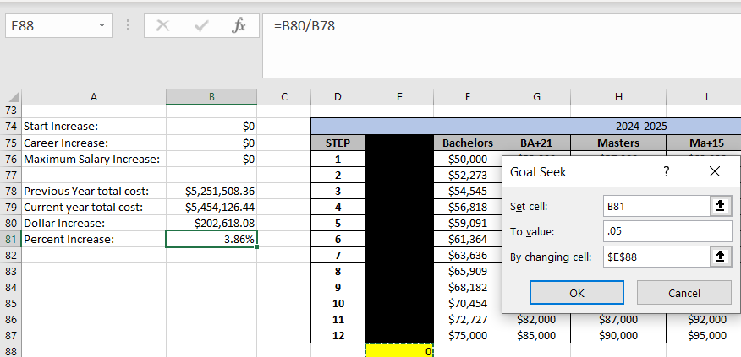
How to use (Advanced Salary Schedules)
Find the cell where you want your end result to be (B81.)
Click Goal Seek
Type what you are desiring as an end result in "To Value:" (.05)
Type what other box needs to change to do calculate the result (E88.)
Hit OK

Slide 22
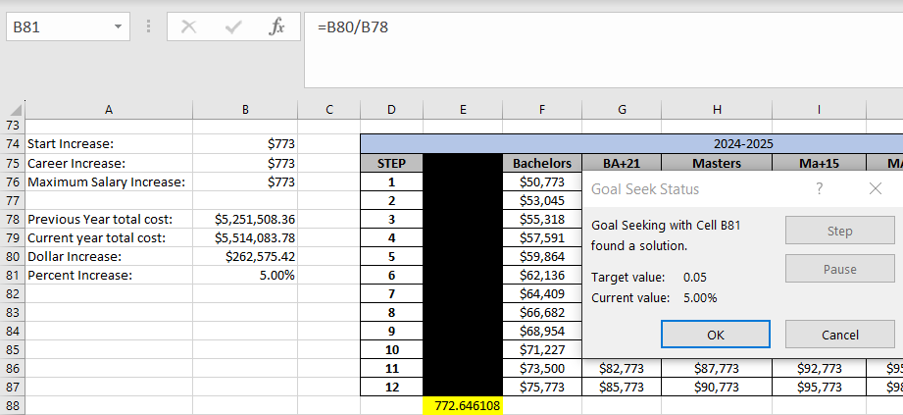
How to use (Advanced Salary Schedules)
Each cell can increase $772.64 in addition to step movement for an overall 5% raise.

Slide 23
Goal Seek Practice Time
Open Data Sheet Titled "Goal Seek"
Complete all 4 Practice Scenarios
The instructions are on the sheet

