Slide 1


Using Excel for Organizing
Part 3
Disseminating Information
While we wait to begin, please:
1
2
3
Rename yourself:
Name/State/Pronouns (Sam/GA-his/him)
Download data set
In the chat, let us know:
  What is an interesting/odd thing you EXCEL at? ☺

Slide 2

Land Acknowledgement
We begin by acknowledging that through a history of colonization and brutality, we are currently on the traditional lands stewarded by generations of the Indigenous people.
We honor these Indigenous people, all elders, past, present, and emerging. We are called to learn and share these learnings about this tribal history, culture, and contributions that have been suppressed in the telling of the story of what we now call the United States of America.

Slide 3

Series Overview
  September 13, 2023
    Part 1: Evaluating membership data
  March 13, 2024
    Part 2: Analyzing your power
  May 15, 2024
    Part 3: Disseminating information
  Each session is 2:30pm-4:00pm EST

Slide 4
Today's Agenda
How can we use Excel to disseminate information to those who we wish?
Why is are Excel tools helpful to me in my staff work?
Session Outcomes
Understanding VLOOKUP
Using Conditional Formatting to check lists
How and why to use Mail Merge

Slide 5





Facilitators:
Seleste Harris
UniServ Director
Maryland State
Education Association
sharris@mseanea.org
Monet Reilly
UniServ Representative
Pennsylvania State
Education Association
mreilly@psea.org
Beth Barton
UniServ Director
Illinois Education Association
Beth.Barton@ieanea.org
Chad Williams
UniServ Consultant Michigan
Michigan Education Association
cwilliams@mea.org

Slide 6
VLookup
Combining information from different spreadsheets

Slide 7
Benefits of VLOOKUP
Membership Audits
Ratification Information (salaries, seniority, step movement etc)
Just need one spreadsheet

Slide 8
VLOOKUP - Notes from the field
Not used everyday
Important to know it can be done when you need it
Practice makes perfect!

Slide 9
Vlookup is a FORMULA (Save this slide!)
All formulas in excel start with “=“
Formula: =
Translation: VLOOKUP(unique identifier on both sheets, range from unique identifier to what data you are looking for, the number of columns over to look, Approximate match (TRUE) or Exact match (FALSE)).
Important Notes:
  Unique identifier will be chosen on the sheet you want the data to be entered in
  The Range selection will be from the sheet you are pulling the other data from.

Slide 10
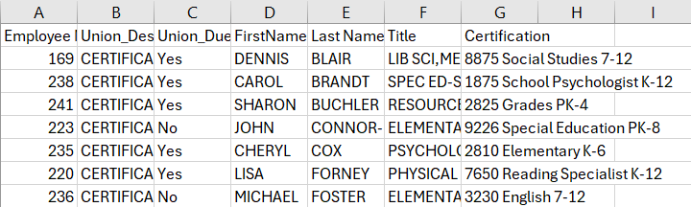
Example
Employee number is easiest to use.
Need certifications combined to membership list

Slide 11





















Let’s highlight what we need first…
Unique identifier on both sheets, range from unique identifier to what data you are looking for, the number of columns over to look, Approximate match (TRUE) or Exact match (FALSE)).
FALSE because we want them to match “16” exactly with “16.” Otherwise, it could match “16” with “169.”
The 7th Column in the Range

Slide 12
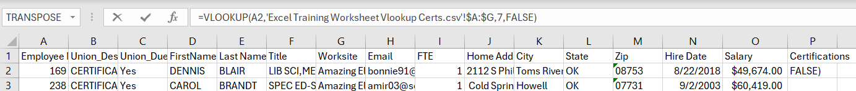




In Practice…
FORMULA: =VLOOKUP(A2,'Excel Training Worksheet Vlookup Certs.csv'!$A:$G,7,FALSE)
Step 1: Type =vlookup(
Step 2: Click the cell with the unique identifier,
Step 3: Go to other sheet and highlight columns from unique identifier to data you want to move over,
Step 4: type the number columns it’s over from your unique identifier,
Step 5: click or type false then close parentheses and hit enter
The 7th Column in the Range

Slide 13
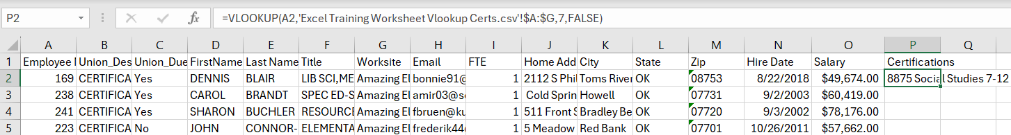
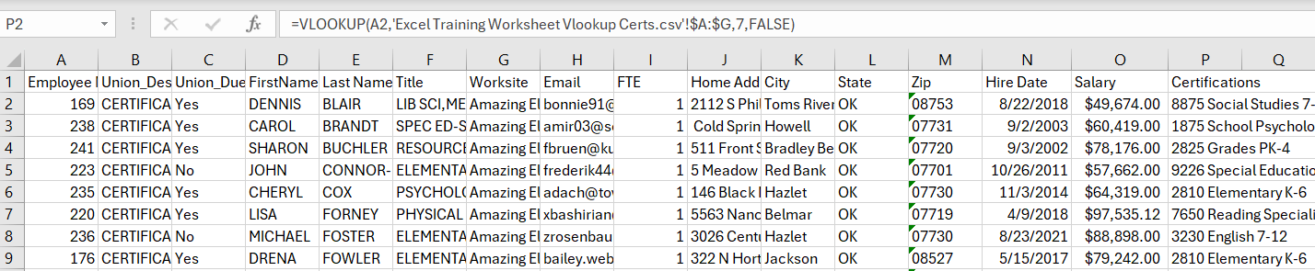
Step 6
Double click the corner of your new cell which will copy the formula down.

Slide 14

Group Work
- Now you try it -
Notes:
15 minutes

Slide 15

Clean Up Reminders:
Sheets are tied together.
Make sure to select column, copy, and paste plain text to preserve data.
Look for errors of missing data. Shows N/A or 0

Slide 16
Conditional Formatting
A Quick Way to Check Lists

Slide 17
Benefits of Conditional Formatting:
Simple
Fast and Visual
Works with any lists

Slide 18
Uses for Conditional Formatting
Compare lists of names/emails
Attendance vs Registration
Create list for Mail Merge

Slide 19
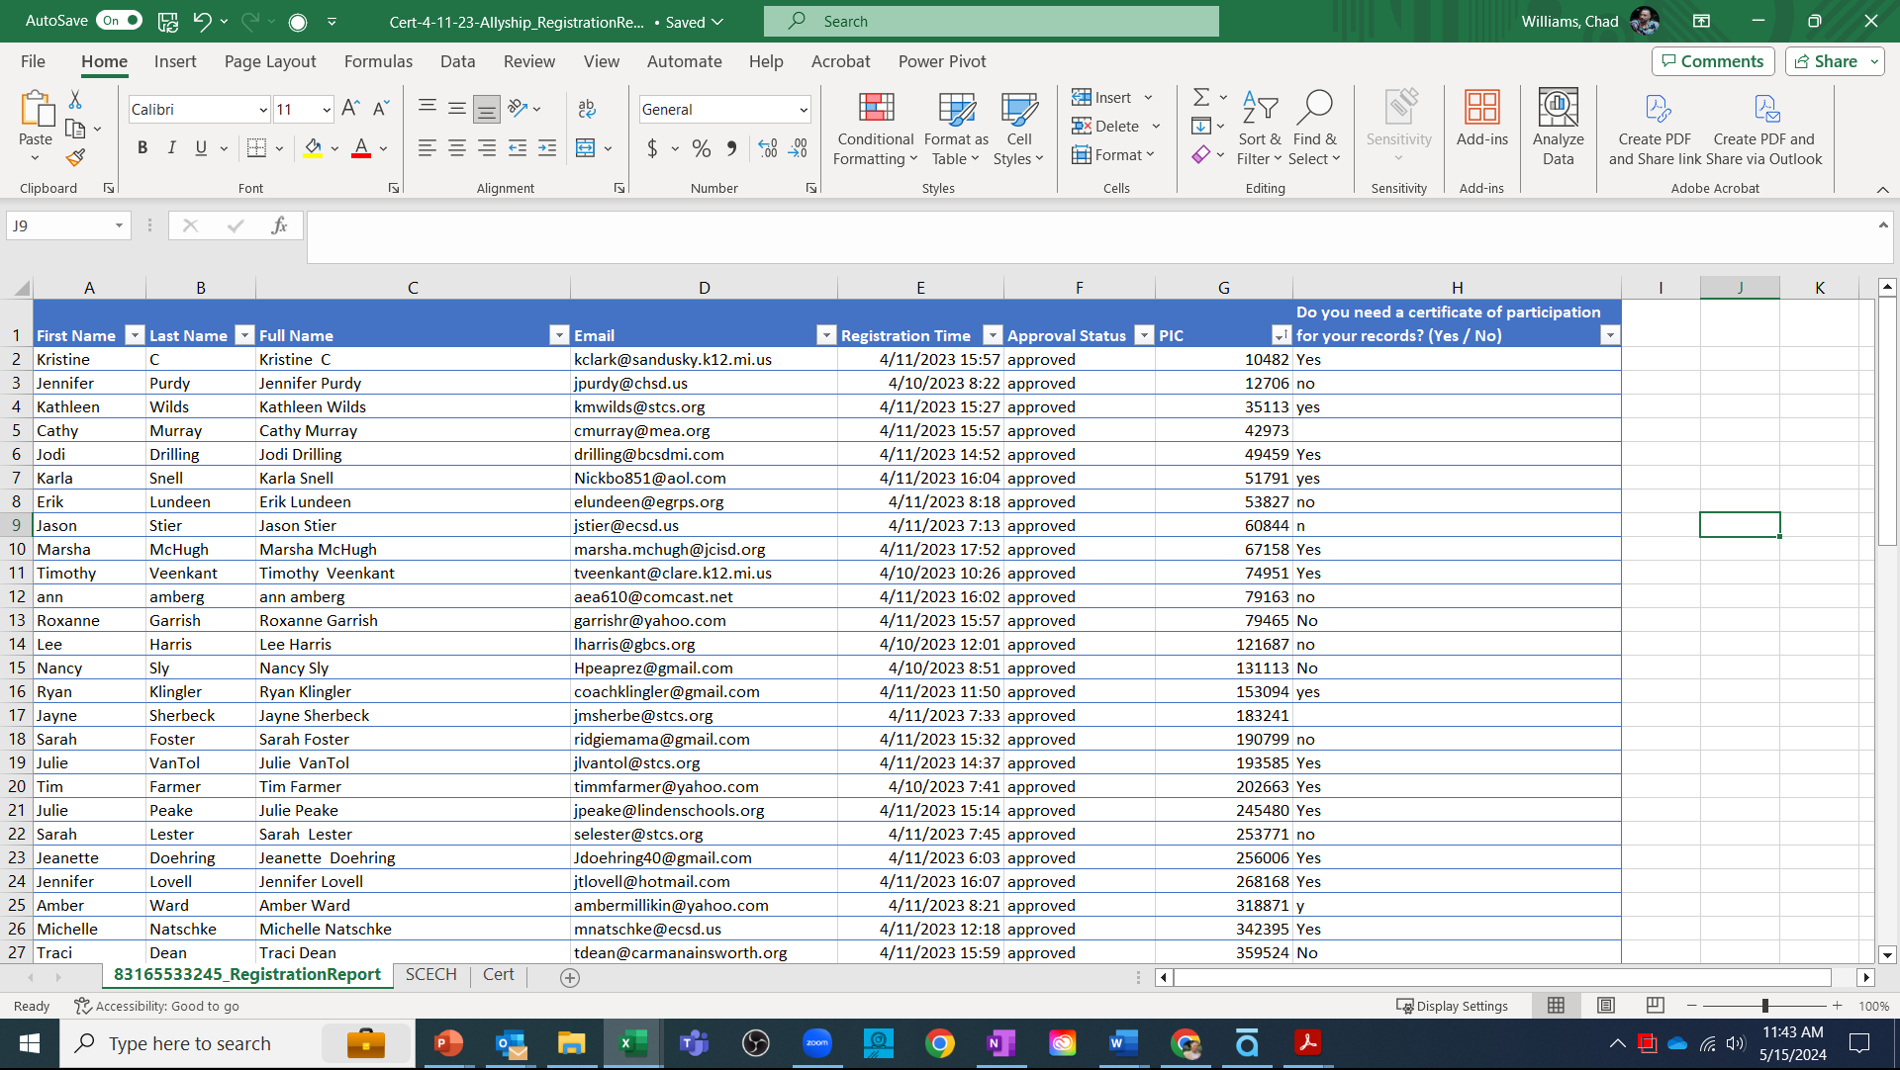
Conditional Formatting
Comparing Zoom Reports to Create Mail Merge List
Objective:
Compare a list of registrants requesting a cert with list of actual attendees and send the cert to the correct people
Notes:
Keep the end in mind.
How do you want to present the information (think about name)? You may need to use the Concatenate feature if you need to separate names
Who do you want to receive the information (members or potential members). You may need to sort the data if you need to separate particular groups of individuals
Note: The emails in our sample data set are not real. Please do not try to use them.
Share screen and encourage participants to follow along on their computers or the instructions sheet.

Slide 20
Conditional Formatting
Comparing Zoom Reports to Create Mail Merge List
Start with your registration report
Sort for certificate request
Notes:
Keep the end in mind.
How do you want to present the information (think about name)? You may need to use the Concatenate feature if you need to separate names
Who do you want to receive the information (members or potential members). You may need to sort the data if you need to separate particular groups of individuals
Note: The emails in our sample data set are not real. Please do not try to use them.
Share screen and encourage participants to follow along on their computers or the instructions sheet.

Slide 21
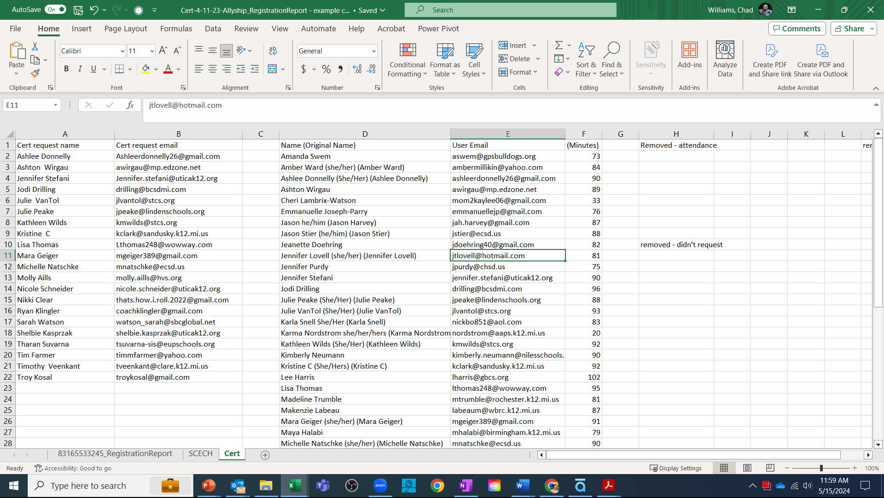
Conditional Formatting
Comparing Zoom Reports to Create Mail Merge List
Next:
Copy Paste the zoom attendance report next to the request list
Select the cells to compare
Notes:
Keep the end in mind.
How do you want to present the information (think about name)? You may need to use the Concatenate feature if you need to separate names
Who do you want to receive the information (members or potential members). You may need to sort the data if you need to separate particular groups of individuals
Note: The emails in our sample data set are not real. Please do not try to use them.
Share screen and encourage participants to follow along on their computers or the instructions sheet.

Slide 22
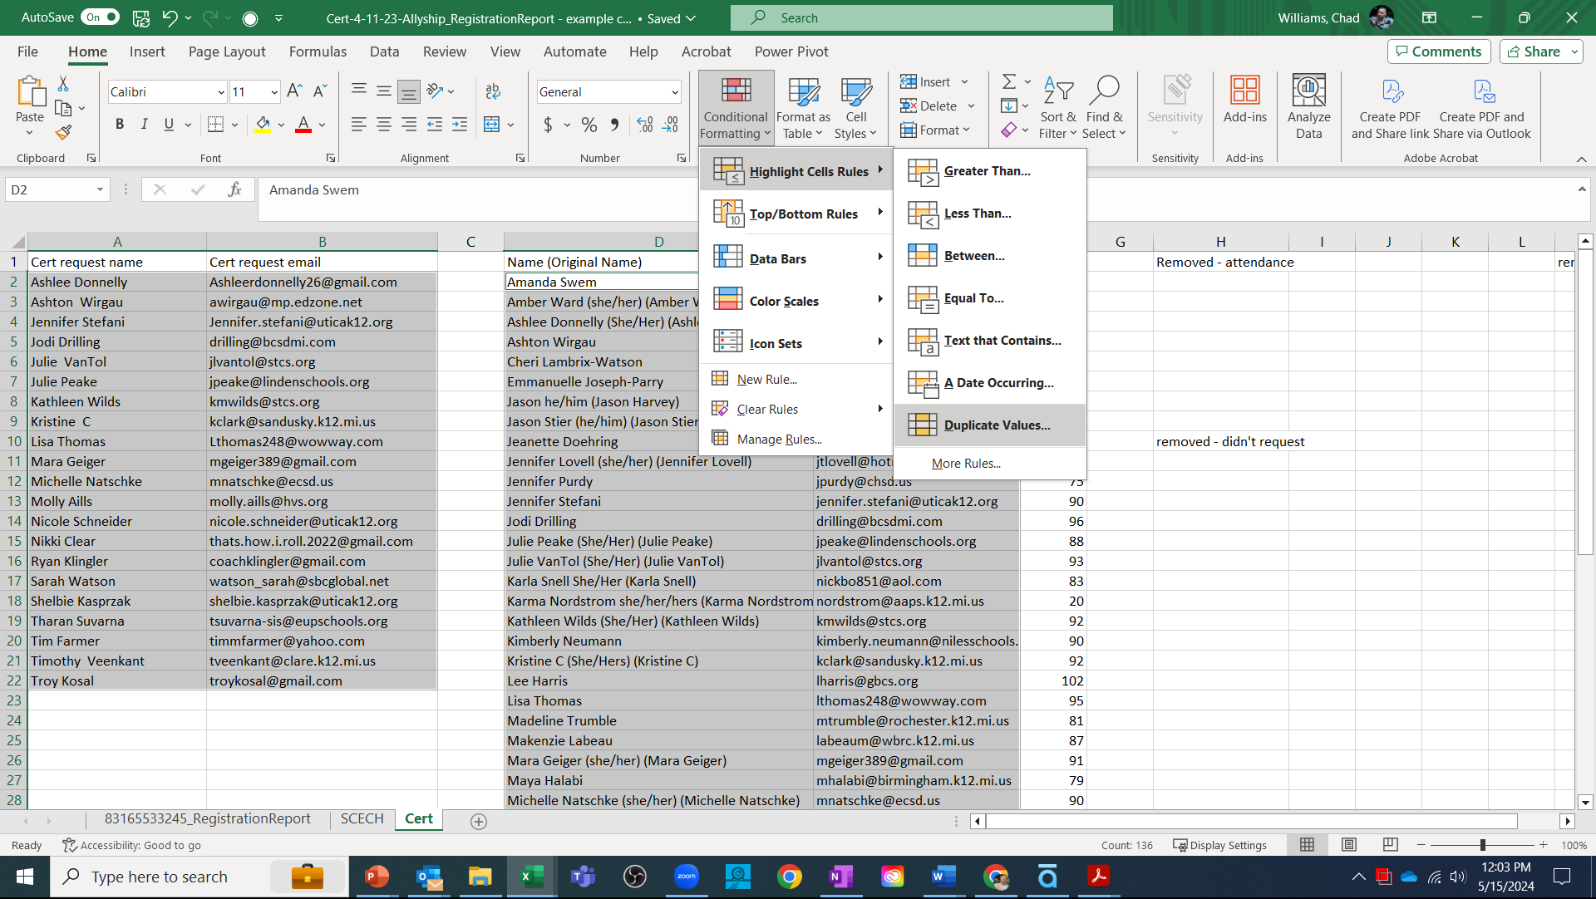
Conditional Formatting
Comparing Zoom Reports to Create Mail Merge List
Use Conditional Formatting to highlight Duplicate Values
Notes:
Keep the end in mind.
How do you want to present the information (think about name)? You may need to use the Concatenate feature if you need to separate names
Who do you want to receive the information (members or potential members). You may need to sort the data if you need to separate particular groups of individuals
Note: The emails in our sample data set are not real. Please do not try to use them.
Share screen and encourage participants to follow along on their computers or the instructions sheet.

Slide 23
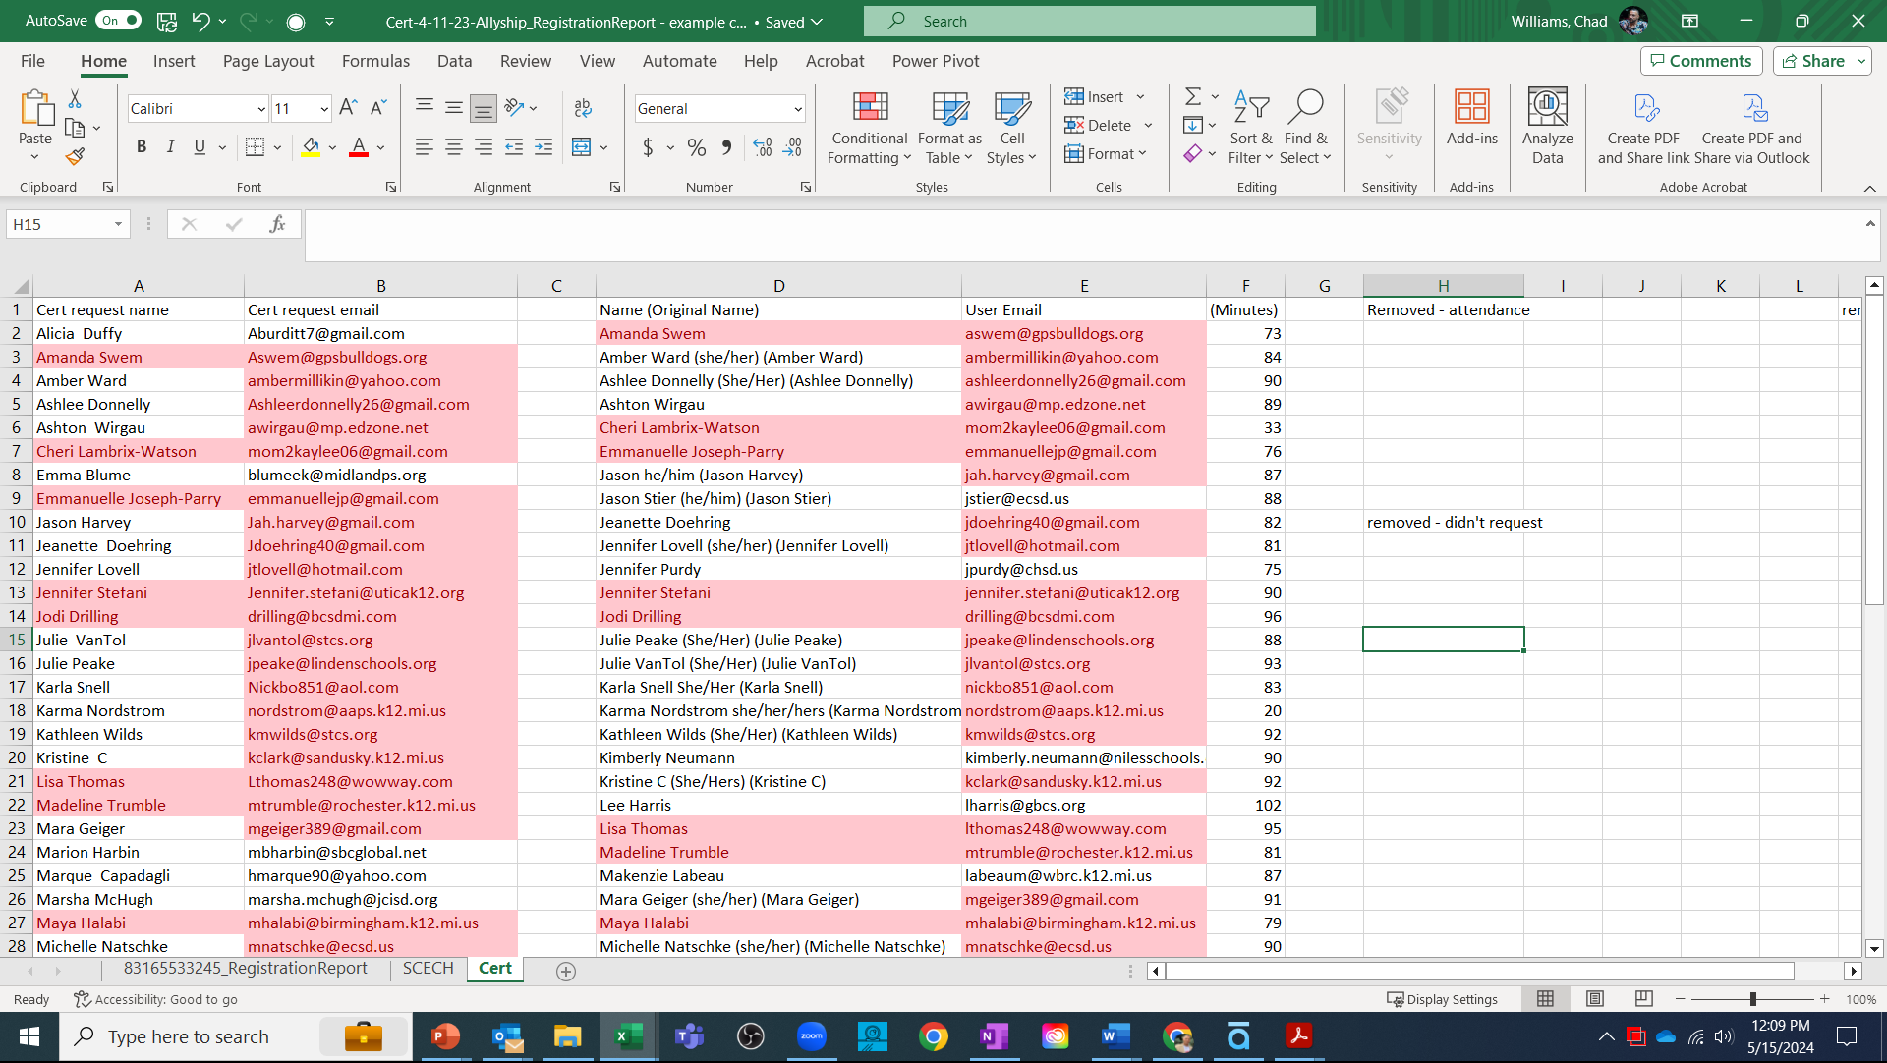
Conditional Formatting
Comparing Zoom Reports to Create Mail Merge List
You can now visually see of those who requested a cert, which also attended.
Delete/move the non-matches
Didn’t request
Didn't attend
Notes:
Keep the end in mind.
How do you want to present the information (think about name)? You may need to use the Concatenate feature if you need to separate names
Who do you want to receive the information (members or potential members). You may need to sort the data if you need to separate particular groups of individuals
Note: The emails in our sample data set are not real. Please do not try to use them.
Share screen and encourage participants to follow along on their computers or the instructions sheet.

Slide 24
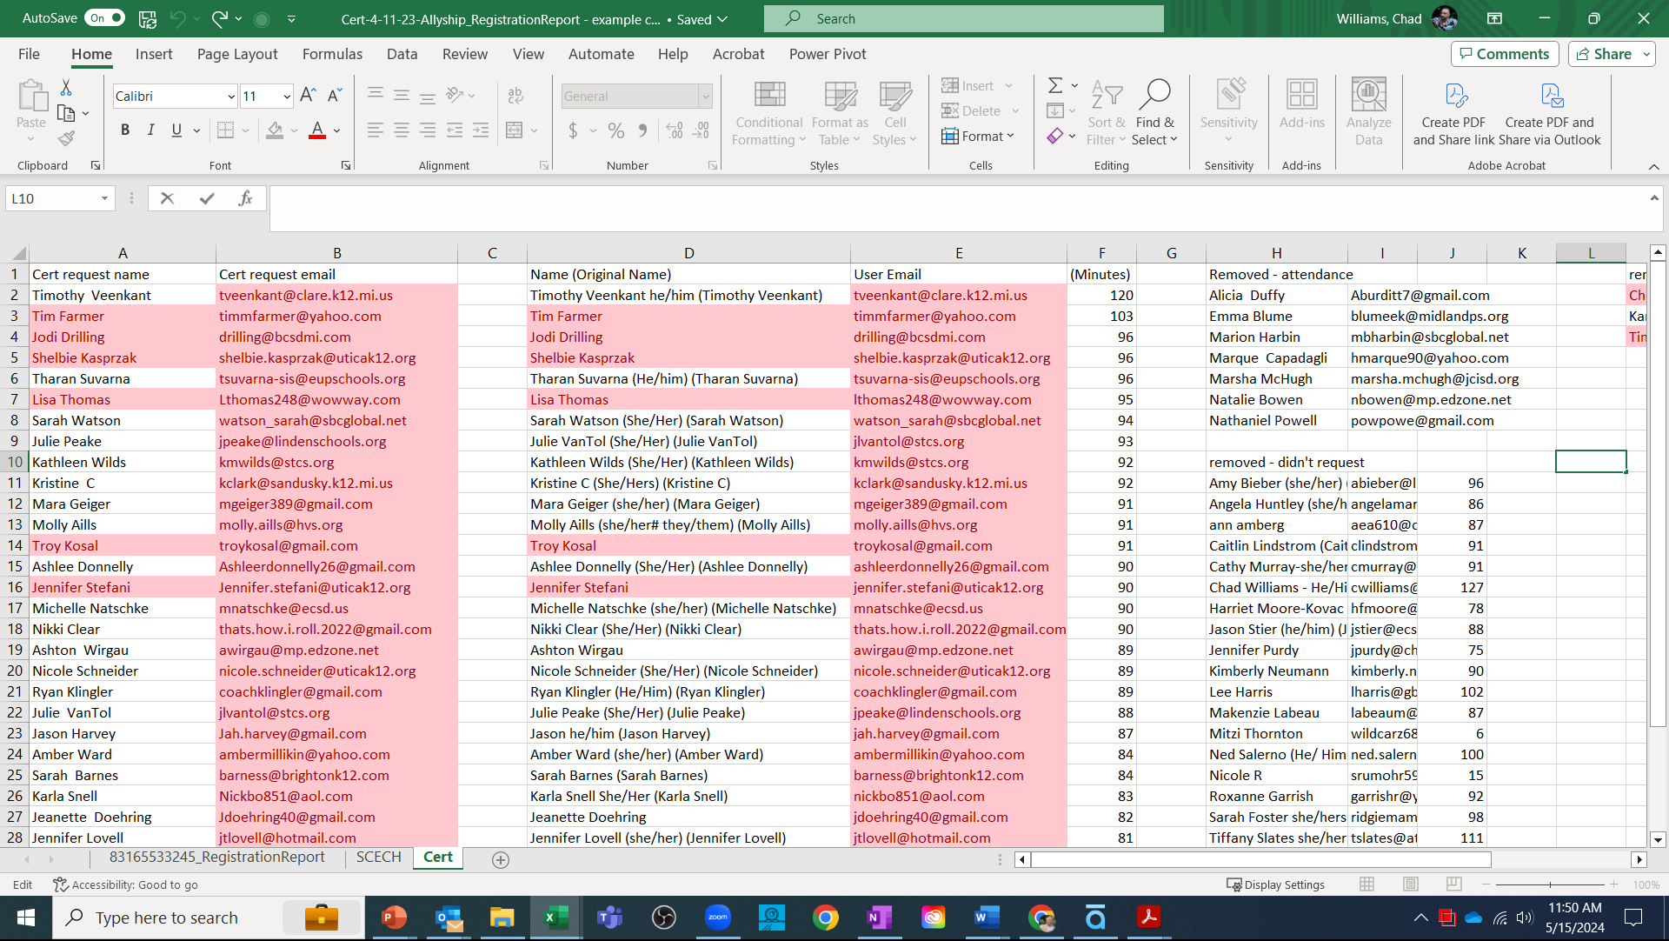
Conditional Formatting
Comparing Zoom Reports to Create Mail Merge List
The Finished List
Contains only those participants who that matched the conditions
Ready to use for Mail Merge
Notes:
Keep the end in mind.
How do you want to present the information (think about name)? You may need to use the Concatenate feature if you need to separate names
Who do you want to receive the information (members or potential members). You may need to sort the data if you need to separate particular groups of individuals
Note: The emails in our sample data set are not real. Please do not try to use them.
Share screen and encourage participants to follow along on their computers or the instructions sheet.

Slide 25
Mail Merge

Slide 26
Use of Mail Merge
Labels
Certificates
Emails
Individualized ratification impact
Notes:
The benefits of the Microsoft suite is that there are features that we are not aware of. Mail merge is one of those features.
We each have different supports available in our office. For some of us, we have associate staff for assistance and for some we are responsible for it all.

Slide 27
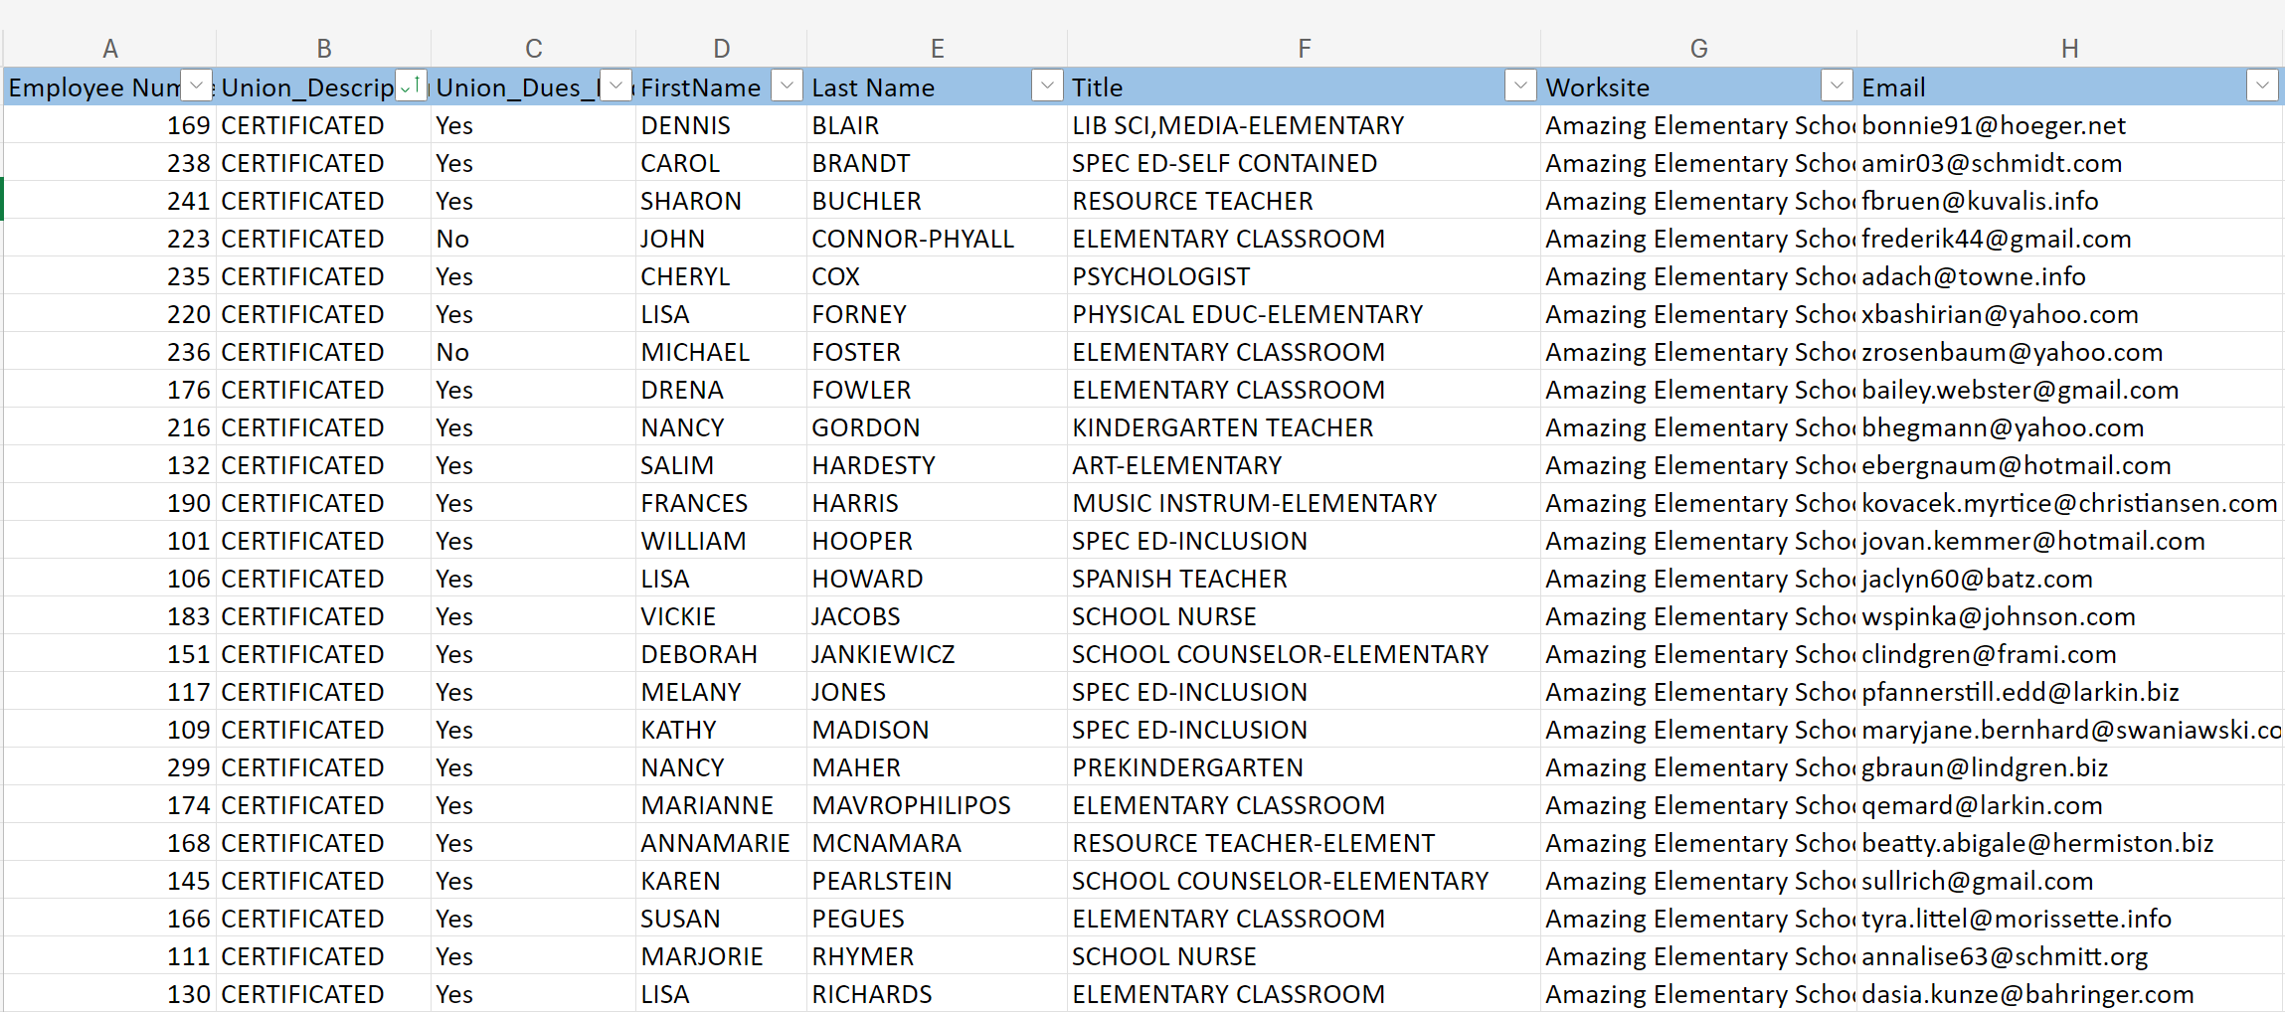
Power of Formatting Data
Notes:
Keep the end in mind.
How do you want to present the information (think about name)? You may need to use the Concatenate feature if you need to separate names
Who do you want to receive the information (members or potential members). You may need to sort the data if you need to separate particular groups of individuals
Note: The emails in our sample data set are not real. Please do not try to use them.
Share screen and encourage participants to follow along on their computers or the instructions sheet.

Slide 28
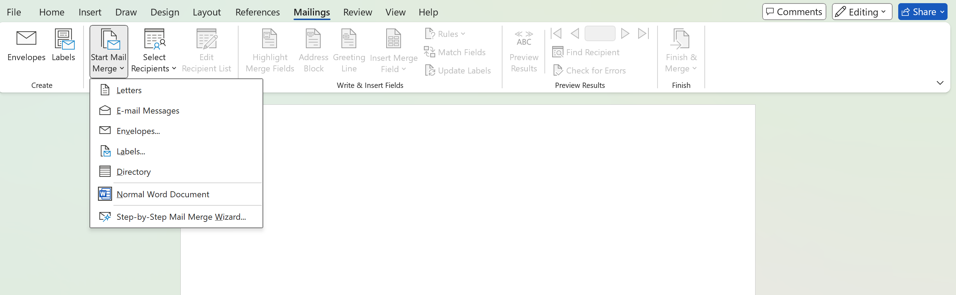
How to create a mail merge
You will be working between Word and Excel
Go to Word
Click on Mailings
Click on Start Mail Merge
Notes:
For this example we are going to use our data to create mailing labels. My favorite labels are the Avery 5160 labels. They have 30 labels on a page.

Slide 29
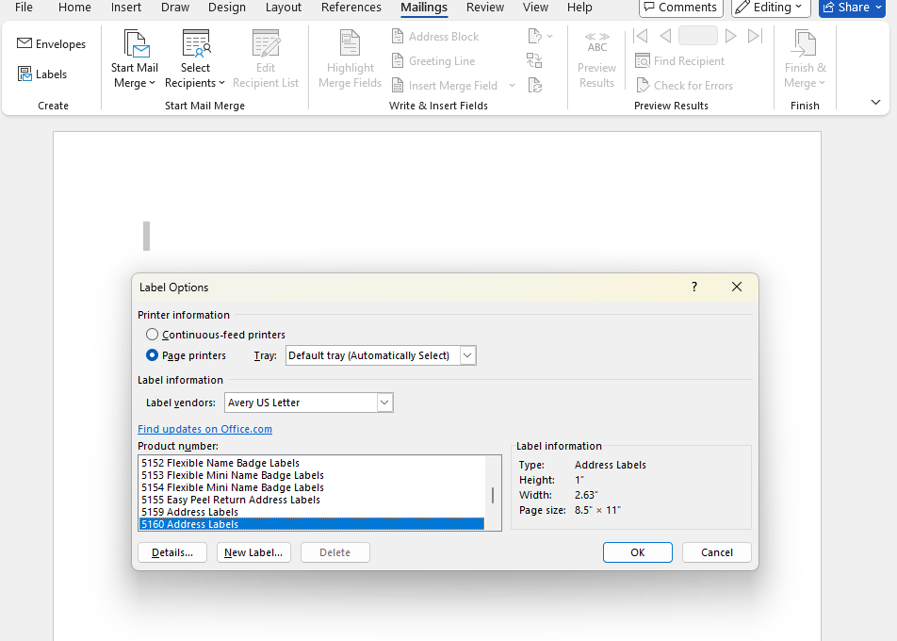
Making Labels
This is where you choose the size and brand labels you want to create. All necessary printing formatting is linked to the labels you choose.
3x10 Avery labels are the labels are being used for this example
Notes:
For this example we are going to use our data to create mailing labels. My favorite labels are the Avery 5160 labels. They have 30 labels on a page.

Slide 30
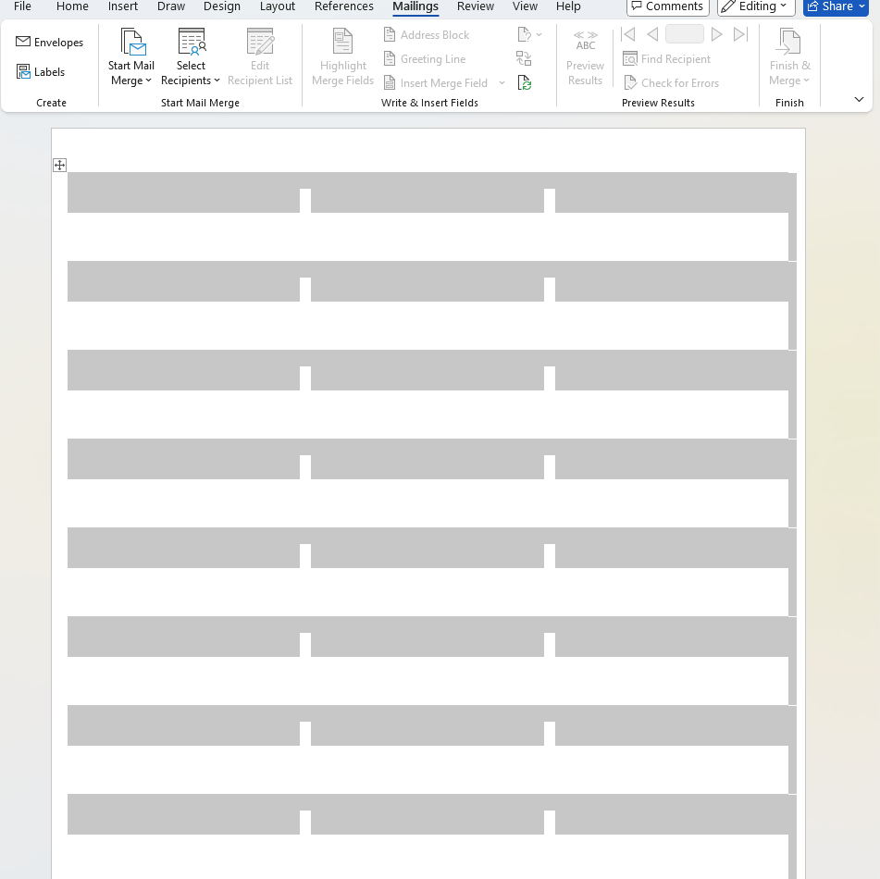
Making Labels
Once you identify the labels, a blank table to be completed for the label dimensions are created.

Slide 31
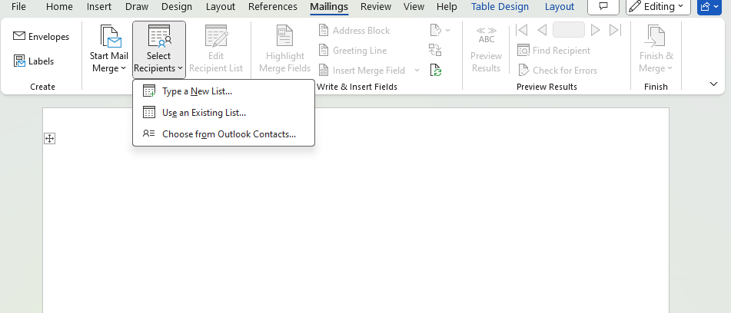
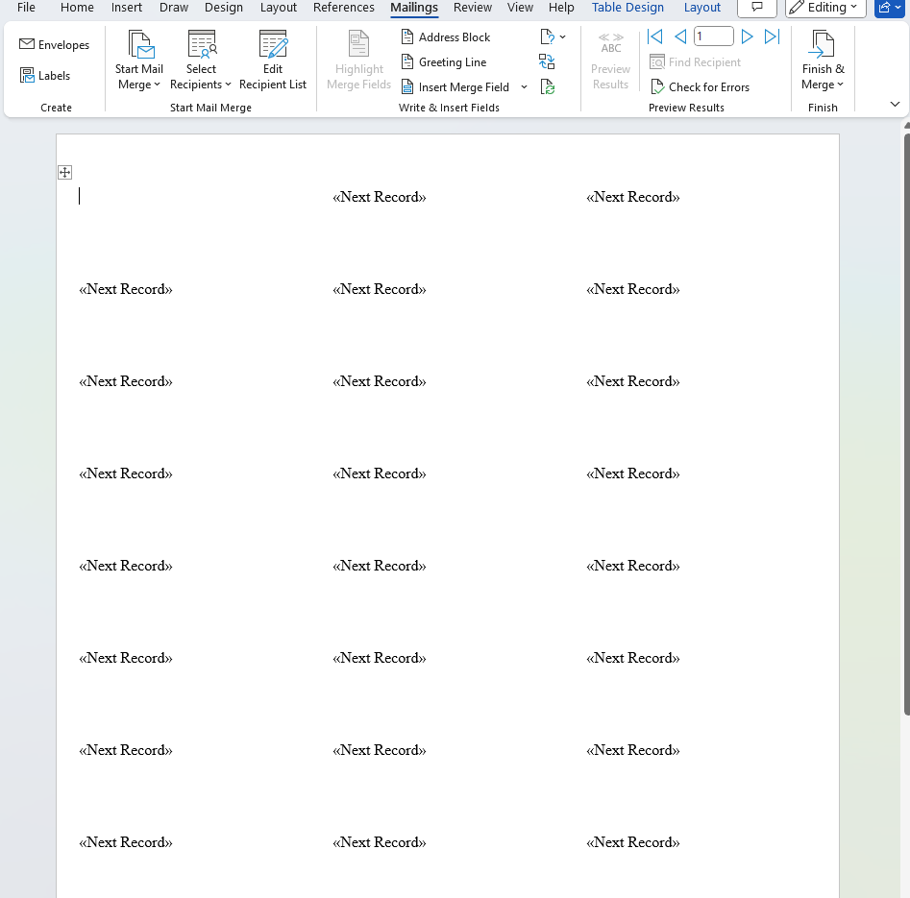
Selecting the Recipients
Select Recipients
Click on Use an Existing List
Once you have selected the list, the screen looks like the screenshot on the right.
Notes:
For this example, we are going to make labels
Choose the labels you are going to work with.

Slide 32
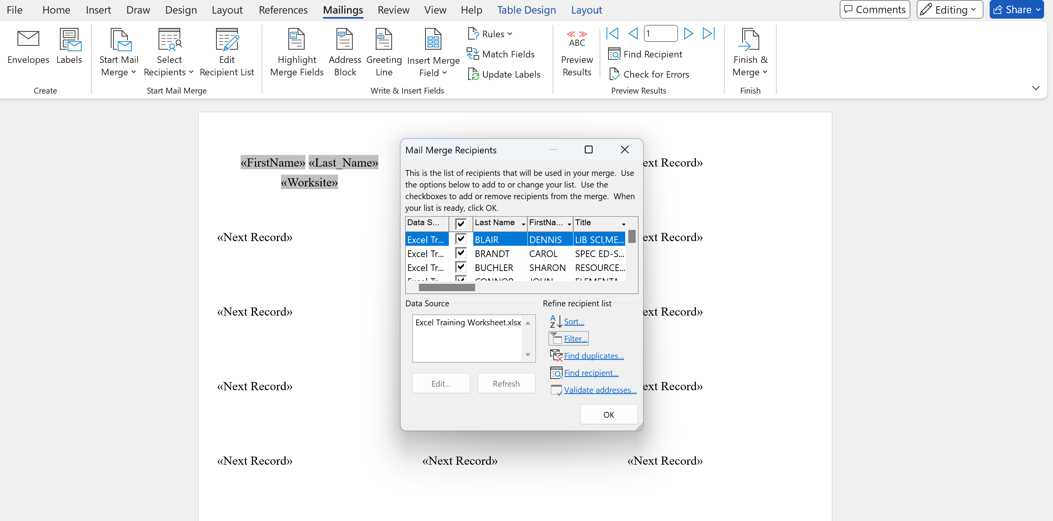
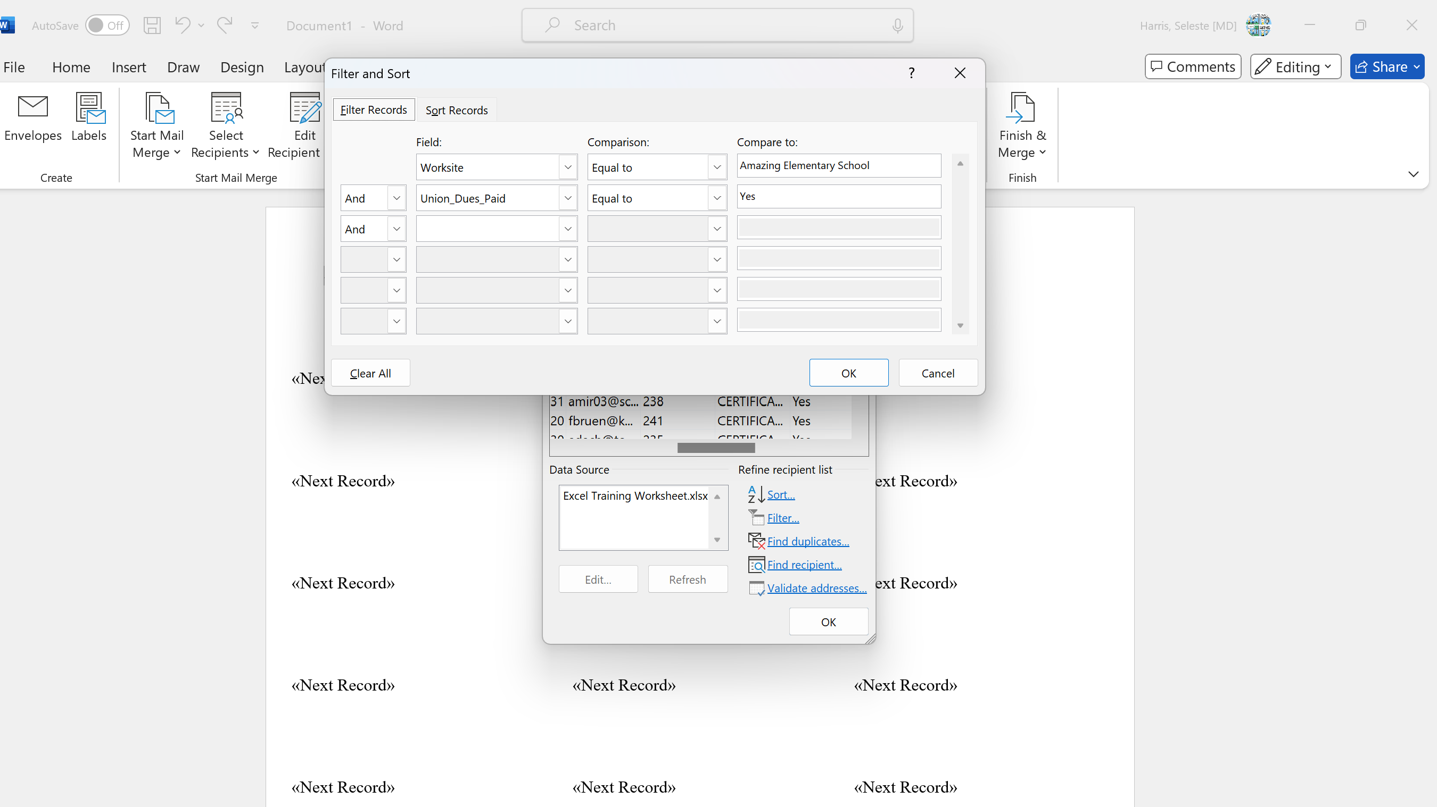
Selecting the Recipients
Because the information is being pulled from an Excel document, the filter and sort features are available to target the Mail Merge recipients.
Notes:
In this example, the flyer is gong going to be sent to the members at Amazing Elementary School.

Slide 33
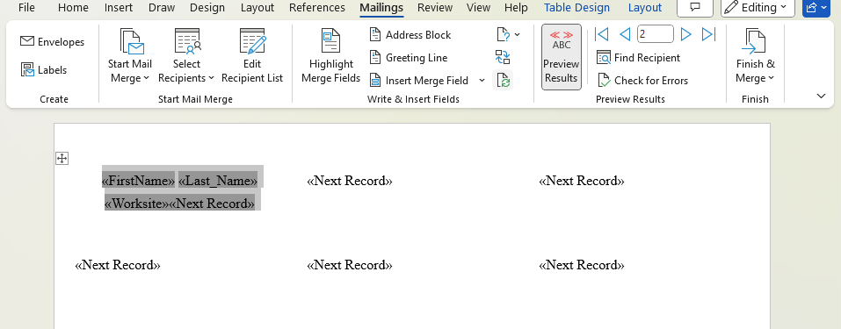
Merging
Click on Insert Merge Field
Use the headers in the selected Excel file.
Format the label layout in the first label.
Notes:
Label formatting includes centering, text font, text size, etc.

Slide 34
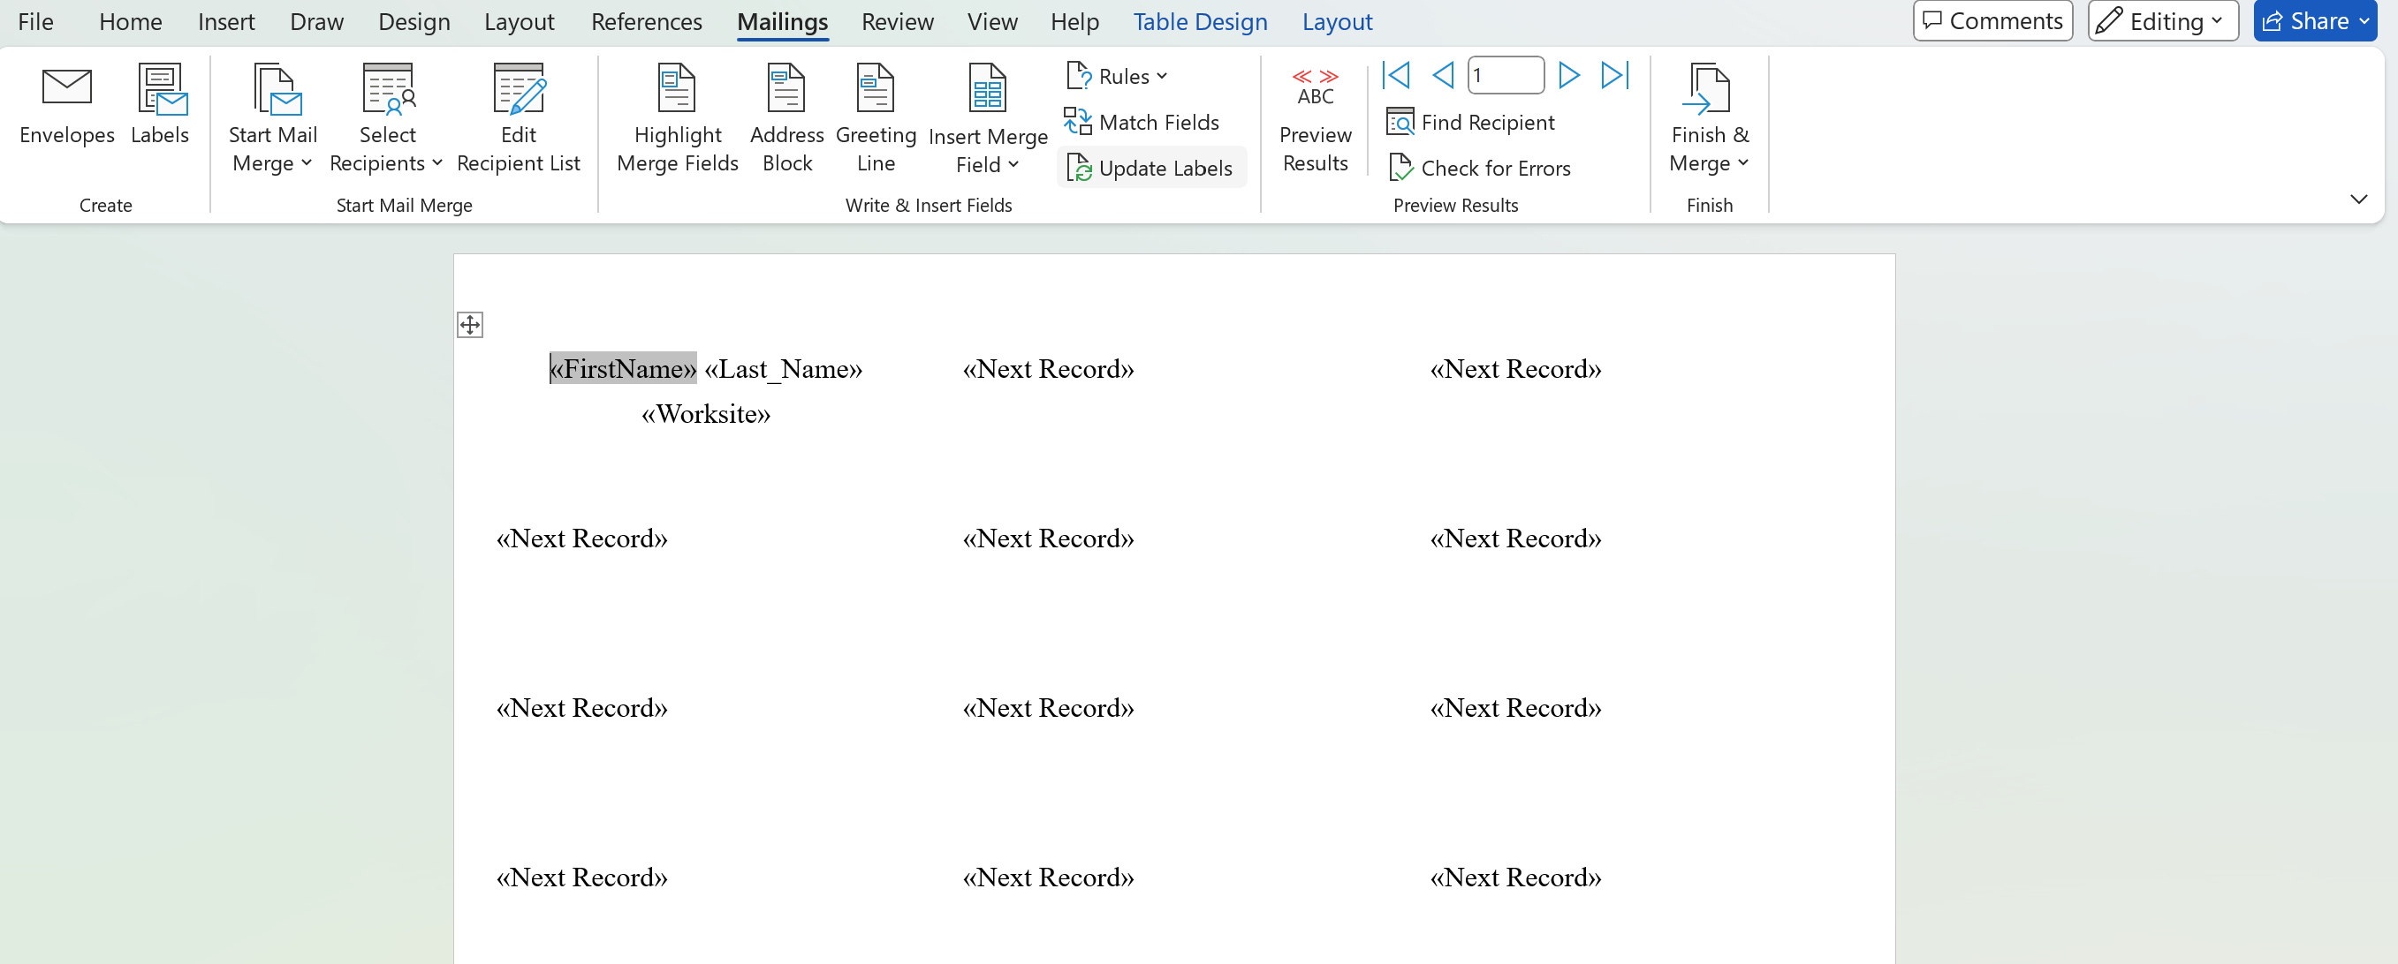
Merging
Clicking on “Update Fields” icon will copy the Excel headers across all the labels.
Notes:
Label formatting includes centering, text font, text size, etc.

Slide 35
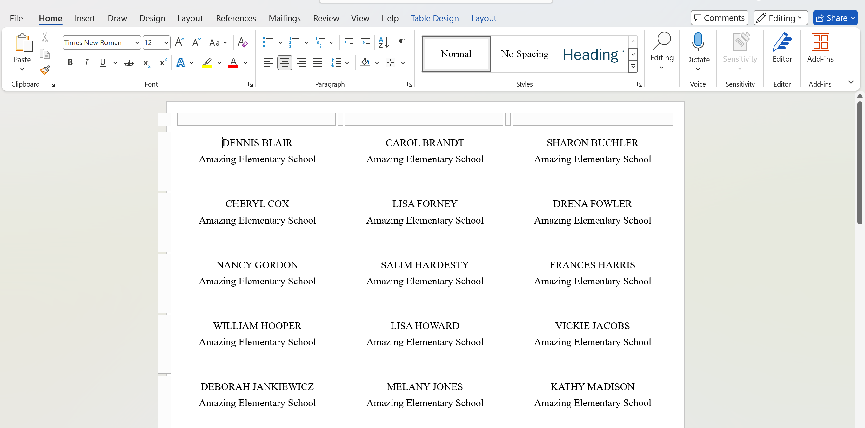
Merging
Click on Finish and Merge to insert the information into the labels.

Slide 36
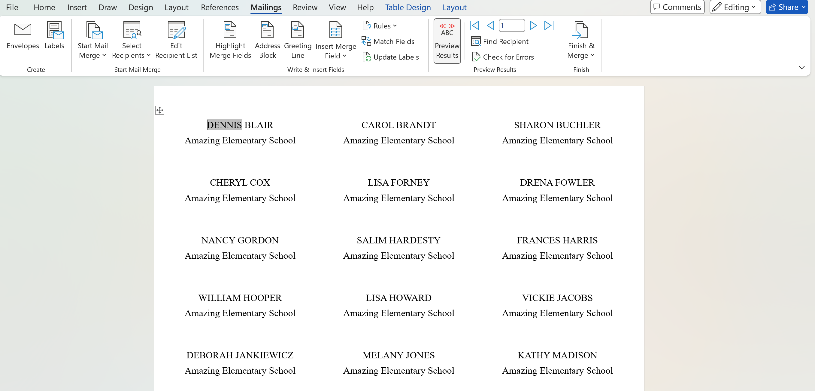
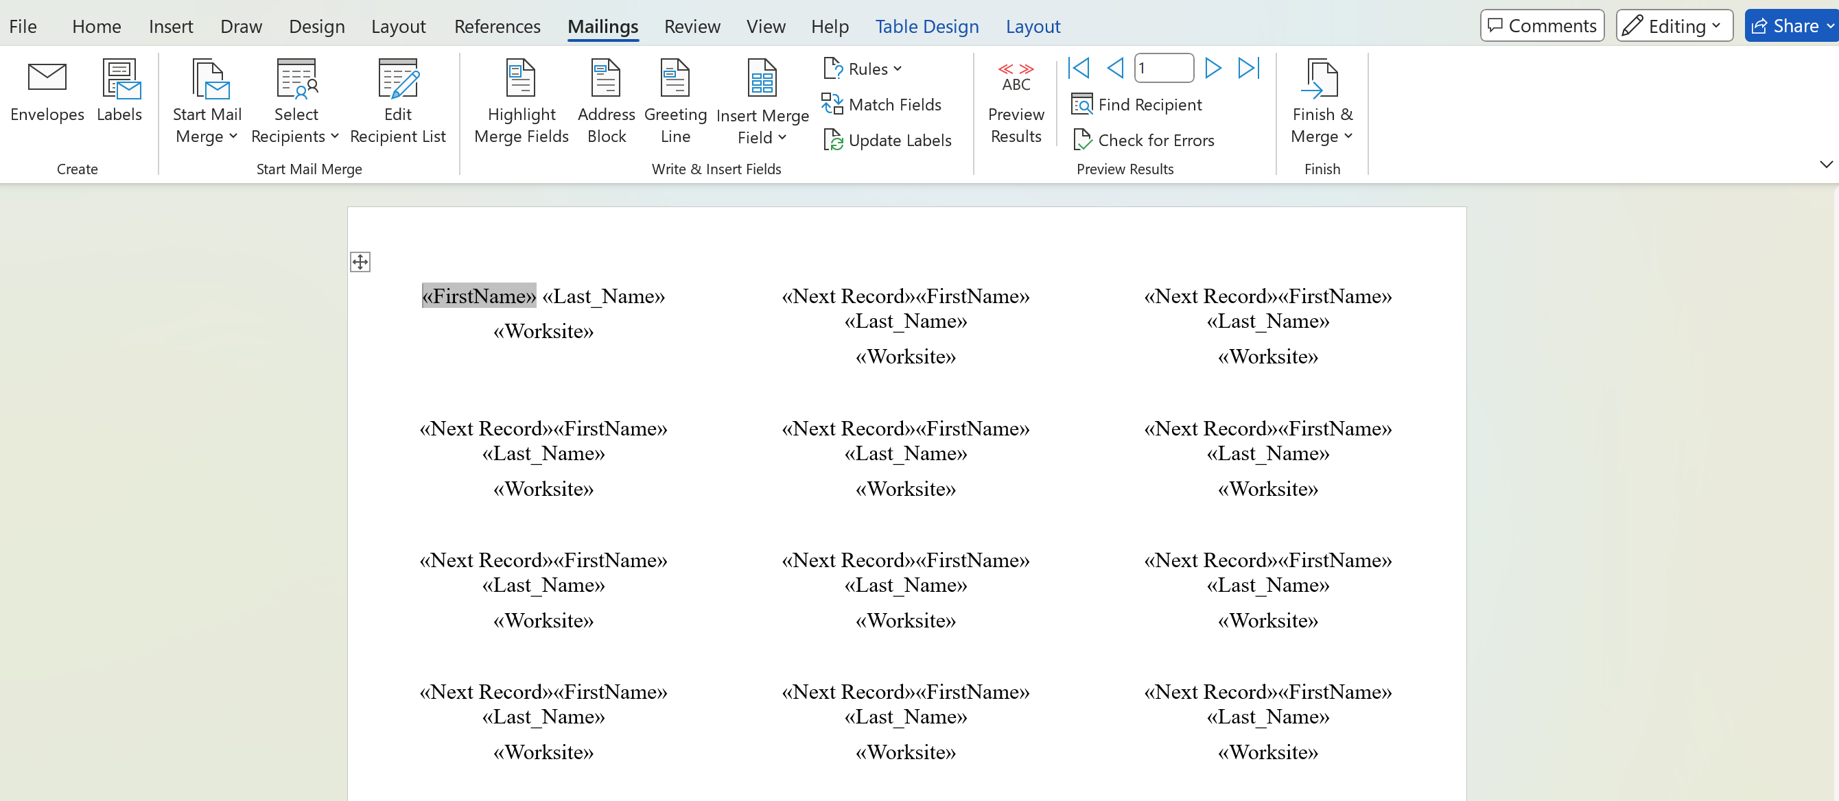
Merging
Before finalizing the labels, click on Preview Results.

Slide 37
Finishing
For the results to be finalized, click on Finish and Merge.
Once clicking on Finish and Merge, a new file will be created including the results of the mail merge.
Save the document prior to printing.
Notes:
Note:
The labels document requires the Excel document to be shared electronically.
I save the labels as a .pdf for electronic sharing.

Slide 38
Group Work
Now you try it -
Use the file _____ that was included in your email.
Create a mail merge and send a form email to the facilitators.

Slide 39
- Debrief & Questions-

Slide 40
Thank You - Contact Us:
Seleste Harris
UniServ Director
Maryland State
Education Association
sharris@mseanea.org
Monet Reilly
UniServ Representative
Pennsylvania State
Education Association
mreilly@psea.org
Beth Barton
UniServ Director
Illinois Education Association
Beth.Barton@ieanea.org
Chad Williams
UniServ Consultant Michigan
Michigan Education Association
cwilliams@mea.org

