Slide 1


Using Excel for Organizing
Part 4
Campaign Process Tracking
While we wait to begin, please:
1
2
3
Rename yourself:
Name/State/Pronouns (Sam/GA-his/him)
Download data set
In the chat, let us know:
  What is an interesting/odd thing you EXCEL at? ☺

Slide 2

Land Acknowledgement
We begin by acknowledging that through a history of colonization and brutality, we are currently on the traditional lands stewarded by generations of the Indigenous people.
We honor these Indigenous people, all elders, past, present, and emerging. We are called to learn and share these learnings about this tribal history, culture, and contributions that have been suppressed in the telling of the story of what we now call the United States of America.

Slide 3
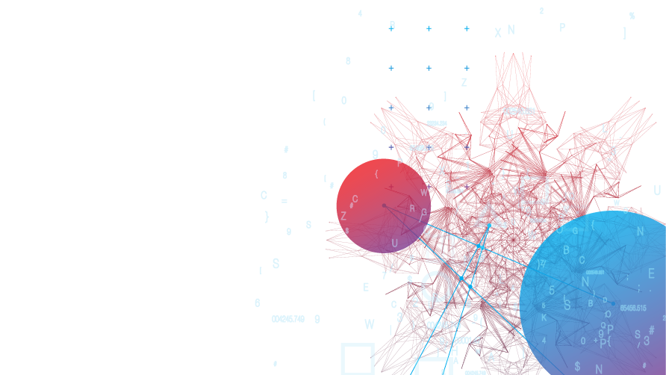
Series Overview
  September 23, 2025
    Part 1: Using Excel to Evaluate Membership
  December 11, 2025
    Part 2: Using Excel: Advanced Tools for Power Analysis
  March 12, 2026
    Part 3: Disseminating information
  May 21, 2026
  Part 4: Campaign Progress Tracking
  Each session is 2:30pm-4:00pm EST
Notes:
Please share if there is another topic you would like to include

Slide 4
Today's Agenda
How can we use data to track campaign progress?
How can we use Copilot to support our work?
How can we use AI tools to track campaign data in the field?
Session Outcomes
Identify campaign tracking tools
How and why use Copilot
How to use AI visual analysis

Slide 5




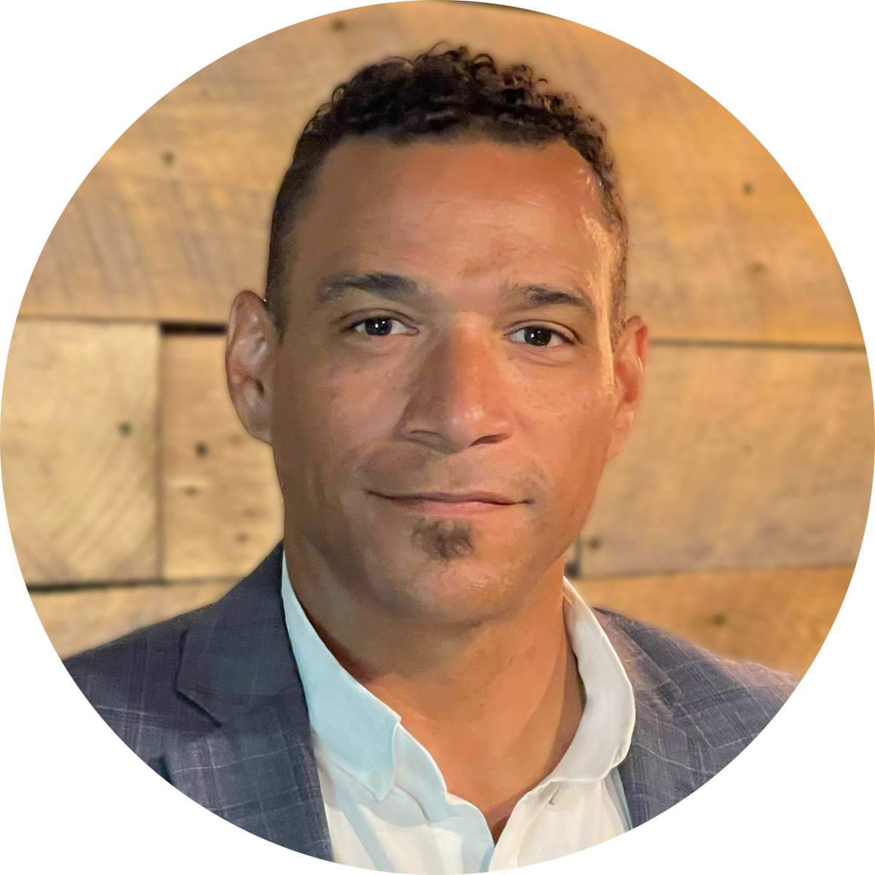


Contributors:
Seleste Harris
UniServ Director
Maryland State
Education Association
sharris@mseanea.org
Monet Reilly
UniServ Representative
Pennsylvania State
Education Association
mreilly@psea.org
Beth Barton
UniServ Director
Illinois Education
Association
Beth.Barton@ieanea.org
Chad Williams
UniServ Consultant
Michigan Education
Association
cwilliams@mea.org
Jeny Gardner
Northwest UniServ Director
Wyoming Education
Association
jgardner@wyoea.org
Dr. Taraja Shephard Allen
UniServ Membership
Consultant
Ohio Education Association
shephardallent@ohea.org
Notes:
Add Taraja

Slide 6
Campaign Tracking
Notes:
Seleste
30 minutes

Slide 7
What campaigns are you or have you been engaged in?
Notes:
Seleste
2-3 minutes

Slide 8
What data do you follow during a campaign?
Notes:
Seleste
5-7 minutes
Participants share types of data they track.

Slide 9

Types of Data Tracked
Names of activists
Event attendance
Email response rate
Prior activism
Member priorities
Notes:
Seleste
Be prepared to add to the list for future presentations
Compare the list to the participants’ responses to the list

Slide 10
What campaign tracking tools do use?
Notes:
Seleste
5-7 minutes
Participants share the tools they use to track data and their feedback on the tool
Before the technology boom, I remember using index cards and rolodexes or chart paper

Slide 11
Types of Data Tracked
Task | Some Tools/Programs
Tracks list of activists | NEA 360 VAN Excel
Tracks event attendance | NEA 360 VAN Excel
Tracks email open and response rate | Action Network Mail Chimp
Tracks member activism/engagement | NEA 360 VAN Excel Group Charts Pictures
Tracks member priorities | Survey Monkey Google Forms Microsoft Forms Group Charts
Notes:
Takeaway
All data from each of these platforms report back to Excel (.csv)
The results from these platforms are only as good as the data that is input
Remember that data collected at events and with groups (pictures, charts) can be saved, analyzed, and tracked as well
Suggestion: Create a plan to start tracking member involvement/engagement

Slide 12
What are some benefits/drawbacks to using electronic tracking tools?
Notes:
Seleste
3-5 minutes
What are some benefits/drawbacks to using electronic tracking tools?
Benefits
Saves time
Saved in a centralized location
Drawbacks
May not be shared with future staff/leaders, if only saved on their local device
How to address some of the drawbacks
Planning

Slide 13
AI Assistants
A Tool You Never New Was Amazing!
Notes:
Taraja-CoPilot
Chad
60 minutes

Slide 14

Copilot as an Organizing Partner
Copilot = a thinking partner, not a decision-maker
Reduces administrative load so staff can focus on organizing and relationships
Supports planning, communication, follow-up, and reflection
Embedded across Microsoft tools (Outlook, Word, Excel, PowerPoint)
Notes:
Seleste

Slide 15
Organizing Strategy & Campaign Planning
Draft organizing plans from rough notes
Turn conversations and meeting notes into clear next steps
Identify themes across surveys, site visits, or staff feedback
Prepare for 1:1s, building visits, and campaign escalation
Notes:
Seleste

Slide 16


Everyday Support – Email, Meetings & Follow-Up
Draft
Draft emails in different tones (supportive, firm, mobilizing)
Create
Create agendas and meeting summaries
Rewrite
Rewrite messages for clarity or accessibility
Generate
Generate follow-up communication after actions or meetings
Notes:
Seleste

Slide 17
Tables, Tracking & Making Sense of Information
Build tables from messy lists or notes
Create organizing tracking tools (issues, actions, worksites, next steps)
Summarize spreadsheets in plain language
Identify patterns without complex data analysis
Notes:
Seleste
Provide Examples

Slide 18
Research, Narrative & Sensemaking
Summarize education news and policy trends
Pull examples to support bargaining, grievance, or organizing narratives
Compare how issues are framed across news outlets or districts
Translate data and policy language into member-facing communication
Notes:
Seleste

Slide 19
Creating Engagement & Local-Level Activities
Generate meeting or professional learning activities
Adapt activities for different local sizes and capacities
Draft discussion prompts and reflection questions
Create facilitator notes or talking points for local leaders
Notes:
Seleste

Slide 20
Let’s Practice! Choose Your Adventure
Draft a follow-up email after a building or member meeting
Turn an issue into 2–3 possible local actions
Create a simple organizing tracking table
Summarize a news story for member communication
Rewrite a message to be clearer or more accessible
Notes:
Seleste

Slide 21
Discussion
What did Copilot save you time on?
What did you still need to adjust using your organizer judgment?
What could this free you up to do more of in your union role?
Notes:
Seleste

Slide 22
Somethings to Consider
Avoid entering confidential or sensitive member information
Copilot drafts; union staff make decisions
Human judgment and relationship-building come first
Transparency builds trust in AI-supported work
Notes:
Seleste
Note, this section was created through CoPilot.

Slide 23
Using AI Visual Analysis
  Capture data:
    In real time
    From analog sources
    Natural field activities

Slide 24
AI Visual analysis
AI Visual Analysis = a pattern recognition and synthesis assistant
Capture real time data during events, trainings, group sessions
Collect and track data with just your phone camera
Enable faster team data collection, synthesis and analysis
AI visual analysis helps under-resourced or solo union organizers quickly identify patterns, leadership potential, engagement levels, and organizing opportunities that would otherwise take significant time to uncover manually. It acts like a second set of analytical eyes, helping organizers work more strategically while freeing more time for relationship-building and action. Used thoughtfully, AI strengthens organizer capacity rather than replacing organizer judgment.

Slide 25
Real world application: Nurse Needs Nexus
Situation: Unit dysfunction
The nursing department was experiencing growing fragmentation between nurse administrators, building nurses, and itinerant nurses, with each group developing different perceptions around workload, communication, support, and professional respect. These tensions were contributing to declining trust, miscommunication, and feelings of inequity that were affecting morale and collaboration across the department.
Objective: Issue Identification / Organize / Cohesion
Help each group recognize that many of their frustrations were structurally interconnected rather than purely interpersonal. Using facilitated dialogue, collaborative exercises, and AI-assisted visual analysis of handwritten charts, synthesize shared themes and translate each group’s concerns into language the others could better understand and allowing for greater bargaining unit harmony, effectiveness, and bargaining unit strength.

Slide 26
Challenge:
How to capture and synthesize data in dynamic group settings
Focus groups
Site lead reports
Group meetings
Think like a spreadsheet
Create consistent prompts to be used across groups
Create a naming and labeling convention
Remember you will be capturing data with pictures

Slide 27
Pre-Planning for AI Visual Analysis
Use role prompting (“You are an experienced organizer…”).
Include a clear key for all colors and symbols. (chart or prompt)
Separate charts by topic, group, or department.
Grouping has significance on the chart.
Keep layouts and color systems consistent across charts.
Add dates or campaign phases to track change over time.
Use trust, influence, significance or other symbols.
Use clear handwriting and dark, readable markers.
Add brief context or organizer notes on chart or prompt.
Notes:
Grab docs from uniserv directory

Slide 28
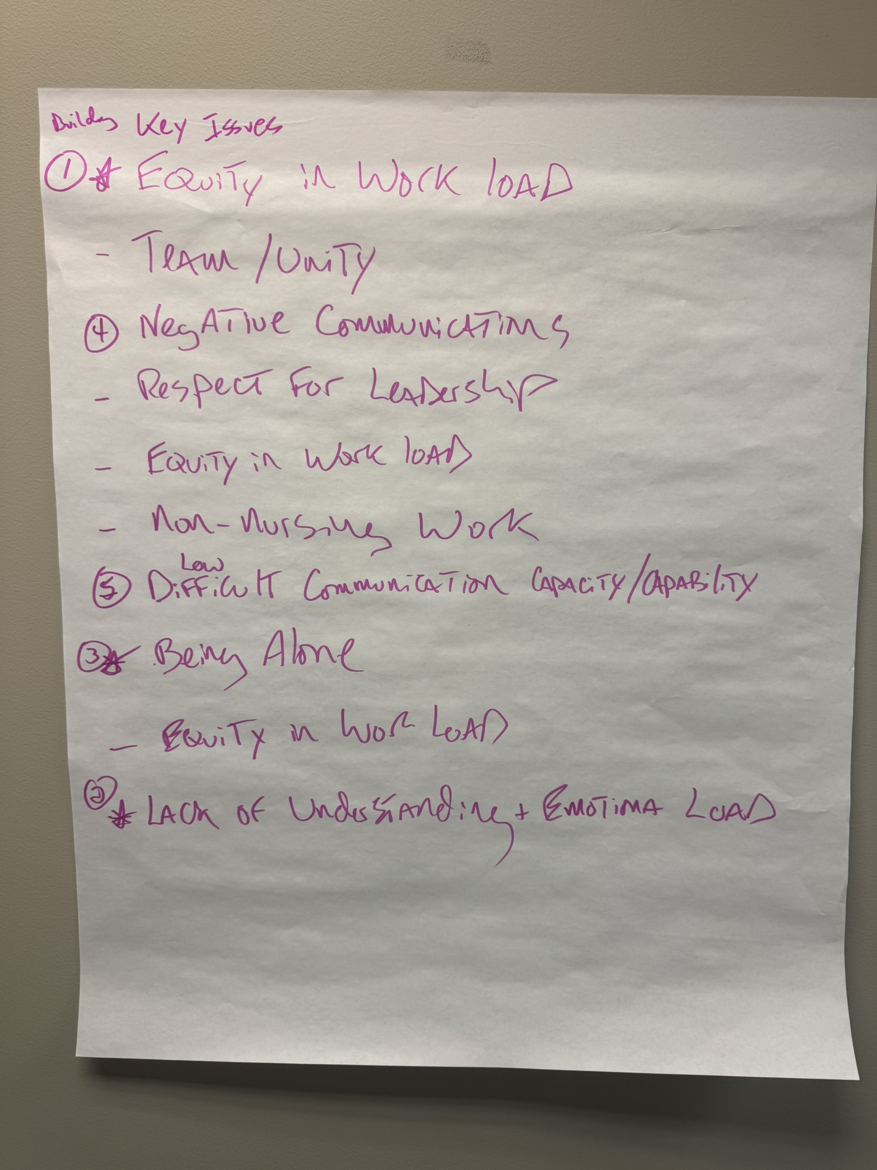
Visual organization for AI Analysis: pre-plan for post session analysis
Group label
Topic label
Hierarchy label
Color coding
Focus groups
Site lead reports
Group meetings

Slide 29
Let’s Practice! Choose Your Adventure
Choose one visual analysis example to explore:
The nurse charts
The leader identification chart
The group dynamic photos.
Images of your own from a campaign
Using the provided best practices, work with an AI assistant to analyze the visuals and identify meaningful organizing insights, patterns, strengths, risks, or leadership indicators.
As you work, reflect on what the AI did well, where human judgment was still necessary, and what additional context improved the quality of the analysis.
Be prepared to briefly report out your use case, key findings, and reflections with the larger group.
Notes:
Grab docs from uniserv directory

Slide 30
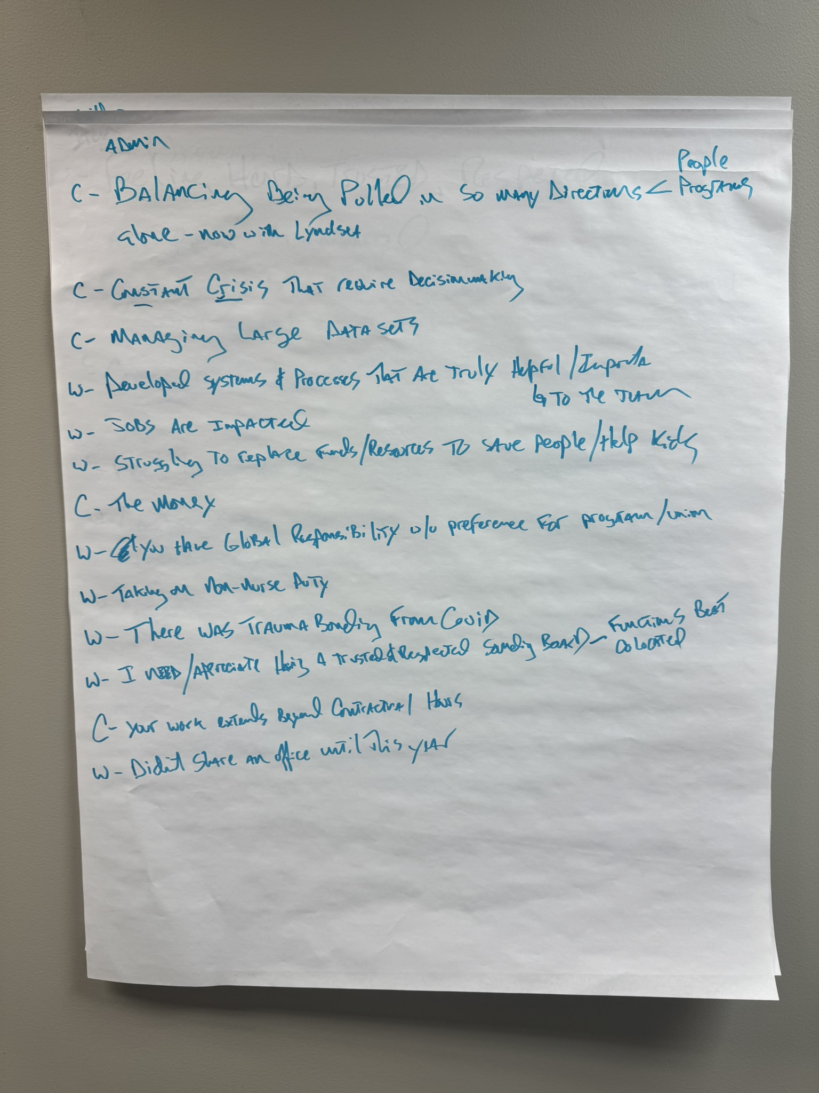
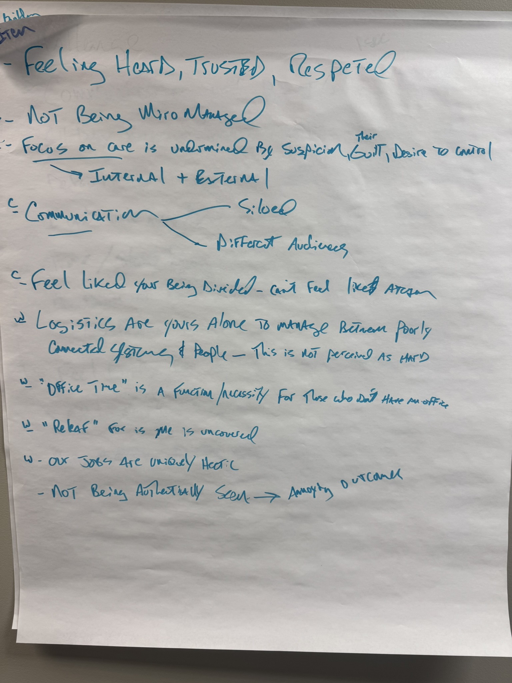
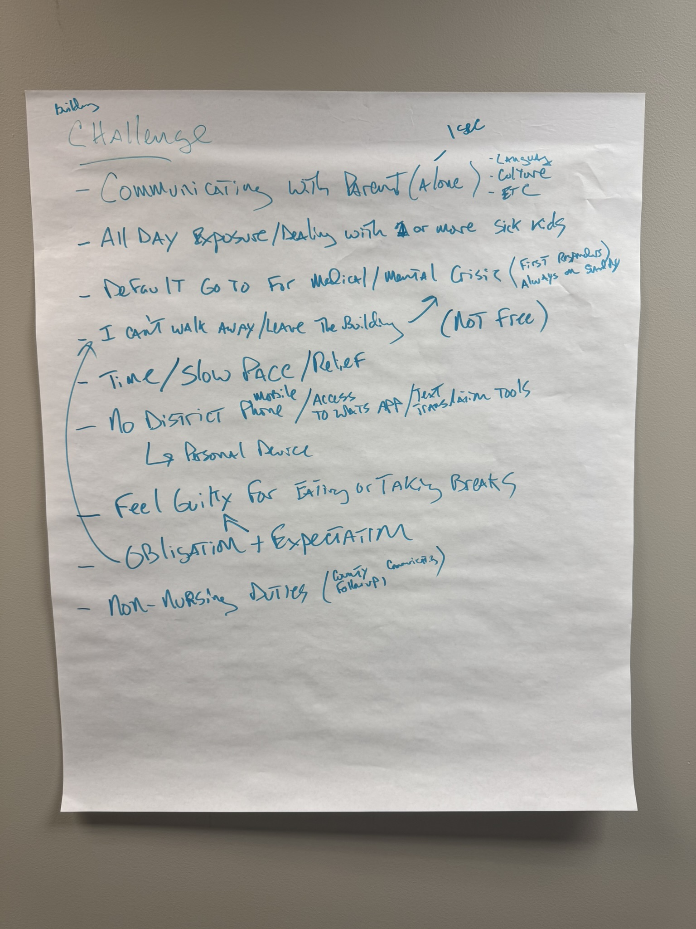
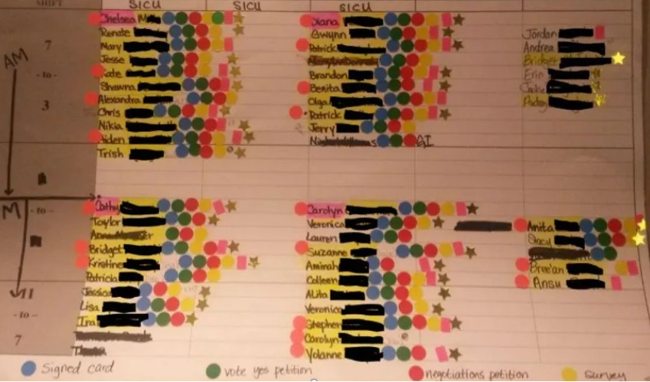
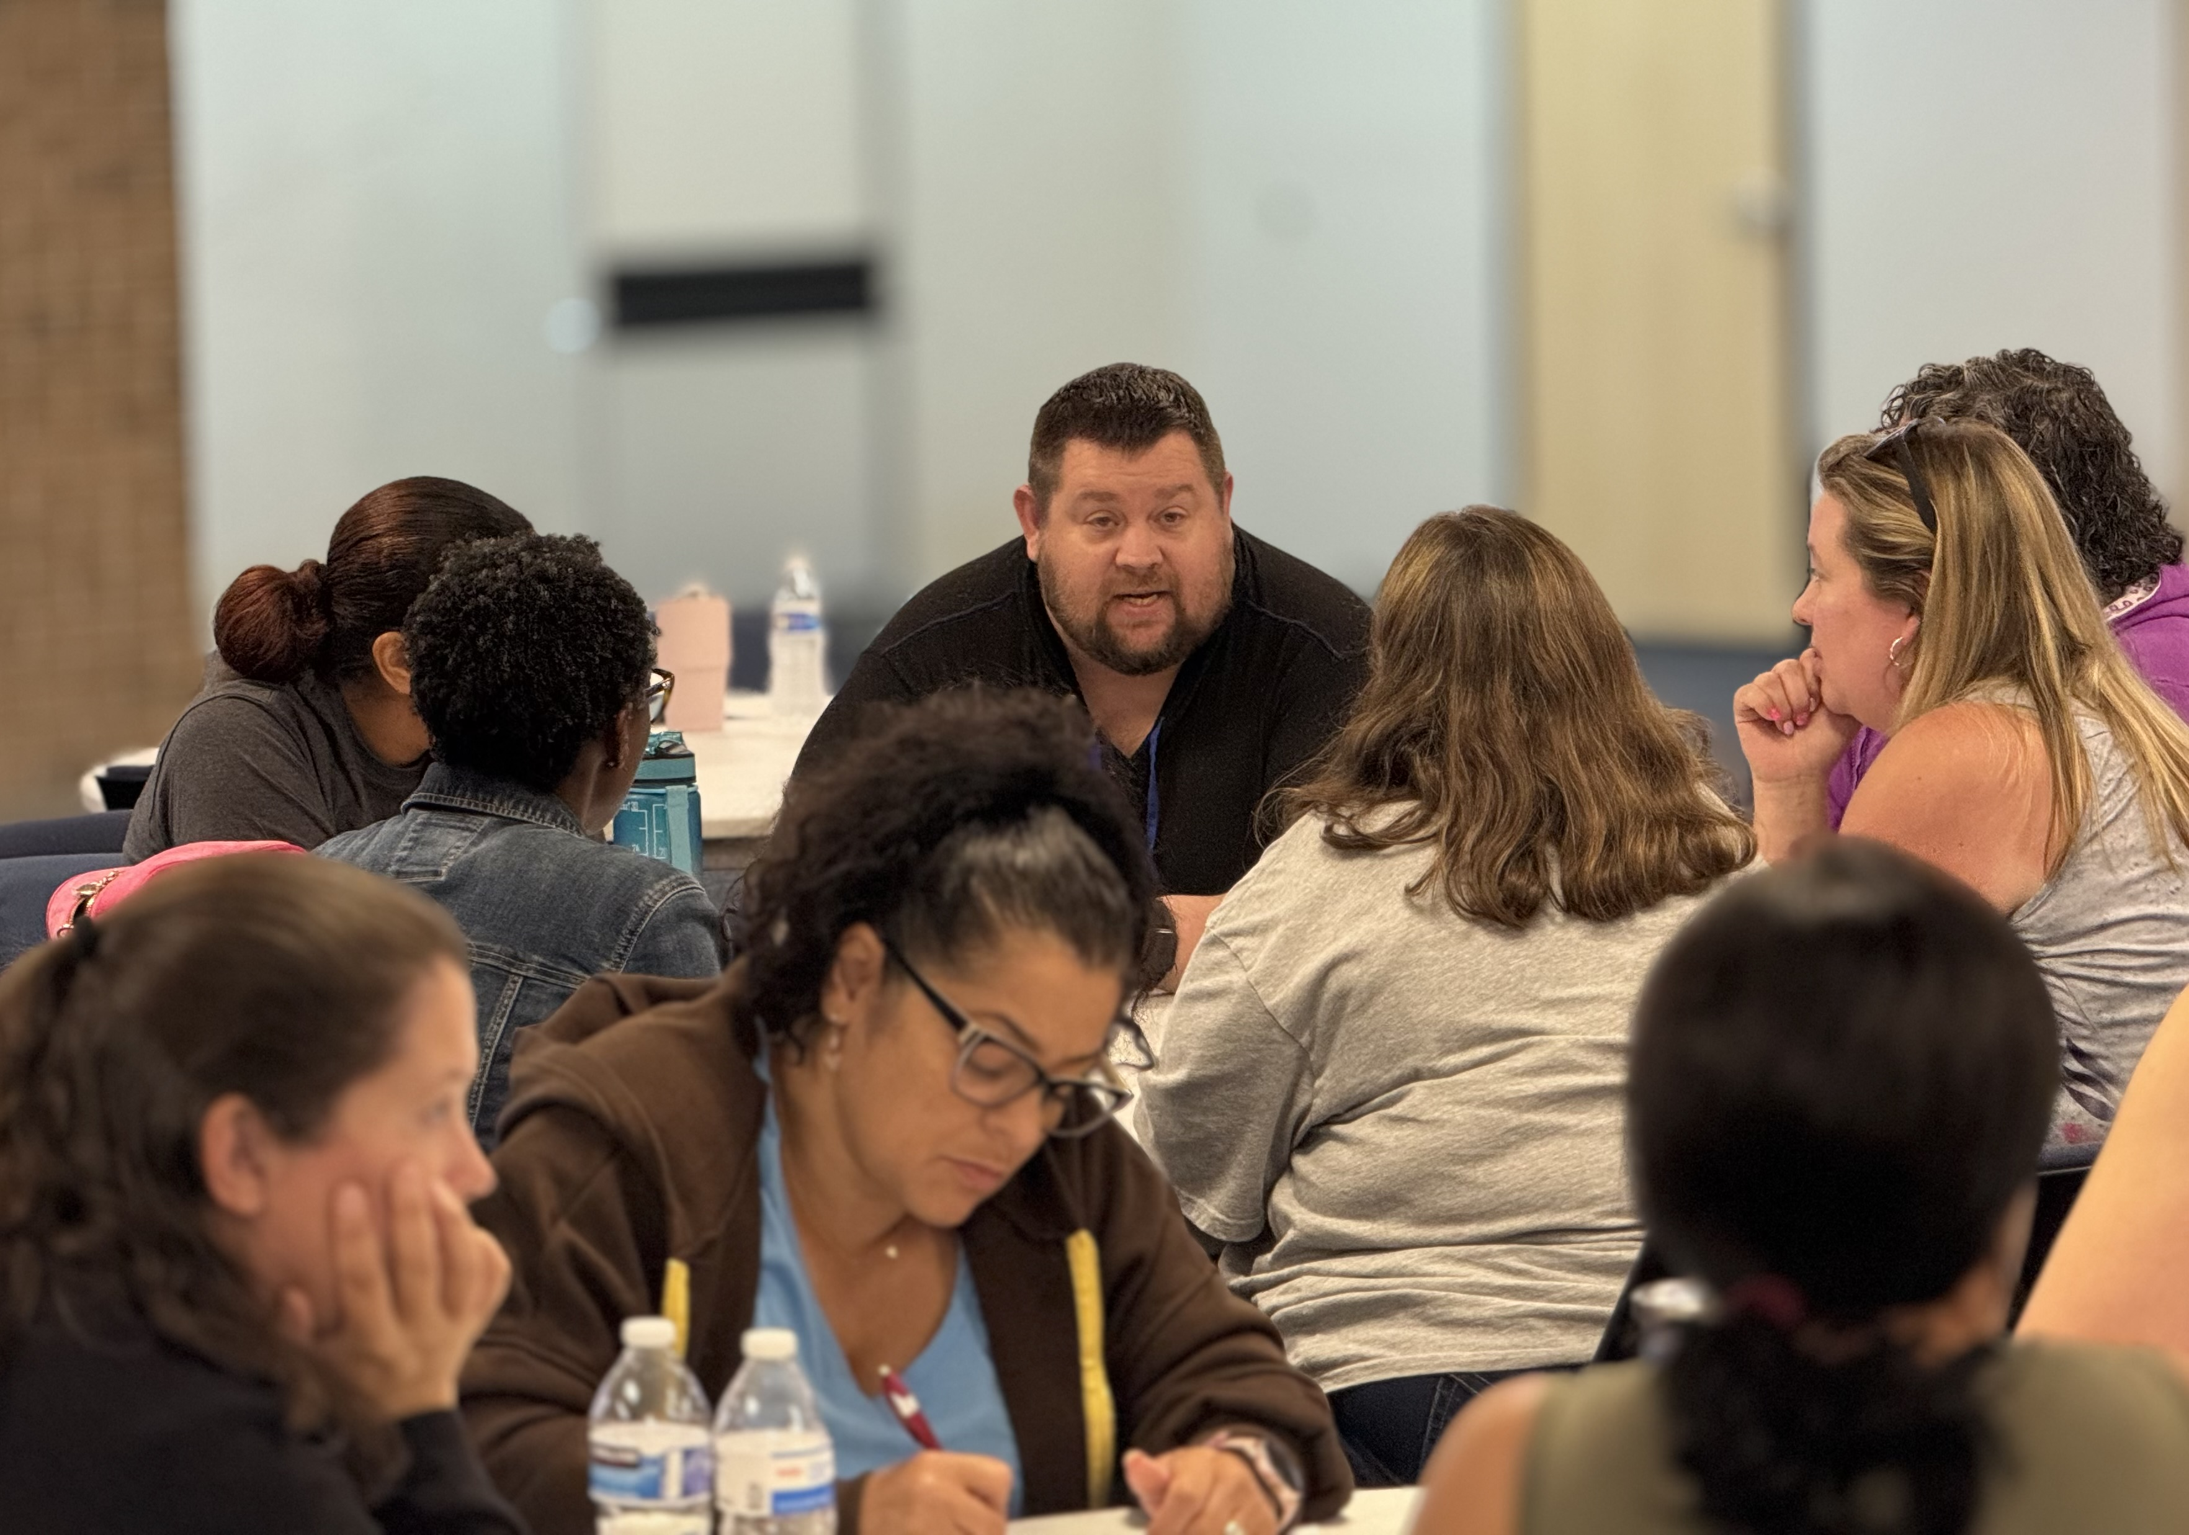
Let’s Practice! Choose Your Adventure
Nurse Group Charts
Leader Identification
Group Dynamics
Your own pictures?
Notes:
Grab docs from uniserv directory

Slide 31
Discussion
What surprised you most about the AI’s interpretation?
How could these insights shape organizer follow-up strategy?
How might standardized visual systems improve future analysis?

Slide 32
Somethings to Consider
AI should support organizer judgment, not replace relational conversations and workplace knowledge.
The quality of the analysis depends heavily on how clearly the visual information is organized and explained.
Visual analysis is most powerful for identifying patterns, relationships, engagement gaps, and leadership potential over time.
Remember we must use AI ethically and carefully, avoiding overconfidence, bias, or conclusions based solely on visuals alone.

Slide 33
- Debrief & Questions-

Slide 34
Contributors:
Seleste Harris
UniServ Director
Maryland State
Education Association
sharris@mseanea.org
Monet Reilly
UniServ Representative
Pennsylvania State
Education Association
mreilly@psea.org
Beth Barton
UniServ Director
Illinois Education
Association
Beth.Barton@ieanea.org
Chad Williams
UniServ Consultant
Michigan Education
Association
cwilliams@mea.org
Jeny Gardner
Northwest UniServ Director
Wyoming Education
Association
jgardner@wyoea.org
Dr. Taraja Shephard Allen
UniServ Membership
Consultant
Ohio Education Association
shephardallent@ohea.org
Notes:
Add Taraja

