Slide 1


Using Excel for Organizing
Part 1: Evaluating membership data
While we wait to begin, please:
1
2
3
Rename yourself:
Name/State/Pronouns (Sam/GA-his/him)
Download data set
Answer the question in the chat.
  "What campaign do you plan to use this knowledge?"
Notes:
Chad will serve as the meeting host.
Chad

Slide 2





Facilitators:
Seleste Harris
UniServ Director
Maryland State
Education Association
sharris@mseanea.org
Monet Reilly
UniServ Representative
Pennsylvania State
Education Association
mreilly@psea.org
Beth Barton
UniServ Director
Illinois Education Association
Beth.Barton@ieanea.org
Chad Williams
UniServ Consultant Michigan
Michigan Education Association
cwilliams@mea.org
Notes:
Chad
UPDATE FACILITATORS
Time Allotment: 5 minutes
Chad
Ask participants to rename themselves with Name/pronouns/state
Get to know you activity
Participants will use poll feature to determine participant comfort level with computers (1-strong, 2-knows it exists but only use when required, 3-"where is the on button?")
Participants will use poll feature to determine participant comfort level with Excel(1-strong, 2-knows it exists but only use when required, 3-"where is the on button?")
Participants will use their Raise Hand feature to answer the following questions
Collective bargaining state
Represent multiple locals
Headquarters staff

Slide 3

Land Acknowledgement
We begin by acknowledging that through a history of colonization and brutality, we are currently on the traditional lands stewarded by generations of the Indigenous people.
We honor these Indigenous people, all elders, past, present, and emerging. We are called to learn and share these learnings about this tribal history, culture, and contributions that have been suppressed in the telling of the story of what we now call the United States of America.
Notes:
Time Allotment: 1 minute
Chad

Slide 4

Series Overview
  October 10, 2023
    Part 1: Evaluating membership data
  December 5, 2024
    Part 2: Using Excel: Advanced Tools for Power Analysis
  March 13, 2025
    Part 3: Disseminating information
  May 22, 2025
    Part 4: Campaign Progress Tracking
  Each session is 2:30pm-4:00pm EST
Notes:
Chad
UPDATE SERIES DATES
Section Allotment: 5 minutes
Chad

Slide 5
Today's Agenda
Why is data important?
Where does data come from?
How to evaluate the data
Session Outcomes
Explore benefits of using Excel to analyze data
Explore the features within Excel that can assist with organizing
Practice using the features within Excel
  Sorting
  Filtering
  Concatenate
  Text to Columns

Slide 6
Why Is Data Important?
Notes:
Time Allotment:
Seleste

Slide 7
- Break Out -
Where do you get data?
What do you use to make it make sense?
Notes:
Time Allotment: 7 minutes total
Seleste
1 minute directions
5 minutes breakout
2 minutes debrief
After reviewing instructions, you are going to broken into groups. You will be in the breakout group for 3-4 minutes to answer the question: Where do you get data?
Based on the number of participants, use no more than 3-5 breakout groups.
After the participants return, ask each group to share 2 sources of data.

Slide 8
- Debrief -
Where do you get data?
What do you use to make it make sense?
Notes:
Time Allotment: 7 minutes total
Seleste
1 minute directions
5 minutes breakout
2 minutes debrief
After reviewing instructions, you are going to broken into groups. You will be in the breakout group for 3-4 minutes to answer the question: Where do you get data? What do you use to make it make sense?
Based on the number of participants, use no more than 3-5 breakout groups.
After the participants return, ask each group to share 2 sources of data.

Slide 9

Where do you get the data from?
FOIA (Freedom of Information Act) requests
School system employee rosters
Membership rosters
NEA 360
Hustle
Survey results
VAN queries
Any other data source
Notes:
Time allotment: 1 minute
Seleste
Thank you for the sources you have provided. Here is a list that summarizes your answers.

Slide 10
Benefits of Excel
Included with Microsoft suite
Most other programs require uploads in .csv or .xls formats
Work smarter not harder
Has more functionality than Google Sheets
More portable and able to grow as the data set grows
Every program with lists feeds into Excel
Excel is not going anywhere
Excel provides insight into previous bargains or campaigns
Notes:
Slide allotment: 1 minute
Seleste

Slide 11

Making the Information Accessible when Evaluating Membership Data
Notes:
Chad

Slide 12
Concatenate
Notes:
Section allotment: 10 minutes

Slide 13
Benefits of Concatenate Feature
Concatenate is the reverse of Text to Columns
Use to combine data in columns
  Mailing addresses
  First and last names
Why use it
  Printed materials for mail merge (certificates, address labels, etc.)
  Salary schedules (Grade and Step)
  Anytime you want to combine associated columns
Notes:
Chad

Slide 14
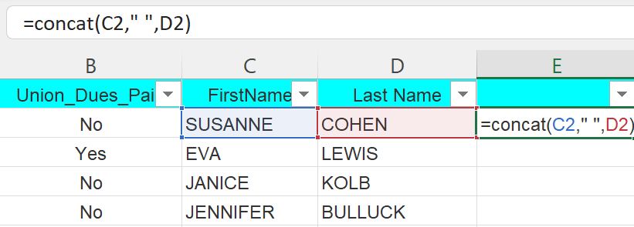
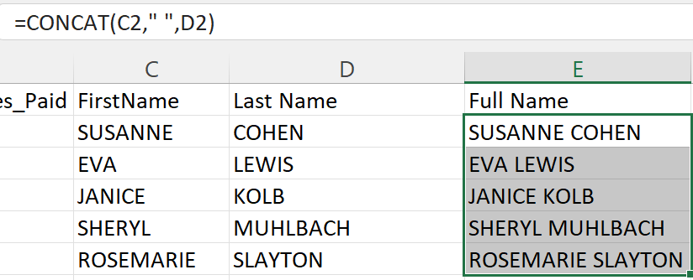
How to Concatenate
Insert new column to the right of the data
Use formula
  =CONCAT(Text 1," ",Text2)
Repeat formula for the rest of the column
  Highlight the column
  When the cursor becomes a small cross, double-click on the square in the bottom right corner
Preserve the data
  Highlight the column
  Right click and copy the data
  Under Paste Options: Paste Values
Notes:
Chad
Time allotment
Model: 2 minutes
Independent practice 5 minutes
Debrief and Reflection: 3 minutes
Now it is time for you to try to concatenate. Encourage participants to turn off their camera while they complete the task. Encourage participants to turn their camera on if they assistance is needed or they are finished.
Combine first and last names of members
Once the task is complete, turn your camera on.

Slide 15
Group Work
- Now you try it -
Notes:
Slide allotment: 5 minutes
Chad will be in the breakout room supporting individuals who need additional support

Slide 16
Text To Columns
Benefits:
Important to separate rows of data into separate columns
Separate information into different columns
  Name: "Mary Smith" becomes "Mary" "Smith"
  Hire Date: "05/18/2014" becomes "05" "04" "2014"
  Address: "123 Main Street, Charleroi, PA" to "123 Main Street" "Charleroi" "PA"
  Other unformatted data
Notes:
Chad
Highlight value of
Naming conventions
Comments
Additional data clean-up may be needed, i.e. / or commas or hyphenations
Note: When separating names, recommend including the hyphen before using text to columns

Slide 17
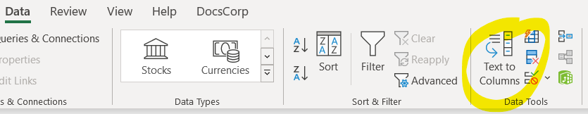
How to use Text to Columns
Data Tab
Click Text to Columns
Click Next
Choose Delimiters (Space, comma, etc.)
Click Next
Click Finish
Notes:
Chad
Time allotment
Model: 2 minutes
Independent practice 5 minutes
Debrief and Reflection: 3 minutes
After showing the instructions, facilitator needs to share screen to show participants how to use the Text to Columns feature
Insert column
Highlight the column you want to split
Data Tab
Click Text to Columns
Click Next
Choose Delimiters (Space, comma, etc.)
Click Next
Click Finish
Participants will apply text to columns feature on hire date. Encourage participants to turn off their camera while they complete the task. Encourage participants to turn their camera on if they assistance is needed or they are finished.
Reminder: DOWNLOAD Excel Training Worksheet FILE BEFORE WORKING IN IT
Separate Month/Day/Year
Choose Other Delimiters "/"

Slide 18
Group Work
- Now you try it -
Notes:
Chad

Slide 19
Filter
Benefits:
Separate specific groups of members from a larger group
  Job title
  Time working with the school system
  Members vs. potential members
Notes:
Section Allotment: 15 minutes
Jeny
Who has used the filter feature in Excel? When do you use it? Ask participants to use the raise hand feature to share when they use the filter feature.
Filtering is a feature that will allow you to identify a list of members who meet a certain set of criteria. For example, given the data in the Excel for Training workbook, why would you find value in identifying the elementary school teachers in the membership list?

Slide 20
How to Filter
Home ribbon
Editing
Sort & Filter
Click on the dropdown in Row 1
Use checkboxes to identify areas to filter
Notes:
Jeny
Time allotment
Model: 2 minutes
Independent practice 5 minutes
Debrief and Reflection: 3 minutes
Share screen with participants so that they can see how to filter and identify the number of elementary school classroom teachers
Best Practices REMINDER
Make a copy of the worksheet so that you do not compromise your data.
Save your work regularly.
Note that the membership list that was received from the school system has 302 individuals in the bargaining unit
After filtering the list
there are 42 elementary school teachers
2 Art
20 Elementary classroom
4 Library media
4 Instrumental music
1 Vocal music
2 PE
6 Resource teachers
3 School counselors
Now it is time for you to try to filter. When you hear the magic word, turn off your camera and filter the bargaining unit for the following:
Identify the number of members
How many staff work at Perfect Elementary School?
After completing the task, turn your camera on
Once all cameras are on
Ask participants the to identify the number of members in the unit
Ask the participants the number of staff at Perfect Elementary School
Reflection
How can you use this tool in your current work world?

Slide 21
Sort
Benefits:
Arrange information in a particular order
  Alphabetical order
    Worksites
    Unit Description
    Hire date
    Member name
Notes:
Section Time Allotment: 15 minutes
Jeny
Maybe have them sort addresses to go knock on doors. How did they choose to sort it?

Slide 22
How to Sort
Home ribbon​
Editing​
Sort & Filter​
Custom Sort​...
Set the rules around how to arrange the data
Notes:
Jeny
Time allotment
Model: 2 minutes
Independent practice 5 minutes
Debrief and Reflection: 3 minutes
Share screen with participants so that they can see how to filter and identify the number of elementary school classroom teachers
Best Practices REMINDER
Make a copy of the worksheet so that you do not compromise your data.
Save your work regularly.
Note that the membership list that was received from the school system has 302 individuals in the bargaining unit
After filtering the list
there are 42 elementary school teachers
2 Art
20 Elementary classroom
4 Library media
4 Instrumental music
1 Vocal music
2 PE
6 Resource teachers
3 School counselors
Now it is time for you to try to filter. When you hear the magic word, turn off your camera and filter the bargaining unit for the following:
Identify the number of members
How many staff work at Perfect Elementary School?
After completing the task, turn your camera on
Once all cameras are on
Ask participants the to identify the number of members in the unit
Ask the participants the number of staff at Perfect Elementary School
Reflection
How can you use this tool in your current work world?

Slide 23
Group Work
- Now you try it -
Notes:
Slide allotment: 5 min
Jeny will go into the breakout to support individuals who need additional assistance.

Slide 24
Formatting Matters!
Commas, decimals, and percentages
Merge and Center
Format as table
Wrap Text
Notes:
Time allotment: 3 minutes
Seleste
Show two examples of spreadsheets, talk about difference between formatting.
Depending on time have them do it themselves.

Slide 25
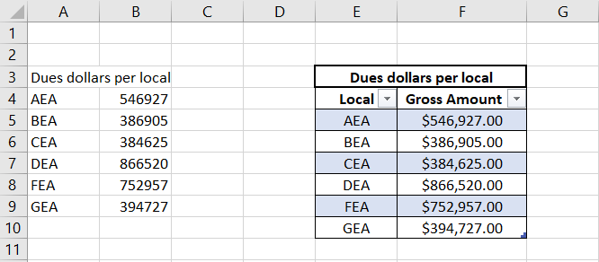
Formatting Matters!
Spot the differences
Notes:
Time allotment: 3 minutes
Seleste
Show two examples of spreadsheets, talk about difference between formatting.
Depending on time have them do it themselves.

Slide 26
CHALLENGE:
Sort addresses to go knock on doors. How do you choose to create it?
Tips: May need to use Sort, Filter, Text to Columns or Concatenate
Notes:
Time allotment will be based on time available in the session.
Seleste will go into breakout if time allows to support individuals who need additional assistance.

Slide 27
Key Concepts:
  Excel is a tool that is widely available and the basis of all database programs.
  Functions such as Sorting, Filtering, Concatenate, and Text to Columns allow you to evaluate existing data to strategize based on the data.
Notes:
Seleste
Slide allotment: 1 minute

Slide 28
Looking Ahead:
You will receive an evaluation email from Ellen Holmes.
Mark your calendars
  December 6, 2023 at 2:30pm EST
    Part 2: Analyzing your power
  March 13, 2024 at 2:30pm EST
    Part 3: Disseminating information
  May 15, 2024 at 2:30pm EST
    Part 4: Participant choice
Notes:
CHAD
UPDATE SERIES DATES
Seleste
Slide allotment: 1 minute

Slide 29


Thank You - Contact Us:
Ellen Holmes
She/Her
National
Education Association
Eholmes@nea.org
Monet Reilly
Sher/Her
UniServ Representative
Pennsylvania State
Education Association
mreilly@psea.org
Beth Barton
She/Her
UniServ Director
Illinois Education Association
Beth.Barton@ieanea.org
Jeny Gardner
UniServ Director
Wyoming Education Association
jgardner@wyoea.org
Using Excel for Organizing
Part 1: Evaluating membership data
Notes:
CHAD
UPDATE PICTURES

