Slide 1
Foundations for
Winning Campaigns
Day 2
Notes:
Katie B

Slide 2

Please rename yourself(if need be)
Name
Required Pronoun
State, and Job Title
Notes:
Katie B

Slide 3
Honoring This Space
We begin by acknowledging that through a history of colonization and brutality, we are each currently on the traditional lands stewarded by generations of indigenous people.
We honor these indigenous people, all elders, past, present, and emerging. We are called to learn and share these learnings about this tribal history, culture, and contributions that have been suppressed in the telling of the story of what we now call the United States of America.
Notes:
Katie B
Invite participants to drop local Tribe names in chat if they know them?

Slide 4

Community Agreements
Using Self-Awareness and Self-Knowledge
Listening for Understanding
Being Gracious
Staying Engaged
Being Open and Suspend Judgment
Saying “I”- tell your truth
Seeking Discomfort
Reaching Empathy
Expecting Non-Resolution and Non-Closure
*Adapted from “Embracing equity and inclusion”, Annie E. Casey Foundation
Notes:
Awareness and Self-Knowledge
This requires self-knowledge and self-awareness. Self-knowledge allows you to see what causes you pain and conflict and enables you to embrace your contradictions and inconsistencies. It allows the space to work on things about yourself that you are not happy with. In turn, self-knowledge helps to prevent you from projecting your negative aspects onto other people. Bringing your best self also requires that you have a positive attitude, are willing to deeply explore your perspectives and remain open to the perspectives and experiences of others.
Listening for Understanding
Be an active listener. Active listening involves paying full and careful attention to the other person, looking him or her in the eye, avoiding interruptions, reflecting your understanding, clarifying information, summarizing the other person’s perspectives and sharing your own. Remember that most people need time to open up and might not be willing to immediately share their personal stories, hopes, fears and/or concerns.
Being Gracious
Being kind is a vital way of bringing meaning to our own lives, as well as the lives of others. Kindness is about caring genuinely for others around you, wanting the best for them and recognizing in them the same wants, needs, aspirations and even fears that you may have. Being kind and generous allows us to communicate better with others, to be more self-compassionate and to be a positive force in other people’s lives. This includes following the COVID protocols that are in place to protect the health of this learning community.
Stay Engaged
Staying engaged requires you to be morally, emotionally, intellectually and socially involved in the conversation. Staying engaged means that you are listening with curiosity and willing to deepen your understanding. Staying engaged might also require you to sustain the conversation even when it gets uncomfortable or diverted. This also means a commitment to keeping your electronic communications to a minimum with folks not present in this learning community.
Be Open and Suspend Judgment
Listening with an open mind includes being receptive to the influence of others. You can suspend judgment by becoming aware of preconceived notions and listening to everything someone has to say before jumping to conclusions. Most importantly, suspending judgment also means listening to what the speaker has to say for understanding, not just to determine whether the speaker is right or wrong.
Say “I”- tell your truth
Speaking your truth in authentic and courageous conversations about race requires a willingness to take risks. It means that you will be absolutely honest and candid about your own thoughts, feelings, experiences and opinions and not just saying what you perceive others want to hear. Speaking your truth will require you to speak from the “first person” and use “I” statements.
Seek Discomfort
Leaning in to discomfort will require you to let go of racial understandings and stereotypes that you may be holding onto in order to move forward. Leaning in means that you will avoid judgment, assume positive intent and be open to the kernel of wisdom in each individual’s experiences. Leaning in to discomfort will require you to sit through moments of embarrassment, confusion, anxiety and/or fear.
Reaching Empathy
Empathy and compassion allow you to understand the other person’s point of view. When you are empathetic, you are more understanding, patient and kind. Expanding your capacity to feel empathy will also allow others to enter your circle of human concern.
Resolution and Closure
Expect and accept that there may not be closure. It is not likely that you will resolve your personal understanding about race or another person’s racial experience in a single conversation. The more you talk about race with another person, the more you learn and the more they will learn. Authentic and productive conversations about race are continuous and always evolving.
*Adapted from “Embracing equity and inclusion”, Annie E. Casey Foundation

Slide 5
First Thoughts
Please share in the chat:
What are the values that drive you in this work?
What values are reflected in your current campaigns?
Notes:
Katie B

Slide 6

Agenda
Convene
Power Analysis
Values Triangle
Break
Power as a Function of Courage and Unity
Adjourn
Notes:
Katie B

Slide 7
Structure of a Campaign
Step 1: Problem and Issue - The problem and issue is the spark! Why we are coming together, why we want a contract etc.
Step 2: Power Analysis – What power do the decision makers have? Who has power over them? What power do we have?
Step 3: Target- Who has the power to make a change? Who is the PERSON who can make the change.
Step 4: Demand - What needs to be changed? By when? By who?
Step 5: Strategy and Tactics -How will we get our demands met? Who needs to be in the fight?
Step 6: Escalation-Always plan to escalate. What happens when the target says no? Or doesn’t respond?
Notes:
Yvie J:
Lets start by reviewing the steps to campaign building. We need these building blocks. (Steps 1, 2, 3, 4, 5, & 6).
(Go through steps on slide)
We are going to focus on the power analysis and a values triangle you can use with your leaders to do a deeper assessment of power.

Slide 8
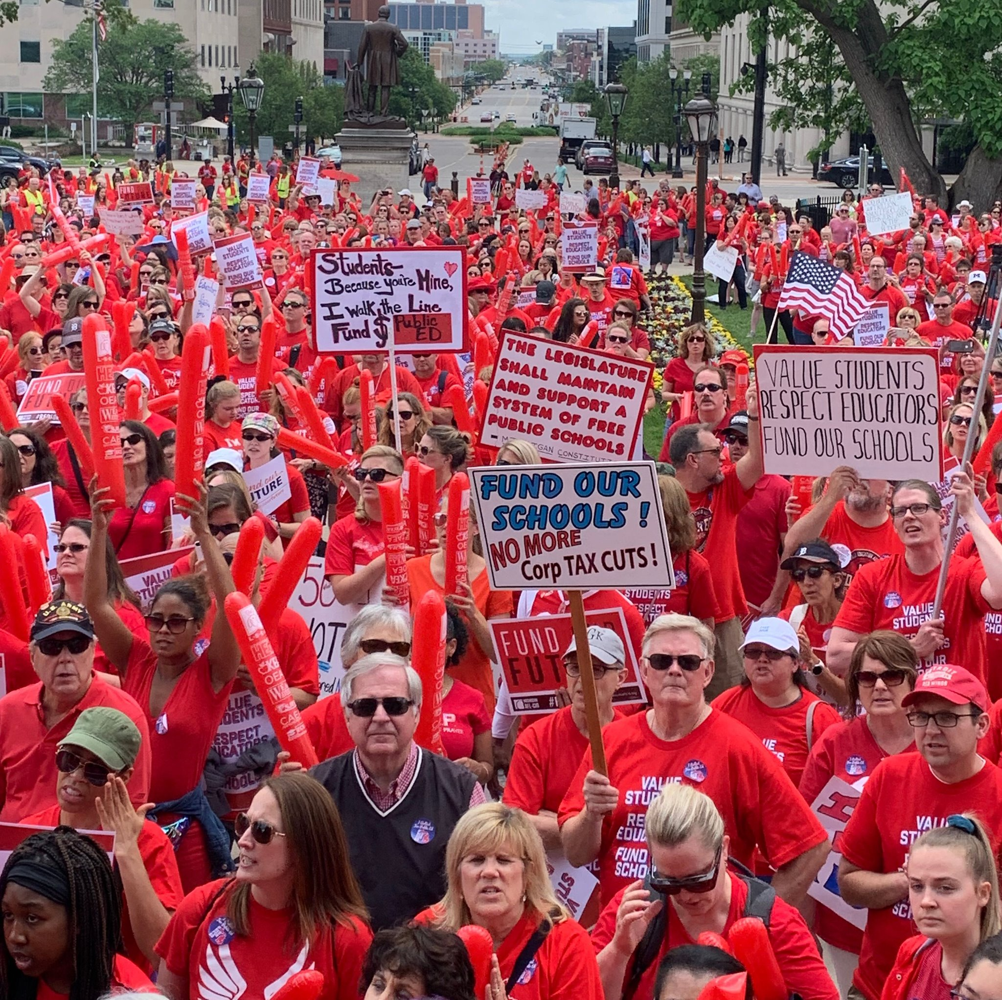
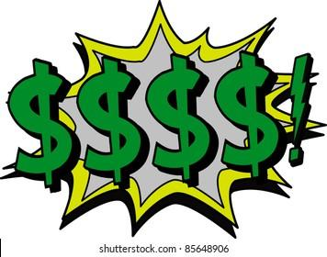
REMEMBER POWER
Power is the ability to control, create, and prevent change.
Power is organized people and organized resources (money).
Notes:
Yvie J

Slide 9
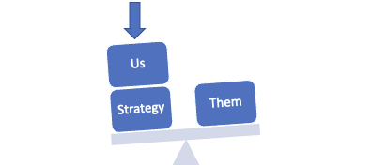
Purpose of Power Analysis
Understand how (& by who) power is exercised to cause and maintain the problems & conditions that we seek to change
Develop effective strategies for:
  Permanently altering power relationships in favor of the people suffering from the problems & conditions that we seek to change
  Grassroots organizing to build power
  Issue campaigns that BOTH help to build power AND win change
  Connecting short term activities to LONG TERM goals
Notes:
Yvie J:
Now why do we do a power analysis and what is it?
Power analysis is a systematic approach to understanding our own power and the power of our allies and opponents on the issue that we have identified. Doing a power analysis allows us to understand how and by whom power is being exercised to cause and maintain the problems and conditions that we seek to change. This allows us to identify and understand how to move the decision maker who can give us what we want and to develop effective strategies for:
Permanently altering power relationships in favor of our communities & the conditions that we seek to change
Grassroots organizing to build power
Developing Issue campaigns that BOTH help to build power AND win change
Connecting short term activities to LONG TERM goals

Slide 10
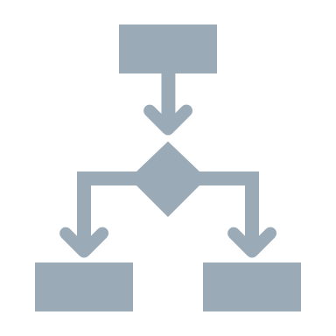


Process of Power Analysis
1. Issue Background
2. System Landscape
3. Identify & Analyze Target(s)
Notes:
Yvie J
These are the steps of power analysis for a specific issue you have identified:
1. Issue Background
2. System Landscape
3. Identify and Analyze Target(s)

Slide 11

Process of Power Analysis
1. Issue Background
2. System Landscape
3. Identify & Analyze Target(s)
Notes:
Yvie J
Once we’ve identified an issue, what might we need to find out about it in order to build an effective campaign?
What is the history and current status of the issue?
What are the competing agendas or positions on the issue?
What are the narratives surrounding the issue?
Who are allies on the issue? Who are opponents on the issue?

Slide 12
Process of Power Analysis
1. Issue Background
2. System Landscape
3. Identify & Analyze Target(s)
Notes:
Yvie J
Next step is researching the system landscape. The two main questions are:
What are the decision making processes on this issue?
Who is involved in each step of the decision making process?

Slide 13
Process of Power Analysis
1. Issue Background
2. System Landscape
3. Identify & Analyze Target(s)
Notes:
Yvie J
Now we’ll move into Part 3 of the Power Analysis, identifying and analyzing the Target(s). Who has an idea of what we mean by a target in the context of a campaign?

Slide 14

A Target Is
The person with the power to give you what you are demanding.
This person
Has a name
Has a face
Has an address
Notes:
Yvie J
A target is the person who can make the decision to give you what you want. The target is the person who can meet your demands. We need to be very specific in identifying the target. A target is not an organization or a committee. A target is a person with a face, name, and an address.
Once you have done the system landscape and understand the decision making process, you will be able to identify the Target.

Slide 15
Values Triangle
Self-Interest
Power
Values
Relationships
Notes:
Zac J
First, we need to understand our own power. There is a helpful tool for power analysis that we call the Values Triangle. The triangle works from the bottom up and the inside out. At the bottom of the triangle, we have relationships. Everything starts with relationships because everything we do happens in, through, with and because of who we know and how we trust them. Inside the triangle is where we have values. Do you remember how we defined values this morning? Values are deeply-held beliefs that shape who you are. We are our best possible selves when we have clarity on our values. The world we want to see and how we define ourselves are based on our values. A person who is clear on their values knows who they are and what they believe in.
On the left of the triangle, we have self-interest. Self-interest is what our values look like in the world, the tangible manifestation of our values. When you understand your values you can discover your self-interest. Your self-interest is what you’re willing to fight for. For example, if one of your values is people over profits, one of your self-interests could include stronger unions, living wage policies, hazard pay for essential workers, and more. On the right side of the triangle is Power. Who remembers our definition of Power? Power is the ability to create, control, and prevent change. Power is made up of organized people and organized resources. Bringing it all together, we build relationships, so that we can agitate people to live up to their values and get clear on their self-interest so that we can build the power we need to make the world reflect our values. Understanding this triangle is key to your work and to making change. Every person and organization has one of these.

Slide 16
Values Triangle
Self-Interest
Democracy
Power
Worker Voice
People over profit
Member organizing
Living Wages
Democracy
Dues
Strong Public Schools
Values
Collective Bargaining
Relationships
Members
CWA
IAF
Great Ed CO
America Votes
UNE
Eliza Hamrick
Notes:
Zac J
One helpful tool for completing a power analysis of our own context is called the Values Triangle. The triangle works from the bottom up and the inside out. At the bottom of the triangle, we have relationships. Everything starts with relationships because everything we do happens in, through, with and because of who we know and how we trust them. Inside the triangle is where we have values. Do you remember how we defined values this morning? Values are deeply-held beliefs that shape who you are. We are our best possible selves when we have clarity on our values. The world we want to see and how we define ourselves are based on our values. A person who is clear on their values knows who they are and what they believe in.
On the left of the triangle, we have self-interest. Self-interest is what our values look like in the world, the tangible manifestation of our values. When you understand your values you can discover your self-interest. Your self-interest is what you’re willing to fight for. For example, if one of your values is people over profits, one of your self-interests could include stronger unions, living wage policies, hazard pay for essential workers, and more. On the right side of the triangle is Power. Who remembers our definition of Power? Power is the ability to create, control, and prevent change. Power is made up of organized people and organized resources. Bringing it all together, we build relationships, so that we can agitate people to live up to their values and get clear on their self-interest so that we can build the power we need to make the world reflect our values. Understanding this triangle is key to your work and to making change. Every person and organization has one of these.

Slide 17
Story Time with Zac – Woodland Park, CO
Ken Witt - Superintendent
Self-Interest
Power
Values
Relationships
Brad Miller (Attorney)
Freedom Foundation
State Policy Network
Transform Colorado
Truth And Liberty Coalition
Charis Bible College / Andrew Wommack
Notes:
Zac example (This slide is for Zac. Can be edited to complete each field as an example)

Slide 18
Story Time with Zac – Woodland Park, CO
Ken Witt - Superintendent
Self-Interest
Freedom
Power
American/Family Values
Parents Rights
alues
Relationships
Brad Miller (Attorney)
Freedom Foundation
State Policy Network
Transform Colorado
Truth And Liberty Coalition
Charis Bible College / Andrew Wommack
Notes:
Zac example (This slide is for Zac. Can be edited to complete each field as an example)

Slide 19
Story Time with Zac – Woodland Park, CO
Ken Witt - Superintendent
Self-Interest
Freedom
Power
Conservatives in Power
American/Family Values
Parents Rights
Charter Schools
Local Control
alues
Curriculum Adoption
Relationships
Brad Miller (Attorney)
Freedom Foundation
State Policy Network
Transform Colorado
Truth And Liberty Coalition
Charis Bible College / Andrew Wommack
Notes:
Zac example (This slide is for Zac. Can be edited to complete each field as an example)

Slide 20

Story Time with Zac – Woodland Park, CO
Self-Interest
Freedom
Power
Conservatives in Power
American/Family Values
Foundation $$
The Federalist
Parents Rights
Charter Schools
Church Networks
House Meetings
Local Control
School Board
alues
Curriculum Adoption
Relationships
Brad Miller (Attorney)
Freedom Foundation
State Policy Network
Transform Colorado
Truth And Liberty Coalition
Charis Bible College / Andrew Wommack
Notes:
Zac example (This slide is for Zac. Can be edited to complete each field as an example)

Slide 21
In your breakout room:
Read about the Apple Education Association
Go to your assigned jamboard page
Complete the values triangle as a group using sticky notes for each field
Notes:
Zac J
Share links in chat:
https://jamboard.google.com/d/1HA21zY0XJgiABicuWKt1Pbrn_Fqei-AH6qleePVsyPY/edit?usp=sharing
Yvie will share links and show how to move slides and stickies
https://docs.google.com/document/d/1Tey7ezc_cQNehPXEmYuK0xXvNUAXkj805WN5jODpD6U/edit?usp=sharing

Slide 22

Key Ideas
During a campaign, understanding the values, self-interest, and power of those who we need to influence helps to underpin and strengthen our strategy, increasing our likelihood of success.
Notes:
Zac J

Slide 23
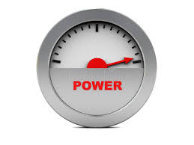
Power is a function of courage and unity.
Assessment Scale
1. Low Power - Lack of unity, lack of leaders, no structures for union action, low resource, low membership
5. High Power – High Unity, leaders in all places and levels, many structures to do union action, resource rich, high membership
Notes:
Katie B
The amount of Courage or Effort that is needed to commit to act
And the relationship to the Number of people feeling the pain, sharing the values, and participating in the change (unity and shared responsibility) is what gets us to our ultimate power to win the demand.

Slide 24
Power is a function of Courage and Unity
Our Ultimate Power
Amount of Effort or Courage to Persist and Act
Unity - Number of People Sharing the Values, Pain, and Actions
Notes:
Katie B
The more the courage and the more people who are acting – the more power we have.

Slide 25
Low level of courage and high number of actors…
Amount of Effort or Courage to Persist and Act
Sign an online Petition
Unity - Number of People Sharing the Values, Pain, and Actions
Notes:
Katie B
high participation, low effort and courage – low power to cause the target to concede the demand

Slide 26
High level of courage and low number of actors…
Storm the Superintendent’s Office
Amount of Effort or Courage to Persist and Act
Unity - Number of People Sharing the Values, Pain, and Actions
Notes:
Katie B
a lot of courage and effort but low participation – low power to cause the target to concede the demand.

Slide 27
BREAK OUT!
In your breakout room, take the following tactics and put them on your own Jam Board axis of unity and courage.
Where do the following activities land on chart?
Staff are unhappy with their worksite supervisor. They take a unanimous vote of no confidence against the superintendent.
Teacher from each worksite of the locals' 45 worksites send a representative to share their concerns verbally with a district manager.
Staff sign up 25 new members and achieve 75% membership in the bargaining unit.
Worksite leads connect with PTSA presidents at their school and get 50% of PTSA presidents to attend a school board meeting in support of their bargaining campaign.
25% of the employees in a school district post about the lack of air conditioning in their school and tweet (X?) at the Superintendent.
Notes:
Katie B
Demonstrate the Jam Board, how to change slides and move post its.
Each tactic has heir own jam board. there we will have 5 post for each room to move.
Move the post it note to where it should land on the axis, based on the situation.
Go through all the jam board slides (there will be 5), your room should come to concensus on where to place the post it based on the scenario above.

Slide 28
High Participation Is a Prerequisite to Power - Super Majority of Workers Engaged
Notes:
Katie B
Yes, a tactic has many components- but if we are focused on building power to win our demands, we need to consider the depth of engagement and how difficult/how much courage it takes to do the tactic.

Slide 29
Key Ideas
Power is also situational and can grow and wane over time. If we are not working to build power every day- it is waning. Understanding our power and the effectiveness of a tactics.
Notes:
Katie B

Slide 30
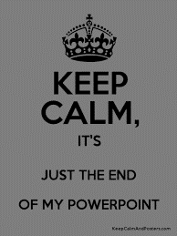
Ending it Right
Feedback via email
Check out other online trainings
Notes:
Zac J
UniServ & Organizer Support | NEA

