Slide 1
Foundations for
Winning Campaigns
In the chat:
Name, Required Pronoun, State
What is a win that you are most proud of?
Notes:
Intro - Lucy screenshare
Section 1 - Lucy screenshare + breakouts, Kristin linkdrop
Section 2 - Melissa screenshare, Melissa runs breakouts
Section 3 - Melissa screenshare, Lucy runs breakouts
LUCY - screenshare and breakout rooms for intro, section 1 (Kristen link drop)

Slide 2
Honoring This Space
We begin by acknowledging that through a history of colonization and brutality, we are all connecting from lands inhabited by indigenous peoples past and present. ​
We honor these indigenous people, all elders, past, present, and emerging. We are called to learn and share these learnings about this tribal history, culture, and contributions that have been suppressed in the telling of the story of what we now call the United States of America.​

Slide 3
Agenda
Intro (5)
Breaking the Cycle of Service (30)
Understanding and communicating the why of campaigns (20)
Campaign Anatomy (30)
Closing (5)
For each topic there will be an interactive presentation and small group breakout discussion (10-15mins)

Slide 4
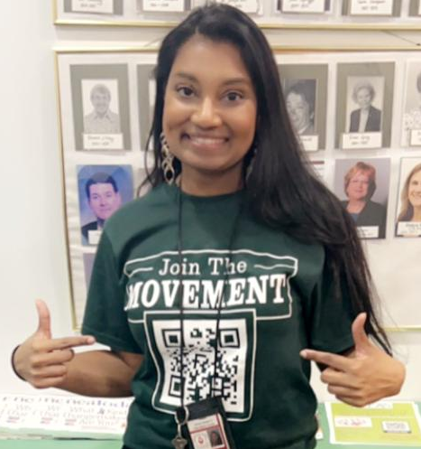


Welcome!
Today’s Facilitators
Series of Online and Face to Face Sessions:
https://www.nea.org/UD-Org-Support
Melissa Dan, she/her
Palm Beach County Classroom
Teacher’s Association
Melissa.Dan@floridaea.org
Lucy Griswold, she/her
Senior Program & Policy Specialist, NEA Leadership Development Team
LGriswold@nea.org
Kristin Lytie, she/her
Organizing Director
Wisconsin Education Association
lytiek@weac.org

Slide 5
Community Agreements
Turing on your Camera
Raising your hand OR unmuting to speak
Asking questions as they arise
Knowing You get out what you put in
Using Self-Awareness and Self-Knowledge
Listening for Understanding
Saying “I” - tell your truth
Seeking Discomfort
Expecting Non-Resolution and Non-Closure
*Adapted from “Embracing equity and inclusion”, Annie E. Casey Foundation

Slide 6
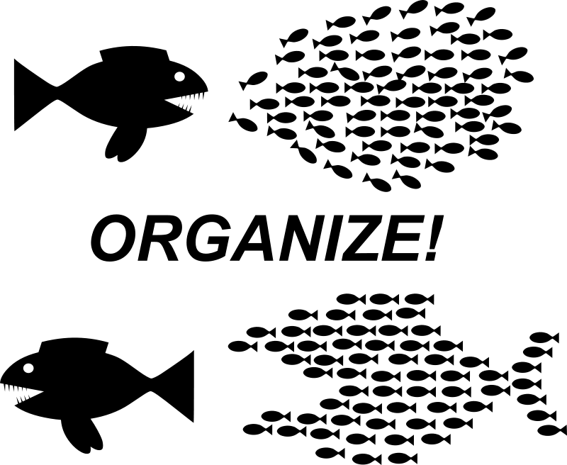
Breaking the Cycle of Service
Organizers understand the basics of recruitment and engagement via organizing conversations. Today we will focus on:
Moving away from the episodic mobilization of the already engaged to the deeper work of moving people to “our” side and having members take ownership of their union while we as staff provide support and coach members through the process.
Drop in the chat: What is your title/role as staff?

Slide 7
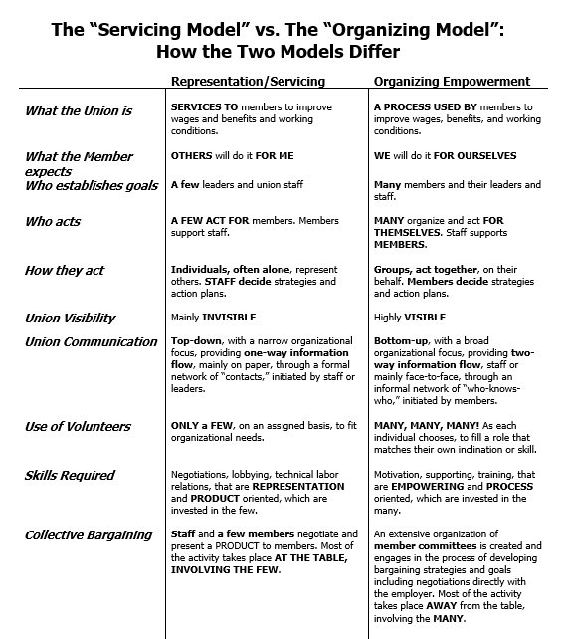

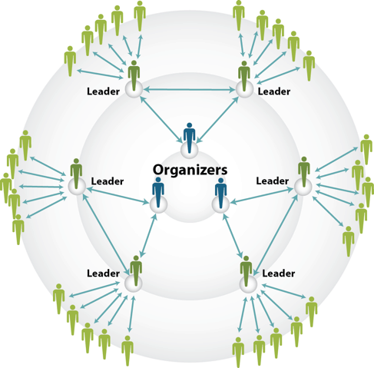
Service
Organizing

Slide 8
Organizing Definition
Organizing is identifying leaders and coordinating them into leadership teams, Building community and commitment around common goals, Building power from the resources of that community, Using that power strategically to make concrete change in the world.
Notes:
Toney, Bekah

Slide 9
Levels of Organizing
Advanced
  Members Lead
  Staff Advise and Coach
Basic
  Member and Staff Partners
  Staff Coach and Build Leader Capacity
Beginning
  Staff Lead
  Staff Focus on Engagement and Leader ID
Survival
  Staff Lead
  Focus on Recruitment and Engagement

Slide 10
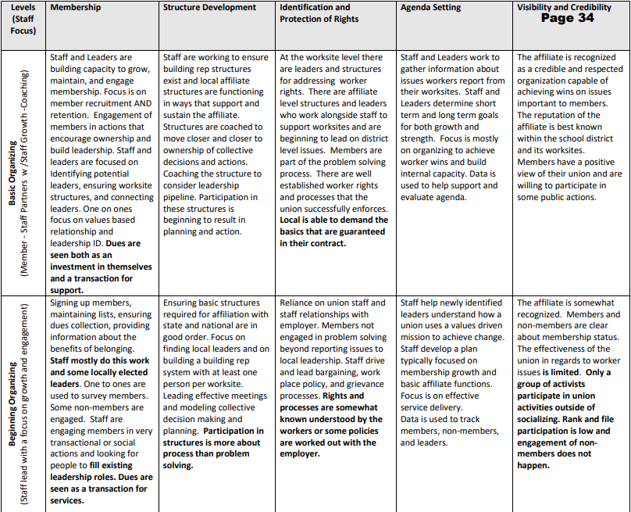
Breakout Rooms (15 minutes)
Select one affiliate that you work with.
Complete an assessment of the affiliate using the Levels of Organizing Chart.
What are some ideas or activities that you would need to put in place to move the affiliate to the next level? (document your ideas on slides 12 and 13)
Select one person to share out from your group.

Slide 11
Debrief: Group Share Out
Advanced
Where did you place your affiliate?
What are some ideas you discussed to move your work to the next level?
Basic
Beginning
Survival

Slide 12
Ideas to move up along the levels of organizing continuum
Basic structure for leadership. Role descriptions.
Convincing leaders to hold a monthly meeting.
Getting to the “now what.”
Letting the new people get involved.
Upholding their contract.
Informational meetings
Realizing that they are workers with a staff/management relationship to navigate
Say “you are the union” and act like it.
poke holes in the idea that labor/management are in a mutual or partnering professional dynamic. Point out that they don’t listen/partner/collaborate

Slide 13
Ideas to move up along the levels of organizing continuum

Slide 14

Reminders…
People grow when they have to stretch. When the union staff step back, members can step forward.
Tasks have to be meaningful, and members need to own them.
Our job is to look for opportunities to increase ownership and leadership wherever possible.
Notes:
Ellen, August

Slide 15
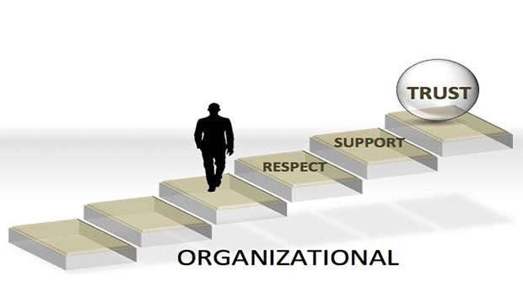
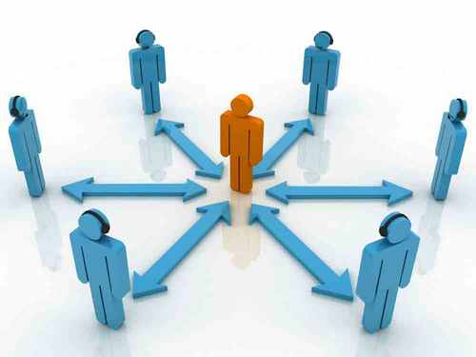
Key Takeaways
Organizing should be the foundation of an issue campaign.
To move across these theories requires a shift in ownership and leadership from staff to workers.
This involves risk and requires some level of trust.

Slide 16
Why campaigns?
Use the chat or the sticky notes on the slide following this one to share your response to the question above.
More on this later, but by CAMPAIGNS we mean:
An issue campaign is an action plan with a beginning, middle, and end, working towards a specific demand that we want to win. A campaign has a target, someone who can give us what we want. It usually involves a series of escalating actions (or tactics), which means that we progressively turn up the heat.

Slide 17
Why campaigns? Select a blank shape below and begin typing to add your response
click and drag a heart below to show support

Slide 18
Key Takeaways
Campaigns help us assess and build our power
Strengthen our organization: campaigns attract and engage new members/supporters and increases our community’s capacity to work together to make change.
Develop individuals: campaigns builds the leadership, skills, and capacity of our membership and supporters
To measure success, we consider both Strength (did we win what we wanted?) and Growth (did we grow our grow our numbers, develop our people, deepen our relationships, and expand our capacity to work together?)

Slide 19
Leader recruitment
Without a campaign...
With a campaign...
“Will you serve as a building rep? Your site needs someone to attend the monthly meetings and get distribute materials at the worksite.”
“
“All of us can serve students better when students have the resources they need to be successful. We want a school nurse, social worker, and trauma-informed therapist at every school site. Are you willing to talk with three of your coworkers about this plan?”

Slide 20
Potential Member recruitment
Without a campaign...
With a campaign...
“Will you join our organization? We offer legal representation, member benefits, and fight for improvements to the contract.”
“
“We need your perspective at our worksite member meeting tomorrow - we are discussing our proposal for how to spend the 200 million of remaining COVID relief funds and want to be sure your voice is heard. Will you join me and become a member right now?”

Slide 21
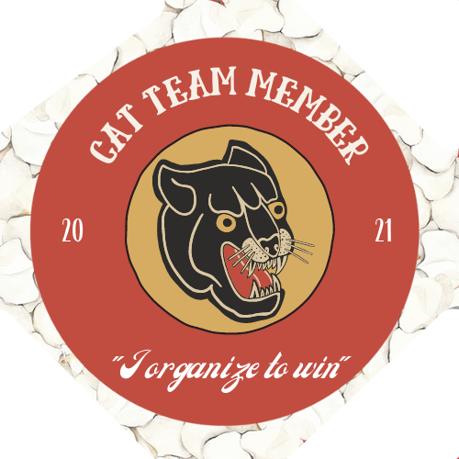
Building worksite structure
Without a campaign...
With a campaign...
“Did you know our bylaws say we can have more one building representative for every 20 members? Would you like to be the second rep for your worksite?”
“
“We need every member plugged into our contract campaign - As a member of our worksites Contract Action Team you will be responsible for communicating with and mobilizing 10-20 of our colleagues - can you step up and join the CAT team?

Slide 22
In Breakouts
10
What is the pushback to campaigns that you experience in your work?
What have you tried to overcome the pushback?
SHARE OUT: determine who will do a 1 minute share out with the full group that captures a highlight of your conversation

Slide 23
Lasting power is the goal
Lasting power is the goal, not just a one-time win. Campaigns should help us shift power in the workplace and develop more member-leaders, not just for one action, but for the long term. Campaigns are also an opportunity to build a permanent structure in the workplace—with strong leaders—and a solid member-to-member network that can mobilize members for action.

Slide 24
An Issue Campaign Defined:
An issue campaign is an action plan with a beginning, middle, and end, working towards a specific demand that we want to win. A campaign has a target, someone who can give us what we want. It usually involves a series of escalating actions (or tactics), which means that we progressively turn up the heat.

Slide 25
Anatomy of an Issue Campaign
Problem and Issue-what’s wrong?
Target-who is the decision maker?
Demand-what do we want?
Power Analysis-how do we make the decision maker fix it?
Strategy, Tactics and Escalation-the public pressure we put on the decision maker.

Slide 26

PROBLEM vs. ISSUE
A problem is the whole pie. Problems are vast, complex, and entrenched.
When we try to tackle a problem, we reinforce the hopelessness of the situation. We are trying to take on the full pie all at once.
Issues are the pieces of the pie. It’s a small chunk of the larger problem that we can make progress on, and in turn we are slowly taking on the full problem over time.
Notes:
What are some “red flags” to look out for when identifying the issue?

Slide 27
An issue is a slice of the larger problem
that is manageable and solvable.
Widely felt and/or deeply felt.
  The pain can be felt by just one, but the injustice
of that pain is shared by many.
Winnable.
Builds their union and builds leaders.
Has a connection to students and the public.

Slide 28
Is it an issue that we could build a campaign around?
Increasing funding to public schools
Bad morale in the school
Removing mold in a classroom

Slide 29

Mini-Breakout - 5 minutes
In Your Breakouts
  How have you moved members to think about strategically targeting an issue from a wide focussed problem?
  What activities have you led to help members build consensus around identifying an issue?
  Report out

Slide 30
Tactics
Are actions that make your demand visible in the workplace.
As a campaign progresses actions should increase:
Numbers of participants
Risk taken
Pressure on your decision maker
In the chat- what are some of your favorite tactics?

Slide 31
Campaign mountain
Foundation
Kickoff
Escalation
Resolution and reset
Peak action
The foundation is where we have one-on-ones, identify issues and leaders, and build the organization. It is also where the union plans out the campaign, identifies targets, and makes a timeline for tactics
The kickoff is the public launch of the campaign.
Members turn up the heat by making actions more intense.
Result, assess, continue building
Most intense action we are building towards— our most powerful weapon

Slide 32
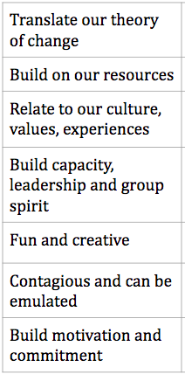
Sequencing Tactics
New Salary Schedule
Peak:
Attending Board Meeting in Mass with Press
70
xx
List of Grievances as a petition
Peak:Event with Potential Members to Grow campaign
Resources (People)
xx
Launch:
Inservice Day at hobart Park for Union Members
Open Meetings
xx
xx
1:1’s
Planning Meeting
7
Time
August 18th at NOON
September
October
When
October

Slide 33
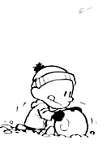
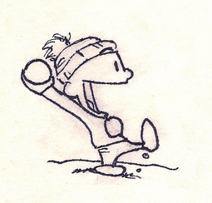

Strategic Goal
Relational tactic: Building up power
Campaign tactic: Launching power
Campaign
Tactic
Resources
Campaign
Tactic
Relational Tactic
Campaign
Tactic
Relational Tactic
Relational Tactic
Time

Slide 34
Tactics and Action as a Structure Test
The increasing involvement is as important for an internal evaluation as it is for showing management the issue is widely felt.
Escalation makes management feel the urgency to act.
To show management a goal is widely supported our actions need to achieve a supermajority of involvement from ALL staff.
This is an opportunity for membership growth, when we put our values into action people can clearly understand the importance of the union.

Slide 35
In the breakout room (7 mins):
What are the indicators that showed you a campaign was thriving?
Have you as staff ever felt like you were the one making a campaign happen? What was your takeaway?

Slide 36
Inoculation
-Getting union members prepared for the reaction from management to challenging the power dynamic.
-Don’t sugarcoat. Organizing is hard and often scary. The best leaders act in spite of their fear. Be skeptical of people who say they’re unafraid; they probably aren’t prepared for the fight.
It’s important to ask your working group:
How do you think your principal will respond to this?
If your principal utilizes weaponized guilt what will we do?

Slide 37
Key Takeaways for Building a Campaign:
  •Involves a series of escalating actions (or tactics) that combine to solve a particular issue.
  •Increases pressure on decision-makers to give what will solve the issue.
  •Builds power by increasing engagement, developing leaders, and building capacity around the values and shared concern of the common issue.
  •Throughout the campaign we identify milestones that indicate we have enough power to try something more and something bigger and win!

Slide 38
Contact Us!
Today’s Facilitators
Series of Online and Face to Face Sessions:
https://www.nea.org/UD-Org-Support
Melissa Dan, she/her
Palm Beach County Classroom
Teacher’s Association
Melissa.Dan@floridaea.org
Lucy Griswold, she/her
Senior Program & Policy Specialist, NEA Leadership Development Team
LGriswold@nea.org
Kristin Lytie, she/her
Organizing Director
Wisconsin Education Association
lytiek@weac.org

Slide 39
Resources
The Service vs. Organizing Model
Levels of Organizing Chart
Notes:
The Service vs. Organizing Model - https://docs.google.com/document/d/1w2xWPL-Awg_eusCEO5ukGsyzUDSFQO8m/edit?usp=sharing&ouid=100024743257039220001&rtpof=true&sd=true
Levels of Organizing Chart - https://drive.google.com/file/d/1gtLMM2Pym3dia0wSgq2ymUfTvPbp2aF5/view?usp=sharing

