Slide 1
Coaching Leader Development through a Campaign
How escalating actions, and more importantly, how failures, grow engagement and develop leaders

Slide 2

While You Wait Share in the Chat Window
Name
Required Pronoun
State
(in 1 sentence) A win you are proud of

Slide 3


Land Acknowledgement
We begin by acknowledging that through a history of colonization and brutality, we are currently on the traditional lands stewarded by generations of the Indigenous people.
We honor these Indigenous people, all elders, past, present, and emerging. We are called to learn and share these learnings about this tribal history, culture, and contributions that have been suppressed in the telling of the story of what we now call the United States of America.
Notes:
Time Allotment: 1 minute
Chad

Slide 4
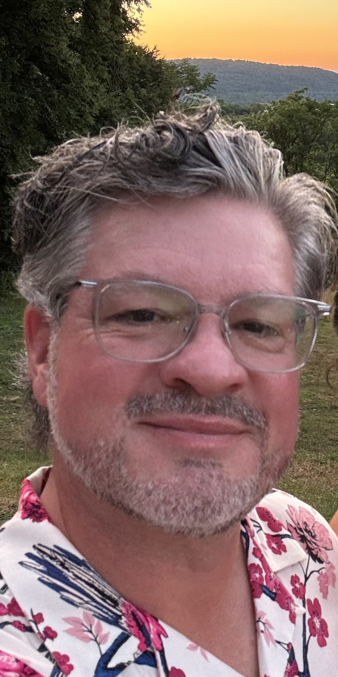
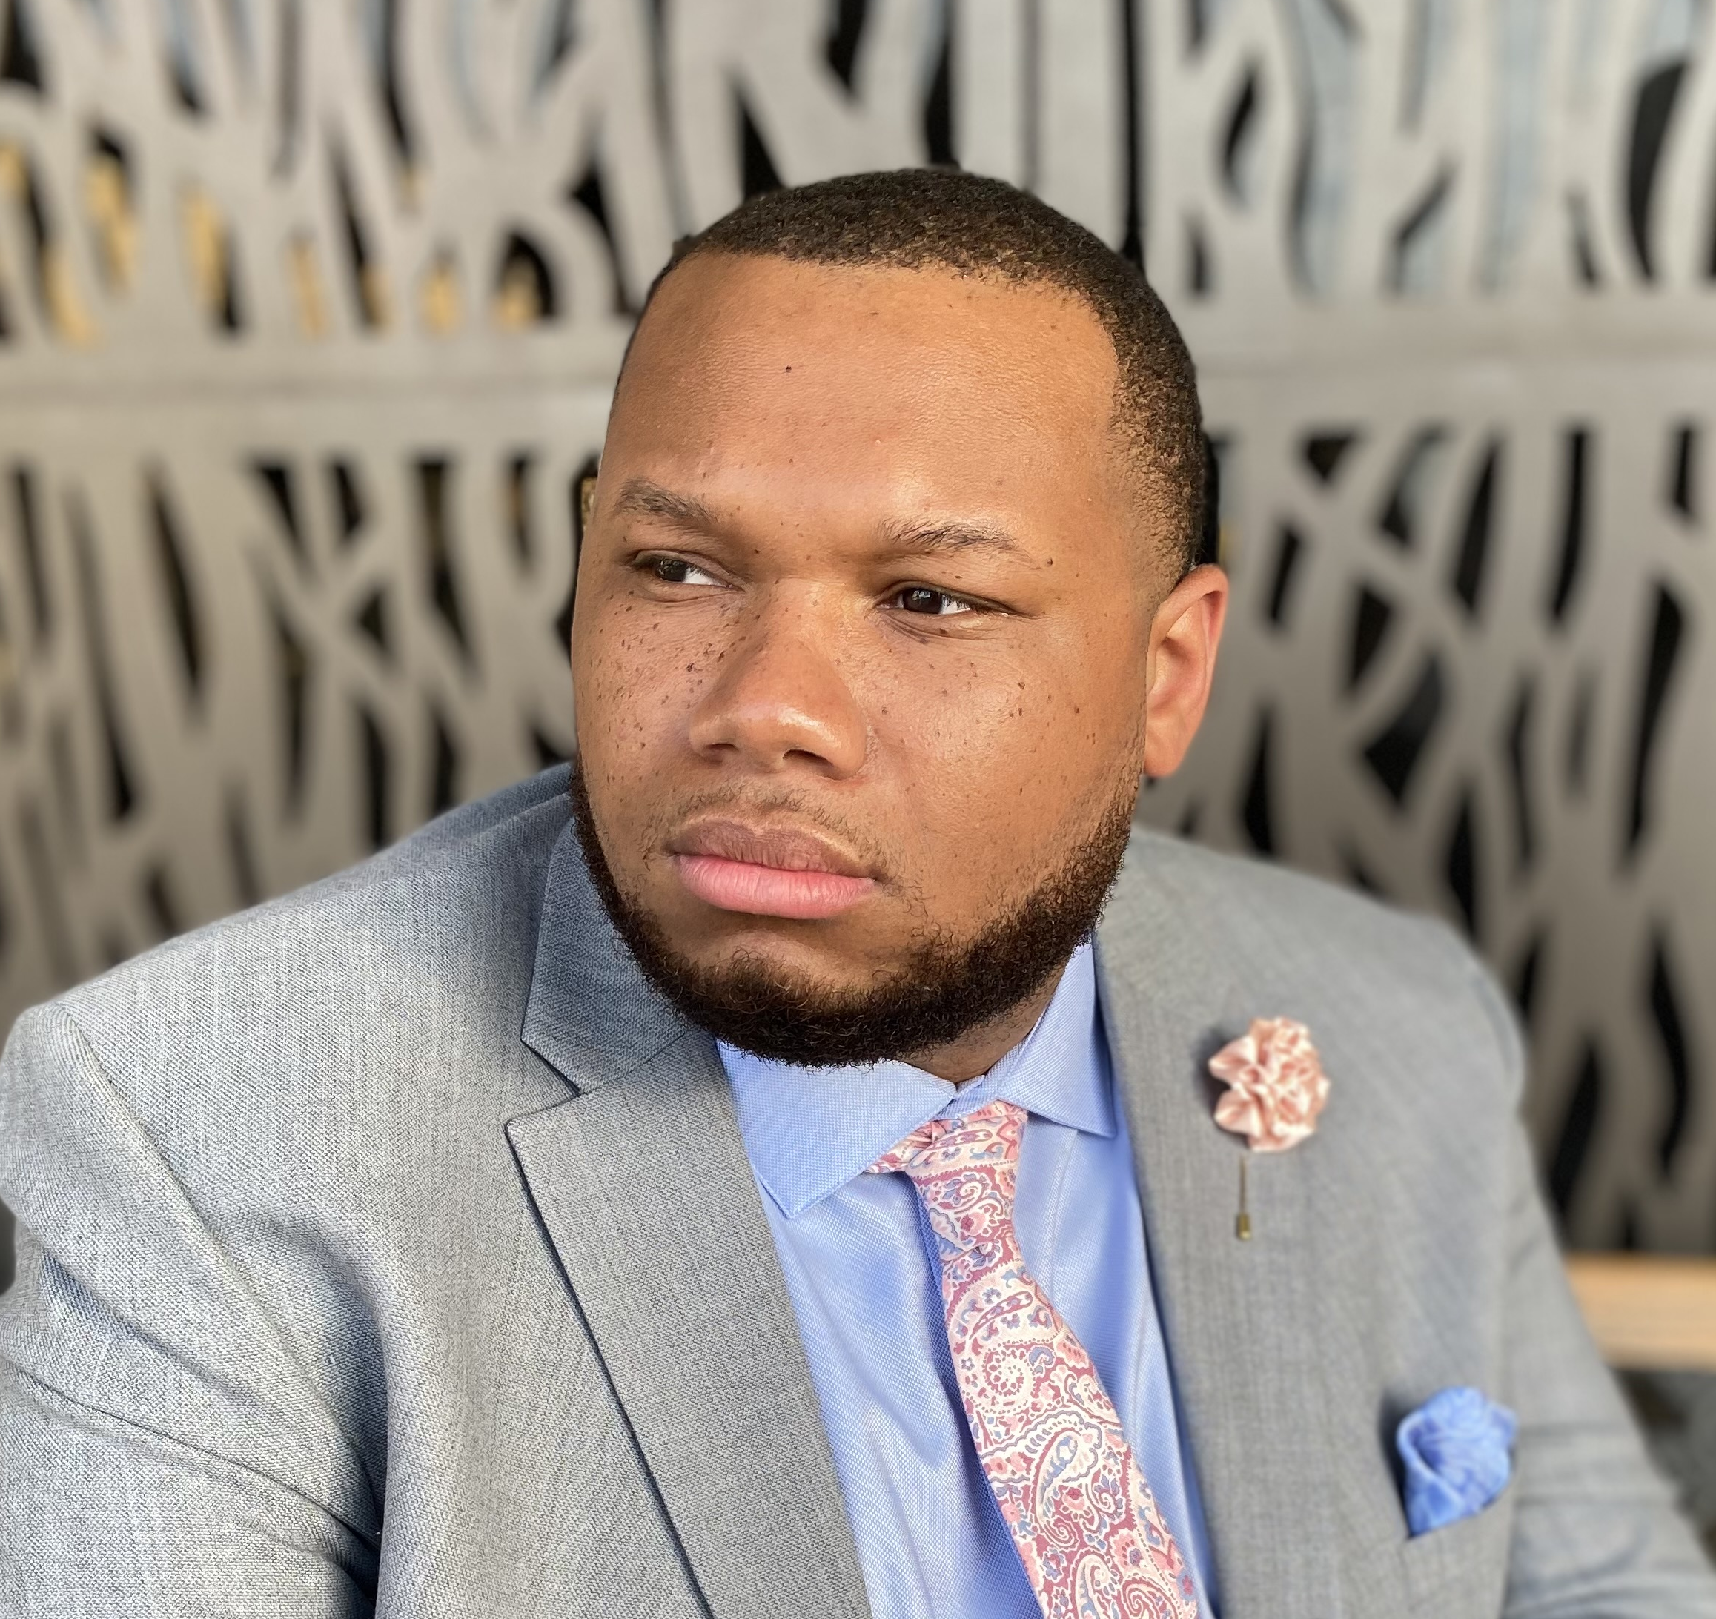
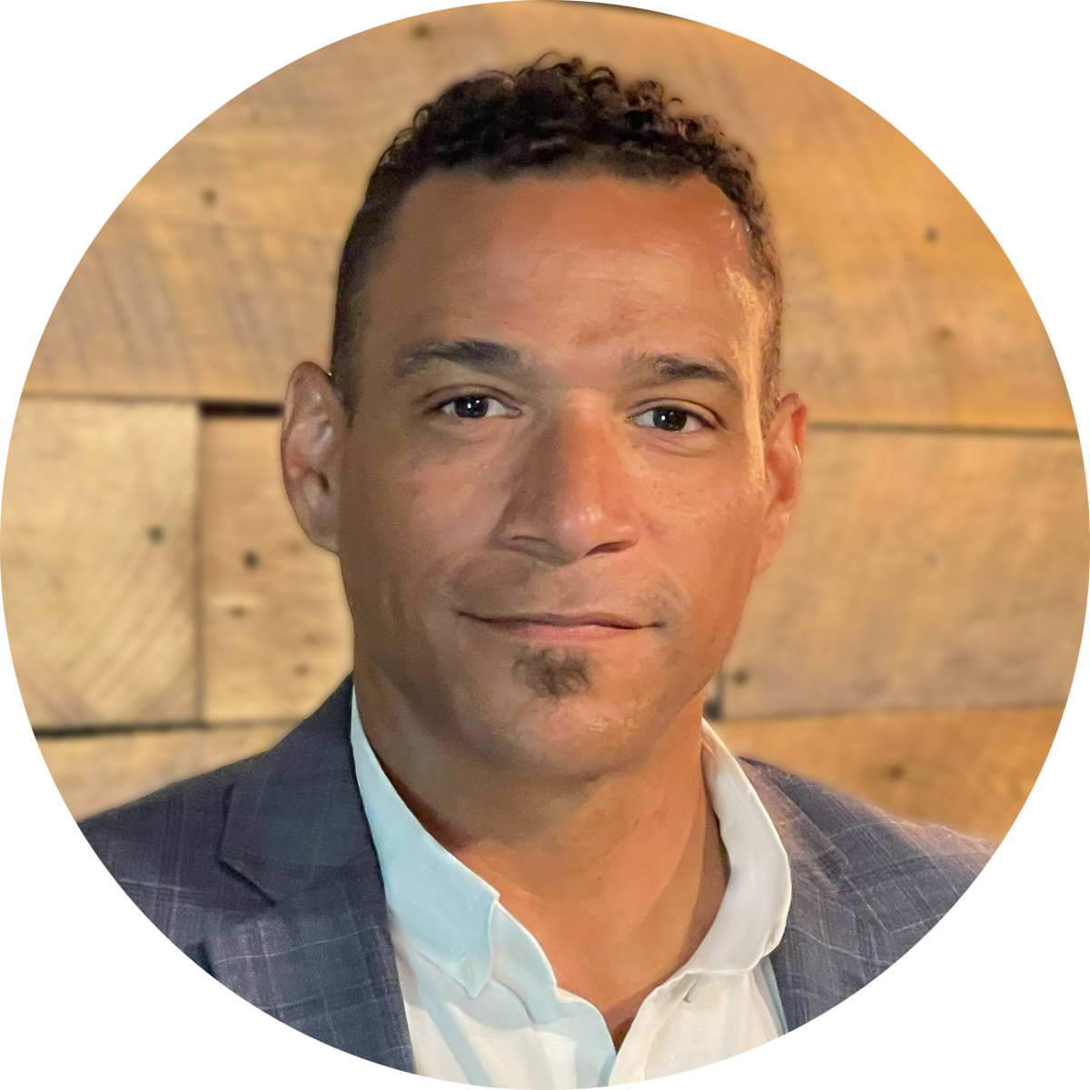

Facilitators
Melissa Dan
Labor Relations Consultant
Palm Beach CTA
Melissa.Dan@floridaea.org
Matt Fargen
UniServ Director
PSEA - Pennsylvania
Mfargen@psea.org
Albert Jones
Organizational Specialist
Maryland State
Education Association
aljones@mseanea.org
Chad Williams
UniServ Consultant
Michigan Education Association
cwilliams@mea.org

Slide 5

WHY ARE WE HERE?
NEA has an enterprise-wide emphasis on organizing.
Series of Online and
Face to Face New for 2024-25
https://www.nea.org/UD-Org-Support

Slide 6
Community Agreements
Using Self-Awareness and Self-Knowledge
Listening for Understanding
Being Gracious
Staying Engaged
Being Open and Suspend Judgment
Saying “I”- tell your truth
Lean into Discomfort
Reaching Empathy
Expecting Non-Resolution and Non-Closure
*Adapted from “Embracing equity and inclusion”, Annie E. Casey Foundation

Slide 7

Today’s outcomes:
Participants will discuss the following concepts:
Using tactics to identify leaders, mobilizers, and activists
Coaching members in using escalating actions to grow engagement and leaders
Coaching Through Debriefs

Slide 8
Part 1:
Using Tactics to identify leaders

Slide 9
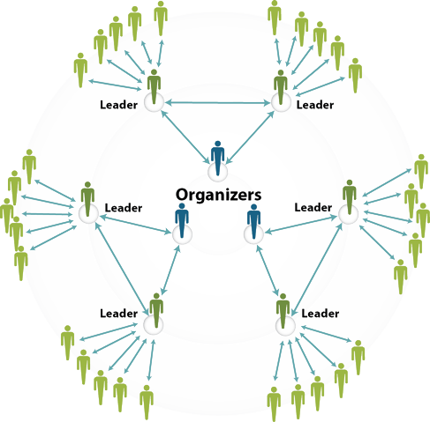
Starting with Common Understandings:
Organizing is people coming together to collectively create the change they want to achieve; it is people joining together to work toward common goals.
Organizing requires leaders.
Leaders are trusted and respected and have followers.
Leaders connect mobilizers into the structure.

Slide 10

In addition to leaders
Mobilizer – a person actively working on the behalf of the union and carrying out actions that get others involved; they get activists into the work.
Activist – a pro-union supporter who may take action if asked; they see their relationship with their union as a participatory one.

Slide 11
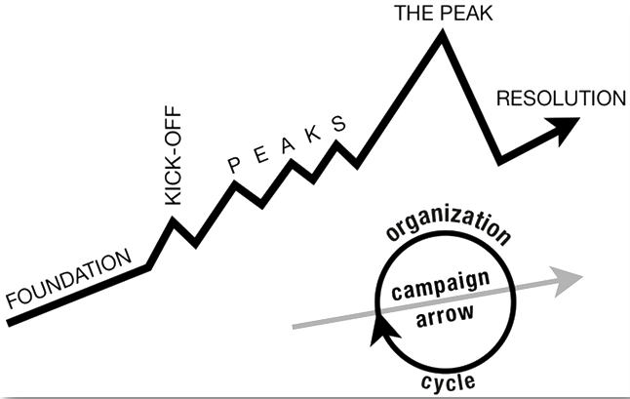
Organizing & Campaigns

Slide 12
Tactics- the Peaks of Campaign Mountain
Tactic: Actions we take as a part of an escalation plan that increases pressure on your target to try to win your demand.
Tactics Must:
Put pressure on your Target (puts them out of their comfort zone)
Build your Power (develops leaders, brings more people in, etc.) * this is our focus today*
Be Strategic

Slide 13

Read through, if you haven’t already, the scenario adapted from Jane McAlevey
Included in the scenario is the description of a tactic in a campaign.
In your breakouts, identify who the leader(s), mobilizer(s), and activist(s) are based on their engagement with the tactic.

Slide 14

Tactics are About More than the Target
Tactics should be used to identify and grow leaders, mobilizers, and activists

Slide 15
Part II:
Coaching through Campaign Tactics
Governance leaders develop new leaders to distribute leadership and "build the bench."
Staff coach governance leaders in this role, and we also surface trusted and respected leaders that we come across through our work.
Notes:
1 minute to intro section

Slide 16

As staff, how would your own willingness to risk failure change, if you didn't consider how your governance and/or your managers might react?
Notes:
Waterfall: Waiting to hit "Enter" on your response, but please put your thoughts on this question into the chat. ​
3 minutes

Slide 17
Coaching through the Campaign
TACTICS
What are some ways that staff can coach governance to find and develop leaders through their choice, planning, and execution of campaign tactics?
Mindset of Distributive Leadership
Steps of the Tactic
Risk / Solidarity
Potential for Failure
Notes:
Zoom Breakout Room: 5 minutes to do content and get into room, 8 minutes in the room, 5 minutes to get them back and debrief answers.
When we think of the "Peaks" on the Campaign Mountain, or Tactics, we have to make sure that we're coaching established leaders on being intentional about how they build tactics, so that no opportunity to engage members or develop emerging leaders is lost.
CLICK TO REVEAL THE ZOOM INFO AND QUESTIONS
We're going to head into a breakout room for about 8 minutes to discuss ways that staff can coach governance to find and develop leaders through their choice, planning, and execution of campaign tactics? Notice we're saving the debrief of the tactics; we'll talk about that in the next section. In your discussion, you might chat about how you:
coach the established member into a mindset of distributive leadership despite the potential leaders being overworked and exhausted;
talk about breaking each tactic down into individual components that are opportunities to develop potential leaders;
discuss the ideal of having high solidarity/turnout for whatever is planned, but that there also might be potential for a higher-risk, visible tactic that might be done by a smaller group (lower turnout/solidarity); and/or
support the veteran leader in remaining open to using tactics that aren't a 100% guaranteed success, so there might be a potential for failure.
Each room will be able to record some thoughts in a Google doc, so that we can preserve and give you back your own wisdom to take back with you. We are dropping a link the chat; someone in each breakout room should make some notes in the table of your discussion. The question is also pasted at the top of the doc.
When back: share screen with document to debrief answers
https://docs.google.com/document/d/19JeTEUCIaSAwq0Q4EERc9JBeCNylAJRAQjW5q8iAkIE/edit?usp=sharing

Slide 18
How we model our willingness to risk failure influences how willing our leaders are to do the same. We need to cultivate a culture of learning from failure in our workplaces.
Established leaders can often feel pressure to "not burden" their members with asks, but it's the only way the work gets done, the work is visible, and future leaders can emerge.
We can coach current leaders to use campaign tactics as an essential way to identify and develop emerging leaders.
Notes:
1 minute to look at key takeaways

Slide 19
Part III: Coaching Through Debriefs
points throughout campaign mountain- always evaluating
Notes:
(Heidi)

Slide 20
We did a thing, now what? →Coaching the Debrief
After each action/tactic, it is crucial to debrief before you escalate up campaign mountain.
Break it down by item, using the same method used to build the action/tactic.
How do you know if you were successful?
And as staff, how do we use this as a coaching opportunity to help the members recognize when they’ve been successful or when to shift their approach?
Notes:
2 mins

Slide 21

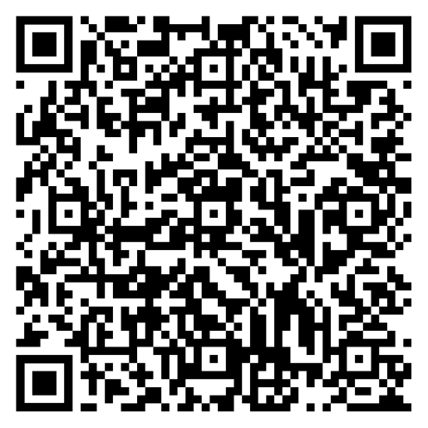
We did a thing, now what? →Coaching the Debrief
Breakdown the tactic in the same way you built it.
  Did you achieve your objective?
  Did you move or impact your target?
  What were successful strategies the lead identified? What challenges did they face?
  Was the location, time, and date appropriate ?
  Did you meet your turnout goal?
    If yes, what strategies helped you be successful?
    If no, what barriers did you encounter and how can we readjust?
  Did it work to achieve your goal? How do you know?
Notes:
See doc as example Debrief Your Tactics.docx
5 mins

Slide 22
Coaching the Debrief
What questions would you ask leaders to help them evaluate each piece of the plan they used to build the action/tactic?
If their action/tactic was successful, what questions might you ask to help them identify what made it successful?
If their action/tactic was not successful, what questions might you ask to help them identify why it was not successful?
Notes:
3 min to get them in rooms
10 mins to chat
2 mins to get them back

Slide 23
Coaching the Debrief-Notes
We didn't meet our objective.
We were successful!
Use coaching questions to help your team through the ‘why’
When they present what went wrong, turn it back to what could we do next time to improve or avoid that issue.
Is there any connection between what doesn’t work and who is involved?
Is there a disconnect between the tactic/action and the goal?
What bright spots can we identify, even if the objective isn’t met?
Your team met their turnout goal or exceeded it.
They identified new individuals with leadership potential or skills.
Is there any connection between what worked and who is involved?
Escalate!
Repeat the process with each tactic/action.
Notes:
5 mins to debrief the breakout

Slide 24
After we win...
You used 1:1s originally, to identify those trusted and respected individuals in worksites.
After you climb the mountain and experience success, breathe, then use your structure to return to the members.
The 1:10 ratio is golden.
Notes:
3 mins

Slide 25
Reach out!
Melissa Dan
Labor Relations Consultant
Palm Beach CTA
Melissa.Dan@floridaea.org
Matt Fargen
UniServ Director
PSEA - Pennsylvania
Mfargen@psea.org
Albert Jones
Organizational Specialist
Maryland State
Education Association
aljones@mseanea.org
Chad Williams
UniServ Consultant
Michigan Education Association
cwilliams@mea.org
Thank you!

