Slide 1

Me and White Supremacy

Slide 2

As You Log On – Introductions Via Chat Window
Please enter your
Name
Required Pronouns
Work Location

Slide 3

Series Overview
4/13 Overview
4/21 Week 1 - Through Page 74
4/27 Week 2 – Through Page 123
5/4Week 3 – Through Page 170
5/11 Week 4 – Through Page 210 and Overall Commitments

Slide 4
Getting Started
Agenda
  Welcome and community building
    How our work is framed
    How we will work together
    How we will schedule the reading

Slide 5

Honoring This Space
We begin by acknowledging that through a history of colonization and brutality, we currently reside on and are connecting from the traditional lands stewarded by generations of indigenous people.
We honor these indigenous people, all elders, past, present, and emerging. We are called to learn and share these learnings about this tribal history, culture, and contributions that have been suppressed in the telling of the story of what we now call the United States of America.

Slide 6
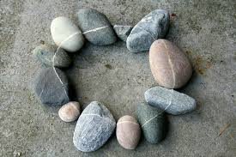
Honoring all of You
Full screen, camera if you can, share your name, your location, AND a six word resume.
Examples of a six word resume:
I am tired but also inspired.
I am moving through COVID time.
Organizer by profession, daughter by birth.

Slide 7
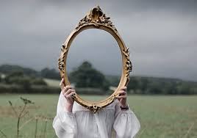
The Intent for this Series
I am inviting you to participate in a five-part series where we explore how to create the change our world needs by creating a change in ourselves.

Slide 8
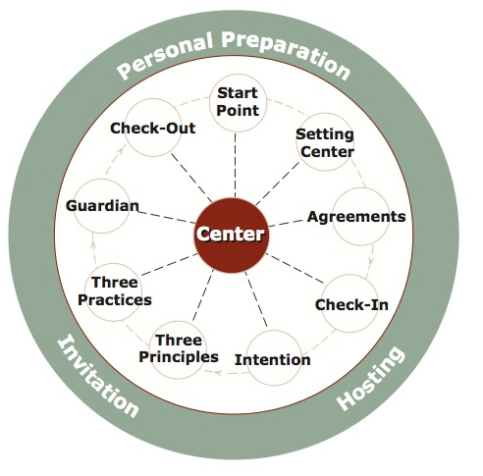
Our Process
Circle Components
“What transforms a meeting into a circle is the willingness of the people to shift from informal socializing or opinionated discussion into a receptive attitude of thoughtful speaking and deep listening.”

Slide 9

Opening for Tonight
“Everything the power of the world does is done in a circle. The sky is round, and I have heard that the Earth is round like a ball and so are all the stars. The wind, in its greatest power, whirls. Birds make their nests in circles, for theirs is the same religion as ours. The sun comes forth and goes down again in a circle. The moon does the same and both are round. Even the seasons form a great circle in their changing and always come back again to where they were.”
Chief Black Elk, Holy Man of the Oglala Sioux

Slide 10

Our Center

Slide 11
Our Agreements
We hold all stories or personal material in confidentiality.
We listen to one another with compassion and curiosity.
We ask for what we need and we offer what we can.
We agree to employ a group guardian to watch our needs, timing, and energy.
We agree to pause at a signal and when we feel the need to pause.

Slide 12
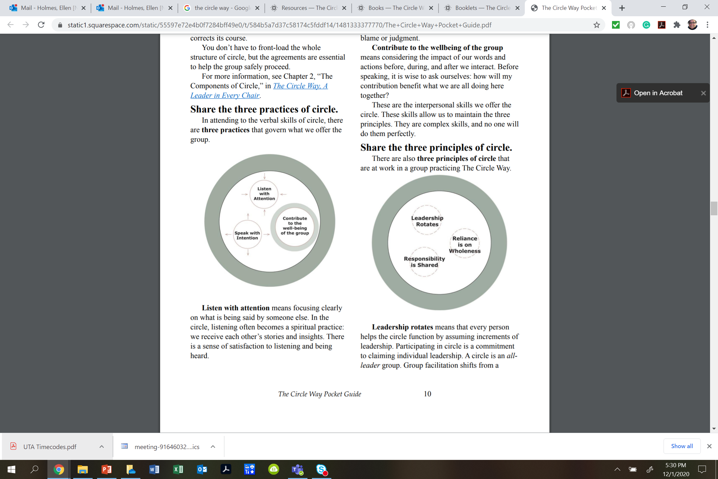
3 Practices

Slide 13
3 Principles

Slide 14
How will we accomplish this –
Whole Group Convenes
Small Group – Focus on the Book
Whole Group – Bring Something Back (Pick a reporter FIRST)
Whole Group Closing

Slide 15
3 Roles for Every Circle
Host: The person who issues the invitation, prepares the space where a circle conversation will be held (setting the rim and center), helps define the scope of conversation, and then participates in it from a position of peer leadership.
Guardian: A volunteer who teams with the host to help the circle stay centered and intentional. They build in pauses discussed in our fourth agreement. A signal is made twice: once to stop the action — a few seconds of observed pause — followed by a second bell that signals return to interaction. The guardian then speaks to the reason for pausing. Anyone can ask the guardian to initiate a pause.
Reporter: A circle participant(s) who agrees to preserve insights and notes decisions and actions. Rather than having a single scribe, responsibility for harvesting the conversation is shared by all participants.

Slide 16
Expectations of Circles
Conversation – Free flow
Practices
Talking Piece – Use our Raised Hand
Silence – Freedom to not Speak
Host invites but not requires engagement

Slide 17
Things to Remember Always
It is no one’s responsibility to justify their reality or satisfy your curiosity.
If you are curious, write it down and do some research outside of this
White fragility and white supremacy culture behaviors will sneak in – challenge these in yourself and others.
In a circle – every place holds a leader.

Slide 18
Open Conversation – Small Group
Determine your roles – Host, Guardian, Reporter
Discussion foci:
Who are you?(Name and Place quickie)
What brings you to participate in this case study of Layla Saads work?
What do you think will be your biggest challenges and rewards for participating in this series?
Prepare your reporter:
Who will speak for this group in the large circle ?

Slide 19
Whole Group
Round 1: What does your small circle have to give to the whole? (One person from each group)
Remember to use your raised hand icon when speaking, and to turn it off when you are not speaking.
Round 2: Anyone have a connection, reflection, or wondering to give to the whole group?
Again, used the raised hand icon when you are speaking, and to turn it off when you are not speaking

Slide 20
Closing
What is the weather like in your mind right now as a result of tonight’s meeting?

