Slide 1

Me and White Supremacy

Slide 2
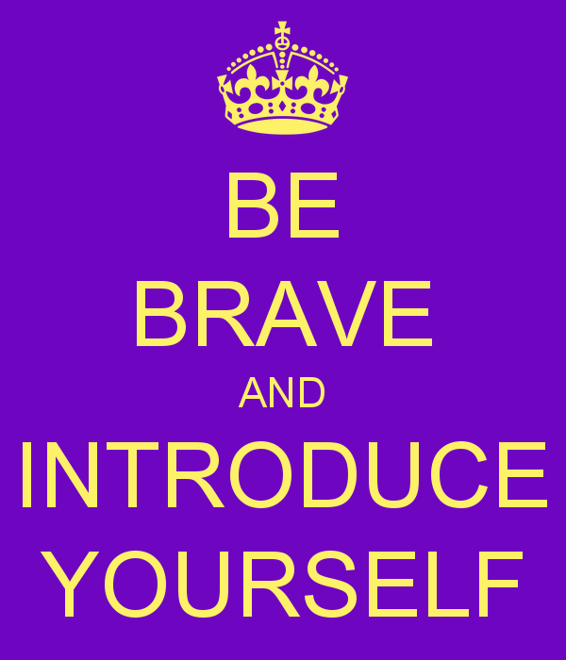
As You Log On – Introductions Via Chat Window
Please enter your
Name
Required Pronouns
Work Location

Slide 3
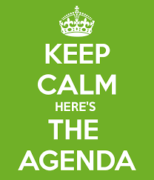
Series Overview
4/13 Overview
4/21 Week 1 - Through Page 74
4/27 Week 2 – Through Page 123
5/4Week 3 – Through Page 170
5/11 Week 4 – Through Page 210 and Overall Commitments

Slide 4
Getting Started
Agenda
  Welcome
  Whole Group Overview
  Small Group Book Discussion
  Whole Group Debriefing
  Closing

Slide 5

Honoring This Space
We begin by acknowledging that through a history of colonization and brutality, we currently reside on and are connecting from the traditional lands stewarded by generations of indigenous people.
We honor these indigenous people, all elders, past, present, and emerging. We are called to learn and share these learnings about this tribal history, culture, and contributions that have been suppressed in the telling of the story of what we now call the United States of America.

Slide 6
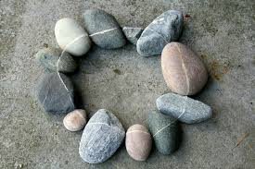
Honoring all of You
Full screen, camera if you can, share your name, your location, AND a six word resume.
Examples of a six word resume:
I am tired but also inspired.
I am moving through COVID time.
Organizer by profession, daughter by birth.

Slide 7
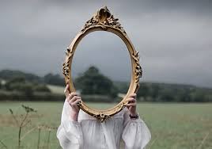
The Intent for this Series
I am inviting you to participate in a five-part series where we explore how to create the change our world needs by creating a change in ourselves.

Slide 8

Our Center

Slide 9
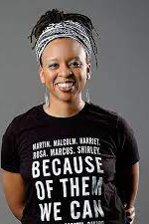
Opening for Tonight
Invitation to Brave Space
by Micky ScottBey Jones
Together we will create brave space.
Because there is no such thing as a “safe space” —
We exist in the real world.
We all carry scars and we have all caused wounds.
In this space
We seek to turn down the volume of the outside world,
We amplify voices that fight to be heard elsewhere,
We call each other to more truth and love.
We have the right to start somewhere and continue to grow.
We have the responsibility to examine what we think we know.
We will not be perfect.
This space will not be perfect.
It will not always be what we wish it to be.
But
It will be our brave space together,
and
We will work on it side by side.

Slide 10
Our Agreements
We hold all stories or personal material in confidentiality.
We listen to one another with compassion and curiosity.
We ask for what we need and we offer what we can.
We agree to employ a group guardian to watch our needs, timing, and energy.
We agree to pause at a signal and when we feel the need to pause.

Slide 11
Things to Remember Always
It is no one’s responsibility to justify their reality or satisfy your curiosity.
If you are curious, write it down and do some research outside of this
White fragility and white supremacy culture behaviors will sneak in – challenge these in yourself and others.
In a circle – every place holds a leader.

Slide 12
How will we accomplish this –
Whole Group Convenes
Small Group – Focus on the Book
Whole Group – Bring Something Back (Pick a reporter FIRST)
Whole Group Closing

Slide 13
3 Roles for Every Circle
Host: The person who issues the invitation, prepares the space where a circle conversation will be held (setting the rim and center), helps define the scope of conversation, and then participates in it from a position of peer leadership.
Guardian: A volunteer who teams with the host to help the circle stay centered and intentional. They build in pauses discussed in our fourth agreement. A signal is made twice: once to stop the action — a few seconds of observed pause — followed by a second bell that signals return to interaction. The guardian then speaks to the reason for pausing. Anyone can ask the guardian to initiate a pause.
Reporter: A circle participant(s) who agrees to preserve insights and notes decisions and actions. Rather than having a single scribe, responsibility for harvesting the conversation is shared by all participants.

Slide 14
Expectations of Circles
Conversation – Free flow
Practices
Talking Piece – Use our Raised Hand
Silence – Freedom to not Speak
Host invites but not requires engagement

Slide 15
Open Conversation – Small Group
Determine your roles – Host, Guardian, Reporter
What have these last sessions taught you about –
  how white supremacy works through you?
  the dehumanizing ways you think about or treat (or experience as a) BIPOC and why?
  you and anti-blackness?
Prepare who will speak for the group in the large circle

Slide 16
Whole Group
Round 1: What does your small circle have to give to the whole? (One person from each group)
Remember to use your raised hand icon when speaking, and to turn it off when you are not speaking.
Round 2: Anyone have a connection, reflection, or wondering to give to the whole group?
Again, used the raised hand icon when you are speaking, and to turn it off when you are not speaking

Slide 17

Closing
From The Crow Girl by Bodil Bredsdorff
“You will find two kinds of people in this world. Some say there are the bad and the good. But it isn’t like that. Since what is good for one may be bad for another. No, that doesn’t work.
You have to depend on your intuition.”
“There are those who make you feel inside as if you are drinking a good, warm soup-even if you are hungry and the two of you have nothing to eat. In spite of that, they nourish you.”
“And then there are others who cause you to freeze inside, even if you are sitting before a roaring fire and have eaten your fill. Those you should keep away from. They are not good for you, even though others might say that they are good people. Remember that, my chick.”

