Slide 1

Me and White Supremacy

Slide 2
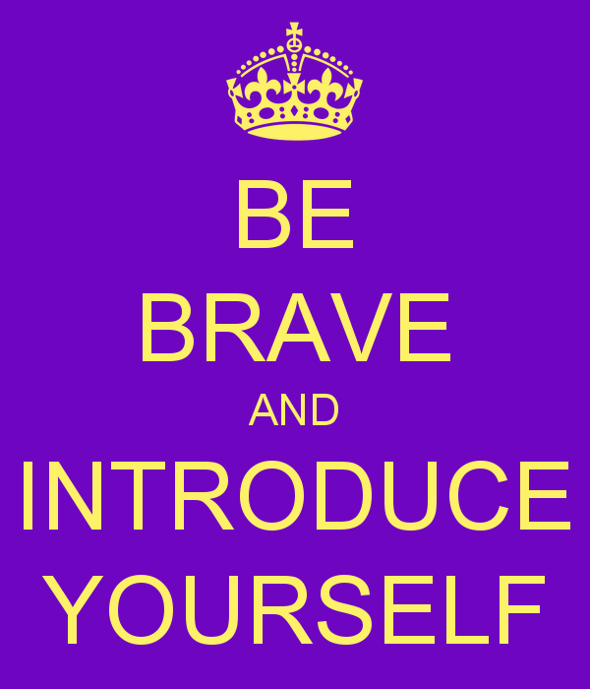
As You Log On – Introductions Via Chat Window
Please enter your
Name
Required Pronouns
Work Location

Slide 3
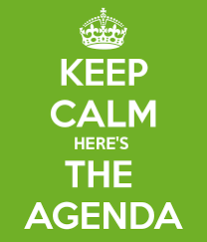
Series Overview
4/13 Overview
4/21 Week 1 - Through Page 74
4/27 Week 2 – Through Page 123
5/4Week 3 – Through Page 170
5/11 Week 4 – Through Page 210 and Overall Commitments

Slide 4
Getting Started
Agenda
  Welcome
  Whole Group Overview
  Small Group Book Discussion
  Whole Group Debriefing
  Closing

Slide 5

Honoring This Space
We begin by acknowledging that through a history of colonization and brutality, we currently reside on and are connecting from the traditional lands stewarded by generations of indigenous people.
We honor these indigenous people, all elders, past, present, and emerging. We are called to learn and share these learnings about this tribal history, culture, and contributions that have been suppressed in the telling of the story of what we now call the United States of America.

Slide 6
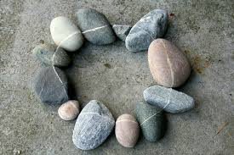
Honoring Your Power
Full screen, camera if you can, share your name, your location, AND a verbal check-in.
My name is __________ and I am from __________. One thing you cannot tell just by looking at me is __________. This is important for me to tell you because_______.

Slide 7
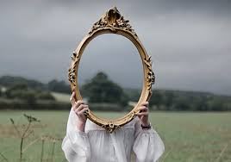
The Intent for this Series
I am inviting you to participate in a five-part series where we explore how to create the change our world needs by creating a change in ourselves.

Slide 8

Our Center

Slide 9
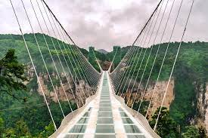
Opening our Circle
ALLY is a verb. Take action or you will find that you are not just failing the movement but perpetuating the violence with your silence.
- Author unknown

Slide 10
Our Agreements
We hold all stories or personal material in confidentiality.
We listen to one another with compassion and curiosity.
We ask for what we need and we offer what we can.
We agree to employ a group guardian to watch our needs, timing, and energy.
We agree to pause at a signal and when we feel the need to pause.

Slide 11
Things to Remember Always
It is no one’s responsibility to justify their reality or satisfy your curiosity.
If you are curious, write it down and do some research outside of this
White fragility and white supremacy culture behaviors will sneak in – challenge these in yourself and others.
In a circle – every place holds a leader.

Slide 12
How will we accomplish this –
Whole Group Convenes
Small Group – Focus on the Book
Whole Group – Bring Something Back (Pick a reporter FIRST)
Whole Group Closing

Slide 13
3 Roles for Every Circle
Host: The person who issues the invitation, prepares the space where a circle conversation will be held (setting the rim and center), helps define the scope of conversation, and then participates in it from a position of peer leadership.
Guardian: A volunteer who teams with the host to help the circle stay centered and intentional. They build in pauses discussed in our fourth agreement. A signal is made twice: once to stop the action — a few seconds of observed pause — followed by a second bell that signals return to interaction. The guardian then speaks to the reason for pausing. Anyone can ask the guardian to initiate a pause.
Reporter: A circle participant(s) who agrees to preserve insights and notes decisions and actions. Rather than having a single scribe, responsibility for harvesting the conversation is shared by all participants.

Slide 14
Expectations of Circles
Conversation – Free flow
Practices
Talking Piece – Use our Raised Hand
Silence – Freedom to not Speak
Host invites but not requires engagement

Slide 15
Open Conversation – Small Group
Determine your roles – Host, Guardian, Reporter
Discussion :
What three (3) concrete, out-of-your-comfort zone actions are you committed to taking towards antiracism in the next couple of weeks?
Where are you starting to do your anti-racism work and where are you still holding back?
Prepare who will speak for the group in the large circle

Slide 16
Whole Group
Round 1: What does your small circle have to give to the whole? (One person from each group)
Remember to use your raised hand icon when speaking, and to turn it off when you are not speaking.
Round 2: Anyone have a connection, reflection, or wondering to give to the whole group?
Again, used the raised hand icon when you are speaking, and to turn it off when you are not speaking

Slide 17
Closing
What is a positive hope or anticipation you have for our next circle?
Last Session Overall Discussion – Through Page 210
Be Prepared to Enter your Commitment for Change in a Google Doc before next meeting – more info to come from Ellen.

Slide 18
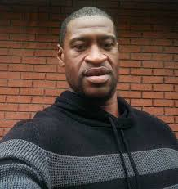
Closing thoughts…
Race and racism is a reality that so many of us grow up learning to just deal with. But if we ever hope to move past it, it can’t just be on people of color to deal with it. It’s up to all of us – Black, white, everyone – no matter how well-meaning we think we might be, to do the honest, uncomfortable work of rooting it out. It starts with self-examination and listening to those whose lives are different from our own. It ends with justice, compassion, and empathy that manifests in our lives and on our streets."
– Michelle Obama in a statement following the harrowing death of George Floyd

