Slide 1

Me and White Supremacy

Slide 2

As You Log On – Introductions Via Chat Window
Please enter your
Name
Required Pronouns
Work Location

Slide 3

Tonight is Different
4/13 Overview
4/21 Week 1 - Through Page 74
4/27 Week 2 – Through Page 123
5/4Week 3 – Through Page 170
5/11 Week 4 – Through Page 210 and Overall Commitments

Slide 4

Honoring This Space
We begin by acknowledging that through a history of colonization and brutality, we currently reside on and are connecting from the traditional lands stewarded by generations of indigenous people.
We honor these indigenous people, all elders, past, present, and emerging. We are called to learn and share these learnings about this tribal history, culture, and contributions that have been suppressed in the telling of the story of what we now call the United States of America.

Slide 5
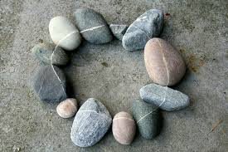
Honoring Your Growth
Full screen, camera if you can, share your name, your location, AND a verbal check-in.
Share one personal change you notice as a result of participating in this series.

Slide 6
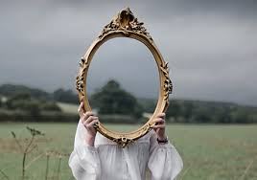
The Intent for this Series
I am inviting you to participate in a five-part series where we explore how to create the change our world needs by creating a change in ourselves.

Slide 7

Our Center

Slide 8
Opening our Circle

Slide 9
Our Agreements
We hold all stories or personal material in confidentiality.
We listen to one another with compassion and curiosity.
We ask for what we need and we offer what we can.
We agree to employ a group guardian to watch our needs, timing, and energy.
We agree to pause at a signal and when we feel the need to pause.

Slide 10
Things to Remember Always
It is no one’s responsibility to justify their reality or satisfy your curiosity.
If you are curious, write it down and do some research outside of this
White fragility and white supremacy culture behaviors will sneak in – challenge these in yourself and others.
In a circle – every place holds a leader.

Slide 11
How will we accomplish this –
Whole Group Only

Slide 12
Expectations of the Circle
Conversation – Free flow
Practices
Talking Piece – Use our Raised Hand
Silence – Freedom to not Speak
Host invites but not requires engagement

Slide 13
3 Roles for Every Circle
Host: The person who issues the invitation, prepares the space where a circle conversation will be held (setting the rim and center), helps define the scope of conversation, and then participates in it from a position of peer leadership.
Guardian: A volunteer who teams with the host to help the circle stay centered and intentional. They build in pauses discussed in our fourth agreement. A signal is made twice: once to stop the action — a few seconds of observed pause — followed by a second bell that signals return to interaction. The guardian then speaks to the reason for pausing. Anyone can ask the guardian to initiate a pause.
Reporter: A circle participant(s) who agrees to preserve insights and notes decisions and actions. Rather than having a single scribe, responsibility for harvesting the conversation is shared by all participants.

Slide 14
Closing
What is a specific gratitude that you have that you have not yet shared with someone in this group?

