Slide 1
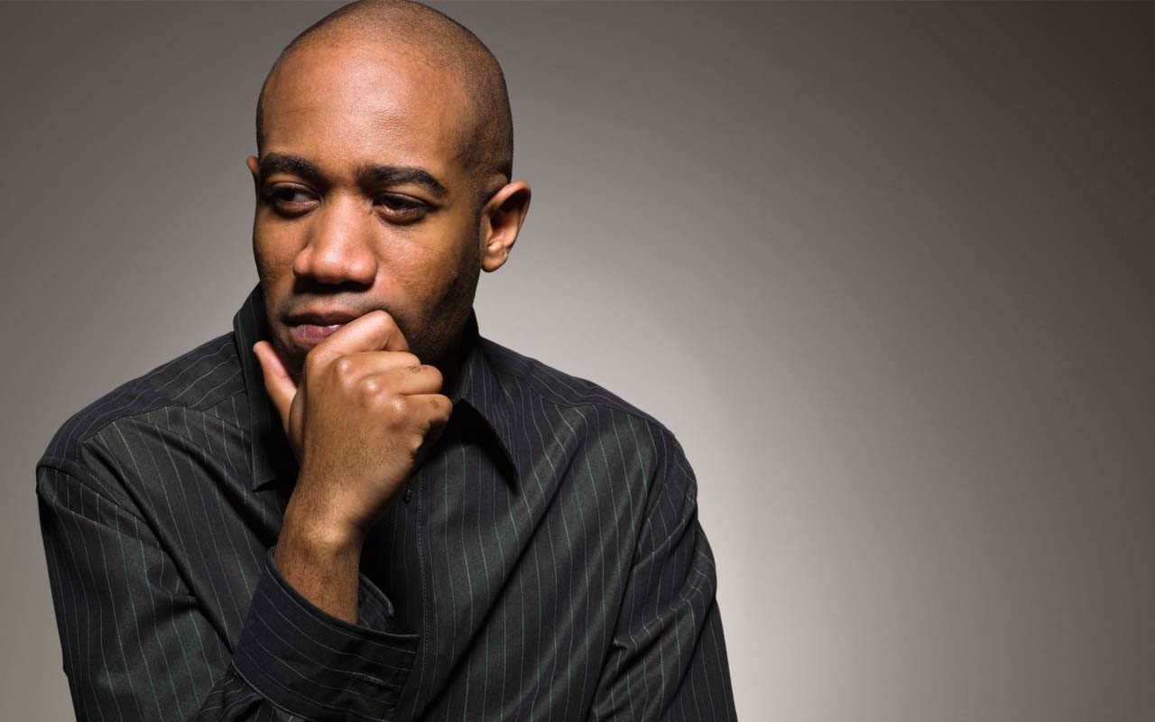
Entry Activity
What do you know about really effective advocacy?

Slide 2
Organizing through Advocacy
UniServ Focus Academy
Notes:
Ellen

Slide 3

Honoring This Space
We begin by acknowledging that through a history of colonization and brutality, we are currently on the traditional lands stewarded by generations of the O'Odham and Piipaash, Salt River Pima Mericopa, Gila River Indian Community.
We honor these indigenous people, all elders, past, present, and emerging. We are called to learn and share these learnings about this tribal history, culture, and contributions that have been suppressed in the telling of the story of what we now call the United States of America.
Notes:
Ellen

Slide 4

Why are we here?
Notes:
Ellen

Slide 5

Meet the Team and
Each Other
Notes:
Ellen

Slide 6

Three Day Agenda Overview
Days 1-2
  Convene at 8:30
  Lunch from Noon to 1:00
  15 Min Breaks at 10:00 and 2:00
  4:30 to 5:00 Networking
  5:00 Adjourn
Day 3
Lunch is a boxed lunch at 1:00 PM
1:00 PM Adjourn, no flights before 3:30
Notes:
Ellen

Slide 7
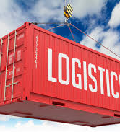
Logistics to Remember
Parking Lot
Bathroom Location
Materials
Food
Room Temp
Karla as Resource
Questions?
Notes:
Ellen

Slide 8

Community Agreements p. 2-3
Using Self-Awareness and Self-Knowledge
Listening for Understanding
Being Gracious
Staying Engaged
Being Open and Suspend Judgment
Saying “I”- tell your truth
Seeking Discomfort
Reaching Empathy
Expecting Non-Resolution and Non-Closure
*Adapted from “Embracing equity and inclusion”, Annie E. Casey Foundation
Notes:
Ellen
Community Agreements for Our Time
Awareness and Self-Knowledge
This requires self-knowledge and self-awareness. Self-knowledge allows you to see what causes you pain and conflict and enables you to embrace your contradictions and inconsistencies. It allows the space to work on things about yourself that you are not happy with. In turn, self-knowledge helps to prevent you from projecting your negative aspects onto other people. Bringing your best self also requires that you have a positive attitude, are willing to deeply explore your perspectives and remain open to the perspectives and experiences of others.
Listening for Understanding
Be an active listener. Active listening involves paying full and careful attention to the other person, looking him or her in the eye, avoiding interruptions, reflecting your understanding, clarifying information, summarizing the other person’s perspectives and sharing your own. Remember that most people need time to open up and might not be willing to immediately share their personal stories, hopes, fears and/or concerns.
Being Gracious
Being kind is a vital way of bringing meaning to our own lives, as well as the lives of others. Kindness is about caring genuinely for others around you, wanting the best for them and recognizing in them the same wants, needs, aspirations and even fears that you may have. Being kind and generous allows us to communicate better with others, to be more self-compassionate and to be a positive force in other people’s lives. This includes following the COVID protocols that are in place to protect the health of this learning community.
Stay Engaged
Staying engaged requires you to be morally, emotionally, intellectually and socially involved in the conversation. Staying engaged means that you are listening with curiosity and willing to deepen your understanding. Staying engaged might also require you to sustain the conversation even when it gets uncomfortable or diverted. This also means a commitment to keeping your electronic communications to a minimum with folks not present in this learning community.
Be Open and Suspend Judgment
Listening with an open mind includes being receptive to the influence of others. You can suspend judgment by becoming aware of preconceived notions and listening to everything someone has to say before jumping to conclusions. Most importantly, suspending judgment also means listening to what the speaker has to say for understanding, not just to determine whether the speaker is right or wrong.
Say “I”- tell your truth
Speaking your truth in authentic and courageous conversations about race requires a willingness to take risks. It means that you will be absolutely honest and candid about your own thoughts, feelings, experiences and opinions and not just saying what you perceive others want to hear. Speaking your truth will require you to speak from the “first person” and use “I” statements.
Seek Discomfort
Leaning in to discomfort will require you to let go of racial understandings and stereotypes that you may be holding onto in order to move forward. Leaning in means that you will avoid judgment, assume positive intent and be open to the kernel of wisdom in each individual’s experiences. Leaning in to discomfort will require you to sit through moments of embarrassment, confusion, anxiety and/or fear.
Reaching Empathy
Empathy and compassion allow you to understand the other person’s point of view. When you are empathetic, you are more understanding, patient and kind. Expanding your capacity to feel empathy will also allow others to enter your circle of human concern.
Resolution and Closure
Expect and accept that there may not be closure. It is not likely that you will resolve your personal understanding about race or another person’s racial experience in a single conversation. The more you talk about race with another person, the more you learn and the more they will learn. Authentic and productive conversations about race are continuous and always evolving.
*Adapted from “Embracing equity and inclusion”, Annie E. Casey Foundation

Slide 9

Agenda Review - Today
8:30-10:00 Introductions, Getting Started, Reflection
10:00-10:15 Break
10:15-12:00 Levels of Org., Problem Solving
12:00-1:00 Lunch
1:00-2:15 Grievance Scenarios
2:00-2:15 Break
2:30-4:15 Hearing Grievances, Prep for Bd. Hearing
4:15-4:30 Final Thoughts, Prep for Tomorrow
Notes:
Ellen

Slide 10
August

Slide 11

Fold the Line
Name, Pronouns, Location
What do you know about really effective advocacy?
Notes:
August

Slide 12
Seleste

Slide 13

Where do you stand?
Notes:
Seleste
Prep Work
* Make 4 signs that say "Litigator, Guide on the Side, Fixer, and Strategic Organizer"
Slide Allocation: 1 minute
For the next few minutes we are going to move and visually answer the questions of, "what are the challenges with advocacy in your/our worklife?"

Slide 14
The Litigator
The Guide on the Side
The Strategic Organizer
The Fixer
Notes:
Seleste
Slide Allocation: 5 minutes
Look on the wall, you should see 4 compass points with the roles that UniServ play
The Litigator- mount cases that will result in legal decisions and policy wins for members
The Guide on the Side –support and train members who handle advocacy at the worksite and affiliate level
The Fixer – work with management to solve problems quickly and effectively
The Strategic Organizer – turn individual issues into collective issues for organizing.

Slide 15
Corner Discussion
Three Prompts for Three Rounds
Where are you most comfortable most of the time?
Where does your manager expect you to be most of the time?
Where do leaders and members expect you to be most of the time?
DISCUSS – Why do you feel this way?
Notes:
Seleste
Slide allotment: 8 minutes
You are going to answer the question by physically moving to the quadrant that best applies to your work situation.
In a minute, not until I say "go," you are going to move to your quadrant. Once there, please introduce yourself and tell each other why you feel this way.
Slide allocation: 8 minutes to talk in the corner groups.
Debrief question: Why did you select this response?
Debrief time 5 minutes

Slide 16
What does it all mean?
For each corner consider –
Who has the power?
Who is the story about?
How many people are engaged?
Notes:
Seleste
Slide allotment: 5 minutes

Slide 17
Corner Discussion
Three Prompts for Three Rounds
Where are you most comfortable most of the time?
Where does your manager expect you to be most of the time?
Where do leaders and members expect you to be most of the time?
DISCUSS – Why do you feel this way?
Notes:
Seleste
Slide allotment: 8 minutes
You are going to answer the question by physically moving to the quadrant that best applies to your work situation.
In a minute, not until I say "go," you are going to move to your quadrant. Once there, please introduce yourself and tell each other why you feel this way.
Slide allocation: 8 minutes to talk in the corner groups.
Debrief question: Why did you select this response?

Slide 18
What does it all mean?
For each corner consider –
Who has the power?
Who is the story about?
How many people are engaged?
Notes:
Seleste
Slide allotment: 5 minutes

Slide 19
Corner Discussion
Three Prompts for Three Rounds
Where are you most comfortable most of the time?
Where does your manager expect you to be most of the time?
Where do leaders and members expect you to be most of the time?
DISCUSS – Why do you feel this way?
Notes:
Seleste
Slide allotment: 8 minutes
You are going to answer the question by physically moving to the quadrant that best applies to your work situation.
In a minute, not until I say "go," you are going to move to your quadrant. Once there, please introduce yourself and tell each other why you feel this way.
Slide allocation: 5 minutes to talk in the corner groups.
Debrief question: Why did you select this response?

Slide 20
What does it all mean?
For each corner consider –
Who has the power?
Who is the story about?
How many people are engaged?
Notes:
Seleste
Slide allotment: 5 minutes

Slide 21

Key Points
Balancing the short-term individual needs with long term system needs is difficult but necessary.
Work to lean towards the corner that builds the most power.
Notes:
Seleste

Slide 22
Steven

Slide 23
Explore the Unorganized to Fighting Union Continuum p. 4
Unorganized
Club
Union
Fighting Union
Notes:
Steven

Slide 24

BREAK

Slide 25
Steven

Slide 26
Discuss the Unorganized to Fighting Union Continuum at Your Table
Unorganized
Club
Union
Fighting Union
Notes:
Steven

Slide 27
Whole Room
What did you notice?
Notes:
Steven

Slide 28

Assessing Your Local p.4
Think of one local you work with facing a significant challenge.
Step 1 – On your own, take 5 minutes to assess where one of your locals is on the Unorganized to Fighting Union continuum – especially as it relates to advocacy.
Step 2 – Table Discussion, 10 minutes to share at your table what your findings are.
Notes:
Steven

Slide 29
Let's All Talk
What did you notice?
What surprised you about your assessment?
What are you wondering about?
Notes:
Steven

Slide 30
Key Points
Don’t grieve in silence
When your union fights members need to know
When you handle advocacy at an individual level, the real winner is the boss
Notes:
Steven

Slide 31
Vanessa

Slide 32
Problem-Solving
Notes:
Vanessa

Slide 33

Remember the four corners?
Issues and complaints require problem solving, and problem solving has distinct components.
Problem-solving is all our jobs.
Notes:
Vanessa

Slide 34
Problem Solving Model
6 Steps
Problem Identification
Develop Alternative Solutions
Choose Solution and Actions
Implementation
Evaluation
Problem Analysis
Notes:
Vanessa

Slide 35
Problem-Solving Steps
When Individual is the Center
Problem Identification – Step 1
What happened?
Where?
When?
Why?
Problem Analysis – Step 2
Contract/policy/handbook
Laws
Brainstorm Possible Solutions– Step 3
Adversarial or collaborative?
Grievance remedies
Ways to solve the problem & the cost/benefits associated with each
Past practices
Who?
How?
Venting?
Organizing remedies
Notes:
Vanessa

Slide 36
Problem Solving Steps – Individual (continued)
Choose Solution and Actions – Step 4
Member needs
Association needs/procedures
District needs
Resources
Implementation – Step 5
When?
Where?
Evaluation – Step 6
What happened?
Did it work?
Feedback?
Who does what?
What's your remedy
Notes:
Vanessa

Slide 37
Pitfalls to Resolving Conflicts
Not handling emotions first.
Failing to identify hidden agendas.
Not defining the problem/clarifying the issues.
Insufficient or disrupted brain-storming.
Ending prematurely.
Lack of follow-up.
Not engaging members /building leaders throughout the process
Notes:
Vanessa

Slide 38
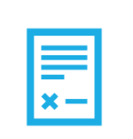
Initial Analysis & Interpretation of Contract/Policies
Contract
History/Past Practice
Local Board Policy
Keep an open mind/allow for creativity
Notes:
Vanessa

Slide 39
A couple key terms for discipline
Notes:
Vanessa

Slide 40

Garrity Rights
If allegations can also lead to potential
criminal charges, invoke Garrity Rights which protect public employees from being compelled to incriminate themselves during investigatory interviews conducted by their employers.
5th Amendment Protection.
Notes:
Vanessa
This protection stems from the fifth and fourteenth to the United States Constitution, which declares that the government cannot compel a person to be a witness against him/herself.
Garrity Rights come into play depends primarily on whether they are compelled to answer questions. If they face little or no penalty and then makes statements, those statements are voluntary. However, if they face a sufficiently severe penalty for refusing to answer, courts would generally hold that those statements were compelled and thus their use in a future criminal proceeding would be unconstitutional.

Slide 41
But it depends...

Slide 42
A “no” answer to any of the below questions means that the employer did not have just cause to discipline the employee.
7 Tests of Just Cause p. 15
1. Did management adequately warn the employee of the consequences of his conduct ?
2. Was management's rule or order reasonably related to efficient and safe operations ?
3. Did management investigate before administering the discipline ?
4. Was the investigation fair and objective ?
5. Did the investigation produce substantial evidence or proof of guilt ?
6. Were the rules, orders and penalties applied evenhandedly and without discrimination to all employees ?
7. Was the penalty reasonably related to the seriousness of the offense and the past record ?
Notes:
Vanessa

Slide 43
Key Points
A formalized problem-solving process helps you ensure nothing is overlooked or omitted.
Notes:
Steven

Slide 44
Bekah

Slide 45
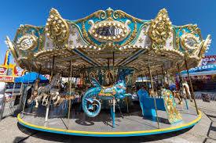
Best Practice Carousel
Using p. 9-21 and your own fabulous knowledge in your group – create a chart about the best practices in handling a grievance
Count by 5's
Notes:
Bekah

Slide 46



Best Practice Carousel-Debrief
WOW!
AGREE
QUESTION?
Notes:
Bekah

Slide 47
Key Points
While there are several ways across states to approach advocacy, being thorough, adhering to a process, and completely documenting advocacy matters are necessary practices.
Notes:
Steven

Slide 48
Toney

Slide 49

Individual Grievance Scenario Intro
You'll be assigned a scenario and team.
This afternoon your teams will each write a Level 1 grievance.
Before Lunch all your teams are doing is getting familiar enough with your assigned scenario.
Notes:
Charles

Slide 50

Scenario Count Off
Count by 6
Scenario 1 - p. 22 Discrimination (1, 2 Teams)
Scenario 4 - p. 51 Academic Freedom (3,4 Teams)
Scenario 5 - p. 64 Professional Development (5,6 Teams)
Read the scenario, skim supplements.
Notes:
Toney

Slide 51
Read Well Enough to Answer the Following
1. Is there a grievance procedure?
2. Are there timelines to consider?
3. Who can be a grievant?
4. Is there a form for your procedure? (p. 10-12, p. 43)
Notes:
Toney

Slide 52
Worktime
15 Minutes
Notes:
Toney

Slide 53

Lunch

Slide 54
Charles

Slide 55
Grievance Statement and Form
Who is involved in the grievance?
When did the grievance occur?
Where did the grievance occur?
Why is this a grievance?
What contract/policy did the action violate?
How to remedy?
Be CONCISE
Notes:
Charles

Slide 56
Words to Remember
Date of grievance "ongoing", when relevant
"All others similarly situated", when relevant
" All other provisions that apply", when relevant
"Any other relief deemed just and proper", when relevant
One most-important note...you will never get an apology, so do not write an apology as a remedy.

Slide 57
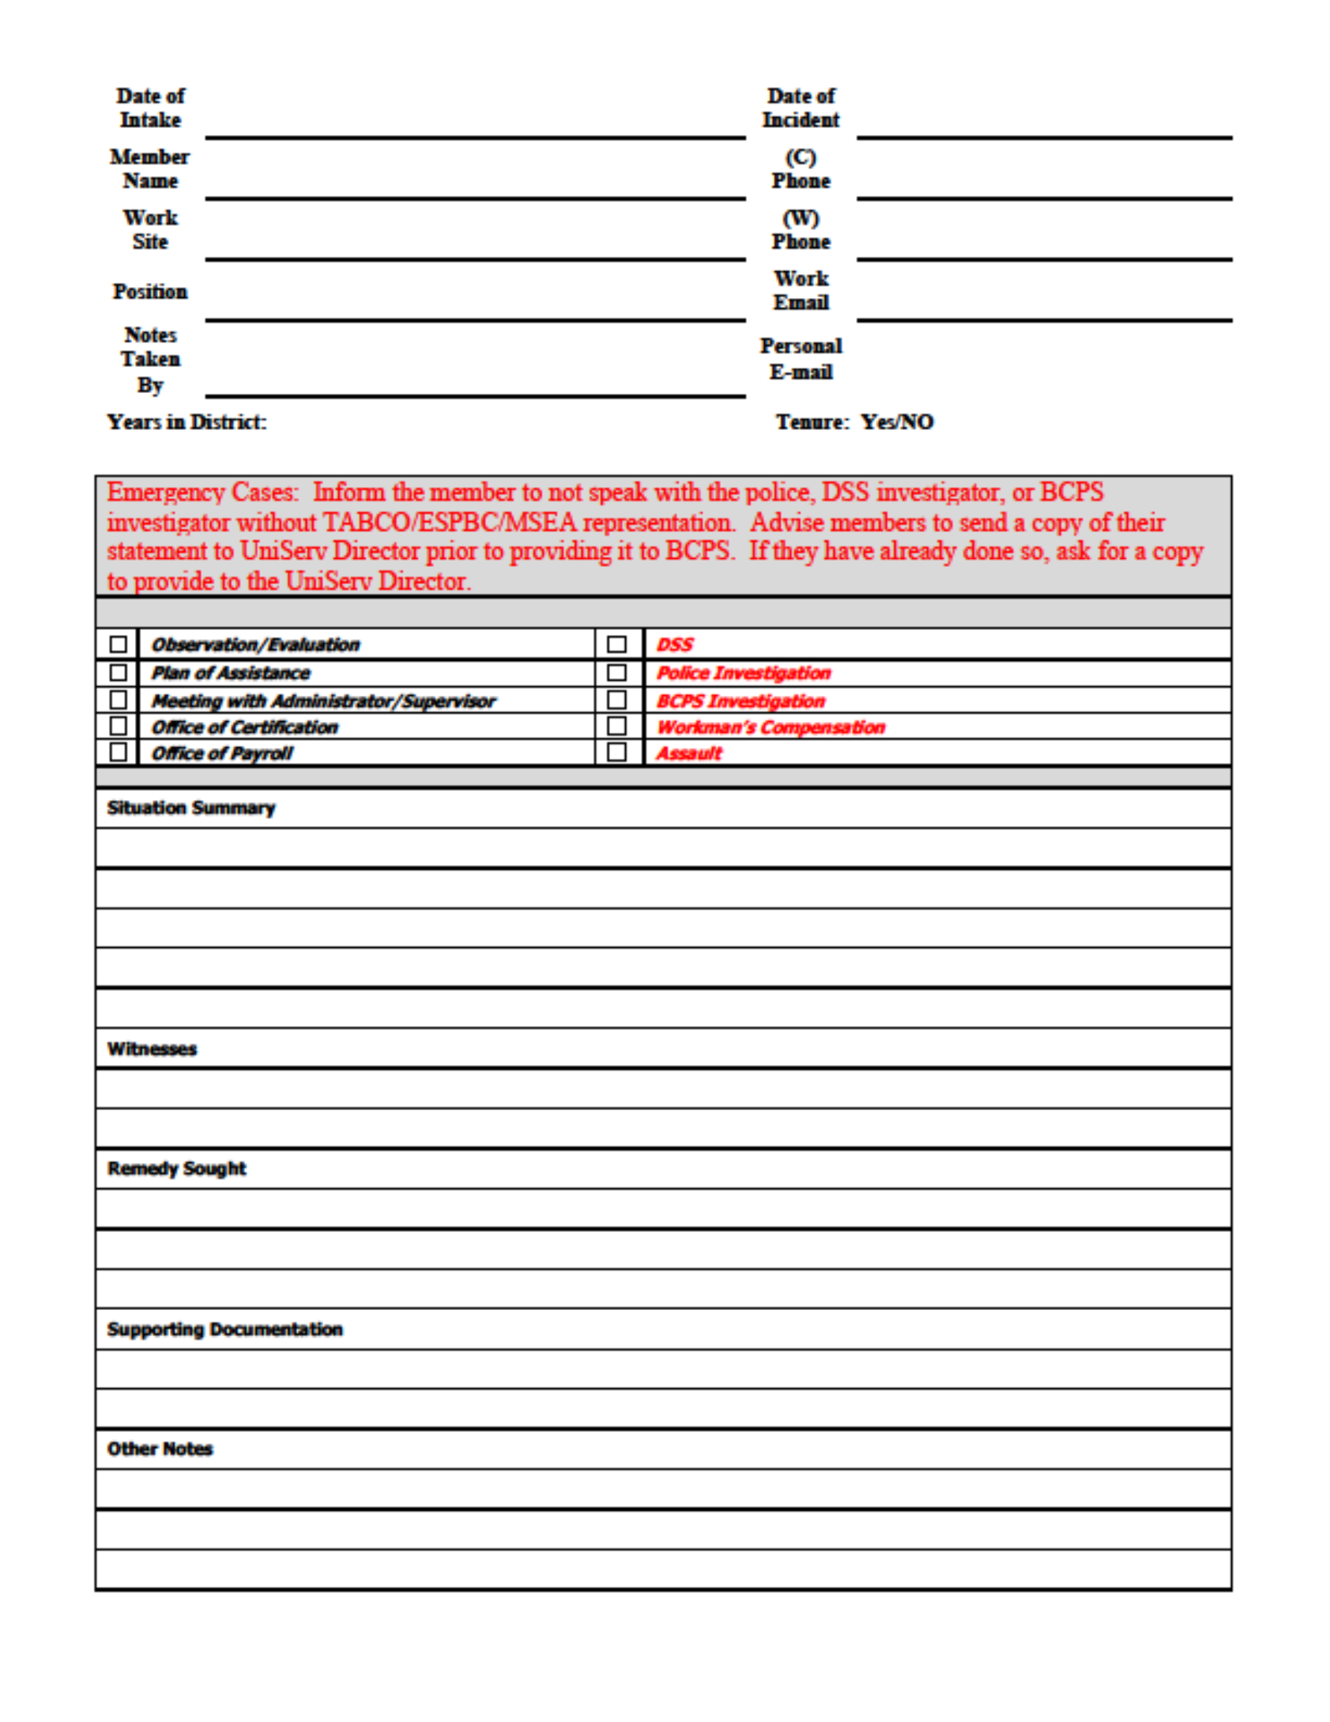
Intake Forms Make the Member a Partner
List of basic questions
Can engage the member more in the process
Can also provide valuable information
Can make the member feel ownership

Slide 58
Scenario-Directions
You will write a Level 1 grievance.
It will be submitted to Principal Ellen Holmes who will summarily deny the grievance.
Eholmes@nea.org
Notes:
Charles

Slide 59
Worktime and Submit to Principal Ellen eholmes@nea.org
Notes:
Charles

Slide 60
Tips for Processing Grievances
Prepare for Step/Level hearings; Investigate and handle every case as though it will eventually end in a School Board Hearing/Arbitration
If it exists, fully inform the grievance committee
Anticipate potential employer responses to grievance
Do not depend on the employer to assume authority for solving problems. Exercise authority and dispose of issues promptly.
NOTE: Often there is an Informal Step prior to the formal Step/Level 1
Be mindful of timelines
Notes:
Charles

Slide 61

DON’T GRIEVE IN SILENCE
If we don’t file grievances for contract violations, we devalue our language, and can make it unenforceable.
Grievances can be an opportunity to organize around an issue, especially when an issue impacts multiple people.
When your union fights, members need to know.
What other things can you do while the grievance process plays out?
Who does it benefit for you to be silent?
Notes:
Charles

Slide 62
Preparing for Steps 1, 2, and 3 Hearings
Arrive early
Be organized
Prepare to articulate the concern in sequential order
Understand and communicate the reason the action violated each policy
Communicate the remedy and rationale for the remedy
Notes:
Charles

Slide 63
Scenario-Directions
Now, prepare how you will present the case at the superintendent/district level.
Notes:
Charles

Slide 64


Group Presentation Time
There are two teams for each scenario because, one team will be the school district while the other team is the Union and then reverse.
Notes:
August

Slide 65
30 Minutes to Prepare Case Presentation
Notes:
Charles

Slide 66
BREAK

Slide 67
August

Slide 68
Group Presentation Time
Group 1 presents Group 2
Group 3 presents Group 4
Group 5 presents Group 6
Then, reverse!
Notes:
August

Slide 69
Group Presentations-Roles
Union
Person 1: Advocate-presents the case (person w/least experience presenting)
Person 2: Grievant
Person 3: Building Rep.
District
Person 1: Superintendent
Person 2: Asst. Superintendent
Person 3: Supervisor/Principal
Notes:
August

Slide 70
Group Presentations-Debrief
What did you take away from listening to your partner group's presentation?
What was challenging as a presenter?
If you were doing this for real, how many workers would be involved on the union side?
Notes:
August

Slide 71
Key Points
Know your grievance procedure.
Use your grievance procedure.
Know how to analyze your CBA/policy.
Connect as many workers as possible to the work of the union, including grievance work.
Notes:
August

Slide 72
Preparing for
School Board Hearings...
Notes:
Charles, Vanessa, Steven

Slide 73
Charles

Slide 74
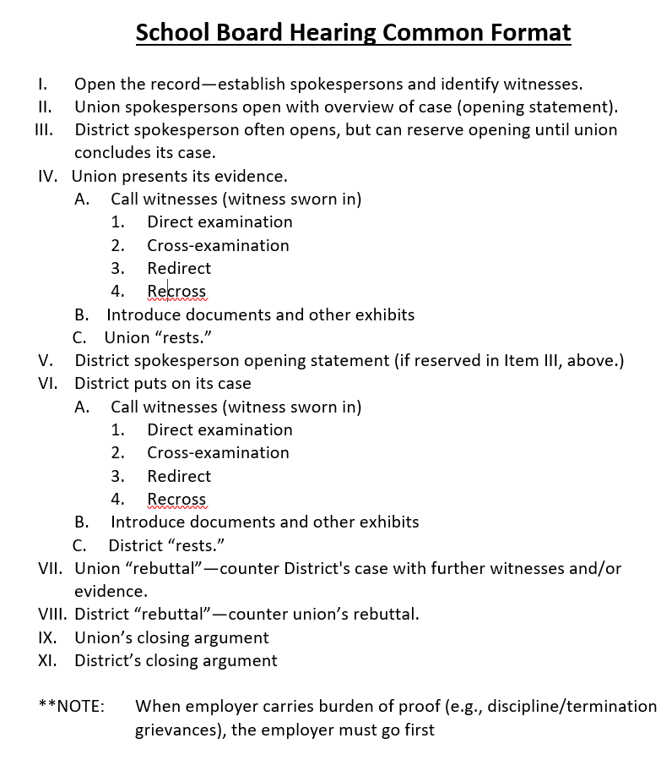
School Board Hearing Common Format
Notes:
Charles, Vanessa, Steven

Slide 75
Writing an Opening Statement
Notes:
Charles, Vanessa, Steven

Slide 76

Opening Statement
Provides a roadmap for the School Board and Hearing Officer
Notes:
Charles, Vanessa, Steven

Slide 77
A Good Opening Statement
Gives description of the district and the bargaining unit​
Gives employment background of grievant and other pertinent information​
States the action which gave rise to the grievance
States the issues to be decided
Notes:
Charles, Vanessa, Steven

Slide 78
A Good Opening Statement, cont.
Summarizes
States the remedy
Identifies the entitlements (contract provisions; laws; practices; etc.)
Explains what you intend to prove and evidence you will introduce grievance
Notes:
Charles, Vanessa, Steven

Slide 79

Write your Opening Statement
15 minutes to write your draft opening statement
Notes:
Charles, Vanessa, Steven

Slide 80
Pair Share: Opening Statement use p. 10 of additional handout.
Present your opening statement to a partner.
Your partner will listen to see if you've touched the key points and ask good clarifying questions when finished.
Notes:
Charles, Vanessa, Steven

Slide 81
Debrief-Opening Statements
What was challenging about presenting this?
What surprised you?
How might you as a UD support your members/leaders in doing this?
Notes:
Charles, Vanessa, Steven

Slide 82
Key Points
Opening Statements provide a roadmap of your case.
Notes:
Charles, Vanessa, Steven

Slide 83

Ending it Right...Ellen
Choice Networking
Housekeeping
Notes:
Ellen

Slide 84

Choice Network Time
Notes:
Ellen

