Slide 1
Organizing Through Advocacy
UniServ Focus Academy
Notes:
Ellen

Slide 2

Entry Activity
Please sit with scenario teams.
Is Advocacy a Service
or is it Organizing?
Notes:
Ellen

Slide 3
Feedback on Feedback
71% response rate – 4.75 to 4.93 ratings highest were for materials and facilitators.
Some themes –
Plus - loved the structure of the day, pleased with the movement, practical and hands on, active engagement, time to discuss with each other.
Miss – coffee, 5:00 PM end time ☺, clear directions in just a couple of spots,
Notes:
Ellen

Slide 4
Feedback on Feedback Your Words
Just a bit more time or understanding that when we were presenting our scenarios to the other team. We knew we would be presenting, but we were not prepared to discuss the "district side" of things.
I love the multiple activities and methods of engagement to allow us as participants be hands on with the work that is practical to take back to our unions.
Maybe more feedback on how we are doing?
I appreciate the time built in for networking and table discussions. I always feel enriched and like my learning is richer when I get to hear from others in different contexts who provide multiple perspectives.
Notes:
Ellen

Slide 5

Agenda Review - Today
8:30-9:00 Reentry, Review Comm. Agreements
9:00-10:00 Questioning
10:00-10:15 Break
10:15-12:00 Questioning, Strengths/Weakness, Interrupting the Grievance Process
12:00-1:00 Lunch
1:00-2:15 Great Advocacy, Our People
2:15-2:30 Break
2:30-4:15 Leaders, Problems/Issues
4:15-4:30 Final Thoughts, Prep for Tomorrow
Notes:
Ellen

Slide 6

Community Agreements p. 2
Using Self-Awareness and Self-Knowledge
Listening for Understanding
Being Gracious
Staying Engaged
Being Open and Suspend Judgment
Saying “I”- tell your truth
Seeking Discomfort
Reaching Empathy
Expecting Non-Resolution and Non-Closure
*Adapted from “Embracing equity and inclusion”, Annie E. Casey Foundation
Notes:
Ellen
Community Agreements for Our Time
Awareness and Self-Knowledge
This requires self-knowledge and self-awareness. Self-knowledge allows you to see what causes you pain and conflict and enables you to embrace your contradictions and inconsistencies. It allows the space to work on things about yourself that you are not happy with. In turn, self-knowledge helps to prevent you from projecting your negative aspects onto other people. Bringing your best self also requires that you have a positive attitude, are willing to deeply explore your perspectives and remain open to the perspectives and experiences of others.
Listening for Understanding
Be an active listener. Active listening involves paying full and careful attention to the other person, looking him or her in the eye, avoiding interruptions, reflecting your understanding, clarifying information, summarizing the other person’s perspectives and sharing your own. Remember that most people need time to open up and might not be willing to immediately share their personal stories, hopes, fears and/or concerns.
Being Gracious
Being kind is a vital way of bringing meaning to our own lives, as well as the lives of others. Kindness is about caring genuinely for others around you, wanting the best for them and recognizing in them the same wants, needs, aspirations and even fears that you may have. Being kind and generous allows us to communicate better with others, to be more self-compassionate and to be a positive force in other people’s lives. This includes following the COVID protocols that are in place to protect the health of this learning community.
Stay Engaged
Staying engaged requires you to be morally, emotionally, intellectually and socially involved in the conversation. Staying engaged means that you are listening with curiosity and willing to deepen your understanding. Staying engaged might also require you to sustain the conversation even when it gets uncomfortable or diverted. This also means a commitment to keeping your electronic communications to a minimum with folks not present in this learning community.
Be Open and Suspend Judgment
Listening with an open mind includes being receptive to the influence of others. You can suspend judgment by becoming aware of preconceived notions and listening to everything someone has to say before jumping to conclusions. Most importantly, suspending judgment also means listening to what the speaker has to say for understanding, not just to determine whether the speaker is right or wrong.
Say “I”- tell your truth
Speaking your truth in authentic and courageous conversations about race requires a willingness to take risks. It means that you will be absolutely honest and candid about your own thoughts, feelings, experiences and opinions and not just saying what you perceive others want to hear. Speaking your truth will require you to speak from the “first person” and use “I” statements.
Seek Discomfort
Leaning in to discomfort will require you to let go of racial understandings and stereotypes that you may be holding onto in order to move forward. Leaning in means that you will avoid judgment, assume positive intent and be open to the kernel of wisdom in each individual’s experiences. Leaning in to discomfort will require you to sit through moments of embarrassment, confusion, anxiety and/or fear.
Reaching Empathy
Empathy and compassion allow you to understand the other person’s point of view. When you are empathetic, you are more understanding, patient and kind. Expanding your capacity to feel empathy will also allow others to enter your circle of human concern.
Resolution and Closure
Expect and accept that there may not be closure. It is not likely that you will resolve your personal understanding about race or another person’s racial experience in a single conversation. The more you talk about race with another person, the more you learn and the more they will learn. Authentic and productive conversations about race are continuous and always evolving.
*Adapted from “Embracing equity and inclusion”, Annie E. Casey Foundation

Slide 7
Charles
Notes:
Steven or Charles

Slide 8
Union Witnesses (Direct Examination)
Prepare your witnesses
Lay your foundation
Use open ended questions
Notes:
Steven or Charles

Slide 9
District's Witnesses (Cross Examination)
Listen and take notes
Objections
Ask leading close-ended questions
Notes:
Steven or Charles

Slide 10
ENTERING DOCUMENTS INTO EVIDENCE
During direct, you will have to get documents in through a witness if you did not stipulate to them initially.
Example:
  Advocate: “Please look at Exhibit A. Can you identify this? "
  Witness: “Yes, I can.”
  Advocate: “What is it?”
  Witness: “An email I received from my principal on May 1, 2021"
  Advocate: “I move to enter this document as Union Exhibit A.
Notes:
Steven or Charles

Slide 11
Steven
Notes:
Steven or Charles

Slide 12

Preparing Questions for a Hearing
Return to your scenario group (1-6) from yesterday.
Direct Examination
Identify 1 aspect of the union's case you want to emphasize through a line of questioning. Develop 5 questions for your witness that will support that aspect of the case.
Cross Examination
Identify 1 aspect of the district's case you anticipate you will need to address on cross-examination. Develop a line of 5 questions for the cross examination of the district's witness.
The team will have 30 minutes to prepare the 2 lines of questions.
Notes:
Steven or Charles

Slide 13

BREAK

Slide 14
Toney
Notes:
Steven or Charles

Slide 15
Time to Do it!
Questions for a Hearing Practice
Each team will have 10 minutes to present their lines of questions to the team they presented their level 2 grievance to yesterday.
1-2
3-4
5-6
Notes:
Toney

Slide 16
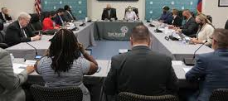
Presenting your Case
Notes:
Toney

Slide 17

Debrief
What was challenging about developing these lines of questions?
What did you learn from observing others?
Even at this level, how many workers would be engaged?
Notes:
Toney

Slide 18
Bekah
Notes:
Steven or Charles

Slide 19
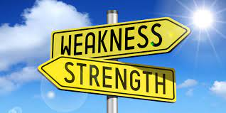
Strengths and Weaknesses
Notes:
Bekah

Slide 20
Strengths and Weaknesses-Directions
Make a T-chart of strengths and weaknesses of doing great advocacy
Notes:
Bekah

Slide 21
Strengths and Weaknesses-Report Out
Notes:
Bekah

Slide 22

Key Points
Great advocacy is necessary but not sufficient
Individual advocacy is only a pathway to effective organizing
Individual advocacy does not build collective power
Notes:
Steven

Slide 23
Steve
Notes:
Steven or Charles

Slide 24
Interrupting the Individual
Grievance Process
Notes:
Steven

Slide 25
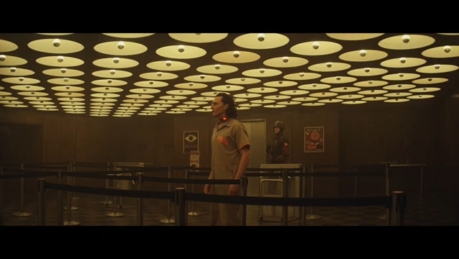
Notes:
Bekah

Slide 26
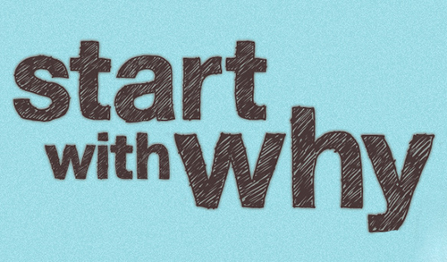
Why do people join their Union?
Notes:
Steven

Slide 27
Problem Solving Model with Organizing
Problem Identification
Develop Alternative Solutions
Choose Solution and Actions
Implementation
Evaluation
Problem Analysis
Notes:
Steven

Slide 28
Problem Solving Steps – Collective p.94
What Is the Problem – Step 1
Why Is It a Problem? – Step 2
How Can the Problem Be Solved? – Step 3
What are other people saying about this?
What does the building rep say about this?
How can we get more people involved?
Is this a symptom of a larger problem?
What are the issues related to this problem?
What are people willing to risk to solve the problem?
Who has the power to provide relief on this problem?
Once this problem is “solved” who will the story be about?
What is a desired outcome?
Notes:
Steven

Slide 29
Problem Solving Steps – Collective p.94
Choose Solution and Actions – Step 4
Implementation – Step 5
Who does what?
When?
Where?
Evaluation – Step 6
What happened?
Did it work?
Feedback?
Impact on the future?
What is the strategic plan for achieving a solution that engages as many people as possible?
Who is the story about?
What do members need to lead on the solution?
What actions are people willing to take that apply pressure?
Notes:
Steven

Slide 30
Key Points
When your union fights, members need to know
Members join unions that are visible
This moves unions toward the fighting union end of the continuum
Notes:
Steven

Slide 31
Ellen
Notes:
Steven or Charles

Slide 32
Three Theories of Change-Jane McAlevey
Advocacy
Mobilizing
Organizing
Notes:
Steven

Slide 33

Theory of Change p.5-8
Step 1 –Which theory would maximize membership?
Step 2 – Share at your table what your findings are.
Notes:
Steven

Slide 34
Debrief
Which theory did you choose?
What does this tell you about advocacy?
What are you wondering about?
Notes:
Steven

Slide 35
A Fighting Union is…
A Union is a group of people affiliated around a common purpose. They are committed to collectively sharing their resources and taking collective risks to achieve the demands they make. Collectively, they believe that they deserve better than their current status.
A strong Union has a structure of people who are in relationship and in communication about workplace dreams, problems, issues, and possible solutions.
Your primary staff union role is to build this.
Notes:
Steven

Slide 36
Key Points
When you handle advocacy at an individual level, the real winner is the boss
Organizing is how workers build power to win
Notes:
Steven

Slide 37

Lunch

Slide 38


Slide 39
Seleste
Notes:
Steven or Charles

Slide 40
Why isn’t great advocacy enough?
Notes:
Seleste

Slide 41

Why isn’t advocacy enough?
Using the two articles found on p. 91, p. 92-93
  Agree with - Underline
  Argue about - Circle
  Aspire to – STAR IT
Notes:
Seleste

Slide 42
Whole Group Discuss
Agree
Argue
Aspire
Notes:
Seleste

Slide 43
Remember this…
“The best measures of powerless union are a large, well-funded, staff-led, lobbying department AND a staff that is focused on answering calls for help. You might win some legal and policy demands – but you will not have enough power to implement them and keep them. You might win some cases for individuals, but you will never have enough leaders to create a just working environment. Power is built through money, position, or people.”
  (Leader from Seattle Education Association)
We have people.
Notes:
Seleste

Slide 44
Vanessa
Notes:
Steven or Charles

Slide 45
Problem Solving Steps – Collective
What Is the Problem – Step 1
What does the building rep say about this?
What are other people saying about this?
How can we get more people involved?
Who are my people?
Notes:
Vanessa

Slide 46
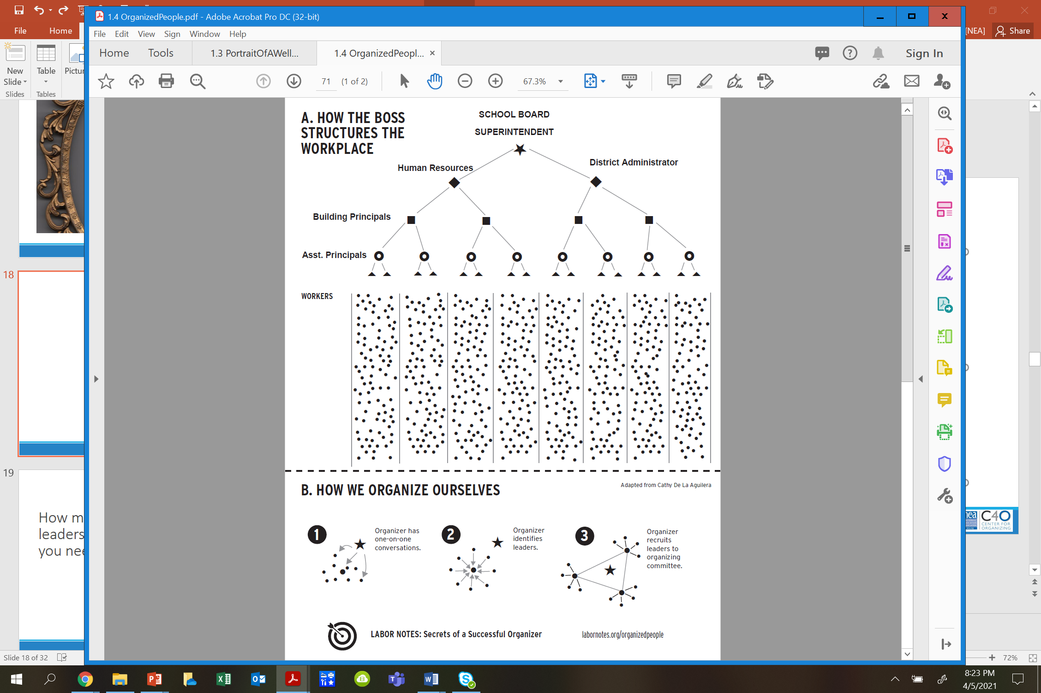
Notes:
Vanessa

Slide 47
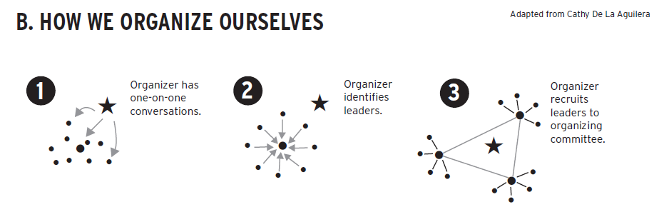
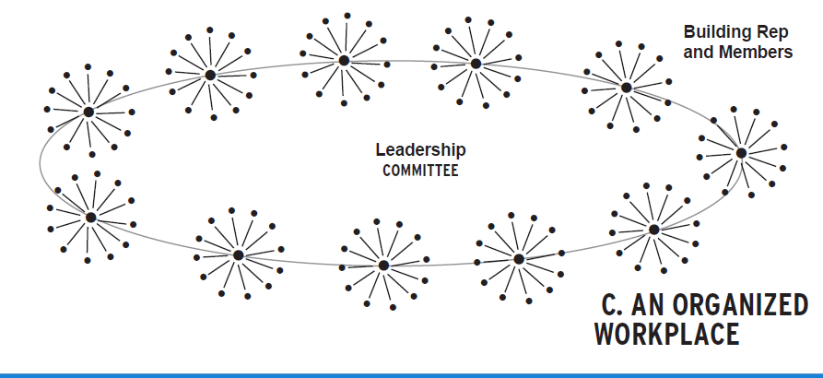
Notes:
Vanessa

Slide 48
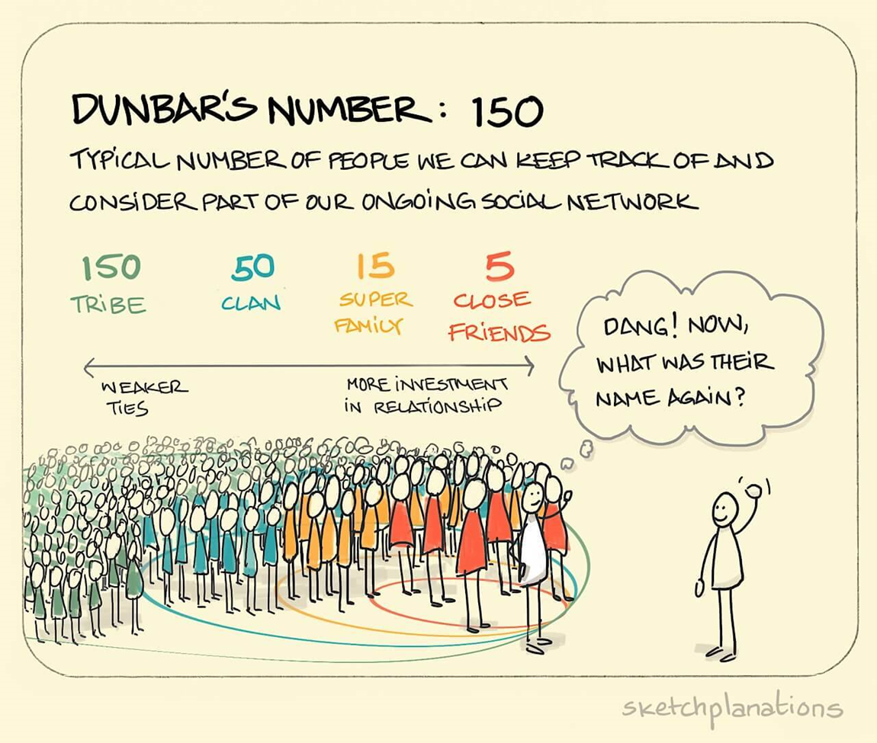
How many leaders do you need?
Notes:
Vanessa

Slide 49

People are the base of our power
Notes:
Vanessa

Slide 50
Key Points
Without enough leaders who have enough connections with members (and non-members), you can’t build and use power
  The role of staff is in the facilitation of relationships by connecting leaders.
  WE begin this work by focusing at the worksite level and building the sense of allegiance among workers using a shared narrative.
Notes:
Vanessa

Slide 51
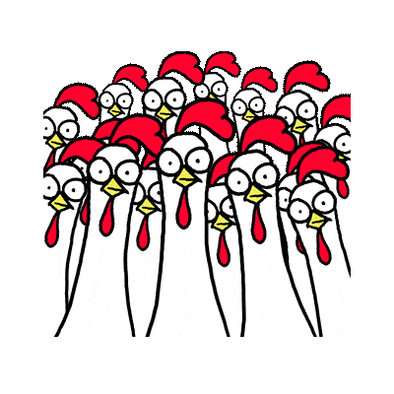
Who Are My People?
Return to your scenarios. Each group will assess the following for their scenario:
Who are all the possible people who might be affected by the situation?
How would you identify or recruit the other people impacted by the scenario who were not named?
Notes:
Vanessa

Slide 52
Who Are My People?- Debrief
How many more people are NOW part of the problem solving process?
What barriers or challenges, if any, did you anticipate in engaging more people?
How did you address those barriers/challenges?
Notes:
Vanessa

Slide 53
BREAK

Slide 54
Ellen, August
Notes:
Steven or Charles

Slide 55
How do we get members to lead?
Notes:
Ellen, August

Slide 56
What is power?
Power is the ability to act and cause others to act.
Notes:
Ellen, August

Slide 57
Where is the power, visibility and accountability:
UniServ Staff?
Member?
Table Talk
Individual Grievances
Collectivized Grievances
Notes:
Ellen, August

Slide 58
Power comes from
Members using their collective agency to strategically make change.
Notes:
Ellen, August

Slide 59
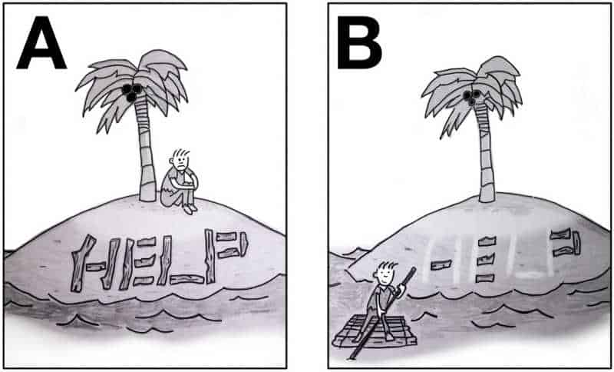
Agency within Educator Unions
Agency is the ability for an individual to decide they can act.
When individuals have developed their sense of agency to the point where they feel they are capable of doing what is needed to win the fights they engage in, they take bigger risks and they grow.
Notes:
Ellen, August

Slide 60
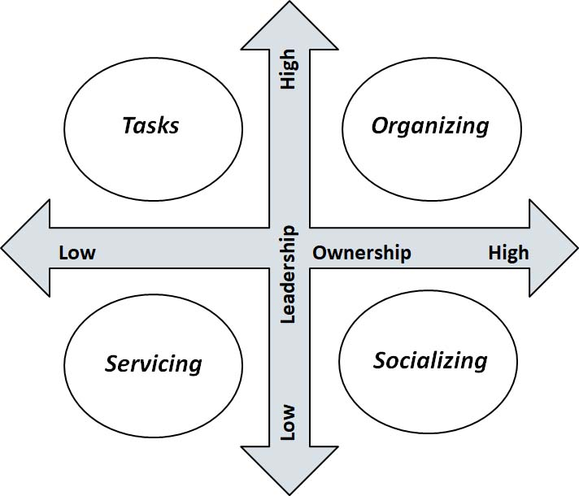
Engagement Grid
Notes:
Ellen, August

Slide 61
Moving Advocacy at Your Tables
You write and file the grievance form.
You find the grievance form, you tell the member how to
complete and submit it. They do it.
The members attend a meeting where you explain one of
the benefits of membership – advocacy.
A member contacts their building rep, who helps prep them for their meeting and helps them complete the paperwork. The building rep connects with your after the end of the meeting to let you know how it went and seek your advice on what they could have done differently.
A team of members build solidarity across the bulk of their worksite on an issue. They survey, do one on ones, sit outside the principal’s office, and then pack a school board meeting to apply pressure in order to win their demand.
Notes:
Ellen, August

Slide 62
Engagement Grid Discussion
What kinds of supports do you think are necessary for members to move higher on leadership and ownership? Of those supports, what can you, as the UD, provide?
What do you see as an obstacle in moving advocacy from the lower ownership quadrant to a higher ownership quadrant? What strategies would you apply to overcome that?
Notes:
Ellen, August

Slide 63
RULE #1
Don’t do for others what they can do for themselves.
Notes:
Ellen, August

Slide 64
RULE #2
Always make the story about member agency.
Notes:
Ellen, August

Slide 65
Coaching up to Organizing from Advocacy p.94
Remember...
1. What does the building rep think?
2. What are other people saying?
3. Who are the leaders in this building and are they aware of this?
4. How can you bring the members into this?
5. Who’s the right person to go with the member to the principal?
6. What would it take for you not to be in that meeting?
7. How can this be a story about the members?
8. What new leaders are on your radar?
9. What’s your plan for this member?
10. What’s the membership plan at this school?
Notes:
Ellen, August

Slide 66
Key Points
People grow when they have to stretch. When the union staff step back, members can step forward.
Tasks have to be meaningful and members need to own them
Our job is to look for opportunities to increase ownership and leadership wherever possible.
Notes:
Ellen, August

Slide 67
Toney
Notes:
Steven or Charles

Slide 68
How do we use great advocacy to organize?
Notes:
Toney, Bekah

Slide 69
Review our definition…
Organizing is identifying leaders and coordinating them into leadership teams, Building community and commitment around common goals, Building power from the resources of that community, Using that power strategically to make concrete change in the world.
Notes:
Toney, Bekah

Slide 70
Organizers ask…
Who are my people?
What are their issues?
What do they want as a remedy?
What are they willing to do/risk to get the change they want?
Who has the power to prevent that change they want?
Notes:
Toney, Bekah

Slide 71
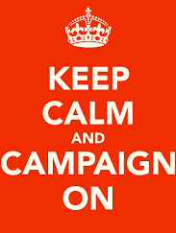
Organizing is always a campaign.
A campaign is an action plan with a beginning, middle, and end, working towards a specific demand
A campaign involves a series of escalating actions (or tactics)
A campaign creates increasing pressure on decision-makers over time by escalating the intensity and visibility of the tactics and increasing the numbers of people involved
Campaigns are a way to identify in advance the ingredients we need to win and put them together in a way that maximizes our chances of success
Notes:
Toney, Bekah

Slide 72
Key Points
Grievances are typically invisible, with private, transactional relationships
Campaigns are visible, with collective displays of power, that transform member relationships with their Union.
Notes:
Toney, Bekah

Slide 73
Bekah
Notes:
Steven or Charles

Slide 74
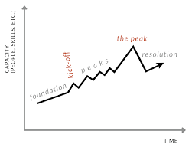
Campaign Plan
How do we convert the individual grievance process to a campaign planning process?
Notes:
Toney, Bekah

Slide 75
Problem Solving Steps – Collective
Why Is It a Problem? – Step 2
Is this a symptom of a larger problem?
What are the issues related to this problem?
What is a desired outcome?
What are their issues?
What do they want as a remedy?
Notes:
Toney, Bekah

Slide 76

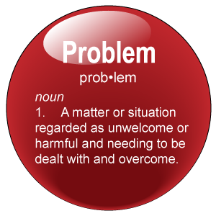
The BIG Problem and the Issues
Notes:
Toney, Bekah

Slide 77
Example – Problem to Issue to Win
PROBLEM -Educators do not feel respected by their principal.
  Issue – There is not structure or policy that allows educators to have meaningful input on decisions that affect their workday
  Issue – Educators’ time to teach is severely limited by tests and data meetings that don’t improve learning
  Issue – Educators’ work and professional practices are not adequately compensated for
Strategic WIN – Educators feel Respected by their Principal
  Tactical WIN – A joint building level joint labor management team is established
  Tactical WIN – More time to teach and meaningful content and less unnecessary testing and data dives
  Tactical WIN – Compensation matches work and expectations
Notes:
Toney, Bekah

Slide 78

Assessing an Issue
It is widely felt.
It is deeply felt.
It is winnable.
It builds the union and builds leaders.
Notes:
Toney, Bekah

Slide 79

Scenario Time-Issues
Each group will chart the possible organizing issues found in their scenario.
Using pages 100, 101, 102 define the issues inherent in the problem and assess them.
Notes:
Toney, Bekah

Slide 80
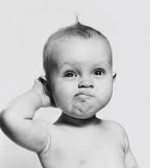
What are some issues your team identified?
How do you know that they would be good issues?
Notes:
Toney, Bekah

Slide 81
Key Points
The boss wins when we don’t have collective action
Identifying the RIGHT issues matters in building a broad base
Campaigns are visible, with collective displays of power, that transform member relationships with their Union.
Notes:
Toney, Bekah

Slide 82
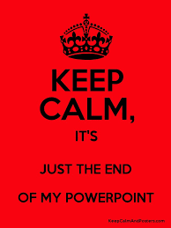
Ending it Right
Choice Networking
Housekeeping
Evening Evaluation
Notes:
Toney, Bekah

Slide 83

Choice Network Time
Notes:
Ellen

