Slide 1
Organizing Through Advocacy
UniServ Focus Academy
Notes:
Ellen

Slide 2
Ellen
Notes:
Steven or Charles

Slide 3
Feedback on Feedback
71% return rate. High of 4.6 for facilitators and a low of 4.46 for materials
There are some patterns that always occur on day 2 - Love the movement we have had enough moving.
There is an appreciation for the facilitators
We did not intentionally have coffee yesterday … it just was
Afternoons on Day 2 are a little tough.

Slide 4
Feedback on Feedback
I’m struggling with always having to do a campaign cycle in NEA trainings. I know each of us are at different levels in our locals, but it would be nice to dig deep on some of these topics. What does it look like to do these things at a site level. Are there examples of what advocacy looks like through organizing? Are there locals that have done it successfully? I do love to learn and appreciate the time I our union siblings are doing. 💝
I love the movement and opportunity to talk with so many people about this work. I am learning so much.
All the grievance discussion with what different UDs within the US experience was wonderful!
Notes:
Ellen

Slide 5
Meeting During Lunch
Contract and policy is clear – 30 Minutes Duty Free Lunch
Elementary school with 50% probationary teachers
VERY VERY VERY TOUGH SCHOOL
Grievance or Campaign

Slide 6
Problem – Tough School, Too much Testing, Can’t transfer if there are any low marks on evaluation.
Issue – Meeting during lunch. Those still in probationary period ESPECIALLY being pressured to spend lunch doing data.
Common value – Respect for the contract, Freedom to do human things
Who are my people?– Who else is upset by this? What are you willing to do?
Target – Principal and Literacy Coach
Demand and Win – Not meeting to go over reading data with literacy coach at lunchtime
Tactic 1 - Just Say No. Those with “tenure” refuse to meet during lunch hoping to force an in writing formal request to meet during lunch (100% of tenure)
Tactic 2 – F2P Buddy Buttons (100% of Tenure)
Tactic 3 – Invite probies to eat in classrooms with tenure hoping to force an in writing formal request to meet during lunch (100% of Classroom Staff)

Slide 7

Agenda Review - Today
Final Team Planning
Sharing Practices
Boxed Lunch 1:00-2:00PM
Notes:
Ellen

Slide 8

Community Agreements p. 2
Using Self-Awareness and Self-Knowledge
Listening for Understanding
Being Gracious
Staying Engaged
Being Open and Suspend Judgment
Saying “I”- tell your truth
Seeking Discomfort
Reaching Empathy
Expecting Non-Resolution and Non-Closure
*Adapted from “Embracing equity and inclusion”, Annie E. Casey Foundation
Notes:
Ellen
Community Agreements for Our Time
Awareness and Self-Knowledge
This requires self-knowledge and self-awareness. Self-knowledge allows you to see what causes you pain and conflict and enables you to embrace your contradictions and inconsistencies. It allows the space to work on things about yourself that you are not happy with. In turn, self-knowledge helps to prevent you from projecting your negative aspects onto other people. Bringing your best self also requires that you have a positive attitude, are willing to deeply explore your perspectives and remain open to the perspectives and experiences of others.
Listening for Understanding
Be an active listener. Active listening involves paying full and careful attention to the other person, looking him or her in the eye, avoiding interruptions, reflecting your understanding, clarifying information, summarizing the other person’s perspectives and sharing your own. Remember that most people need time to open up and might not be willing to immediately share their personal stories, hopes, fears and/or concerns.
Being Gracious
Being kind is a vital way of bringing meaning to our own lives, as well as the lives of others. Kindness is about caring genuinely for others around you, wanting the best for them and recognizing in them the same wants, needs, aspirations and even fears that you may have. Being kind and generous allows us to communicate better with others, to be more self-compassionate and to be a positive force in other people’s lives. This includes following the COVID protocols that are in place to protect the health of this learning community.
Stay Engaged
Staying engaged requires you to be morally, emotionally, intellectually and socially involved in the conversation. Staying engaged means that you are listening with curiosity and willing to deepen your understanding. Staying engaged might also require you to sustain the conversation even when it gets uncomfortable or diverted. This also means a commitment to keeping your electronic communications to a minimum with folks not present in this learning community.
Be Open and Suspend Judgment
Listening with an open mind includes being receptive to the influence of others. You can suspend judgment by becoming aware of preconceived notions and listening to everything someone has to say before jumping to conclusions. Most importantly, suspending judgment also means listening to what the speaker has to say for understanding, not just to determine whether the speaker is right or wrong.
Say “I”- tell your truth
Speaking your truth in authentic and courageous conversations about race requires a willingness to take risks. It means that you will be absolutely honest and candid about your own thoughts, feelings, experiences and opinions and not just saying what you perceive others want to hear. Speaking your truth will require you to speak from the “first person” and use “I” statements.
Seek Discomfort
Leaning in to discomfort will require you to let go of racial understandings and stereotypes that you may be holding onto in order to move forward. Leaning in means that you will avoid judgment, assume positive intent and be open to the kernel of wisdom in each individual’s experiences. Leaning in to discomfort will require you to sit through moments of embarrassment, confusion, anxiety and/or fear.
Reaching Empathy
Empathy and compassion allow you to understand the other person’s point of view. When you are empathetic, you are more understanding, patient and kind. Expanding your capacity to feel empathy will also allow others to enter your circle of human concern.
Resolution and Closure
Expect and accept that there may not be closure. It is not likely that you will resolve your personal understanding about race or another person’s racial experience in a single conversation. The more you talk about race with another person, the more you learn and the more they will learn. Authentic and productive conversations about race are continuous and always evolving.
*Adapted from “Embracing equity and inclusion”, Annie E. Casey Foundation

Slide 9
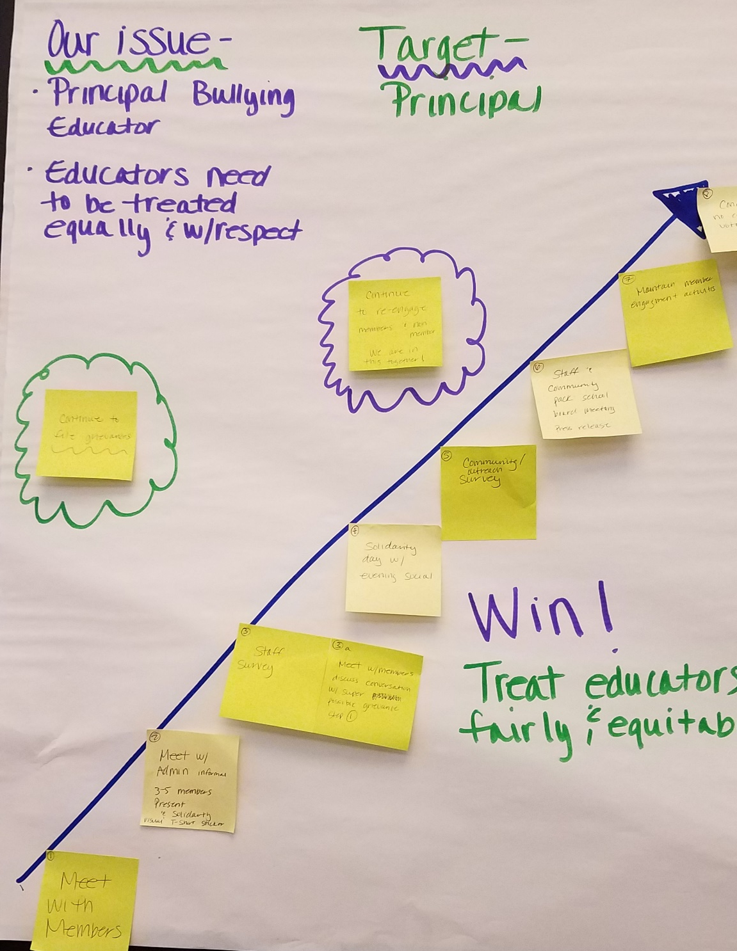

The Final Product Produced
Notes:
Ellen

Slide 10
Seleste
Notes:
Steven or Charles

Slide 11
Targets and Demands
Notes:
Seleste
Section time allotment: 30 minutes

Slide 12
Problem Solving Steps – Collective
How Can the Problem Be Solved? – Step 3
What are people willing to risk to solve the problem?
Who has the power to provide relief on this problem?
Once this problem is “solved” who will the story be about?
What are they willing to risk to achieve the change they want?
Who has the power to prevent that change?
Notes:
Seleste
Slide allotment: 1-2 minutes

Slide 13

Targets:
A single person- a name, face, & address
Has the power to give you what you are demanding
Notes:
Seleste
Slide allotment: 1-2 minutes

Slide 14
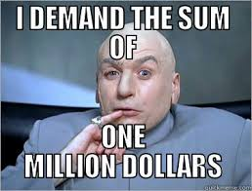
When making a demand …
  Measurable
  Achievable
  Should result in real tangible improvements in workers lives
  Focuses resources on a single outcome
  Builds the capacity of our constituency
  Uses a point of leverage: our constituency’s strength or our opposition’s weakness
  Focuses on a motivational issue that is visible and significant to our constituency
Notes:
Toney, Bekah

Slide 15

The greater the issue, bigger the demand, and more powerful the target – the more risk, resources, and people you need.
Notes:
Seleste
Slide allotment: 1-2 minutes

Slide 16
Return to the Scenario
20 minutes to determine:
Who is the target?
What are the demands?
Notes:
Seleste
Slide allotment: 20 minutes
Please return to your scenario groups. For the next 20 minutes you are going to identify your target(s) and your demand(s).

Slide 17
Organizing is about
building power
Notes:
Seleste
Slide allotment: 1-2 minutes

Slide 18
What is power?
Power is the ability to act and cause others to act.
Notes:
Seleste
Slide allotment: 1-2 minutes

Slide 19

Key Points
A well thought out campaign has a strong issue, with an identifiable target and a strategic demand.
It takes power to achieve your demand.
Notes:
Seleste
Slide allotment: 1-2 minutes

Slide 20
Charles and Steven
Notes:
Steven or Charles

Slide 21

Resources
https://www.neacollectivebargaining.org/
Notes:
Charles, Steven

Slide 22
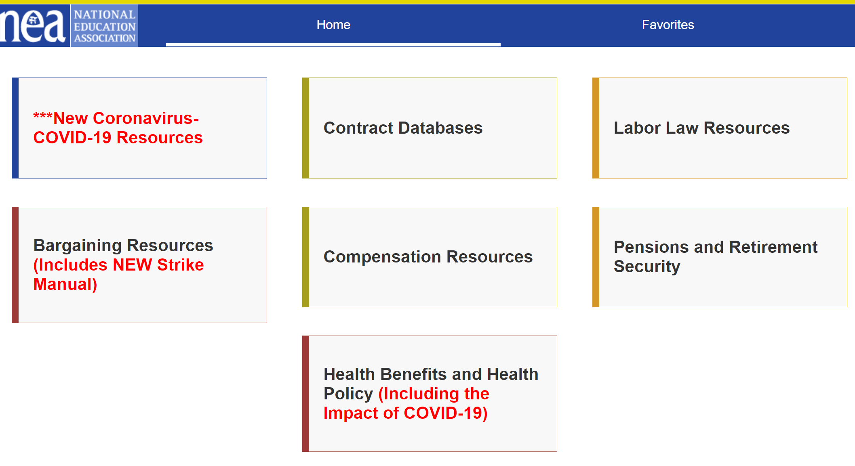
Notes:
Charles, Steven

Slide 23
Research Resources Activity
15 minutes to research resources that might be relevant to your group scenario.
10 minutes debrief
Notes:
Charles, Steven

Slide 24
Debrief
Notes:
Charles, Steven

Slide 25
Vanessa
Notes:
Steven or Charles

Slide 26
Tactics: How to Apply Pressure
Notes:
Vanessa

Slide 27

Tactics
Demand – Where we want to go – the destination – the BIG win- the big goal.
Strategy- What we think is needed to accomplish the demand
Tactic – Small actions that support the strategy that is designed to reach the destination
Notes:
Vanessa

Slide 28


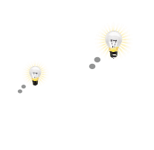

A GOOD TACTIC IS
Goal
1.
Serves the strategy
2.
Strengthens your organization
Develops individuals
Notes:
Vanessa

Slide 29
Example – Demand, Strategy, and Tactics
Demand- Educators want a voice in district decisions (through the creation of a stakeholder committee).
Strategy- Apply pressure to district decision makers.
Tactic– Building-level letter writing campaign
Tactic- Mass member attendance to school board meetings
Strategy- Use the contract/policy to legally enforce existing provisions
Tactic- File a grievance
Tactic-File an EEOC/HRA complaint
Strategy- Build partnerships in the community by increasing visibility and building trust
  Tactic– Canvassing the community and visiting parents to discuss their experience with the school district
  Tactic- Host listening sessions with potential community partners to discuss shared interests and values
Notes:
Toney, Bekah

Slide 30

Why should tactics escalate gradually?
GOAL
Tactic
Tactic
Notes:
Vanessa

Slide 31

Escalation of Tactics
Solidarity Actions
Escalation Actions
Concerted actions which demonstrate unity, but do so in a manner that increases pressure on the employer
Visible & concerted actions designed to show you all stand together
Why do we escalate?
→Structure tests←
Like giving HW or quizzes before a test.
Escalation of Tactics
Notes:
Vanessa
Structure tests: We have to test ourselves to see if we’ll be successful.
Akin to giving hw and quizzes before a test, and chapter tests before a final exam.

Slide 32
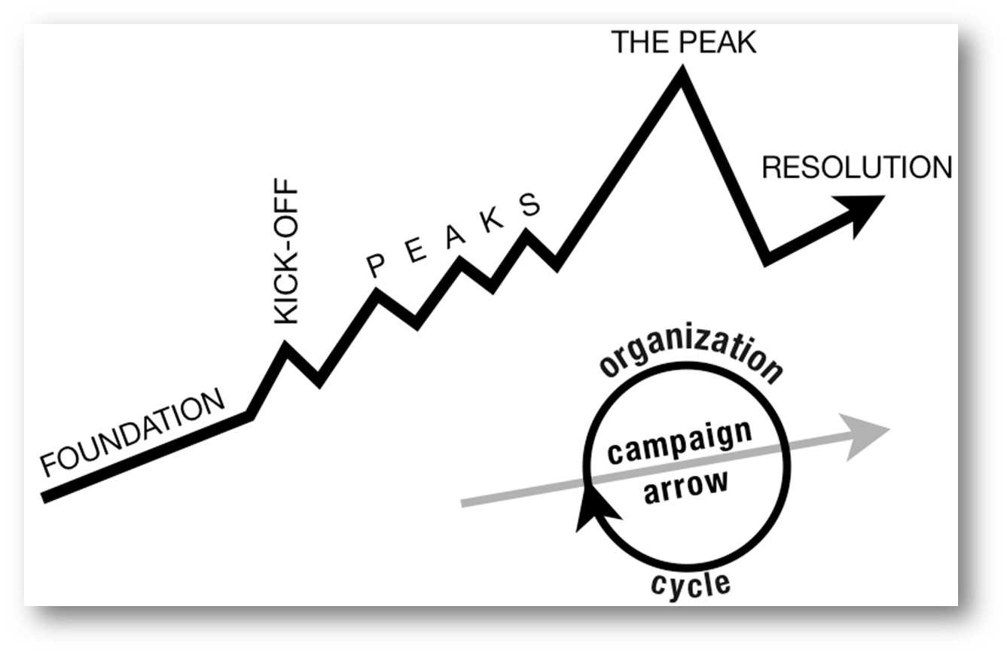
ORGANIZE TACTICS INTO… A CAMPAIGN Timeline
WIN
Notes:
Vanessa
Tactic scramble!

Slide 33
Key Points
Strategy without tactics is simply a collection of good ideas and big dreams.
Tactics without strategy are a random collection of activities and wasted resources.
Notes:
Vanessa

Slide 34
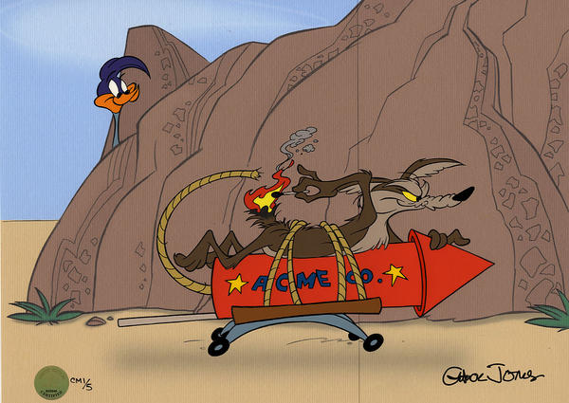
Return to Your Scenarios
Think about the tactics you could use at each point in your organizing campaign. Tactics should escalate as you move through the plan.
Consider how your organizing plan coincides with the grievance process.
Notes:
Vanessa

Slide 35
Bekah
Notes:
Steven or Charles

Slide 36
Problem Solving Steps – Collective
Choose Solution and Actions – Step 4
Implementation – Step 5
Who does what?
When?
Where?
Evaluation – Step 6
What happened?
Did it work?
Feedback?
Impact on the future?
What is the strategic plan for achieving a solution that engages as many people as possible?
Who is the story about?
What do members need to lead on the solution?
What actions are people willing to take that apply pressure?
Notes:
Bekah

Slide 37
Structure of a Campaign
WIN
Notes:
Bekah
Tactic scramble!

Slide 38
Team Work Time
Notes:
Toney and All

Slide 39
Toney
Notes:
Steven or Charles

Slide 40
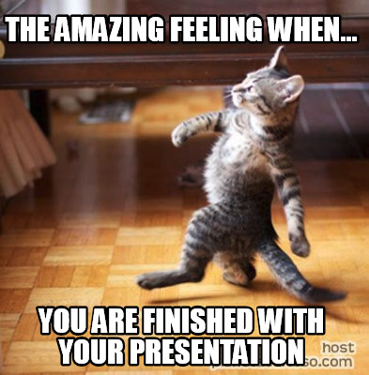
Team Presentation and Coaching Time
Notes:
Toney and All

Slide 41
Key Points
Individual services are about individual interests and credibility and produce a narrative about an individual’s relationship with their union.
Collective actions that are publically shared build community around the shared struggles and provides a different narrative about solidarity and collective relationship.
Notes:
Toney and All

Slide 42
Ellen
Notes:
Steven or Charles

Slide 43
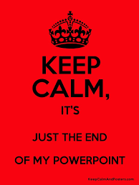
Ending it Right
Choice Networking
Housekeeping
Plus and Delta at the Door

