Slide 1
Organizing through Advocacy
UniServ Focus Academy
- We will begin shortly -
In the chat let us know:
Who you are
Your state affiliate
An organizing win you had as a youth, or a youth achieved on you
Notes:
Chad

Slide 2

Honoring This Space
We begin by acknowledging that through a history of colonization and brutality, we are currently on the traditional lands stewarded by generations of the Indigenous people.
We honor these indigenous people, all elders, past, present, and emerging. We are called to learn and share these learnings about this tribal history, culture, and contributions that have been suppressed in the telling of the story of what we now call the United States of America.
Notes:
Chad

Slide 3
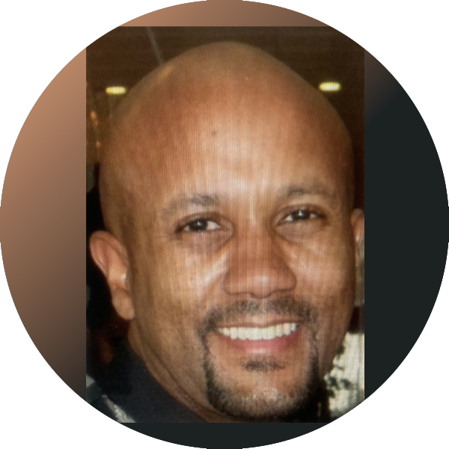


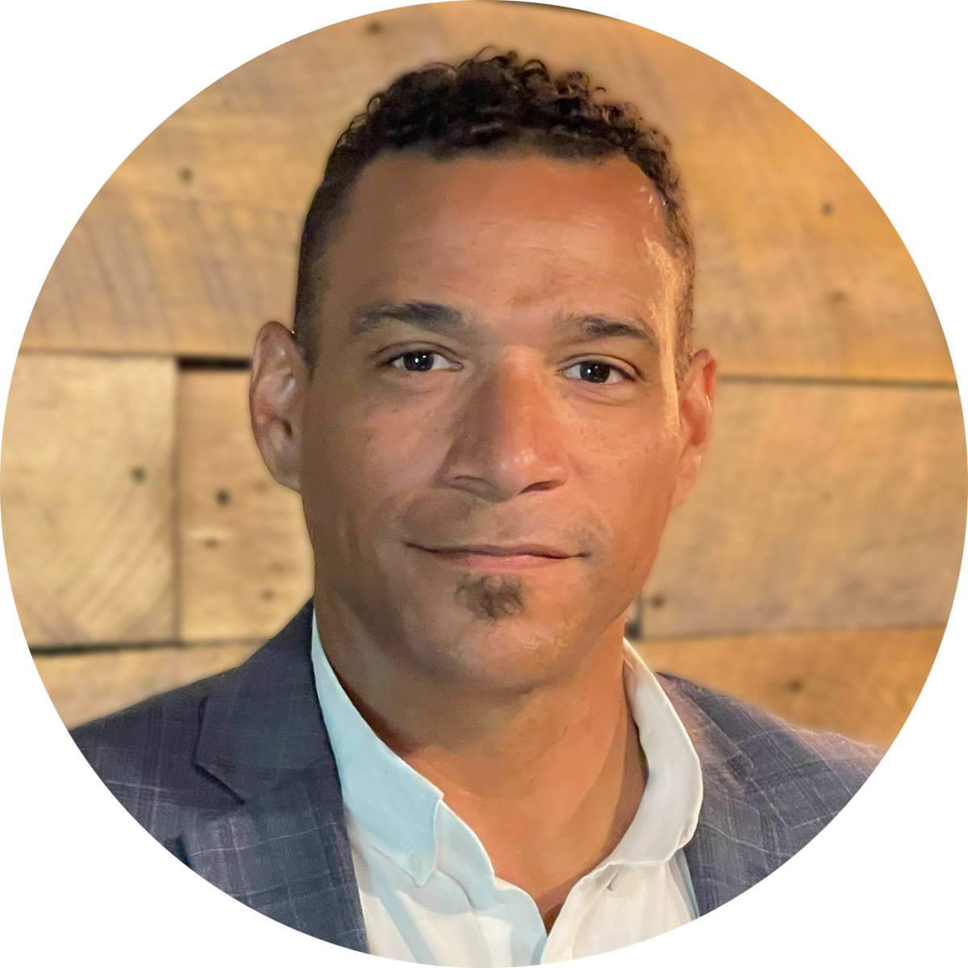

Facilitators:
Charles Holmes
Senior Collective Bargaining Specialist
National Education Association
cholmes@nea.org
C. August Haywood
UniServ Specialist
Alabama Education Association
august.haygood@alaedu.org
Melissa Dan
Labor Relations Consultant
Palm Beach County CTA
melissa.dan@floridaea.org
Chad Williams
UniServ Consultant Michigan
Michigan Education Association
cwilliams@mea.org
Notes:
Time Allotment: 5 minutes
Chad
Ask participants to rename themselves with Name/pronouns/state
Get to know you activity
Participants will use poll feature to determine participant comfort level with computers (1-strong, 2-knows it exists but only use when required, 3-"where is the on button?")
Participants will use poll feature to determine participant comfort level with Excel(1-strong, 2-knows it exists but only use when required, 3-"where is the on button?")
Participants will use their Raise Hand feature to answer the following questions
Collective bargaining state
Represent multiple locals
Headquarters staff

Slide 4

Three Session Agenda Overview
Session 1 – Know your role and formal complaints
Session 2 – Change, problem solving, turning members into leaders
Session 3 – Turning advocacy into organizing into power
Notes:
Chad

Slide 5
Agenda Review - Today
Knowing your role
Formal Complaints and Grievances
Notes:
Chad

Slide 6

Where do you stand?
Notes:
Chad

Slide 7
[NW] I mount cases that will result in legal decisions and policy wins for members.
[NE] I support and train members who handle advocacy at the worksite and affiliate level.
[SW] I work with management to solve problems quickly and effectively.
[SE] I turn individual issues into collective issues for organizing.
Notes:
Chad
The Litigator- mount cases that will result in legal decisions and policy wins for members
The Guide on the Side –support and train members who handle advocacy at the worksite and affiliate level
The Fixer – work with management to solve problems quickly and effectively
The Strategic Organizer – turn individual issues into collective issues for organizing.

Slide 8
The Litigator
The Guide on the Side
[NW] I mount cases that will result in legal decisions and policy wins for members.
[NE] I support and train members who handle advocacy at the worksite and affiliate level.
The Fixer
The Strategic Organizer
[SW] I work with management to solve problems quickly and effectively.
[SE] I turn individual issues into collective issues for organizing.
Notes:
Chad
The Litigator- mount cases that will result in legal decisions and policy wins for members
The Guide on the Side –support and train members who handle advocacy at the worksite and affiliate level
The Fixer – work with management to solve problems quickly and effectively
The Strategic Organizer – turn individual issues into collective issues for organizing.

Slide 9
Discussion
Why do you think you gravitate to that role?
Which role does your manager expect you to be most of the time?
Which role do leaders and members expect you to be most of the time?
Does your career stage affect your perspective?
The Fixer
The Litigator
The Guide on the Side
The Strategic Organizer
Notes:
Chad

Slide 10
What does it all mean?
When occupying a role, consider:
Who has the power?
Who is the story about?
How many people are engaged?
When is it appropriate to code switch?
Notes:
Chad
Slide allotment: 5 minutes

Slide 11
The Unorganized to Fighting Union Continuum
Unorganized
Club
Union
Fighting Union
Advocacy | None, or done by staff and/or local president Used as one of the few justifications to pay dues | Few members may help with advocacy with much support from staff. Advocacy is solely viewed as a service to single members. | Intentional identification and training of member advocates who conduct low-level meetings with support of higher levels from staff. Most advocacy is still viewed as a service to individuals with some understanding that protecting the work standards are in everyone’s interest. | Advocacy is primarily viewed as way to build worker solidarity and ways to exercise collective action in response to poor work standards. Issues to organize around.
Activity | None, or led by the union, the staff, or by union members. No ownership. | Programs for individual interest with little risk in participating. Led by one person, and focus of change is on personal practice. | Works to have leaders design and lead the programs. Focus is on change of relationship with the union from rank and file to leader. Mobilizing and activism are the norms focused on traditional worker issues. | Organizing is the norm focused on the solidarity of the group and the work is to apply pressure on a system of oppression. Issues are broad and include social movement thinking.
Notes:
Chad

Slide 12

Key Points
Balancing the short-term individual needs with long term systems needs is difficult but necessary.
Don’t advocate in isolation - When your union fights members need to know and know how.
We aren’t born fully developed advocates/organizers. Work at developing capacity in each role.
Notes:
Chad
What was missing: acknowledging your place your career. Understanding through doing and having done is important (proving to self and proving to colleagues) before you can move onto teaching others to do (proving that others can do).

Slide 13
Charles
Disciplinary Meetings and Grievance Processing
Notes:
Charles

Slide 14

Disciplinary Meetings
Check the Contract/policy. Commonly, language outlines:
General purpose of the meeting
24-48 hr advance notice
If an advocate is allowed to attend the meeting:
Listen, take notes, and advocate
Private caucus with the member at any point in the meeting
*Most States follow Weingarten rights (U.S. Supreme Court in 1975 in NLRB v. J. Weingarten, Inc.) to have an advocate at the meeting.
Notes:
Charles

Slide 15
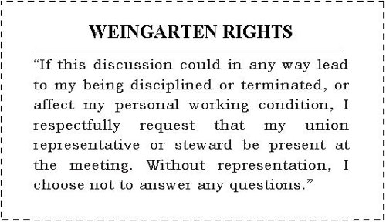
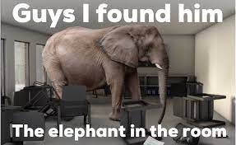
But what about Weingarten??
Notes:
Charles

Slide 16

Disciplinary Meeting Common Format
  Employer’s allegations and questions
  Your advocacy
  Subsequently, employer decides to:
        Not discipline
        Some level of discipline
        Recommend termination
  Next step:
  Prepare to file grievance, or;
  In the case of termination, contact the state affiliate attorney (...internal affiliate process for handling termination cases)
Notes:
Charles

Slide 17
If allegations can also lead to potential criminal charges as well.. invoke Garrity Rights
Garrity Rights protect public employees from being compelled to incriminate themselves during investigatory interviews conducted by their employers. This protection stems from the fifth and fourteenth to the United States Constitution, which declares that the government cannot compel a person to be a witness against him/herself.
Garrity Rights come into play depends primarily on whether the person is compelled to answer questions. If he faces little or no penalty and then makes statements, his statements are voluntary. However, if he faces a sufficiently severe penalty for refusing to answer, courts would generally hold that his statements were compelled and thus their use in a future criminal proceeding would be unconstitutional.
Inform employer, caucus with the member, and let the member decide
Notes:
Charles

Slide 18
“Just Cause”
In some states, for termination,
“due process” [Loudermill rights] is the only process used
A “no” answer to any of the below questions means that the employer did not have just cause to discipline the employee:
Did management adequately warn the employee of the consequences of his conduct ?
Was management's rule or order reasonably related to efficient and safe operations ?
Did management investigate before administering the discipline ?
Was the investigation fair and objective ?
Did the investigation produce substantial evidence or proof of guilt ?
Were the rules, orders and penalties applied evenhandedly and without discrimination to all employees ?
Was the penalty reasonably related to the seriousness of the offense and the past record ?
Notes:
Charles

Slide 19
Grievance Processing
Notes:
Charles

Slide 20


Initial Concern Intake
Interview the employee with a concern
Ask specific questions
Ask clarifying questions
Restate the complaint
Identify potential solutions
Have employee provide a written version of the incident
Check contract/policy to determine timeline deadlines
Notes:
Charles

Slide 21
Analyze the Complaint
*Research and examine the complaint
  Contract, board policies, past practices, similar grievances, manuals, handbooks, and laws
*Decide if complaint is a formal grievance
  -Review grievance definition
  -Did the action violate specific language or practice?
*Advise the employee of the action that you and Association plan to take.
Notes:
Charles

Slide 22
How to Remedy?
What adjustments are necessary to completely correct?
What is needed to place the aggrieved person in the same position he/she would have been in, had an injustice not occurred?
Notes:
Charles

Slide 23
Writing the Grievance
Notes:
Charles

Slide 24
Grievance Statement
Who is involved in the grievance?
When did the grievance occur?
Where did the grievance occur?
Why is this a grievance?
What contract article/policy did the action violate?
How to remedy?
Notes:
Charles

Slide 25
Grievance Form Example (also in your resources)
Notes:
Charles

Slide 26
Tips for Processing Grievances
Investigate and handle every case as though it will eventually end in an Arbitration
If it exists, fully inform the grievance committee
Anticipate potential employer response to grievance
Do not depend on the employer to assume authority for solving problems. Exercise authority and dispose of issues promptly.
NOTE: Often there is an Informal Step prior to the formal Step/Level 1
Prepare for your Step/Level hearings
Notes:
Charles

Slide 27
Preparing for Hearings at all Grievance steps/levels
Arrive early
Be organized
Prepare to articulate the concern in sequential order
Notes:
Charles

Slide 28
Preparing for Hearings at all Grievance steps/levels
Communicate contract/policy violations
For Board level and Arbitrations:
-Opening Statement
-Exhibits and packet copies
Communicate the remedy and rationale for the remedy
Notes:
Charles

Slide 29
Preparing for
School Board Hearings
School Board Hearing Common Format Overview
(See Resource)
Notes:
Charles

Slide 30
Opening Statement
***Provides a roadmap for the School Boad Hearing Officer
Notes:
Charles

Slide 31
A GOOD OPENING STATEMENT:
Gives description of the district and the bargaining unit
Gives employment background of grievant and other pertinent information
States the action which gave rise to the grievance
Notes:
Charles

Slide 32
A GOOD OPENING STATEMENT:
States the issues to be decided
Identifies the entitlements (contract provisions; laws; practices; etc.)
Explains what you intend to prove and evidence you will introduce
Notes:
Charles

Slide 33
A GOOD OPENING STATEMENT:
Summarizes
States the remedy
Notes:
Charles

Slide 34
Union Witnesses
(Direct Examination)
Prepare your witnesses ...including
*keeping the answers brief/succinct
*only answer questions that are asked
Lay foundation (name; occupation; etc.)
“OPEN ENDED” questions re their specific connection to the issue …to help prove your case through witness testimony
Notes:
Charles

Slide 35
District’s Witnesses
(Cross Examination)
Listen and take notes on anything that goes against your case
Objections (see resource)…object to questions asked of a witness
Ask leading close ended questions
Notes:
Charles

Slide 36
ENTERING DOCUMENTS INTO EVIDENCE
**During direct, you will have to get documents in through a witness if you did not stipulate to them initially.
Example:
  Advocate: “Please look at Exhibit A.
  …….Can you identify this? "
  Witness: “Yes, I can.”
  Advocate: “What is it?”
  Witness: “An email I received from my principal on May 1, 2021"
  Advocate: “I move to enter this document as Union Exhibit A.
Notes:
Charles

Slide 37
Key Concepts of Formal Advocacy
Know your formal complaint/grievance process
Formal complaints, grievances and arbitration are formal procedures, but it doesn’t preclude informal negotiation and discussions throughout the process
A formal complaint/grievance may be personal to the grievant, but the cause and remedy of a grievance impacts the contract and whole bargaining unit.
Notes:
Charles

Slide 38
Advocating inside vs outside the 4-corners of the Grievance
How do we connect our skillset with formal grievance and complaints to our larger organizing goals?
Formal grievance/ complaints can help locals organize by showing that they are (valued) and your organization is capable and willing to take action (safety). A well-managed complaint process can transform dissatisfied members into well-informed members who can take action (agency).
This reflects core hierarchy of needs leading individuals and groups to self-actualization, the core of organizing.
Notes:
Chad or Charles

Slide 39
Let's All Talk – break out
How does grievance/formal complaint fit into your view of advocacy?
How does grievance/formal complaint fit into your view of organizing?
What are you wondering about?

Slide 40
Let's All Talk – Report out
How does grievance/formal complaint fit into your view of advocacy?
How does grievance/formal complaint fit into your view of organizing?
What are you wondering about?

Slide 41
Looking ahead to the next session:
Going Beyond Grievance and Formal Complaint
Change theory
Problem solving
Members into leaders

