Slide 1
Organizing Through Advocacy
UniServ Focus Academy
UniServ Focus Academy
- We will begin shortly -
In the chat let us know:
Who you are
Your state affiliate
A change you are proud to be a part of helping come about
Going Beyond Grievance and Formal Complaint
Notes:
Chad

Slide 2

Honoring This Space
We begin by acknowledging that through a history of colonization and brutality, we are currently on the traditional lands stewarded by generations of the Indigenous people.
We honor these indigenous people, all elders, past, present, and emerging. We are called to learn and share these learnings about this tribal history, culture, and contributions that have been suppressed in the telling of the story of what we now call the United States of America.
Notes:
Chad

Slide 3
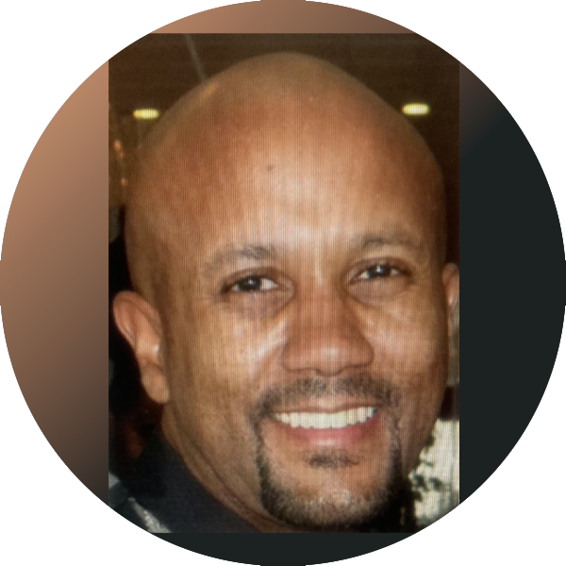
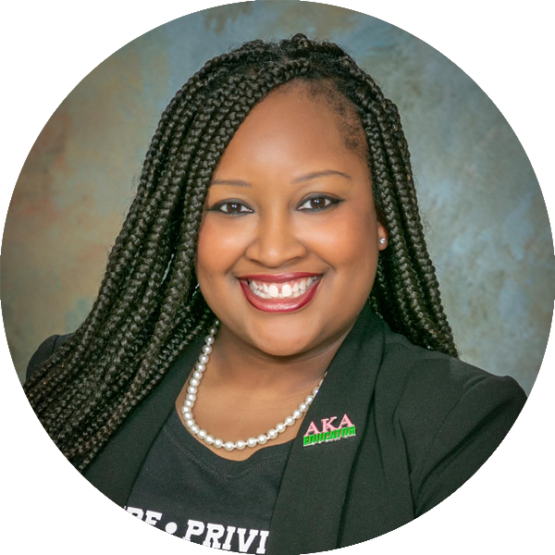
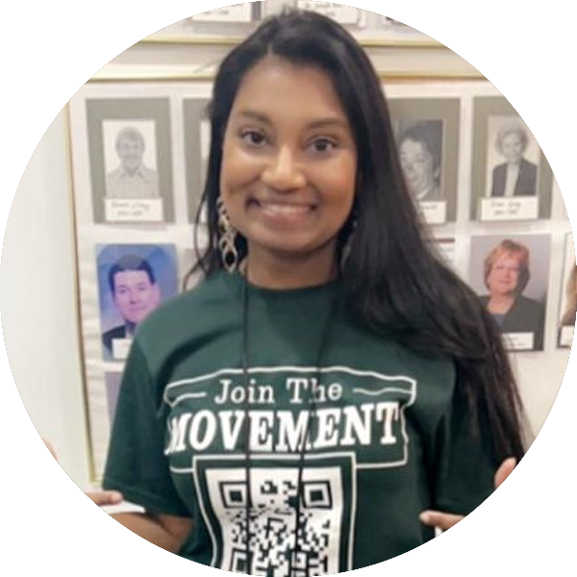
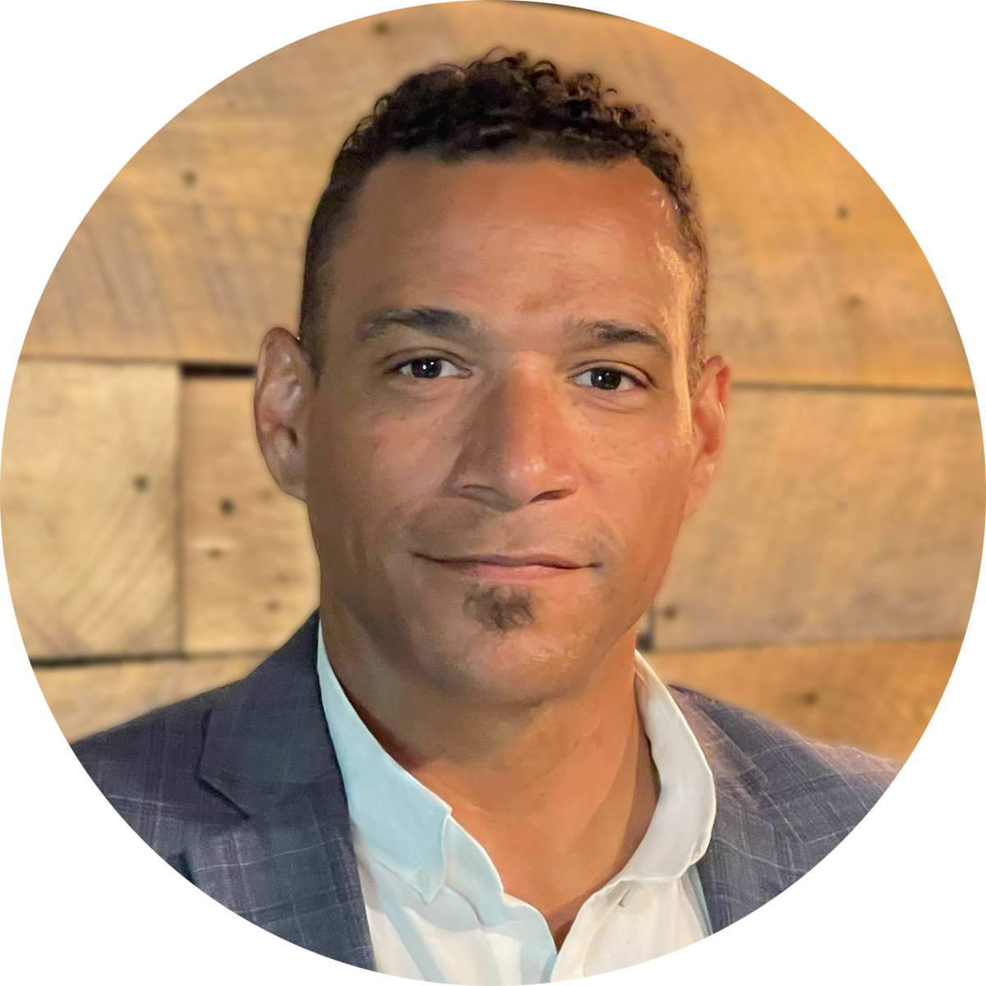
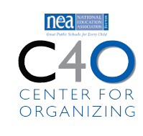
Facilitators:
Charles Holmes
Senior Collective Bargaining Specialist
National Education Association
cholmes@nea.org
C. August Haywood
UniServ Specialist
Alabama Education Association
august.haygood@alaedu.org
Melissa Dan
Labor Relations Consultant
Palm Beach County CTA
melissa.dan@floridaea.org
Chad Williams
UniServ Consultant Michigan
Michigan Education Association
cwilliams@mea.org
Notes:
Time Allotment: 5 minutes
Chad
Ask participants to rename themselves with Name/pronouns/state
Get to know you activity
Participants will use poll feature to determine participant comfort level with computers (1-strong, 2-knows it exists but only use when required, 3-"where is the on button?")
Participants will use poll feature to determine participant comfort level with Excel(1-strong, 2-knows it exists but only use when required, 3-"where is the on button?")
Participants will use their Raise Hand feature to answer the following questions
Collective bargaining state
Represent multiple locals
Headquarters staff

Slide 4

Three Session Agenda Overview
Session 1 – Know your role and formal complaints
Session 2 – Change, problem solving, turning members into leaders
Session 3 – Turning advocacy into organizing into power
Notes:
Chad

Slide 5
Agenda Review - Today
Change theory
Problem solving
Turning members into leaders
Notes:
Chad

Slide 6
Going Beyond Grievance and Formal Complaint
August
Notes:
August

Slide 7
Three Theories of Change-Jane McAlevey
Advocacy
Mobilizing
Organizing
Notes:
August

Slide 8
Three Theories of Change-Jane McAlevey
Advocacy
Theory of power – Elite. Seeks one-time wins, policy changes
Strategy – Litigation/Legal
People Focus - None
Notes:
August

Slide 9
Three Theories of Change-Jane McAlevey
Mobilizing
Theory of power – Primarily elites. Ambitious goals (perhaps weakly enforced)
Strategy – Campaigns run by professional staff
People Focus – People already committed to the cause
Notes:
August

Slide 10
Three Theories of Change-Jane McAlevey
Organizing
Theory of power – Mass, inclusive and collective
Strategy – Recruiting large numbers of people
People Focus – Organic leaders who can recruit other people
Notes:
August

Slide 11

Theory of Change - Breakout
Which theory would maximize membership?
As staff, how would you describe your relationship to each theory of change?
Notes:
August

Slide 12
Debrief
Which theory did you choose?
What does this tell you about advocacy?
What are you wondering about?
Notes:
August

Slide 13
A Fighting Union is…
A Union is a group of people affiliated around a common purpose. They are committed to collectively sharing their resources and taking collective risks to achieve the demands they make. Collectively, they believe that they deserve better than their current status.
A strong Union has a structure of people who are in relationship and in communication about workplace dreams, problems, issues, and possible solutions.
Your primary staff union role is to build this.
Notes:
August

Slide 14

Handling advocacy at an individual level is a necessary skill
Translating and transferring those skills to others through organizing is how staff help workers build power to win
Notes:
August

Slide 15
Why isn’t great advocacy enough?
Chad
Notes:
Chad

Slide 16
Remember this…
“The best measures of a powerless union are large, well-funded, staff-led, lobbying department AND a staff that are focused on answering calls for help. You might win some legal and policy demands – but you will not have enough power to implement them and keep them. You might win some cases for individuals, but you will never have enough leaders to create a just working environment. Power is built through money, position, or people.”
  (Leader from Seattle Education Association)
We have people.
Notes:
Chad

Slide 17

Remember the compass…
Issues and complaints require problem solving, and problem solving has distinct components.
Problem-solving will involve all aspects of your staff role.
Notes:
Chad

Slide 18
Problem Solving Model
6 Steps
Problem Identification
Choose Solution and Actions
Implementation
Evaluation
Develop Alternative Solutions
Problem Analysis
Notes:
Chad

Slide 19
Problem-Solving Steps
When Individual is the Center
Problem Identification – Step 1
What happened?
Where?
When?
Why?
Problem Analysis – Step 2
Contract/policy/handbook
Laws
Brainstorm Possible Solutions– Step 3
Adversarial or collaborative?
Grievance remedies
Ways to solve the problem & the cost/benefits associated with each
Past practices
Who?
How?
Venting?
Organizing remedies
Notes:
Chad

Slide 20
Problem Solving Steps – Individual (continued)
Choose Solution and Actions – Step 4
Member needs
Association needs/procedures
District needs
Resources
Implementation – Step 5
When?
Where?
Evaluation – Step 6
What happened?
Did it work?
Feedback?
Who does what?
What's your remedy
Notes:
Chad

Slide 21
Pitfalls to Resolving Conflicts
Not handling emotions first.
Failing to identify hidden agendas.
Not defining the problem/clarifying the issues.
Insufficient or disrupted brain-storming.
Fear of or over-dependence on Grievance/Formal Complaint
Lack of follow-up.
Not engaging members /building leaders throughout the process
Notes:
Chad

Slide 22
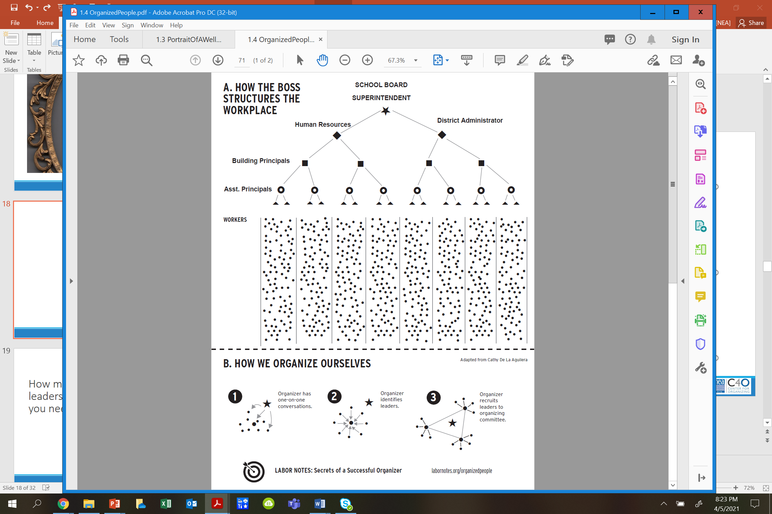
Are we unintentionally replicating this structure?
When helping to solve problems…
Notes:
Chad
Are we mimicking the bosses structure in our work?

Slide 23
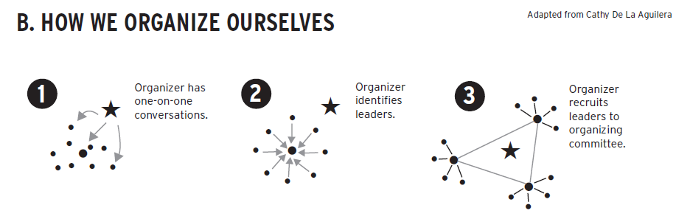
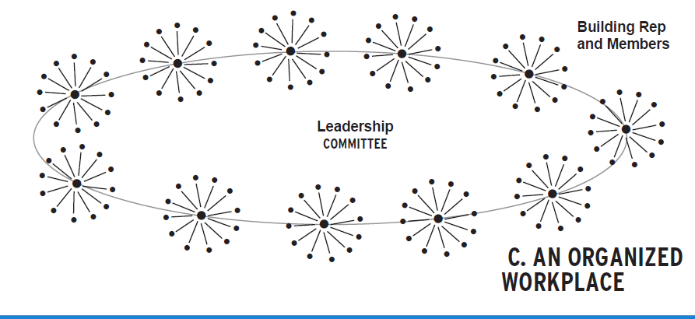
Do we understand our role as staff in this structure?
When helping to solve problems…
Notes:
Chad

Slide 24
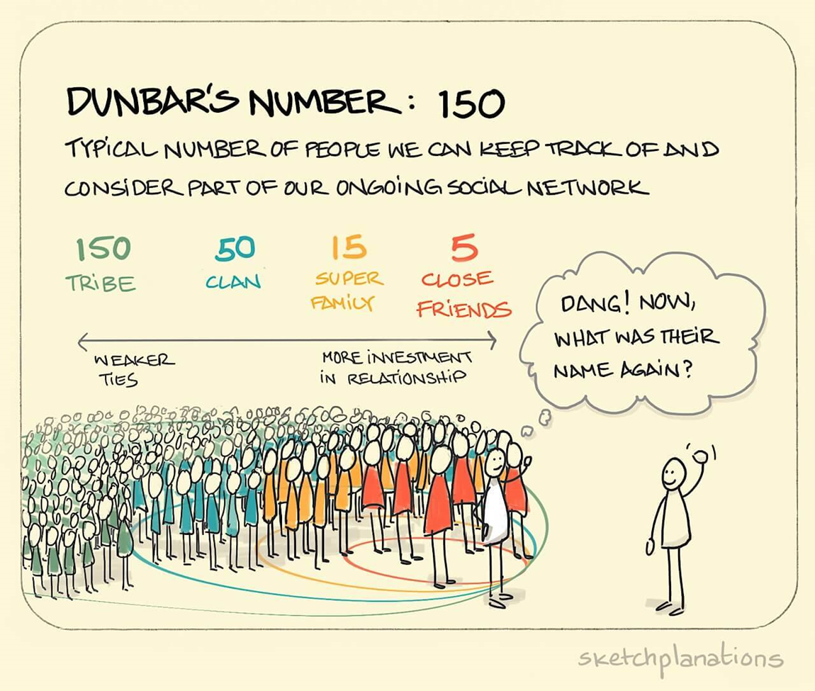
How many leaders do you need?
When helping to solve problems…
Notes:
Chad

Slide 25
Without enough leaders who have enough connections with members (and non-members), you can’t build and use power
The role of staff is in the facilitation of relationships by connecting and supporting leaders.
WE begin this work by focusing at the worksite level and building the sense of allegiance among workers using a shared narrative.
Notes:
Chad

Slide 26
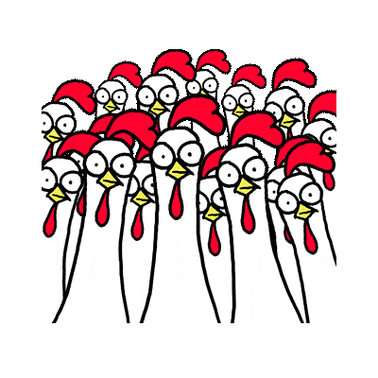
Who Are My People? (Break out)
Scenario
Who are all the possible people who might be affected by the situation?
How would you identify or recruit the other people impacted by the scenario who were not named?
Notes:
Chad

Slide 27
Who Are My People?- Debrief
How many more people are NOW part of the problem solving process?
What barriers or challenges, if any, did you anticipate in engaging more people?
How did you address those barriers/challenges?
Notes:
Chad

Slide 28
How do we get members to lead?
Notes:
Ellen, August

Slide 29
What is power?
Power is the ability to act and cause others to act.
Notes:
Ellen, August

Slide 30
Power comes from
Members using their collective agency to strategically make change.
Notes:
Ellen, August

Slide 31
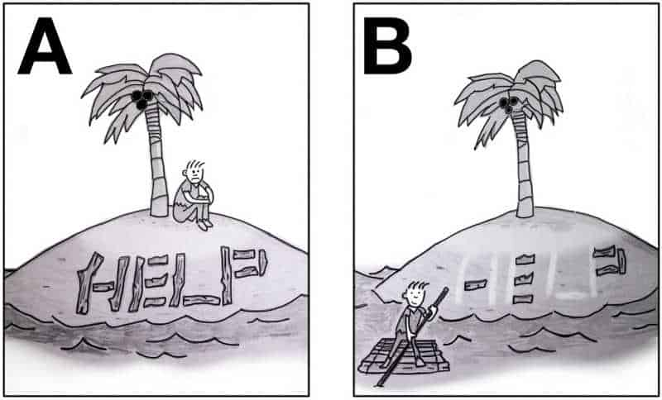
Agency within Educator Unions
Agency is the ability for an individual to decide they can act.
When individuals have developed their sense of agency to the point where they feel they are capable of doing what is needed to win the fights they engage in, they take bigger risks and they grow.
Notes:
Ellen, August

Slide 32
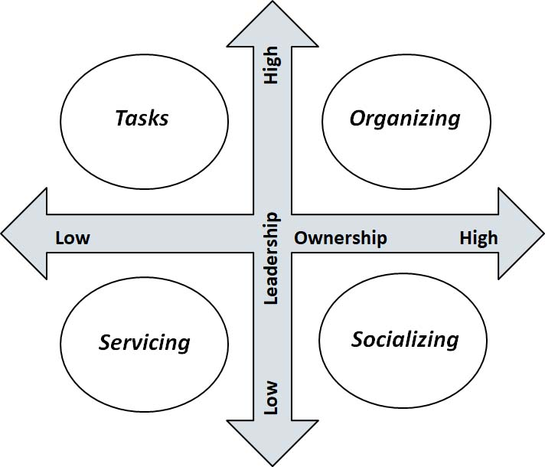
Engagement Grid
Notes:
Ellen, August

Slide 33
Engagement Grid Discussion
What kinds of supports do you think are necessary for members to move higher on leadership and ownership? Of those supports, what can you, as the UD, provide?
What do you see as an obstacle in moving advocacy from the lower ownership quadrant to a higher ownership quadrant? What strategies would you apply to overcome that?
Notes:
Ellen, August

Slide 34
People grow when they have to stretch. When the union staff step back, members can step forward.
Tasks have to be meaningful and members need to own them
Our job is to look for opportunities to increase ownership and leadership wherever possible.
Notes:
Ellen, August

Slide 35
How do we use great advocacy to organize?
Notes:
Chad

Slide 36
Review our definition…
Organizing is identifying leaders and coordinating them into leadership teams, Building community and commitment around common goals, Building power from the resources of that community, Using that power strategically to make concrete change in the world.
Notes:
Chad
You (staff) are a resource too…as well as contract language, grievance/formal complaint procedure, board policy that have built over time as a consequence of advocacy and organizing.

Slide 37
Organizers ask…
Who are my people?
What are their issues?
What do they want as a remedy?
What are they willing to do/risk to get the change they want?
Who has the power to prevent that change they want?
Notes:
Chad

Slide 38
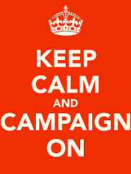
Organizing is always a campaign.
A campaign is an action plan with a beginning, middle, and end, working towards a specific demand
A campaign involves a series of escalating actions (or tactics)
A campaign creates increasing pressure on decision-makers over time by escalating the intensity and visibility of the tactics and increasing the numbers of people involved
Campaigns are a way to identify in advance the ingredients we need to win and put them together in a way that maximizes our chances of success
Notes:
Chad

Slide 39
Grievance and formal complaint unused or misused are typically invisible, with private, transactional relationships
Campaigns are visible, with collective displays of power, that transform member relationships with their Union.
Notes:
Chad

Slide 40
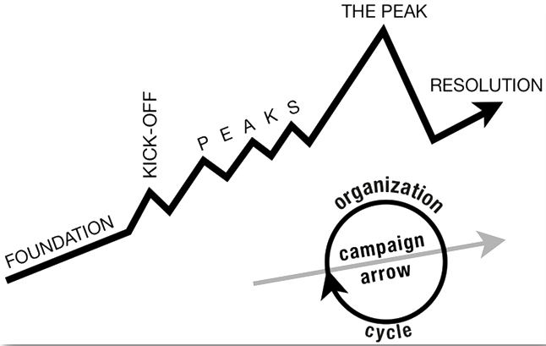
Preview
Campaign Plan
How do we convert the individual grievance process to a campaign planning process?
Notes:
Chad

Slide 41
Looking ahead to the next session:
Turning advocacy into organizing into power
Change theory
Problem solving
Members into leaders

