Slide 1
Organizing Through Advocacy
UniServ Focus Academy
Turning advocacy into organizing into power
Notes:
Ellen

Slide 2

Honoring This Space
We begin by acknowledging that through a history of colonization and brutality, we are currently on the traditional lands stewarded by generations of the Indigenous people.
We honor these indigenous people, all elders, past, present, and emerging. We are called to learn and share these learnings about this tribal history, culture, and contributions that have been suppressed in the telling of the story of what we now call the United States of America.

Slide 3
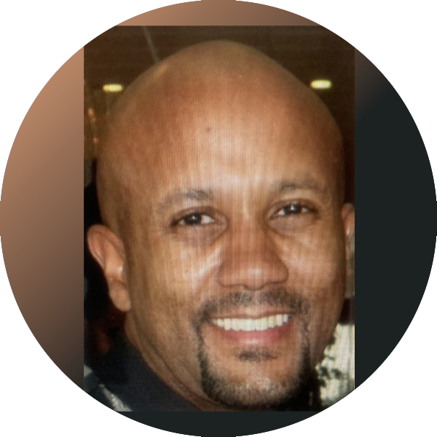
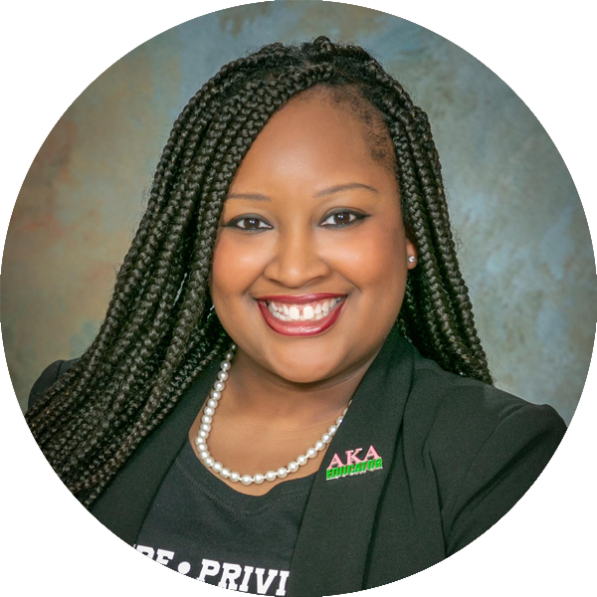
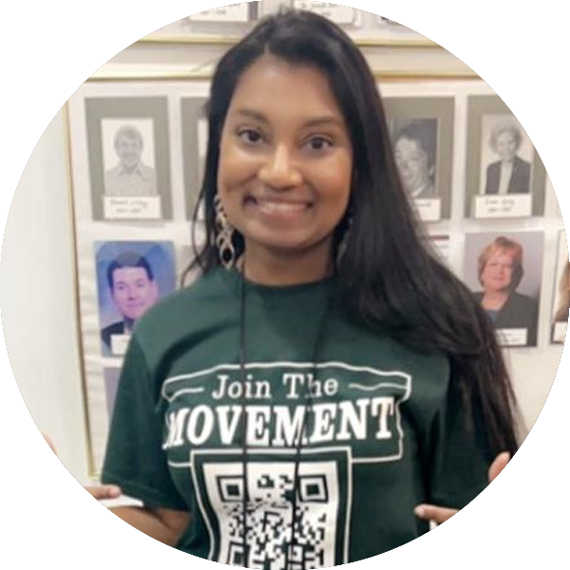
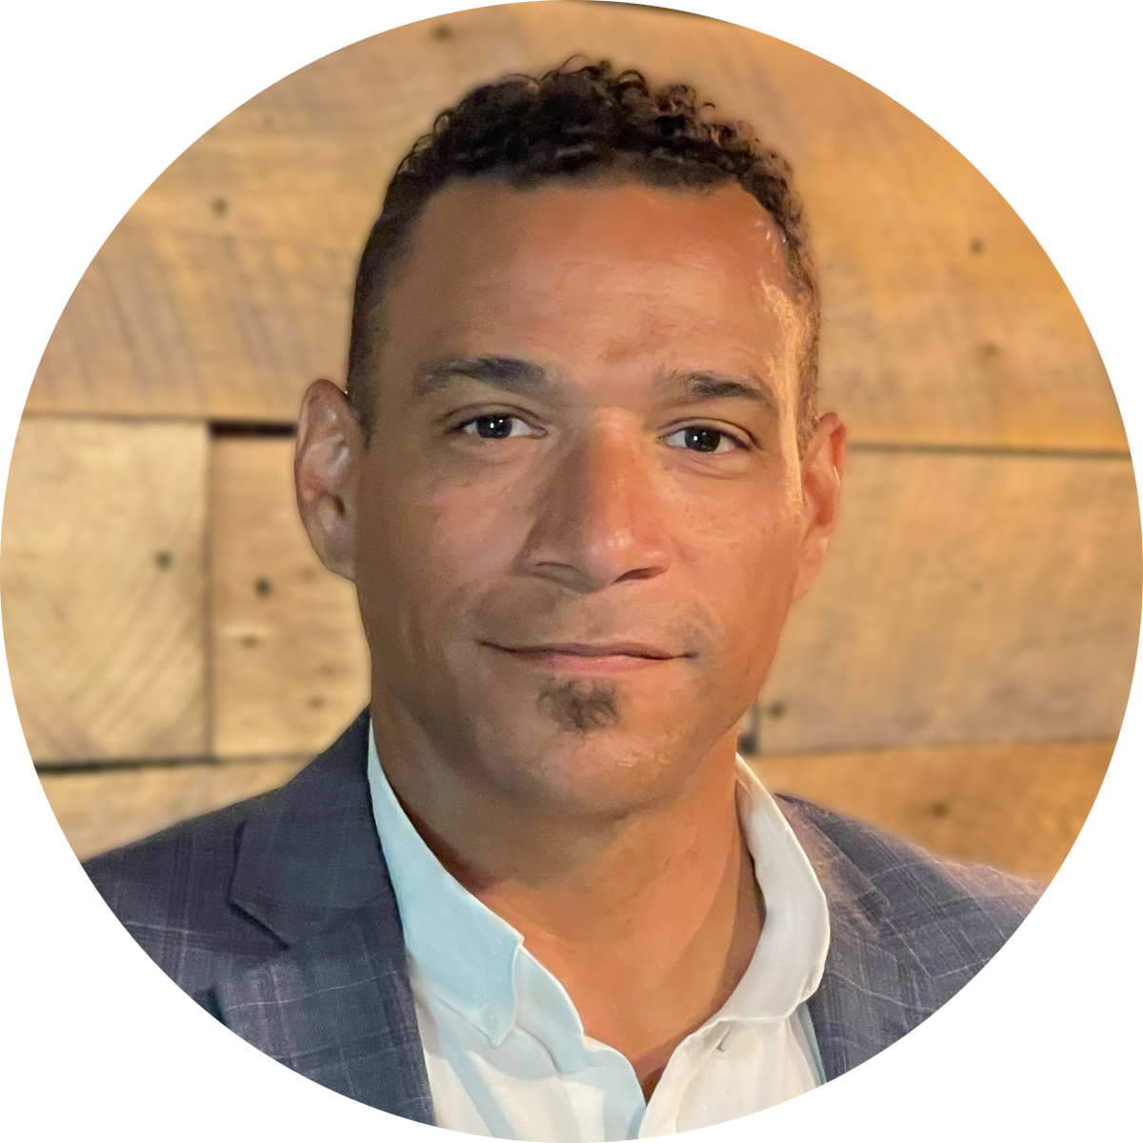

Facilitators:
Charles Holmes
Senior Collective Bargaining Specialist
National Education Association
cholmes@nea.org
C. August Haywood
UniServ Specialist
Alabama Education Association
august.haygood@alaedu.org
Melissa Dan
Labor Relations Consultant
Palm Beach County CTA
melissa.dan@floridaea.org
Chad Williams
UniServ Consultant Michigan
Michigan Education Association
cwilliams@mea.org
Notes:
Time Allotment: 5 minutes
Chad
Ask participants to rename themselves with Name/pronouns/state
Get to know you activity
Participants will use poll feature to determine participant comfort level with computers (1-strong, 2-knows it exists but only use when required, 3-"where is the on button?")
Participants will use poll feature to determine participant comfort level with Excel(1-strong, 2-knows it exists but only use when required, 3-"where is the on button?")
Participants will use their Raise Hand feature to answer the following questions
Collective bargaining state
Represent multiple locals
Headquarters staff

Slide 4

Three Session Agenda Overview
Session 1 – Know your role and formal complaints
Session 2 – Change, problem solving, turning members into leaders
Session 3 – Turning advocacy into organizing into power

Slide 5
Agenda Review - Today
Tactics and Demands
Targets
Applying Pressure

Slide 6


Targets and Demands

Slide 7
Targets:
A single person- a name, face, & address
Has the power to give you what you are demanding
Notes:
Melissa
Slide allotment: 1-2 minutes

Slide 8
Demands:
  Measurable
  Achievable
  Should result in real tangible improvements in workers lives
  Focuses resources on a single outcome
  Builds the capacity of our constituency
  Uses a point of leverage: our constituency’s strength or our opposition’s weakness
  Focuses on a motivational issue that is visible and significant to our constituency
Notes:
Melissa
Slide allotment: 1-2 minutes

Slide 9

The Big issue
The greater the issue, bigger the demand, and more powerful the target – the more risk, resources, and people you need.
Notes:
Seleste
Slide allotment: 1-2 minutes

Slide 10
Organizing is about
building power
Notes:
Melissa
Slide allotment: 1-2 minutes

Slide 11

What is power?
Power is the ability to act and cause others to act.
Notes:
Seleste
Slide allotment: 1-2 minutes

Slide 12

A well thought out campaign has a strong issue, with an identifiable target and a strategic demand.
It takes power to achieve your demand.
Notes:
Melissa
Slide allotment: 1-2 minutes

Slide 13

In your groups, return to your scenario and decide the:
Issue Keep in mind what makes a good issue!
Demand What do you want to win to solve your issue?
Target Who has the power to give you your demand?
Scenario

Slide 14
In your groups, return to your scenario and decide the:
Issue Keep in mind what makes a good issue!
Demand What do you want to win to solve your issue?
Target Who has the power to give you your demand?
Report out

Slide 15
Tactics: How to Apply Pressure
Notes:
Melissa

Slide 16

Tactics
Demand – Where we want to go – the destination – the BIG win- the big goal.
Strategy- What we think is needed to accomplish the demand
Tactic – Small actions that support the strategy that is designed to reach the destination
Notes:
Vanessa

Slide 17


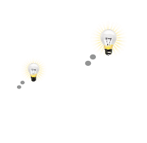

A GOOD TACTIC IS:
1.
Serves the strategy
Goal
2.
Strengthens your organization
Develops individuals
Notes:
Melissa

Slide 18
Demand- Educators want a voice in district decisions (through the creation of a stakeholder committee).
Strategy- Apply pressure to district decision makers.
  Tactic– Building-level letter writing campaign
  Tactic- Mass member attendance to school board meetings
Strategy- Use the contract/policy to legally enforce existing provisions
  Tactic- File a grievance
  Tactic-File an EEOC/HRA complaint
Strategy- Build partnerships in the community by increasing visibility and building trust
    Tactic– Canvassing the community and visiting parents to discuss their experience with the school district
    Tactic- Host listening sessions with potential community partners to discuss shared interests and values
Example:
Demand, Strategy, and Tactics
Notes:
Melissa

Slide 19

Why should tactics escalate gradually?
GOAL
Tactic
Tactic
Notes:
Melissa

Slide 20

Escalation of Tactics
Solidarity Actions
Escalation Actions
Concerted actions which demonstrate unity, but do so in a manner that increases pressure on the employer
Visible & concerted actions designed to show you all stand together
Why do we escalate?
→Structure tests←
Like giving HW or quizzes before a test.
Escalation of Tactics
Notes:
Melissa
Structure tests: We have to test ourselves to see if we’ll be successful.
Akin to giving hw and quizzes before a test, and chapter tests before a final exam.

Slide 21

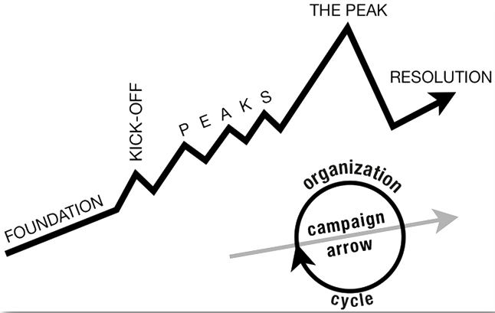
ORGANIZE TACTICS INTO… A CAMPAIGN Timeline
Notes:
Vanessa
Tactic scramble!

Slide 22
Strategy without tactics is simply a collection of good ideas and big dreams.
Tactics without strategy are a random collection of activities and wasted resources.
Notes:
Vanessa

Slide 23
Scenario
Think about the tactics you could use at each point in your organizing campaign. Tactics should escalate as you move through the plan.
Consider how your organizing plan coincides with the grievance process.
Notes:
Melissa

Slide 24
Scenario
Foundation – gather info, id issues, id leadership team
Kick-off –public event that indicates what the issue, demand, and targets are
Escalating peaks of activity that should escalate in
  Risk
  Capacity (people, resources, engagement)
  Increase leadership and ownership
  Campaign Compression Points
THE PEAK – The most public, risky, momentum, engagement, and resources
The Win- We achieve our demand
Debrief, regroup, and continue to climb
Notes:
Melissa

Slide 25
Report out
Are there different demands at different levels?
How many people would be engaged?
How will you know if the tactic was successful?
How did the grievance process connect to the campaign?

Slide 26
Individual services are about individual interests and credibility and produce a narrative about an individual’s relationship with their union.
Collective actions that are publicly shared build community around the shared struggles and provides a different narrative about solidarity and collective relationship.

Slide 27
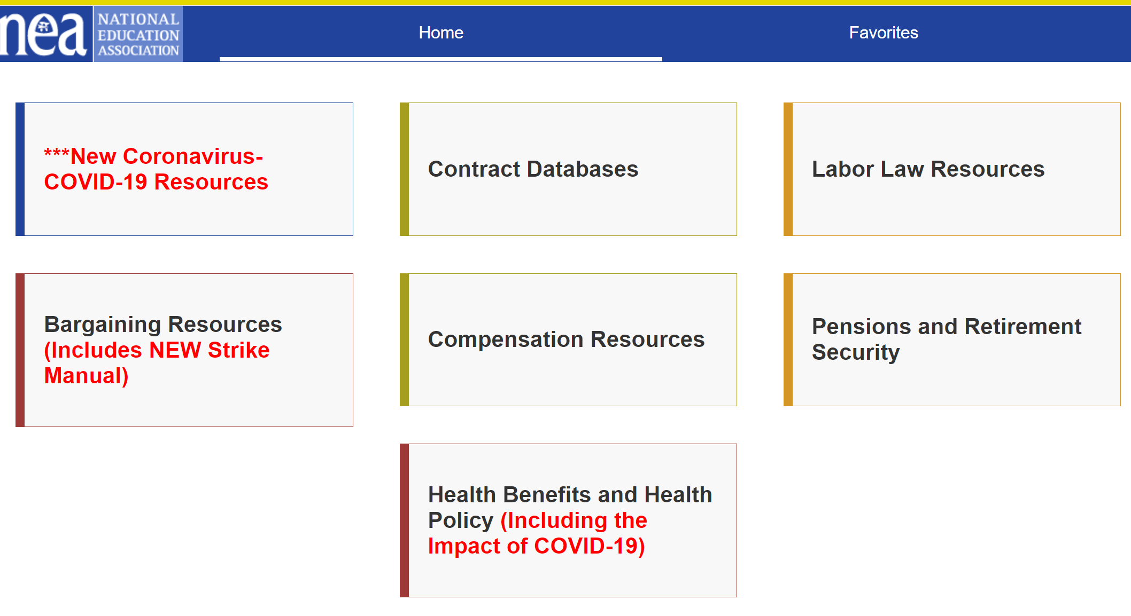
Resources:
https://www.neacollectivebargaining.org/

Slide 28
Thank You!
Charles Holmes
Senior Collective Bargaining Specialist
National Education Association
cholmes@nea.org
C. August Haywood
UniServ Specialist
Alabama Education Association
august.haygood@alaedu.org
Melissa Dan
Labor Relations Consultant
Palm Beach County CTA
melissa.dan@floridaea.org
Chad Williams
UniServ Consultant Michigan
Michigan Education Association
cwilliams@mea.org

