Slide 1




Virtual Meeting-Notables
Please use the chat box for questions.
Please change your name to include your state & pronouns.
(Ex. Heidi Miller-ISTA-she/her/hers)
You are muted.
Please share your video.
Notes:
Heidi

Slide 2

Community Agreements
Share Responsibility for the Success of Each Learning Session
Move up, Move back
Respect Confidentiality
Be Responsible for Building Deep Understanding
  Be timely with your presence, your speaking, and your listening
  Be fully present with speakers and open to new perspectives
  Place tech on silent and stay checked-in
  Share using “I” statements
  Connect to your core values and speak from your heart
Expect and Accept Imperfection
Expect/accept non-closure (agree to disagree)
Notes:
Heidi

Slide 3
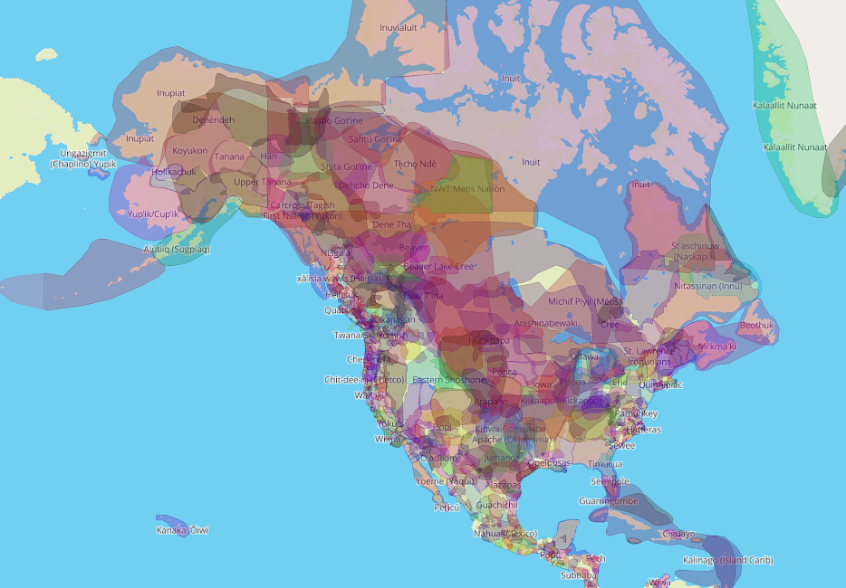
Native Lands Map
Notes:
Heidi
We begin by acknowledging that we meet on the traditional lands served by the first native people. We honor America’s First People and all elders, past, present and emerging and we are called on to learn and share what we learn about the tribal history, culture, and contributions that have been suppressed in telling the story of America. We invite you to think about the spaces you are inhabiting and the Indigenous people who came before them and were stewards of the land.
https://native-land.ca/

Slide 4
Intros-in the chat box
Name
Have you ever run a campaign
Favorite thing about running a campaign
Scariest thing about running a campaign
State
Notes:
Heidi
5 mins

Slide 5
Objectives for Campaign Construction Module
Familiarize participants with core components of a campaign
Reflect on the need to be intentional when developing a campaign
Construct a campaign relevant to your work
Create opportunities for participants to receive coaching and feedback from peers on their campaigns

Slide 6
Day 1-Agenda
Problem/Issue Identification
Winnable issues
Targets
Escalation of the campaign
Groups for campaign construction
Notes:
Heidi

Slide 7


Why Campaign?
Notes:
2min
Sheria/Heidi
Chat

Slide 8
Grievance/Complaints
Who is speaking, presenting, and doing the most talking/advocacy?
Direct, Staff-led Advocacy is the lowest form of member engagement and is most often invisible.
Well- organized worksites have a positive, visible union presence and members feel that they have the collective power to solve their problems.
When the entire building comes to a grievance meeting- that is powerful!
Notes:
2 mins
Sheria/Heidi

Slide 9

NEA Foundations Academy:
Campaign Construction Module
Alice Floros-MNEA
Steven Lagnena-NYSUT
Sheria Griffin-FEA
Heidi Miller-ISTA
Ellen Holmes-NEA
Notes:
Heidi

Slide 10
Campaign
A campaign is an action plan with a beginning, middle, and end, working towards a specific demand
A campaign involves a series of escalating actions (or tactics)
A campaign creates increasing pressure on decision-makers over time by escalating the intensity and visibility of the tactics and increasing the numbers of people involved
Campaigns are a way to identify in advance the ingredients we need to win and put them together in a way that maximizes our chances of success
Notes:
2min
Sheria/Heidi
Members want to BELONG to something that they are key actors in THE STORY -- so in a campaign when you ask - who is the story about - the answer is Members. If you don't encourage members to lead on grievances and complaints -- and you ask who is the story about -- it is the UD.

Slide 11
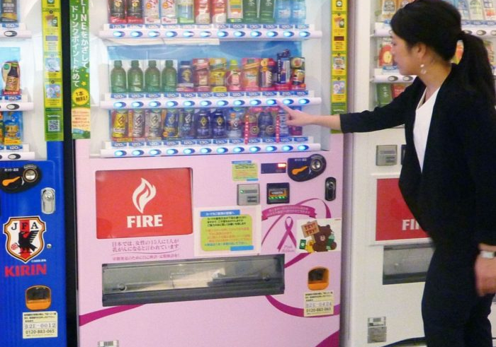
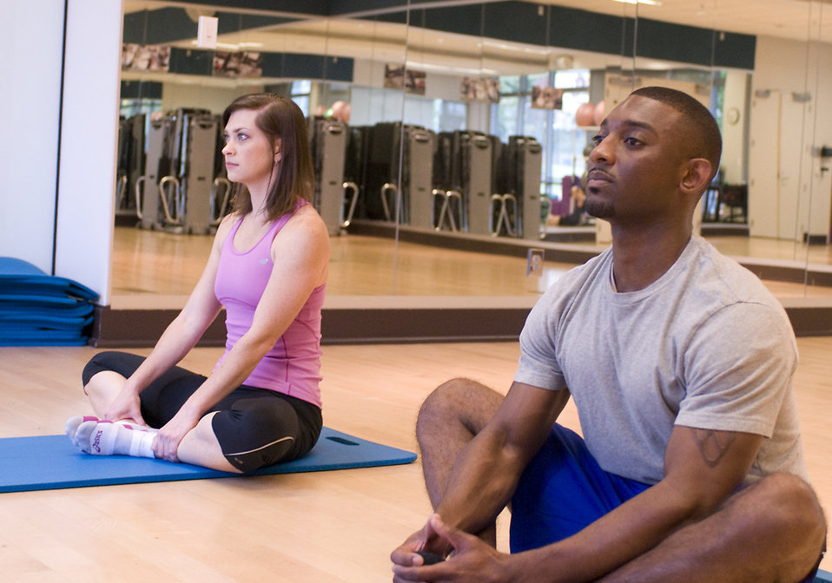
Transactional v Transformational
Notes:
2min
Sheria/Heidi
Campaigns change the relationship of members w/their union
Transactional: Members pay dues in order to get desired service.
Transformational: Members pay dues in order to participate and affect change.

Slide 12

Key Points
Grievances/complaints are typically invisible.
Campaigns are visible and shift power.
Notes:
1min
Sheria/Heidi

Slide 13

We don’t choose the issues, the people who want the change choose the issue.
Notes:
1min
Alice

Slide 14

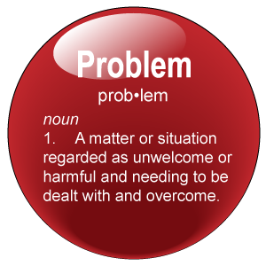
The BIG Problem and the Issues
Notes:
1 min
Alice

Slide 15
Problem vs. Issue
Problem is big, societal, conceptual, overwhelming, but without a specific solution
Issue is personal, manageable, specific to the problem needing to be solved, with a tangible solution
Notes:
2 min
Alice

Slide 16
Example – Problem to Issue to Win
PROBLEM -Educators do not feel respected in this building.
Issue – There is not structure or policy that allows educators to have meaningful input on decisions
Issue – Educators’ time to teach is severely limited by tests that don’t improve learning
Issue – Educators’ work and professional practices are not adequately compensated for
Strategic WIN – Educators feel Respected
Tactical WIN – A joint building leadership team is established
Tactical WIN – More time to teach meaningful content and less unnecessary testing
Tactical WIN – Compensation matches work and expectations
Notes:
3min
Alice

Slide 17
Breakout rooms
The problem:
Students need to feel represented when they look at their teachers. Our district has less than 5% BIPOC educators and 80% BIPOC students.
In your groups, pick a notetaker and break this PROBLEM into 2 specific issues.
Notes:
8 mins total (5 mins in room)
Alice—Put in the chat: The problem: Students need to feel represented when they look at their teachers. Our district has less than 5% BIPOC educators and 80% BIPOC students.

Slide 18
Breakout rooms-Debrief
Problem v Issue activity
Notes:
3 mins
Alice

Slide 19

Assessing an Issue
It is widely felt.
It is deeply felt.
It is winnable.
It builds the union and builds leaders.
It has a connection to students and the public.
Notes:
2 mins
Alice
You’ve got 3 issues now … let’s assess them for how strong and viable they are for designing campaigns that will lead to a BIG WIN.
Assess each of your three issues based on the worksheet on PAGE ____.

Slide 20
Key Points
We don’t choose the issues, the people who want the change choose the issue.
Notes:
1 min
Alice

Slide 21

Elements of a Good Strategy
Goal
Target
Demand
Tactics support the goal, put pressure on the targets and achieve your demand
Notes:
Steve

Slide 22
Art of War
“Strategy without tactics is the slowest route to victory. Tactics without strategy is the noise before defeat.” ~Sun Tzu

Slide 23

Goals
Goals are specific statements of what the organization intends to achieve.
A goal must indicate in concrete and specific terms:
  who is responsible
  what the outcome is to be
  how the outcome is to be measured, and
  the target completion date for the goal.
  An example of a concise goal:
The Action Committee (WHO) of the local will complete 45 (MEASUREMENT) one-to-one conversations (OUTCOME) by December 31st (TARGET DATE).
Notes:
Steve

Slide 24

Targets:
A single person-a name, face, & address
Has the power to give you what you are demanding
Notes:
2 mins
PollEV
Steve

Slide 25
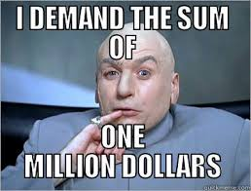
When making a demand …
  Measurable
  Achievable
  Should result in real tangible improvements in workers lives
  Focuses resources on a single outcome
  Builds the capacity of our constituency
  Uses a point of leverage: our constituency’s strength or our opposition’s weakness
  Focuses on a motivational issue that is visible and significant to our constituency
Notes:
3 mins
Steve

Slide 26
Key Points
A well thought out campaign has a strong issue, with an identifiable target and a strategic demand.
Notes:
1min
Steve

Slide 27

Demand
Tactics
Demand – Where you want to go – the destination – the BIG win.
Tactic – Small actions you to take to accomplish the small goals along the way to get to your destination.
Notes:
2 min
Heidi

Slide 28


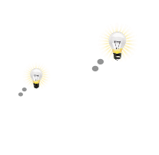

A GOOD TACTIC
Goal
1.
Is strategic
2.
Strengthens your organization
Develops individuals
Notes:
1 min
Heidi

Slide 29

Why would Jane McAlevey say tactics escalate gradually?
Breakout
GOAL
Tactic
Tactic
Notes:
Heavy v light lifts breakout. Why not start at strike?
10 min (6 for breakout, 4 for debrief)
Chat/pollEV?
Heidi

Slide 30
Why would Jane McAlevey say tactics escalate gradually?
GOAL
Breakout Debrief
Tactic
Tactic
Notes:
Heavy v light lifts breakout. Why not start at strike?
10 min (6 for breakout, 4 for debrief)
Chat/pollEV?
Heidi

Slide 31
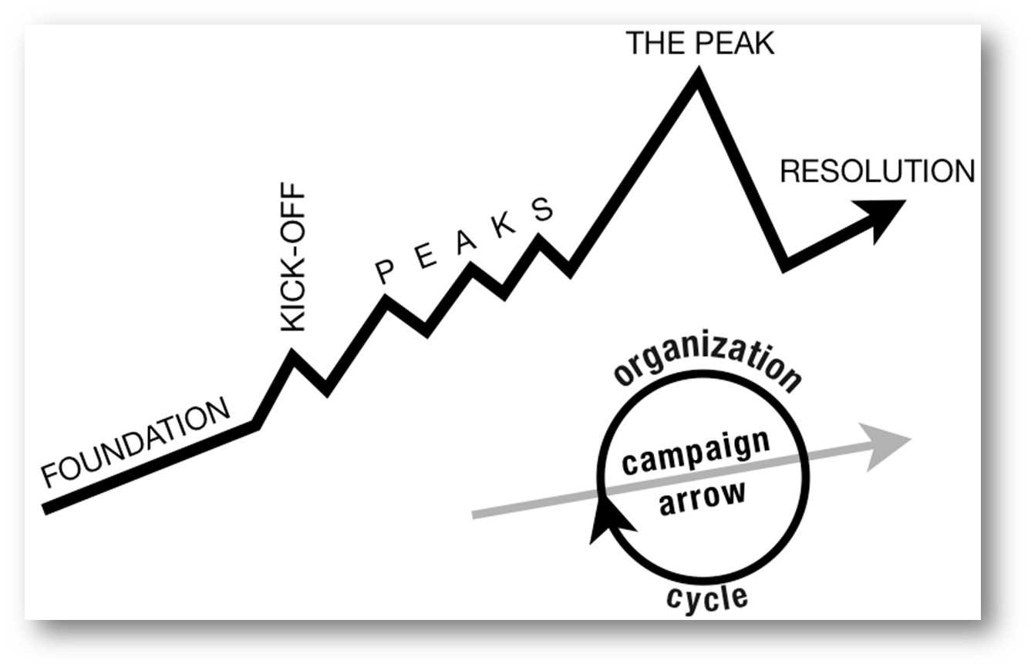
ORGANIZE TACTICS INTO… A CAMPAIGN Timeline
WIN
Who should decide the pace of the tactics?
Notes:
2 min
chat
STRUCTURE TESTS
Heidi

Slide 32
Key Points
Strategy without tactics is simply a collection of good ideas and big dreams.
Tactics without strategy are a random collection of activities and wasted resources.
Notes:
1 min
Heidi

Slide 33

Constructing a Campaign: Activity
Purpose: To give participants an authentic opportunity to design their own campaign relative to a current work assignment (e.g. union, school, work or community issue).
This Photo by Unknown Author is licensed under CC BY-SA
Notes:
Steve

Slide 34

Campaign Components
Campaign Issue
Current Power
Goal
Latent Power
Timetable of Tactics
Problem
Demand
Data Collection
Roles of Current Leadership
Campaign Team and Roles
Data Assessment
Incorporating Natural Leaders
Mapping
Adjustments
Notes:
Steve

Slide 35
Campaign Components
Current Power
Latent Power
Problem
Issue
Demand
Campaign Team and Roles
Goal
Mapping
Roles of Current Leadership
Incorporating Natural Leaders
Timetable of Tactics
Debrief
Data Collection
Data Assessment
Adjustments
Notes:
Steve

Slide 36
Constructing a Campaign: Support Group
Purpose: Create space for participants who intend to construct similar campaigns so that they may share ideas and receive feedback.
Task: Self-select a group that is aligned as close to your campaign issue.
Notes:
15 mins
Steve
What we deserve…
Contract campaign…
School budget/BOE…
Potpourri…
Build Capacity…

Slide 37
Campaign Support Group: Breakout
Breakout 1: What we deserve…
Breakout 2: Contract campaign…
Breakout 3: School budget/BOE…
Breakout 4: Build Capacity…
Breakout 5: Potpourri…

Slide 38
Notes for Next Module in UniServ Academy
April 6th: Leadership
Go to the shared folder to check for any pre-attendance work information.
https://tempiea-my.sharepoint.com/:f:/g/personal/beth_barton_ieanea_org/ErYCaabd1z5Mj-2kD13Z3BIB7I0s2F5ooBdNTIOphIzLaw?e=AEjdqs
April 28th back with us to share your draft campaign
Notes:
Heidi

Slide 39
Day 2-Agenda
Coaching on campaign construction
  Run through
  Feedback on escalation
  How do we pivot
Emotional rollercoaster-tips to survive

Slide 40
Community Agreements
Share Responsibility for the Success of Each Learning Session
Move up, Move back
Respect Confidentiality
Be Responsible for Building Deep Understanding
  Be timely with your presence, your speaking, and your listening
  Be fully present with speakers and open to new perspectives
  Place tech on silent and stay checked-in
  Share using “I” statements
  Connect to your core values and speak from your heart
Expect and Accept Imperfection
Expect/accept non-closure (agree to disagree)
Notes:
Heidi

Slide 41
Native Lands Map
Notes:
Heidi
We begin by acknowledging that we meet on the traditional lands served by the first native people. We honor America’s First People and all elders, past, present and emerging and we are called on to learn and share what we learn about the tribal history, culture, and contributions that have been suppressed in telling the story of America. We invite you to think about the spaces you are inhabiting and the Indigenous people who came before them and were stewards of the land.
https://native-land.ca/

Slide 42
Run-throughs: Breakout Rooms
Sketches/Outlines in breakout groups
Roadblocks Experiencing/solutions
Notes:
Steve
Participants will come with rough drafts of campaign plans
Reminder of break out room plan, facilitators pop in and out of rooms to support
Use Ellen's question set and give to folks ahead of time

Slide 43
Run-throughs: Debrief
Notes:
Steve

Slide 44

Remember the Framework
You are here ….
Who are my people?
What are their issues?
What is the change they want?
What are the resources they have to achieve their goal?
How will they measure their progress?
Notes:
Alice

Slide 45
What is your people’s most precious resource ?
Notes:
Alice

Slide 46

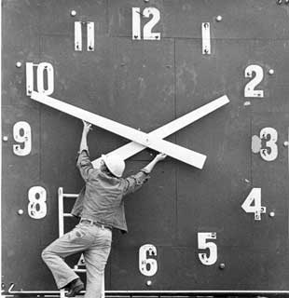

Tangibles
Resources that shrink as you use them.
Time/Energy
Money
Notes:
Alice
Resources are what your people have to help them make change. These are resources that are limited and are reduced as you use them.

Slide 47

Resources that Grow as You Use Them
Relationships
Skills
Hope
Trust
Conviction
Notes:
Alice
These resources are the most important. The more you use relationships, the more you trust, the more that you coach people in using their skills the more capacity they develop for action- these resources grow.

Slide 48
Key Points
The bigger the win you want, the more resource you need.
Good tactics actually result in more resources – relationships, skills, hope and trust.
Notes:
Alice

Slide 49

Resources and Tactics
Notes:
Sheria

Slide 50
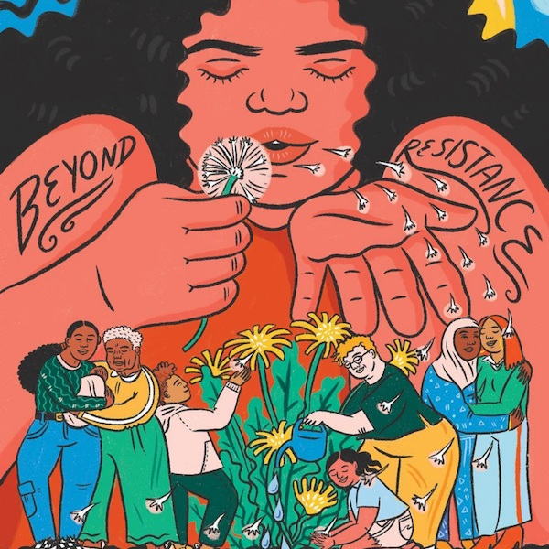
Breakout:
During this campaign, how are we deepening the relationships between people?
How can we adjust to make that happen more?
From Adrienne Maree Brown’s 2017 book Emergent Strategy: Shaping Changes, Changing Worlds
Art by Ashley Lukashevksy
Notes:
Alice

Slide 51
Debrief:
During this campaign, how are we deepening the relationships between people?
How can we adjust to make that happen more?
From Adrienne Maree Brown’s 2017 book Emergent Strategy: Shaping Changes, Changing Worlds
Art by Ashley Lukashevksy
Notes:
Alice

Slide 52
Notes for Next Module in UniServ Academy
May 6th: Organizing
Go the shared file for any pre-attendance work information
https://tempiea-my.sharepoint.com/:f:/g/personal/beth_barton_ieanea_org/ErYCaabd1z5Mj-2kD13Z3BIB7I0s2F5ooBdNTIOphIzLaw?e=AEjdqs
Notes:
Heidi

Slide 53
Day 3-Agenda
Presentations
Notes:
Heidi

Slide 54
Community Agreements
Share Responsibility for the Success of Each Learning Session
Move up, Move back
Respect Confidentiality
Be Responsible for Building Deep Understanding
  Be timely with your presence, your speaking, and your listening
  Be fully present with speakers and open to new perspectives
  Place tech on silent and stay checked-in
  Share using “I” statements
  Connect to your core values and speak from your heart
Expect and Accept Imperfection
Expect/accept non-closure (agree to disagree)
Notes:
Heidi

Slide 55
Native Lands Map
Notes:
Heidi
We begin by acknowledging that we meet on the traditional lands served by the first native people. We honor America’s First People and all elders, past, present and emerging and we are called on to learn and share what we learn about the tribal history, culture, and contributions that have been suppressed in telling the story of America. We invite you to think about the spaces you are inhabiting and the Indigenous people who came before them and were stewards of the land.
https://native-land.ca/

Slide 56
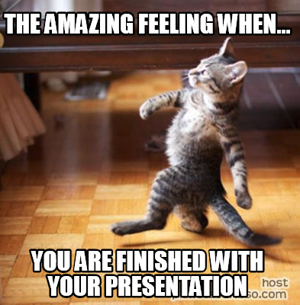
Presentation and Coaching Time

Slide 57
Acknowledgement and Future
Committing to this work is commendable.
In person UA for the future
Notes:
picture show of attendees or some sort of acknowledgement

