Slide 1

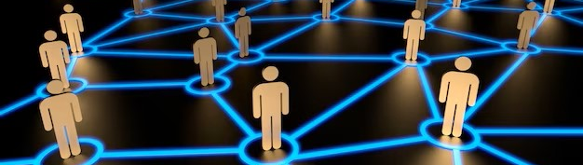

Reframing Membership
NEA Organizer Support Program
December 7, 2023

Slide 2
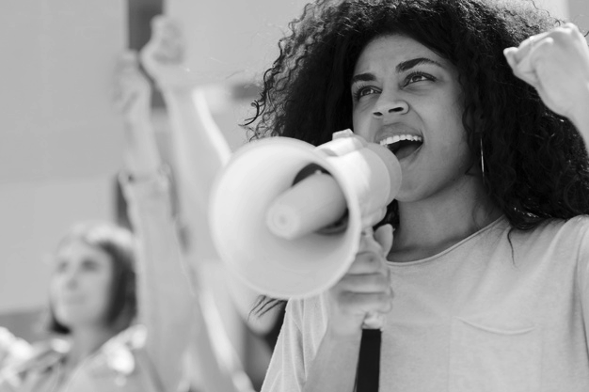
In the chat…
Name
Required Pronoun
State
Insert question here

Slide 3
Honoring This Space
We begin by acknowledging that through a history of colonization and brutality, we are all connecting from lands inhabited by indigenous peoples past and present.
We honor these indigenous people, all elders, past, present, and emerging. We are called to learn and share these learnings about this tribal history, culture, and contributions that have been suppressed in the telling of the story of what we now call the United States of America.

Slide 4

Why are we Here?
NEA has an enterprise-wide emphasis on organizing.
Our UniServ focused events don’t always meet the needs of organizers.
Series of Online and Face to Face Sessions:
  https://www.nea.org/UD-Org-Support

Slide 5
Welcome!
Series of Online and
Face to Face Sessions:
https://www.nea.org/UD-Org-Support
Today’s Facilitators
Name, Required Pronoun
State/Local Affiliate
Email Address
Melissa Dan, She/Her
Palm Beach County Classroom Teacher’s Association
Melissa.Dan@floridaea.org
Name, Required Pronoun
State/Local Affiliate
Email Address
Name, Required Pronoun
State/Local Affiliate
Email Address
Name, Required Pronoun
State/Local Affiliate
Email Address

Slide 6

Community Agreements
Turn on your Camera
Raise your hand OR unmute to speak
Ask questions as they arise by raising your hand or typing in the chat
Know that you get out what you put in
Using Self-Awareness and Self-Knowledge
Listening for Understanding
Saying “I” - tell your truth
Seeking Discomfort
Expecting Non-Resolution and Non-Closure
*Adapted from “Embracing equity and inclusion”, Annie E. Casey Foundation

Slide 7

Today’s Outcomes
Participants will discuss the following concepts:
How we recruit establishes member expectations
Who recruits matters more than how
Shared values, risk taking, and winning are worth more than coupons and clubs

Slide 8
Breakout Room
1- What is being communicated by these join 'asks'. (Links to come)
2- Reflect on your back home membership 'ask'/'invitation'.
3- What do you think potential members learn about the union from these sites?
Similar or different? At its core, what expectations and/or values does your invite communicate?
Notes:
In a moment, I will open up 5 break out rooms. I will give you a link.
1- What is becoming communicated by these join 'asks'.
2- Reflect on your back home membership 'ask'/'invitation'.
Similar different. But at its core what expectations and/or values does your invite communicate?
No shade or judgement- looking at 5 random webpages to see what is being communicated by these 5 different web pages.

Slide 9
Breakout Room Assignments
1. https://okea.org/join-oea/
2. https://join.nea.org/louisiana/?_ga=2.88326299.1863554204.1669648611-847814035.1669648611
3. https://auroraea.org/members/benefits-of-belonging/#:~:text=Your%20benefits%20include%20representation%20at,support%20for%20your%20Local%20Association.
4. https://www.orangecta.com/why-join-cta/index
5. https://www.nysut.org/resources/special-resources-sites/our-union/why-union#:~:text=The%20union%20offers%20contract%20protection,%2C%20retirement%20security%20%2D%20and%20more.
Notes:
Cut and paste these and drop them into the chat for people to pick based on their room.
If we have more people than 25. Then open 10 rooms and have 6 go to link 1, 7 go to link 2, 8 go to link 3, 9 go to link 4, and 10 go to link 5.

Slide 10
Break Out!
Come back and be ready to share out a summary of your discussion (in 3 tight sentences) in response to the three prompts:
1- What is being communicated by these join 'asks'. (Links to come)
2- Reflect on your back home membership 'ask'/'invitation'.
3- What do you think potential members learn about the union from these sites?
15 minutes

Slide 11
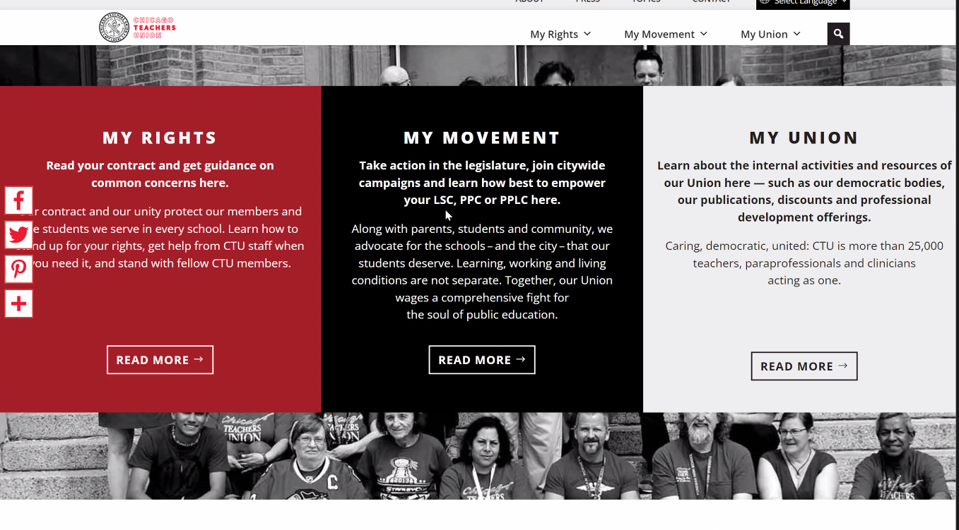
CTU
Notes:
We saw this as a very strong example. Is there anything that stands out to you?
A stand out for us: Intentional. READ your contract. My union. Not we will defend, but that they actively take a part in their own agency and desire for their value of respect to be realized through their own action.
This is a bargaining state, but we put in quite a few examples in your pre-reading about Amazong because they do not have a history or culture of bargaining and shows that they clearly communicated values (fairness/respect/safety), risk (this will not be easy, but it will be worth it), and they won (they got recognition).

Slide 12
Core Values
Fairness, honesty/integrity, responsibility, compassion/empathy, safety, health, generosity, hard work/responsibility, community, freedom, democracy, binding contracts, equality, opportunity, respect, stability/security, unity, quality work, justice, collective action, dignity/respect, charity/community service, and due process. Ideally: Unions advance the welfare of all workers. They are based on the idea of justice, progress, and betterment of self and of society. They embody the universal ideal of human rights and the need to aspire to become more complete human beings. By becoming an active participant in the labor movement, members become part of something larger than themselves.
Notes:
Wanted to ground us in this before we move onto semantics and how we use words to communicate our values.
Take a second to soak these in.
In the chat, please share the word that resonated with you to get into this work.
*** Should be 30 minutes in.

Slide 13
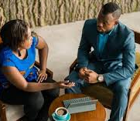
What happens when we say…

Slide 14
Raising Expectations and Engagement
Planning
Coaching
Partnering
Included
Hooked
Activated
Intrigued
Interested
Aware
Unaware
Page 35 of your Participant Resources:
We get what we ask for.
How does the invitation change as you move up the ladder?
Notes:
Most of our asks do not get us past the first 4 hooks. Page 35 of the handouts.
Harry Hans- how do organizations build organizers.
We get who we invite.
In a minute go to breakout rooms- page 35.
We will give you 4 classic invitations to the union, I have used all these in my work.
Your ask in group- how far does the invite take you up this ladder?
How could you adjust your invite to move up the ladder?
Example: Chris Smalls, we will not be doing this for you, he asked people to join him in the struggle and to do the work. All the organizers invited people into the work and to partner.
Think about your invitation, if you say pizza party that may not be worth your time. But the issue they care about, people will find time to address it. Is the issue the right one to invite them in on? A consideration.
Where do you end up with your "ask""invitation" from your state/local?

Slide 15
Breakout Room Assignments
Being a member won’t take a lot of your time. You’ll get information that you might find important, and it is really a lot of fun.
When you get into trouble, we will be here to help you. We have a really great track record of helping our members stay employed and get the rights they deserve.
We are more expensive than the other groups, but we do a lot of heavy lifting at the legislature on your behalf. You can also use your membership to save on everyday purchases.
You can really get a lot of support to do your job better. We have a lot of great programs that build you up as a professional.
Notes:
10 minutes Breakout
Think about... Picture in your head the educator that would be most attracted to this type of invite?
Only open 4 rooms this time.
1 and 5, 2 and 6, 3 and 7, 4 and 8.
Break them out and have them answer the question that relates to their room number.

Slide 16
Report Out!
Planning
Coaching
Partnering
Included
Hooked
Activated
Intrigued
Interested
Aware
Unaware
How does the invitation change as you move up the ladder?
Notes:
Most of our asks do not get us past the first 4 hooks. Page 35 of the handouts.
Harry Hans- how do organizations build organizers.
We get who we invite.
In a minute go to breakout rooms- page 35.
We will give you 4 classic invitations to the union, I have used all these in my work.
Your ask in group- how far does the invite take you up this ladder?
How could you adjust your invite to move up the ladder?
Example: Chris Smalls, we will not be doing this for you, he asked people to join him in the struggle and to do the work. All the organizers invited people into the work and to partner.
Think about your invitation, if you say pizza party that may not be worth your time. But the issue they care about, people will find time to address it. Is the issue the right one to invite them in on? A consideration.
Where do you end up with your "ask""invitation" from your state/local?

Slide 17
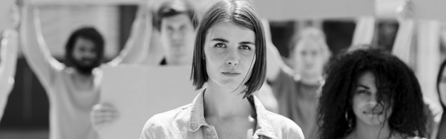
Who asked you?
Notes:
In the chat- reflect on who asked you to get involved with your union? What made you say yes?

Slide 18
Breakout Room Assignments
Who is the best person to be inviting workers to join their union?
What methods and/or resources do these people need to invite workers to join their union?
Is this how it is typically done where you work?
Notes:
10 minutes.
Break it down to 2-3 per room.
Quick 5 minute share out.

Slide 19
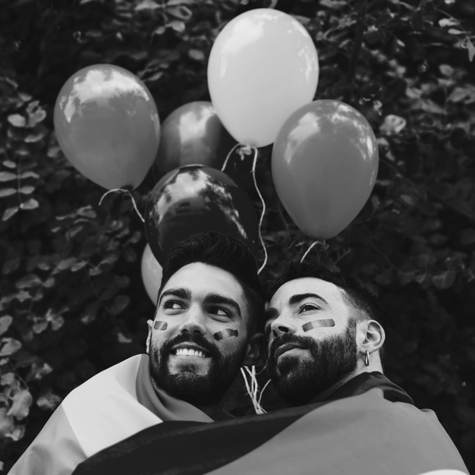
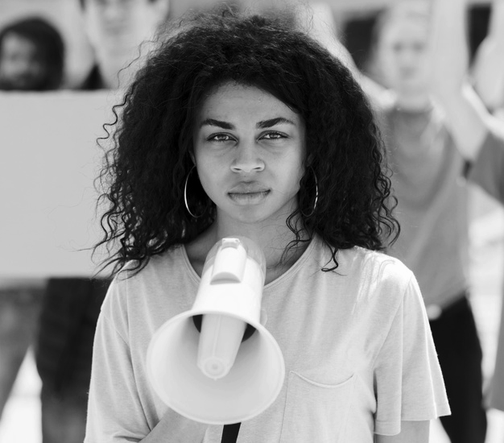

the intentional and continual inclusion of those who are not already part of the base.
Building power requires…
Notes:
If it is just a club of certain leaders- we will fail to grow our power and represent the entirety of our membership. Missing out on power.

Slide 20
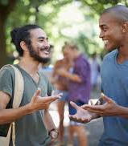
Reframing Membership:
The best person to make the invitation…
Is someone who is trusted and respected
Can present a relatable, value centered why
Is honest about the risk involved with making change
Notes:
Relationships between members is the strongest currency we have as a union. Tapping into that currency is something we cannot have as staff.
Our role is to support member leaders with this work and support their growth from services to values based invitation that includes values, risk, and a hopeful vision or wins.
Page 40 and 47 are great resources

Slide 21
Ending it Right
Email Feedback Form – Please Complete
Next online session – February 23 Flipping School Board Elections
Next Face to Face Event - January 31- February 2, Constituency Organizing, From Club to Fighting Union
https://www.nea.org/UD-Org-Support
Notes:
Alice will conclude.
Katie can put link in the chat.

Slide 22

Don’t
You can’t use the following words:
The union (or union at all),
  We
  Us
  Our
  I
With your zoom roomies restate the assigned phrases.
The Union

Slide 23
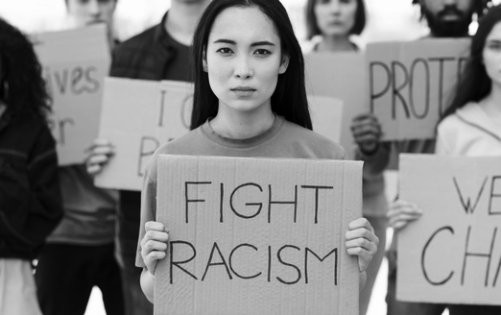
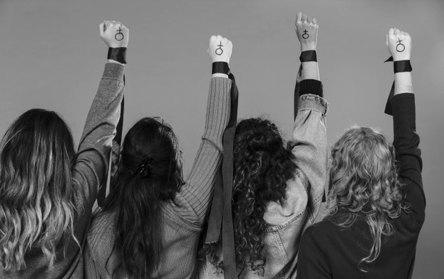
Three Theories of Power
Advocates are not rank and file people, just privileged people pressuring decision makers on behalf of others.
Mobilizers have larger networks of rank-and-file people, but they are connected to the same people (little risk of rejection) without much intentional thought for who IS NOT included.
Organizers understand that the collective success depends on continually expanding the base of ordinary people who are willing to take a collective risk.
Notes:
Advocates are those who have the privilege to advocate.
Mobilizers- not as connected
Organizers- Leaders who are trusted and respected.

Slide 24
Contact Us!
Series of Online and
Face to Face Sessions:
https://www.nea.org/UD-Org-Support
Today’s Facilitators
Name, Required Pronoun
State/Local Affiliate
Email Address
Melissa Dan, She/Her
Palm Beach County Classroom Teacher’s Association
Melissa.Dan@floridaea.org
Name, Required Pronoun
State/Local Affiliate
Email Address
Name, Required Pronoun
State/Local Affiliate
Email Address
Name, Required Pronoun
State/Local Affiliate
Email Address

